Slide 1
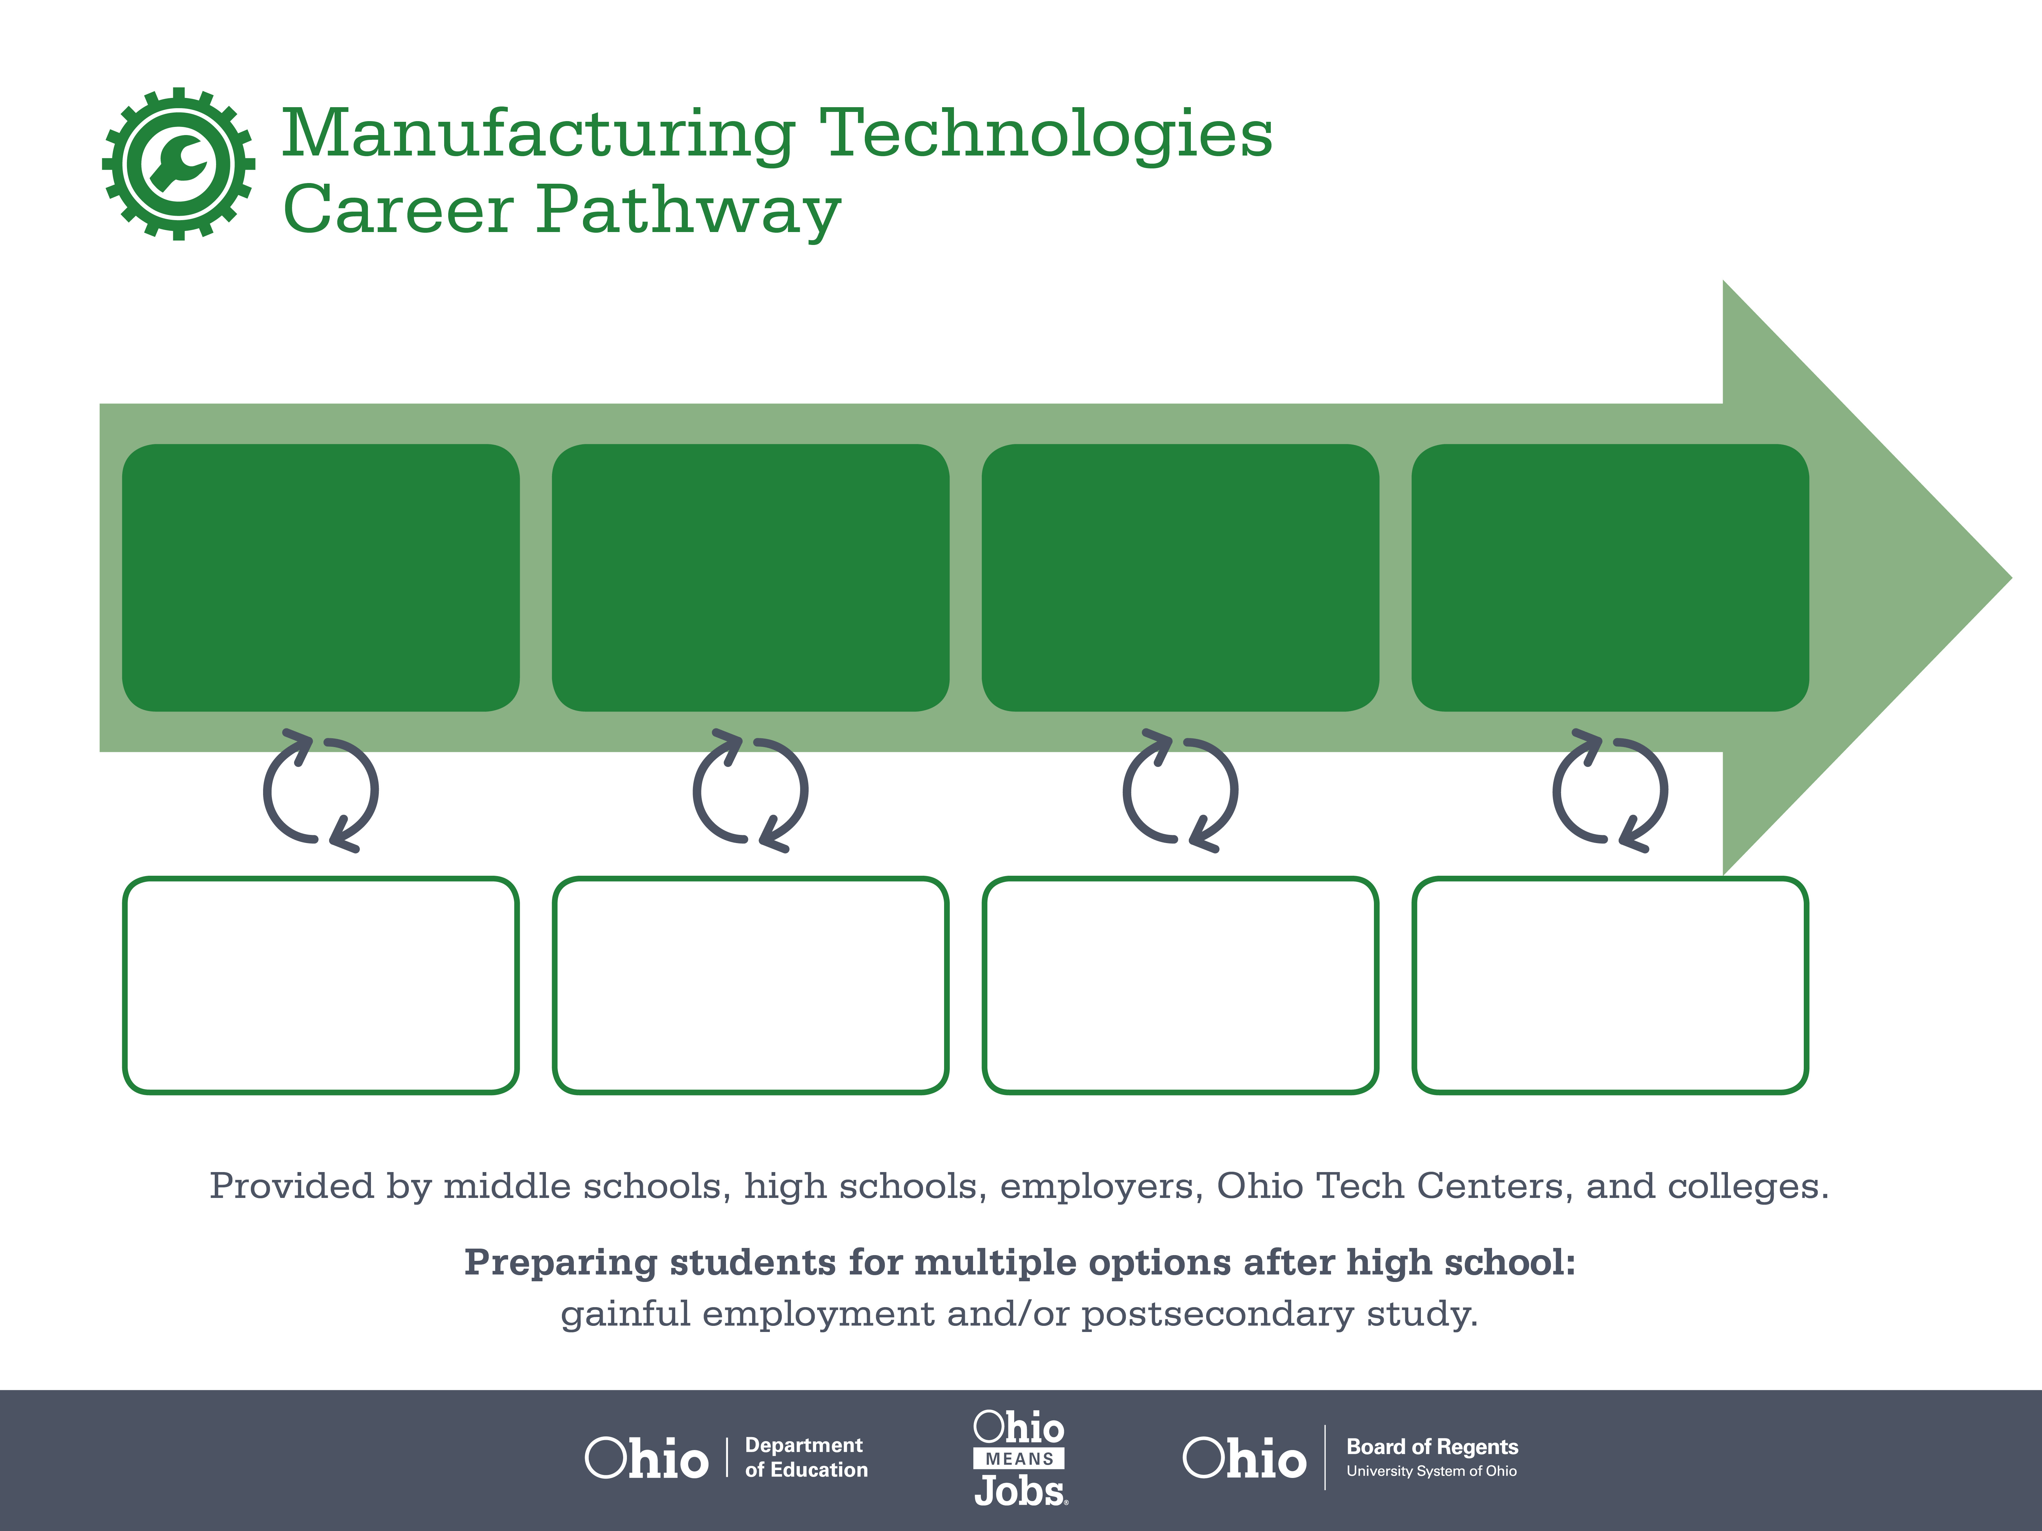
Certificate
Associate Degree,
Industrial Technology
Bachelor’s Degree,
Industrial Engineering
Start Pre-Manufacturing
As early as grade 7
(based on readiness)
Materials Inspector
Median Salary: $34,290
Job Growth (10 yr): 5.5%
Annual Openings: 590
Average Tuition (1 yr): $0 –$3,900/yr
Industrial Engineering Technician
Median Salary: $48,410
Job Growth (10 yr): 4.1%
Annual Openings: 68
Average Tuition (2 yrs): $3,900/yr
Industrial Engineer
Median Salary: $72,520
Job Growth (10 yr): 5.1%
Annual Openings: 290
Average Tuition (4 yrs): $9,600/yr
Workplace Visits
Job Shadow
Internship
Work
Supervised Experience
---
Work
Supervised Experience
Internship
---
Work
Internship
---
Work
Ohio In-demand Occupations
Data reflects 2014 Ohio labor statistics and public institutions of higher education for 2013-2014. For specific tuition costs, visit ohiohighered.org.

Slide 2

Secondary Pathway: Manufacturing Operations |  |  |  | Postsecondary Program: Industrial Technology
An Example of Courses with Secondary and Postsecondary Credits
Secondary | 7 8 | English I | Algebra I | Physical Science | Social Studies | Fine Arts | Pre-Engineering Technologies
 | 9 10 | English II | Geometry | Biology | World History | Health (.5) PE (.5) | Manufacturing Operations | World Languages
 | 11 | English III | Algebra II | Chemistry | U.S. History | Engineering Principles | Machine Tools | World Languages
 | 12 | English IV | Trigonometry/ Calculus | Physics | U.S. Government | Computer Integrated Manufacturing | Mechanisms & Drives
Postsecondary | Year 1 1st Semester | Computer-Aided Design | Industrial Safety | Electrical Systems | Mechanical Maintenance | Introduction to Engineering Technology | Technical Math
 | Year 1 2nd Semester | Employability Skills | Hydraulics & Pneumatics | Programmable Logic Control | Dimensional Metrology | Software Applications | Motor and Motor Controls
 | Year 2 1st Semester | English | Hydraulic Trouble-shooting | Electrical Trouble-shooting | Electrical Distribution | Automated Systems
 | Year 2 2nd Semester | Business Communication | Small Group Communication | Micro-economics | Industrial Machine Maintenance | Industrial Technology Projects | Humanities Elective
 |  | High School Career-Technical Education Program Courses
 |  | High School Courses for Postsecondary Credit (Including Apprenticeship Hours) and the Corresponding Postsecondary Courses
 |  | Required Courses
 |  | Recommended Electives
Visit education.ohio.gov/CareerConnections for reference information.
Course titles and sequences will vary between schools.
11/2014

