Slide 1
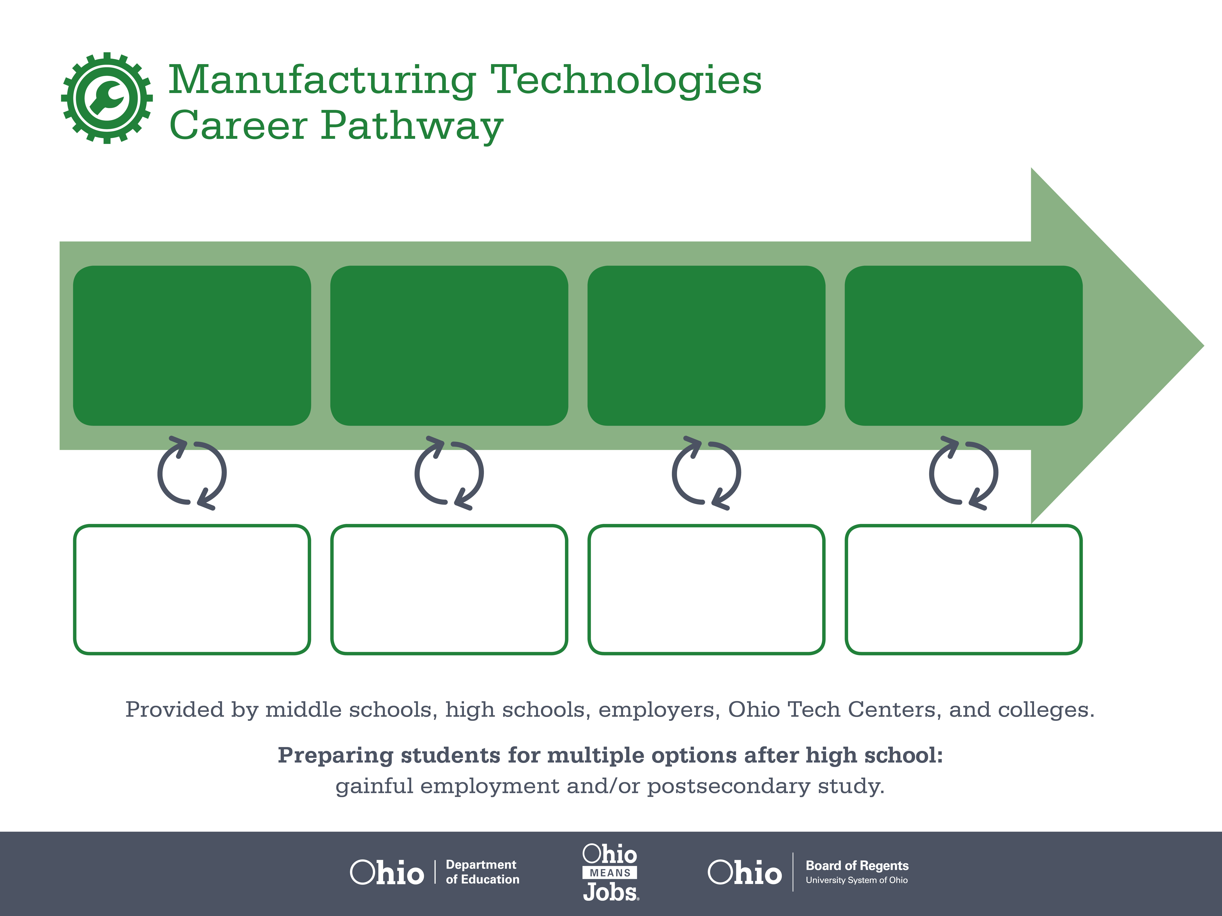
Certificate,
CNC
Associate Degree,
Industrial Technology
Bachelor’s Degree,
Industrial Management
Start Pre-Manufacturing
As early as grade 7
(based on readiness)
Apprentice Machinist
Median Salary: $24,160
Job Growth (10 yr): 7.4%
Annual Openings: 685
Average Tuition (1 yr): $0 –$3,900/yr
Machinist
Median Salary: $37,800
Job Growth (10 yr): 7.4%
Annual Openings: 685
Average Tuition (2 yrs): $3,900/yr
Industrial Production Manager
Median Salary: $84,340
Job Growth (10 yr): 7.7%
Annual Openings: 317
Average Tuition (4 yrs): $9,600/yr
Workplace Visits
Job Shadow
Internship
Work
Supervised Experience
---
Work
Supervised Experience
Internship
---
Work
Internship
---
Work
Ohio In-demand Occupations
Data reflects 2014 Ohio labor statistics and public institutions of higher education for 2013-2014. For specific tuition costs, visit ohiohighered.org.

Slide 2

Secondary Pathway: Manufacturing Operations |  |  |  | Postsecondary Program: Industrial Technology
An Example of Courses with Secondary and Postsecondary Credits
Secondary | 7 8 | English I | Algebra I | Physical Science | Social Studies | Fine Arts | Pre-Engineering Technologies
 | 9 10 | English II | Geometry | Biology | World History | Health (.5) PE (.5) | Manufacturing Operations | World Languages
 | 11 | English III | Algebra II | Chemistry | U.S. History | Machine Tools | Mechanisms and Drives | World Languages
 | 12 | English IV | Trigonometry/ Calculus | Physics | U.S. Government | Computer Integrated Manufacturing | Machining with Industrial Lathes (CNC)
Postsecondary | Year 1 1st Semester | English | Technical Math | PLC I | AC/DC Electrical
 | Year 1 2nd Semester | OSHA Safety & Health | Industrial Maintenance | PLC II | Digital Electronics | Mechatronics
 | Year 2 1st Semester | Communication | Quality Processes | PLC III | Fluid Power | Leadership
 | Year 2 2nd Semester | Financial Management | Management | Applied Electricity | Automation (Robotics) | Physics
 |  | High School Career-Technical Education Program Courses
 |  | High School Courses for Postsecondary Credit (Including Apprenticeship Hours) and the Corresponding Postsecondary Courses
 |  | Required Courses
 |  | Recommended Electives
Visit education.ohio.gov/CareerConnections for reference information.
Course titles and sequences will vary between schools.
11/2014

