Slide 1
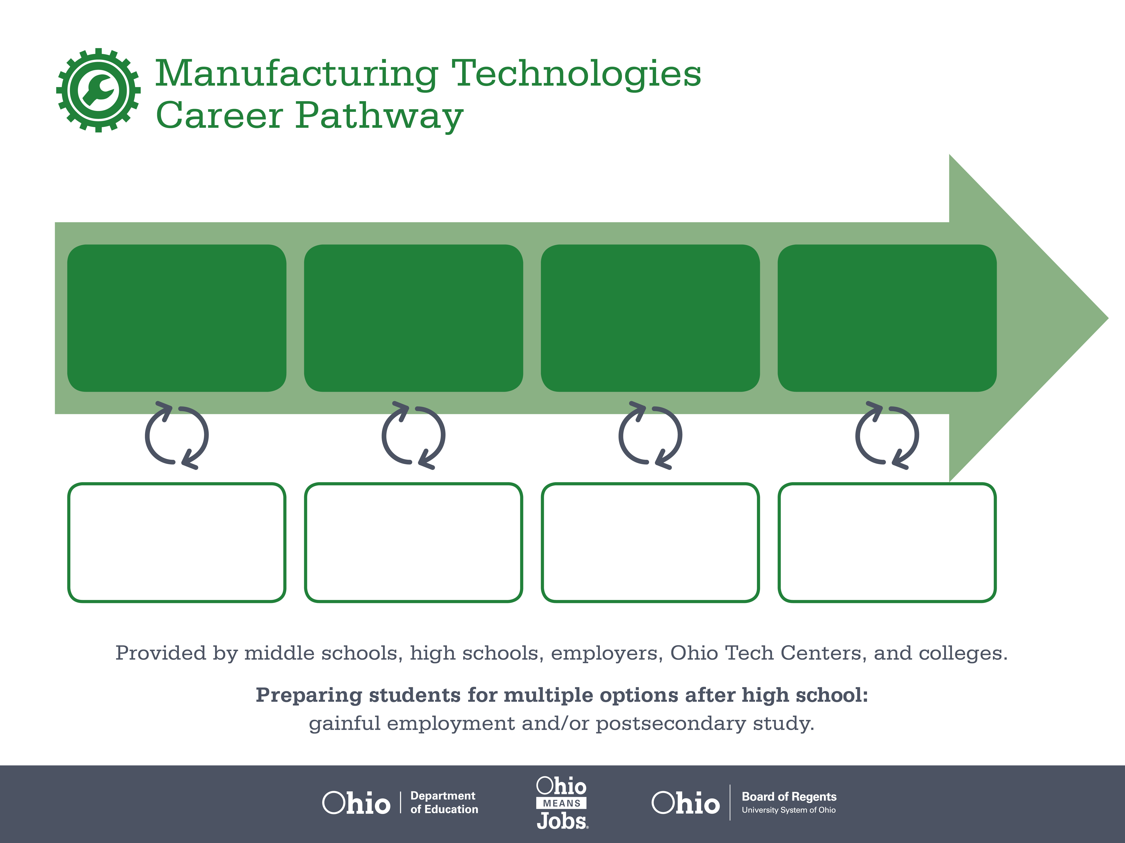
Certificate
Associate Degree,
Systems Technology
Bachelor’s Degree,
Systems Engineering
Start Pre-Manufacturing
As early as grade 7
(based on readiness)
Mold Operator
Median Salary: $28,420
Job Growth (10 yr): 1.5%
Annual Openings: 166
Average Tuition (1 yr): $0 –$3,900/yr
Production Technician
Median Salary: $57,150
Job Growth (10 yr): 1.5%
Annual Openings: 70
Average Tuition (2 yrs): $3,900/yr
Manufacturing Engineer
Median Salary: $70,940
Job Growth (10 yr): 2.7%
Annual Openings: 146
Average Tuition (4 yrs): $9,600/yr
Workplace Visits
Job Shadow
Internship
Work
Supervised Experience
---
Work
Supervised Experience
Internship
---
Work
Internship
---
Work
Ohio In-demand Occupations
Data reflects 2014 Ohio labor statistics and public institutions of higher education for 2013-2014. For specific tuition costs, visit ohiohighered.org.

Slide 2

Secondary Pathway: Manufacturing Operations |  |  |  | Postsecondary Program: Systems Technology
An Example of Courses with Secondary and Postsecondary Credits
Secondary | 7 8 | English I | Algebra I | Physical Science | Social Studies | Fine Arts | Pre-Engineering Technologies
 | 9 10 | English II | Geometry | Biology | World History | Health (.5) PE (.5) | Manufacturing Operations | World Languages
 | 11 | English III | Algebra II | Chemistry | U.S. History | CNC Technology | Machine Tools | World Languages
 | 12 | English IV | Trigonometry/ Calculus | Physics | U.S. Government | Computer Integrated Manufacturing | Robotics
Postsecondary | Year 1 1st Semester | English Composition | College Algebra | Computer Applications | Environmental Health & Safety | Operations Management I | Print Reading & Sketching
 | Year 1 2nd Semester | Technical Writing | Statistics | Quality Management Systems | Manufacturing Processes | Operations Management II | Human Relations in the Workplace
 | Year 2 1st Semester | Communication | Labor Relations | Effective Management | CNC Programming | Lean Systems
 | Year 2 2nd Semester | Psychology | Manufacturing Automation | Machine Reliability | Problem Solving & Decisions
 |  | High School Career-Technical Education Program Courses
 |  | High School Courses for Postsecondary Credit (Including Apprenticeship Hours) and the Corresponding Postsecondary Courses
 |  | Required Courses
 |  | Recommended Electives
Visit education.ohio.gov/CareerConnections for reference information.
Course titles and sequences will vary between schools.
6/2015

