Slide 1
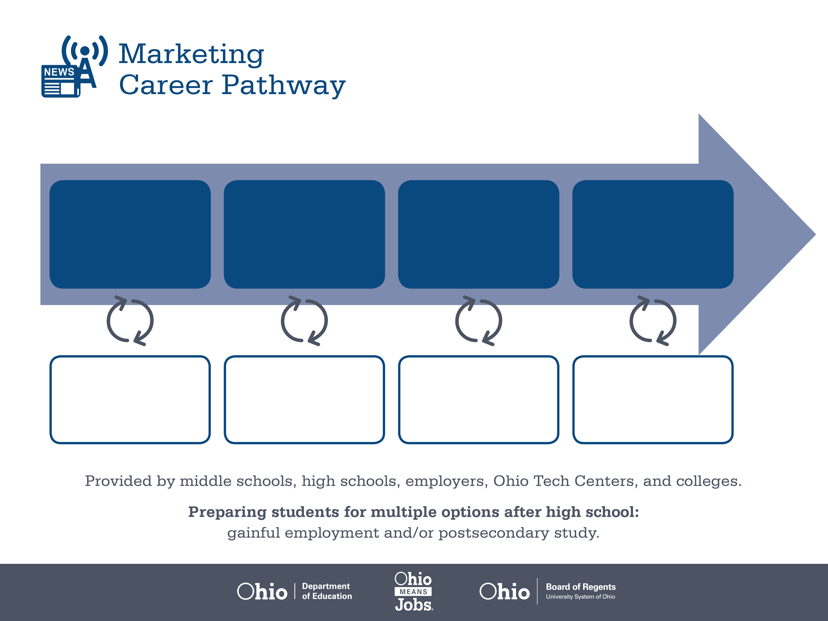
Certified Professional
Salesperson
Bachelor’s Degree,
Marketing
Master’s Degree,
Marketing
Start Pre-Marketing
As early as grade 7
(based on readiness)
Sales Representative
Median Salary: $48,430
Job Growth (10 yr): 13.2%
Annual Openings: 908
Average Tuition (1 yr): $0 –$3,900/yr
Sales Supervisor
(Non-Retail)
Median Salary: $64,960
Job Growth (10 yr): -0.5%
Annual Openings: 359
Average Tuition (4 yrs): $9,600/yr
Marketing Manager
Median Salary: $113,080
Job Growth (10 yr): 8.8%
Annual Openings: 186
Average Tuition (2 yrs): $11,300/yr
Workplace Visits
Job Shadow
Internship
Work
Supervised Experience
---
Work
Supervised Experience
Internship
---
Work
Internship
---
Work
Ohio In-demand Occupations
Data reflects 2014 Ohio labor statistics and public institutions of higher education for 2013-2014. For specific tuition costs, visit ohiohighered.org.

Slide 2

Secondary Pathway: Marketing Management |  |  |  |  | Postsecondary Program: Marketing
An Example of Courses with Secondary and Postsecondary Credits
Secondary | 7 8 | English I | Algebra I | Physical Science |  | Social Studies | Fine Arts | Fundamentals of Business & Admin.
 | 9 10 | English II | Geometry | Biology |  | World History | Health (.5) PE (.5) | Business Foundations | Marketing Principles | World Languages
 | 11 | English III | Algebra II | Chemistry |  | U.S. History | Marketing Applications | Professional & Technical Sales | World Languages
 | 12 | English IV | Trigonometry/ Calculus | Physics |  | U.S. Government | Marketing Research | Marketing Capstone
Postsecondary | Year 1 1st Semester | English | Statistics | Retailing |  | Micro-economics | Digital Media Preparation | College Seminar
 | Year 1 2nd Semester | Marketing Principles | Financial Accounting | Supply Chain Mgmt Principles |  | Branding | Customer Service & Sales | Physics | American History
 | Year 2 1st Semester | Web & Electronic Marketing | Advertising & Promotion | Business-to-Business Marketing |  | Marketing Info & Consumer Analysis | Managerial Accounting
 | Year 2 2nd Semester | Global Marketing | Project Management Principles | Direct & Database Marketing |  | Marketing Seminar | Marketing Practicum | Fundamentals of Interactive Media
 |  | High School Career-Technical Education Program Courses
 |  | High School Courses for Postsecondary Credit (Including Apprenticeship Hours) and the Corresponding Postsecondary Courses
 |  | Required Courses
 |  | Recommended Electives
Visit education.ohio.gov/CareerConnections for reference information.
Course titles and sequences will vary between schools.
11/2014

