Slide 1
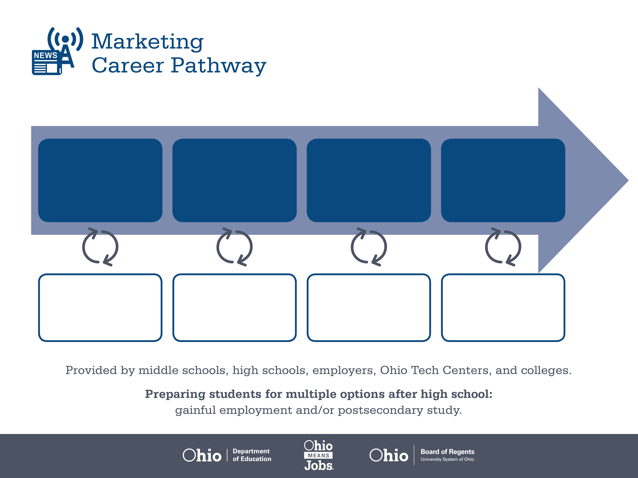
Certificate
Associate Degree,
Marketing
Bachelor’s Degree,
Marketing
Start Pre-Marketing
As early as grade 7
(based on readiness)
Online Fulfillment Associate
Median Salary: $29,920
Job Growth (10 yr): 4%
Annual Openings: 281
Average Tuition (1 yr): $0 - $3,900/yr
E-Commerce Manager
Median Salary: $60,880
Job Growth (10 yr): 5.6%
Annual Openings: 692
Average Tuition (2 yrs): $3,900/yr
Online Sales Director
Median Salary: $99,920
Job Growth (10 yr): 6%
Annual Openings: 459
Average Tuition (4 yrs): $9,600/yr
Workplace Visits
Job Shadow
Internship
Work
Supervised Experience
---
Work
Supervised Experience
Internship
---
Work
Internship
---
Work
Ohio In-demand Occupations
Data reflects 2014 Ohio labor statistics and public institutions of higher education for 2013-2014. For specific tuition costs, visit ohiohighered.org.

Slide 2

Secondary Pathway: Marketing Management |  |  |  |  | Postsecondary Program: Marketing
An Example of Courses with Secondary and Postsecondary Credits
Secondary | 7 8 | English I | Algebra I | Physical Science |  | Social Studies | Fine Arts | Fundamentals of Business & Admin.
 | 9 10 | English II | Geometry | Biology |  | World History | Health (.5) PE (.5) | Marketing Principles | Digital Marketing & Management | World Languages
 | 11 | English III | Algebra II | Chemistry |  | U.S. History | Marketing Applications | Professional & Technical Sales | World Languages
 | 12 | English IV | Trigonometry/ Calculus | Physics |  | U.S. Government | Merchandising & Buying | Strategic Entre-preneurship
Postsecondary | Year 1 1st Semester | English | Statistics | Retailing |  | Micro-economics | Digital Media Preparation | College Seminar
 | Year 1 2nd Semester | Marketing Principles | Financial Accounting | Supply Chain Mgmt Principles |  | Branding | Customer Service & Sales | Physics | American History
 | Year 2 1st Semester | Web & Electronic Marketing | Advertising & Promotion | Business-to-Business Marketing |  | Marketing Info & Consumer Analysis | Managerial Accounting
 | Year 2 2nd Semester | Global Marketing | Project Management Principles | Direct & Database Marketing |  | Marketing Seminar | Marketing Practicum | Fundamentals of Interactive Media
 |  | High School Career-Technical Education Program Courses
 |  | High School Courses for Postsecondary Credit (Including Apprenticeship Hours) and the Corresponding Postsecondary Courses
 |  | Required Courses
 |  | Recommended Electives
Visit education.ohio.gov/CareerConnections for reference information.
Course titles and sequences will vary between schools.
1/2016

