Slide 1
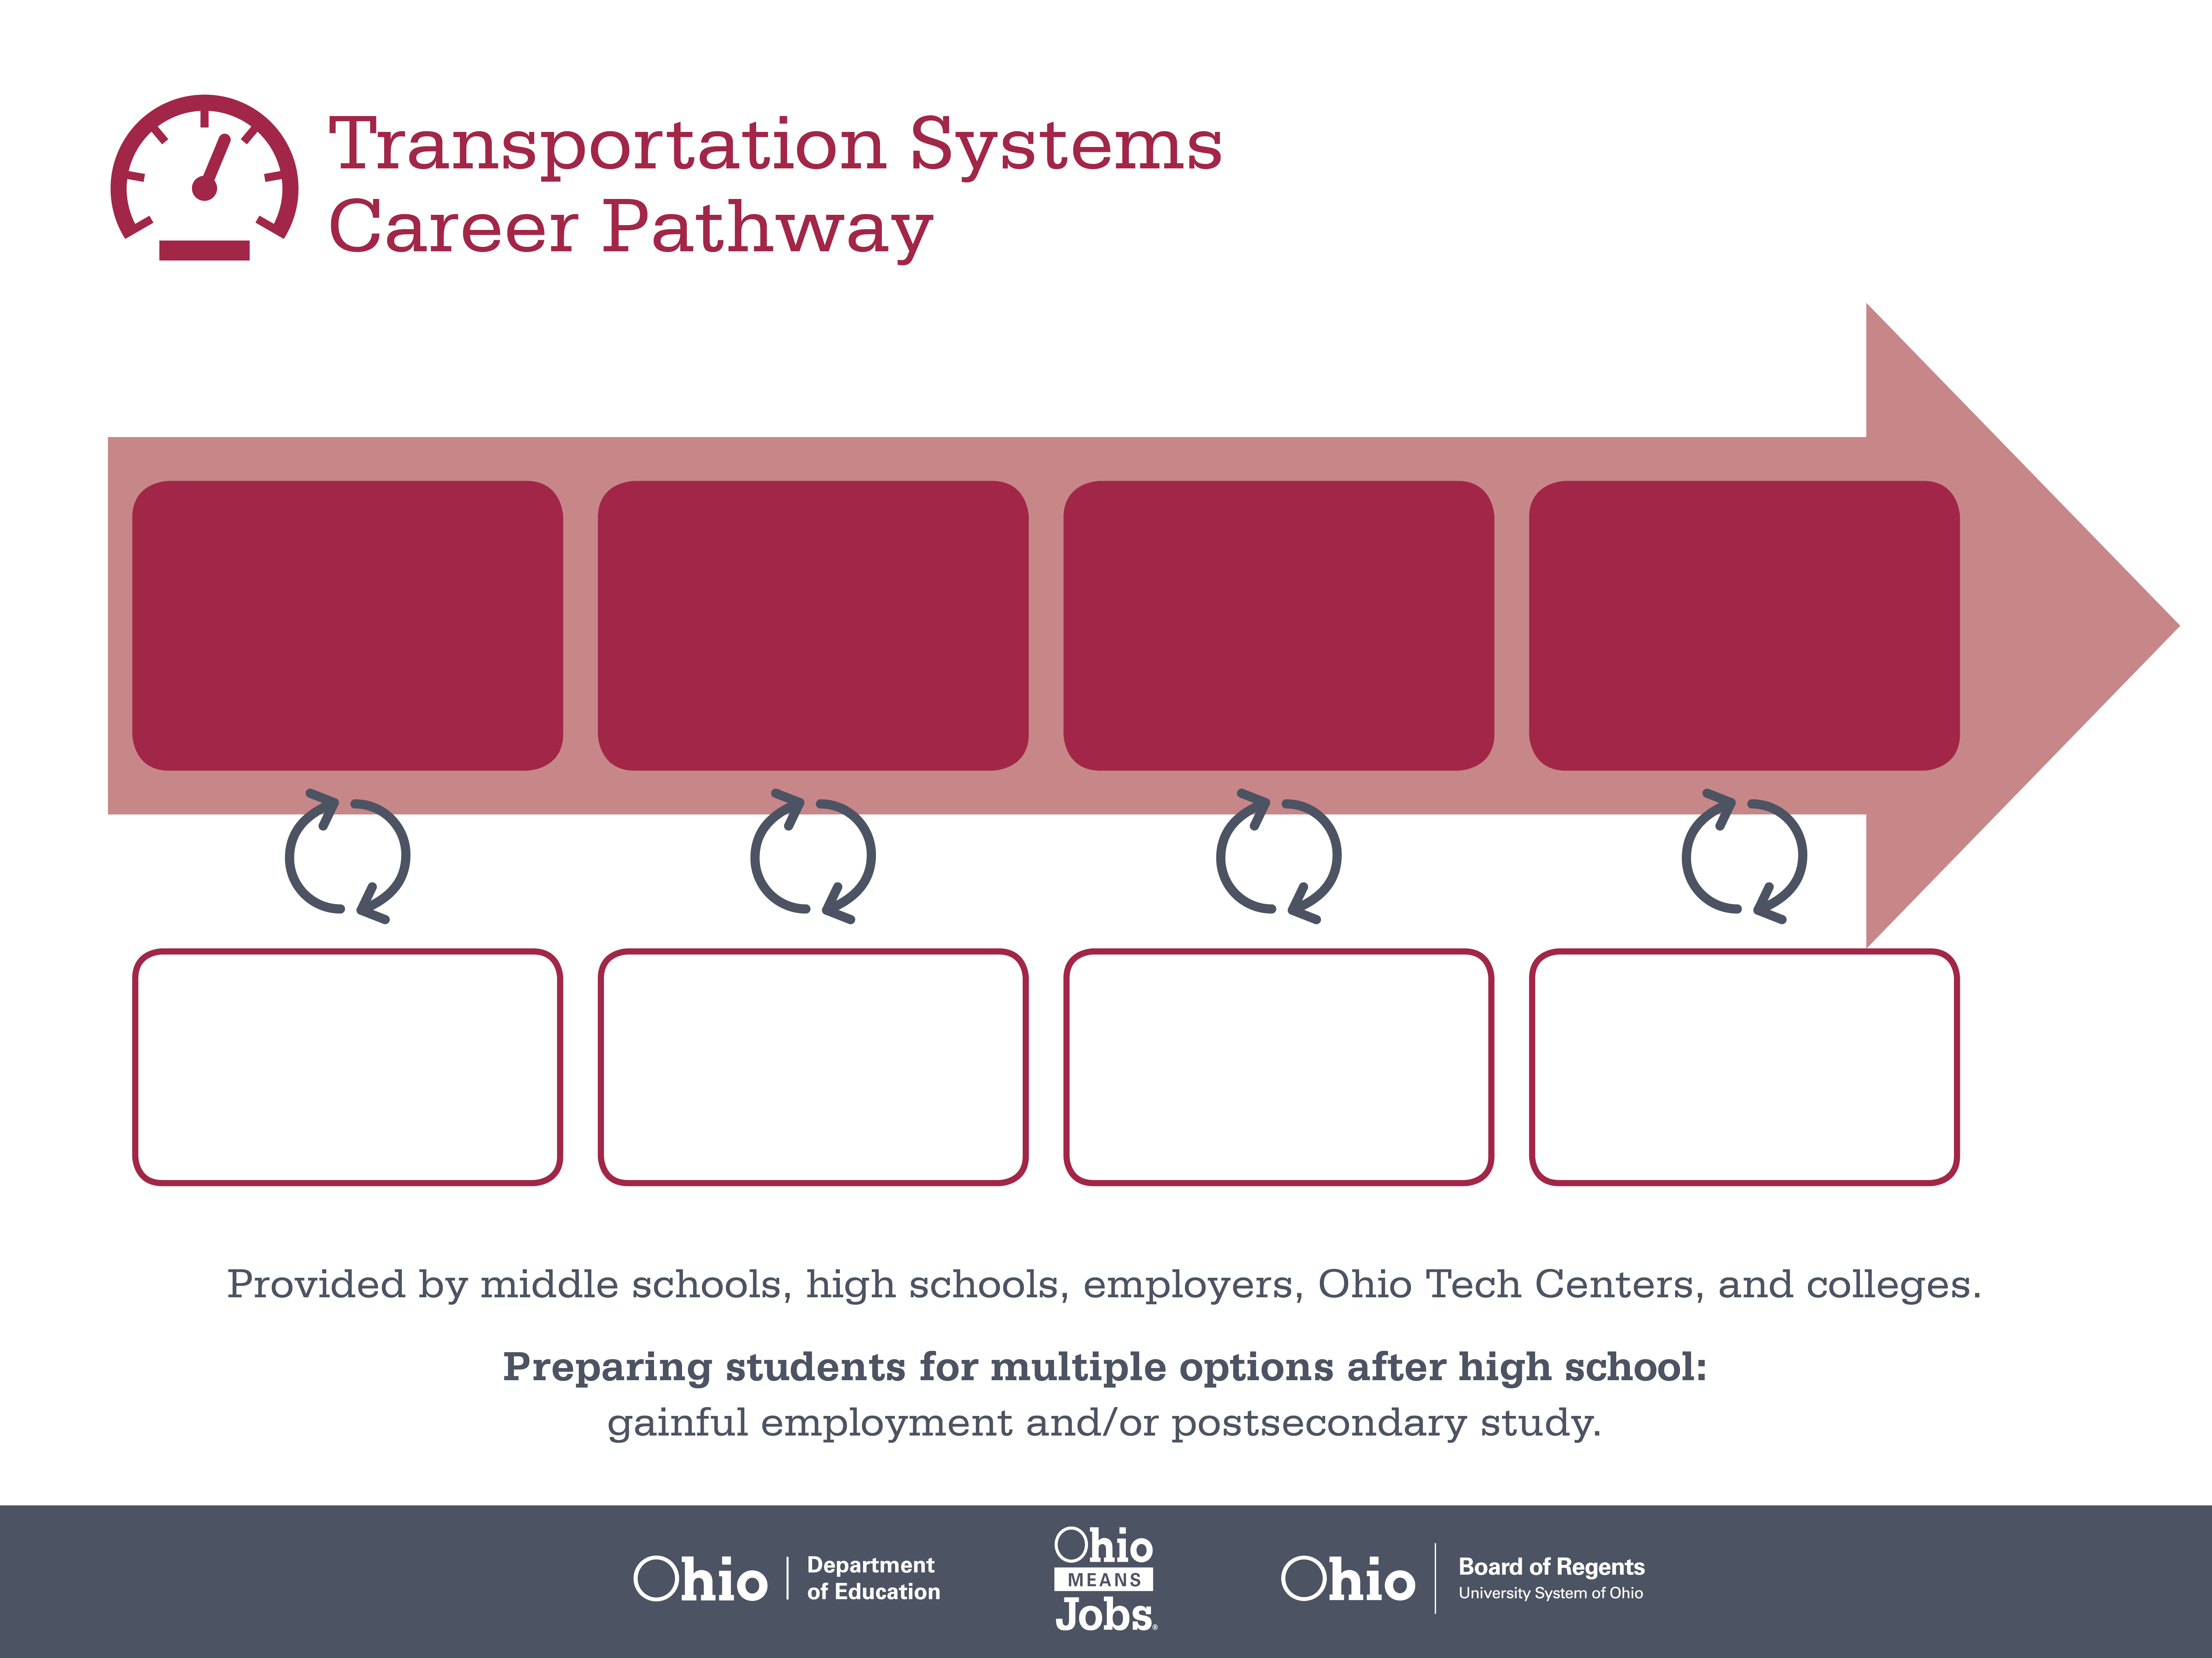
ASE Certification,
Student or A Series
ASE Certification,
A Series or G1
ASE Master
Certifications
Start
Pre-Transportation
As early as grade 7
(based on readiness)
Automotive Service Technician
Median Salary: $33,590
Job Growth (10 yr): 5.7%
Annual Openings: 835
Average Tuition (1 yr): $0 –$3,900/yr
Certified Auto Service Technician
Median Salary: $42,440
Job Growth (10 yr): 8.2%
Annual Openings: 293
Average Tuition (2 yrs): $3,900/yr
Master Auto Service Technician
Median Salary: $57,110
Job Growth (10 yr): 5.6%
Annual Openings: 501
Average Tuition (4 yrs): $9,600/yr
Workplace Visits
Job Shadow
Internship
Work
Supervised Experience
---
Work
Supervised Experience
Internship
---
Work
Internship
---
Work
Ohio In-demand Occupations
Data reflects 2014 Ohio labor statistics and public institutions of higher education for 2013-2014. For specific tuition costs, visit ohiohighered.org.

Slide 2
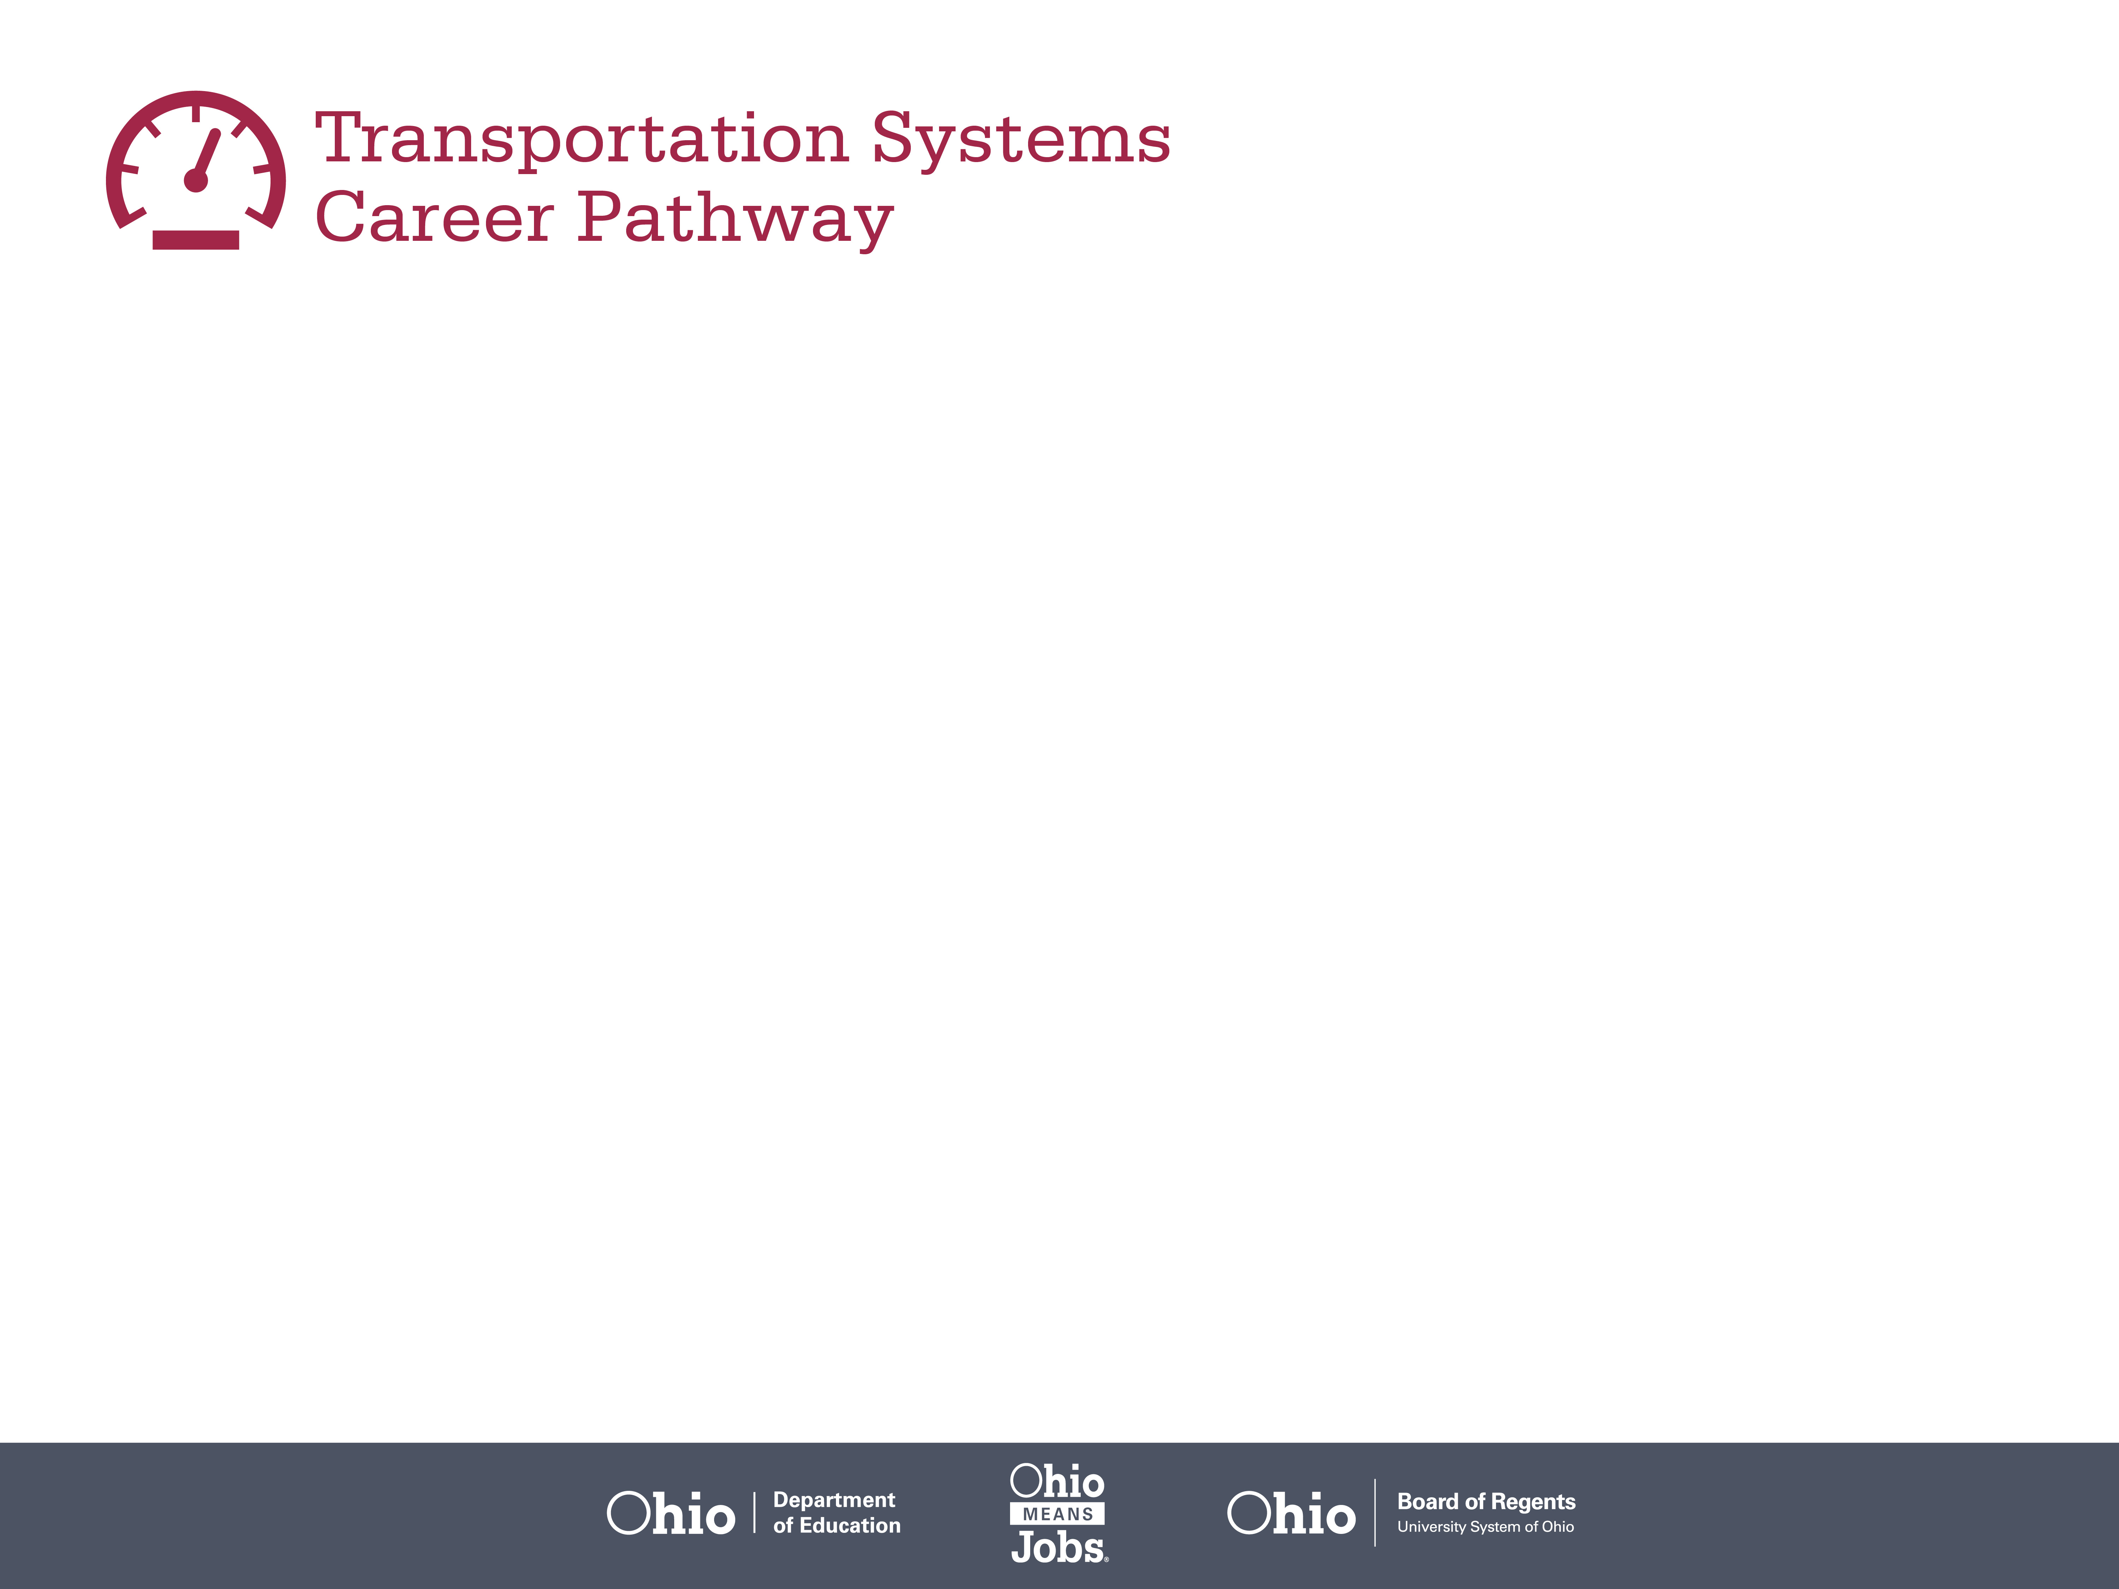
Secondary Pathway: Automotive Technology |  |  |  | Postsecondary Program: Automotive Technology
An Example of Courses with Secondary and Postsecondary Credits
Secondary | 7 8 | English I | Algebra I |  | Physical Science | Social Studies | Fine Arts
 | 9 10 | English II | Geometry |  | Biology | World History | Health (.5) PE (.5) | Ground Transportation Maintenance | Braking, Suspension, & Steering | World Languages
 | 11 | English III | Algebra II |  | Chemistry | U.S. History | Engine & Power Train | HVAC | World Languages
 | 12 | English IV | Trigonometry/ Calculus |  | Physics | U.S. Government | Electrical/ Electronic | Engine Performance | Transportation Capstone
Postsecondary | Year 1 1st Semester | English | Computer Applications |  | Shop Safety & Procedures | Numerical Applications | Intro to Automotive Service | Transmission & Drivetrain | Automotive Electrical Fundamentals
 | Year 1 2nd Semester | Math | Humanities Elective |  | Automotive Engines | Alignment, Steering & Suspension | Braking Systems | Auto Field Experience
 | Year 2 1st Semester | Communication | Intro to Business |  | Economics | Automotive HVAC | Engine Performance | Auto Electrical Systems | Automotive Field Experience
 | Year 2 2nd Semester | Automatic Transmissions | Auto Electronic Engine Controls |  | Auto Electrical Diagnosis | Auto Service Operations | Automotive Field Experience | Social & Behavioral Science
 |  | High School Career-Technical Education Program Courses
 |  | High School Courses for Postsecondary Credit (Including Apprenticeship Hours) and the Corresponding Postsecondary Courses
 |  | Required Courses
 |  | Recommended Electives
Visit education.ohio.gov/CareerConnections for reference information.
Course titles and sequences will vary between schools.
6/2015

