Slide 1
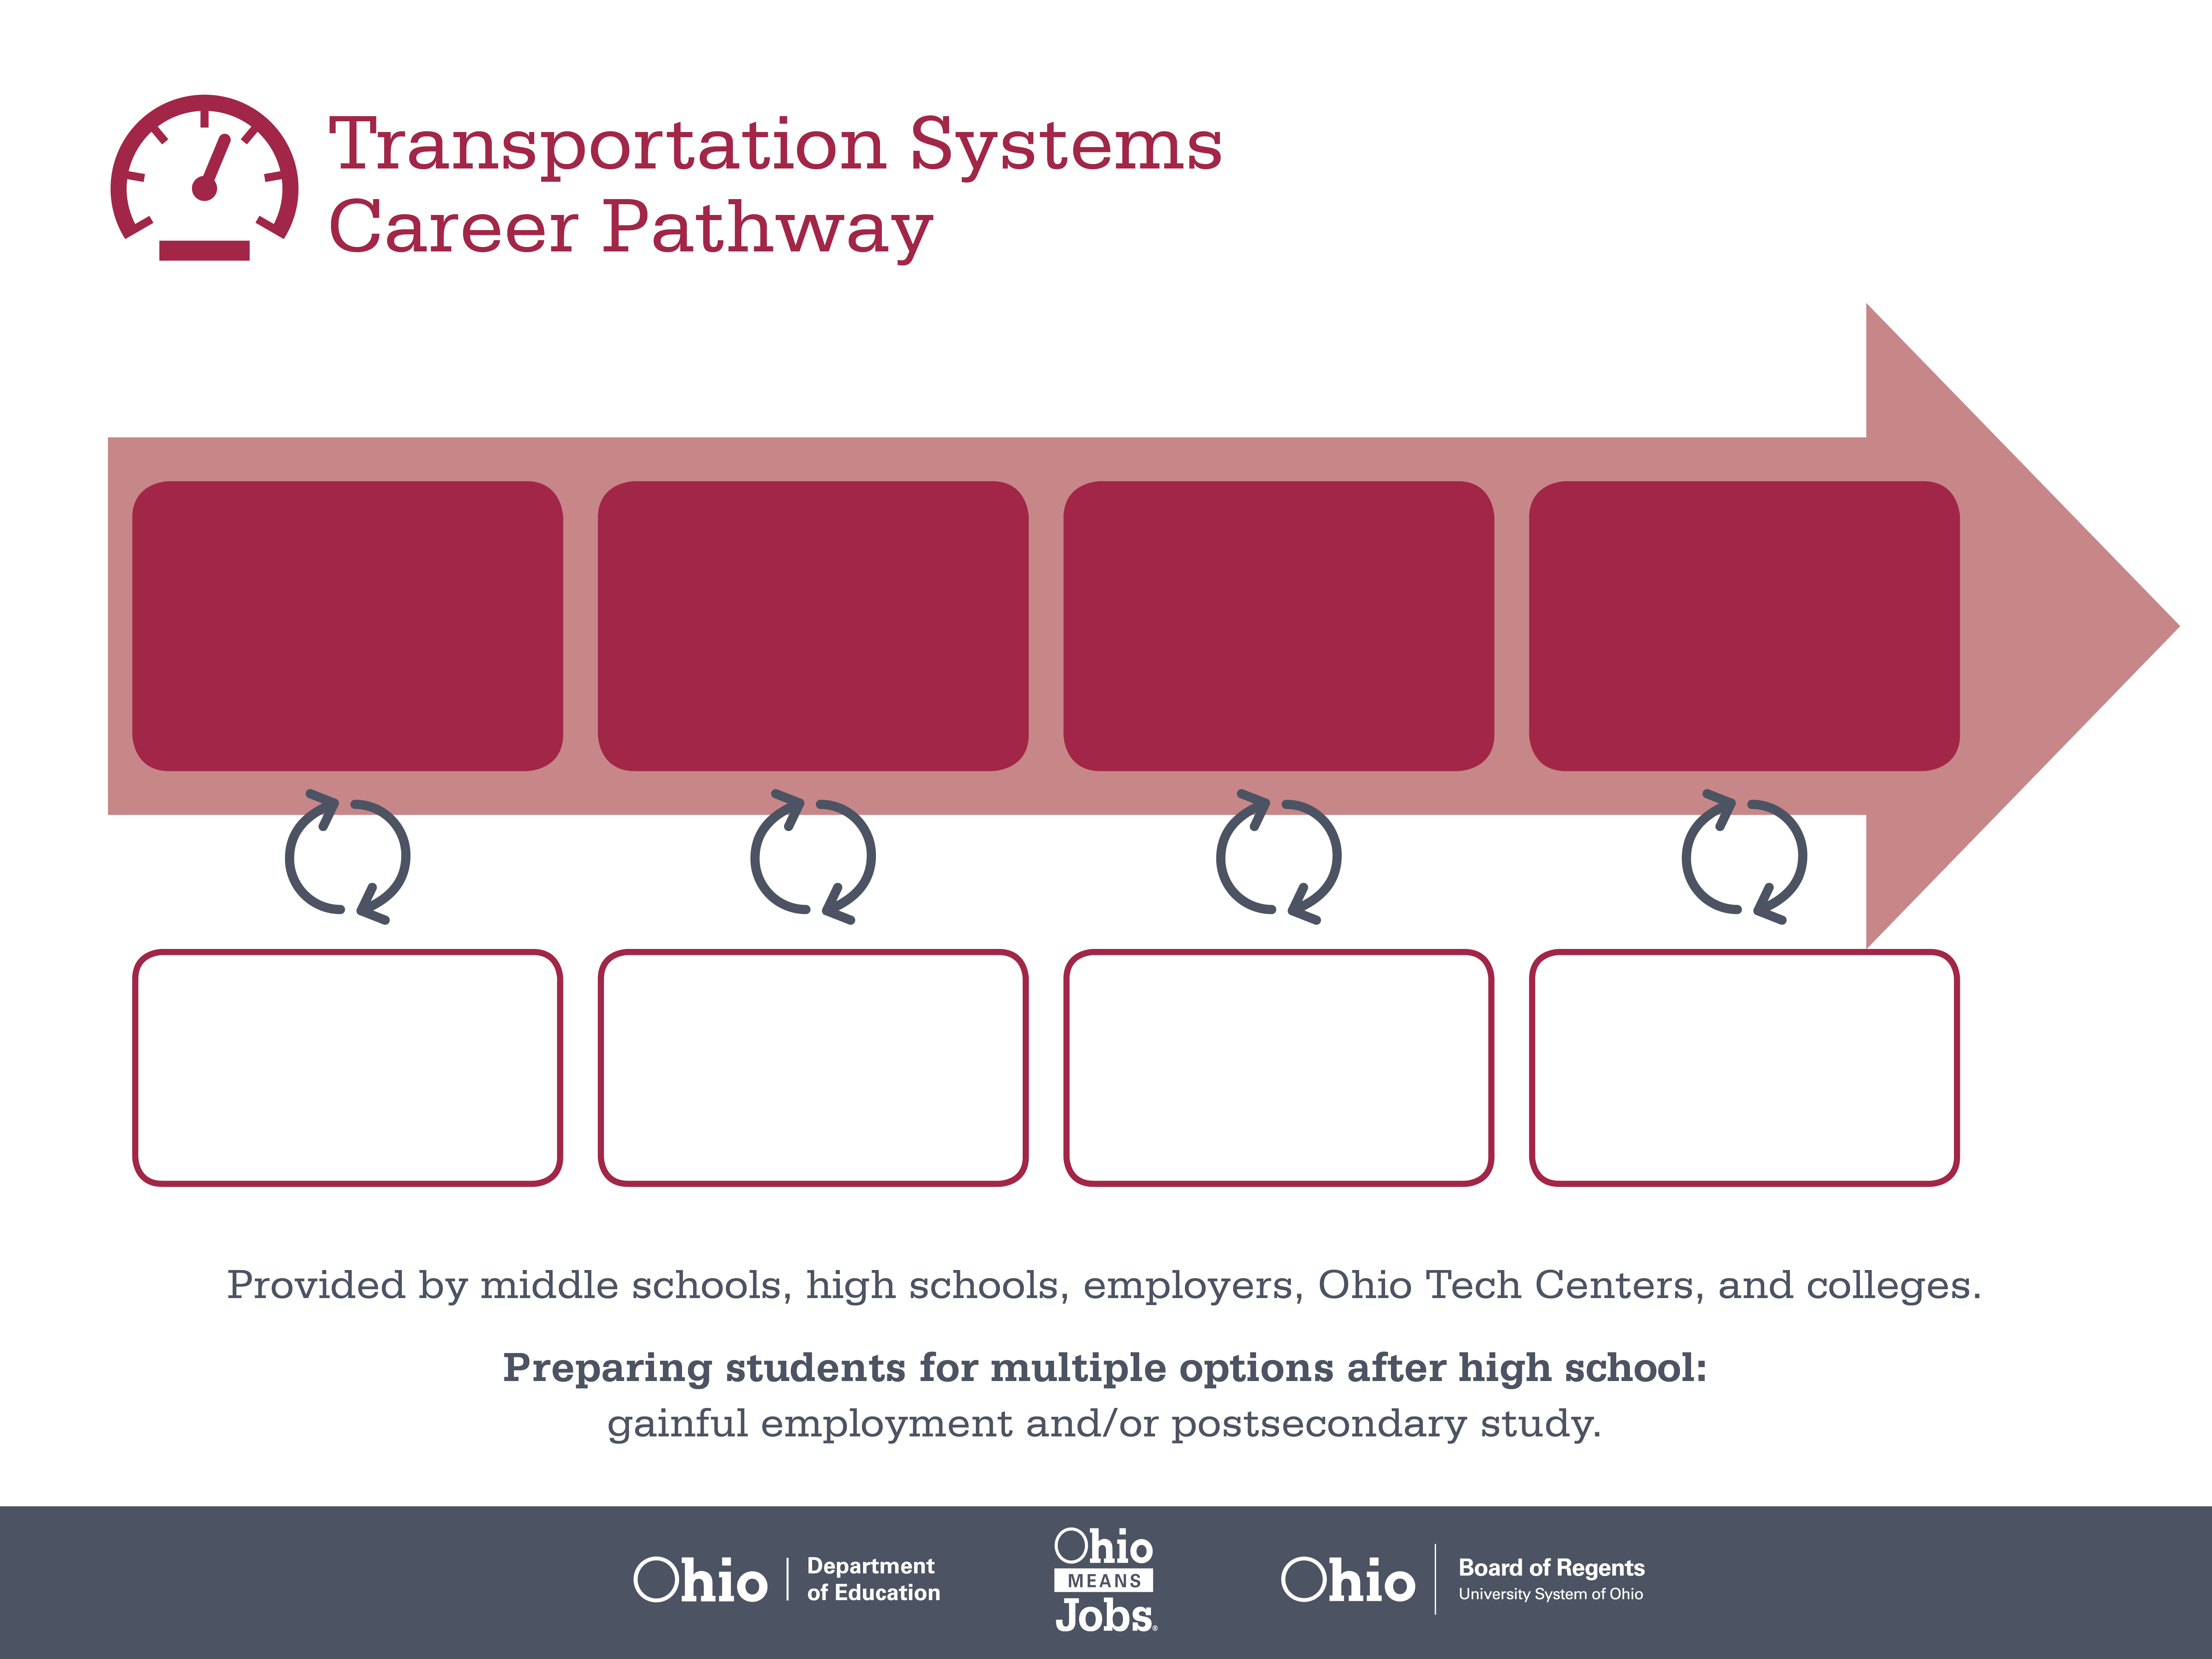
License
License
Associate Degree
Start
Pre-Transportation
As early as grade 7
(based on readiness)
Light Truck Driver
Median Salary: $27,800
Job Growth (10 yr): 7.6%
Annual Openings: 865
Average Tuition (1 yr): $0 –$3,900/yr
Heavy Truck Driver
Median Salary: $37,410
Job Growth (10 yr): 17.1%
Annual Openings: 2,447
Average Tuition (1 yr): $0 –$3,900/yr
Transportation Supervisor
Median Salary: $50,770
Job Growth (10 yr): 9.6%
Annual Openings: 258
Average Tuition (2 yrs): $3,900/yr
Workplace Visits
Job Shadow
Internship
Work
Supervised Experience
---
Work
Supervised Experience
Internship
---
Work
Internship
---
Work
Ohio In-demand Occupations
Data reflects 2014 Ohio labor statistics and public institutions of higher education for 2013-2014. For specific tuition costs, visit ohiohighered.org.

Slide 2

Secondary Pathway: Ground Transportation |  |  |  | Postsecondary Program: Diesel Technology
An Example of Courses with Secondary and Postsecondary Credits
Secondary | 7 8 | English I | Algebra I |  | Physical Science | Social Studies | Fine Arts
 | 9 10 | English II | Geometry |  | Biology | World History | Health (.5) PE (.5) | Ground Transportation Maintenance | Braking, Suspension & Steering | World Languages
 | 11 | English III | Algebra II |  | Chemistry | U.S. History | Engine & Power Train | Truck Brake, Suspension & Steering Sys. | World Languages
 | 12 | English IV | Trigonometry/ Calculus |  | Physics | U.S. Government | Truck Diesel Engines | Engine Performance | Ground Transportation HVAC
Postsecondary | Year 1 1st Semester | Personal Finance | Basic Electrical |  | Preventive Maintenance | Heavy Truck Drive Trains | Industrial & Engineering Technology
 | Year 1 2nd Semester | Employability Skills | Industrial Calculations |  | Hydraulic Theory & Operation | Fundamentals of Engines | Truck Steering & Suspension | Welding Processes | Truck Brake Systems
 | Year 2 1st Semester | English Composition | Computer Concepts & Applications |  | Advanced Electrical & Electronics | Heavy Truck HVAC | Social Science Elective
 | Year 2 2nd Semester | Interpersonal Communication | Business Communication |  | Customer Relations | Engine Performance | Heavy Truck Automatic Transmissions
 |  | High School Career-Technical Education Program Courses
 |  | High School Courses for Postsecondary Credit (Including Apprenticeship Hours) and the Corresponding Postsecondary Courses
 |  | Required Courses
 |  | Recommended Electives
Visit education.ohio.gov/CareerConnections for reference information.
Course titles and sequences will vary between schools.
6/2015

