Slide 1
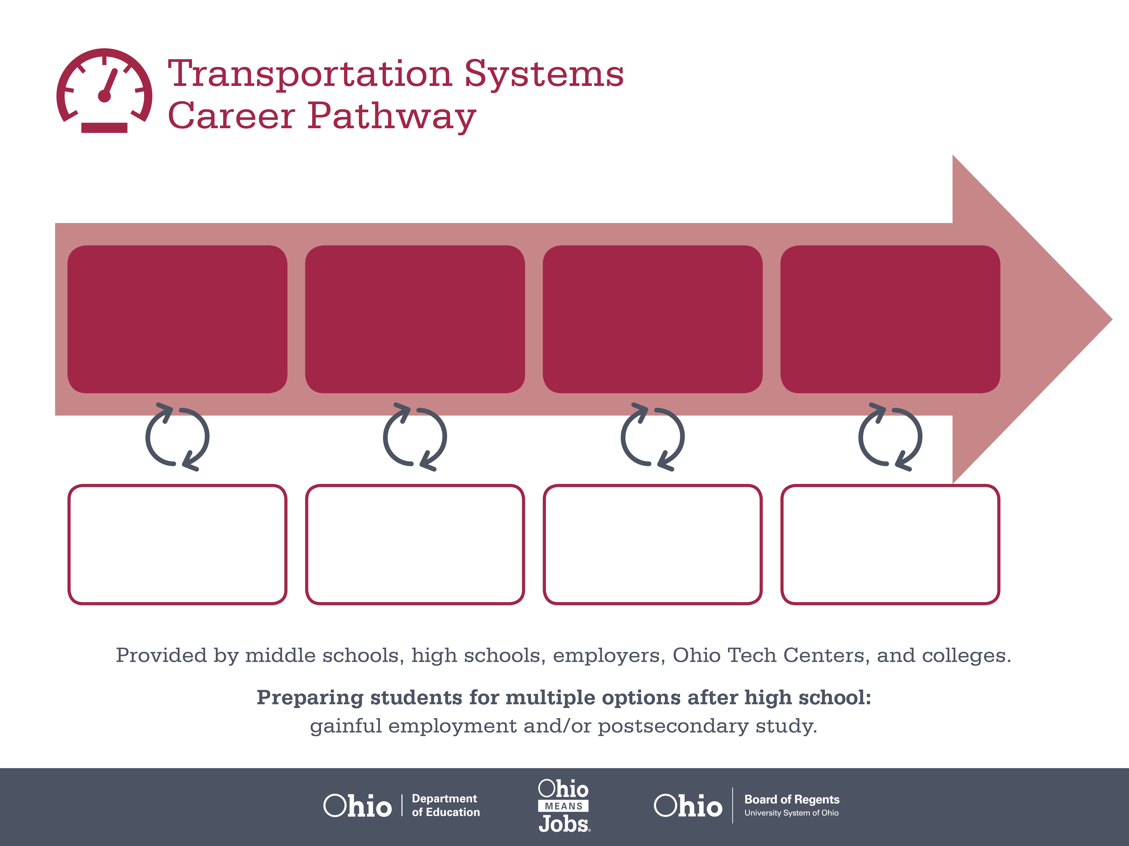
Certificate
Apprenticeship
Bachelor’s Degree,
Business Operations
Start
Pre-Transportation
As early as grade 7
(based on readiness)
Service Technician
Median Salary: $35,440
Job Growth (10 yr): 6.3%
Annual Openings: 1,404
Average Tuition (1 yr): $0 –$3,900/yr
Freight Car Repairer
Median Salary: $55,060
Job Growth (10 yr): 11.5%
Annual Openings: 33
Average Tuition (2 yrs): $3,900/yr
Operations Manager
Median Salary: $89,770
Job Growth (10 yr): -1.3%
Annual Openings: 829
Average Tuition (4 yrs): $9,600/yr
Workplace Visits
Job Shadow
Internship
Work
Supervised Experience
---
Work
Supervised Experience
Internship
---
Work
Internship
---
Work
Ohio In-demand Occupations
Data reflects 2014 Ohio labor statistics and public institutions of higher education for 2013-2014. For specific tuition costs, visit ohiohighered.org.

Slide 2
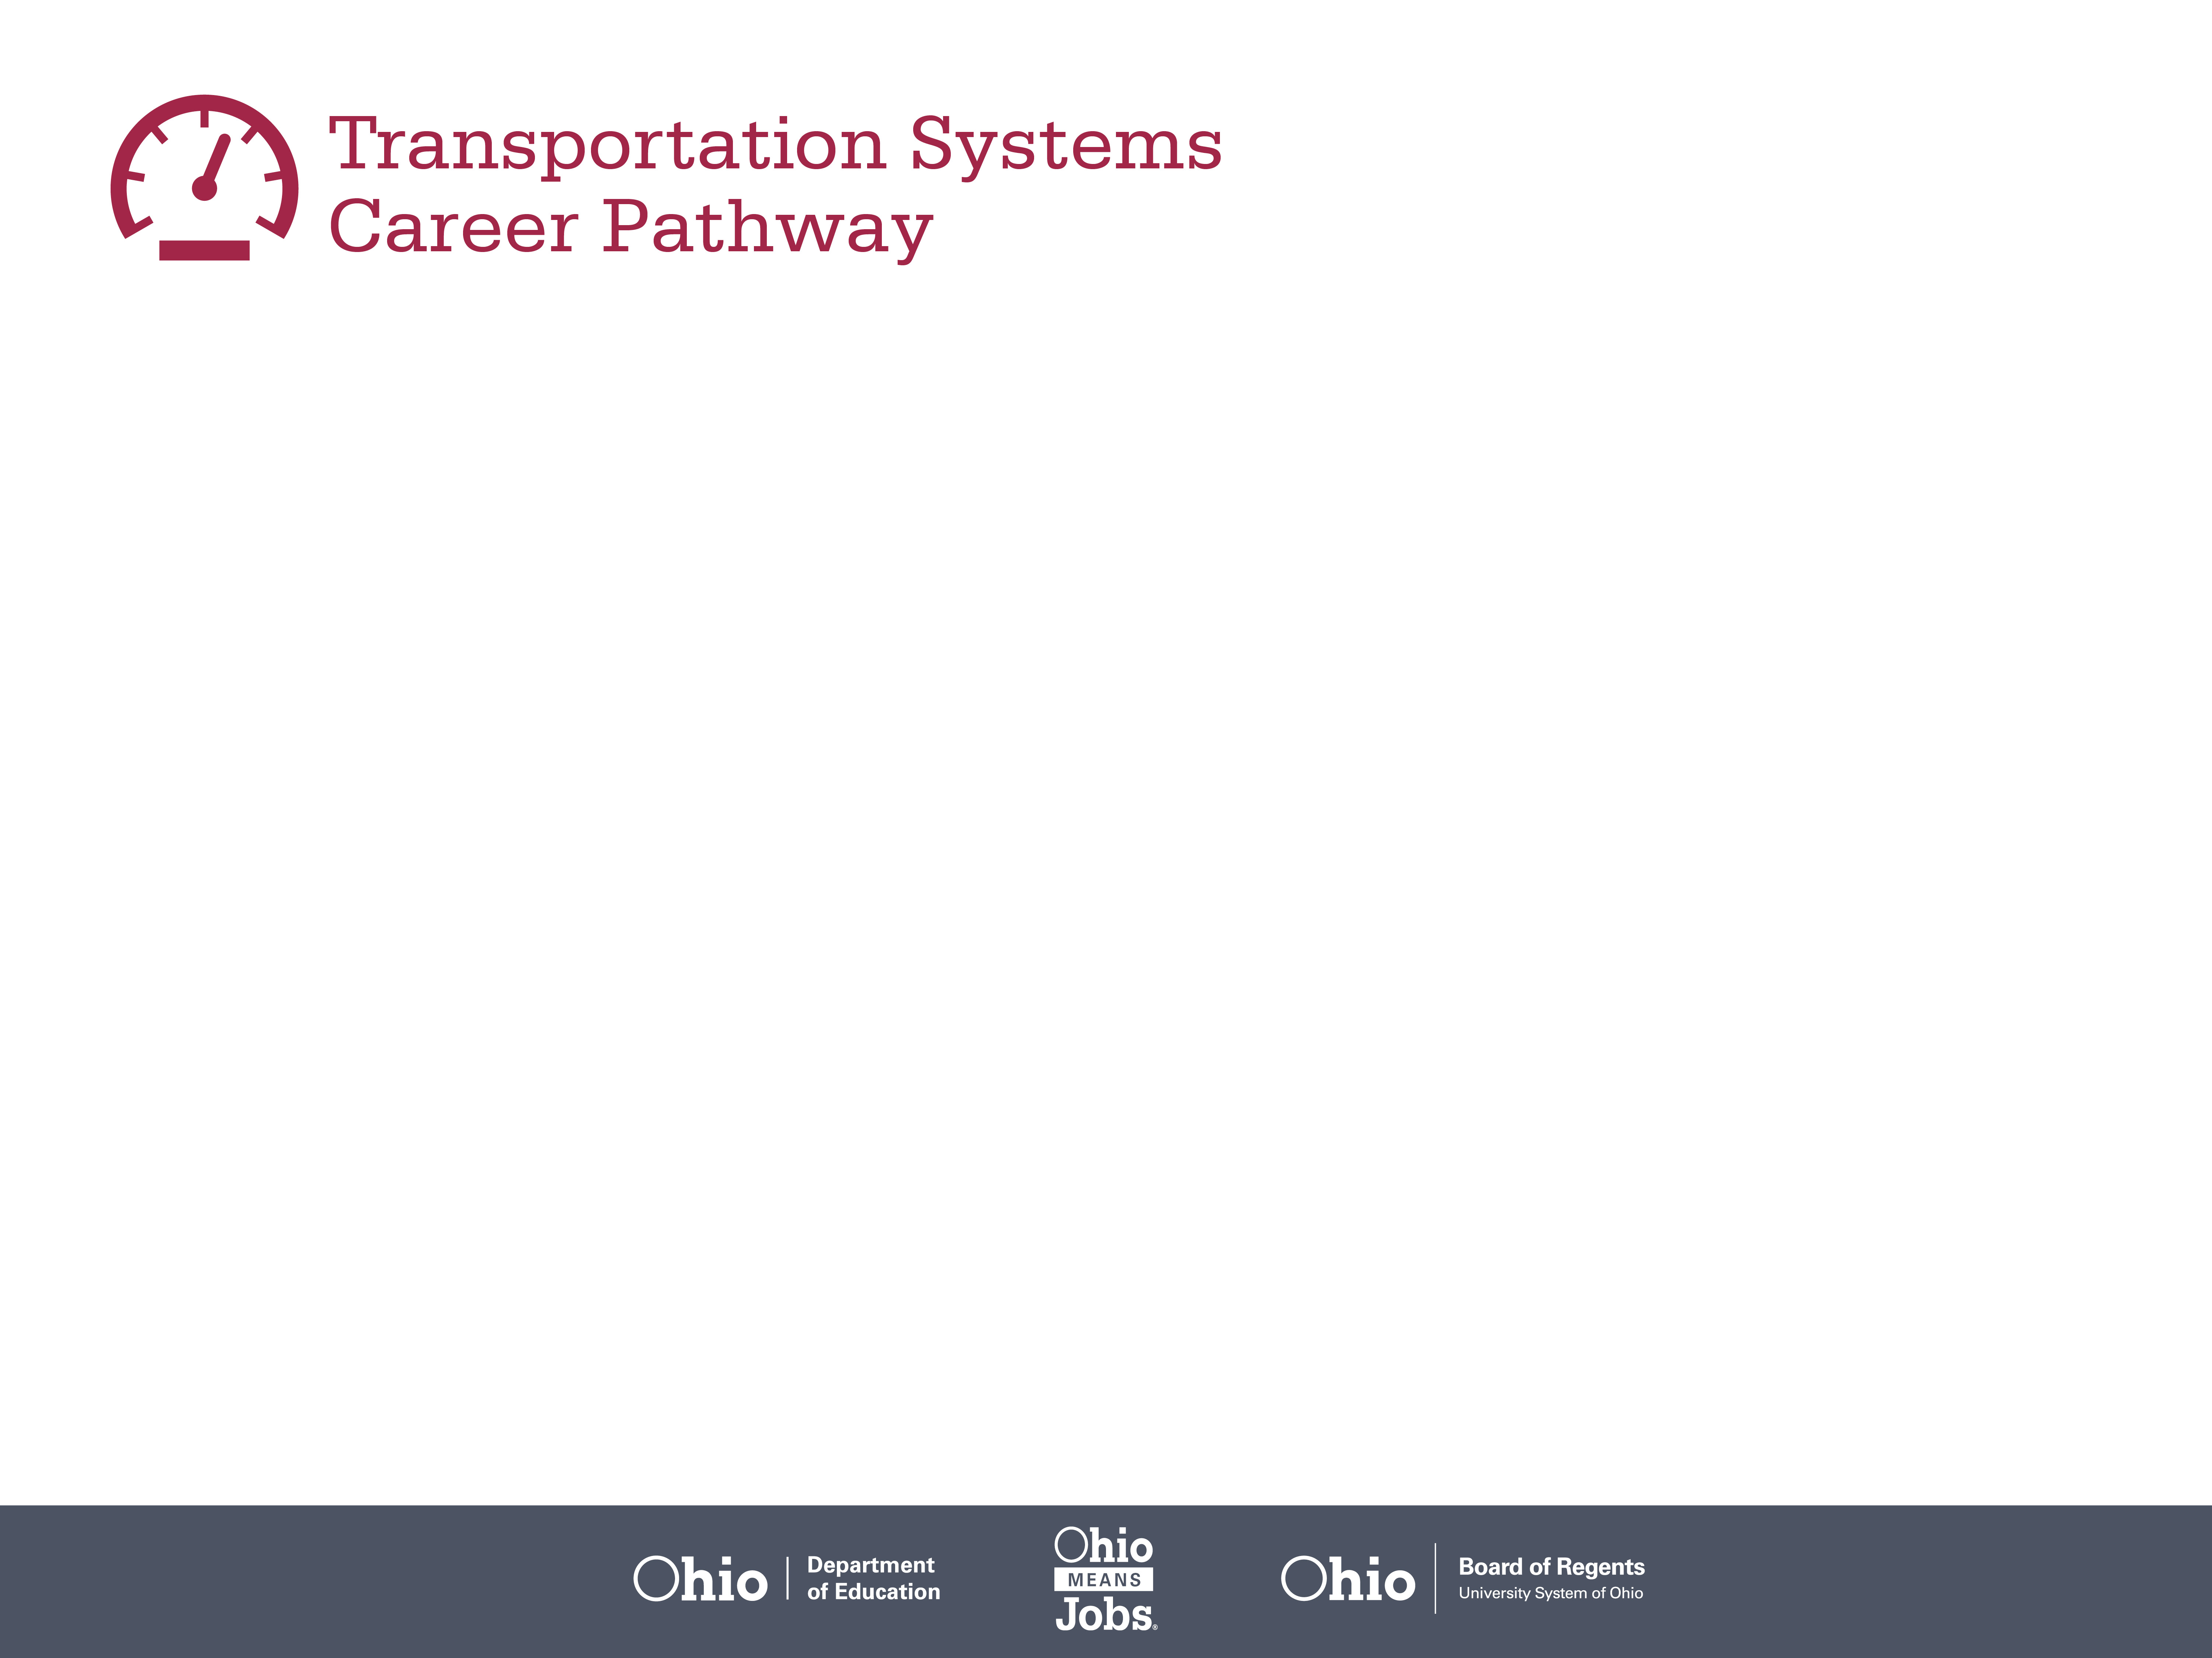
Secondary Pathway: Automotive Technology |  |  |  | Postsecondary Program: Heavy Equipment Technology
An Example of Courses with Secondary and Postsecondary Credits
Secondary | 7 8 | English I | Algebra I |  | Physical Science | Social Studies | Fine Arts
 | 9 10 | English II | Geometry |  | Biology | World History | Health (.5) PE (.5) | Ground Transportation Maintenance | Breaking, Suspension & Steering | World Languages
 | 11 | English III | Algebra II |  | Chemistry | U.S. History | Engine & Power Train | HVAC | World Languages
 | 12 | English IV | Trigonometry/ Calculus |  | Physics | U.S. Government | Electrical/ Electronic Systems | Engine Performance | Transportation Capstone
Postsecondary | Year 1 1st Semester | English Composition | College Algebra |  | Trouble Shooting Strategies | HEQT Maintenance Fundamentals | HEQT Electronics
 | Year 1 2nd Semester | Industrial Writing | Fluid Power Fundamentals |  | Physics | Planned Maintenance Systems | HEQT Electrical Systems
 | Year 2 1st Semester | Humanities Elective | Diesel Fuel Systems |  | HEQT Brakes-Suspension Systems | HEQT Engine Technology | Transport Refrigeration Systems
 | Year 2 2nd Semester | Social Science Elective | Intro to Welding |  | HEQT Auto Transmissions | Power Transfer Technology | Internship
 |  | High School Career-Technical Education Program Courses
 |  | High School Courses for Postsecondary Credit (Including Apprenticeship Hours) and the Corresponding Postsecondary Courses
 |  | Required Courses
 |  | Recommended Electives
Visit education.ohio.gov/CareerConnections for reference information.
Course titles and sequences will vary between schools.
6/2015

