Slide 1
Ohio Career Readiness Network
Working with Students on Developing their Skills to Get and Keep a Job!
November 9, 2020
Notes:
Cassie

Slide 2
Meeting Etiquette
Use Mute when others are speaking
Use chat box to ask Questions
Please introduce yourself in the chat box. Your name, role and district.
If possible, please turn your video on.
Fill out survey at the end of presentation.
Notes:
Cassie

Slide 3
Agenda
Introductions
Using the OhioMeansJobs Readiness Seal
Online Tools for Teaching Professional Skills
Interviewing Practice and Tips!
Next meet-up December 14 @ 1p
Notes:
Cassie

Slide 4
Introductions
Facilitators:
Amy Harker - ESC of Northeast Ohio
Cassandra Palsgrove - Program Administrator – ODE Career Connections and SuccessBound
Kayla Mickens – ODE Program Consultant
Michelle Washington – ODE Program Specialist
Special Guest:
Yusef Abdul-Zahir - Senior Clinical Talent Acquisition Partner, Nationwide Children’s Hospital
Introduce yourself with your name, school, and role in the chat!
Notes:
Cassie

Slide 5
Using the OhioMeansJobs Readiness Seal to Teach Skills to Keep the Job!
These 15 skills are what employers want.
They can be embedded into any course!
Notes:
Cassie

Slide 6
Online Tools for Teaching Professional Skills
LRNG
Padlet
EnvisionIT
Notes:
Cassie

Slide 7
LRNG
The office of Career Connections is looking to work with the LRNG in publishing an online playlist of activities students can engage in to build their academic knowledge and understanding of how each of the OhioMeansJobs – Readiness Seal professional skills are applied in the world of work.
Background:
In 2018 the Southern New Hampshire University (SNHU) and LRNG, merged to build one of the largest and most innovative learning and workforce solutions for cities and employers across the U.S. The LRNG is focused on closing the equity gap by transforming how young people access and experience learning, and the paths they take to success.
Notes:
Kayla

Slide 8
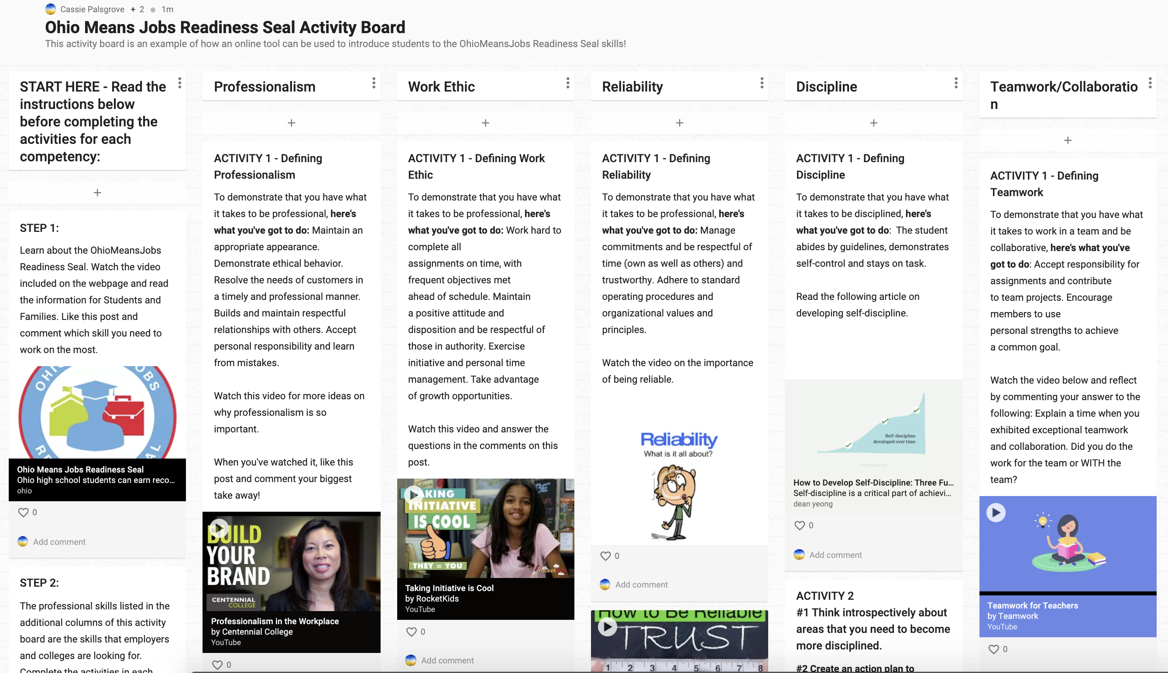
OMJ Readiness Seal Skill Padlet
Each skill has 3 activities
Includes ways to engage mentors
Padlet can be modified
Notes:
Michelle

Slide 9
EnvisionIT Curriculum
Free employability skills curriculum
Standards aligned
Google and Schoology enabled
This Photo by Unknown Author is licensed under CC BY
Notes:
Brenna

Slide 10
Interviewing Practice and Tips!
Online resources through OMJ
Special Guest Tips
Notes:
Cassie

Slide 12
OhioMeansJobs K-12
9-12th Grade View
How to find the
Practice Interviews and Tips

Slide 13
OhioMeansJobs K-12 Practice Interview Center

Slide 14
OhioMeansJobs K-12
Practice Interview Center Example

Slide 15
OhioMeansJobs K-12 Supports and Contacts
Student-based account support call:
1-888-451-6446 (Ohio schools and students, select option 3)
K-12 Admin support and general information about OhioMeansJobs K-12:
careerconnections@education.ohio.gov

Slide 16
Interviewing skills from an HR Professional

Slide 17
Where does it start...

Slide 19
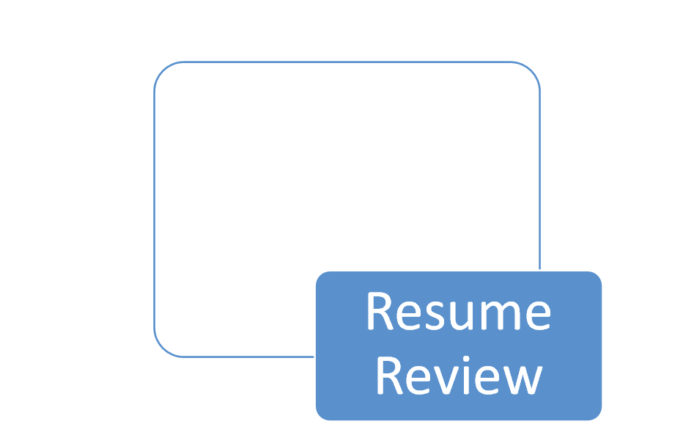
What HR Professionals pay attention to when reviewing a candidate's resume?

Slide 20
What HR Professionals Look For!
What TO do...
Review candidates' achievements (academic and community based)
Review skills developed outside of work(volunteer, classes, clubs, faith-based groups volunteer)
Review education, experience, and industry recognized credentials
Encourage professional social media presence (Linkedin, Indeed)

Slide 21
What HR Professionals Look for!
What NOT to do…
Misrepresent yourself on your resume
Allow resume to become outdated
Adding personal Social Media information
Allow personal contact information to be outdated (phone and email)
Provide references that would not speak highly of you

Slide 22
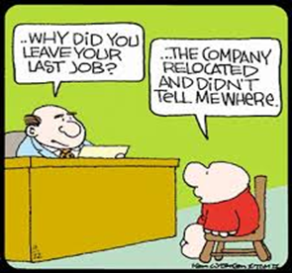
Behavior Based Interviewing
An interviewing strategy based on the premise that past behavior predicts future behavior.
Emphasis is placed on obtaining specific examples of what a person has done in order to predict what a person will do.

Slide 23
Why are there laws that regulate the selection process?
Civil Rights Act of 1964
Age Discrimination in Employment Act
Equal Pay Act of 1963
Pregnancy Discrimination Act
•American with Disabilities Act
Genetic Information Non-Discrimination
•Uniformed Services Employment and Re-employment Act

Slide 24
Preparing Students Remotely for work!
Schedule mock interview from local employers.
Job search utilizing job boards
Teaching employability skills virtually.
Advice on professional dress
Remote ettiquette for job interviews

Slide 25
Through the lens of an HR Professional
Sharing insights from past interviews
Advice for students entering the workforce
How to keep a job? (interpersonal skills, compliance & performance)
Opportunities offered by employers (scholarships & tuition reimbursement)
Advancing in career (continued education, understanding company culture & learning new technology)

Slide 26
Questions?

Slide 28
Share your learning community with us!
#MyOhioClassroom
Celebrate educators!
#OhioLovesTeachers

