Slide 1
Lancaster City Schools
Early Literacy Program
Building a Community to Increase Literacy

Slide 2
Third Grade Guarantee
  According to a study by Early Education for All, we can expect a return to society of more than $17 for every tax dollar invested in a high quality early education program

Slide 3
Lancaster City Schools
Demographics
Community Factors Below State Average by 15% +
  Adults w/Bachelors Degree, Income Levels, Homeownership
  56.2% Free & Reduced Lunch
Reading Performance (3rd Grade OAA)
  2010-11 – 85.7%, 2011-12 – 84.4%, 2012-13 – 85.4%
Challenges
  Student Transiency – 62% of students under 392 are transient
  Parent Involvement

Slide 4

Early Literacy Grant
Strengthen Community Partnerships
    Lancaster City Schools
    West After School Center
    Fairfield County Library
    Ohio University- Lancaster
    United Way
    Lancaster Rotary
    Robert K. Fox – Family Y
    Fairfield Association for the Education of Young Children
    Head Start
    Maywood Mission: Sheltering Arms Day Care
    Community Pre Schools

Slide 5
Early Literacy Grant
The grant focus has been on four main components:
  Increase student achievement,
  Impact teachers in the classrooms
  Strengthen our partnerships with local community agencies
  Provide a stronger connection between home and school.

Slide 6
Early Literacy Program
Impact on Student Achievement
Instruction
  Daily instruction (240 minutes of extended learning opportunities) focused on students identified target areas
  Direct Instruction, Lexia and Leveled Literacy Interventions
Resources
  Summer Academy / Summer Bridges
Data Analysis
  STAR and Lexia – quarterly and progress monitoring
Title I Coordination
  Teaching Staff and Educational Assistants focused on target groups as part of the district RTI process – ongoing teacher collaboration and flexible groups

Slide 7
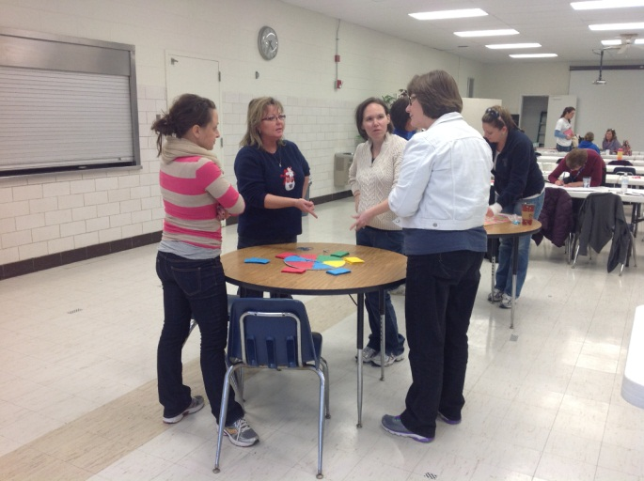
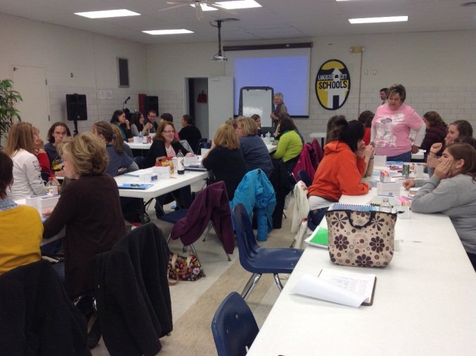
Professional Development
Impact on Staff and Building Capacity
After School Programs / Training
  Systematic
  Data Driven
Job Embedded
  Daily use of resources
  Orton Gillingham Focus
  Five Core Areas
  Classroom Follow Up
RTI Coordination

Slide 8

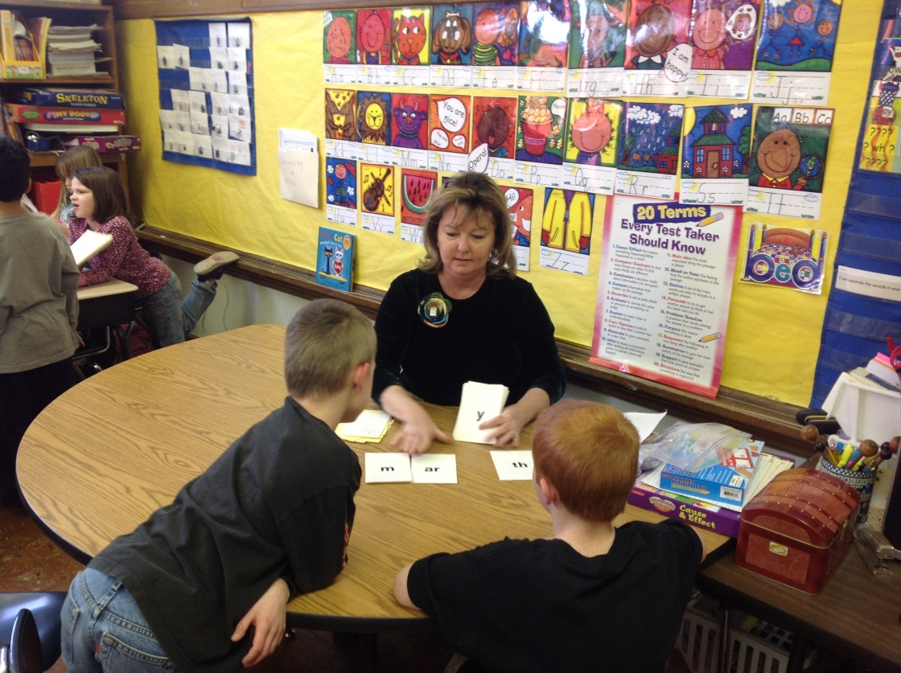
Teacher Perspective
Impact on student learning (Extended Day Program)
Building Capacity (Professional Development)
  Teacher Collaboration
Individual Connections with Students

Slide 9
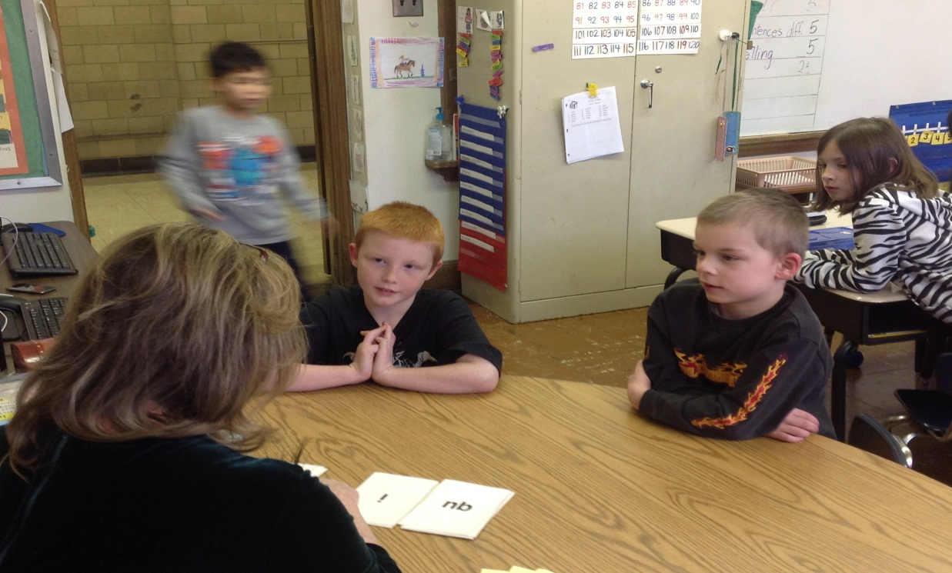
Parent Perspective
Student Impact
  Why it works
    Case Studies
Parent Communication

