Slide 1
FY18 Fall CTE Informational Meetings
Office of Career-Technical Education

Slide 2
Objectives
Share priorities and focus of the Office of Career-Technical Education for FY18
Update on Apprenticeships, CTE at Middle Schools, Compliance, and Civil Rights
Share collaborative activities between ODE and the Ohio Department of Higher Education

Slide 3
Update on federal Perkins and state funding
Describe new operational compliance functions and CCIP planning tool
Collaboration between the Office for
Exceptional Children and Office of Career-Technical Education

Slide 4
Office of CTE Priorities and Focus

Slide 5
Pre-apprenticeships
In Ohio
Linda O’Connor
Assistant Director

Slide 6

Ohio State Apprenticeship Council

Slide 7
Pre-apprenticeship Certificate
Industry-recognized Credential List across career fields
12 Points to High School Graduation
Eligible for ApprenticeOhio scholarships
Articulates to post-secondary/journeyperson status

Slide 8
ApprenticeOhio
Ohio State Apprenticeship Council - Registers Apprenticeship programs (Ohio 2nd to California) and apprentices
Ohio has more than 19,000 registered apprentices in fields as diverse as: aerospace, construction, energy, health care, manufacturing, and utilities

Slide 9
Difference
Registered - Industry Aligned Standards (nationally and internationally recognized)
Unregistered (formalized training program) – no validation of standards
Recognized by – meets state standards and utilizing some registered programs (certificates) and scholarships

Slide 10
Six Secondary Schools
Miami Valley Career Center
Upper Valley Career Center
Southwestern City Schools
Grant Career Center
Northwestern Local Schools (Wayne County Career Center)
Cleveland Metropolitan School District

Slide 11
Ten Post-Secondary Sponsors
Tri-C (Cuyahoga Community College)
Rhodes State – Lima
Columbus State Community College
Marion Technical College
Lorain County Community College
North Central State
Edison State – Piqua
Sinclair Community College
Stark State – Canton
Washington State Community College

Slide 12
ApprenticeOhio Concentration
Information Technology
Business Services
Healthcare
Advanced Manufacturing

Slide 13
Pre-Apprenticeship Program
Basic technical and job-readiness skills for a designated apprentice occupation
Classroom and on-the-job (paid experience)
To prepare participants for Registered Apprenticeship training.

Slide 14
Multi-tiered Status
Pre-apprentice (secondary level)
Apprentice (at the company level)
Employed
Enrolled in an Apprenticeship Training Program with post-secondary (earning an associate degree)
Simultaneously (no duplication of training)
Little to no cost to the student

Slide 15
Apprenticeship
An apprenticeship is a formalized training program of on-the-job training and related classroom instruction under the supervision of a journey-level or trade professional craft person aligned to a highly skilled occupational industry standards.

Slide 16
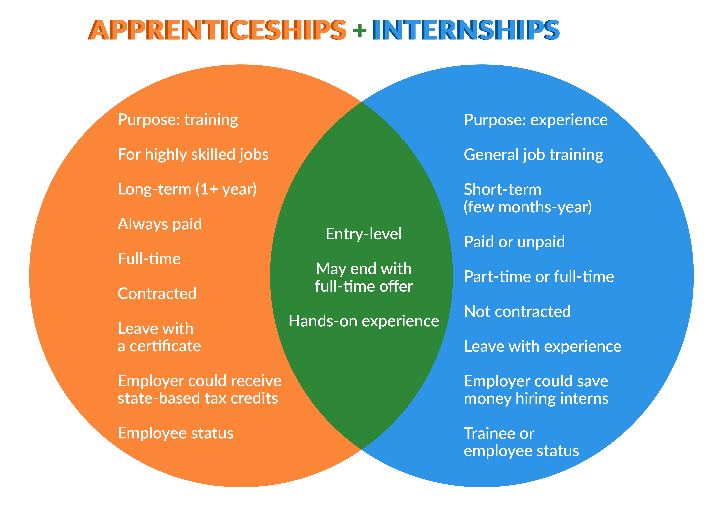
US Department of Labor

Slide 17
Co-ops
Co-operative Education (Co-op) is a type of internship program that enables college students to receive career training with pay as they work with professionals in their major fields of study.
Some high school students (e.g. Agriculture) participate in co-ops. Co-ops last longer than a semester and usually up to a year.

Slide 18
Recognition Application
EEO Recruitment
Enrollment
Operating Plan = Instructional Content/Design (aligned with industry standards by occupation)
More than one industry
Reporting to the Council
Safety
Program Administration
Linkage (Registered Apprenticeship Sponsors)

Slide 19
Forms/Models
http://education.ohio.gov/Topics/Career-
Tech/Apprenticeships-and-Internships
NAPE Construction Workbooks and Lesson Plans (Equity Outreach) – Manufacturing end of October

Slide 20
Student-Parent Agreement
List requirements and expectations:
Attendance must be maintained at 95%
Grade point average
Transportation
Absence
Records that must be maintained
Problems/Issues
Safety/Employer Rules

Slide 21
Apprenticeship Agreement Employer-Student
State all parties responsibilities: parent, student, teacher, coordinator, employer
Wage
Evaluation of Performance
Training Plan Progress
Related Instruction

Slide 22
Training Plan
List job tasks/competencies that student will be performing/learning, aligned to class room competencies.
Attach B.A.T. (Bureau of Apprenticeship and Training) standards for that occupation

Slide 23
New Subject Code
990365 – Pre-apprenticeships/CTE-26 funding application (not tied to recognition)
May be used as the 4th course (no test) for concentrators (enrolled in third course)
OJT Hours
Program still requires 450 hours

Slide 24
Next Workshop
October 19 ( 9 – Noon)
Upper Valley Career Center
8811 Career Drive
Piqua, OH 45356
Register: SAFE/STARS (CTE pre-apprenticeship)

Slide 25
CTE at Middle Schools and Compliance
Cindy Brill
Education Program Specialist

Slide 26
Updates
Expansion of CTE in Middle School
Ohio Revised Code 3313.90(B)
Middle School Validation Process

Slide 27


CTE Middle School Expansion
Grades 7-9
Includes Community and STEM Schools
Funding available
If a new program, a CTE-26 and Program of Study is required
Contact your ODE Career Field Specialist for guidance on program development

Slide 28
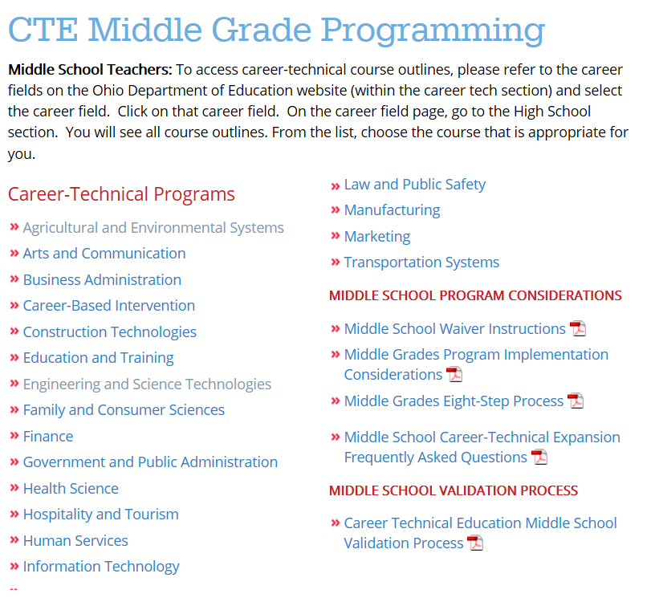


Middle School Courses
Home > Career Tech> CTE Middle Grade Programming

Slide 29


Pathway Courses
Hospitality Fundamentals
(Grade 7)
Introduction to Hospitality and Tourism
(Grade 8)

Slide 30





High School Diploma or GED
Certified Sous Chef
Certified Chef de Cuisine
Apprenticeship 2-3 years
4,000 hours On-the-Job Training plus 445 class hours
EXIT
Combination College & Apprenticeship
6,000
hours
On-the-job Training
EXIT
Pre- Apprenticeship
Certified Master/Pastry Chef
Business Management
Culinary Educator/ Administrator
Middle/High School
Pre-Hospitality
Community College
2 years
3-5 yr.
Executive Sous Chef/Pastry Chef
Personal Certified Chef
Executive Chef/ Company Owner
1-2 yr. entry level culinarian/ pastry
specialized
Supervisory Management
EXIT
certifications
University 4 years
Certified Culinarian or Pastry Culinarian

Slide 31
Serving Middle School Students in CTE
Revised Q & A Document is posted
Outline of current law (3313.90) regarding the district's intent not to provide career-technical education to students enrolled in grades seven and eight

Slide 32
O.R.C. 3313.90 (B)
Career-Technical Education Programs
(B)
If the board of education of a city, local, or exempted village school district adopts a resolution that specifies the district's intent not to provide career-technical education to students enrolled in grades seven and eight for a particular school year and submits that resolution to the department by the 30th day of September of that school year, the department shall waive the requirement for that district to provide career-technical education to students enrolled in grades seven and eight for that particular school year.

Slide 33

O.R.C. 3313.90 (B)
“specifies the district's intent not to provide”

Slide 34

Timeline
SEPT 30, 2017 -O.R.C. 3313.90 (B)
Adopt local board approved resolution
Submit to the Department
Must be revisited annually

Slide 35
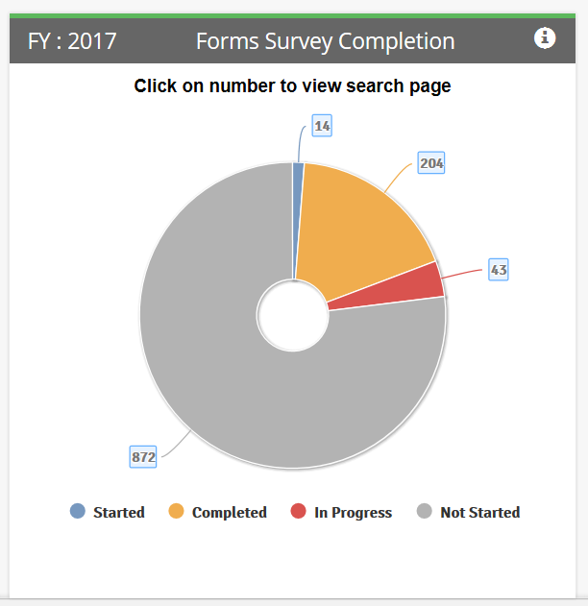

Middle School Waiver

Slide 36
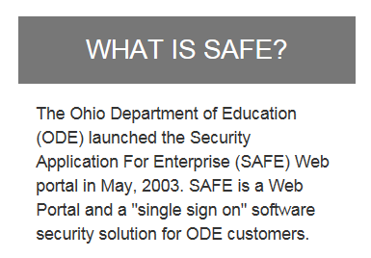

Slide 37
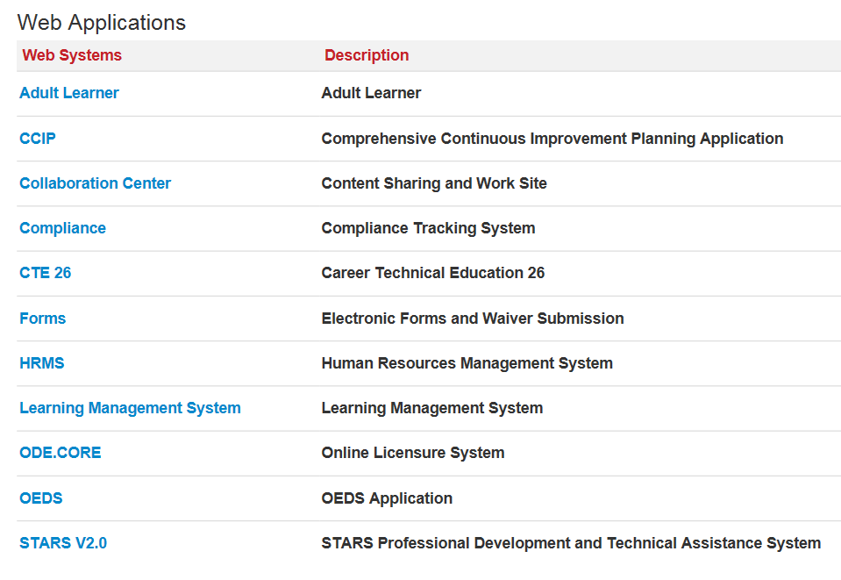

Slide 38
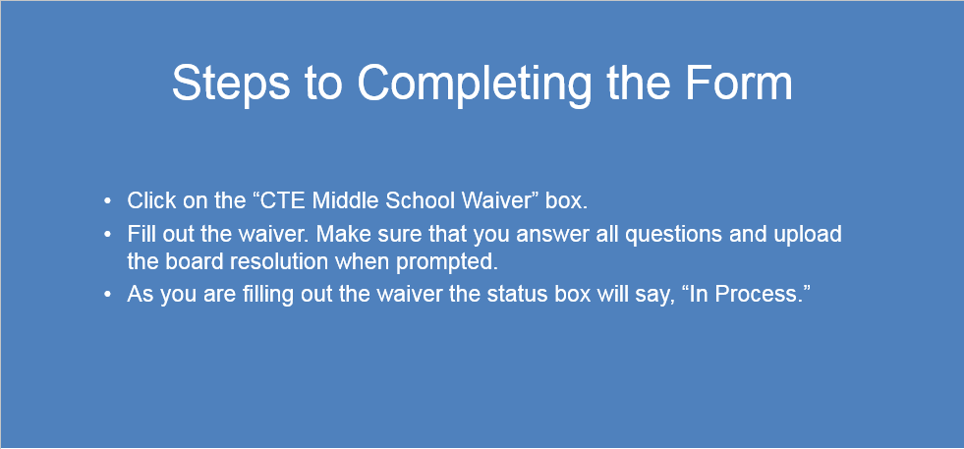
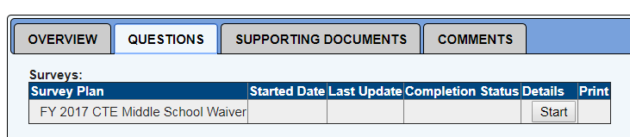
Steps to Completing the Form
Click on the “CTE Middle School Waiver” box.
Fill out the waiver. Make sure that you answer all questions and upload the board resolution when prompted.
As you are filling out the waiver the status box will say, “In Process.”

Slide 40


Middle School Validation

Slide 41

Professional Development
3 CEU’s

Slide 42

Ohio High Schools That Work/Making Middle Grades Work Annual Conference
LOCATION:
Renaissance Columbus Downtown Hotel
50 North Third Street
Columbus, Ohio 43215
SAVE THE DATE! November 16-17, 2017

Slide 43
Career-Technical Education
Civil Rights
Ray Timlin
MOA/OCR Coordinator/ODE

Slide 44
Career-Technical Education
Civil Rights
Court decided in 1973 that vocational education was violating the civil rights of certain students
CTE must comply with civil rights laws and states must monitor

Slide 45
Career-Technical Education
Civil Rights
Purpose
To determine if anyone is being denied access to CTE due to their race, national origin, color, sex or disability.
Secondary, Post-Secondary and Correctional Institutions offering CTE programs

Slide 46
4 Major Civil Rights Laws
Title VI of the Civil Rights Act of 1964
Title IX of the Education Amendments of 1972
Section 504 of the Rehabilitation Act of 1973
Title II of the Americans with Disabilities Act of 1990
Age Discrimination in Employment Act (ADEA) of 1967

Slide 47
Career-Technical Education
Civil Rights
Criteria for Being Monitored
Offer Career-Technical Education
(2) Receive Federal Financial Assistance

Slide 48
Areas to be Reviewed
Recruitment
Admissions
Counseling
Services to students with disabilities
Accessibility (Facilities)
Work study, co-op, job placement
Employment

Slide 49
CAUTION!
A civil rights on-site review is not a special education review.
IDEA vs. Section 504
Special Education Civil Rights

Slide 50
Career-Technical Education
Civil Rights
Targeting Plan approved by USDOE
Enrollment of protected classes of students (race, gender, students with disabilities) in CTE programs to total enrollment of protected classes in institution

Slide 51
Postsecondary sub-universe in
State Year 2017-2018
Rio Grande CC Columbus State
Sinclair CC Cuyahoga CC
Southern State Edison State
Washington State
Zane State
Belmont Technical
Central Ohio Technical
Cincinnati State

Slide 52
Secondary sub-universe in
State Year 2017-2018
Pickaway Ross JVSD Oregon City
Pike County JVSD Parma City
Pioneer JVSD Plain Local CTPD
Polaris JVSD Sandusky City
Scioto JVSD Six District Compact
Southern Hills JVSD Southwestern City
Springfield-Clark JVSD
Penta County JVSD

Slide 53
What are the Typical Findings?
Continuous Notification
Annual Notification
Title IX and Section 504 Coordinators
Grievance Procedures
Facilities/Parking Areas

Slide 54
Combined Notice
The “Your Institution” does not discriminate on the basis of race, color, national origin, sex, disability, or age in its programs and activities.
The following person(s) have been designated to handle inquiries regarding the non-discrimination policies:
Section 504
Name and Title, Address, Phone Number, email address
Title IX
Name and Title, Address, Phone Number, email address

Slide 55
OHIO DEPARTMENT OF HIGHER EDUCATION UPDATES

Slide 56
UPDATES
WHO WE ARE
Postsecondary Perkins
Articulation and Transfer CTE Work
College Credit Plus
WIOA
Attainment Goal

Slide 57
WHO WE ARE
Ohio Department of Higher Education
Academic Affairs
Institutional Collaboration
Postsecondary CTE Portfolio
  Ohio Technical Centers
  Perkins
  Tech Prep
  College Completion Initiatives
  Career Pathways
Work with ODE (Perkins, SCTAI, Tech Prep, WIOA)

Slide 58
OUR WORK WITH OTCs
Support and Compliance
  Data
  Funding
  Program Approval
  Policy
Advancing Apprenticeships

Slide 59
PERKINS
Serving OTCs and Colleges
$3.6M – OTCs; $4.1 Colleges
Tech Prep
  FY 2018 $2,872,948
  FY 2019 $1,936,474
Notes:
200545, Career-Technical Education Enhancements, up to $2,872,948 in fiscal year 2018 and $1,936,474 in fiscal year 2019 shall be used by the Department of Education to fund competitive grants to tech prep consortia that expand the number of students enrolled in tech prep programs

Slide 60
Career Technical
Articulation and Transfer
One Year Option (Adult, 600-900+) Clock Hour Programs w/ Approved Credentials.
  Webinars planned for early November to address transfer policy and student registration processes (including transcription)
Statewide Career Technical Articulation Agreements (CTAGs)
  New research underway for Cybersecurity statewide agreement
  Complete listing of CTAGs available: https://www.ohiohighered.org/sctai/ctags
  Interactive learning module available for CTE teachers and students: https://www.ohiohighered.org/transfer/ct2/earning-college-credit
Notes:
The One Year Option Initiative, by legislative code is for adult students who graduate from Ohio Technical centers in 600 -900 clock hour programs with chancellor approved credentials. Last year was a program to let OTC’s and Public Colleges and University’s know that the initiative is live. HLC was also invited to that event to signal the importance of accreditation and discussed the ways in which the process of designing the OYO addressed accreditation considerations.
Webinars are planned for early November to address participation, policy, and student registration and transcription processes. There will be additional webinars in the Spring semester as well. For more information you can contact Jamilah Tucker in articulation and transfer.
Statewide Career Technical Articulation Agreements (CTAGs) have been expanded to include an impressive inventory of courses offering statewide articulation for secondary students, that are directly aligned to ODE CTE courses. Institutions are encouraged to adopt as many of those courses for alignment that offer credit as possible. Not all courses align. The first link will take you to a listing of available CTAGs and EMIS aligned courses.

Slide 61
COLLEGE CREDIT PLUS
Beginning of Year 3 (2017-2018) underway!
Changes based on House Bill 49
  Payments: Standard Tuition Rate, Default Payment Structure, Payment Deadlines
  Assessment Testing: Student Eligibility Criteria, Institutional Responsibility
  Rule-Making: Course Eligibility, Underperforming Students
  Date Change: Annual Notice (February 1)
  Definitions: Minor Labor Law, Early College High School
  Appeals: April 1 Approval, Grade Disputes
  Reporting: Outcomes, Biennial
Larisa Harper, Ph.D., Director, College Credit Plus
614-752-9472, lharper@highered.ohio.gov
https://www.ohiohighered.org/content/college_credit_plus_info_students_families

Slide 62
Workforce Innovation and Opportunity Act - WIOA
Ohio’s WIOA Combined State Plan in effect
  Carl D. Perkins CTE is a required partner
10 Plan Reform Areas
  Require Registration in OhioMeansJobs.com; (Aspire and adult Perkins programs required to do this by HB 64 - active
  Require a Common Application for Adult Basic and Literacy Education (ABLE), WIOA and Carl D. Perkins Adult Career Technical Schools - pending;
  Develop Integrated Case Management - pending;
  Common Assessment Strategy - pending;
  Co-enrollment between Programs and Services - pending;
  Require a Regional/Local Combined Plan - active;
  Increase Access to Remedial Education and High School Credential Training - active;
  Embed Job Readiness and Soft-Skills Training in All Workforce Training Programs - active;
  Ensure Career Counseling - active; and
  Develop Workforce Success Measures (Common Measures) - active.

Slide 63

  65% of Ohioans, ages 25-64, will have a degree, certificate or other postsecondary credential of value in the workplace by 2025.
65 percent of Ohioans, ages 25-64, will have a degree, certificate or other postsecondary workforce credential of value in the workplace by 2025.

Slide 64
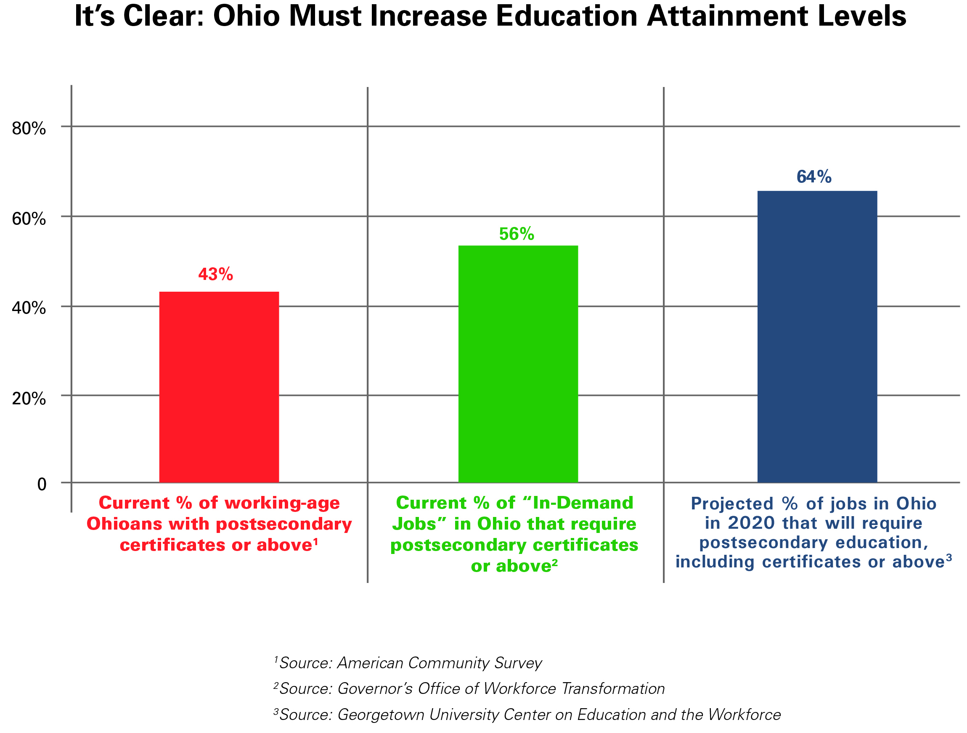
Attainment Goal 2025

Slide 65
Strategic Priorities
Aligning Credentials to In-Demand Jobs
Identifying, validating and counting all levels of credentials
Achieving attainment rates with greater parity among people of all races, ethnicities and socioeconomic levels
Educating more adults
Increasing high school graduation rates and movement into post-secondary education
Rethinking systems
Monitoring and measuring progress

Slide 66
THANK YOU
Brett Visger – 614-466-6000
bvisger@highered.ohio.gov
Tony Landis – 614-387-124
alandis@highered.ohio.gov
Jeff Gove – 614-752-1642
jgove@highered.ohio.gov
Verda McCoy – 614-387-1020
vmccoy@highered.ohio.gov
Theresa Bryant – 614-466-0544
tbryant@highered.ohio.gov

Slide 67


Slide 68
Federal Carl D. Perkins and
State Funding
Raúl Soto Ph.D.
Associate Director
Office of Career-Technical Education

Slide 69
Objectives
Update on new Carl D. Perkins reauthorization
Describe state funding for FY18 and FY19
Notes:
Thank presenter
Welcome audience to the pre-conference event and CTE
Read objectives.

Slide 70

WIOA Combined Plan
We are here
FY17
FY18
FY19
FY20
FY21
FY22
FY23
FY24
4-Year WIOA
New 6-Year Perkins Law

Slide 71
New Carl D. Perkins Themes
Devolution of federal oversight/authority to states and locals
Linkages to other federal education and workforce development programs
Stronger focus on programs’ labor market alignment

Slide 72
Themes
Streamlining/refocusing state and local planning requirements
Formalizing processes to drive funding decisions (e.g. comprehensive needs assessment)
Heightened attentiveness to equity issues as a result of election and ESSA implementation

Slide 73
Structure
Fed-to-state and state-to-local formulas remain
6-year authorization period- (4-year Plan)
Authorization levels include 8.5 percent increase over the course of the Act

Slide 74
Needs Assessment
At least once every two years
List of groups to consult with regularly
Key areas:
  Student performance
  Size, scope and quality of programs
  Labor market alignment
  Programs of study implementation progress
  Strategies for special populations
  Improving educator recruitment, retention and training, including transition to teaching from business and industry

Slide 75
Local Application to Include
Results of the needs assessment
Programs of study to be supported by Perkins
Description of career guidance/counseling
Description of activities for special populations
** Other requirements the state might add

Slide 76
Local Uses of Funds
Career exploration and career development activities
Professional development
Skills necessary for students to pursue high skill, high wage occupations

Slide 77
Local Uses of Funds
Integration of academics and CTE
Supporting programs of study and student achievement (17 permissive activities)
Evaluations

Slide 78
Other Highlights
State governance structure remains the same
Expansion of state reserve fund 10% to 15%
State/local flexibility to meet labor market needs

Slide 79

Friendly Reminders
Keep Records of operating procedures
Keep EDGAR
Study EDGAR
  Education Department
  General Administrative
  Regulations

Slide 80
Key Parts of the NEW EDGAR
Title 34
  Part 75 – Direct Grant Programs
  Part 76 – State-Administered Programs
  Part 77 – Definitions
  Part 81 – General Education Provisions Act (GEPA)
Title 2
  Part 200 – Cost/Administrative/Audit Rules
  Part 3474 – USDE Exceptions – Adopts Part 200
  Part 3485 – Nonprocurement Debarment and Suspension
    Incorporates 2 CFR Part 180, OMB’s Guidelines on Debarment and Suspension

Slide 81
Financial Management Rules
200.302(b)
Identification of Awards (NEW)
Financial Reporting
Accounting Records (Source Docs)
Internal Control
Budget Control
Written Cash Management Procedures (NEW)
Written Allowability Procedures (NEW)

Slide 82
Control

Slide 83
State Funding for
Career-Technical Education

Slide 84
Foundation Program
Centered on needs of students
Funds distributed based on district characteristics
Largest part of ODE’s budget

Slide 85
Funding Formula Elements
Traditional Districts
Opportunity Grant | Economically Disadvantaged | Transportation
Targeted Assistance | Limited English Proficiency | Special Education
K-3 Literacy | Gifted Education | Career-Technical Education Supplemental $$
Capacity Aid | Third Grade Reading Bonus | Graduation Bonus

Slide 86

Opportunity Grant Per Pupil Funding Increase
Increase to $6,010 in FY2018
Increase to $6,020 in FY2019

Slide 87
Transitional Aid
“Guarantee” based on drop in ADM
(% change between FY14 and FY16)
5%
10%
5% or less
Between 5% and 10%
10% or more
100% of previous year
95% of previous year
(% change FY14 and FY16) + 1.05

Slide 88
Gain Cap
Funding increases are limited to 3% in each fiscal year, unless a district has experienced increasing enrollment.
Maximum growth of 5.5% in FY18 and 6% in FY19.

Slide 89
Funding Formula Elements
JVSD
Opportunity Grant | Economically Disadvantaged | Transportation
Targeted Assistance | Limited English Proficiency | Special Education
K-3 Literacy | Gifted Education | Career-Technical Education Supplemental $$
Capacity Aid | Third Grade Reading Bonus | Graduation Bonus

Slide 90
Career-Tech Supplemental Funding
Continues outside of both the cap and the guarantee.
A secondary guarantee established for career tech funding at traditional districts.
Guarantee = FY17 career-tech funding.

Slide 91
Foundation Formula – FY17
JVSD
*FY17 June Payment

Slide 92
Career Technical Education
No changes in per pupil amounts from FY17.
Supplemental CTE funding for five categories continues
Lead district receives $245 for associated services for each CTE FTE

Slide 93
Career Technical Education
Category | Career Fields | Amount
1 | Agricultural & environmental systems, construction technologies, engineering & science technologies, finance, health science, information technology, manufacturing technologies | $5,192
2 | Business & administration, hospitality & tourism, human services, law & public safety, transportation systems, arts &communications | $4,921

Slide 94
Career Technical Education
Category | Career Fields | Amount
3 | Career based intervention | $1,795
4 | Education & training, marketing, workforce development academics, public administration, career development | $1,525
5 | Family and consumer sciences (which includes students enrolled in GRADs) | $1,308

Slide 95
What factors influence district aid?
Student Population and Demographics
Property Valuation
Income
Historical Funding – Caps and Guarantees

Slide 96
Friendly Reminders
Refer to EDGAR Guide for fiscal regulations.
2. Work with:
  CTE Education Program Specialist
  School Finance Area Coordinators
  ODE Office of School Finance

Slide 97
New Operational Functions and Expectations
Tawanna Fields-Mphande
Education Program Specialist

Slide 98
Compliance Overview
Risk-Based
Assessment
Perkins Monitoring
Comprehensive Continuous Improvement Plan (CCIP)
Notes:
Making the connection between the 3 processes.
[When presenting, this slide requires multiple clicks to reveal each element]

Slide 99
Risk-Based Assessment

Slide 100

Risk-Based Assessment
The process is designed to conduct a more thorough review for Perkins recipients with higher risk factors.
The risk-based assessment review identifies potential problems that could lead to risks in the accountability, fiscal accounting and grant operations.
Notes:
A high-risk assessment does not necessarily mean a district is not meeting the requirements of the program, federal regulations or administrative procedures.
The risk-based assessment review is a process to identify potential problems that could lead to risks in the accountability, fiscal accounting and grant operations.
Potential risk factors include: program performance (Federal indicators), fiscal operations, and data reporting.
The risk-based process will include a review of financial reports, performance reports, management of prior grant awards and single-audit findings.
Districts identified as “high risk” will receive targeted technical assistance.

Slide 101

Risk-Based Assessment
Performed annually prior to the grant awards.
Identify districts risk levels
(High, Medium,& Low)
Provide continuous technical assistance over time, to assist districts with their needs.
Notes:
When: Performed annually prior to the grant awards
Why: The state administers the Perkins Risk-Based Assessment reviews to measure the effectiveness of the Perkins grants. Based on the results of the risk assessment, all districts will be categorized as low, medium or high risk. The risk-based assessment process is designed to conduct a more thorough review for Perkins recipients with higher risk factors
Benefit: Provide preventative technical assistance
strengthening accountability” by improving policies
In accordance with recent guidance outlined in the OMNI Federal Circular §200.331, the state must use a risk-based approach to monitor sub-recipients.
This includes all federal programs -each department has their own process.
Districts may have already been identified as high-risk via other programs/departments.

Slide 102

Criteria Selection Process

Slide 103
Criteria Selection Process
Previously non-compliant
Failure to meet 90% of the negotiated target
Failure to meet stated deadlines
Notes:
Briefly explain.
The following are the criteria used to determine the risk level of subrecipients for the 2017-2018 school year:
Previously non-compliant- Perkins monitoring CAP process (district received a CAP and did not submit the evidence)
Failure to meet 90% of the negotiated target for accountability measures (2S1 and 5S1 previous year’s data)
Failure to meet stated deadlines-reallocation and FER’s

Slide 104
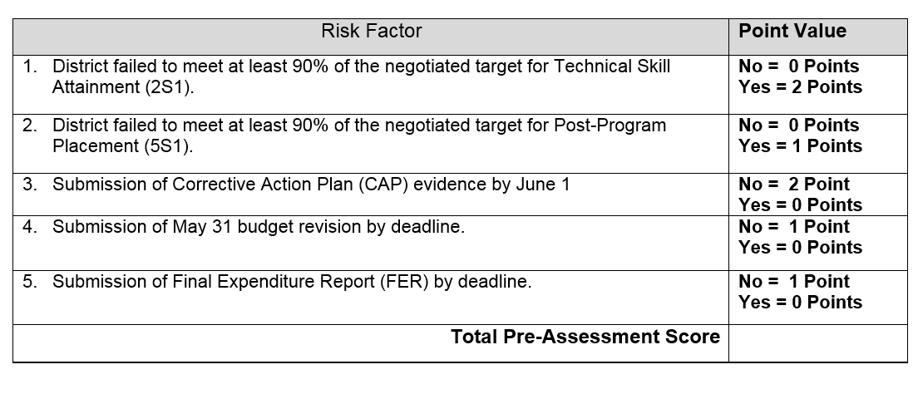
Risk-Based Assessment Tool
Notes:
FY18 Assessment Tool- Technical skill attainment based on last year report card.
Sample of the risk factors and assigned point values. The listed risk factors are attainable and reasonable. The Compliance team met numerous occasions to determine the risk factors. Your feedback is appreciated. FY17 was the piloted year.
(Note: *The selection criteria for FY18 process is based on FY16 data.
The risk assessment criteria include risk factors that help identify changes critical to assessing the districts’ risk levels.

Slide 105
Assessment Scores
0 to 2 points low risk
3 to 5 points medium risk
6 to 7 points high risk
Notes:
The following will be used to determine each district score. The districts with scores between 0 to 1 points will be low risk. The districts with scores between 2 to 3 points will be medium risk. The districts with scores between 4 to 7 points will be high risk. The risk assessment criteria include risk factors that help identify changes critical to assessing the districts’ risk levels.

Slide 106
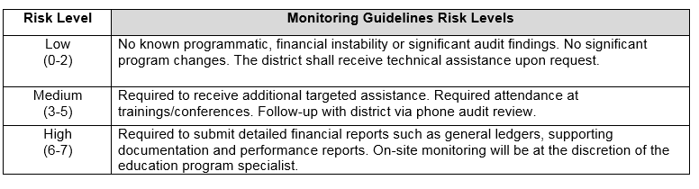
Risk Levels

Slide 107
Special Technical Assistance Cohort (STAC)

Slide 108
Special Technical Assistance Cohort (STAC)
Technical assistance provided to districts identified as medium or higher risk.
FY18 nine districts were identified as medium risk.
The FY18 cohort will receive in depth analysis that will include three elements.

Slide 109
Three Elements
Intensive analysis and improvement planning
Ongoing accountability for improvement
External consultation and insight from cohort peers

Slide 110
Ongoing Technical Assistance
Conference Call
OCTA Cohort Workshop
Technical Assistance Follow-up
Notes:
Conference call- review of self-assessment (4 questions)
Workshop- Discussion of the cohort workshop and the continuous improvement teams to determine root causes and highlight best practices specific to their determined needs.
January – OCTA review/site visits
Spring – OCTA follow up

Slide 111
Perkins Monitoring

Slide 112
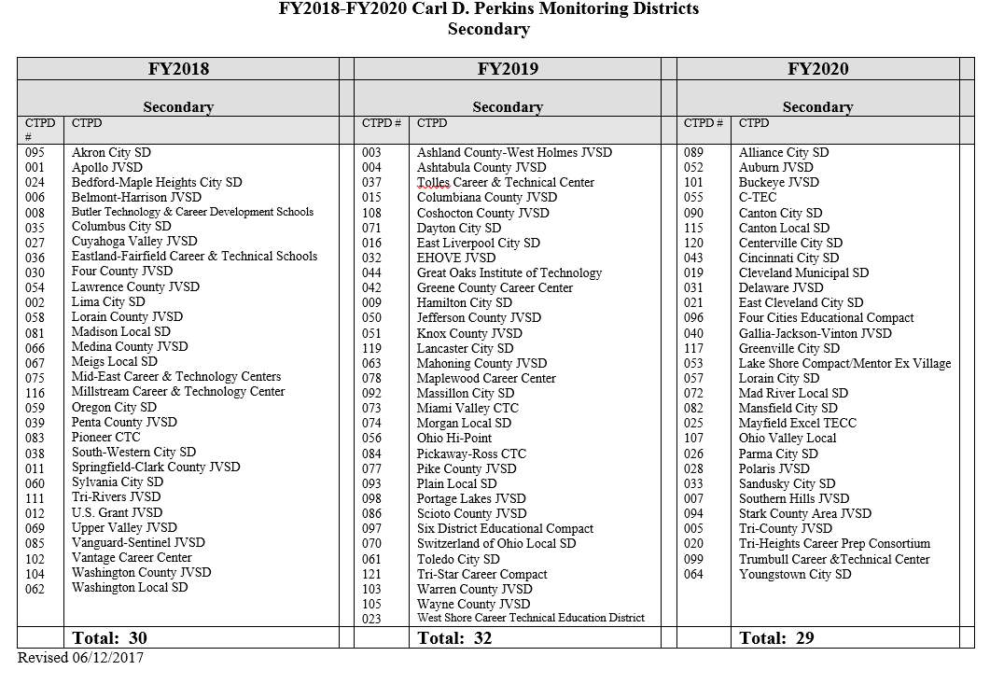
Districts Scheduled to be Monitored
Notes:
Annual fall workshop for districts scheduled to be monitored. The workshop provides a comprehensive overview of the entire process.

Slide 113
Perkins Monitoring
Self-assessment review (December 1)
Aligns with the Comprehensive Continuous Improvement Plan (CCIP) process.
Corrective Action Plan submission process by June 1 (Risk Factor 2 Point Value).
Notes:
Making the connection to CCIP & Risk Assessment (CAP evidence).
Issue and Corrective Action Plan process submission process. CAP is a risk-factor-two points if district fails to submit evidence by June 1.

Slide 114

Compliance Enhancements

Slide 115
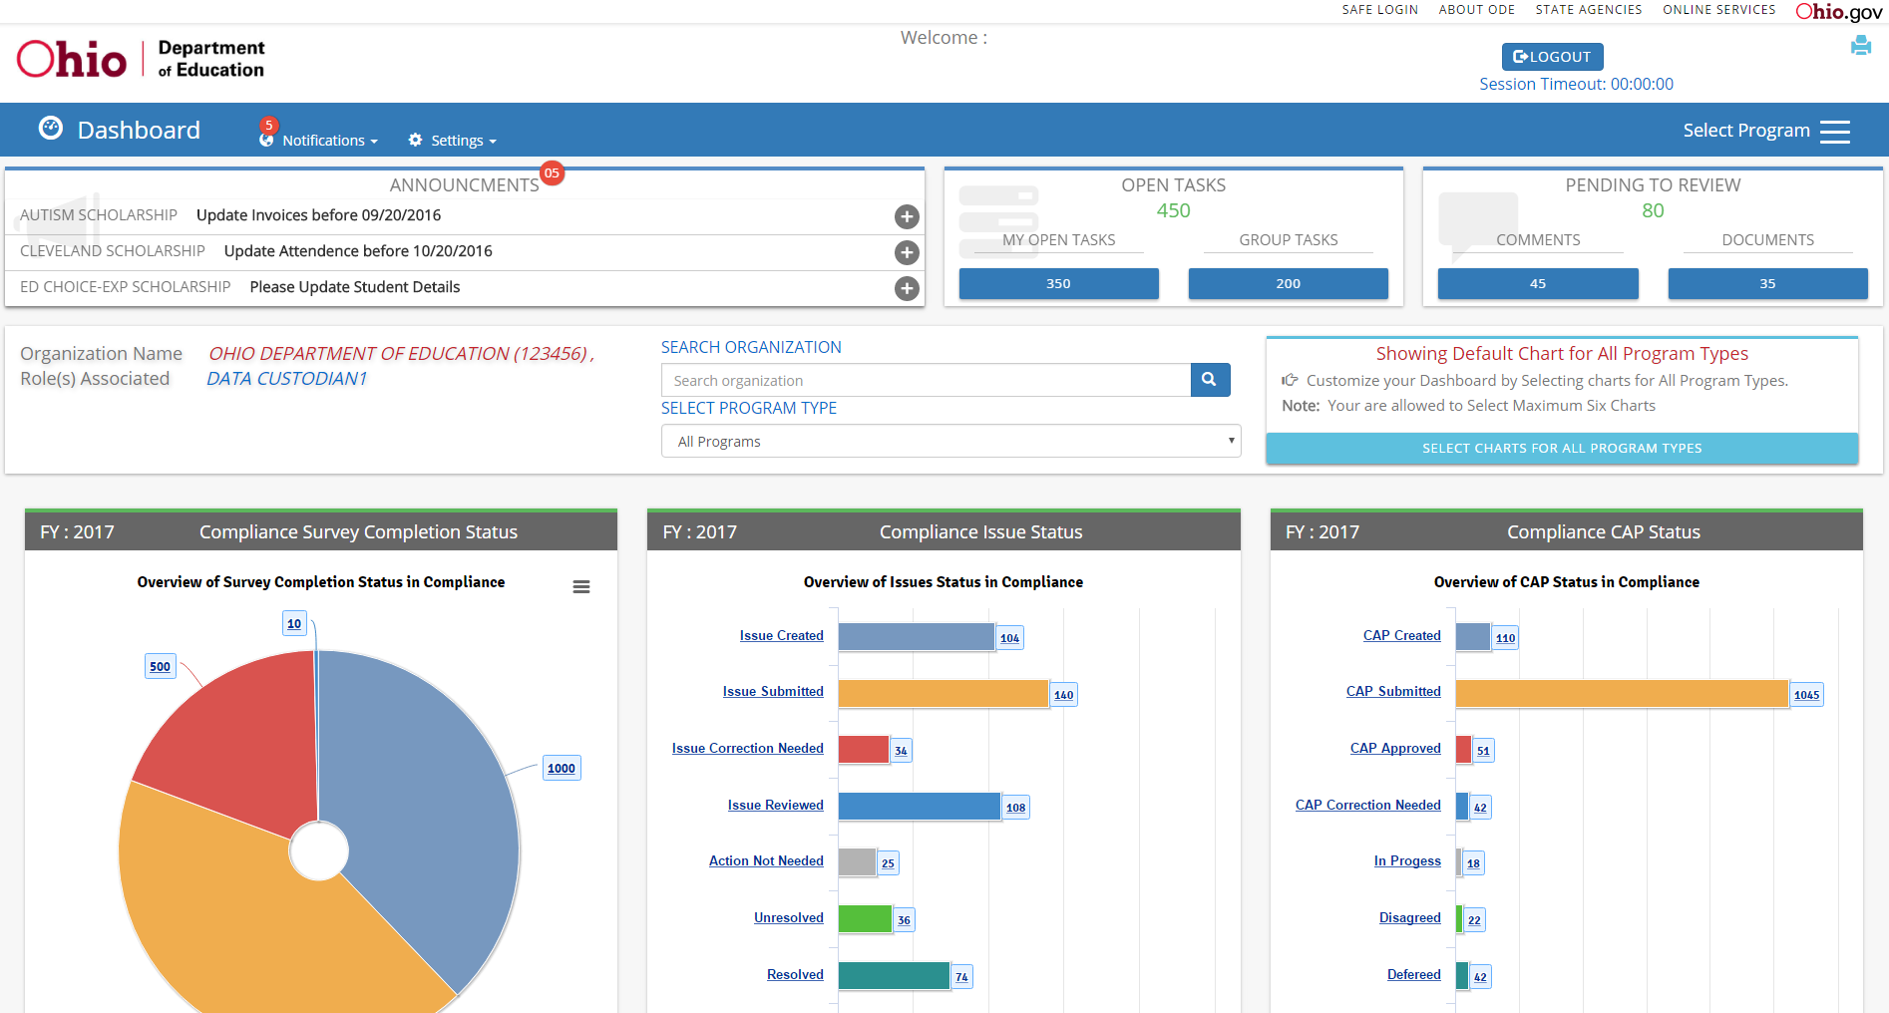
Compliance Dashboard
Notes:
•Task management - help people be aware of what actions they need to complete in an IT system in order to keep a business process flowing.
Tasks are just notifications/reminders, they do not affect the ability to perform work in the usual manner
Youtube Video

Slide 116
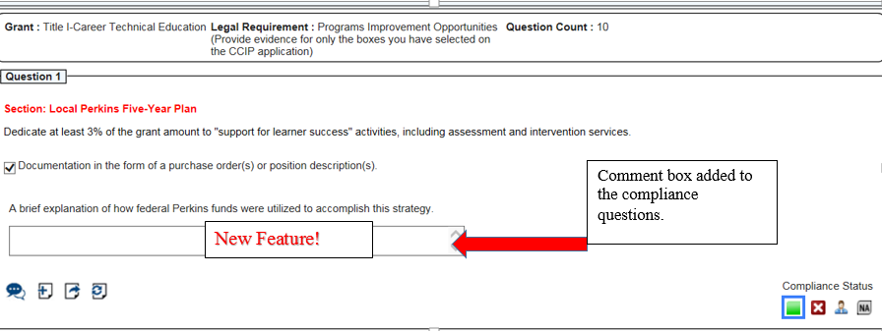
Compliance Comment Box
Notes:
New feature! Questions 1-9 all have a comment box. The AFS team would like to see a brief narrative explaining how the funds were spent. Aligning the CCIP strategies to the monitoring process. Holding districts accountable for the work stated in CCIP.

Slide 117
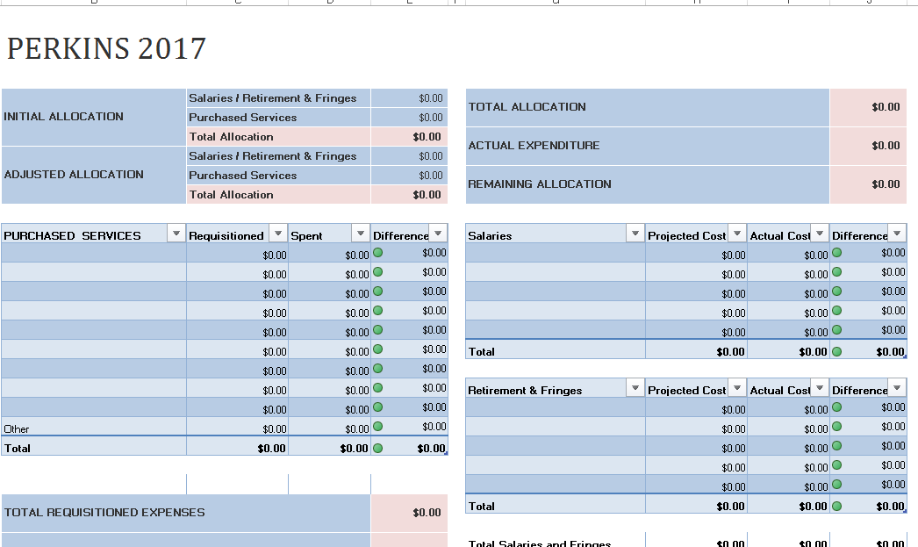
Compliance Budget Page

Slide 118
Comprehensive Continuous Improvement Planning
(CCIP)

Slide 119
CCIP
Can be submitted July 1 of the fiscal year.
Annual workshop to assist you with the process.
Proper access is essential. Make sure that you have the correct Safe account role.
Notes:
The Comprehensive Continuous Improvement Plan (CCIP) is a grants application and verification system
Consist of two parts:
The Planning Tool contains the goals, strategies, action steps and district goal amounts for all grants in the CCIP.
Make sure your strategies align with the application page.
The Funding Application contains the budget, budget details, nonpublic services and other related pages.
The date the CCIP has been approved by the district superintendent is referred to as the substantially approved date. This is the date funds may be charged against the grant(s).

Slide 120
Planning Tool Alignment
Be mindful of the strategies and action step listed in your plan.
District are held accountable for information listed in the plan via the monitoring process.

Slide 121

Connections
Notes:
How does this all connect?

Slide 122
Continuous Process
CCIP
Perkins Monitoring
Risk Assessment
Notes:
April- Pre-risk assessment is conducted. Based on the score, the districts will be notified.
May- Notification will go out to high-risk districts only. The district will be notified via CCIP and a letter to the superintendent.
June-Districts identified as high-risk are monitored for compliance(submission of documentation or adjustment to CCIP)
July-Perkins funds are allocated to the field.
Please be advised this is not a punitive process. Technical assistance will be provided.

Slide 123
Advisory and
Stakeholder Meetings
Ray Timlin and Michelle Ward

Slide 124
Objectives
Definition
Relevance
Characteristics
Notes:
Our objective today is to speak with you about advisory committee and stakeholder committee meetings. We will define each of these groups, talk about their characteristics, and discuss why they are relevant.

Slide 125
Definition
Advisory or Stakeholder?
Who is at the table?
What is the purpose and expected outcome of the meeting?
Notes:
Stakeholders meetings are for the specific purpose of advising the administration and staff regarding the maintenance, extension and improvement of CTE programming, and the administration OF THE Perkins grant. They help maintain the quality and relevance of CTE. Stakeholders include Business and industry partners, parents, community leaders, students, postsecondary partners.
Advisory committees work at an individual program level, and should include representatives of the occupational area served by the program. Curriculum content, equipment, facilities and placement are relevant topics for discussion.
Committees have three purposes : they advise (for improvement of a specific area) to assist (on specific activities) and to support/advocate, in the form of tours, internships, job shadowing, talking to legislators, marketing, etc.

Slide 126
Relevance
Community and stakeholder involvement
Building strong programs
Ensuring that programming is germane to community need
Accountability and compliance
Notes:
We already touched on the first three (read them) but we have not spoken of accountability and compliance. Both Federal Perkins and state law require the use of advisory and stakeholder committees. You can find this in Perkins law section 135, the Ohio Administrative Code, and as assurances signed off on the program application.
ODE checks for compliance a couple of ways. The new program review and approval process will look at whether the requirement is met, and when AFS does the monitoring compliance, we have you upload all documentation for review.

Slide 127
Characteristics
Documentation and record keeping
Discussion reflecting Perkins goals
Recruitment of members
Organized procedures and rules
Notes:
Minutes and a Sign-in sheet. Agendas should be used but we no longer require them as included in evidence for monitoring.
Discussion of Perkins goals, especially placement. Technical skill attainment, academic integration, non-traditional enrollment are all Perkins goals.
Do you have . . .
An effective recruitment process?
An orientation?
A charter including goals, rules, objectives, procedures?
Regular meetings
Feedback?
A diverse group?
Public recognition?

Slide 128
Office for Exceptional Children

Slide 129
Serving Students with Disabilities in Career Education Pathways
CTE Regional Meetings Fall 2017

Slide 130
Session Outcomes
Share a common message regarding the provision of career technical education and special education services for students with disabilities.
Discuss the next steps for continued improvement.

Slide 131
Agenda
Common Focus
Common Message
Collaborative Action Plan
Next Steps
Notes:
Spend about 10 minutes on the common focus and current landscape, move into the bulk of our discussion around the common message for approximately 15 minutes which will include some table talk and share out time, bring things to a close with our collaborative action plan and wrap it up with the next steps. I need to run right at 2:00 to a presentation in the concurrent Career Connections conference.

Slide 132

Common Focus: Collaboration
Improve postsecondary outcomes in
Competitive integrative employment;
Education/training; and
Independent living for students with disabilities.
Notes:
The Office of Career Technical Education and the Office for Exceptional Children collaboratively support the provision of career technical education and special education services to improve postsecondary outcomes in competitive integrative employment, education/training, and independent living for students with disabilities.

Slide 133
OEC and CTE Collaborative Meetings
March 22, 2017
May 23, 2017
June 6, 2017
July 13, 2017
September 8, 2017
Notes:
The message we will be sharing today did not come about accidentally or without effort. Members from the Office of Career Technical Education (Dr. Passias, Leah Amstuz, Kevin Williams, Dee Sturgill, David Bruce and Office for Exceptional Children, Jessica Dawso, Wendy Stoica, Olivia Schmidt, John Magee, Emilie Coen, and I have met on four occassions two full days and two shorter-focused hour-long meetings to discuss and develop a common message regarding the provision of special education and career technical education for students with disabilities in Ohio. We realized quickly and that even though we could say what each office “did” there was not necessarily a common understanding or interpretation of what it really meant and looked in the context of special education and career technical education. For example, provide FAPE,
So we went back, back, way back and started from scratch, reviewing vocabulary and legislation, historical workgroups and recommendations, discussing successes, challenges and possible solutions. All in all, we have and continue to learn a lot about our work and each other.
So we hope that this session doesn’t only serve to share out common message, but also provide some ways in which you may want special education and career technical education personnel in your district, building, etc. may want to communicate and collaboration.

Slide 134
OEC and CTE Collaborative Meetings
Responsibility
Access
Provision of special education services
Notes:
As we worked through our meetings, three foundational topics or themes came to the forefront. I am sure they are not of any surprise to any of you. Our common messages have been developed around these. Keep them in mind as I share our current landscape.

Slide 135

Common Message
Notes:
What does it look like? Either said than done. Given all of previous discussion and research, we needed to establish a consensus around access to and provision of special education services in the context of career technical education. We know we need it, and that we want it. What does it look like? How do we do it?

Slide 136
What is the Goal?
Postsecondary Engagement
Competitive Integrated Employment
(with or without supports)
Education/Training
Independent Living
Notes:
So first we need to know our goal. Yes, consensus, but consensus on what? Consensus that our goal is to provide all students with the services we need to move them toward competitive integrated employment. Ohio’s Operating Standards for the Education of Children with Disabilities defines An integrated setting means a setting typically found in the community in which the individual interacts with individuals without disabilities (not including supervisory personnel or individuals who are providing services to the employee) to the same extent as individuals without disabilities in comparable positions interact with others.
Competitive integrated employment includes supported or customized employment. 34 CFR Part 397.1(a)

Slide 137
Common Message
Collaborative responsibility for a free and appropriate public education (FAPE).
Equal and accessible for all.
Provided per the Individualized Education Program (IEP) in the least restrictive environment.
Notes:
Responsibility for FAPE: DOR, Comprehensive, Compact, JVSD

Slide 138
Collaborative Responsibility
A Joint Vocational School District (JVSD) is responsible for providing FAPE for students with disabilities who attend the JVSD in collaboration with the school district of residence (DOR).
Ohio Operating Standards for the Education of Children with Disabilities apply to each educational program, including those within a Career Technical Center/JVSD, that the DOR accesses to meet the educational and social-emotional needs of its students with disabilities.

Slide 139
Collaborative Responsibility
A Joint Vocational School District (JVSD) is responsible for providing FAPE for students with disabilities who attend the JVSD in collaboration with the school district of residence (DOR).
A JVSD receives state funds for special education and Perkins federal funds for special populations and must meet applicable federal and state special education regulations. Legislation provides that a JVSD can bill back to the DOR for excess costs for special education service delivery.
ORC 3317.0214

Slide 140
Access & Provision of Service
Technical and academic course offerings in state-approved career technical programs/pathways shall meet all state and federal requirements with regard to access, non-discrimination and meeting of performance expectations for special populations, including preparation for careers in industry sectors requiring technical expertise.
OAC 3301-61-03 (D)(4)

Slide 141
Access & Provision of Service
All CTE providers will make every effort to assure that students with disabilities are provided supplementary services (defined as curriculum modifications, equipment modification, classroom modification, supportive personnel, and instructional aides and devices.
CFR 34 403.190, CFR 34 400.4 (b)
Notes:
#1 Was the student in this program provided access to all programs, or was this the only program offered? #2 Does this program represent the least restrictive environment for the student?
It is possible that a program may be a “special class” provided it is in fact the least restrictive environment.
Here is the exact language from Operating Standards that we would use to decide if the placement was appropriate for a student. We consider the student within the regular education environment with supports and services first, and then work backward from there.
Each school district must ensure that:
(a) To the maximum extent appropriate, children with disabilities, including children in public or nonpublic institutions or other care facilities, are educated with children who are nondisabled; and
(b) Special classes, separate schooling, or other removal of children with disabilities from the regular educational environment occurs only if the nature or severity of the disability is such that education in regular classes with the use of supplementary aids and services cannot be achieved satisfactorily.
This is the continuum of placements we follow:
Regular classes, resource room with regular class placement, special classes, special schools, home instruction, instruction in hospitals/residential.
IEP teams have to justify on the IEP why the student is being pulled from the general education environment.

Slide 142
Access & Provision of Service
Students may participate in career-technical education without completing an entire one or two-year program.
Technical Skill Attainment
Industry Credential

Slide 143
Collaborative Action Plan
Common Focus

Slide 144
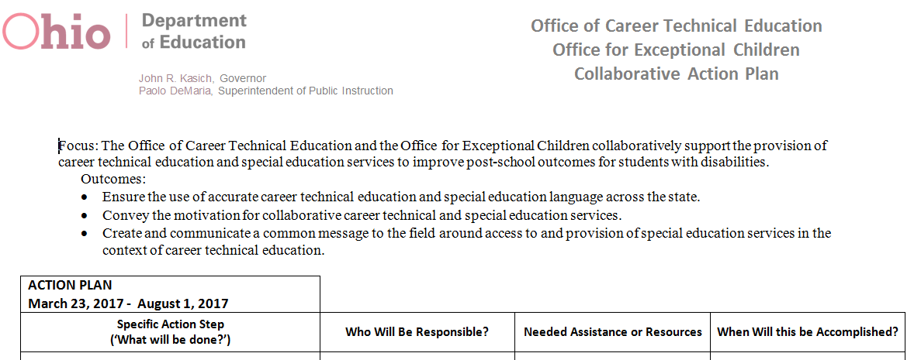
Collaborative Action Plan

Slide 145
Career-Technical Planning District Consultants
CTPD Consultant | State Support Team Regions
Angela Dietrich | 1, 6, 7
Ron Zybura & Linda Thayer | 2, 3, 4, 8
Andy Tommelleo | 5, 9, 12
Kristina Ropos | 10, 13, 14
TBA | 11,15, 16
Notes:
Tiers of Support: Intensive, Targeted, Universal levels
Self-Review” Needs Assessment based on the Communications Document conducted at the Universal and Intensive levels
Corresponding professional development materials created to address identified needs and provided as targeted group supports
Creation of a learning management system module for the self-review process
Continued career technical education special education collaborative meetings across the state.

Slide 146
Next Steps
Continued Collaboration!
CTE/OEC Joint Memo
CTE/OEC Monitoring Partnerships
And more…

Slide 147
Questions & Answers

Slide 148


Slide 149

education.ohio.gov

Slide 150




Join the Conversation
OHEducation
OHEducation
@OHEducation
@OHEducationSupt
OhioEdDept
Notes:
Did you hear the news? We’re now on Instagram! Check out our official account and follow us at instagram.com/OHEducation. There, you can keep up with top news and updates and, this fall, be on the lookout for fun connections with Ohio teachers in their classrooms.
You also can stay up to date by following our other social media channels. In addition to Instagram, connect with us on Facebook, Twitter, and YouTube. Our handles are on the slide.
Superintendent of Public Instruction Paolo DeMaria even has his own Twitter account. Follow him @OHEducationSupt.

Slide 151

education.ohio.gov/Text
Notes:
The department is connecting with families with tips and information. We encourage everyone to go to eduation.ohio.gov/text. From there, you may choose from a variety of subjects on which to receive text messages.
On the slide are two examples: Useful information for families with children in preschool through elementary school and ideas and information for families with middle school and high school students.

