Slide 1
Language and Comprehension
Decode
print into
words
3. Create
a mental
model
2. Activate
knowledge.
“The dr/a/gon br/ea/thed fire ….”
… onto the frightened knight who ran away.
What are the implications of this for dual language learners?

Slide 2
Early Vocabulary Predicts Later Vocabulary and Comprehension
Age 3 and 4 vocabulary predicts grades 3 and 4 vocabulary and reading (ECCRN, 2005, Walker et al., 1994; Storch & Whitehurst, 2002).
Kindergarten vocabulary predicts 4th and 7th grade vocabulary and reading (Dickinson & Porche, 2011; Dickinson & Tabors, 2001).
First grade vocabulary predicts 11th grade reading (Cunningham & Stanovich, 1997).
Second language learners: knowledge of English in the preschool years affects later reading comprehension. (Mancilla-Martinez & Lesaux, 2011).

Slide 3
Low-Income Children’s Vocabulary Lags Behind Others
At kindergarten entry there are large differences in achievement associated with income (1.25 SD). These widen somewhat in early elementary school (Reardon,2014).
Differences observed in the preschool years persist throughout the elementary school years.
For native speakers of English (Farkas & Beron, 2004).
For second language learners who start school with limited knowledge of English (Mancilla-Martinez & Lesaux, 2011).

Slide 4
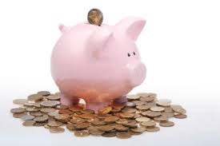
Invest Early By Supporting Your Child’s Vocabulary Development
Invest by using many interesting words
A large vocabulary helps children learn new words and ideas quickly.
The return on your investment will be great.

Slide 5
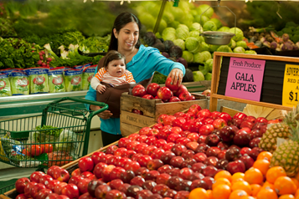
Strategies for Fostering Language Learning in and Out of Classrooms

Slide 6
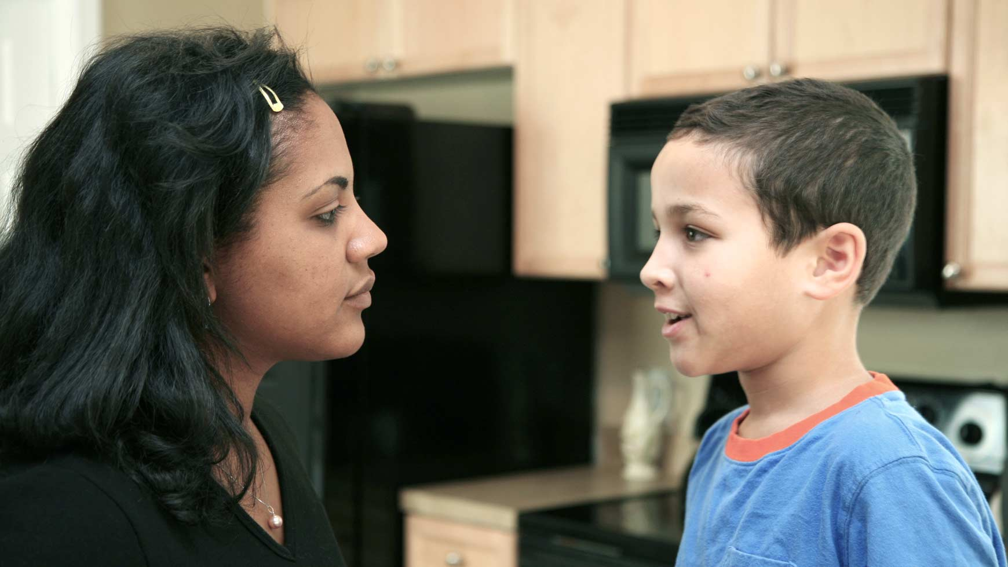
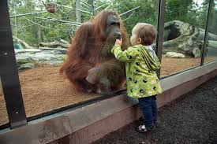
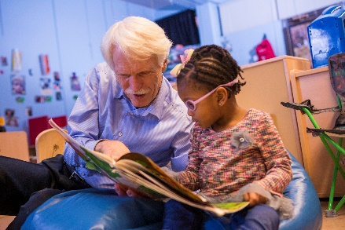
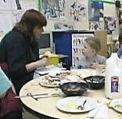
Language Goals
Have sustained conversations
“Strive for five” back-and-forth exchanges.
Expand knowledge and vocabulary by nurturing your child’s interests
Use a curriculum with science activities and vocabulary
Take trips: zoo, cultural events, museums, grocery store
Read every day
Read story books and information books.
Use your local library
Use books as occasions for talking and teaching
Plan to teach language:
Activities that build knowledge
Identify words to teach
Create daily times for rich conversations

Slide 7
What Methods Have You Found to be Effective in Helping Parental Engagement? Have you had success with parents whose children are learning English?

Slide 8
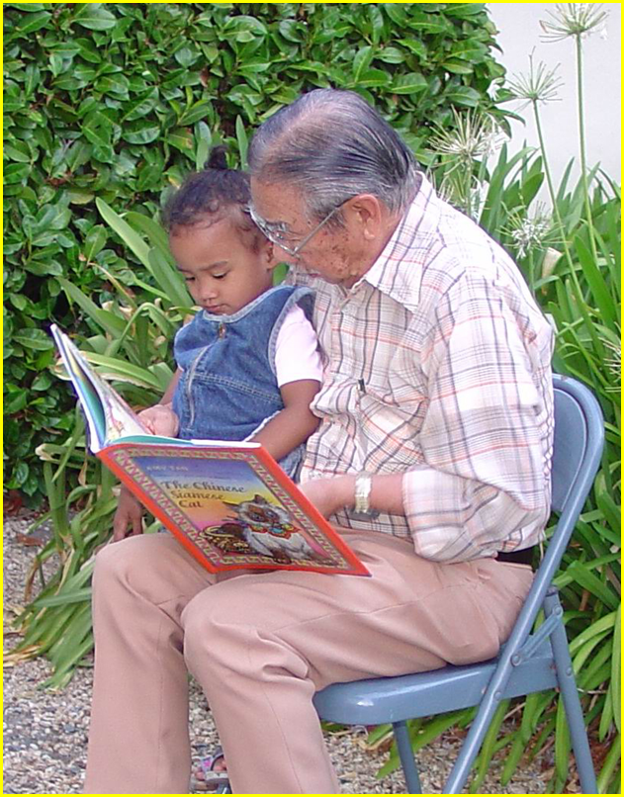
Raising Bilingual Children
Language carries culture and binds children to older generations.
Children do not confuse languages. Growth in each may be slower, but overall development is not hurt by learning 2 languages.
Children do not learn English well when a parent with very weak English uses it with the child.
Children who enter kindergarten with some English make faster progress when instruction is in English.
Dual language teaching in the primary grades supports English learning and can help maintain the child’s first language.

Slide 9
Rich Conversations …
Are Sustained
Back-and-forth exchanges (strive for five)
Extend child’s thinking. Do not simply echo the child’s words.
Follow the child’s lead
Are about things that interest the child
Model adult language
Use full sentences
Use varied and specific vocabulary
Teach
Help children understand the meanings of new words
Explain complex ideas
Deepen Relationships
Provide children opportunities to initiate talk about important issues.
Enable teachers to learn about children’s experiences, concerns and interests.

Slide 10
Times When You Can Have Rich Conversations: Mealtime
Use of sophisticated vocabulary by parents during home meal times in kindergarten is related to 4th grade vocabulary, which helps predict reading comprehension. (Weizman & Snow, 2001)
In Head Start classrooms meal conversations helped predict vocabulary fall-spring growth (Barnes, Grifenhagen & Dickinson, under review):
1. Use of sophisticated vocabulary mixed with
2. Talk about home experiences
3. Minimal amounts of managerial and manners talk

Slide 11
Mealtime Talk in a Head Start Program
Social-Personal Focus
Food/Academic Focus
Child: Everybody was sick.
Teacher: Who was sick?
Child: My granny and my poppa momma.
Teacher: What's wrong with granny?
Child: She had to get a shot.
Teach: She ok? What's wrong with momma granny?
Child: mm she had surgery.
Teacher: She did? She in the hospital?
Child: Yes.
Teacher: Do we have a vegetable today?
Child: yeah.
Teacher: What kinda vegetable do we have on our plates?
Child: Banana!
Teacher: Umm. Banana's a fruit. What kinda vegetable do we have?
Child: Broccoli!
Teacher: Broccoli and potatoes. Well potatoes are sorta like something that you call a starch.

Slide 12
Analyze this Lunchtime Transcript
Child 1: Tuna fish. Tuna fish. I like.
Child 2: Ah, Mina needs one of those.
Tch: Why, thank you. That was very thoughtful. Will you give it to her for me? Thank you Jerry.. And you can start eating your sandwiches. Do you want a pickle or a carrot?
Child 1: [unintelligible]
Tch: I can’t hear you.
Child 1: I took a piece, and I didn’t like it.
Tch: Okay. Thank you for tasting. One pickle. Did everybody get a carrot?
Child 2: Yeah

Slide 13
Head Start Mealtime
Head Start teacher in Boston
9 language backgrounds and 11 second language
learners.
End of mealtime when 4-year-old boy started to tell
her a story.
..\..\..\..\..\Desktop\N CA Folder\racoon_talk.mov
What strategies do you see her using?

Slide 14
JOHN: I saw a raccoon in the tree last night.
TCH: You saw a raccoon …. last night?
JOHN: Only in the tree. Up in the tree.
TCH: That’s so funny because you know what? Last weekend when I
went to New Hampshire, I saw a raccoon up in a tree. What did your raccoon do?
JOHN: It was …. It was moving.
E: XXX Cindy.
TCH: Wait. I want to hear about John’s raccoon. He saw a raccoon last night. What was it doing last
night, John?
JOHN: It … it was moving.
TCH: It was moving. Can you show me how?
JOHN: It was …. it’s eyes was open.
TCH: It’s eyes were open; so it was awake.
JOHN: Yeah.
TCH: Can you show me how it was moving? Can you show us how it was moving?
JOHN: It was moving backwards.
Tch: Moving backward?
JOHN: Yeah.
TCH: Did it … it didn’t fall off the tree though?
JOHN: No.
TCH: No. And then what did it do after it was moving?
JOHN: It …. it just came at me. It was walk. It just climbed right into the tree.
TCH: Oh, it climbed inside the tree.
JOHN: Yeah.

Slide 15
JOHN: I saw a raccoon in the tree last night.
TCH: You saw a raccoon …. last night? Followed child’s lead. Open-ended.
JOHN: Only in the tree. Up in the tree.
TCH: That’s so funny because you know what? Last weekend when I went to New Hampshire, I saw
a raccoon up in a tree. What did your raccoon do? Personal connection Open-ended
JOHN: It was …. It was moving.
E: XXX Cindy.
TCH: Wait. I want to hear about John’s raccoon. He saw a raccoon last night. What was it doing last
night, John? Focus on one child; Sustained topic – prompt for sharing
JOHN: It … it was moving.
TCH: It was moving. Can you show me how? Open-ended (non-verbal invitation)
JOHN: It was …. it’s eyes was open.
TCH: It’s eyes were open; so it was awake. Model adult usage; teach vocabulary
JOHN: Yeah.
TCH: Can you show me how it was moving? Can you show us how it was moving?
JOHN: It was moving backwards.
TCH: Moving backward?
JOHN: Yeah.
TCH: Did it … it didn’t fall off the tree though? Sustained topic
JOHN: No.
TCH: No. And then what did it do after it was moving? Open-ended, Sustained topic
JOHN: It …. it just came at me. It was walk. It just climbed right into the tree.
TCH: Oh, it climbed inside the tree. Teach vocabulary
JOHN: Yeah.

Slide 16
Building Language, Fostering Deeper Relationships
Stops and listens.
Briefly shares her own experience – builds a bond around a shared experience.
Sustains the conversation over multiple turns.
Encourages others to listen.
Asks clarifying questions.
Repeats and makes subtle grammatical correction; models adult syntax.
Teaches word meanings by supplying the precise word the child needs.

Slide 17
Plan Engaging Activities that Build on Your Curriculum
Making lemonade. (Analyses by Jin-sil Mock).
Activity suggested by the OWL curriculum. Teacher used many of the suggested words.
Same lesson taught in very different ways.
Teacher 1: Like a cooking lesson. Focus on activity completion following the steps suggested.

Slide 18
Teacher with a Procedural Focus

Slide 19
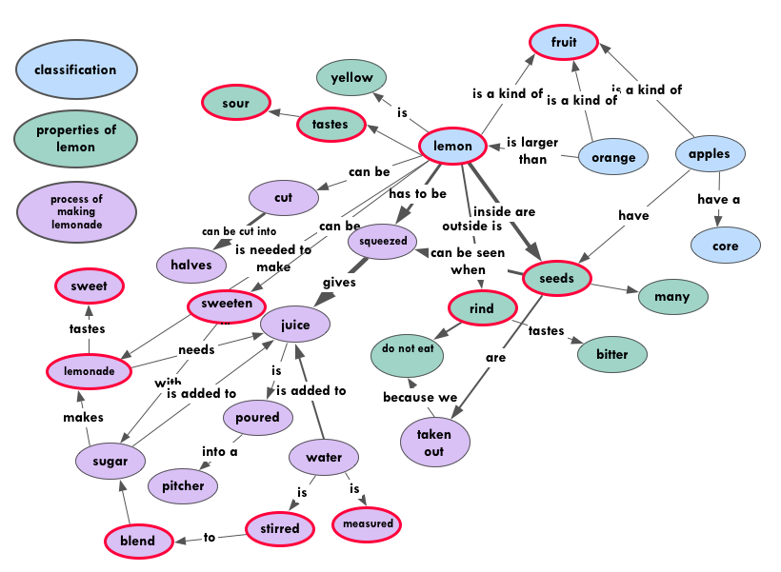
Teacher with a Conceptual Focus
What strategies does she use that can foster language learning? (start at 2;00)
..\..\..\..\..\Desktop\Lemonade lesson\TT020_Head Start Making Lemonade #1 top.wmv

Slide 20
Instructional Style Varies by Context
Conceptual Teacher Across the Day
Procedural Teacher Across the Day

Slide 21
Fostering Language Fosters the Development of the Whole Child
Sustained conversations with individual children
during informal times: meals, arrival, centers
Responsive to comments during small and large
groups when possible.
Lessons are planned with language goals in mind and delivered with a focus on content
Parents and care providers are encouraged to support for language at home.

Slide 22
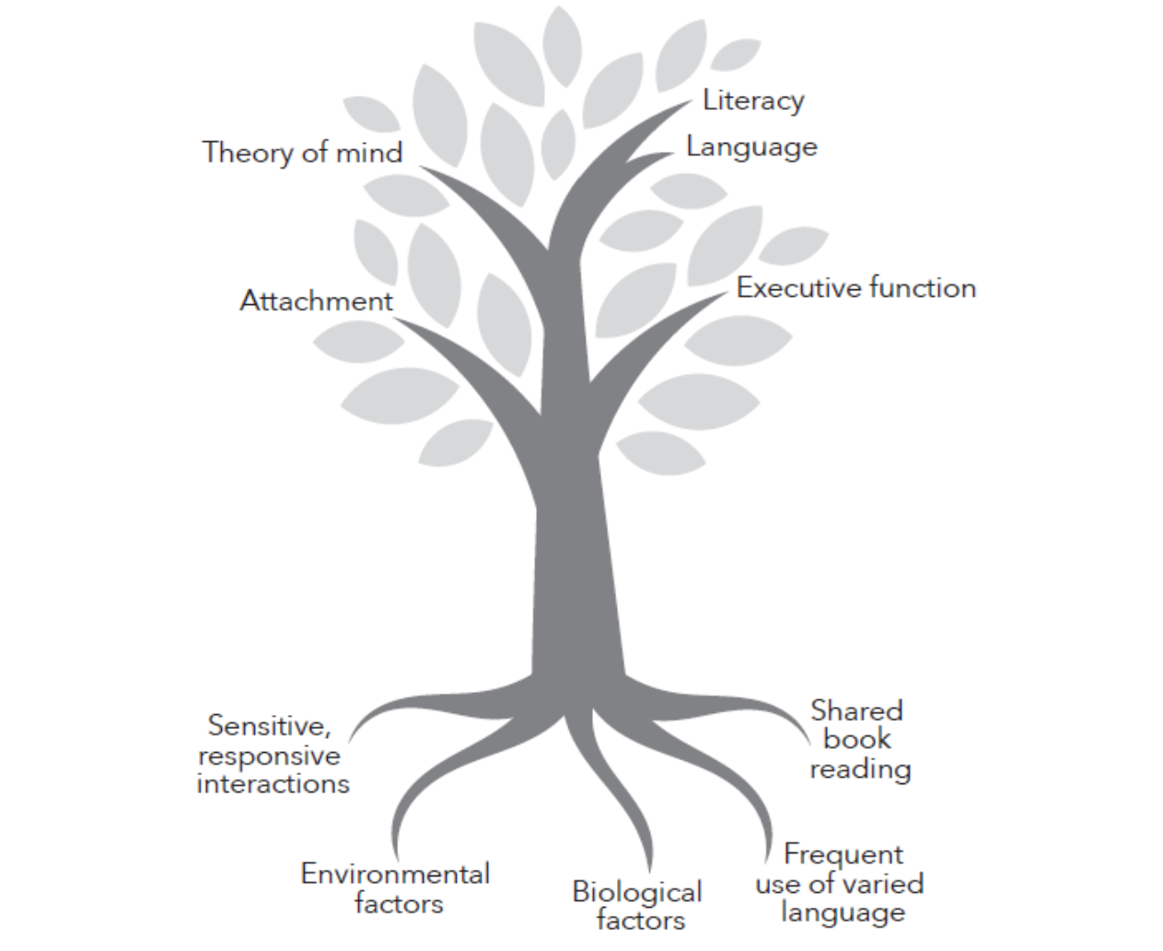
Reviews the research I have been reporting.
Profiles programs that support parents in ways that foster language growth.
http://bit.ly/Connect-Talk

Slide 23
Guiding Principles
Teach with intentionality.
Reflect constantly.
Believe passionately in the importance of your work.

Slide 24
A Thought to Live By
I am only one.
But still I am one.
I cannot do everything.
But still I can do something.
And because I cannot do everything
I will not refuse to do the something that I can do.
Rev. Edward Everett Hale
from: Singing the Living Tradition,
Unitarian Universalist hymnal

