Slide 1
Standards for Mathematical Practices
Look for and Make Use of Structure
Yelena Palayeva – Jan. 11, 2022

Slide 2
Welcome

Slide 4
Virtual Meeting Norms
Be respectful.
Recognize that everyone has expertise.
Assume positive intent.
Seek clarification in language and ideas.
Share experiences.
Use the chat feature when you have a question.
Mute your microphone when not speaking.

Slide 5
Assign yourself
By grade band:
K-5
6-8
9-12

Slide 7
Each Child Our Future
Our Vision
In Ohio, each child is challenged to discover and learn, prepared to pursue
a fulfilling post-high school path and empowered to become a resilient,
lifelong learner who contributes to society.

Slide 8
Math as a “Whole”

Slide 9
Why Math?
“How can it be that mathematics, being after all a product of human thought independent of experience, is so admirably adopted to the objects of reality?”
(Einstein 1928, p.28)
Understand and critique the world
Cultivate wonder, joy and beauty
Expand professional opportunities
Foster analytical way of thinking

Slide 10
Analytical Way of Thinking
Applies knowledge fluidly and creatively
Adapts previously mastered definitions and techniques
Reasons by analogy on similar problems
Uses known approaches in novel situations

Slide 11
Developing Analytical Thinking Ability
To go beyond dependency on basic skill
To avoid route memorization
To apply ways of thinking with repeated practice over time
To produce strategies

Slide 12
Focus, Rigor, Coherence
Help better understand the standards
Challenge deficit of access to grade-level work
Promote deeper understanding of content
Help in adoption of instructional resources
Move toward equal access to grade level content

Slide 13
Standards for Math Practices (SMPs)
Make sense of problems and persevere in solving them
Reason abstractly and quantitatively
Construct viable arguments and critique the reasoning of others
Model with mathematics
Use appropriate tools strategically
Attend to precision
Look for and make use of structure (I can use what I know to solve new problems)
Look for and express regularity in repeated reasoning

Slide 14
SMP.7: Look for and Make Use of Structure
Mathematically proficient students look closely to discern a pattern or structure. Young students, for example, might notice that three and seven more is the same amount as seven and three more, or they may sort a collection of shapes according to how many sides the shapes have. Later, students will see 7 × 8 equals the well-remembered 7 × 5 + 7 × 3, in preparation for learning about the distributive property. In the expression x² + 9x + 14, older students can see the 14 as 2 × 7 and the 9 as 2 + 7. They recognize the significance of an existing line in a geometric figure and can use the strategy of drawing an auxiliary line for solving problems. They also can step back for an overview and shift perspective. They can see complicated things, such as some algebraic expressions, as single objects or as being composed of several objects. For example, they can see 5 – 3(x – y) 2 as 5 minus a positive number times a square and use that to realize that its value cannot be more than 5 for any real numbers x and y.”

Slide 15
Why Structure?
Mathematics has structure
Number system has structure
Logic has structure
Algebra notation has structure
Geometry has structure

Slide 16
SMP.7 is About Discovering
Connection
Coherence
Exclusion
Inconsistency
Equivalence

Slide 17
SMP.7 is About Similarity of
“Looks”
Concepts
Patterns
Relationships
Representations

Slide 18
NCTM. Catalyzing Change in High School
Math Teaching Practices
Establish mathematics goals to focus learning
Implement tasks that promote reasoning and problem solving
Use and connect math representations
Build procedural fluency from conceptual understanding
Facilitate meaningful mathematical discourse
Pose purposeful questions
Support productive struggle in learning mathematics
Elicit and use evidence of student thinking

Slide 19
Math Teaching Practices and Standards for Math Practices
From: Emphasis
on Answers
Through: Standards for Math Practices and
Math Teaching Practices
To: Emphasis on Understanding Mathematics

Slide 20
Standards for Math Practices
Notes:
The set of SMPs is a tool kit from which each tool can be used as needed.

Slide 21
Look for and Make Use of Structure: Noticing Equivalence
How many squares are in the border of an “n x n” grid?

Slide 22
Look for and Make Use of Structure: Border Problem
How many squares are in the border of a 10x10 grid?

Slide 23
Verbalize Your Way of Thinking…

Slide 24
Describe your Way of Thinking…

Slide 25
Move From Concrete to General

Slide 26
Generate Outcomes

Slide 27
Look for and Make Use of Structure: Notice Equivalence
n + (n – 2) + n + (n – 2)
n + 2(n – 2) + (n – 2)
4(n – 2) + 4
(n – 1)·4
4n – 4
n² – (n – 2)²

Slide 28
SMP.7
and
SMP.8

Slide 29
Standards for Math Practices
Make sense of problems and persevere in solving them
Reason abstractly and quantitatively
Construct viable arguments and critique the reasoning of others
Model with mathematics
Use appropriate tools strategically
Attend to precision
Look for and make use of structure (I can use what I know to solve new problem)
Look for and express regularity in repeated reasoning

Slide 30
Look for and Make Use of Structure
SMP.7
SMP.2
SMP.4
SMP.8

Slide 31
SMP.7 vs. SMP.8
SMP7 | SMP8
Focuses on structure in a mathematical object Makes a shift to a big picture or a complex construction Finds a relationship between parts of mathematical situation and simplifies them, if necessary. Reduces the complexity of the expressions Transforms a structure of the model to reveal its phenomena Connects concepts and representations | Recognizes similarity within numbers, objects, operations, problems Helps finding entry point to an unfamiliar situation Focuses on reasoning, not on object Builds mathematics model by abstracting from the concrete examples
Notes:
Here is a comparison of SMP 8 and SMP7.
Take a couple moments to study this slide.

Slide 32
SMP.7: Connect Concepts
99 + 46 and 100 + 45
8 · 24 = 192 and 8(20 + 4) = 160 + 32 = 192
8(x + 4) = 8x + 32 and 8x + 32 = 8(x + 4)
15 = 3 · 5 and x² + 9x + 14 = (x + 7)(x + 2)

Slide 33
SMP.7: Connect Concepts
x² – 9 = (x – 3)(x + 3) and
11 – (x - 3)² = [11 – (x – 3)][11 – (x + 3)] =
(14 – x)(8 – x)
Completing a square and the quadratic formula
Transformations of functions and transformations of shapes

Slide 34
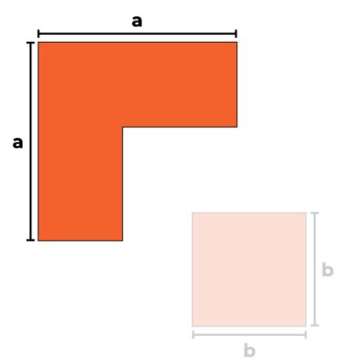
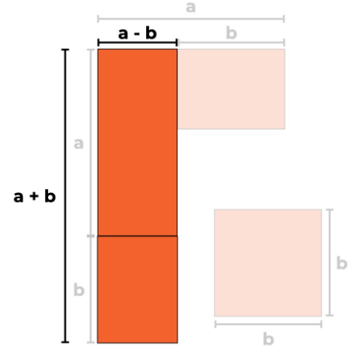
SMP.7: Connect Representations
$$a^{2}−b^{2}=(a −b)(a+b)$$
$$Δ^{2}−⊠^{2}=\left(Δ −⊠\right)\left(Δ+⊠\right)$$
$$\left(a −b\right)\left(a+b\right)= a^{2}−b^{2}$$
16 = 2 · 8 = (5 – 3) (5 + 3) = $5^{2}−3^{2}$= 25 – 9 = 16

Slide 35
Video: Find the Area of the Figure
https://vimeo.com/103522928?embedded=true&source=video_title&owner=
18324331
Notes:
Watch the video. The link is on the slide.

Slide 36
Look for and Make Use of Structure
Mathematically proficient students
Discern a pattern or structure
Overview and shift perspective
Considering perspectives of others
See complicated things as collection of single objects

Slide 37
Breakout Rooms A
Notes:
Now, it is time for the round of BOR A.
The rooms have educators from the same grade band. Later in the session, there will be another opportunity for BORs. Educators will remain in the same BORs.
This round of BOR is 10 min long to discuss 3 items. The items are independent. Each item is aligned to the different content standard.
https://docs.google.com/presentation/d/1i3e-IEGzYXJFhyOll3nTyH_6j6MxIBi49tGrmJ_Zz7M/edit#slide=id.ga80333bd55_0_119

Slide 38
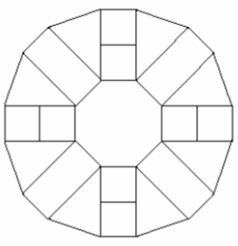
Breakout Room A (ES)
Increase the largest 4-digit number by 1. Then, decrease the smallest 3-digit number by 1. Find the difference of the two numbers.
Emely visited the store where she purchased two pieces of the same kind of fabric. The first piece was 5 yd long. The second piece was 7 yd long. The total price for the purchase was $36. What was the price for each piece of fabric?
Katarina makes the pattern using shape blocks.
Write the names of the shapes she uses.
Notes:
This slide is for ES teachers.

Slide 39
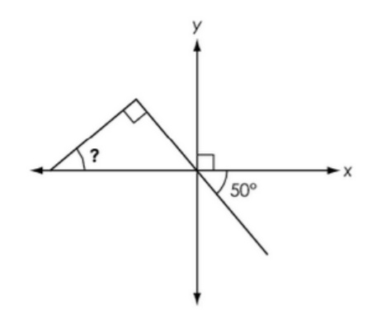
Breakout Room A (MS)
Without doing calculations show that
(24 • 17 + 17 • 6) is divisible by 5.
Using the most efficient method, evaluate the expression
6.8c – (3.6c – 2.1 + 2.2c) for c = 2.59
A figure is shown. What is the measure in degrees, of the missing angle?
Notes:
This slide is for MS teachers.

Slide 40
Breakout Room A (HS)
A square and a rhombus that is not a square have equal perimeters. Compare the areas of those shapes by showing your work.
Using the most efficient method, solve the equations
(12x + 5)² – 8(12x + 5) = -7
(3x - 2)² = 6x – 4
Consider two algebraic expressions (n + 2)² – 4 and n² + 4n. Use the figures to illustrate why the expressions are equivalent. Verify this result algebraically.
Notes:
This slide is for HS teachers

Slide 41
Share Out
Notes:
After BORs’ time is over, this is an opportunity to share.

Slide 42
Ohio Learning Standards
Notes:
http://education.ohio.gov/Topics/Learning-in-Ohio/Mathematics/Ohio-s-Learning-Standards-in-Mathematics
This slide shows the cover page of the Ohio Learning Standards document. Note that the Standards for Math practices is an integral part of it.

Slide 43
G8-Geometry Learning Progressions by Topic

Slide 44
Seeing Structure…

Slide 45
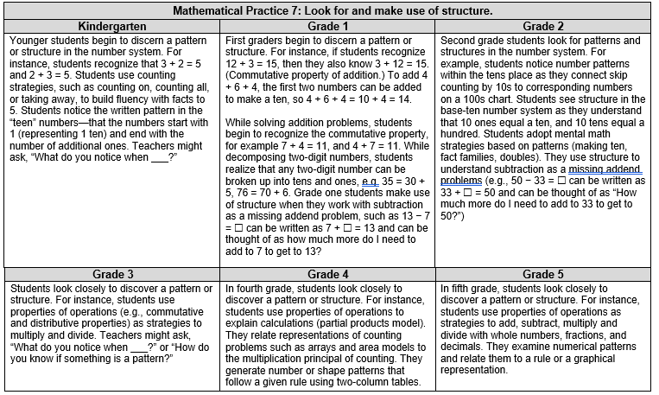

Slide 48
Progression K-HS: SMP. 7 Look for and Make Use of Structure
Notes:
The theme of the conversation in the next round of BORs is a progression of SMP.7

Slide 49
Breakout Rooms B
Notes:
In this round of BORs, educators stay in the same Breakout Rooms and review the same 3 items through the lenses of Standards for Math Practice Progressions document.
The time in BORs was 10 min.

Slide 50
Breakout Room B (ES)
Increase the largest 4-digit number by 1. Then, decrease the smallest 3-digit number by 1. Find the difference of the two numbers.
Emely visited the store where she purchased two pieces of the same kind of fabric. The first piece was 5 yd long. The second piece was 7 yd long. The total price for the purchase was $36. What was the price for each piece of fabric?
Katarina makes the pattern using shape blocks.
Write the names of the shapes she uses.
Notes:
These are Elementary School items.

Slide 51
Breakout Room B (MS)
Without doing calculations show that
(24 • 17 + 17 • 6) is divisible by 5.
Using the most efficient method, evaluate the expression
6.8c – (3.6c – 2.1 + 2.2c) for c = 2.59
A figure is shown. What is the measure in degrees, of the missing angle?
Notes:
These are Middle School items.

Slide 52
Breakout Room B (HS)
A square and a rhombus that is not a square have equal perimeters. Compare the areas of those shapes by showing your work.
Using the most efficient method, solve the equations
(12x + 5)² – 8(12x + 5) = -7
(3x - 2)² = 6x – 4
Consider two algebraic expressions (n + 2)² – 4 and n² + 4n. Use the figures to illustrate why the expressions are equivalent. Verify this result algebraically.
Notes:
These are High School items.

Slide 53
Share Out
Notes:
After BORs’ time is over, this is an opportunity to share.

Slide 54
SMP.7: Avenue of thinking
Students | Teachers
What type of problem is it? | What observations do you make about..?
Does it remind me of another problem situation? | What ideas have you learned before that were useful in solving this problem?
How is this (situation, process, etc.) behaving? | What pattern do you find in…?
Can I connect it to something I know? | What are some other problems that are like this one?
What are the parts (chunks) of the process? | What are the parts you can chunk the problem into?
How can I get the answer without doing all calculations? | What parts of the problem might you eliminate or simplify?
How can I use properties to uncovers structure? | What do you notice when…?
How can I connect a different representations? | How are there representations alike or different?
How can I change the form of (number, etc.) to surface the underlying structure? | What properties does it relate to?

Slide 55
NCTM “Look Fors”
Notes:
The next couple slides show rubrics that students and teachers can use to access their ability to use SMP.7.
This one is an NCTM rubric for Students and Teachers.
https://www.google.com/search?q=nctm+math+practice+look+fors&rlz=1C1GCEU_enUS820US820&oq=NCTM+math&aqs=chrome.1.69i57j35i39j0i20i263j0l2j69i60l3.3630j0j4&sourceid=chrome&ie=UTF-8

Slide 56
SMP.7: Implementing Standards for Math Practices
Notes:
Teachers’ rubric to assess SMP.7 tasks.

Slide 57
SMP.7: Student Rubric
Notes:
Another teachers’ rubric to evaluate students’ ability to use SMP.7. This rubric can be edited to become the tool for the students to assess their SMP.7 skills.

Slide 58
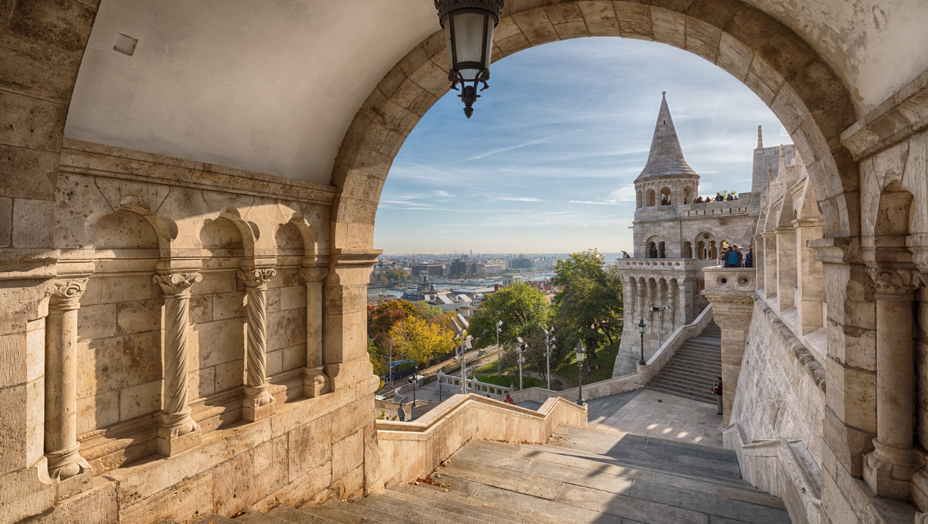
When we build, let us think that we build forever.”
– John Ruskin

Slide 59
Mathematics Questions?
Name | Email
Brian Bickley | Brian.Bickley@education.ohio.gov
Anna Cannelongo | Anna.Cannelongo@education.ohio.gov
Annika Moore | Annika.Moore@education.ohio.gov
Yelena Palayeva | Yelena.Palayeva@education.ohio.gov

Slide 60
References
Illustrative Mathematics. (2014, May 6). Standards for Mathematical Practice: Commentary and Elaborations
for 6–8. Tucson, AZ.
Koestler, C., Felton-Koestler, M. D., Bieda, K., & Otten, S. (2013). Connecting the NCTM process standards
and the CCSSM practices. Reston, VA: The National Council of Teachers of Mathematics.
O'Connell, S., & SanGiovanni, J. (2013). Putting the practices into action: Implementing the common core
standards for mathematical practice, K-8. Portsmouth, NH: Heinemann.
.
Boston, M., Dillon, F., Smith, M., & Miller, S. (2017). Taking Action Implementing Effective Mathematics Teaching Practices, Grades 9-12. Reston, VA: The National Council of Teachers of Mathematics
Graham, K., Cuoco, A., & Zimmermann, G., (2010). Focus on High School Mathematics: Reasoning and Sense Making. Reston, VA: The National Council of Teachers of Mathematics

Slide 61
References
https://www.louisianabelieves.com/docs/common-core-state-standards-resources/guide--teacher-planning-for-math-practice-implementation.pdf?sfvrsn=2
“The Power of Making Mistakes in Learning Math”
http://mathpractices.edc.org/browse-by-mps.html#overlay-context
https://www.insidemathematics.org/common-core-resources/mathematical-practice-standards
https://www.redlandsusd.net/site/handlers/filedownload.ashx?moduleinstanceid=8304&dataid=8093&FileName=Standards%20for%20Mathematical%20Practice%207.pdf
https://education.ohio.gov/getattachment/Topics/Learning-in-Ohio/Mathematics/Model-Curricula-in-Mathematics/Standards-for-Mathematical-Practice/Math-Practices-Rubric.pdf.aspx?lang=en-US
http://www.siam.org/Portals/0/Publications/Reports/gaimme-full_color_for_online_viewing.pdf?ver=2018-03-19-115454-057
http://education.ohio.gov/Topics/Learning-in-Ohio/OLS-Graphic-Sections/Learning-Standards
https://docs.google.com/document/d/1zz8_G_qrdND_Ep2e4zvzICBHcOK_r61vfuwcHnP0oJk/edit

Slide 62
Resource Links
Ohio Department of Education Documents
Standards for Mathematical Practice
Kindergarten - Grade 5
Grades 6-8
High School
University of Arizona Progressions
Standards for Mathematical Practice: Commentary and Elaborations for 6-8
Other National Resources
Inside Mathematics
Illustrative Mathematics
Robert Kaplinsky: Math CCSS Math Practices Readable

Slide 63
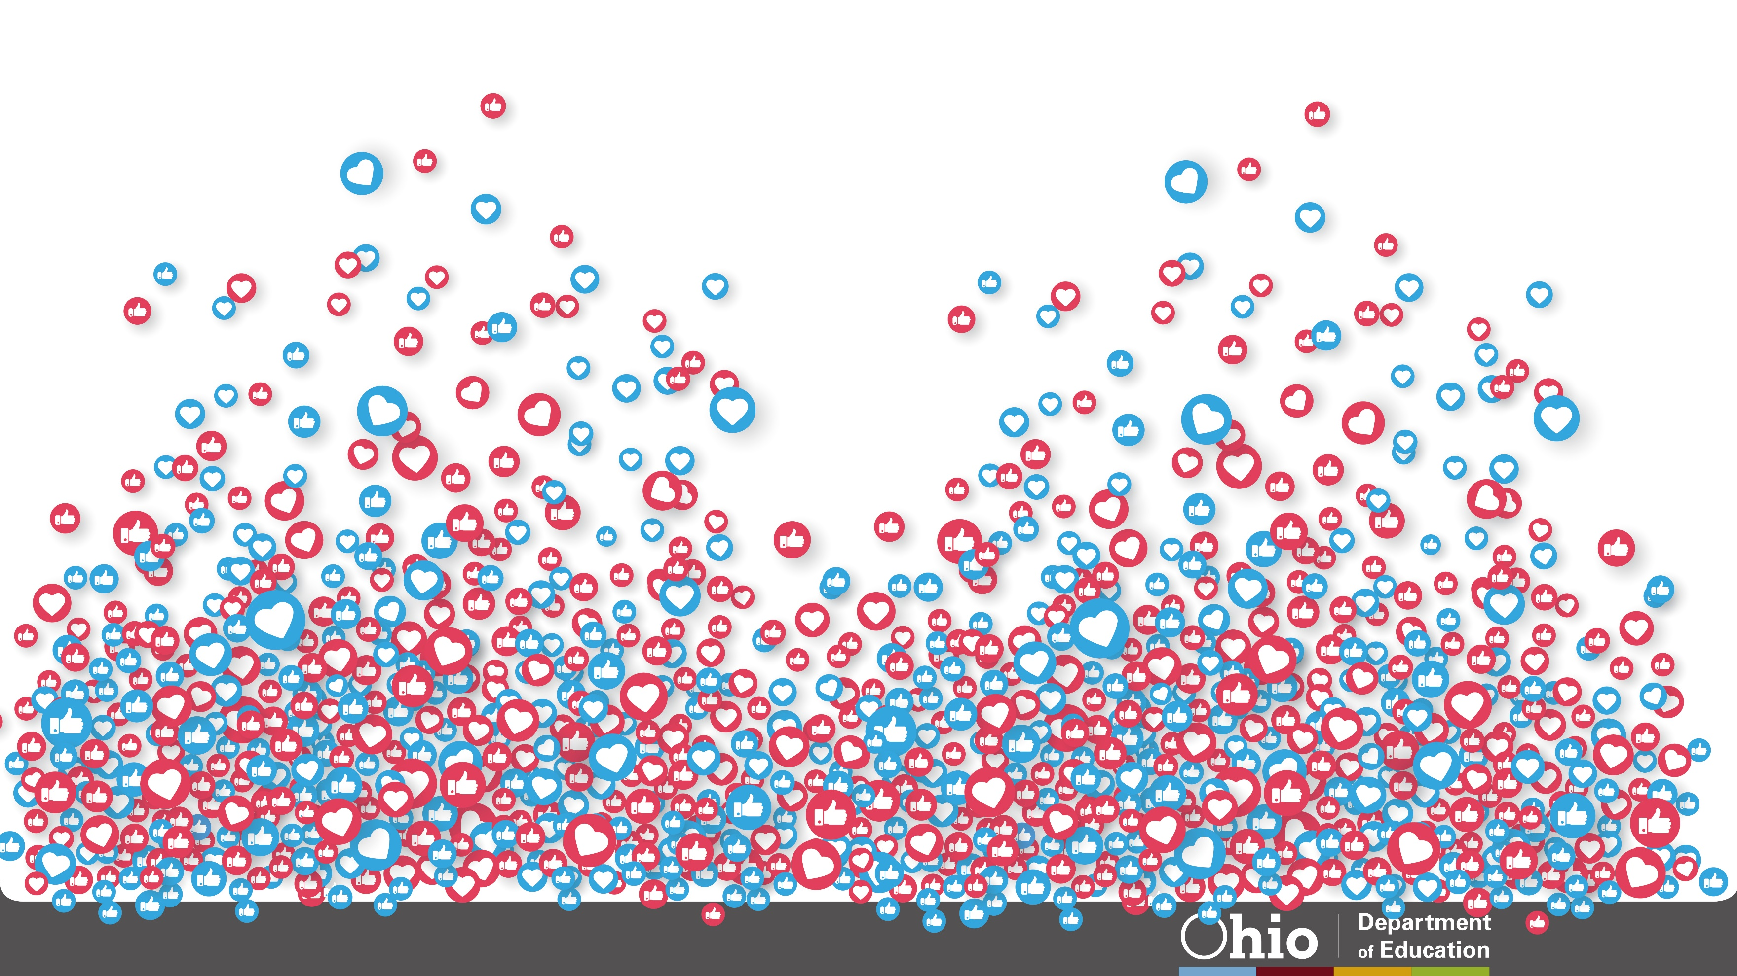
@OHEducation

