Slide 1
Mathematical Practices
SMP.3 Construct Viable Arguments and Critique the Reasoning of Others
Anna Cannelongo ∙ Nov. 23, 2021

Slide 2
Welcome

Slide 3
Note:
Rename yourself by grade band
K-2
3-5
6-8
HS

Slide 5
Virtual Meeting Norms
Be respectful.
Recognize that everyone has expertise.
Assume positive intent.
Seek clarification in language and ideas.
Share experiences.
Use the chat feature when you have a question.
Mute your microphone when not speaking.

Slide 6
Each Child Our Future
Our Vision
In Ohio, each child is challenged to discover and learn, prepared to pursue
a fulfilling post-high school path and empowered to become a resilient,
lifelong learner who contributes to society.

Slide 7
Math Practices
Make sense of problems and persevere in solving them.
Reason abstractly and quantitatively.
Construct viable arguments and critique the reasoning of others.
Model with mathematics.
Use appropriate tools strategically.
Attend to precision.
Look for and make use of structure.
Look for and express regularity in repeated reasoning.

Slide 8
Introduction

Slide 9
Proof = Narrative
“Mathematicians are storytellers. Our characters are numbers and geometries. Our narratives are the proofs we create about these characters.”
-Marcus Du Sautoy

Slide 10
What makes a courtroom so dramatic?
Put your thoughts in the chat box!
https://www.youtube.com/watch?v=CFdJza0AbeA

Slide 11
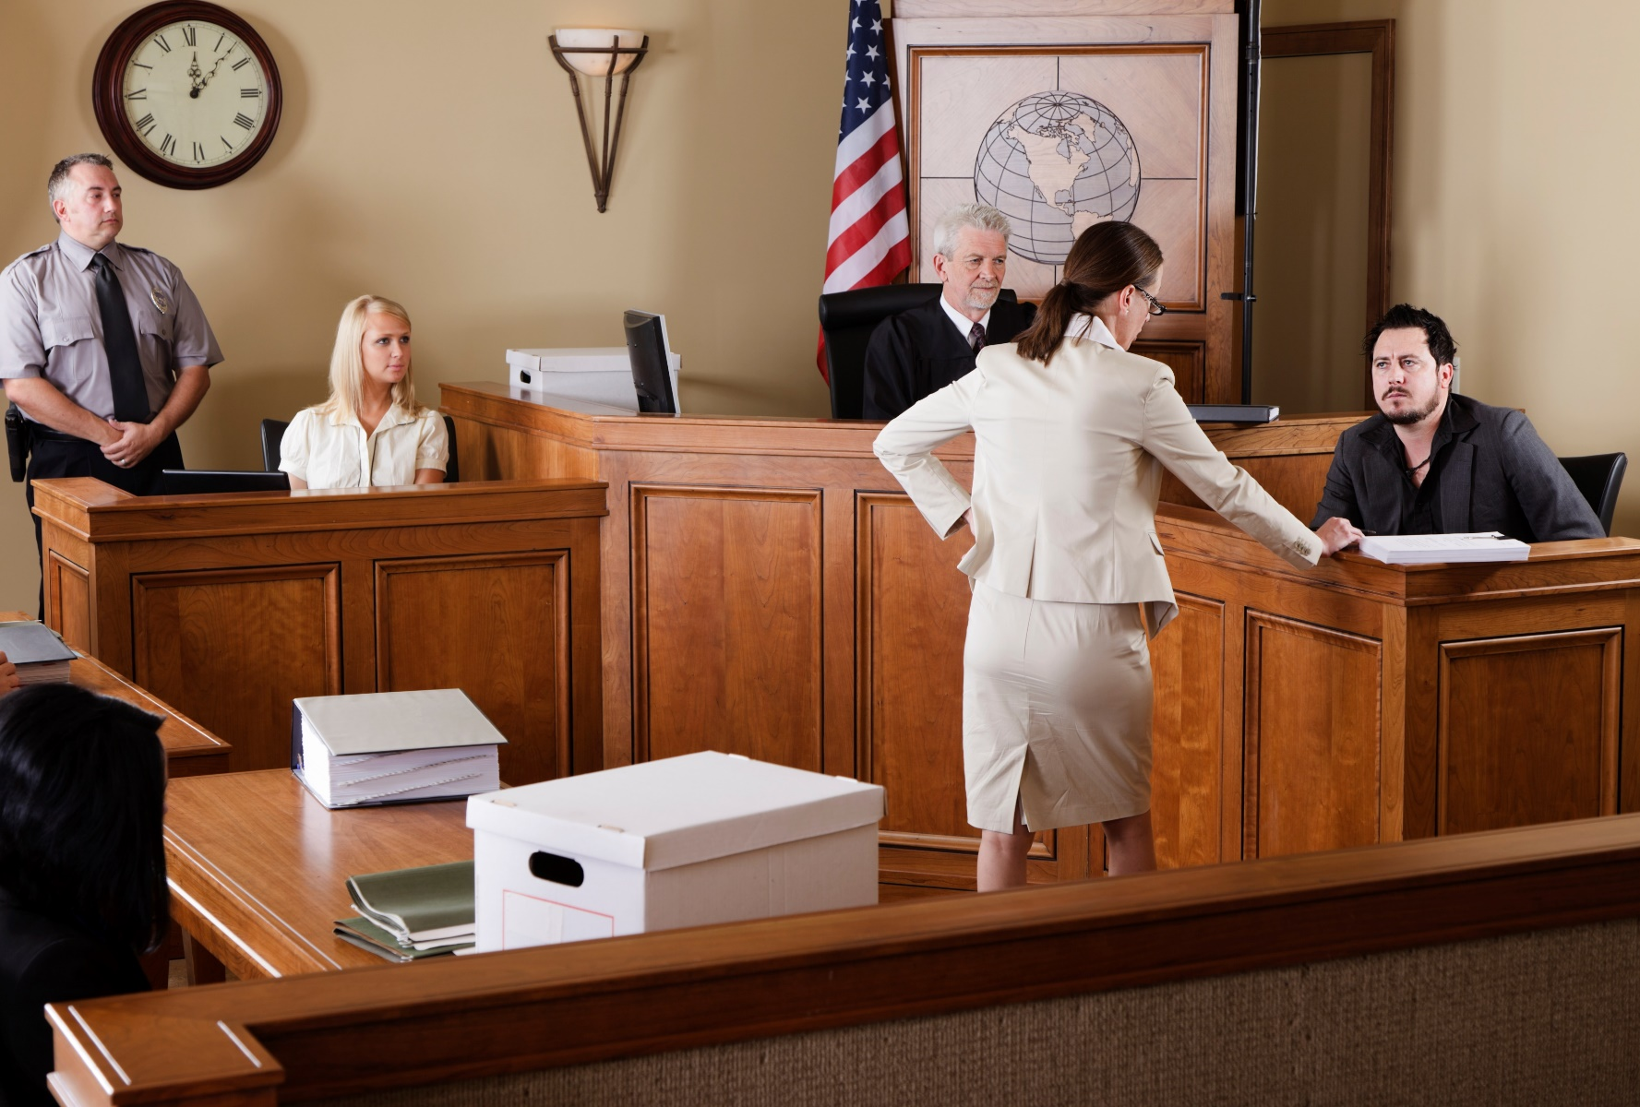
How is Doing Mathematics Like a Courtroom Drama?
Construct Arguments/ Conjectures/ Claims
Put your thoughts in the chat box!
Evidence/
Data
Critique Reasoning/ Proving or Disproving
Revising Arguments
Drawing Conclusions/ Reaching Verdicts
Notes:
This also links to the SMP. 4 Model with Mathematics.
With movie about 8-10 minutes. Without movie about 5-7 minutes.

Slide 12
Breakout Rooms
Notes:
https://docs.google.com/presentation/d/1i3e-IEGzYXJFhyOll3nTyH_6j6MxIBi49tGrmJ_Zz7M/edit#slide=id.ga80333bd55_0_119

Slide 13
Part 1: What is Proof?

Slide 14
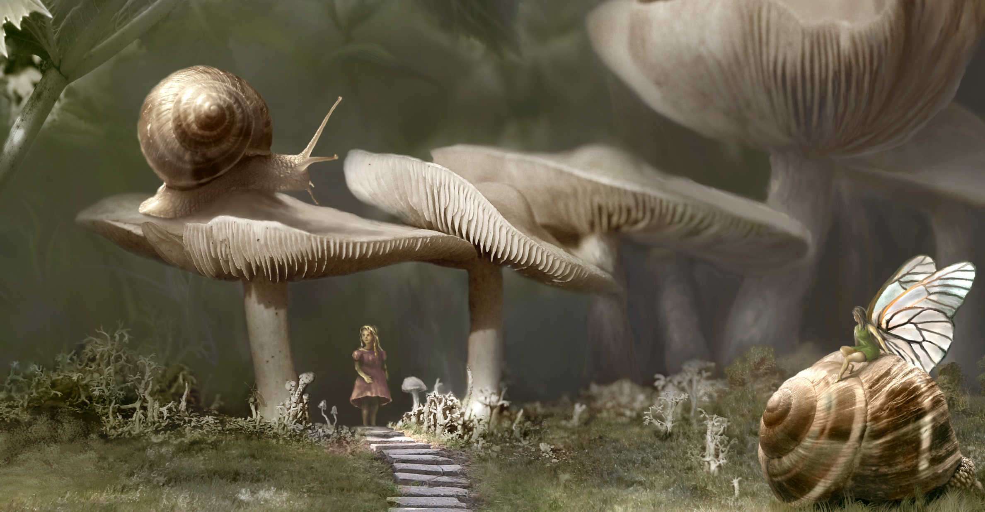
“A successful proof is like a set of signposts that allow all subsequent mathematicians to make the same journey. It is like the moment of harmonic resolution in a piece of music or the revelation of whodunnit in a murder mystery.
- Marcus Du Sautoy
Proof = Narrative

Slide 15
Evidence/ Data/ Referent/ Grounds/ Facts/ Givens
Claim/
Conjecture
Conclusion
Narrative Link
Warrant
Proof
Viable Argument
Counter Arguments/ Rebuttal/
Critiquing the Reasoning of Others/

Slide 16
Mathematical Argumentation
“Proof is a subset of argument, requiring deductive steps from one mathematical claim to another. Unlike a proof, an argument can depend on any data or warrants that students in the class find convincing including statements that might not be mathematically correct or complete.”
-Singletary & Conner
Argument
Proof
Notes:
In a mathematical argument, empirical evidence is insufficient for establishing that a general claim must be true. In a scientific argument, it is not possible to establish a general claim as necessarily true. The Next Generation Science Standards clearly outline this difference: “Scientific arguments are always based on evidence, whereas mathematical arguments never are”

Slide 17
Mathematical Argumentation
”Argumentation—in mathematics and other subject areas — goes beyond these types of communication.
We view mathematical argumentation as a process of dynamic social discourse for discovering new mathematical ideas and convincing others that a claim is true.”
-Rumsey & Langrall
Notes:
Slides 12-16~ 5 minutes

Slide 18
Part 2: Convince Me!

Slide 19
I’m thinking of a math story….
1, 2, 4, 8….
What are the next steps in our math story?
What to you notice? What do you wonder?

Slide 20
16 is the next step, but I’m not convinced that you have the story figured out yet.
I’m thinking of a math story….
1, 2, 4, 8, 16….
What’s the next number in my story?
Convince Me!

Slide 21
Note: Some sequences have 32 as the next term, but mine does not!
I’m thinking of a math story….
32 is not correct!
1, 2, 4, 8, 16….
What’s the next number in my story?
Convince Me!

Slide 22
Now, what do you think the next part of the story is?
1
2
4
8
16

Slide 23
Things are not always as they appear! Dig Deeper!
What did you learn about proof from this?
Notes:
I think this is accessible to elementary schools kids.
Do slides 17-22 in the chat.
Note: The formula is $\left(n^{4}−6n^{3}+23n^{2}−18n+24\right)/24$

Slide 24
Part 3: Convince Me!

Slide 25
Breakout Rooms
Notes:
https://docs.google.com/presentation/d/1i3e-IEGzYXJFhyOll3nTyH_6j6MxIBi49tGrmJ_Zz7M/edit#slide=id.ga80333bd55_0_119

Slide 26
Part 4: Convince Me!

Slide 27
Breakout Rooms
Notes:
https://docs.google.com/presentation/d/1i3e-IEGzYXJFhyOll3nTyH_6j6MxIBi49tGrmJ_Zz7M/edit#slide=id.ga80333bd55_0_119

Slide 28
Communicating Proof
Visually
Algebraically
Verbally (short statements or paragraphs)

Slide 29
Part 5: Teaching SMP.3

Slide 30
Progression of Reasoning
Empirical
Supports but does not justify a conjecture
“It works in a number of cases”
Pre-formal
Role of intuitive explanations and partial arguments that lend insight into what is happening.
Formal
The role of formal argumentation (based on logic) in determining mathematical certainty (proof) or in making statistical inferences.

Slide 31
Choosing a Good Task
Focuses on higher-level demands: Tasks that bring out multiple representations or approaches and use error analysis.
Requires students to figure out things for themselves.
Requires communication and discussion.
Requires students to provide evidence and explain their thinking.
Uses a sequence of related tasks to help deepen student thinking.
https://robertkaplinsky.com/beware-fake-math-modeling-problems/
EMTP.1: Establish mathematics goals to focus learning.
EMTP.2: Implement tasks the promote reasoning and problem solving
Notes:
Taking Action

Slide 32
Asking the Right Questions
Ask advancing to probing student thinking and that require explanation or justification.
Ask questions that build on student thinking (as opposed to funneling) thinking.
Anticipate common misconceptions and ask students questions that will confront them.
Sample questions:
How do you know that works?
Why did you use that method?
Can you prove that to us?
Are you convinced by your own argument?
Will others be convinced by your argument?
Did your classmate convince your or do you have more questions?
Do you agree or disagree? Why?
What mathematical evidence supports your thinking?
How can you be sure that ____________.?
How can you demonstrate a counterexample?
Which of your statements are assumptions? Which are conjectures?
EMTP.4: Pose purposeful questions.
EMTP.3: Facilitate meaningful discourse.

Slide 33
Fostering an Inquiry-Based Environment
Encourage questioning: Teacher to student, student to student, student to teacher.
Answer a question with a question. Do not give answers.
Foster student collaboration.
Create a safe space to make mistakes and where mistakes are made to leverage learning.
Encourage listening to one another’s ideas and clarifying what was said by repeating back.
Give opportunities for student to listen to the solution strategies of others, discuss alternative solutions and defend their ideas.
Use routines that produce reasoning such as “Notice and Wonder.”
EMTP.8:Elicit and use evidence of student thinking.
EMTP.7: Support productive struggle in learning matheamtics.

Slide 34
Other Instructional Strategies
Model Effective Arguments.
Model and Encourage Mathematical Language
Provide Language Supports
Specify Conditions
Introduce False Claims
Manipulate Familiar Contexts to Be Unfamiliar

Slide 35
Routines
Which One Doesn’t Belong
Students are given four choices and decide which one to eliminate based on a mathematical reason. “______ doesn’t belong because….”
Agree or Disagree?
Students are given a statement and students agree or disagree and give reasoning to support their statement.
My Two Cents
Students get sample arguments with flawed or incomplete logic and work together to try to improve the sample.

Slide 36
Routines: Number Talks
Fractions, fractions, fractions!
Visual Patterns
Estimation 180
Number Strings
Open Middle
Which One Doesn’t Belong?
Graphing Stories
http://www.sfusdmath.org/math-talks-resources.html

Slide 37
Resources: http://www.sfusdmath.org/math-talks-resources.html
Routines: Number Talks
Visual Patterns
Estimation 180
Open Middle
Math Talks
Robert Kaplinsky
Graphing Stories
Would you rather?
Number Strings
Fraction Talks
101 Questions

Slide 38
Part 6: Assess

Slide 39
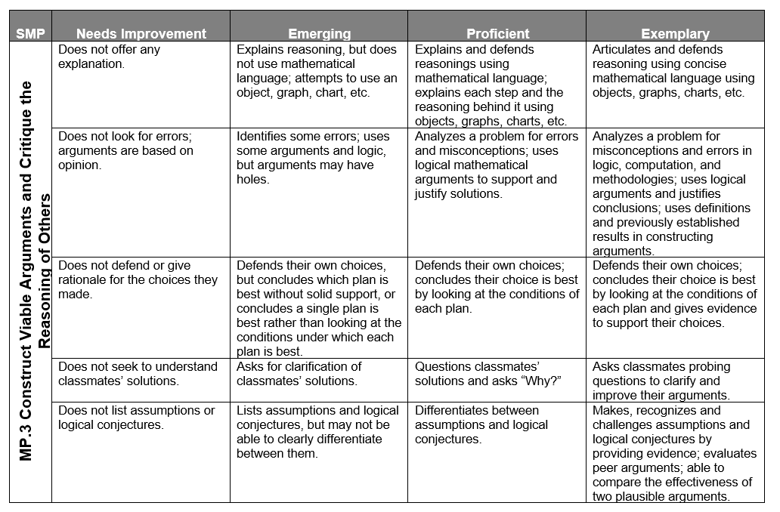
SMP Student Rubric

Slide 40
Another Rubric
Notes:
Institute for Advanced Study/Park City Mathematics Institute Summer 2011 Secondary School Teachers Program/Visualizing Functions

Slide 41
NCTM “Look Fors”
Students
Teachers
Notes:
ems&tl'Project,'2012''''''''*'All'indicators'are'not'necessary'for'providing'full'evidence'of'practice(s).' Each'practice'may'not'be'evident'during'every'lesson
file:///C:/Users/10154237/Downloads/5-SMP%20Look%20Fors%20(1).pdf

Slide 42
CCSSO Performance Level Descriptors for K-2
Notes:
https://ccsso.org/sites/default/files/2019-06/Combined%20K-2%20Performance%20Level%20Descriptor.pdf

Slide 43
Math Practice Rubrics
Math Argumentation Rubric
https://docs.google.com/document/d/1zz8_G_qrdND_Ep2e4zvzICBHcOK_r61vfuwcHnP0oJk/edit
Student Language Math Argumentation Rubric
https://docs.google.com/document/d/1fb5LgaBeiTOzv-iMKmRMCLOZLmUzTI8oyDPXugnJWro/edit

Slide 44
Breakout Rooms
Notes:
https://docs.google.com/presentation/d/1i3e-IEGzYXJFhyOll3nTyH_6j6MxIBi49tGrmJ_Zz7M/edit#slide=id.ga80333bd55_0_119

Slide 45
Thank you!
SMP.3 Construct viable arguments and critique the reasoning of others.

Slide 46
References
“Levels of Convincing” by Robert Kaplinsky.
“How Mathematicians are Storytellers and Numbers are the Characters” by Marcus du Sautoy.
Where Proof, Evidence, and Imagination Intersect” by Patrick Honner.

Slide 47
References
Putting the Practices Into Action by Susan O’Connell and John SanGiovanni
Taking Action: Implementing Effective Mathematics Teaching Practices
Developing Essential Understanding of Mathematical Reasoning
Focus in High School Mathematics: Reasoning and Sense Making

Slide 48
References
Read “The Power of Making Mistakes in Learning Math” posted on the Tarheelstate Teacher. Pay special attention to the 8 Reasons Why Making Mistakes in Math Class Are Valuable, which she took from Tracy Zager’s book Becoming the Math Teacher You Wish You Had: Ideas and Strategies from Vibrant Classrooms.
https://www.louisianabelieves.com/docs/common-core-state-standards-resources/guide--teacher-planning-for-math-practice-implementation.pdf?sfvrsn=2
https://www.forsyth.k12.ga.us/cms/lib/GA01000373/Centricity/Domain/1730/NASD%20Mathematical%20Practice%203%20Newsletter.pdf
http://mathpractices.edc.org/browse-by-mps.html#overlay-context=
https://www.insidemathematics.org/common-core-resources/mathematical-practice-standards/standard-3-construct-viable-arguments-critique-the-reasoning-of-others

Slide 49
Mathematics Questions?
Name | Email
Brian Bickley | Brian.Bickley@education.ohio.gov
Anna Cannelongo | Anna.Cannelongo@education.ohio.gov
Annika Moore | Annika.Moore@education.ohio.gov
Yelena Palayeva | Yelena.Palayeva@education.ohio.gov

Slide 50
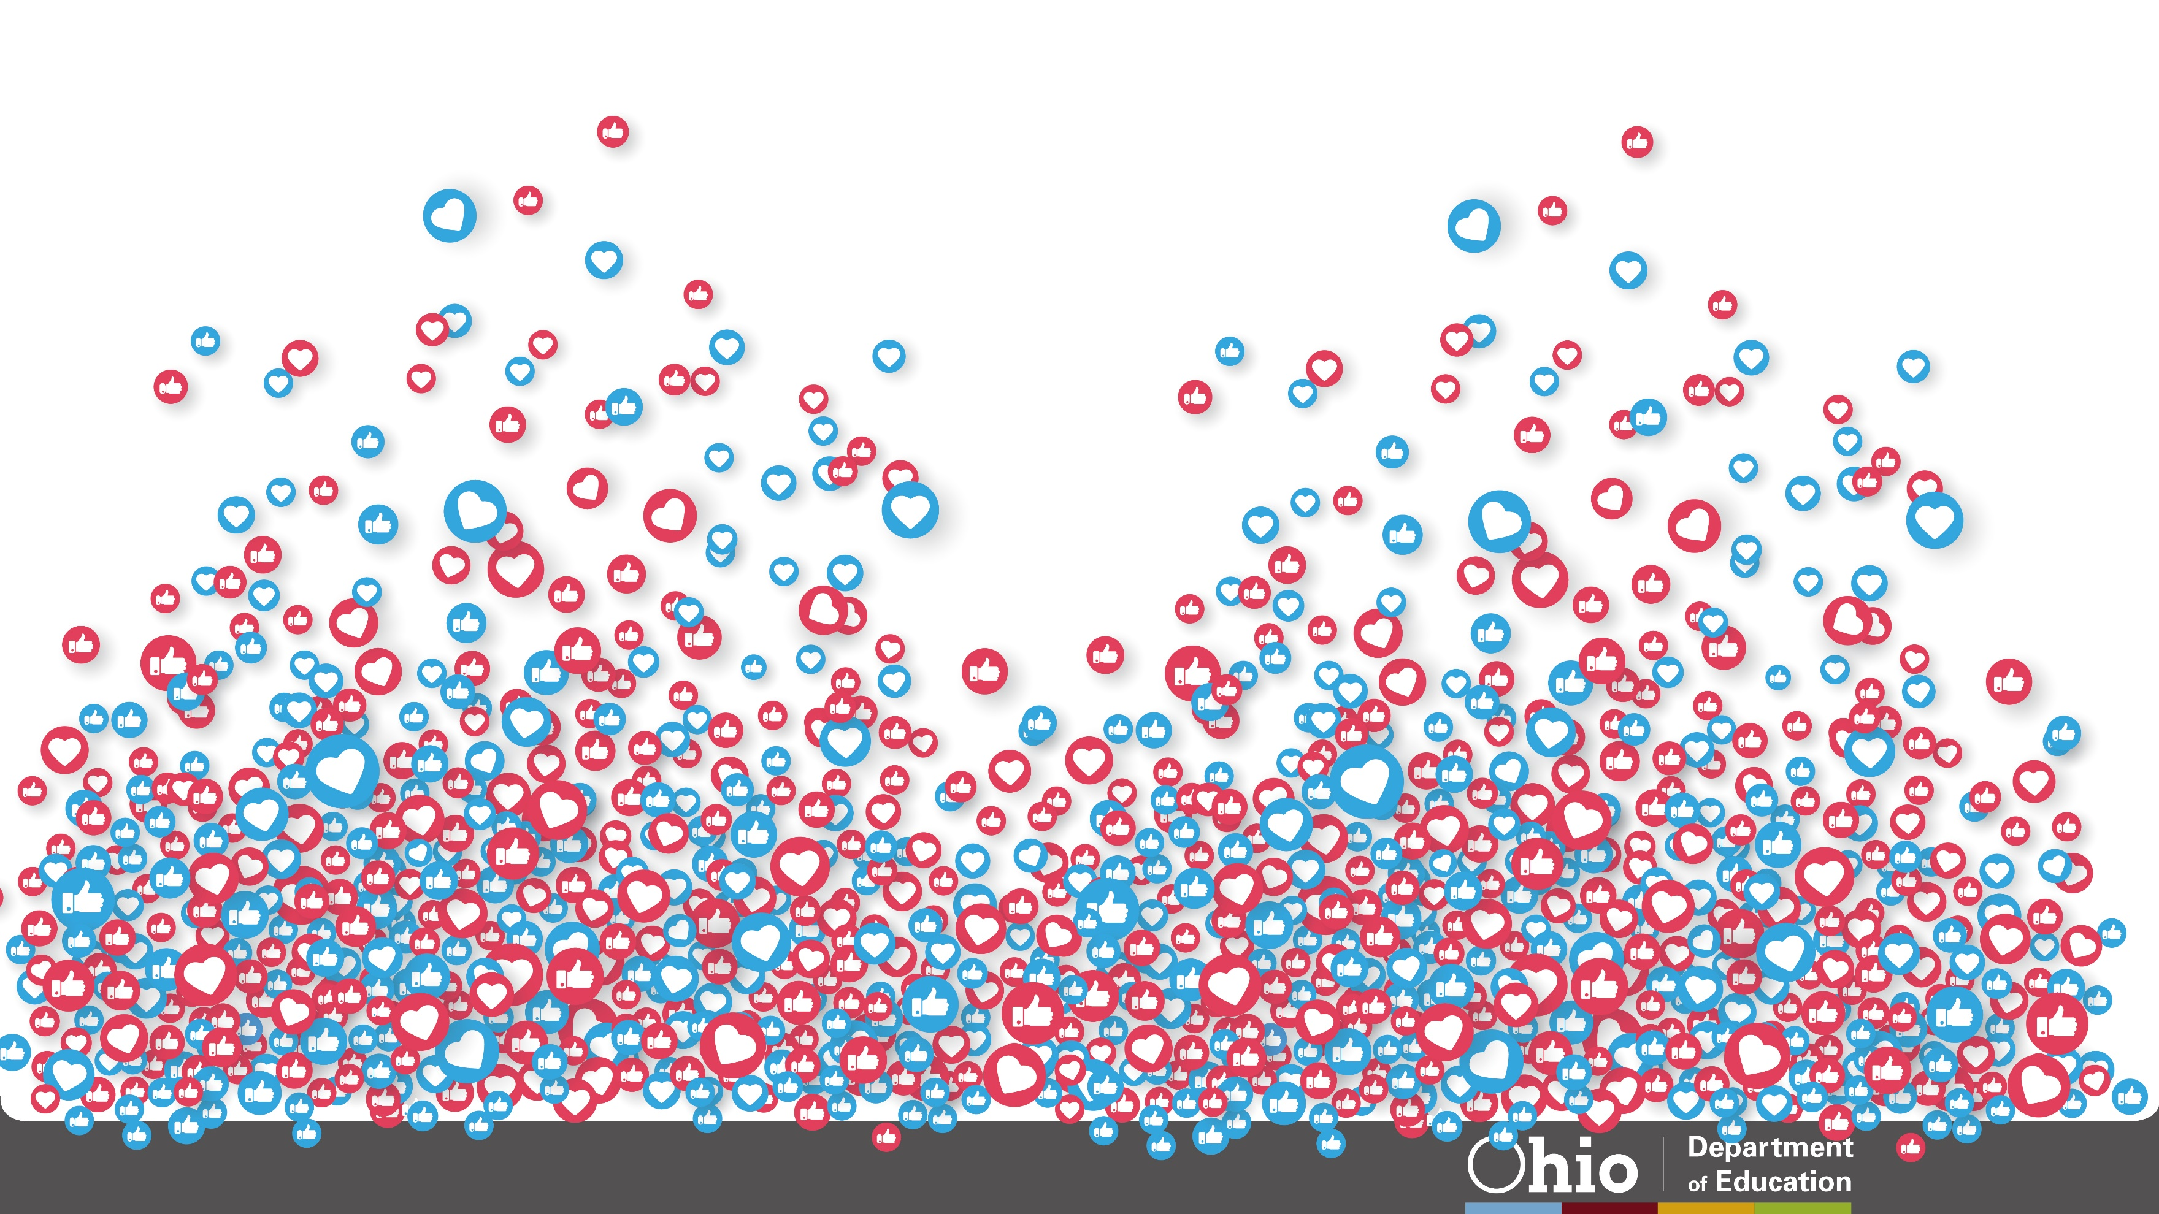
@OHEducation

Slide 51
Introductory Slides

Slide 52
What’s the purpose of a trial?
Notes:
Slides 1-7 ~ 10 minutes

Slide 53
Who are the Characters in a Courtroom?
Easiest
Hardest
In the Google Slide Deck, rank the level of convincing each person needs.
Notes:
Put Group Member in breakout rooms. Create this in Google Slides.

Slide 54
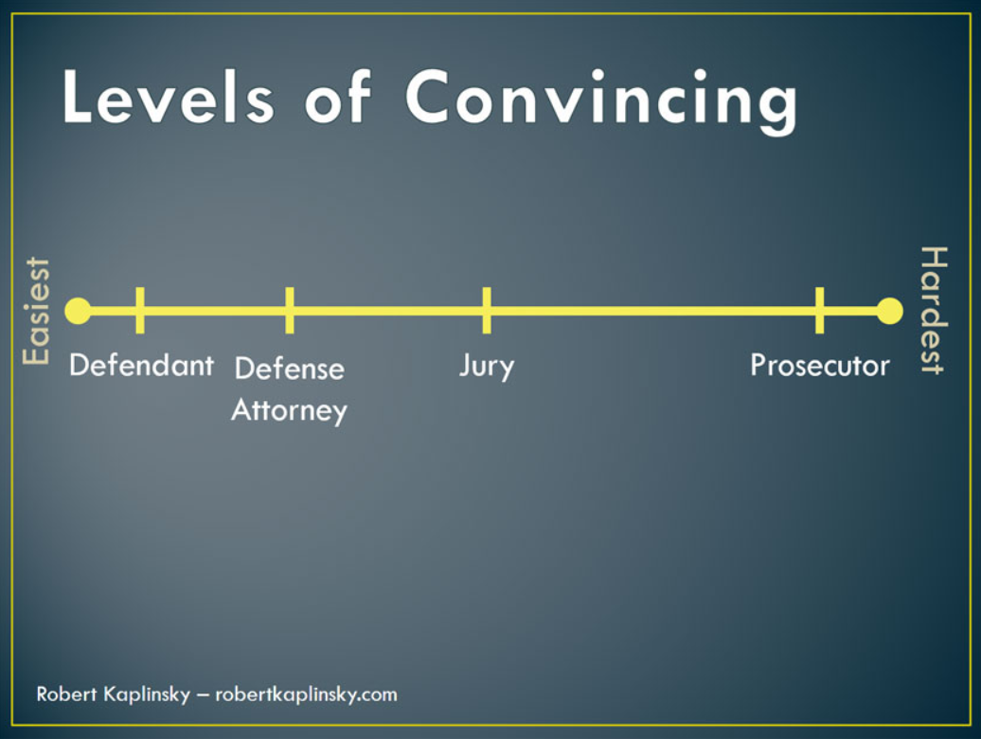
If you wanted to convince someone of something, create a scenario and discuss who in your life would play each of these roles?

Slide 55
Discuss the slide. How does this relate to math class?
How does it relate to math practice 3: Construct viable arguments and critique the reasoning of others?
Notes:
Put this in Google Slides.
Some Notes from https://robertkaplinsky.com/levels-of-convincing/ blog: Like the jury the judge should begin the process as undecided, perhaps leaning in the defendant’s favor because of the presumption of innocence. The judge is also unique in this situation as the expert arbiter of the law. But a judge still needs to refrain from influencing the jury. The obvious correlation here is to the teacher whose role is to listen carefully to the arguments, orchestrate the classroom procedings, apply rules of law or content knowledge when necessary, and allow the students to come to agreement on the correct solution rather than revealing it to them.
The judge serves as the 13th juror and arbriter of the facts. If the judge agrees with the findings of the jury, the judge accepts the jury’s verdict and enters their verdict and consents to their findings. But if the judge disagrees with the jury’s verdict the judge sets aside the jury’s findings and enters the judge’s verdict not withstanding the jury’s findings (Commonly referred to in legal circles as JNOV – Judgment notwithstanding the verdict, also called judgment non obstante veredicto).

Slide 56
In this mathematics class we need to be both defendants and friendly prosecutors. This will make us stronger mathematicians.
Notes:
Slides 8-11 ~ 10 minutes in small groups (maybe 7)
From https://robertkaplinsky.com/levels-of-convincing/:
Think about what this metaphor looks like in a classroom context. A student (the defendant) solves a complex problem and then explains her reasoning to the partner (defense attorney) she had been working with. Her partner agrees with her reasoning, and the teacher has the pair of students share their findings with the rest of the class. Some students in the class may have not found a solution to the problem (the jury), and after listening to the students’ reasoning, they are convinced. However, a few other students used a different method to solve the problem and reached a different conclusion (the prosecution). The believe that they are correct and will try their best to emphasize the merits of their methods and critique any others. They may ultimately change their minds, but it won’t be easy.
The jury context may be useful in helping students visualize an audience they have to convince. Too often students equate explaining their reasoning with simply describing the steps they took. Students may not realize that describing their steps is not the same as explaining their reasoning, but they do realize that it wouldn’t convince a doubter, undecided, or possibly even a friend.
Note the open circle at “undecided” for “critique the reasoning of others”. Undecided people do not have an argument to critique. However once they’ve settled on a different viable argument, then you will have to critique their reasoning to convince them.

Slide 57
Part 3 Slides

Slide 58
Claim: An odd number + an odd number equal an odd number: TRUE or FALSE
Convince Me!
Notes:
Is there anyway I could have people upload pictures? Draw a picture and place it up to the camera perhaps?
5 minutes-breakout room for slides 23-27.

Slide 59
COUNTEREXAMPLE
How many counterexamples do you need?
Notes:
See https://mathforlove.com/lesson/counterexamples/ for more Elementary ideas for counterexamples

Slide 60
Claim: Any two lines either intersect or are parallel: TRUE or FALSE
Convince Me!
Notes:
Is there anyway I could have people upload pictures? Draw a picture and place it up to the camera perhaps?
5 minutes-breakout room for slides 23-27.

Slide 61
COUNTEREXAMPLE
How many counterexamples do you need?
Notes:
Add counter example for younger kids.

Slide 62
Part 4 Slides

Slide 63
Some number patterns have a story to tell. What do you notice if you add up any two counting numbers that are next to each other? What do you wonder?
What’s their story?
1 + 2
2 + 3
3 + 4
4 + 5
Prove your idea.
Notes:
file:///C:/Users/10154237/Downloads/[23270780%20-%20Teaching%20Children%20Mathematics]%20Early%20Algebra%20to%20Reach%20the%20Range%20of%20Learners.pdf
https://www.heinemann.com/shared/onlineresources/oconnellstandardsprek2/reasproofwebsam.pdf
https://www.joyfulmathematics.com/blog/thrillofproof
http://www.ms.uky.edu/~lee/ma310sp09/Standards_for_School_Mathematics_Reasoning_and_Proof.pdf

Slide 64
Some number patterns have a story to tell. What do you notice if you add up any two counting numbers that are next to each other? What do you wonder?
Is there a better way?
Hint: Try using counters or graph paper.
1 + 2
2 + 3
3 + 4
4 + 5
Etc…
Notes:
file:///C:/Users/10154237/Downloads/[23270780%20-%20Teaching%20Children%20Mathematics]%20Early%20Algebra%20to%20Reach%20the%20Range%20of%20Learners.pdf
https://www.heinemann.com/shared/onlineresources/oconnellstandardsprek2/reasproofwebsam.pdf
https://www.joyfulmathematics.com/blog/thrillofproof
http://www.ms.uky.edu/~lee/ma310sp09/Standards_for_School_Mathematics_Reasoning_and_Proof.pdf

Slide 65
Some number patterns have a story to tell. What do you notice if you add up any two counting numbers that are next to each other? What do you wonder?
Proof by example means that you have to try all examples that exist in the whole world? How long would that take? Is it worth the effort?
1 + 2
2 + 3
3 + 4
4 + 5
Etc…
Notes:
file:///C:/Users/10154237/Downloads/[23270780%20-%20Teaching%20Children%20Mathematics]%20Early%20Algebra%20to%20Reach%20the%20Range%20of%20Learners.pdf
https://www.heinemann.com/shared/onlineresources/oconnellstandardsprek2/reasproofwebsam.pdf
https://www.joyfulmathematics.com/blog/thrillofproof
http://www.ms.uky.edu/~lee/ma310sp09/Standards_for_School_Mathematics_Reasoning_and_Proof.pdf

Slide 66
A visual picture can be a proof!

Slide 67
Odd integers also have a story to tell. What do you notice if you add up consecutive odd integers starting at one? What do you wonder?
What’s their story? Make a conjecture.
1 + 3
1 + 3 + 5
1 + 3 + 5 + 7
1 + 3 + 5 + 7 +….
Prove your conjecture.
Notes:
Groups?

Slide 68
What do you notice if you add up consecutive odd integers starting at one? What do you wonder?
Proof by example means that you have to try all examples that exist in the whole world? How long would that take? Is it worth the effort?
1 + 3
1 + 3 + 5
1 + 3 + 5 + 7….
Is there a better way?
Hint: Try using counters or graph paper.
Convince Me!
Notes:
Come up with different conclusions for younger kids. But they could still use the same problem.
x

Slide 69
A visual picture can be a proof!

Slide 74
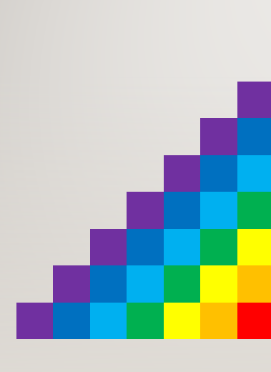
Are the prosecutors convinced?
Notes:
Note: There is also an equation to prove this $f\left(n\right)=f\left(n−1\right)+2n−1$.

Slide 75
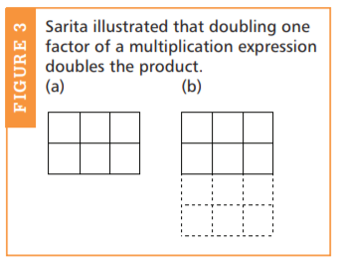
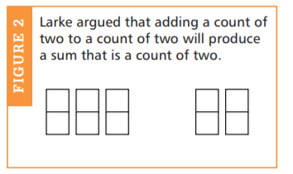
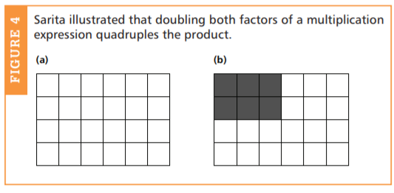
Even numbers have a story to tell. What do you notice about even numbers?
Product of even numbers or odd numbers?
if one factor in a multiplication expression doubles, the product also double
sen numbers?
which numbers can you draw a square made up of that many squares.

Slide 76
Proof by contradiction is also possible with young children. A first grader argued from his knowledge of whole-number patterns that the number 0 is even: "If 0 were odd, then 0 and 1 would be two odd numbers in a row. Even and odd numbers alternate. So 0 must be even." Beginning in the elementary grades, children can learn to disprove conjectures by finding counterexamples. At all levels, students will reason inductively from patterns and specific cases. Increasingly over the grades, they should also learn to make effective deductive arguments based on the mathematical truths they are establishing in class.
Notes:
http://www.ms.uky.edu/~lee/ma310sp09/Standards_for_School_Mathematics_Reasoning_and_Proof.pdf

