Slide 1
Where Are They?
The Underrepresentation of Black and Brown Students in STEM Pathways.
Dr. Charles Bowman
November 10, 2021

Slide 2
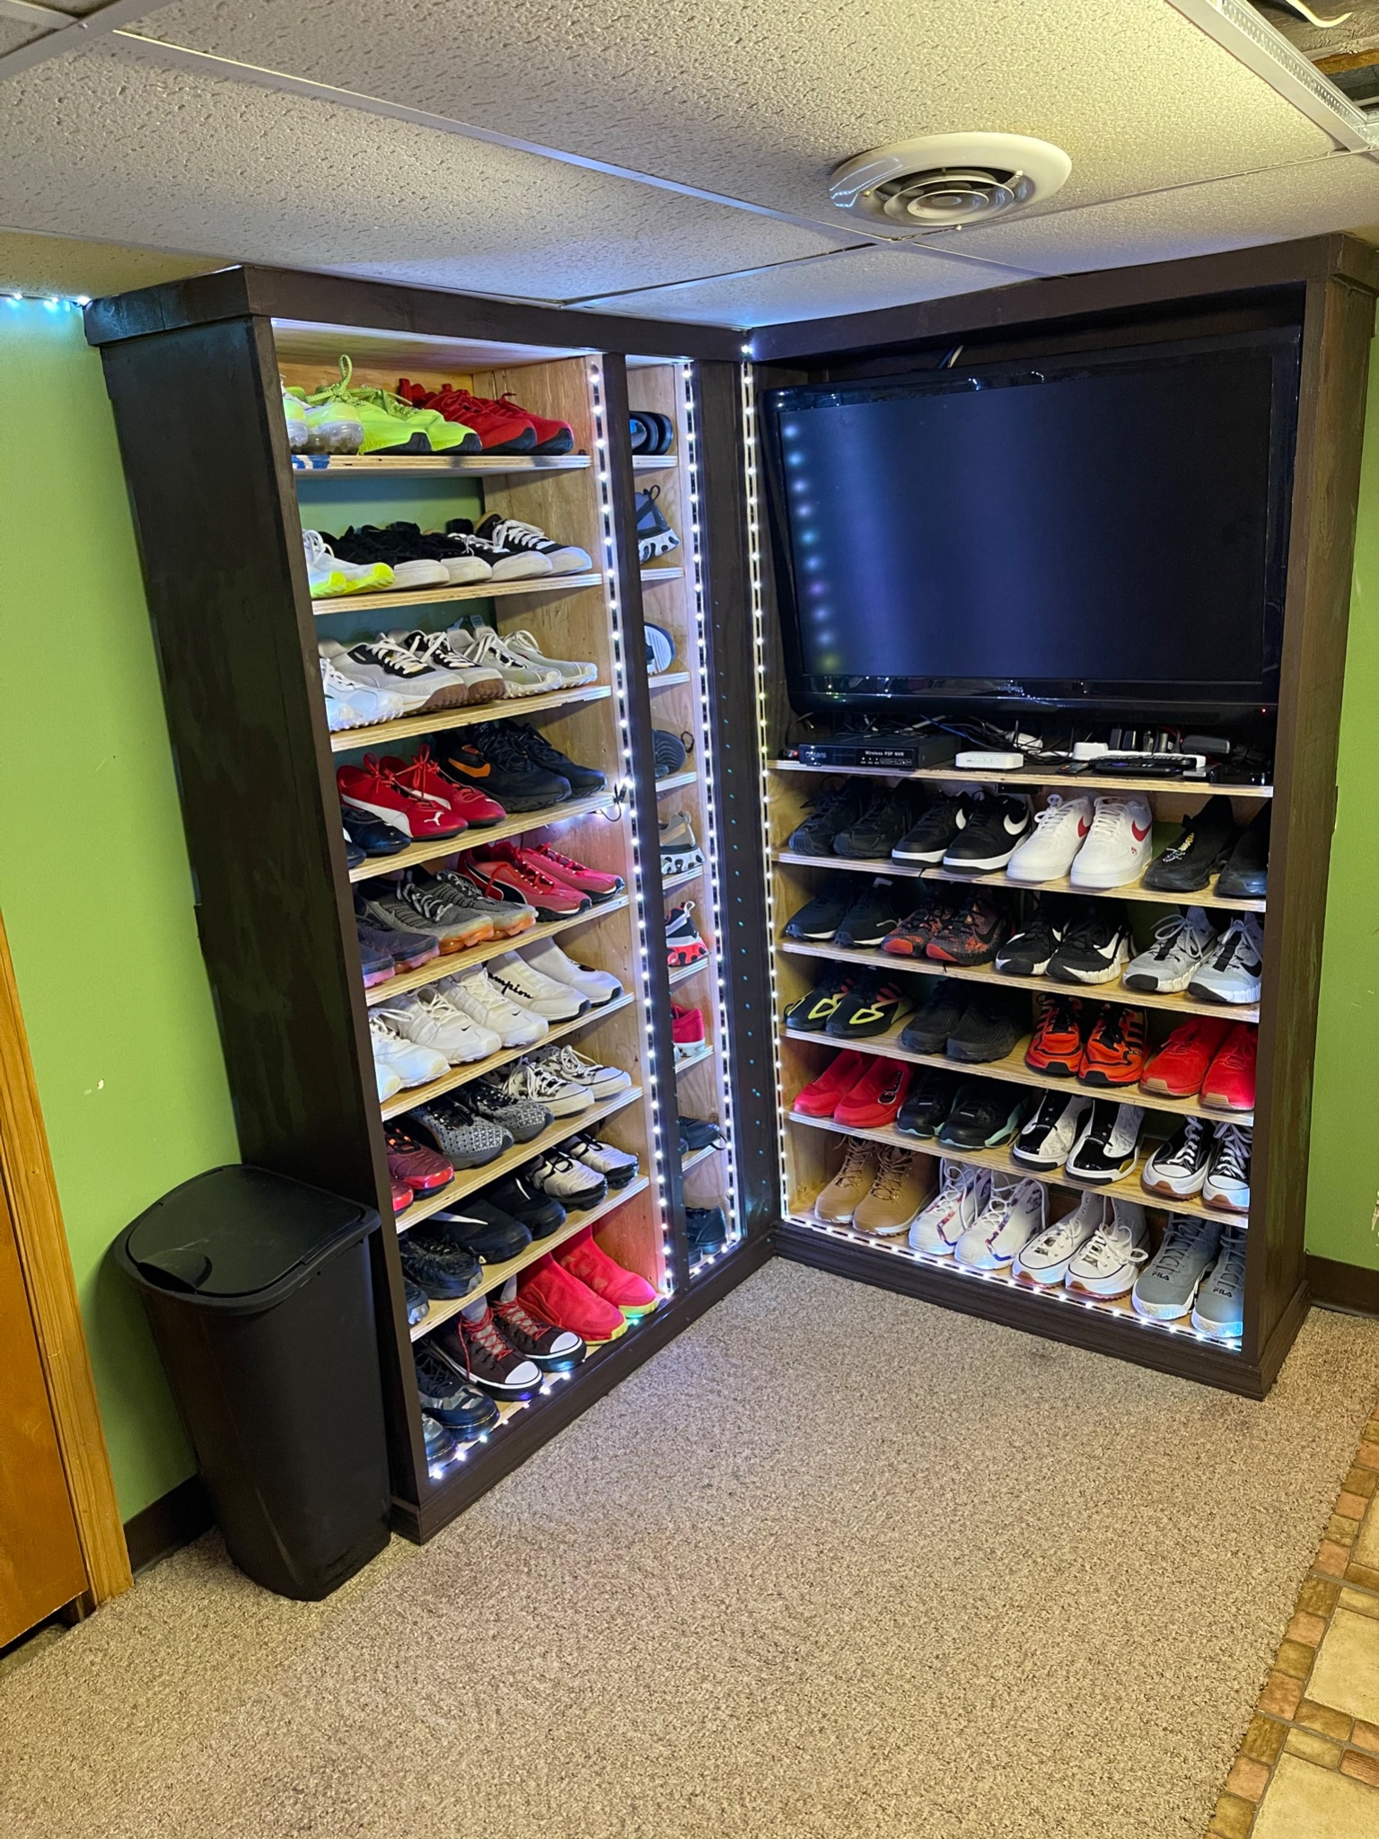
who is
Charles Bowman
A true geek/nerd at heart
Avid Dallas Cowboys Fan
Lover of all things Star Wars
Professional Student
Technology explorer
Father of 3 girls
Happily married husband
Carpenter/woodworker
A believer/faith
Advocate
A servant-leader
Shoe Addict - (Intervention needed)
Educator

Slide 3
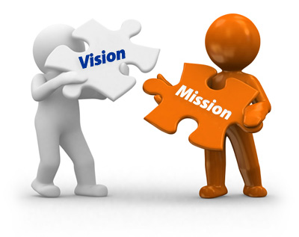
Meeting Norms
Listen generously
Be open-minded, but be mindful of using a critical lens
Be aware of how implicit bias can show up in the work and call it out
Use asset-based lenses and language when discussing.
Be present and actively engage in the session
Be apart of the conversation - THIS IS A SAFE SPACE!
Seek clarification of thoughts and ideas
Never make assumptions
Assume positive intent

Slide 4
Our Collective Goals
In order to achieve this, we will…
develop a space where we can discuss math education, experiences, ideas, and barriers that keep Black and Brown students from opportunities in STEM pathways
provide opportunities for educators to push on the work we are doing in STEM pathways and hold us accountable for creating culturally relevant resources and materials that will attract Black and Brown students
support each other in bringing joy, authenticity, and innovation to math education through STEM pathways
collectively work to identify opportunities to empower Black and Latinx students

Slide 5
Advocacy Defined
In order to achieve this, we will…
become an advocate meaning you are someone that recognizes we don’t live in a just society.
advocates aren’t comfortable with the status quo.
advocates are willing to speak up on the behalf of others.

Slide 6
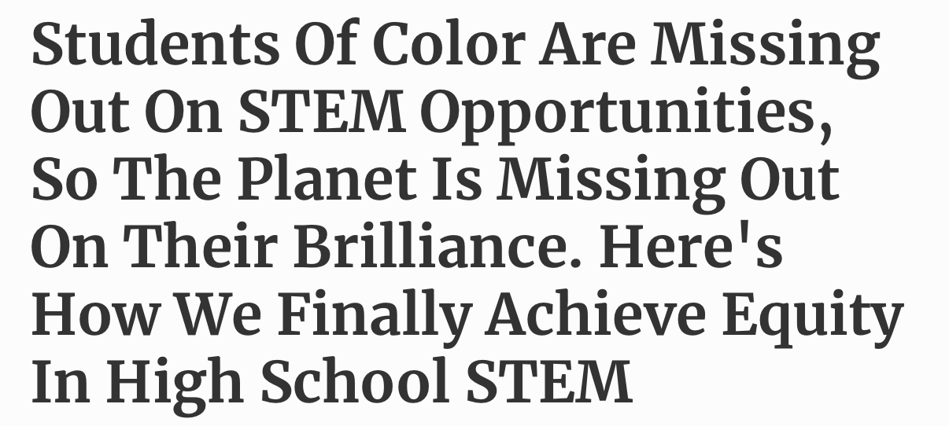
Campbell, 2014
Milgrom-Elcott, 2020
Newsome, 2021

Slide 7
Where are the Black and Brown students?
Between 2001 - 2016: only 9% of Black graduates earned a degree in science
Current figures show a decline from 5% to 4% in engineering degrees
Mathematics degrees also show a decline from 7% to 4%
In 2018, Black students only comprise of 7% of STEM bachelor degrees
Credit: Newsome, 2021

Slide 8
Barriers that are often presented...
Black and Brown students are often denied access to limited seats in advanced courses, particularly in racially diverse schools where they are not the majority.
STEM curricula and materials prioritize the stories of STEM contributions made by white men, and minimize, omit, or perpetuate harmful stereotypes about the knowledge and history of STEM leaders of color.
A lack 0f inclusion and sense of belonging has caused Black and Brown students to leave STEM pathways.
A University of Maryland student said, “A lot of people develop impostor syndrome. I was often the only Black student in my engineering classes. “It’s, like, ‘Do I even belong here?’ I wear a hijab, and being a Black Muslim woman, it’s like being minority on minority on minority.”

Slide 9
Cultural Relevance Makes The Connection
The decision-makers and innovators should consist of a diverse group. In order to reflect the needs of the entire society, you need people who can innovate in that space and represent the needs of their culture, their community and the world.
Different experiences, perspectives and approaches lead to greater scientific innovation, growth and competitiveness.
Credit: Virginia Booth Womack, 2013
For example: If people of color aren’t involved in the development of facial recognition the software may misidentify Black people.

Slide 10
Black and Brown Exemplars

Slide 11
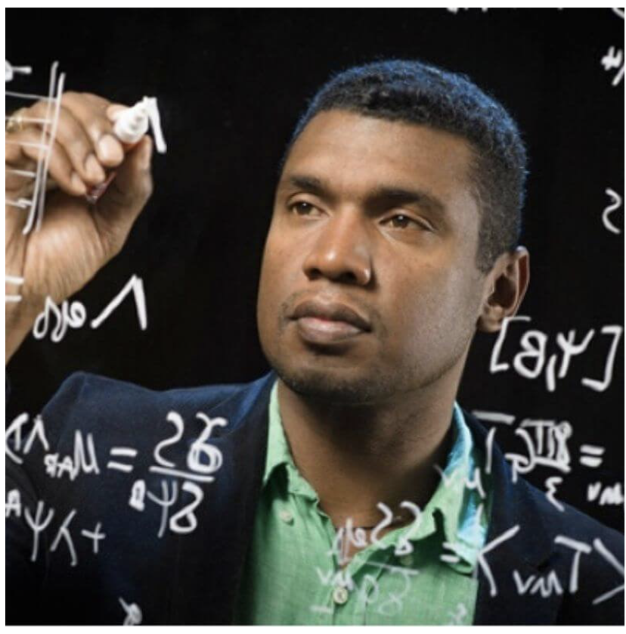
Black and Brown Exemplars
Dr. Stephon Alexander is a theoretical physicist and professor at Brown University who specializes in string theory and particle physics.
He co-invented a model that helps to explain the early expansion of the universe.

Slide 12
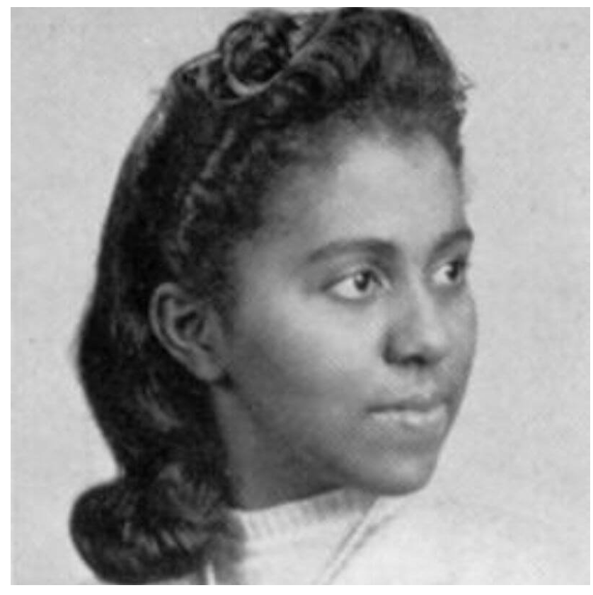
Black and Brown Exemplars
Dr. Marie M. Daly was a biochemist and the first Black woman to obtain a PhD. in chemistry in the United States.
She made several critical contributions to medicine, including the discovery of the relationship between high cholesterol and heart disease and conducting pioneering research into the effects of cigarette smoke on the lungs.

Slide 13
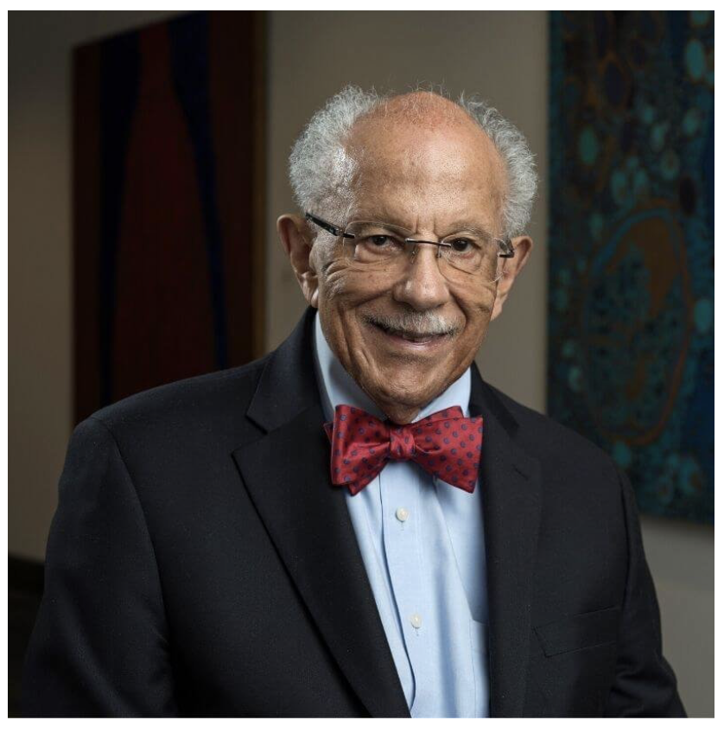
Black and Brown Exemplars
Dr. Warren Washington is a distinguished climate scientist and former chair of the National Science Board.
After completing his PhD. in meteorology, he became a research scientist at the National Center for Atmospheric Research (NCAR). While there, he developed one of the first atmospheric computer models of Earth’s climate. He went on to become the head of NCAR’s Climate Change Research Section

Slide 14
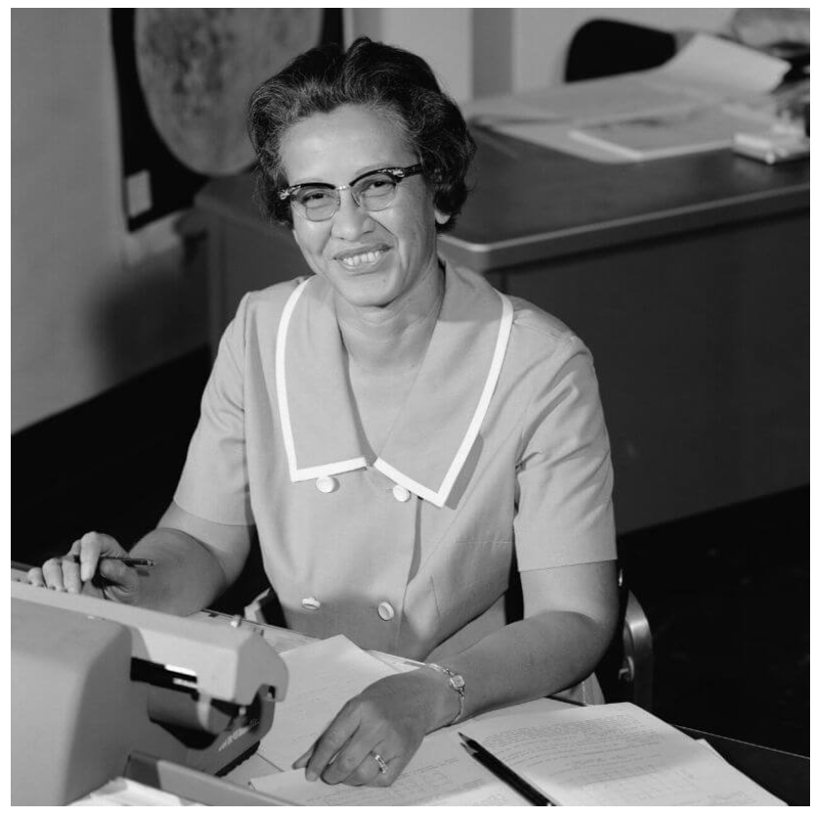
Black and Brown Exemplars
Katherine Johnson was one of the famous Hidden Figures who worked at NASA and made the 1969 moon landing possible.
After working as a teacher in public schools, she joined NASA (then NACA) as a research mathematician in the Langley laboratory’s all-Black West Area Computing section.

Slide 15
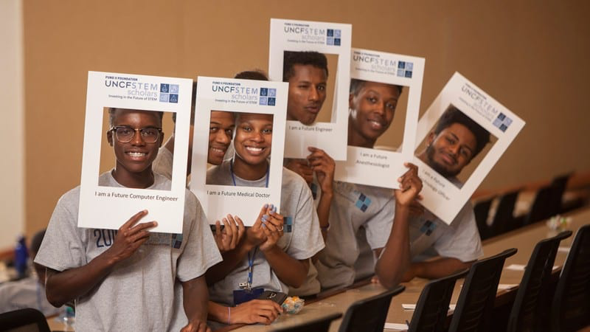
Unpacking The Need for Black and Brown Students in STEM Pathways
Failure will perpetuate racial stereotypes
Implicit bias creeps in unknowingly (attitudes towards the abilities of Black and Brown students or associate stereotypes will creep in without conscious knowledge)
We must recognize that we all see and engage differently
DEI design is not perfect, but the representation of work must be authentic.
Cultural identification and increased representation within the design gives a voice and connection to marginalized communities.

Slide 16
3-Ways to Change the Trend
1. Ensure high school STEM coursework is relevant and applicable to a 21st century context
STEM education must engage and excite students through hands-on or project-based learning that connects to personal lived experiences and relevant career options.
2. Support more teachers to facilitate active and applied STEM learning
Infuse more STEM knowledge and capacity to teach STEM courses that are personally-relevant and career-connected, especially to students of color, into teacher preparation. Students of color do better when taught by teachers of color, at no cost to their white classmates.
3. Create systems that ensure equitable STEM teaching and learning
Systemic and cultural changes in school structures, tracking policies, and the separation of Career and Technical Education from advanced STEM courses are needed to disrupt norms that harmfully prevent students of color from accessing and thriving in relevant, career-ready STEM experiences.

