Slide 1
Gifted Regional Meeting
Office for Exceptional Children
September 2018

Slide 2
Today’s Presenters
Michael Demczyk – Education Program Specialist for Gifted Services, Office for Exceptional Children
Maria Lohr – Education Program Specialist for Gifted Services, Office for Exceptional Children
Jeffrey Shoemaker – Education Program Specialist for Gifted Services, Office for Exceptional Children

Slide 3
2018 Operating Standards for Identifying and Serving Students Who are Gifted

Slide 4
Effective: July 27, 2018
Increases amount of time to earn PD clock hours.
Reduces the requirement for some teachers.

Slide 5
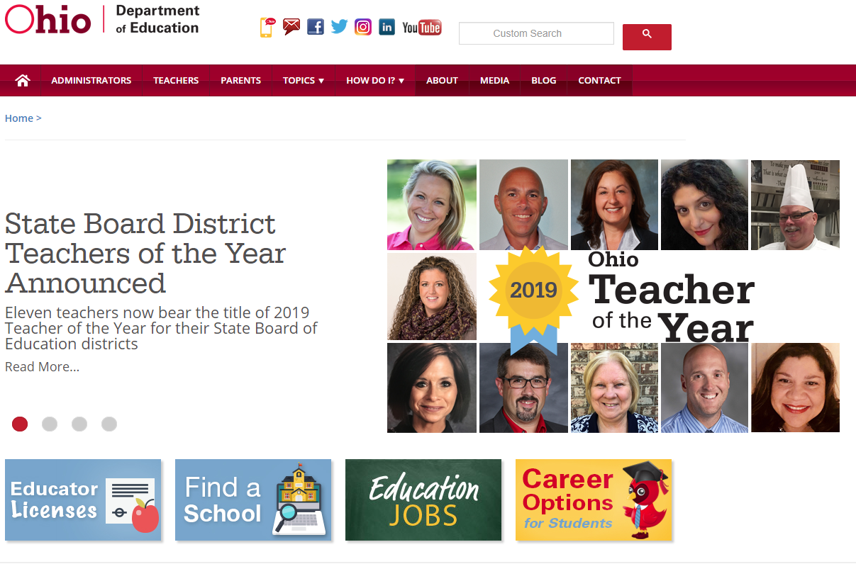
Search:
Gifted Operating Standards
Notes:
Guidance documents available on the Department website (search keywords: gifted operating standards).

Slide 6
Required Professional Development (60 clock hours)
For general education teachers who are:
Designated providers of gifted services.
Not certified Advanced Placement or International Baccalaureate teachers who have earned at least 24 hours of certified AP or IB training within the past 5 years.
Receive gifted professional development in eight competencies (a-h).
Receive 15 clock hours of gifted professional development each year over four years.

Slide 7
Required Gifted Education Competencies (60 clock hours)
(A) Differentiate instruction | (B) Select, adapt or create differentiated curriculum
(C) Extend or replace curriculum | (D) Social and emotional needs
(E) Culturally responsive pedagogy | (F) Monitor growth
(G) Select, use, and interpret formal and informal assessments | (H) Develop Written Education Plans (WEPs)

Slide 8
Required Professional Development (30 clock hours)
For general education teachers who are:
Designated providers of gifted services.
Certified Advanced Placement or International Baccalaureate teachers who have earned at least 24 hours of certified AP or IB training within the past 5 years.
Receive gifted professional development in five competencies (a, b, d, e, and h).
Receive 7.5 clock hours of gifted professional development each year over four years.

Slide 9
Required Gifted Education Competencies (30 clock hours)
(A) Differentiate instruction
(B) Select, adapt, or create differentiated curriculum
(D) Social and emotional needs
(E) Culturally responsive pedagogy
(H) Develop Written Education Plans (WEPs)

Slide 10
Guidance: Gifted Education Professional Development
A teacher is considered a gifted service provider unless the teacher fails to meet the required clock hours by the end of the school year.
Count any clock hours in excess of the minimum toward the requirement.

Slide 11
Guidance: Gifted Education Professional Development
Convert college or university credit hours to clock hours.
The district shall determine ongoing gifted education professional development clock hours.
Count documented clock hours of gifted professional development received in the previous 24 months.

Slide 12
Summary of Key Requirements
My gifted education assignment… | Professional Development Clock Hours Required | Ongoing Professional Development Required | Ongoing Support Required
Gifted Intervention Specialist | No | Yes | No
General Education | Yes | Yes | Yes
Honors | Yes | Yes | Yes
Advanced Placement | Yes | Yes | Yes
International Baccalaureate | Yes | Yes | Yes
College Credit Plus | No | No | No
Trained Arts Instructor | No | No | Yes
Gifted Coordinator | No | Yes | No

Slide 13
Professional Development for General Educators
Summary of Key Requirements from the Operating Standards
Must meet related competencies
Provided by an educator who: Holds gifted licensure or endorsement Holds a graduate degree in gifted education Is a state or national presenter in gifted education
Earn required clock hours each year over four years, with additional clock hours as determined by the district each year after the total is met.
Receive ongoing support

Slide 14
Documented hours
Previously earned clock hours count toward the requirement.

Slide 15
Scenario 1
Third grade teacher
2017-2018 school year
Provides services in a cluster group setting
Documented 30 clock hours of qualifying professional development
Notes:
A third grade teacher who is designated a provider of services in a cluster group setting, documented 30 clock hours of qualifying professional development in gifted education for the 2017-2018 school year.

Slide 16
Scenario 1
Third grade teacher
2018-2019 school year
Remainder of 30 clock hours of qualifying gifted professional development
No additional clock hours required for 2018-2019
Notes:
This teacher has a remainder of 30 total clock hours of qualifying gifted education professional development and no additional clock hours are required during the 2018-2019 school year.

Slide 17
Scenario 2
High School AP teacher
2017-2018 school year
24 hours of certified AP training within previous 5 years
Documented 30 clock hours of qualifying gifted professional development
Notes:
A high school AP teacher who provides services through AP has 24 hours of certified AP training earned during the preceding 5 years. During the 2017-2018 school year, this teacher documented 30 clock hours of qualifying gifted education professional development.

Slide 18
Scenario 2
Met total clock hours
High School AP teacher
Will need on-going gifted professional development clock hours as determined by the district
24 hours of certified AP training within previous 5 years
Notes:
This teacher has met the total clock hours specified. Will need on-going gifted education professional development clock hours as determined by the district.

Slide 19
Scenario 3
Middle School advanced science teacher
2017-2018 school year
Not reportable as gifted services
Documented 15 clock hours of gifted professional development
Notes:
A middle school advanced science teacher was designated a provider of gifted services and documented 15 clock hours of gifted education professional development during the 2017-2018 school year.
While this would not have met requirements for reporting gifted service for the 2017-2018 school year, these documented clock hours can still be applied to the requirement.

Slide 20
Scenario 3
Middle School advanced science teacher
2018-2019 school year
Remainder of 45 total clock hours of qualifying gifted professional development
Expected to earn a minimum of 15 clock hours of gifted professional development
Notes:
Thus, this teacher has a remainder of 45 total clock hours of qualifying gifted education professional development and is expected to earn a minimum of 15 clock hours during the 2018-2019 school year.

Slide 21
Questions?

Slide 22
Common List of Approved Assessments

Slide 23
Common List of Approved Assessments
In prior years, the Department issued multiple Requests for Qualifications (RFQ) to develop approved lists.
The Common RFQ establishes an application by which vendors may submit qualifications for tests across areas.
Assists districts in selecting tools that will maximize their use of time and resources and provide high educational value.

Slide 24
Application Process
RFQ posted: Feb. 20, 2018
Vendors notified that all assessments must be submitted for review, even those currently approved
Question and answer period for vendors
Letter of Intent submitted by vendors

Slide 25
Application Process
Applications submitted by vendors
Review of applications by the Department
Vendors notified of review outcomes
Appeal period
Vendor lists announced: June 15, 2018

Slide 26
Review and Scoring Rubric
Review of applications and scoring rubric:
Program review for general rubric items
Conducted by Department staff across content areas
Technical review for validity, reliability, norming, etc.
Conducted by Department staff with a background in testing metrics and statistics
Apply a consistent set of criteria
All assessments that meet the criteria are included on the list

Slide 27
2018-2019 List of Approved Assessments
Available on the Department website (search keywords: list of approved assessments).

Slide 28
Grace Period
Given the number of concerns raised by districts that already purchased tools for the 2018-2019 school year prior to the release of the new list, the Department will offer a grace period for previously approved assessments across all areas covered by the Common RFQ.

Slide 29
Grace Period
The Department will allow the use of previously approved 2017-2018 assessments through June 30, 2019.
Districts can also use the newly approved assessments for the 2018-2019 school year.
After June 30, 2019, districts can only use the assessments on the new list.

Slide 30
2017-2018 List of Approved Assessments
Available on the Department website (search keywords: list of approved assessments).

Slide 31
Next Steps
The Department will open a new Common RFQ this fall for approval of any area without assessments or for vendors that are not on the new list.
The new list will be available in spring 2019 for use in the 2019-2020 school year.
After June 30, 2019, districts can only use the assessments on the new list.

Slide 32
Key Changes
CogAT scores have been clarified by the publisher
NNAT3 is approved for identification
i-Ready is approved for identification at particular grade levels
Logramos, 3rd Edition, is now also approved for Superior Cognitive identification

Slide 33
Key Changes
Woodcock-Munoz Language Survey III is approved for identification
Woodcock-Johnson IV, Tests of Cognitive Abilities, Gf-Gc Composite is now also approved for identification for students with score discrepancies per the Technical Manual
(See vendor information forms for specifics)

Slide 34
Test-Specific Information
Each assessment links to a vendor information form with Department guidelines.
Includes grade levels, subtests (where applicable) and scores for intelligence tests.

Slide 35
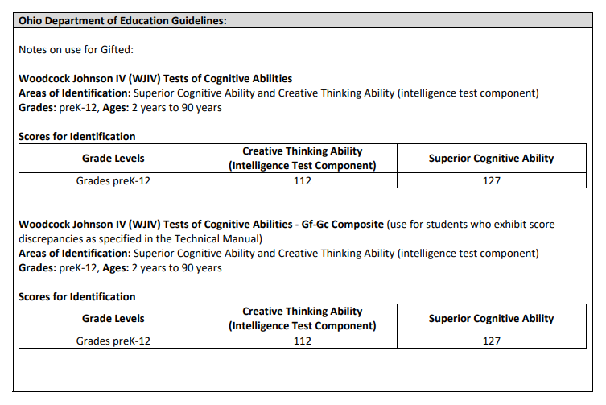
Example

Slide 36
Screening versus
Pre-Screening

Slide 37
Definition of Screening
In Ohio, screening means administering a test approved for gifted identification.
Notes:
It might be helpful to think of pre-screening as another way to refer students for gifted identification.
While referrals are typically generated by parents or teachers based on individual student performance or behaviors, pre-screening generates referrals based on assessment data.
In addition, pre-screening usually goes a step beyond typical referrals by casting a wider net as pre-screeners are often administered to groups of students, if not entire grade levels.
Since pre-screening instruments cannot be used for gifted identification, students referred for gifted identification based on pre-screening are then further tested with approved instruments.

Slide 38
Assessments Approved For…
Identification | Pre-Screening
Approved for gifted identification | NOT approved for gifted identification
Must use to meet whole-grade screening opportunities | CANNOT be used to meet whole-grade screening opportunities
Must use to meet referral opportunities | CANNOT be used to meet referral opportunity requirements for gifted identification
Reported in EMIS | NOT reported in EMIS

Slide 39
Examples

Slide 40
Questions?

Slide 41
Gifted Education Updates

Slide 42
Gifted Education Updates
Revised OLAC Gifted Education Professional Development Modules
Gifted Education Cost Study
Innovative Gifted Services Application
Identification Plan and Gifted Education Policy
Ohio Assessment for Educators for Gifted Education

Slide 43
Revised OLAC Gifted Education Professional Development Modules
Revised in partnership with the Gifted Advisory Council and the Ohio Department of Education
Available soon through the OLAC website
Consists of 7 Foundational Concepts and 7 related Projects

Slide 44
Revised OLAC Gifted Education Professional Development Modules
Seven Foundational Concepts:
Social Emotional Needs of the Gifted
Culturally Responsive Pedagogy
Differentiated Instruction for Advanced Learners
Written Education Plans
Acceleration
Access to Advanced Curriculum
Measuring Growth for Advanced Learners

Slide 45
Gifted Education Cost Study
Included in Ohio's FY2018-2019 main operating budget (HB 49).
Required the Department to conduct a study to determine appropriate amounts of funding and appropriate methods of funding, with an emphasis on rural districts.
Conducted by the Ohio Education Research Center and consulting partners.

Slide 46
Gifted Education Cost Study, Continued
Used state and district level data, including onsite visits and interviews with districts and ESC partners.
Executive Summary, Research Brief, and the Full Report are available on the Ohio Department of Education’s website.

Slide 47
Innovative Gifted Education Services Application
Developed in partnership with the Gifted Advisory Council
Focuses on five priority areas

Slide 48
Innovative Service Application, Priority Areas
Services specifically designed for underrepresented populations
Services in grades K-2
Services to enhance career readiness in a particular field
Services to support social and emotional needs
District-determined priority area

Slide 49
Innovative Service Application Tentative Timeline
Fall 2018: Notification and information from the Department regarding Innovative Service Applications
Winter 2018/2019: Application opens

Slide 50
Innovative Service Application Tentative Timeline
Winter 2019: Applications due
Spring 2019: Districts notified regarding decisions

Slide 51
Identification Plan and Gifted Education Policy
FY19 window for submitting revised plans is not yet open.
Notification will be provided by the Department when the window is open.
In SAFE, through Compliance Dashboard.

Slide 52
Ohio Assessment for Educators for Gifted Education
State Board voted on recommended scores (September 2018).
Will be required as of January 1, 2019 for those applying for gifted licensure or endorsement.

Slide 53
Questions?

Slide 54
Gifted Reporting and Indicator

Slide 55
EMIS Data Guide for Gifted Reporting
Search keywords: Gifted EMIS data
Includes streamlined gifted EMIS Codes
Also explains conditions for reporting services per the gifted operating standards

Slide 56
Reporting Gifted Identification
Identification is cumulative. Once identified, always identified.
Identification date is the date the district received the test scores.

Slide 57
Reporting Gifted Identification
Students are included in the 2018 Gifted Indicator if they are identified no later than March 31. Students identified after March 31 will be included in the 2019 calculation.

Slide 58
Student Gifted Education Record (GG)
Screening | Assessment | Identification | Identification Date | Served
No / Yes | No / Yes | No / Yes | Year / Month | No / Yes

Slide 59
Reporting Services
For a particular service, use either:
Program code in the Student Program Record (GQ)
OR
GE/GA code in the Course Master Record (CN)

Slide 60
Student Program Record (GQ) Gifted Education Services Provided by Gifted Intervention Specialists (Not Teacher of Record)
Program Code | Program Name
206060 | Regular classroom with cluster grouping and a gifted intervention specialist works directly with students in the cluster (co-teaching).
206070 | Resource/pull-out room for identified students led by a gifted intervention specialist who is not the teacher of record.
206080 | Educational option(s) with a gifted intervention specialist directly involved with the identified student.
206085 | Other service directly involving a gifted intervention specialist.
206090 | Innovative Services

Slide 61
Student Program Record (GQ) Gifted Education Services Not Provided by Gifted Intervention Specialists
Program Code | Program Name
205050 | Regular classroom with whole grade acceleration
205052 | Regular classroom with subject acceleration
205055 | Regular classroom with early entrance to kindergarten
205062 | Regular classroom with cluster grouping where the gifted intervention specialist does not work directly with students in the cluster.

Slide 62
Student Program Record (GQ) Gifted Education Services Not Provided by Gifted Intervention Specialists
Program Code | Program Name
205065 | Advanced Placement (AP) course(s)
205067 | International Baccalaureate (IB) course(s)
205070 | College Credit Plus (CCP) course(s)
205075 | Honors class(es)

Slide 63
Student Program Record (GQ) Gifted Education Services Not Provided by Gifted Intervention Specialists
Program Code | Program Name
205080 | Educational Option(s)
205085 | Other service
205090 | Innovative services
205095 | Services through a trained arts instructor

Slide 64
Course Master Record (CN) Course Specifically for Students who are Gifted - Gifted Intervention Specialist is the Teacher of Record
Course Master Record (CN) | Code
Student Population (CN340) | GE / GA / RG

Slide 65
Gifted Indicator Thresholds
For the 2016-17 school year and beyond:
Gifted Performance Index = 117 points
Gifted Value-Added = Grade of “C” or higher
Gifted Input Points = 80 points

Slide 66
Gifted Indicator Calculations
Area of Giftedness | Included in Performance Index? | Included in Value Added? | Included in Gifted Inputs?*
Superior Cognitive** | Yes – for all subjects | Yes – for all subjects | Yes
Reading | Yes – for Reading only | Yes – for Reading only | Yes
Math | Yes – for Math only | Yes – for Math only | Yes
Science** | Yes – for Science only | Yes – for Science only | Yes
Social Studies** | No | No | Yes
Visual and Performing Arts | No | No | Yes
Creative Thinking | No | No | Yes
*For Identified and, where applicable, Served, Economic Disadvantaged and Ethnic/Minority ** Per state law, Science and Social Studies tests are not included at the high school level

Slide 67
2017-2018 Performance Index
The calculation is identical to the one done for the regular PI score – except only tests that match the gifted ID type are used
Per state law, the calculation includes:
All tests administered in grades 3-8
ELA 1 and 2
Algebra I, Geometry and Integrated Math 1 and 2
Science and social studies are not included at the high school level

Slide 68
2017-2018 Value Added
The calculation is identical to the one done for the “all students” value-added measure – except only tests that match the gifted ID type are used
Per state law, the calculation includes:
All tests administered in grades 3-8
ELA 1 and 2
Algebra I, Geometry and Integrated Math 1 and 2
Science and social studies are not included at the high school level

Slide 69
Questions?

Slide 70
education.ohio.gov
gifted@education.ohio.gov

Slide 71
Share Your Stories
#MyOhioClassroom
Notes:
There are amazing things happening everyday in Ohio’s classrooms.
#MyOhioClassroom also offers teachers and administrators a way to share stories of success, innovation and other great news with their statewide peers. The hashtag, which is on Instagram and Twitter, is a simple way to engage educators across Ohio and share what’s happening.
We hope to see your social media posts using this hashtag!

Slide 72
Join the Conversation
OHEducation
@OHEducation
@OHEducationSupt
OHEducation
OhioEdDept
education.ohio.gov/text
Notes:
Did you hear the news? We’re now on Instagram! Check out our official account and follow us at instagram.com/OHEducation. There, you can keep up with top news and updates and, this fall, be on the lookout for fun connections with Ohio teachers in their classrooms.
You also can stay up to date by following our other social media channels. In addition to Instagram, connect with us on Facebook, Twitter, and YouTube. Our handles are on the slide.
Superintendent of Public Instruction Paolo DeMaria even has his own Twitter account. Follow him @OHEducationSupt.

