Slide 1
Tier II/III Supports within SW-PBS
Tim Lewis, Ph.D. & Barbara Mitchell, Ph.D.
University of Missouri
OSEP Center on Positive
Behavioral Intervention & Supports
www.pbis.org

Slide 2
Today
Focus is on training content and TA
Missouri Tier II Workbook
Foundations (Chapter 1)
Readiness (Chapter 1 & 2)
Tier II/III Process (Chapter 3, 4 & 8)
Tier II Strategies (Chapters 4-7)
Questions/Clarifications

Slide 3
Assumptions
Fluent in Universals and basic logic of SW-PBS
Familiar with planning (SAS) and fidelity tools (SET, BoQ)

Slide 7
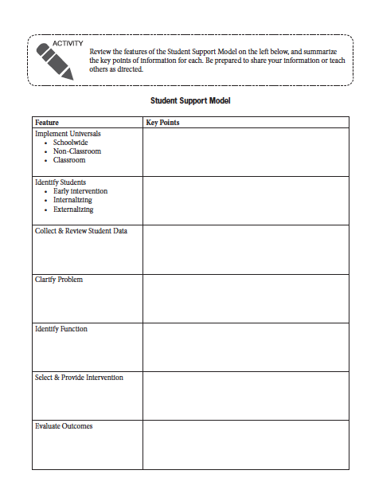

Slide 8
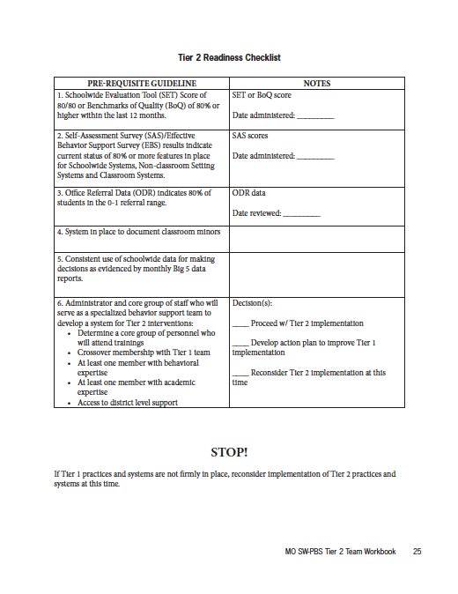

Slide 9
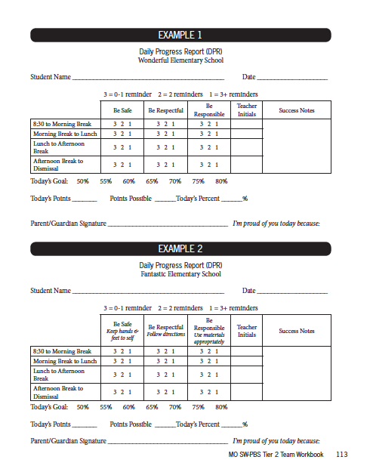

Slide 10
Universal Foundations

Slide 11
School-wide Positive Behavior Support
SW-PBS is a broad range of systemic and individualized strategies for achieving important social and learning outcomes while preventing problem behavior
OSEP Center on PBIS

Slide 12
Designing School-Wide Systems for Student Success
Academic Systems
Behavioral Systems
Intensive, Individual Interventions
Individual Students
Assessment-based
High Intensity
Intensive, Individual Interventions
Individual Students
Assessment-based
Intense, durable procedures
1-5%
1-5%
Targeted Group Interventions
Some students (at-risk)
High efficiency
Rapid response
5-10%
5-10%
Targeted Group Interventions
Some students (at-risk)
High efficiency
Rapid response
Universal Interventions
All students
Preventive, proactive
80-90%
80-90%
Universal Interventions
All settings, all students
Preventive, proactive

Slide 13
Universal
Tier II
Tier III
Continuum of Supports
Math
Science
Spanish
Soc skills
Reading
Horses
Notes:
NOTICE GREEN GOES IS FOR “ALL”

Slide 14
Social Competence &
Academic Achievement
Positive
Behavior
Support
OUTCOMES
Supporting
Decision
Making
Supporting
Staff Behavior
SYSTEMS
DATA
PRACTICES
Supporting
Student Behavior

Slide 15
Universal Strategies: School-Wide
Essential Features
Statement of purpose
Clearly define expected behaviors (Rules)
Procedures for teaching & practicing expected behaviors
Procedures for encouraging expected behaviors
Procedures for discouraging problem behaviors
Procedures for record-keeping and decision making (swis.org)
Family Awareness and Involvement

Slide 16
Benton Elementary
I am…. | All Settings | Classroom | Hallways | Cafeteria | Bathrooms | Playground | Assemblies
Safe | Keep bodies calm in line Report any problems Ask permission to leave any setting | Maintain personal space | Walk Stay to the right on stairs Banisters are for hands | Walk Push in chairs Place trash in trash can | Wash hands with soap and water Keep water in the sink One person per stall | Use equipment for intended purpose Wood chips are for the ground Participate in school approved games only Stay in approved areas Keep body to self | Walk Enter and exit gym in an orderly manner
Respect ful | Treat others the way you want to be treated Be an active listener Follow adult direction(s) Use polite language Help keep the school orderly | Be honest Take care of yourself | Walk quietly so others can continue learning | Eat only your food Use a peaceful voice | Allow for privacy of others Clean up after self | Line up at first signal Invite others who want to join in Enter and exit building peacefully Share materials Use polite language | Be an active listener Applaud appropriately to show appreciation
A Learner | Be an active participant Give full effort Be a team player Do your job | Be a risk taker Be prepared Make good choices | Return to class promptly | Use proper manners Leave when adult excuses | Follow bathroom procedures Return to class promptly | Be a problem solver Learn new games and activities | Raise your hand to share Keep comments and questions on topic

Slide 17
Universal Strategies: Nonclassroom Settings
Identify Setting Specific Behaviors
Develop Teaching Strategies
Develop Practice Opportunities and Consequences
Assess the Physical Characteristics
Establish Setting Routines
Identify Needed Support Structures
Data collection strategies

Slide 18
Universal Strategies: Classroom
Use of school-wide expectations/rules
Effective Classroom Management
Behavior management
Instructional management
Environmental management
Support for teachers who deal with students who display high rates of problem behavior

Slide 20
Readiness

Slide 21
Essential Markers
80% on SET
70% on BoQ
Classroom Universals
Data used at all SW-PBS meetings

Slide 22
Baseline Behavior Data Spring 2008
15% Tier 3
Goal 5%
16% Tier 2
Goal 15%
69% Tier 1
Goal 80%
57 students with 9+ Referrals
6+ Referrals
2-5 Referrals
0-1 Referral
1712 referrals
Notes:
Carrie

Slide 23
Current Behavior Data
2010-2011
16 Students with 9+ Referrals
7% Tier 3
Goal 5%
10% Tier 2
Goal 15%
83% Tier 1
Goal 80%
6+ Referrals
2-5 Referrals
0-1 Referrals
516 Referrals
Notes:
Carrie
Last year, 945 referrals

Slide 24
Stages & Phases
Exploration
Installation
Initial Implementation
Full Implementation
Innovation
Sustainability
Acquisition
Fluency
Maintenance & Generalization

Slide 25
Teams (Data, Practices, Systems)
School-wide PBS
Universals
Connect points to Tier II & III
Tier II (III) (e.g., CARE, SAT, TAT)
Data Decision Rules
Match intervention to need
Classroom Problem Solving
Review data
Develop function-based interventions

Slide 26
Tier II/III Process

Slide 27
Basic Steps
School-wide, including classroom, universals in place
Identify students who need additional supports
Identify what supports student needs
Environment
Intervention
Monitor & evaluate progress

Slide 28
Starting Point
Work within current formal and informal systems
Develop missing steps of efficient process
Provide training and technical assistance to facilitators
Classroom Problem Solving Teams (partnership)
Tier II Team
Guided process with templates for environmental modifications and interventions
Goal = fluency among all faculty and staff

Slide 29
SAT Process
Teacher Training and Support
Targeted Interventions
Individual Student Plans
SAT Team
Administrator
Counselor
Behavior Specialist
Core Team/Classrooms
Implement AIS
Monitor Progress
Refer to SAT
STAT Team
Core Team Representative
SAT Partner
Core Team Teachers
*Meets Weekly
School-Wide Systems
Matrix
Lesson Plans
School-Wide Data
Acknowledgement
Communication
RRKS Team
Core Team Representative
District PBS Support
Building Administrator and Counselors
*Meets Monthly

Slide 30
Tier II/III Support Process
Step 1 – Insure Universals, including Classroom, in place
Step 2 – Student Identification Process
Decision Rules
Referral
Screen
Step 3 – Classroom Problem Solving
Classroom supports (function-based)
Progress monitor
Step 4 - Tier II/III supports
Non-responders to grade level supports
Match function of student behavior to intervention
Progress monitor
Step 5 - Evaluate Process

Slide 31
1. Classroom Universals in place
Review of essential feature
Implementation Plan

Slide 32
Essential
Classroom expectations & rules defined and taught (all use school-wide, create classroom examples)
Procedures & routines defined and taught
Continuum of strategies to acknowledge appropriate behavior in place and used with high frequency (4:1)
Continuum of strategies to respond to inappropriate behavior in place and used per established school-wide procedure
Students are actively supervised (pre-corrects and positive feedback)
Students are given multiple opportunities to respond (OTR) to promote high rates of academic engagement
Activity sequence promotes optimal instruction time and student engaged time
Instruction is differentiated based on student need

Slide 33
Systems
Teach
Brief in-service, single topic focus
Practice (performance feedback)
Peer coaching
Principal “walk throughs”
Notes:
33

Slide 34
Effective Classroom Practices: Mini Modules
MO SW-PBS
pbismissouri.org
Center for PBS
College of Education
University of Missouri

Slide 35
Typical School Day
17% Direct Instruction
33% Seatwork
20% Transitions
30% Discipline & Other Non-Instructional Activities
Cotton, 1995; Walberg, 1988
MO SW-PBS
324
Notes:
Note to Presenter: See page 324 in the MO SW-PBS 2012-13 Team Workbook for further explanation of academic learning time.
When the amount of time spent in various classroom activities was researched only 17% was spent in instruction and 33% in seatwork.
Transitions take 20% of the school day. The typical elementary classroom loses 7-10 minutes each transition from one subject to another; with a typical day including at least 10 transitions, 70 minutes are lost each day; almost one day per week lost to transitions alone.
Unfortunately discipline and other non-instructional activities such as taking attendance, announcements, etc, accounted for 30% of the school day.
Think about your typical day and the time you spend in various activities. How does it compare to these statistics?
Why is this information relevant to us? (discipline takes away from time to teach academic curriculum)
Conclusion: We want to implement effective classroom practices to prevent and decrease interruptions caused by discipline problems and increase the amount of time we have to teach.

Slide 36
Discussion: Importance of expectations & behaviors?
Pair Up
2-Minute Frenzy – Discuss:
How has clarifying schoolwide/non-classroom setting behaviors/rules impacted student behavior in our school?
Why do you think it is important to clarify classroom behaviors/rules?
Notes:
Take 2 minutes and talk to someone near you.
Discuss the impact of schoolwide and non-classroom behaviors/rules in your building.
Talk about how this relates to classroom behaviors/rules.

Slide 37
Guidelines for Writing Classroom Behaviors or Rules
Consistent with school-wide expectations
O = Observable; behaviors that we can see.
M = Measureable–we could actually count the occurrence of the behavior.
P = Positively stated–things to do to be successful.
U = Understandable–student-friendly language.
A = Always applicable.
MO SW-PBS
93
Notes:
Classroom expectations and behaviors or rules must be consistent with schoolwide expectations and rules. School rules are in effect in the classroom. What we identify as classroom rules are additional, extra or specific to the classroom setting – anything not already covered by the schoolwide rules that you want in effect in your classroom.
To enhance the effectiveness of classroom behaviors/rules, 5 guidelines need to be considered.
Classroom rules need to be written in observable measurable terms. Observable means, “I can see it”
Classroom behaviors/rules also need to be written in Measurable terms. Measurable means, “I can count it”
Third, just as we do with schoolwide and non-classroom behavior/rules… classroom rules should be positively stated. Positively stated rules encourage the desired behavior. This means telling students what we want them TO do.
Fourth, classroom rules need to be understandable. Rules are stated so students clearly understand what is meant. Vocabulary should be consistent with student’s grade and/or ability level (ie “use school appropriate language” might be ok at the middle school level, but perhaps is not understandable for a kindergarten classroom)
The last guideline for writing classroom rules is…Always applicable. Rules should be based on problems which typically occur and they should not vary or change within the same setting.

Slide 38
Activity: Classroom Rule Writing Activity Option 1
List problem behaviors in your classroom
List replacement behavior (what we want kids to do instead)
List schoolwide expectations
Categorize rules within schoolwide expectations
Notes:
This activity is for schools who have NOT identified classroom expectations/rules as a column on their matrix. If your school has not addressed classroom rules in any way, you should do this activity… You will need two handouts: 1) Rules Writing Worksheet Example 2) Rules Writing Activity Classroom Rules Worksheet
If your school has identified CLASSROOM expectations/rules that apply to all classrooms in the building, then you will skip Activity Option 1 and complete Activity Option 2 instead.
For Activity Option 1…
First, look at handout Rules Writing Worksheet Example. This can be used as an example while you complete your own rules on handout entitled Rules Writing Activity Classroom Rules Worksheet
Next, using handout Rules Writing Activity Classroom Rules Worksheet, list your schoolwide expectations (safe, respectful, ready)
Then list problem behaviors in your classroom. The behaviors that take time away from learning.
After you have listed problem behaviors, identify the replacement behaviors or what you want students to do instead of the problem behavior.
Remember the guidelines we shared earlier,
Observable
Measureable
Positively stated
Understandable
Always applicable – Something the teacher will consistently enforce
Finally, categorize your replacement behaviors/positively stated rules into your schoolwide expectations. It is important to make that connection.
Give participants 15 - 20 minutes to work on this activity. Discuss when finished.

Slide 41
2. Identifying students
Current data
Confidence in numbers
Consistency across data points
Teacher Referral
Screening
Approximately 10% of total students

Slide 42
Data Decision Rules
Office Discipline Referral (ODR)
Major
Minor
Time out of Instruction
Buddy Room
Safe Seats
“Discipline” Room

Slide 43
RRKS TOC (front side)
RRKS – Time Out of Class Code: _____
Student: _________________________ Date:______________________
Incident Time: ____________________# of min. out of rm.: __________
Teacher: _______________________Subject: ____________________
What did you do/not do that got you sent out of class? ________________________________________________________________________________________________________________________
Circle the RRKS expectation that was not followed:
Respect Responsible Kind Safe
What will you do differently next time?______________________________________

Slide 44
RRKS TOC (back side)
Processing Checklist:
Processing data & time:
Review with the student reason he/she was sent out.
Teach & practice replacement behavior.
Provide positive reinforcement for replacement behavior.
Check the setting in which the behavior occurred.
Whole group instruction
Small group instruction
Individual work
Working with peers
Alone
1-on-1 instruction
Interacting with peers
Other: Please identify below
Minor List: Circle the appropriate code
(MDD) Defiance/Disrespect/Non-compliance | (MDS) Disruption | (MI) Inappropriate Verbal Language
( MO) Other | (MPC) Phys. Contact | (MP) Property Misuse

Slide 45
Other Strategies to Identify Students
Teacher Referral
Questions to discuss:
Who completes
When
What data must be used/cited
Focus on externalizing and internalizing
Screening
What instrument
Schedule

Slide 47
3. Tier II Supports
Students who do not respond to classroom / informal supports (grade level 2-3 weeks)
Student brought to Tier II Team
Based on function of problem behavior and response to classroom supports, match student to Tier II intervention

Slide 48
Tier II Supports
Centralized
Each has a coordinator
Placed in support by Tier II Team
Classroom supports continued / modified
ALL in building aware of their role in supporting students in Tier II Supports

Slide 49
Tier II Supports
Check in / Check Out
Social Skill Groups
Academic Supports

Slide 50
The Behavior Education Program (BEP): A Daily Check-in/Check-out Intervention (CICO)
Crone, Hawken, & Horner, 2010
The Guilford Press

Slide 51
Crone, D. A., Hawken, L. S. & Horner, R. H. (2010). Responding to Problem Behavior in Schools: The Behavior Education Program. New York: Guilford Press.

Slide 52
Check-in/Check-out
Pages 102-103 of your workbook provide an overview of the CICO intervention.
Read these pages then, with your team, discuss how the CICO process is similar to strategies your school already uses.

Slide 53
Check-In/Check-Out
Basic Cycle
Morning check-in (Get Daily Progress Report)
Regular teacher feedback throughout day
End of day check-out
Tally and record points
Receive recognition
Data collection & progress monitoring
Take DPR home & return signed copy

Slide 55
Which Students Will Benefit?
Continue to display problems after Tier 1 supports in place, but don’t require immediate individualized support
Demonstrate behavior patterns across multiple settings
Students in the 2-5 office referral range
Low level disruptions
Talk out, Unprepared, Talk back, Non-compliant

Slide 56
Which Students Will Benefit?
Attention maintained behavior
Willingness to participate
Students with more intense problems may benefit, but will need additional supports!
violent, aggressive or dangerous

Slide 57
What Resources Are Needed?
CICO Coordinator
Oversees facilitators
Manages resources
May have limited contact with students
Facilitators
Provide daily check-in and check-out with students
Maintain student records & data
May serve as many as 10-15 children

Slide 58
Video Example

Slide 59
What Resources Are Needed?
CICO Coordinator
Facilitator A
Student 1
Student 2
Facilitator B
Student 3
Student 4

Slide 60
What Resources Are Needed?
Recommended Roster Limits
No more than 30 students per facilitator at the secondary level
middle, junior high, high school
Approximately 15-20 students per facilitator at the elementary level.
(See Crone, Hawken, & Horner, 2010, p. 92)

Slide 61
Resources Needed
Page 108 of your workbook provides a chart of estimated time for coordinator & facilitator tasks.
Review this page then, with your team, discuss the possible benefits of investing time and resources for this intervention.

Slide 62
Check-In/Check-Out
Research supported practice
Decreases problem behavior
Effective for 60-75% of second tier, at-risk students
Schools can successfully implement
Less effective for students who do not find adult attention reinforcing
Use of Functional Behavior Assessment can enhance success
(Crone, Hawken & Horner, 2010, p. 11)

Slide 63
Social Skills Intervention Group
Definitions & Best Practice

Slide 64
Example Manuals

Slide 65
Social Skills Intervention
Page 167 of your workbook provides an overview of a Social Skills Intervention.
Read these pages then, with your team, discuss how the Social Skills Intervention is similar to strategies your school already uses.

Slide 66
Reasons for Social Skill Deficits
Lack of knowledge
Lack of practice
Lack of cues
Lack of reinforcement
Presence of competing problem behaviors
(Elliott and Gresham, 2008)
Notes:
There are a variety of reasons why students may demonstrate a social skill deficit….

Slide 67
Preparation Phase
Identify Common Deficits
Gather Lessons
Plan for Generalization & Maintenance
Establish Session Procedures

Slide 68
Plan Generalization & Maintenance
Steps for implementation of CW-FIT –
Class-wide Function-Based Intervention Teams
Positive Peer Reporting (PPR)
Tootling

Slide 69
Plan Generalization & Maintenance
Class-wide Function Based Intervention Teams (CW-FIT)
Positive Peer Reporting (PPR)
Tootling

Slide 70
Implementation Phase
Notify Participants
Teach Skill Lessons
Monitor Progress
Evaluate Outcomes

Slide 71
Instructional Approach
Tell = Coaching
Show = Modeling
Do =
Role Play
Practice = Rehearsal
Monitor Progress =
Generalize & Maintain

Slide 72
Check & Connect A Student Engagement Intervention
University of Minnesota
Institute on Community Integration

Slide 73
Intervention Manual - 2012

Slide 74
Check & Connect
Pages 211-213 of your workbook provide an overview of the Check & Connect intervention.
Read these pages then, with your team, discuss how the Check & Connect process is similar to strategies your school already uses.

Slide 75
What is Check & Connect
Descriptive Characteristics
Targeted (tier 2) or intensive (tier 3) intervention
A structured mentoring intervention
Empirically supported
Clearly delineated elements

Slide 76
What is Check & Connect?
Four components =
A mentor who works with students and families for a minimum of 2 years,
Regular “checks” using school data
Timely and individualized intervention - “connect”
Engagement with families
Notes:
Check & Connect consists of 4 components (guiding principles):
A mentor works with students and partners with families for a minimum of two years,
regularly checking on the educational progress of the student,
intervening in a timely manner to reestablish and maintain the student’s connection to school and learning and to enhance the student’s social and academic competencies (C & C Manual, 2008, p. 1)

Slide 77
What is Check & Connect?
Three Core Elements (fundamental principles)
Relationships
Focus on alterable variables
Personalized, data-based intervention
Long-term commitment
Participation in and affiliation with school
Problem solving & capacity building
Persistence-Plus

Slide 78
All Students Get
“Check”
Systematic Data Collection & Recording
All Students Get
“Connect”
Basic
Intensive
Share “check” data
Provide feedback
Discuss Importance of school
Teach Problem solving
Basic + Individualized, additional supports determined by need.

Slide 79
Resources Needed
Coordinator
Mentor 1
Student A
Student B
Mentor 2
Student C
Student D
Mentor 3
Student E
Student F

Slide 80
Video Example
Center for Adolescent Research in Schools (CARS) – training video

Slide 81
Resources
*Institute on Community Integration
University of Minnesota
Web = http://ici.umn.edu/checkandconnect
Publications = Check & Connect: A comprehensive student engagement intervention (manual; cost is $50)

Slide 82
First Step to Success Helping Young Children Overcome Antisocial Behavior
Walker, Golly, Severson, Kavanaugh, Stiller, & Feil,

Slide 83
First Step Description
Early intervention program designed to help children who are at risk for developing aggressive or antisocial behavioral patterns.
Uses a trained behavior coach who works with each student and his or her class peers, teacher, and parents for approximately 50 to 60 hours over a three-month period.

Slide 84
First Step Description
Includes three interconnected modules:
Screening to identify candidates
Classroom intervention
Parent training

Slide 85
First Step Components
Universal Screening and Early Detection:
Screening may be conducted in four ways
teacher nominations, teacher rankings and rating scales, or direct observations
The students who are most at-risk for behavior problems and anti-social behavior are given the intervention.

Slide 86
First Step Components
School Intervention:
The student(s) are taught prosocial behaviors that serve as replacements for problem behavior
individualized instruction, behavioral rehearsal, role-play, and activity-based performance incentives.
Incentives are provided for the First Step student and the class.
Visual prompts (a green/red card) provide feedback to the student on appropriate and inappropriate behaviors.

Slide 87
First Step Components
Home Base Parent Training:
Parents are given lessons and parent-child activities that build child competencies in six key areas that affect school performance and adjustment.
Parents give the child reinforcement for appropriate school performance as reported by the teacher and/or coach.

Slide 88
Video Example
Hill Walker, Ph.D.

Slide 89
Intervention Materials
Starter Kit includes:
Implementation Guide (126 pages)
Home Base Consultant Guide (186 pages)
Home Base Parent Handbooks (84 pages, 3 copies)
3 parent boxes
Overview video
Red/green point cards
Parent help and activity cards
Timer and stickers
Resupply Kit includes materials for one additional implementation.

Slide 90
First Step Research
What Works Clearinghouse
http://ies.ed.gov/ncee/wwc/interventionreport.aspx?sid=179
OSEP Technical Assistance Center of PBIS
http://www.pbis.org/research/secondary/first_steps_to_success.aspx

Slide 91
Select Function-Based Intervention
Advanced Tier Data Spreadsheet
Used for information entry and storage
Graph of student results
Free!
Available on flash-drive or www.pbismissouri.org

Slide 92
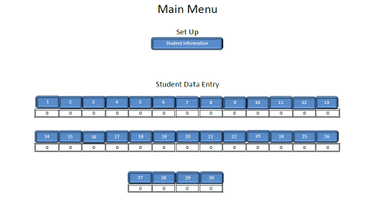
Select Function-Based Intervention

Slide 93
Select Function-Based Intervention
Main Menu > Set Up > Student Information
Name, Date, Method of ID, Grade
Gender, Ethnicity, Race, IEP
ODR, Minor, Absence, Tardy
Academic Performance Level, GPA
Access to Tier 1 (taught & recognized)
Problem Behavior, Possible Function
Interventions selected & Goal

Slide 94
Select Function-Based Intervention
Using the Advanced Tier Data Spreadsheet
Show & practice
www.pbismissouri.org

Slide 95
Interpreting Student Data

Slide 96
4. Monitor Student Progress and Evaluate Process
Original data sources that lead to student identification
ODR
Attendance
Academics
“time out of class”
Teacher perception
Key = frequent and regular
Celebrate success
Adjust if student doesn’t respond (or problems start reappearing)
Cost –Benefit Analysis of overall process

Slide 101
Benchmarks for Advanced Tiers (BAT)
Allows teams to self-assess implementation status of Tier 2 & Tier 3 behavior support systems within their school.
Notes:
The BAT is basically your progress monitoring instrument that your team will use to self-assess your implementation of Tier 2 and (eventually) Tier 3 supports.

Slide 102
Benchmarks for Advanced Tiers (BAT)
Designed to answer 3 questions:
Are foundational (organizational) elements for implementing Tier 2 & Tier 3 behavior support practices in place?
Is a Tier 2 support system in place?
Is a Tier 3 support system in place?
Notes:
These questions will be answered by the BAT.

Slide 103
Using the BAT Results
The BAT assesses progress over time, as scores on each area can be tracked on a year-to-year basis.
School teams should use the BAT to build an action plan that defines next steps in the implementation process.
MO SW-PBS Tier 2 and Tier 3 outcomes and action plans are based on the BAT.
Notes:
This fall, your team will take the BAT for the first time. This will be your baseline data for Tier 2 implementation. As you take the BAT additional times, you will always compare to see if growth is occurring.
Note that the outcomes and action plans for Tiers 2 and 3 are aligned with the BAT.

Slide 104
BAT Scales & Subscales
Foundations
A. Tier 1 Implementation of SWPBS
Tier 2 and 3 Foundations
B. Commitment
C. Student Identification
D. Monitoring & Evaluation
Tier 2 Targeted or Small Group Interventions
E. Tier 2 Support System
F. Main Tier 2 Strategy Implementation
G. Main Tier 2 Strategy Monitoring & Evaluation

Slide 105
BAT Scales & Subscales
Tier 3 Intensive Interventions
H. Tier 3 Support System
I. Tier 3 Assessment & Plan Development
J. Tier 3 Monitoring & Evaluation
Additional Intervention
Tier 2 Strategy Implementation
Tier 2 Strategy Monitoring & Evaluation

Slide 106
Instructions for Completing BAT
Who: The team(s) or individuals involved with Tiers 2 and 3 behavior support
Before starting the first administration, read through the items to determine who on campus will be likely to have knowledge of the topic(s).
If there is not currently a team in place, the BAT should be completed by individuals with the most knowledge and involvement in supports at Tier 2 and Tier 3.
Notes:
Now that you are familiar with the BAT, we are going to give you instructions for completing it.

Slide 107
Instructions for Completing BAT
How: As a group or each member independently.
Team (or individuals involved with Tiers 2 and 3 behavior support) must reach consensus on the score for each item.
If completed independently, the team reconvenes to review scores on each item.

Slide 108
Instructions for Completing BAT
Scoring: After reviewing the rubric for each item, select the score that most closely matches the current level of implementation at the school
Rate each item as …
“2” fully in place,
“1” partially in place, or
“0” not yet started.

Slide 109
Instructions for Completing BAT
When:
This year, you will take the BAT two times:
Today and again by April 15
Enter the BAT Results into PBIS Assessments
Notes:
Consultants – emphasize the information on this slide.

Slide 110
Entry into PBIS Assessments
Three Reports are Generated:
Total Score Report
Subscale Results Report
Individual Items Report

Slide 111
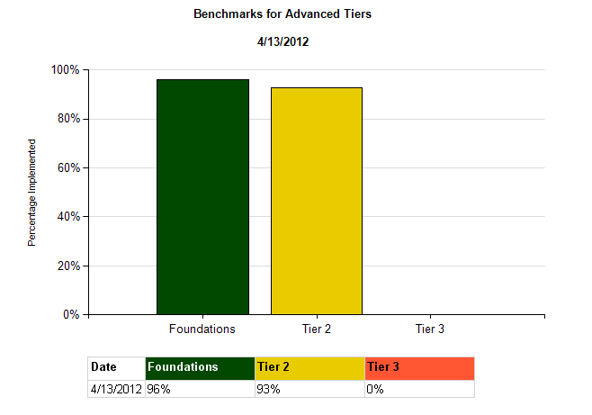
Total Score Report

Slide 112
Subscale Report

Slide 113
Individual Item Report

