Slide 1
Violence Against Children:
Child Abuse and Human Trafficking
Safety and Violence Prevention Curriculum
Notes:
Thank you for coming, and welcome to Module Four, the final module in the Safety and Violence Prevention curriculum. The purpose for today’s training is to help you identify incidents of violence against children and make appropriate referrals in such cases. Specifically, we will discuss how to recognize and intervene in incidents of child abuse and human trafficking behaviors.
Remember that you are not being asked to provide therapeutic interventions for the students involved – we hope you will be able to let the students know that you notice them and that you care, and that you will be able to refer the students involved to the professionals who are trained to provide interventions.

Slide 2

Barriers to Learning
Notes:
This module will cover topics that relate to violence against children. Specifically, it will cover recognizing and intervening in incidents of child abuse behaviors and human trafficking. While these are very broad topics and each deserves its own separate training, the top issues of importance for each are highlighted in this module.
Child abuse and human trafficking share some characteristics: each happen frequently and represent serious barriers to learning for young people. Whether a student is a target of violence by adults or by other students, the impact on the student’s life, and his or her learning, can be profound. For some young people, being a target of violence can result in other mental health issues such as depression, substance use, post-traumatic stress disorder, hyper-vigilance, self-injurious behaviors and suicide as addressed in Modules two and three. Other young people who are targets of violence can become aggressive, abusive and violent toward others. School professionals can interrupt the destructive cycle of violence through proactive referrals.

Slide 3

Recognize, Reach Out and Refer
Child abuse manifests in various behaviors
Notes:
It is important to recognize, reach out and refer before problems can escalate to life-altering levels, such as suicide, violent attacks, abduction or murder. Noticing behavior that isolates the target is critically important for school professionals, who are mandated by law to report suspected child abuse. In many cases, students living with abuse have been conditioned by their abusers, to believe that no one can help them; school professionals may be their only hope.
(REVIEW THE TYPES OF CHILD MALTREATMENT)
Child abuse is an extremely serious topic and one that many educators will address at some point throughout their careers. With 5 to 25 percent of students experiencing some type of abuse or neglect each year (Kalichman, 1999), teachers are often the de facto reporters of child abuse suspicions. School professionals are at times in a position to identify and report such abuse.
However, several barriers to reporting do exist. School personnel may struggle with what constitutes abuse, with personal reactions to learning of a young child’s abuse, with unclear guidelines for reporting the alleged abuse, and with fear regarding the outcome of reporting. These barriers pose a threat to today’s youth, many of whom are at risk for neglect and abuse.
Child abuse also manifests in various behaviors affecting a child, including neglect (neglect of physical, emotional or educational needs), verbal and emotional abuse (calling the child names or disparaging the child), physical abuse (including slapping, kicking and hitting that goes beyond normally accepted parameters of discipline), and sexual abuse (involving the abuser’s sexual gratification gained as a result of contact).

Slide 4

Reports of Child Abuse
Notes:
Nearly 3.3 million reports were made to child protective services in 2010, with one fifth of those substantiated cases of child abuse or neglect.
Ohio is ranked 30th in the rate of child maltreatment in the United States, with 12.4 children out of 1,000 as subjects of abuse. Pennsylvania is ranked 1st with 1.2 children out of 1,000 as subjects of abuse and the District of Columbia is ranked last with 24.0 per 1,000 as subjects of abuse.
Child abuse is related to many other mental, emotional and behavioral disorders. Children who are abused or neglected are more likely to be arrested, commit violent crimes and to be arrested as adults.

Slide 5
Abuse Cases
Neglect
Physical Abuse
Sexual Abuse
Psychological Maltreatment
Notes:
The majority of these cases were neglect (78.3 percent), followed by physical abuse (17.6 percent), sexual abuse (9.2 percent) and psychological maltreatment (8.1). Additionally, in the United States, approximately five children die each day due to child maltreatment. Children are most vulnerable to sexual abuse between the ages of 8 and 12 (Finkelhor, 1994), with the average age for first abuse at 9.9 years for boys and 9.6 years for girls (U.S. Department of Education, 1994).

Slide 6
Child Abuse and Treatment Act
Mandates school personnel and other professionals report child abuse
Notes:
In response to the need for child advocacy, Congress passed the Child Abuse and Treatment Act in 1974. This law mandated that school personnel and other professionals report child abuse. Since that time, all state legislatures have incorporated laws requiring the reporting of abuse and neglect. Child abuse laws state that these reports do not require absolute proof of abuse; rather, they must reflect reasonable cause for suspecting or believing it has occurred (Finlayson and Koocher, 1991).

Slide 7
Sources of Reports
Education Personnel
Legal and Law Enforcement
Social Services Staff
Medical Personnel
Notes:
Such laws seem to have resulted in increased reporting, particularly by school personnel. In Federal Fiscal Year 2010, three-fifths (58.6 percent) of all reports of alleged child abuse or neglect were made by professionals. The most common report sources were education personnel (16.4 percent), legal and law enforcement personnel (16.7 percent), social services staff (11.5 percent), and medical personnel (8.2 percent). Professionals have submitted more than one-half of all reports for the past 5 years, and that percentage has increased slightly each year since 2006 (U.S. Department of Health and Human Services, 2010).

Slide 8

National Incidence Study of Child Abuse and Neglect
Public schools report more cases of child abuse and neglect than any other institution
Notes:
The Fourth National Incidence Study of Child Abuse and Neglect (NIS-4) (Sedlak, McPherson and Das 2010) showed that public schools report more cases of child abuse and neglect than any other institution (52%). These findings reflect the central role school professionals play in identifying children who are abused and neglected. Educators play a unique role because they have access to children and expertise in child development. Providing educators with the tools to identify reach out and refer in cases of abuse and neglect can help prevent or minimize the damaging effects of these violent behaviors (Randolph and Gold, 1994; Sedlak, McPherson and Das, 2010).

Slide 9
Emotional Difficulties
Many survivors blame themselves for the abuse, or blame others for not seeing or stopping the abuse.
Notes:
Additionally, survivors of child abuse often go on to develop other emotional difficulties. Many survivors tend to blame themselves for the abuse, or blame others for not seeing or stopping the abuse. They experience varying symptoms as a result.

Slide 10

Child Abuse
Notes:
Child sexual abuse is a type of abuse that is much more difficult to identify and is often very difficult for us to talk about. Here are some examples of child sexual abuse.
Child sexual abuse occurs more often than we might imagine. It is estimated that up to 20 percent of female children and up to 12 percent of male children are sexually abused before age 18.
The statistics on child sexual abuse are very difficult to interpret due to the extremely low reporting rates of sexual abuse. We do know, however, that girls are more likely to be sexually abused than boys and that the vast majority of sexual abuse occurs between people who know and often trust one another. For children, this is usually a family member or close family friend.

Slide 11

Talking About Abuse
Notes:
A factor that can complicate the accurate identification of abuse is the student’s developmental level. Elementary students, in particular, may have difficulty verbalizing what has happened and naming the person who is abusing them. This inability to communicate abuse can occur despite clear indications that abuse is taking place, often due to the intense and complex relationship that the child likely has with the perpetrator.
An additional reason that child sexual abuse is often unaddressed is that children have difficulty talking about being sexually abused and often feel embarrassed, guilty, or responsible for the abuse. Unfortunately, sometimes adults can reinforce these feelings in children. Research indicates that educators have more difficulty believing a victim of sexual abuse when there is no apparent physical evidence and when the victim is female and over age 10.
Because educators see children often and have relationships with them, their interactions can positively affect whether or not a child discloses abuse. Despite reports that many teachers feel burdened by student mental health and emotional needs, teachers are able to identify students who are likely to benefit from mental health services.

Slide 12
Warning Signs
Anxiety
Depressed Mood
Eating Disorders
Substance Abuse
Notes:
You might notice indicators such as anxiety, depressed mood, eating disorders and substance abuse among students who have been abused. As you can see, child abuse is highly related to all the other topics discussed in this curriculum.
Survivors of sexual violence may display an awareness of sexuality that is not appropriate for their age and sexualized behaviors that are not developmentally or socially appropriate.
These children are also vulnerable to further sexual exploitation, including being forced into commercial sex acts. According to federal law, any minor involved in such exploitation is a victim of a sex trafficking crime.

Slide 13
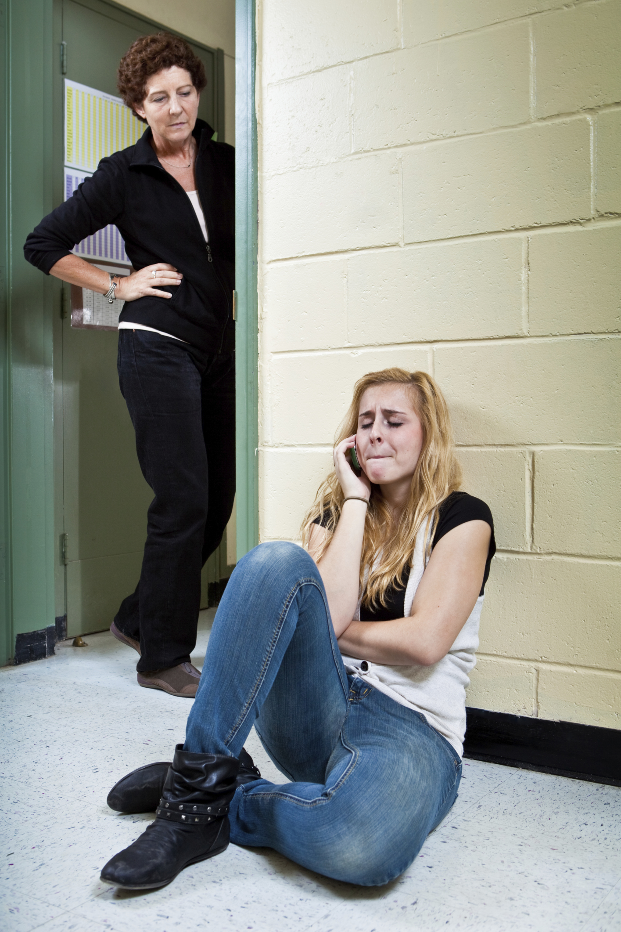
Educators are Mandated Reporters
Notes:
As an educator in the state of Ohio, you are a mandated reporter of suspected child abuse. According to the Ohio Revised Code, you must report knowledge or suspicion of child abuse to your local child protective services agency. Such reports, which can be made anonymously, should be made following your school district’s policies and procedures.
Note that a March 2007 amendment to the Ohio Revised Code states that an educator’s failure to report suspicion of child abuse is a first- degree misdemeanor, punishable by up to six months in prison and up to a $1,000 fine.

Slide 14
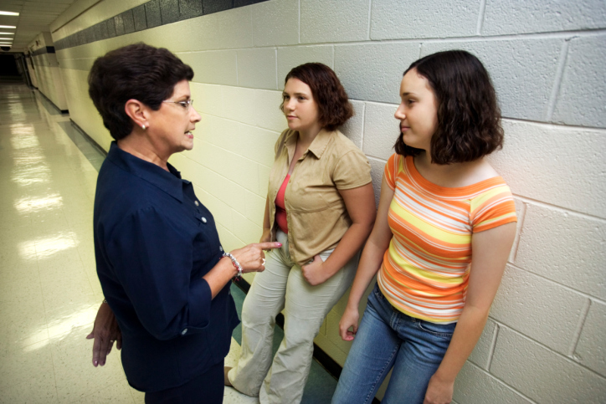
Local Policy
Notes:
Your school district has a policy on how to handle child abuse allegations.
(PASS OUT AND DISCUSS POLICY, INCLUDING THE INFORMATION FOR THE LOCAL CHILD PROTECTIVE SERVICES AGENCY)
When an actual report is made to child protective services, you should call the agency and make as complete a report as possible. You should document the conversation and ensure that the intake coordinator got all of your information.

Slide 15
Intervention Programs
Work with students who have been targets of violence
Students may have difficulty in school and with social interactions
Notes:
In addition to working with students who are presently targeted by violence, you may also work with students who have previously been hurt or abused. These students may display a variety of behaviors and can have difficulty in school and with social interactions.
There are intervention and assistance programs at our school to help such students.
(GIVE INFORMATION HERE ABOUT SCHOOL INTERVENTION ASSISTANCE TEAMS.)

Slide 16
Additional Resources
Ohio Children’s Trust Fund
County children services agency
Notes:
The Ohio Children’s Trust Fund is the Ohio Chapter of Prevent Child Abuse America. Their website contains many resources on what to do if you suspect child abuse or neglect and how to work with children and families to prevent abuse from occurring.
Each county children services agency also has many resources on reporting and preventing child abuse and neglect. According to the Fourth National Incidence Study of Child Abuse and Neglect (NIS-4), better working relationships should be forged between CPS agencies and schools. As a result, facilitators are encouraged to reach out to their local CPS agency.

Slide 17
Human Trafficking
All states have reported cases
Ohio: 50 reported cases in past 9 years with 1,078 U.S. born Ohio youth trafficked in 2011
Notes:
Human trafficking is the recruitment, harboring, provision, or obtaining of a person for the purpose of a commercial sex act, in which a commercial sex act is induced by force, fraud, or coercion and the person forced to perform such an act is under the age of 18 years.
All 50 states have reported cases of human trafficking
200,000 people have been trafficked in the U.S. with an estimated 100,000 children involved in sex trafficking.
In Ohio 50 cases have been reported in past 9 years with 1,078 U.S. born Ohio youth sex trafficked in 2011.

Slide 18

Youth Runaways
Notes:
The work or services may include anything from bonded or forced labor to commercialized sexual exploitation.
Studies suggest that up to 90% of runaway youth become involved in the commercial sex industry.
There are currently about 700 to 800 active missing children cases in Ohio, and about 90% are runaways.
On average, there are 19,000 to 20,000 missing children reports per year in Ohio, with about 90% as runaways. (Missing Persons Unit, Ohio Bureau of Criminal Investigation)

Slide 19
Human Trafficking Dynamic
Seller
Buyer
Victim
Notes:
In the business of human trafficking there is the seller, the buyer and the product or victim.
The sellers or trafficker are men and women from all walks of life.
The seller could be an individual or an organized criminal syndicate that has predatory romantic involvement with the victim.
The seller offers seemingly legitimate work opportunities for food, housing, clothes, and drugs in exchange for sex.
The buyers or Johns also come from all walks of life.
The buyers feel as if they own the victim they purchase and subject them to painful, abusive fantasies.
The buyers and sellers drive the sex trade and profit from the demand for commercial sex.

Slide 20
Human Trafficking Victim
Runaway or homeless
Do not think they are a victim
Do not trust social services, law enforcement
Notes:
Components of the Business – The Victim
The victim has typically run away or is homeless.
Most minor victims “willingly” go with their trafficker or seller.
Many minor victims do not think they are a victim and learn not to trust social services, law enforcement, etc.
Online solicitation is increasing with the use of social media and commercial sex websites.
Components of the Business – The Victim
The average age that a person first enters into the commercial sex industry is 12-14.
Victims of human trafficking are not permitted to leave upon arrival at their destination.
They are held against their will through acts of coercion and forced to work or provide services to the trafficker or others.

Slide 21
Factors Associated with Human Trafficking of Minors
Gang membership
Large amounts of cash
Unexplained absences
Notes:
Presence of pre-existing adult prostitution markets in communities where large numbers of street youth are concentrated.
Prior history of child sexual abuse and child sexual assault.
Large numbers of unattached and transient males.
Membership in gangs, runaways and homeless youth
Recruitment by organized crime groups.
Possesses large amounts of cash and hotel room keys.
Has unexplained school absences and is unable to attend school regularly.
looks like a minor, while claiming to be adult
has indicators of being “branded” (e.g., having a tattoo).
lies about her/his age and/or possesses false identification
tells life stories with inconsistencies
has little knowledge of his/her community or where he/she is

Slide 22
Factors Associated with Human Trafficking of Minors
Involved with abusive or controlling partner
Signs of physical abuse and/or injury
Engaged in scripted communication
Fearful or anxious demeanor
Notes:
Factors associated with human trafficking of minors are:
Minor is involved with abusive or controlling partner/”boyfriend”
Minor has signs of physical abuse and/or injury
Minor appears to be engaging in scripted communication
Minor has fearful or anxious demeanor
Minor appears hungry and/or malnourished
Minor wears clothing that is not appropriate based on season or weather
Minor appears addicted to drugs
Minor shows shift in behavior, dress, or belongings, such as sudden possession of expensive items

Slide 23
Factors Associated with Human Trafficking of Minors
No control over own schedule and ID forms
Talks about sexual activities that exceed
age-group norms
Involved with “boyfriend” who is 10 or more years older
Notes:
Factors associated with human trafficking of minors are:
does not have control over his/her own schedule
does not have control over his/her ID forms
Minor talks about sexual activities that exceed age-group norms
Minor is involved with “boyfriend” who is 10 or more years older than potential victim

Slide 24

Solutions
Notes:
Parents, educators and community members should model healthy relationships and create environments that counter risk factors.
To prevent minors from participating in human trafficking, educators can draw on local violence prevention agencies to access effective prevention programs and best practices.

Slide 25

Resources
Notes:
Adults can contact their local coalition or violence prevention organization to have a speaker talk with students about avoiding the exploitation and violence against minors.
To intervene and report human trafficking of minors, adults can contact their local law enforcement, county children services, local Rescue & Restore Coalition and the National Human Trafficking Resource Center at 1-888-373-7888.
Call 911 (if in immediate danger).
So is referring all you can do? No. There are school wide efforts to ensure schools are safe places – places where kids who are depressed or suicidal get help, where kids who are using alcohol and drugs are noticed, and where bullies, their targets, and children living in abusive homes are helped. This is the kind of school our children deserve and that we can all work to achieve. We hope that you will work with your school improvement team, or school climate committee, to create schools like this.
We have talked about many important issues that affect our students among the non-academic barriers to learning, including depression, suicide, violence, and substance use and abuse. It is important to recognize the inter-connectedness of these topics and ultimately know what to do if you believe that a student is experiencing any of these emotional, behavioral or mental health issues. While you may not feel like an expert on each topic, the most important thing you can do is to recognize in students the signs and symptoms of distress, reach out to them, tell them you care and make the appropriate referral so that they can get the help they need to be successful in school and in life.
To intervene and report child abuse of minors, adults can contact their county job and family services or The Ohio Department of Job and Family Services has launched 855-O-H-CHILD (855-642-4453), an automated telephone directory that will link callers directly to a child welfare or law enforcement office in their county.
As an additional state resource, Ohio Children's Trust Fund (OCTF) is Ohio's sole, dedicated public funding source for child abuse and neglect prevention, OCTF is in the forefront of prevention activities throughout the state. From establishing guidelines for program development to accessing up-to-date prevention curricula to producing educational and public awareness materials – to impacting related social policy initiatives, OCTF provides expertise and resources for legislators, the media, state agencies, and the public. http://jfs.ohio.gov/OCTF/Index.stm
To intervene and report human trafficking of minors, adults can contact their local law enforcement, county children services, local Rescue & Restore Coalition, Ohio Department of Public Safety, Office of Criminal Justice Services, Anti-Trafficking Coordinator at 614.995.7986 or the Office and the National Human Trafficking Resource Center at 1-888-373-7888.

Slide 26

education.ohio.gov

Slide 27





Social Media
Ohio Families and Education
Ohio Teachers’ Homeroom
ohio-department-of-education
storify.com/ohioEdDept
@OHEducation
OhioEdDept

