Slide 1
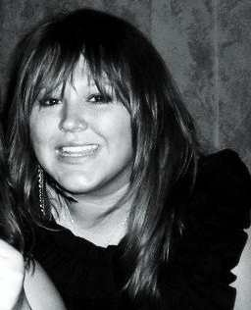
Welcome to the Webinar: What is Human Trafficking? A live webinar for students in Ohio.
To hear the webinar, dial 1-866-551-1530 and enter the Participant Code – 3079470#
Please mute your phone by using *1 or the mute function on your phone. Questions may be submitted via the ‘Chat Box.’ If you have technical difficulty during the webinar, please contact Arkadin (webinar provider) at 1-866-427-5234 or custsvc.us@arkadin.com.
Today’s Presenters
Anthony Talbott Political Science / Human Rights, University of Dayton AbolitionOhio – The Rescue and Restore Coalition in the Miami Valley
Rachel Adkins, MSW, LSW Anti-Human Trafficking Education Specialist, The Salvation Army & The Central Ohio Rescue and Restore Coalition

Slide 2
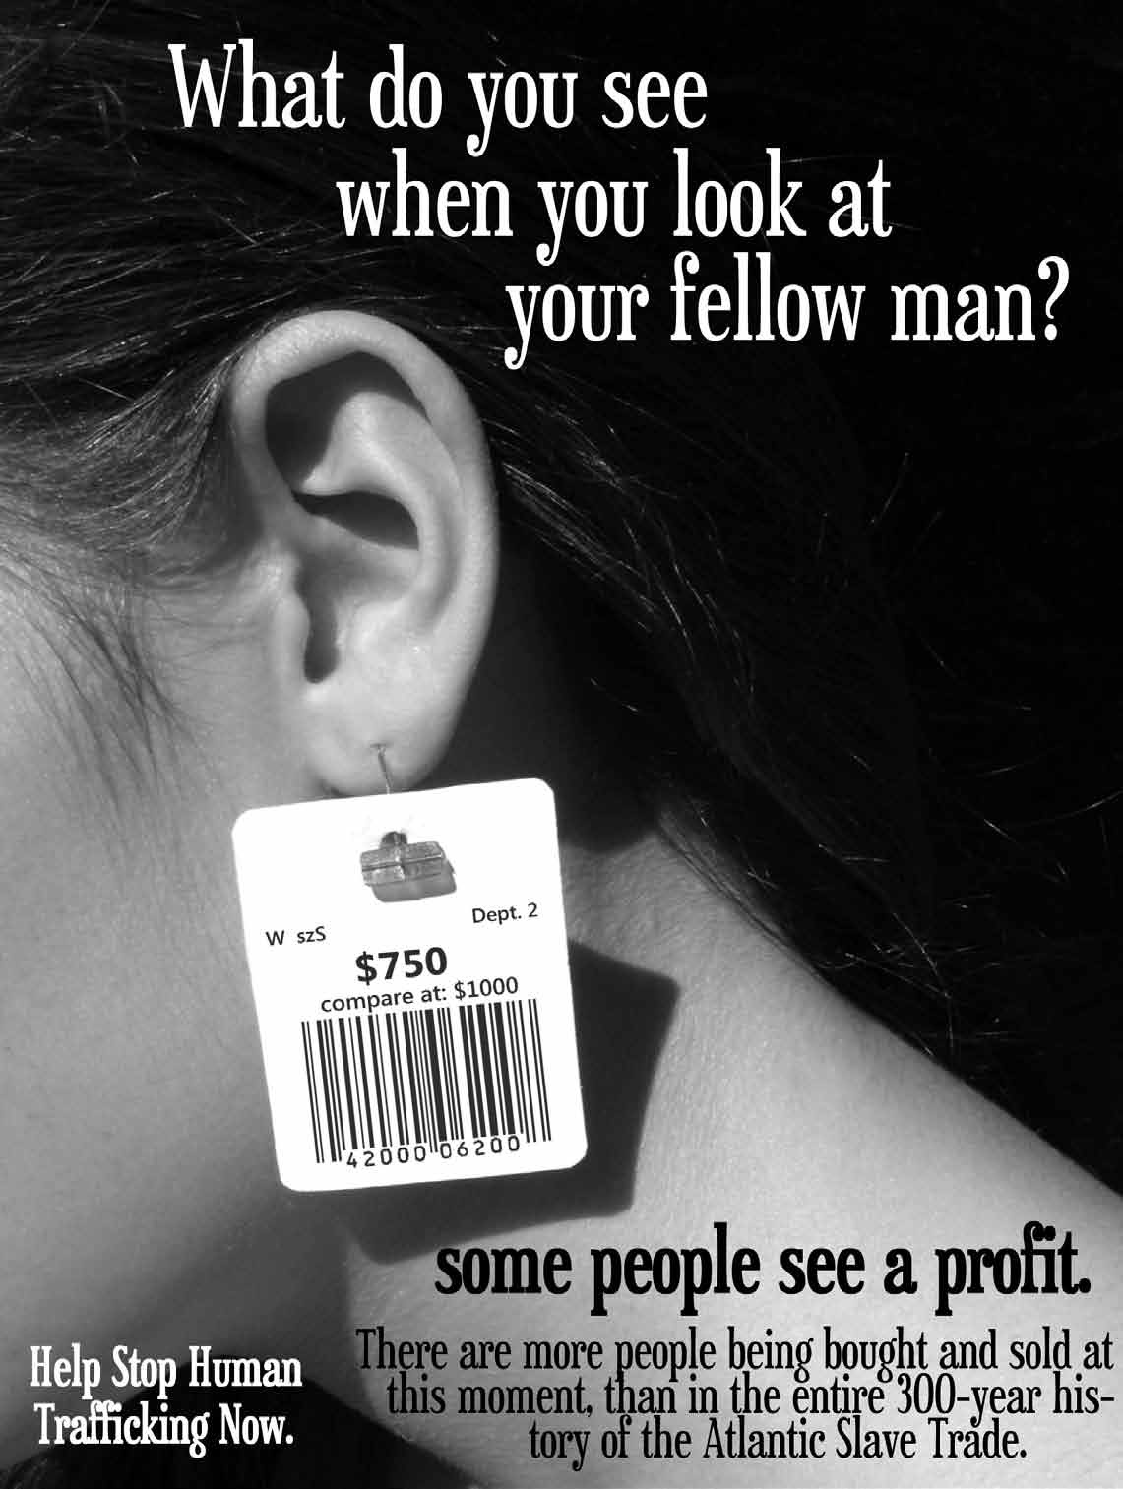
Anthony Talbott Political Science / Human Rights, University of Dayton AbolitionOhio– The Rescue and Restore Coalition in the Miami Valley Rachel Adkins, MSW, LSW Anti-Human Trafficking Education Specialist The Salvation Army & The Central Ohio Rescue and Restore Coalition What is Human Trafficking? A live webinar for students in Ohio

Slide 3
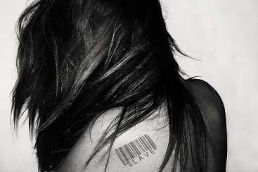
The Problem

Slide 4
A.) Definition
Basic definition
People forced to work or sell sex for another’s profit—Modern Day Slavery
Notes:
Basic definition: “Process through which human beings are bought and sold.”

Slide 5
Trafficking Victims Protection Act 2000
“Severe forms of trafficking in persons” defined as:
1.) Adult Sex Trafficking
2.) Minor Sex Trafficking
3.) Labor Trafficking
Notes:
“TVPA” defined 3 forms of trafficking—adult sex trafficking, minor sex trafficking and labor trafficking.

Slide 6
Trafficking Victims Protection Act 2000
“Severe forms of trafficking in persons” defined as:
1.) Adult Sex Trafficking
“The recruitment, harboring, provision, or obtaining of a person for the purpose of a commercial sex act, in which a commercial sex act is induced by force, fraud, or coercion,
“The What?”
“The Why?”
“The How?”
Notes:
At least one aspect of all three elements—The What, The Why, and The How—needs to be present to be considered adult sex trafficking. But the definition also adds…

Slide 7
Trafficking Victims Protection Act 2000
“Severe forms of trafficking in persons” defined as:
2.) Minor Sex Trafficking
“The recruitment, harboring, provision, or obtaining of a person for the purpose of a commercial sex act, in which a commercial sex act is induced by force, fraud, or coercion, or in which the person forced to perform such an act is under the age of 18 years;
Notes:
Minor sex trafficking.

Slide 8
Trafficking Victims Protection Act 2000
“Severe forms of trafficking in persons” defined as:
3.) Labor Trafficking
“The recruitment, harboring, provision, or obtaining of a person for labor or services, through the use of force, fraud, or coercion for the purpose of subjection to involuntary servitude, peonage, debt bondage or slavery.”

Slide 9
Definitions of Force, Fraud, & Coercion
Force = Using violence to control someone
Fraud = Using lies to control someone
Coercion = Using threats to control someone
.
Notes:
More in-depth explanations of force, fraud and coercion (e.g., examples) should possibly occur later during the discussion about the recruitment tactics of traffickers.

Slide 10
Related Crimes
Prostitution
Child pornography
Alien smuggling
Kidnapping
Rape
Notes:
How do these crimes overlap with human trafficking?

Slide 11
Recap: Distinctions
1.) International or Domestic
2.) Adult or Minor
3.) Sex or Labor
* Focus: Domestic Minor Sex Trafficking (“DMST”)
Notes:
This presentation will focus on DMST because it is the most common and relevant form (to education professionals).

Slide 12
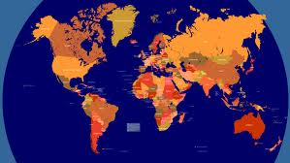
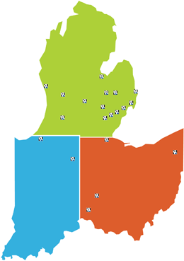
B.) Scope
Twenty-seven million victims of trafficking
80% of victims are female—50% are children
$35 billion dollar revenue
--U.S. Department of State
=
=
+
+
Notes:
“that’s more than Nike, Google, Starbucks combined” (this statement was broadcasted in a Toledo PSA ad).

Slide 13
B.) Scope
200,000 people currently trafficked in the U.S.
Estimated 100,000 U.S. children sex trafficked
All 50 states have reported cases
600,000 minors involved in prostitution or pornography
Notes:
600,000 minors involved in prostitution or pornography.

Slide 14
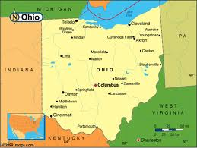
B.) Scope
1,078 U.S.-born Ohio youth sex trafficked last year
50 Ohio cases reported in past 9 years
Toledo: 4th city nationally for arrests and investigations related to minor sex trafficking.
Notes:
Toledo: 4th city nationally for arrests and investigations related to minor sex trafficking.

Slide 15
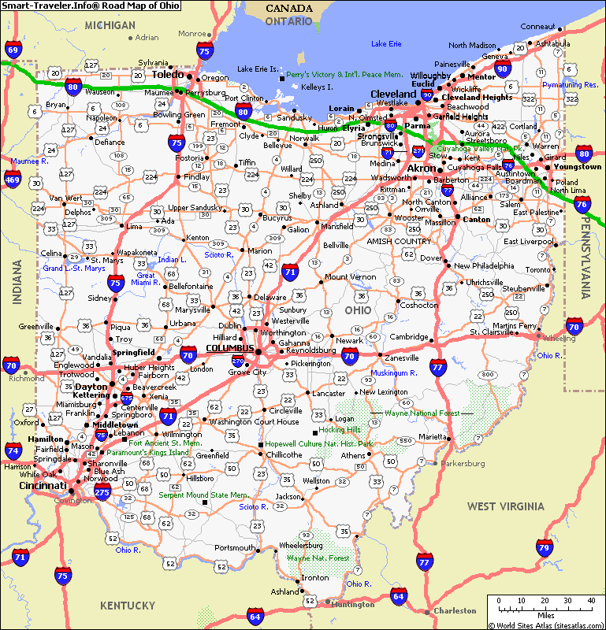
Ohio Vulnerabilities
Extensive highway system
Most truck stops in nation
Within day’s drive to
multiple major
metropolitan cities
Sharply rising immigrant
population
http://www.smart-traveler.info/sitebuildercontent/sitebuilderpictures/map_of_ohio.gif
Notes:
-Ohio is a source, transit, and destination state
-Prime Target:
1. Extensive highway system: can get out of Ohio anywhere within 2 hours; within day’s drive to Indianapolis, St.
Louis, Chicago, Detroit, Nashville, Washington D.C., Pittsburgh, and Toronto
2. Proximity to Canada: Canada is a frequent port-of-entry for international victims, and Toronto has been
identified as a growing trafficking hub; susceptible to international trafficking due to its 146-mile border
along Lake Erie, allowing traffickers the protection of water travel
3. Immigrant population: From 1990-2000, the Hispanic population increased by 50% and the Asian
population nearly as much, with the overall migrant population climbing over 30%
4. Agricultural industry: 130 migrant labor camps that employ numerous individuals, a majority of which are from
the Hispanic migrant labor pool. Because of this market, among others such as restaurants, textile industry,
landscaping, and small factories, Ohio attracts many foreign born immigrant groups looking for work
5. Universities and colleges: 8th highest international student population
6. Poverty: Ohio ranks 42 out of 50 in “children’s vulnerability to homelessness”; in 2006, the Coalition
for the Homeless in Ohio estimated that over 60,000 children experienced homelessness
--In 2008, over 1.5 million Ohioans lived below the poverty level

Slide 16
Ohio Vulnerabilities
5th most strip clubs in nation
Agricultural industry
Unemployment
Poverty
Notes:
Ohio is a source, transit, and destination state
-Prime Target:
1. Extensive highway system: can get out of Ohio anywhere within 2 hours; within day’s drive to Indianapolis, St.
Louis, Chicago, Detroit, Nashville, Washington D.C., Pittsburgh, and Toronto
2. Proximity to Canada: Canada is a frequent port-of-entry for international victims, and Toronto has been
identified as a growing trafficking hub; susceptible to international trafficking due to its 146-mile border
along Lake Erie, allowing traffickers the protection of water travel
3. Immigrant population: From 1990-2000, the Hispanic population increased by 50% and the Asian
population nearly as much, with the overall migrant population climbing over 30%
4. Agricultural industry: 130 migrant labor camps that employ numerous individuals, a majority of which are from
the Hispanic migrant labor pool. Because of this market, among others such as restaurants, textile industry,
landscaping, and small factories, Ohio attracts many foreign born immigrant groups looking for work
5. Universities and colleges: 8th highest international student population
6. Poverty: Ohio ranks 42 out of 50 in “children’s vulnerability to homelessness”; in 2006, the Coalition
for the Homeless in Ohio estimated that over 60,000 children experienced homelessness
--In 2008, over 1.5 million Ohioans lived below the poverty level

Slide 17
C.) Components
Sex Trafficking is a “business” with Supply and Demand
1.) The Buyers: “Johns”
2.) The Sellers: “Pimps”
3.) The Victims—the “product” being bought and sold
Notes:
3 components.

Slide 18
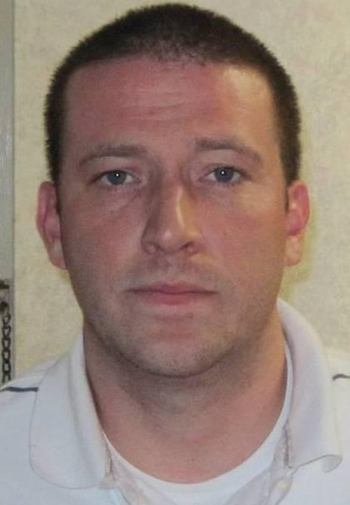
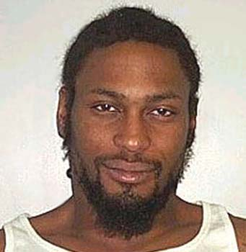
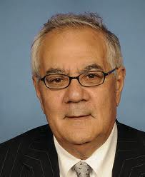
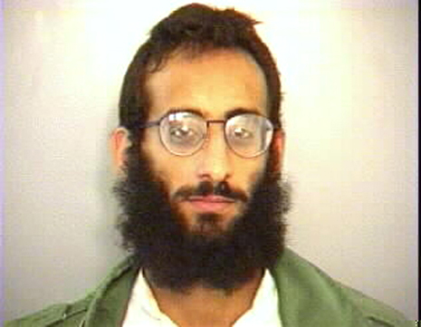
1. The Buyers
Notes:
These are all famous men. The first is a well-known pastor, the second is an R & B star, the third is a billionaire, the fourth is a politician, and the fifth is a leader of Al Qaida.

Slide 19
Buyers are “Johns”
Feel as if they own the girls/women they purchase and subject them to painful, abusive fantasies
Try to reenact porn scenes
1 in 3 men admit to buying sex
Johns come from all walks of life
(-Dr. Teela Sanders, Paying for Pleasure)

Slide 20
Johns drive the sex trade
Account for the DEMAND; without people seeking sex, prostitution & sex trafficking would not exist
In 2007/2008, Central Ohio law enforcement filed 3,575 prostitution charges and only 35 “johns” were arrested
Notes:
Why does drug trafficking exist? Because there is a demand for it. The same is true for trafficking – there is a demand for commercial sex, and as long as the demand is there, someone will be supplying and making a profit off it.

Slide 21
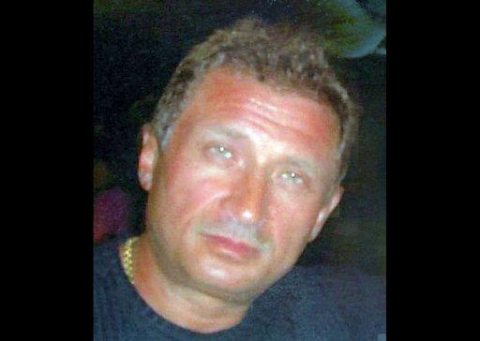
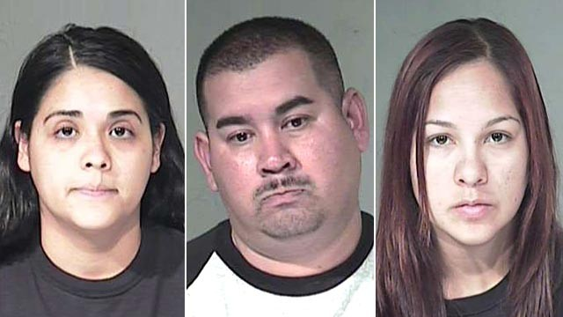
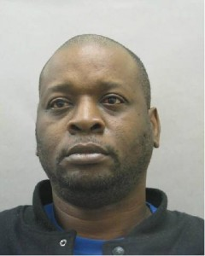
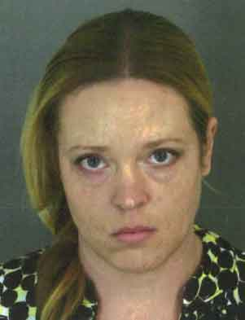
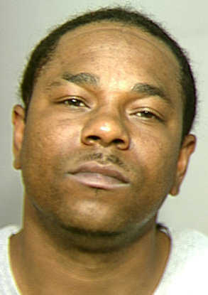
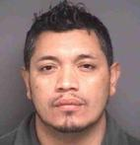
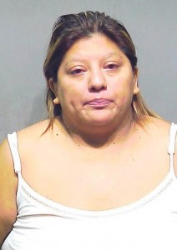
2. The Sellers
1
2
3
4
5
6
7
8
8
9
Notes:
1. Veniamin Gonikman, a fugitive seen in this undated handout from US Immigration and Customs Enforcement(ICE), wanted on human trafficking charges for allegedly forcing eastern European women to dance in Detroit strip clubs was arrested Thursday night at John F. Kennedy International Airport, officials said.
2. Three cops under the command of "America's toughest sheriff," including a deputy in the human smuggling unit, have been arrested in Arizona and charged with trafficking in humans and drugs. Deputy Alfredo Navarrette and two female prison guards were arrested following a year-long sting that netted nine other people in a suspected criminal ring.
3. Police say a man wanted for sex trafficking and promoting prostitution is now in cuffs, thanks to tips from "America's Most Wanted" viewers. Rufus Byers, who was wanted out of New Mexico for allegedly trafficking a young woman, was taken into custody on February 29, 2012 -- a few days after appearing on AMW's two-hour sex trafficking special on Lifetime.
4. MONTEREY, Calif. - A 35-year-old Monterey woman has been arrested in connection to human trafficking and other charges, said police.
The Monterey Police Department arrested Aaliyah Solange Ali Person, also known as Lisa Louise Banner, after investigating an allegation that an underage female runaway from the bay area was brought to Monterey to be a prostitute.
5. Devon Tenille Bradford, 33, was arrested on May 14, 2012, on suspicion of rape, human trafficking, and lewd and lascivious acts, according to police Detective Steve Anderson of the Modesto Police Department. (Modesto Police Department) Read more here: http://www.modbee.com/2012/05/15/2201610/dna-leads-to-modesto-mans-arrest.html#storylink=cpy
6. GREENVILLE, N.C. - The ring leader in a human trafficking organization has been arrested.
That's according to the Pitt County Sheriff's Office. 37-year-old Oscar Salinas-Rodriguez was taken into custody Thursday at a brothel house on Highway 264 East in Greenville. Deputies say the prostitution operation is part of a larger criminal organization. A female victim from western North Carolina was identified and rescued. She was allegedly promised a cleaning job, but when she arrived, she was forced to engage in sex labor. She had been held at the brothel for about a week.
7. Rubicela Montero, an undocumented woman from Chicago, was charged with human trafficking after one of her victims reported the activities of the brothel through a police hotline. Montero, 39, picked up a total of 6 girls with promises of legitimate work but forced them into performing sex several times a week while threatening their lives and those of their loved ones if they exposed her. The Chicago police set up a sting operation and sent an undercover, Spanish-speaking cop, to uncover the brothel and arrest the woman who trafficked her victims for $100 each. Montero is being held on a $400,000 bail and faces 30 years if convicted.
8. Feng Liu of Gaithersburg was the owner of Ya Ya Spa. She has been charged with human trafficking and conducting prostitution. Howard Hao Wang, who operated Tropical Spa and Best Massage, faces the same charges.
9. Mauricio Alex Garcia Guardia of Rockville, who owned Executive Body Work, has a warrant for his arrest on charges of conducting prostitution and human trafficking.

Slide 22
The Sellers
Pimps/Sellers are all races, men, and women
Range from individuals to organized criminal syndicates
Two main recruitment strategies
Finesse Pimping
Guerilla Pimping
Notes:
Exploitation of needs/vulnerabilities may also be called “finesse pimping”.

Slide 23
Recruitment Strategies for Sex Trafficking
A. Exploitation of Needs: “Finesse Pimping”
Seemingly legitimate work opportunities
False/predatory romantic involvement
Offers of food, housing, clothes, drugs,… in exchange for sex
Purchase of girls from impoverished family/guardians (rare)
Notes:
Exploitation of needs/vulnerabilities may also be called “finesse pimping”.

Slide 24
Recruitment Strategies for Sex Trafficking
B. Use of Force: “Guerrilla Pimping”
Kidnapping (uncommon)
Intimidation
Notes:
Use of force may also be called “guerrilla pimping”.

Slide 25
“Pimps”
Typically have about 6 girls and refer to them as a “family” or a “stable”
The girls are instructed to call the pimp “Daddy”
Each girl earns approximately $500 per night for the pimp and $600,000 annually
Victims usually work 7 days a week, 365 days a year and see 10 or more clients a night
Notes:
Difference between “traffickers” and “pimps”?

Slide 26
“Pimp” Control
Pimps are masters of the art of seduction; they are able to identify the vulnerabilities of a specific child and exploit them.
(We will discuss vulnerabilities in a few minutes)
Once seduced, pimps use torture and brain washing tactics to control their victims.
Notes:
Such tactics consistently lead to complete obedience and a breakdown of personal agency and autonomy.
These behaviors include both physical and psychological torture.

Slide 27
Culture & Pimps
Pimps use the increased glamorization of pimp/ho culture, as well as cultural acceptance of demand for child victims, to help maintain control of victims and generate profits .

Slide 28
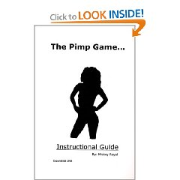
Amazon.com
The Pimp Game: Instructional Guide (Paperback Mickey Royal (Author) "There's only one game and the game is pimping...”36 customer reviews
Rated 4 Stars!
Slide borrowed from Dr. Jeffrey Barrows, Executive Director, Gracehaven
Notes:
Share Excerpt from this book?

Slide 29
The Victims

Slide 30
Victims
Most victims “willingly” go with their trafficker
Many victims do not think they are a victim
Teens are “surviving” not being “victimized”
Online solicitation is increasing
Social media
Use of commercial sex websites
Backpage.com
Notes:
Note: Many victims exhibit anxious or fearful behavior and have been taught to be fearful of social services, law enforcement, etc. They will perceive you as having all of the power and them as having none. Confidentiality is incredibly important – make sure you only speak to the potential victim, as the person accompanying them could be the trafficker (ex: Boyfriend, parent, etc)

Slide 31
Factors Associated with Domestic Minor Sex Trafficking
Runaways and homeless youths
Presence of pre-existing adult prostitution markets in communities where large numbers of street youth are concentrated.
Prior history of child sexual abuse and child sexual assault.
Poverty.
Notes:
A national study shows that 75% of all women used in prostitution were victims of incest and/or physical abuse as children.
(National Task Force on Prostitution)

Slide 32
Factors Associated with Domestic Minor Sex Trafficking
Large numbers of unattached and transient males in local communities including military personnel, truckers, and conventioneers.
Membership in gangs.
Promotion of child prostitution by parents, older siblings and boyfriends.
Recruitment by organized crime units.

Slide 33
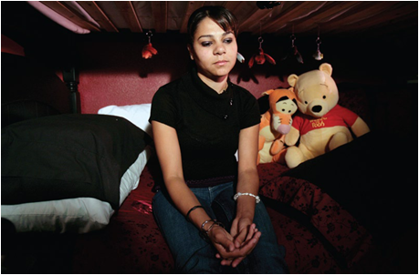
Runaway and Homeless Youth
The average age that a person first enters into the commercial sex industry is 12-14.
Studies suggest that up to 90% of runaway youth become involved in the commercial sex industry.

Slide 34
Runaway and Homeless Youth
There are currently about 700 to 800 active missing children cases in Ohio, and about 90% are runaways.
On average, there are 19,000 to 20,000 missing children reports per year in Ohio, with about 90% as runaways.
(Missing Persons Unit, Ohio Bureau of Criminal Investigation)
Notes:
According to the National Runaway Switchboard, there are between 1,600,000 and 2,800,000 runaway and/or homeless youth in the United States everyday
(National Incidence Studies of Missing, Abducted, Runaway and Throwaway Youth)
.

Slide 35
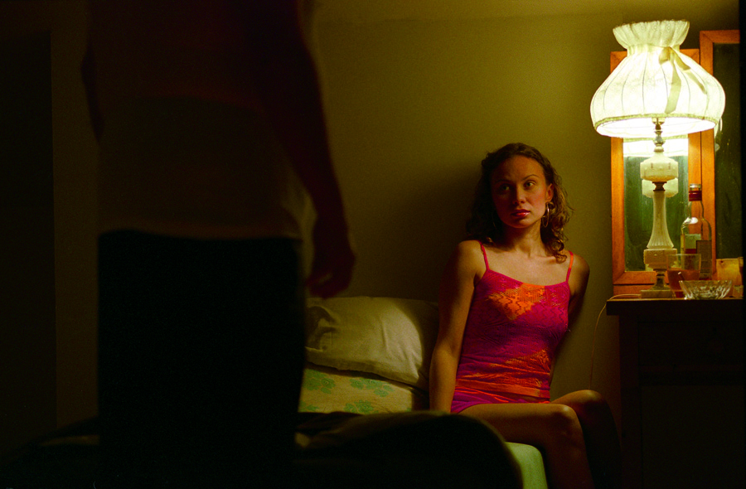
Runaway and Homeless Youth
Within 48 hours of leaving home…
1 in 3
…runaway teens will be approached by someone involved in the commercial sex industry

Slide 36
R.E.S.C.U.E. C.H.I.L.D.
R unaway
E ducational Problems
S exual Assault
C ourt Appearances
U sing drugs and/or alcohol.
E motional Abuse
C hildhood abuse and/or neglect
H omelessness
I nfluential Others.
L oving Someone Much Older
D ifficulty Making Friends

Slide 37
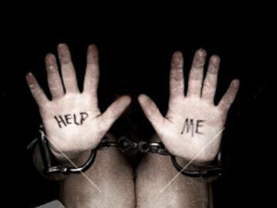
II. Solutions

Slide 38
Outline
I. Problem
A.) Definition
B.) Scope
C.) Components
II. Solution
A.) Intervene
B.) Prevent
C. ) You can be a change agent!

Slide 39
A.) Intervene

Slide 40
A.) Intervene
Step 1: Recognize the “red flags”.
Step 2: Make the call.
Human Trafficking Hotline:
1-888-3737-888

Slide 41
“Red Flags” Signs that a Young Person might be trafficked
If a peer:
Has run away or is homeless
Claims to be an adult
Possesses large amounts of cash
Possesses hotel room keys
Has physical marks, brandings or tattoos (e.g., “daddy”).
Lies about her/his age and/or possesses false identification
Is involved with abusive or controlling partner/”boyfriend”
…then they might be a victim of trafficking

Slide 42
“Red Flags” Signs that a Young Person might be trafficked
If a peer:
Has unexplained school absences; unable to attend school regularly
Talks about traveling to other locations
Shows signs of physical abuse
Is withdrawn, fearful, and/or depressed.
Does not have control over his/her own schedule
Does not have control over his/her identification
…then they might be a victim of trafficking
Notes:
Do pimps let victims keep large amounts of cash? Is this then prostitution since the commericial benefit is also to the victim?

Slide 43
“Red Flags” Signs that a Young Person might be trafficked
If a peer:
Appears hungry and/or malnourished
Wears clothing that is not appropriate based on season or weather
Appears addicted to drugs
Shows shift in behavior, dress, or belongings, such as sudden possession of expensive items or if they seem distant or depressed.
Talks about sexual activities that exceed age-group norms
Is involved with “boyfriend” who is 10 or more years older than potential victim
…then they might be a victim of trafficking

Slide 44
“Red Flags”
Take caution when…
You are told extreme statements from new friends like “I love you”, “I want to protect you”, or “I can take care of you”
Pressure to perform any sexual act that makes you uncomfortable, especially if it’s in exchange for money, food, clothing, or shelter
Anyone’s attempts to change your behavior

Slide 45
“Red Flags”
Take caution when:
Being called over to unfamiliar cars/people for “help” or to compliment you
Notice you are being followed or watched around town, especially at malls or hangout spots
Anytime your instincts tell you something is wrong,
LISTEN – you are probably right!

Slide 46
Step 2: Make the Call
1. Trafficking Hotline—1-888-3737-888
2. 911 (if in immediate danger).

Slide 47
B.) Prevent
You can help PREVENT human trafficking!
Watching pornography contributes to human trafficking by increasing the DEMAND
Many people are being trafficked on-line, especially through porn
Talk to your friends about how pornography is harmful to victims
Notes:
36 porn stars died that we know of from HIV, suicide, homicide and drugs between 2007 and 2010. With what we know about violence in porn, and if boys first look at porn at age 11, that could be their first experience with sex. We need to be talking with young boys to prevent them from becoming perpetrators.

Slide 48
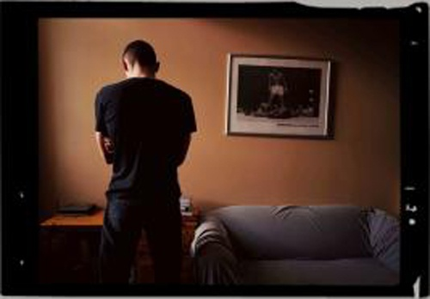
B.) Prevent
As a friend:
Talk to your peers about healthy relationships
Call a peer out when they say a joke or make a comment that objectifies women
Point out gender stereotypes, violence, and unhealthy attitudes
Notes:
Modeling healthy relationships and creating environments that support them help keep youth from the consequences that occur if they think sexual violence and exploitation is acceptable.

Slide 49
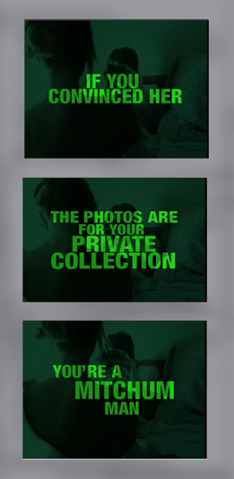
B.) Prevent
Think about how the
media plays a role in
how we view women

Slide 50
You can be a Change Agent!
Talk
Educate your friends, classmates, and family
Tabling
Volunteer
Coordinate donations drives for Street Outreach and the Well
Report
Call the hotline or tell a trusted adult if you think a friend is being trafficked
Be Part of the Solution
Don’t use derogatory or hurtful language towards women
Show Up
Coalition Meetings
Shop
Fair Trade
Reduce Demand
Choose not to contribute to commercial sex
Change requires action….be creative and take action!

Slide 51
Local Coalition Contact Information
Northwest Ohio
419-222-8666
Lucas County
lchumantrafficking
coalition
@gmail.com
Northeast Ohio
440-356-2254
Central Ohio
614-285-4357
Miami Valley
Abolition.ohio@
gmail.com
Cincinnati
Hotline 513-800-1863
Lorain County
1-800-888-6161
Mahoning Valley
330-743-1196
Southeast Ohio
740-374-5820
Notes:
Central Ohio Rescue and Restore Coalition
Trisha Smouse, 614-358-2614, The Salvation Army
Trisha.smouse@use.salvationarmy.org
www.centralohiorescueandrestore.org
End Slavery Cincinnati
Erin Meyer, 513-762-5658, The Salvation Army
Hotline 513-800-1863
Erin.meyer@use.salvationarmy.org
Lucas County Human Trafficking Coalition, Toledo, Ohio
Celia Williamson, PhD, 419-530-4084, University of Toledo
Cwillia4@UTNet.UToledo.edu
The Northeast Ohio Coalition Against Human Trafficking
Karen Walsh, 440-356-2254, Collaborative Initiative to End Human Trafficking
kwalsh@hmministry.org
Abolition Ohio The Rescue and Restore Coalition in the Miami Valley
Anthony Talbott, 937-229-4326, University of Dayton
Abolition.Ohio@gmail.com
AbolitionOhio.org
Human Trafficking Collaborative of Lorain County
Mindi Kuebler RN,BSN,SANE-A, 440-204-9122, the Nord Center
mkuebler@nordcenter.org
The Northwest Ohio Coalition Against Human Trafficking
David Voth, 419-222-8666, vothdavid@aol.com, Crime Victim Services
Emily Wrencher, 419-228-6692, ewrencher@crossroadscrisiscenter.com, Crossroads Crisis Center
Mahoning Valley Organizing Collaborative
Nate Brown, (330) 743-1196, MVOC
nate@mvorganizing.org
Southeast Ohio Human Trafficking Coalition
Annelle Edwards, 740-374-5820, evedirector@suddenlinkmail.com, Eve, Inc.
Michelle Carpenter, 740-439-7233,havenofhope@firewireinternet.com, Haven of Hope

Slide 52
Review
Definition of human trafficking – controlling someone by force, fraud or coercion for commercial gain
Sex trafficking of minors was the focus today
Who are the players? Buyers, sellers, victims
What are the Red Flags? Who is at high risk?
Peers who have runaway
Peers that are vulnerable, especially with a history of sexual abuse
Peers involved with older boyfriends

Slide 53
What Can YOU Do?
Pay attention to the red flags
Make the call - National Human Trafficking Resource Center 1-888-3737-888
Other Local Resources
Local Rescue & Restore Coalition
Local Human Trafficking Coalition
Local Law Enforcement
Children Services in your county

Slide 54
What will happen then?
The National Resource Center will contact a local resource (Rescue & Restore Coalition, County Children Services, Law Enforcement, Child Advocacy Center)
Coordinated services
Health and Safety of youth first
Trauma informed care for youth
Longer term healing strategies
STOP / PROSECUTE TRAFFICKER

Slide 55
Spread the Message
Organize a screening of this presentation with your friends or student organization & let the Department of Education know! (Pete.Lupiba@education.ohio.gov)
Contact your local Human Trafficking Coalition to invite a guest for Q & A or to get involved
Or contact the Ohio Human Trafficking Commission: http://www.ohioattorneygeneral.gov/HumanTrafficking

Slide 56
Review: Numbers to Call
To report a potential case of human trafficking: 1-888-3737-888
To notify the Department of Education of a screening of this presentation: 1-877-644-6338
To invite a speaker or facilitator to your screening, or to your church, student organization, youth group, …; or to be trained as a local presenter contact your local Human Trafficking Coalition.
Notes:
Solution 2 is LEAD. 1.) Spread the message to colleagues by scheduling a screening of this presentation for your campus and/or inviting a speaker from your local coalition. 2.) Spread the message to students by encouraging teachers to screen the October 16th webinar for students and/or inviting speakers from your local coalition.

Slide 57
Local Coalition Contact Information
Northwest Ohio
419-222-8666
Lucas County
lchumantrafficking
coalition
@gmail.com
Northeast Ohio
440-356-2254
Central Ohio
614-285-4357
Miami Valley
AbolitionOhio@
gmail.com
Cincinnati
Hotline 513-800-1863
Lorain County
1-800-888-6161
Mahoning Valley
330-743-1196
Southeast Ohio
740-374-5820
Notes:
Central Ohio Rescue and Restore Coalition
Trisha Smouse, 614-358-2614, The Salvation Army
Trisha.smouse@use.salvationarmy.org
www.centralohiorescueandrestore.org
End Slavery Cincinnati
Erin Meyer, 513-762-5658, The Salvation Army
Hotline 513-800-1863
Erin.meyer@use.salvationarmy.org
Lucas County Human Trafficking Coalition, Toledo, Ohio
Celia Williamson, PhD, 419-530-4084, University of Toledo
Cwillia4@UTNet.UToledo.edu
The Northeast Ohio Coalition Against Human Trafficking
Karen Walsh, 440-356-2254, Collaborative Initiative to End Human Trafficking
kwalsh@hmministry.org
Abolition Ohio The Rescue and Restore Coalition in the Miami Valley
Anthony Talbott, 937-229-4326, University of Dayton
Abolition.Ohio@gmail.com
AbolitionOhio.org
Human Trafficking Collaborative of Lorain County
Mindi Kuebler RN,BSN,SANE-A, 440-204-9122, the Nord Center
mkuebler@nordcenter.org
The Northwest Ohio Coalition Against Human Trafficking
David Voth, 419-222-8666, vothdavid@aol.com, Crime Victim Services
Emily Wrencher, 419-228-6692, ewrencher@crossroadscrisiscenter.com, Crossroads Crisis Center
Mahoning Valley Organizing Collaborative
Nate Brown, (330) 743-1196, MVOC
nate@mvorganizing.org
Southeast Ohio Human Trafficking Coalition
Annelle Edwards, 740-374-5820, evedirector@suddenlinkmail.com, Eve, Inc.
Michelle Carpenter, 740-439-7233,havenofhope@firewireinternet.com, Haven of Hope

Slide 58
What is Human Trafficking? A live webinar for students in Ohio.
Thank you for participating
in today’s webinar.
To access a recording of this webinar, please visit
www.education.ohio.gov
and search keywords
Human Trafficking.

