Slide 1
The 22⁺ Adult High School Diploma Program Provider Application
March 12, 2015

Slide 2
Today’s Presenters
Paul Preston, 22⁺ Adult High School Diploma Program Administrator
Faith Behringer, Assistant Director, Office of Quality School Choice
Russ Howard, Project Manager

Slide 3
Today’s Webinar Outcomes
Participants know how to submit a request to access the Adult Learner web system through the SAFE web portal.
Participants know how to complete all sections of the 22⁺ Adult High School Diploma Program application.
Participants know how to submit the 22⁺ Adult High School Diploma Program application.

Slide 4
Vision
Providers having access to a comprehensive system where adult learners can earn a high school diploma.
Notes:
Our vision is for providers and adult learners having easy access to dependable, user-friendly, high quality computerized provider and student (adult learner) applications and high quality, clear and accurate technical supports, guidance documents, forms, manuals, FAQs, etc.

Slide 5
Mission
To assist in the development, growth and expansion of high quality educational programs for adult learners seeking to obtain a high school diploma and to assure the availability of such programs in approved educational institutions outlined in Revised Code sections 3314.38, 3317.23, 3317.24 and 3345.86.

Slide 6
Program Outcome
Adult Learners Earning High School Diplomas

Slide 7
Questions?
Please submit questions throughout the presentation via the chat feature.
Notes:
Please feel welcome to submit questions via the chat feature throughout the presentation.

Slide 8
Eligible Providers
The following Ohio educational institutions are eligible to be providers:
A charter school that operates a dropout prevention and recovery program;
A city, local or exempted village school district that operates a dropout prevention and recovery program;
A joint vocational school district that operates an adult program; or
A community college, university branch, technical college or state community college.
Notes:
Per 3301-45-02 Definitions (D) “Educational institution” or “provider” means a community school that operates a dropout prevention and recovery program; a city, local, or exempted village school district that operates a dropout prevention and recovery program; a joint vocational school district that operates an adult education program; or a community college, university branch, technical college or state community college.

Slide 9
Provider Application Roles
The following OEDS roles are needed to complete a Provider application for Public Schools:
HSD Nominator – completes the application
Superintendent, Superintendent Designee – submits the application
These roles are assigned by your educational institution’s OEDS Program Administrator
Notes:
These roles are assigned by the educational institution’s OEDS Program Administrator

Slide 10
Provider Application Roles
The following OEDS roles are needed to complete a Provider application for Institutes of Higher Education:
HSD Nominator – completes the application
HSD Authorizer – submits the application
These roles are assigned by your educational institution’s OEDS Program Administrator
Notes:
These roles are assigned by the educational institution’s OEDS Program Administrator

Slide 11
Access to the 22⁺ Adult High School Diploma Program
Providers may request access to the 22⁺ Adult High School Diploma Program as follows:
Access your SAFE Account via the Ohio Department of Education website
Request access to the “Adult Learner” web system
Select the Adult Learner Application
Request Membership as a HSD Provider Applicant
Enter the reason for requesting access to the 22⁺ Adult High School Diploma Program
Click the Submit Button
Notes:
In the reason box, you need to state that you are requesting access to the Adult Learner Web System in order to apply to become a Provider for 22⁺ Adult High School Diploma Program

Slide 12
Login to your SAFE Account
Notes:
Sign in to your SAFE account via the SAFE Account Login Page.

Slide 13
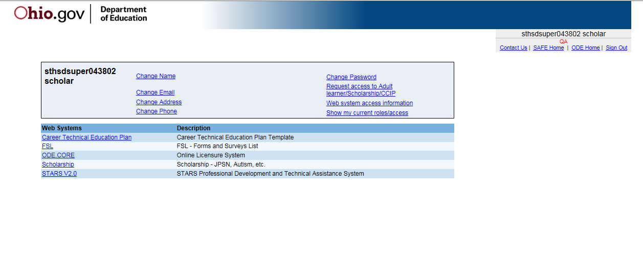
Request Access to the Adult Learner Web System
Notes:
Select Request Access to Adult Learner/Scholarship/CCIP

Slide 14
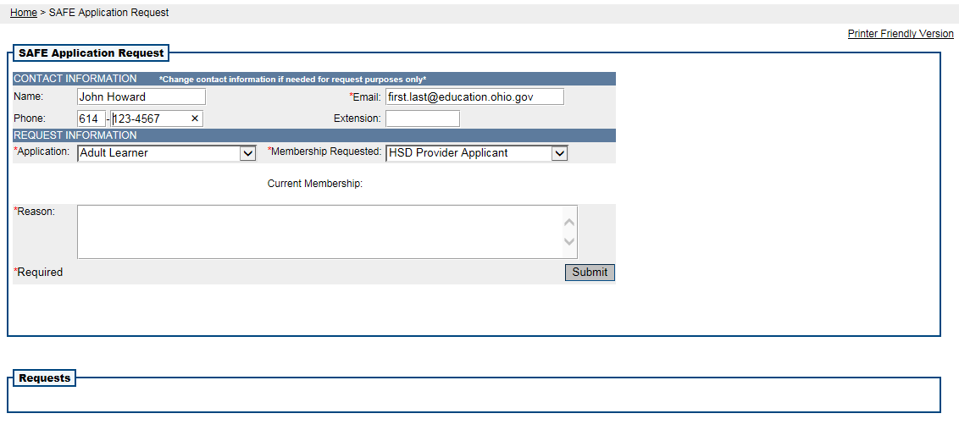
SAFE Application Request
Notes:
Select Adult Learner from the Application drop down and HSD Provider Applicant from Membership Requested drop down
In the Reason text box please define your entity (nonpublic school, public school, business owner, certificated professional, etc.) and your job title. Include the reason for requesting access to the Adult Learner Application, specifically that your educational institution would like to apply to become a Provider for the 22+ Adult High School Diploma Program.
Verify the information that you have entered and then click the Submit button.

Slide 15
Accessing the 22⁺ HSD Provider Application
Once access to the Adult Learner web system is approved and the required OEDS roles are assigned, eligible providers may complete and submit an application to become a provider for the 22⁺ Adult High School Diploma Program by clicking on the Adult Learner link.

Slide 16
Access the Adult Learner Web System
Notes:
Click on the Adult Learner web system link

Slide 17
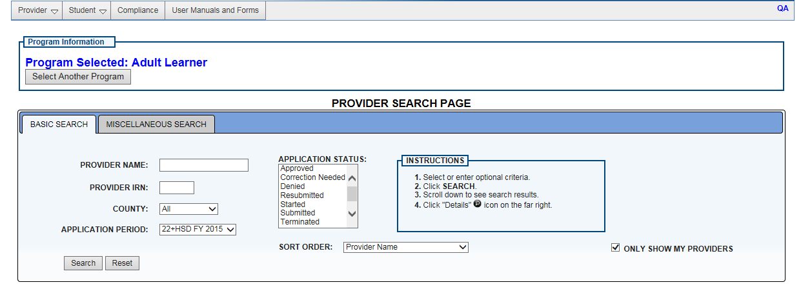
New Provider Application
Select New Provider Application from the Provider drop down
Notes:
Click on the “Provider” drop down located in the top left corner of the page.
Select “New Provider Application”

Slide 18
Agree to Provider Affidavit
Notes:
Click here to read terms and conditions: 22+ Adult High School Provider Affidavit
The Provider Affidavit includes attestations of compliance with program rules. Please review it carefully and verify that you are compliant in all areas before attempting to register as a provider.
If you are compliant with the program rules, check the box to confirm that you have read and agree to the terms and conditions outlined in the New Provider Affidavit.

Slide 19
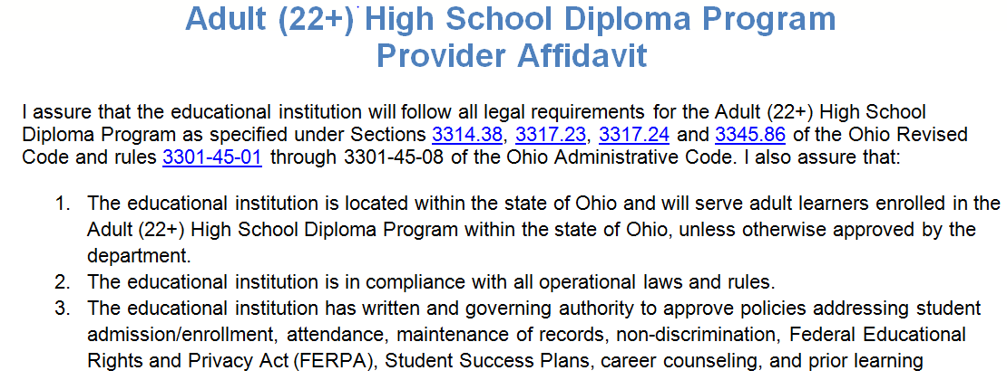
Provider Affidavit
Notes:
Open the Adult (22+) High School Diploma Program Provider Affidavit document.
#7: Prior to applying to be a provider of services to adult learners under this program, the governing authority of a community school that operates a dropout prevention and recovery program shall complete the contract modification process as required by the entity’s sponsor

Slide 20
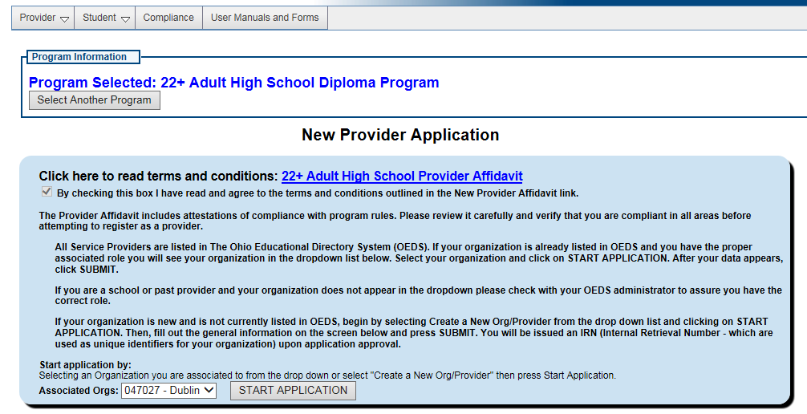
Start Application
Press Start Application
Select your organization
Notes:
Note: The information in this slide and subsequent slides is only sample data from our test environment and is strictly for informational purposes only.
Select the organization you are associated with from the Associated Orgs drop down or select Create a New Org/Provider
Click the Start Application button to start the application

Slide 21
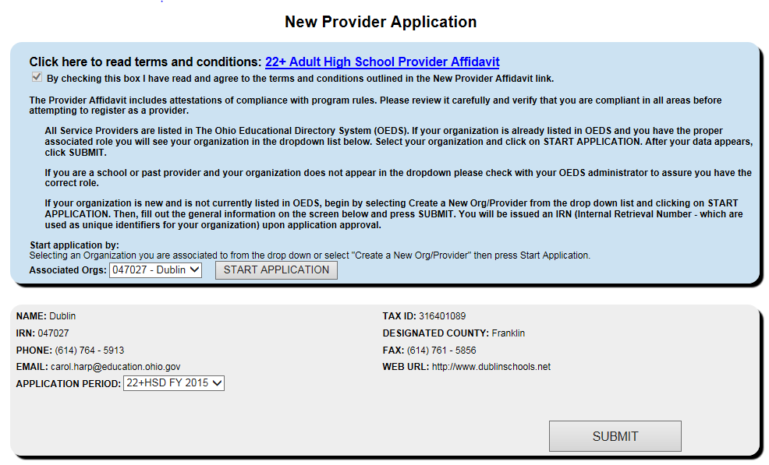
Verify Organization Information
Notes:
Verify the information for your organization is correct. Contact your OEDS Program Administrator if any changes are required.
Click the Submit button to continue with your application

Slide 22
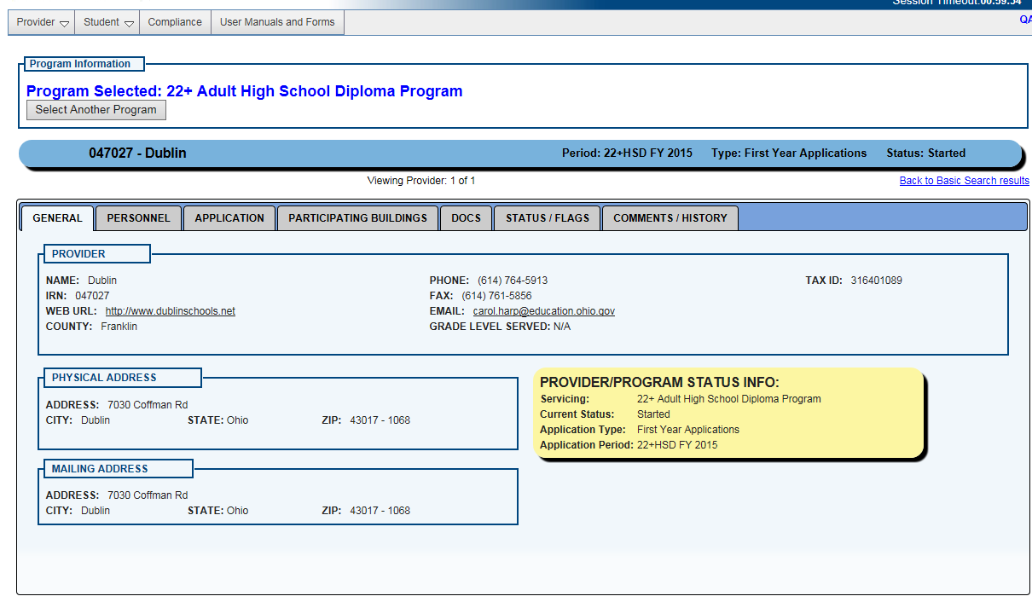
General Information Tab

Slide 23
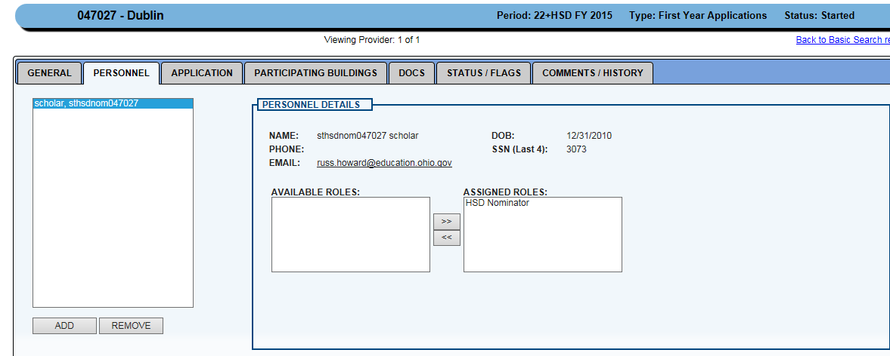
Personnel Tab
Notes:
Explain the HSD Nominator role and that other users can be assigned as HSD Nominators. This role can also be revoked.

Slide 24
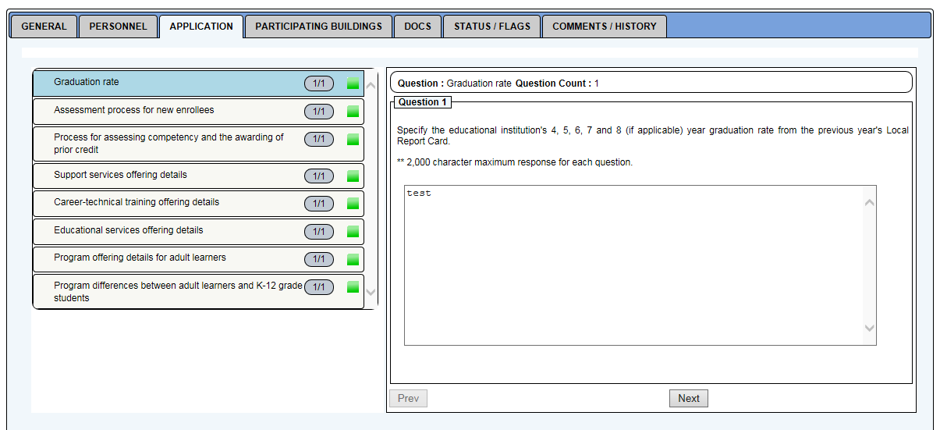
Application Tab - Question 1
Provider Application Response to Graduation Rate
Notes:
The required responses in the application tab are executive summaries of the required documents that must be uploaded. The supporting documents must be completely realized processes for each question. The graduation rate will require the applicant to upload that portion of their local report card.
Specify the educational institution's 4, 5, 6, 7 and 8 (if applicable) year graduation rate from the previous year's Local Report Card. * Supporting documents will need to be uploaded via the DOCS tab.
** 2,000 character maximum response for each question.
Statewide Average based on the local Report Card
LEA only the district Report Cards.
NA for JVSD and local college.
For colleges or JVSDs, this section would be not applicable as they would not receive a report card.

Slide 25
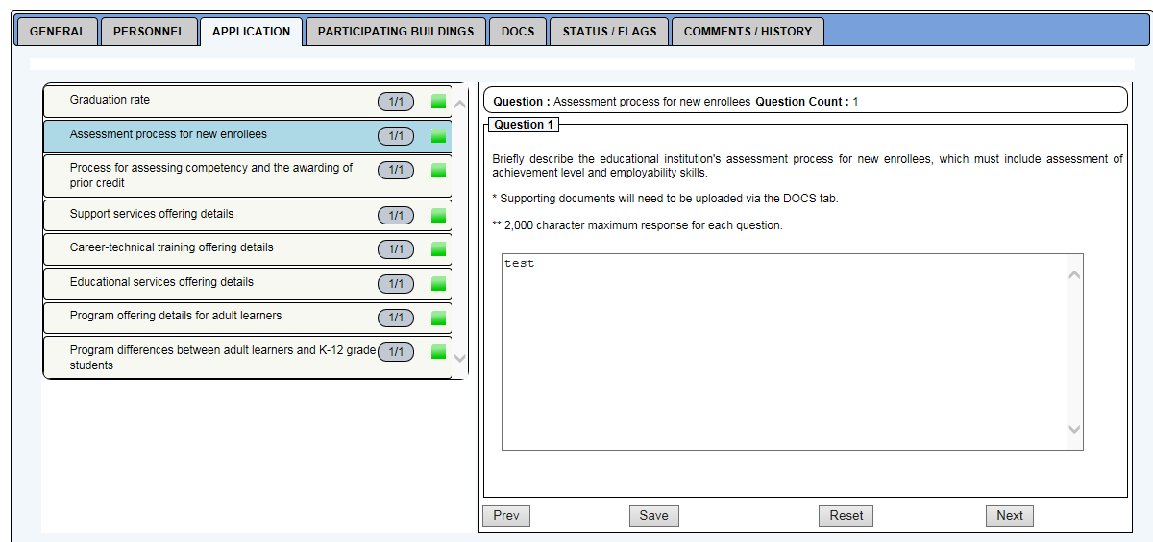
Application Tab - Question 2
Provider Application Response to assessment process for new enrollees
Notes:
Briefly describe the educational institution's assessment process for new enrollees, which must include assessment of achievement level and employability skills. * Supporting documents will need to be uploaded via the DOCS tab. ** 2,000 character maximum response for each question.

Slide 26
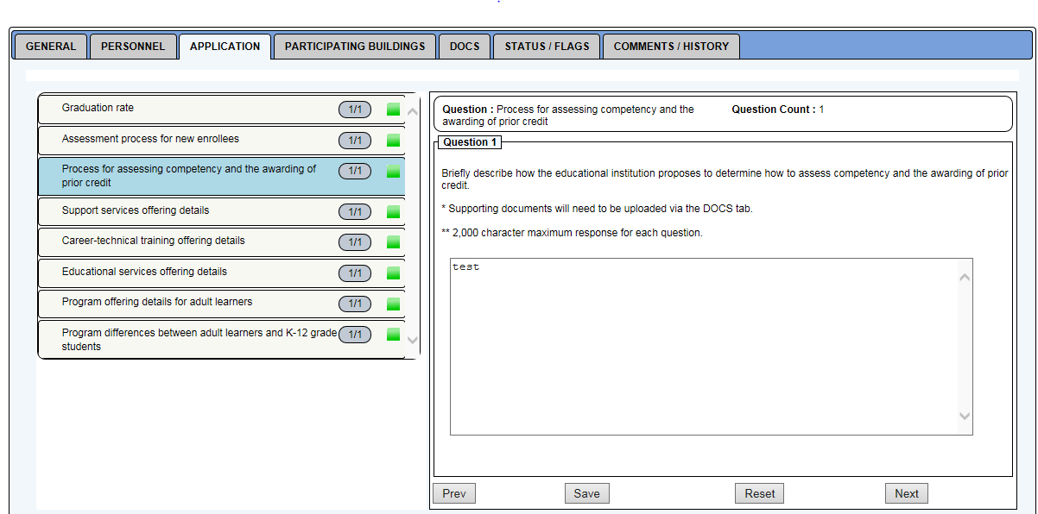
Application Tab - Question 3
Provider Application Response to process for assessing competency and the awarding of prior credit
Notes:
Briefly describe how the educational institution proposes to determine how to assess competency and the awarding of prior credit. * Supporting documents will need to be uploaded via the DOCS tab.
** 2,000 character maximum response for each question.

Slide 27
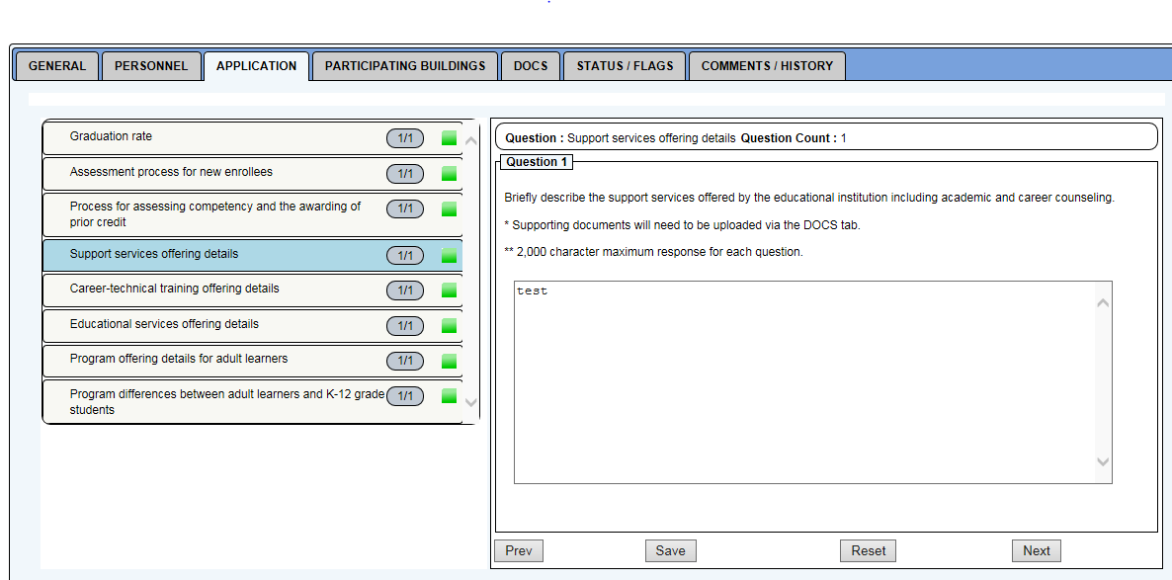
Application Tab - Question 4
Provider Application Response to support services offering details
Notes:
Briefly describe the support services offered by the educational institution including academic and career counseling. * Supporting documents will need to be uploaded via the DOCS tab. ** 2,000 character maximum response for each question.

Slide 28
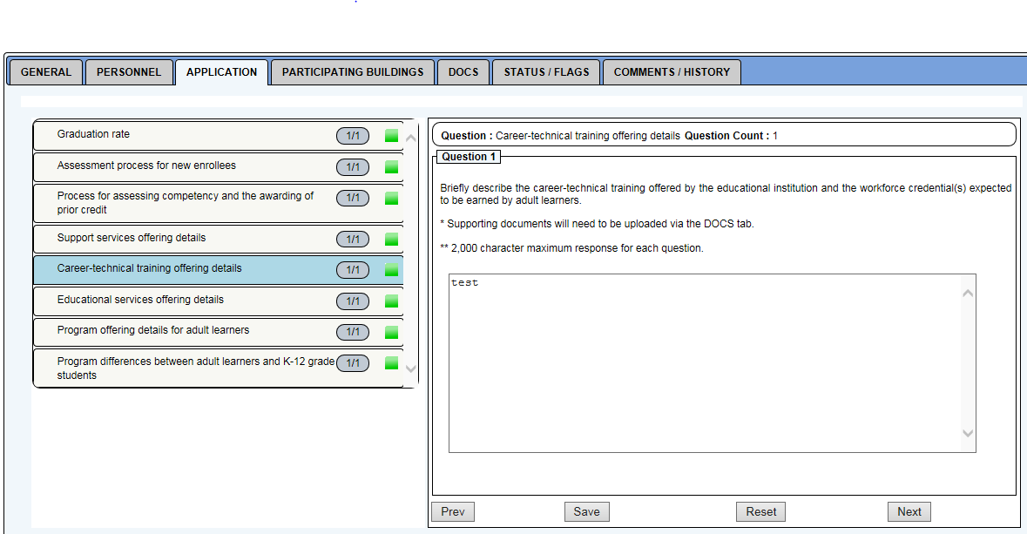
Application Tab - Question 5
Provider Application Response to career-technical training offering details
Notes:
Briefly describe the career-technical training offered by the educational institution and the workforce credential(s) expected to be earned by adult learners. * Supporting documents will need to be uploaded via the DOCS tab. ** 2,000 character maximum response for each question.

Slide 29
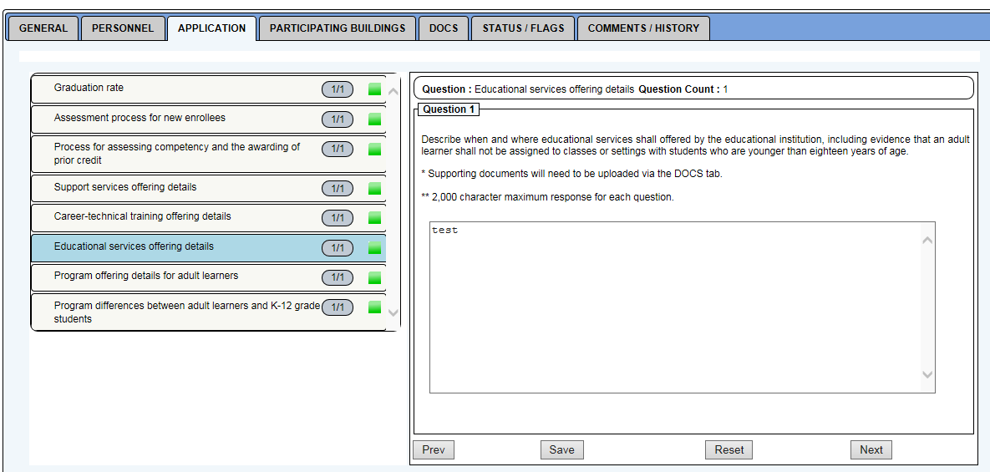
Application Tab - Question 6
Provider Application Response to educational services offering details
Notes:
Describe when and where educational services shall offered by the educational institution, including evidence that an adult learner shall not be assigned to classes or settings with students who are younger than eighteen years of age. * Supporting documents will need to be uploaded via the DOCS tab. ** 2,000 character maximum response for each question LEA only the district Report Cards.

Slide 30
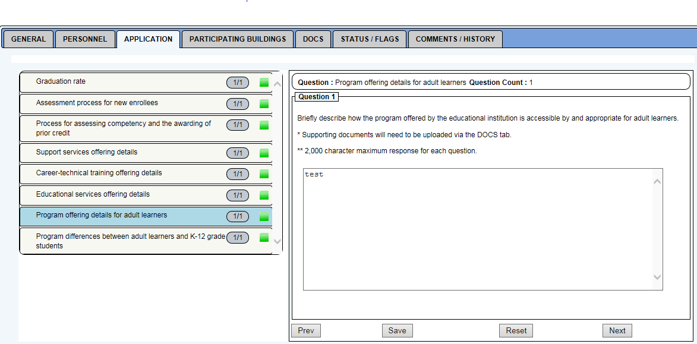
Application Tab - Question 7
Provider Application Response to program offering details for adult learners
Notes:
Briefly describe how the program offered by the educational institution is accessible by and appropriate for adult learners. * Supporting documents will need to be uploaded via the DOCS tab. ** 2,000 character maximum response for each question.

Slide 31
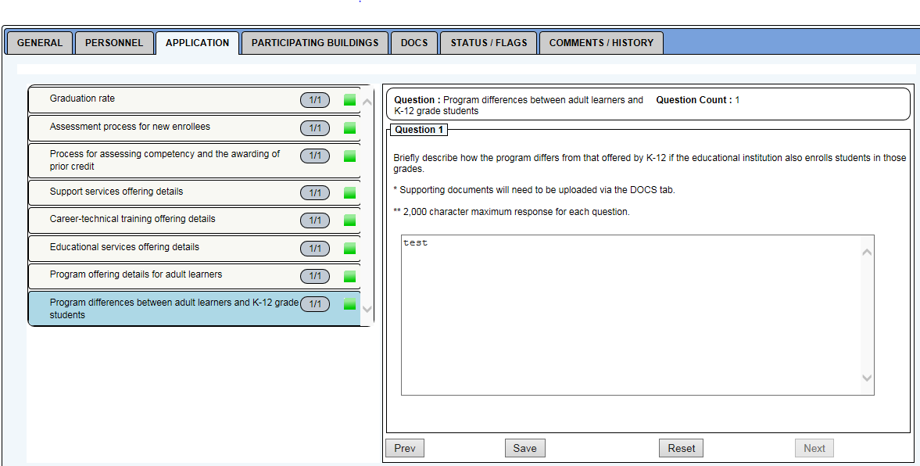
Application Tab - Question 8
Provider Application Response to program differences between adult learners and K-12 grade students
Notes:
Briefly describe how the program differs from that offered by K-12 if the educational institution also enrolls students in those grades. * Supporting documents will need to be uploaded via the DOCS tab. ** 2,000 character maximum response for each question.

Slide 32
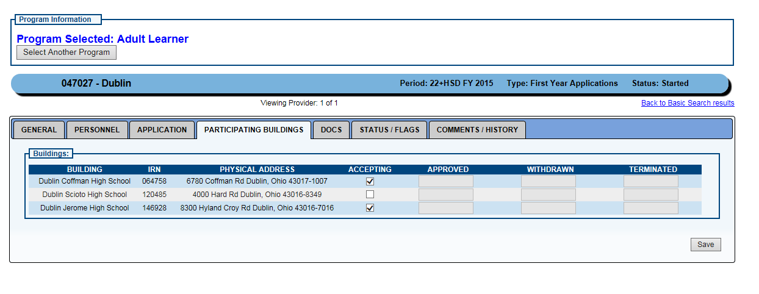
Participating Buildings Tab
Notes:
Select the building(s) that will be accepting students for the 22⁺ Adult High School Diploma Program. At least one building must be selected.

Slide 33
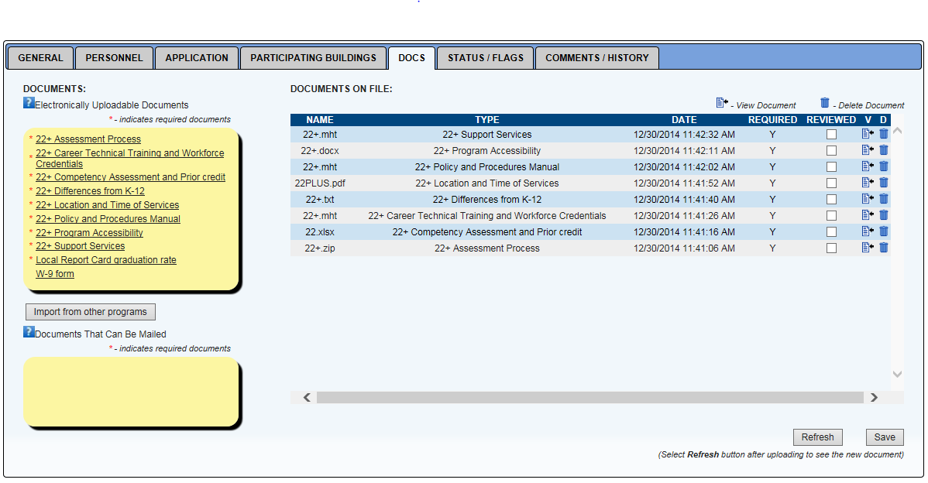
Required Documents Tab
Notes:
Upload the nine required documents. The W-9 form is only required if the Tax ID field in the GENERAL tab is not populated.

Slide 34
Application Status/Flags Tab
Notes:
The Status/Flags tab shows the current status of the application and available actions, as well as any flags that have been applied to the application by the Program Administrator. This is the view that the HSD Nominator sees. There are no actions available, as the HSD Nominator does not have permission to submit the application to become a provider.

Slide 35
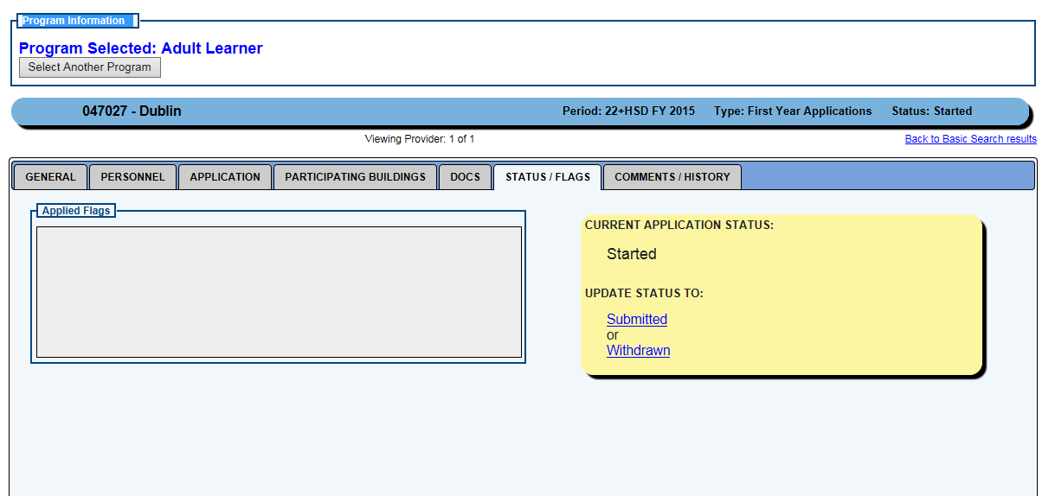
Submit The Application
Click to Submit The Application
Notes:
Update Application Status To Submitted
This can only be done by the Superintendent or Superintendent Designee for Public Schools or by the HSD Authorizer for Institutes of Higher Education. This is the view that these roles see. The application should not be submitted until all the required information has been provided and reviewed.

Slide 36
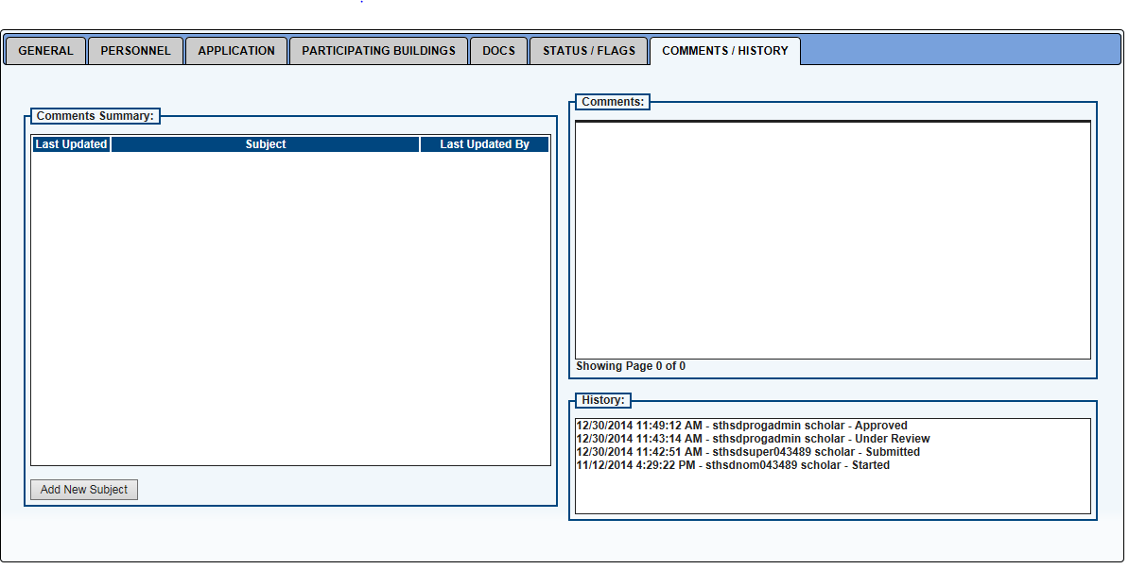
Comments/History Tab
Notes:
The Comments/History tab enables comments to be entered for the attention of the Program Administrator. Please be advised that this is a public document. It also provides a history of the application as well as the current status of the application

Slide 37
Provider Application Opens
The 22⁺ Adult High School Diploma Program Provider Application will be available on March 13, 2015.

Slide 38
Annual Renewal
Providers will need to renew their application annually based on renewal of funding.
Current funding ends June 30, 2015.

Slide 39
22⁺ Adult HSD Program Contact
Paul Preston
Program Administrator
614-464-8369
paul.preston@education.ohio.gov

Slide 40
education.ohio.gov

