Slide 1
Ohio Perkins V Equity Labs
Nov. 7, 2019 · Central Region

Slide 2
Welcome!
Introductions & Updates
Notes:
BRENNA & CRYSTAL
“Who’s in the room?” Introduction of State Staff, SST, Tech Prep

Slide 3
Equity Lab Workbook
Look for this icon at the bottom of the slide to guide you through the Workbook!
ALL INFORMATION in this PowerPoint is also contained in the Workbook!
Page 0
Notes:
BRENNA & CRYSTAL

Slide 4
If you have questions…
Post them in the Equity Lot
Submit them on Survey Monkey
www.surveymonkey.com/r/EquityLabAsk
Notes:
BRENNA & CRYSTAL
(Survey automatically refreshes so you can submit questions continuously!)

Slide 5
What is an “Equity Lab”?
“Ohio will pilot regional CTE Equity Labs…as part of the completion of the comprehensive local needs assessment.
These labs will be facilitated by ODE staff and will require each of the CTPD’s to bring a team of local stakeholders together.”
From the Ohio Perkins V Transition Plan…
Page 6
Notes:
LEAH

Slide 6
What is an “Equity Lab”?
Department staff will lead local teams through a series of facilitated activities to identify and plan for equity. These activities include:
Data Analysis & Review
Identification of Gaps
Root Cause Analysis
Planning for Equity
From the Ohio Perkins V Transition Plan…
Notes:
LEAH

Slide 7
What is an “Equity Lab”?
Meaningful Access
Enrollment & Engagement
Student Outcomes
Notes:
LEAH

Slide 8
What does Perkins V say?
States and Local Education Agencies must…
Make meaningful progress toward improving the performance of special populations.
Identify and quantify gaps between any subgroup and all CTE concentrators.
Evaluate strategies needed to overcome barriers for special populations.
Notes:
LEAH

Slide 9
Five of the six required uses of funds are related to special populations!
Notes:
LEAH

Slide 10
What does #EachChildOurFuture say?
“Ohio’s greatest education challenge remains equity in education achievement for each child.”
Notes:
LEAH

Slide 11
“Equity…is this plan’s greatest imperative and number one principle.”
Notes:
LEAH

Slide 12
Putting the Pieces Together
Equity Labs
Comprehensive Local
Needs Assessment
Perkins Local Application
Notes:
LEAH

Slide 13
“We believe each Career Technical Education student will…
Notes:
LEAH – NEEDS REVIEW!!!

Slide 14
Guidelines for Participation
Acknowledge differences amongst us.
Respect others’ opinions and beliefs.
Commit
to equity.
Engage
all stakeholders.
Page 8
Notes:
LEAH

Slide 15
The Equity-Focused Growth Mindset
Notes:
REBECCA

Slide 16
Let’s Kahoot!
1. Nominate a team captain to represent your team!
2. Using a smartphone or laptop, open the Kahoot! app or open your browser and visit www.kahoot.it
3. Enter the GAME PIN as displayed on the following screen.
4. Type in your team name and enter the game!
GOOD LUCK!
Page 9
Notes:
REBECCA
Link Kahoot!
REMEMBER: One team per CTPD!

Slide 17
Implicit Bias & Privilege
Notes:
REBECCA

Slide 18
15 Minute Reflection & Break
Notes:
Reminder about Pre-Survey, Questions (parking lot and SurveyMonkey), Rebecca’s printed resources?

Slide 19
The Equity Data Report
Page 10
Notes:
CRYSTAL

Slide 20
Perkins V Special Populations
Students with disabilities
Students from economically disadvantaged families
Single parents (including pregnant women)
Students preparing for non-traditional fields
English Learners
*Homeless students
*Youth in or aged out of foster care
*Students with a parent on active military duty
*New Populations as of Perkins V
Notes:
CRYSTAL

Slide 21
Additional Subgroups
Gender
Race & Ethnicity
Notes:
CRYSTAL

Slide 22
CTE Concentrator
Perkins IV (Data Report)
A student who has completed half of an approved program of study and is enrolled in the next half (51%)
Perkins V
A student who has completed at least two courses in a single program of study
Notes:
CRYSTAL

Slide 23
Perkins V Indicators
Graduation Rate
Academic Proficiency
Post-Program Placement
Technical Skill Attainment
Non-Traditional Program Concentration
Work-Based Learning*
Notes:
CRYSTAL
*Work-Based Learning is a Perkins V indicator, however, it is not included in your data. The guiding definition of this indicator is “sustained interactions with industry or community professionals in real workplace settings, to the extend practicable, or simulated environments at an education institution that fosters in-depth, firsthand engagement with the tasks required in a given career-field, that are aligned to curriculum and instruction.

Slide 24
Perkins V Indicators
Gender
Race & Ethnicity
Notes:
CRYSTAL

Slide 25
Data Disclosures
Data Time Period
Multi-Indicator Representation
Scope of Data
Data Masking
(<10)
Data Disclosures
Notes:
CRYSTAL
Data Time Period: CTE Data is on a one year lag. FY19 – CTE Concentrators who left secondary education in 2018.
Multi-indicator representation: Reviewing the indicators (Gender, Race/Ethnicity and Special Populations, we understand that the first two are set. One identifies as either male or female, and of one of the race/ethnicity groups; however, a student may cross over multiple special population indicators. i.e. A Student who is Female and Black-Non-Hispanic may also identify an economically disadvantaged¹ student with a disability² who is an English Learner³.
Scope of Data: Each visualization represents a different set of students. Sometimes concentrators, sometimes participants. It’s important to read each header carefully to understand the scope of students reflected within that visualization.
Data Masking: Populations that have fewer than 10 students are not represented in the visualizations.

Slide 26
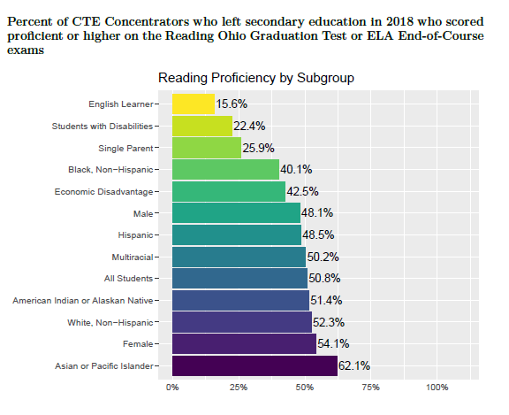
NOTE: This is the first year taking the new assessment.
Page 11
Notes:
CRYSTAL

Slide 27
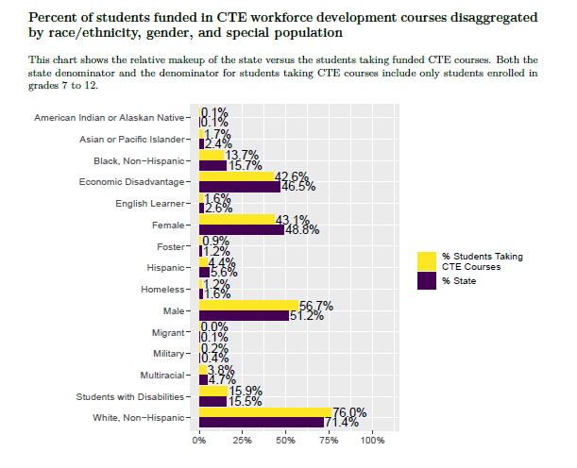
Page 12
Notes:
CRYSTAL

Slide 28
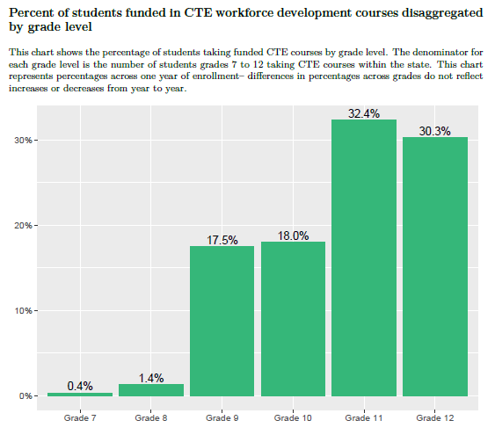
Page 13
Notes:
CRYSTAL

Slide 29
What counts as a gap?
EVERYTHING!
Notes:
CRYSTAL

Slide 30
Data Analysis & Identifying Gaps
Page 14
Notes:
KAYLA

Slide 31
Notice & Wonder Protocol
Step 1
Notice
Facts
Numbers
Gaps
Step 2
Wonder
Why…
If…
How…
Step 3
Narrative
Reveal useful information.
Notes:
KAYLA
Reference: Venables, Daniel R. (2014). How Teachers Can Turn Data into Action. Association for Supervision and Curriculum Development. http://www.ascd.org/publications/books/114007/chapters/Data-Meeting-1@-Reviewing-Existing-Data-and-Asking-Questions.aspx
Step 1: Notice: Notice Statements focus on the factual things we notice in the data
*Free of inference
Step 2: Wonder: Wonder Statements congregate around why it happened, how it happened, and what might be possible.
“Wonder why’s, wonder if’s, wonder whether, and wonder how…
*These observations may not be outright inferences but usually contain a speculative implication
In our next steps we are going to look at the visualizations of your local data. For each visualization I am going to use the sample state-level data to provide a suggested “Notice” and “Wonder” based on my observation to help your teams in identifying the unique Notices and Wonders illustrated in your local data.
*It is important to advise that we are ONLY looking at what the data reveals, unveiling trends and points of significance. This protocol is designed to support root cause analysis, in which you will dig deep into the why’s behind the wonder and attack the gap

Slide 32
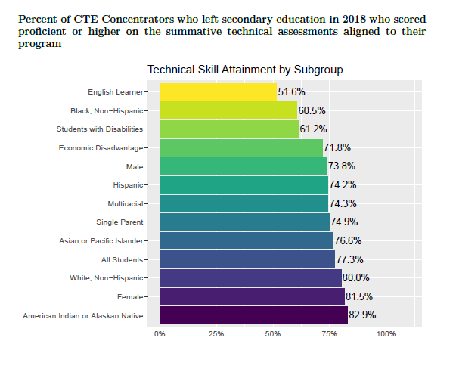
Page 15
Notes:
KAYLA
REMIND THEM: We are PRACTICING using state level data!

Slide 33
I notice…
…that 77.3% of all students scored proficient or higher, but only 51.6% of English learners did.
I wonder…
…if English learners had access to program resources and assessments in their native language?
Notes:
KAYLA

Slide 34
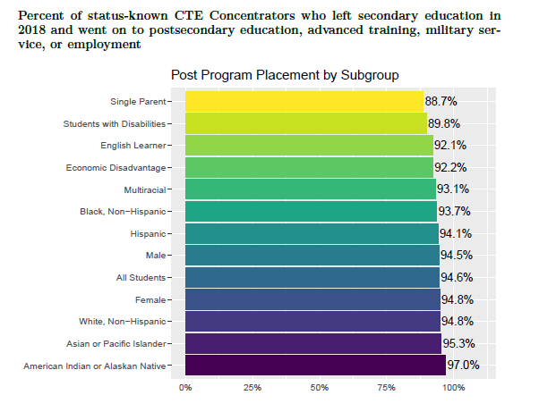
Page 16
Notes:
KAYLA
REMIND THEM: We are PRACTICING using state level data!

Slide 35
I notice…
…88.7% of CTE concentrators who were single parents reported moving on to a post-secondary pathway.
I wonder…
…if single parent students had access to services that promoted awareness and accessibility to these pathways?
Notes:
KAYLA

Slide 36
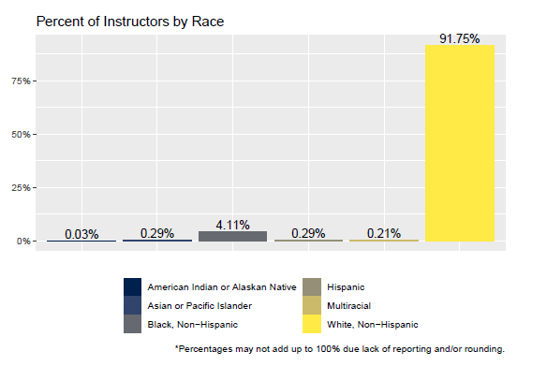
Page 16
Notes:
KAYLA
REMIND THEM: We are PRACTICING using state level data!

Slide 37
I notice…
…that 91.75% of CTE instructors were reported as white, non-Hispanic.
I wonder…
…what barriers in recruitment may be effecting the diversity of our talent pool?
Notes:
KAYLA

Slide 38
Notice Activity – CTPD Data
As a team, select three graphs from the CTPD data report to Notice & Wonder about.
Are there data points mentioned several times?
Do several notices fall under one category?
Which notices have the greatest significance or potential for impact?
Page 17
Notes:
KAYLA
First Step: INDEPENDENT
Second Step: GROUP

Slide 39
Prime the Narrative
Over lunch, consider which notice or data point from your previous discussion you might like to dive deeper into.
Consider notices that might yield the greatest impact, align to existing goals, speak to internal strategy, or represent the most pressing concern.
Notes:
KAYLA
*Reminder: Narratives are what will drive the root cause analysis. It reveals useful information (Notice statements) and becomes the compass for identifying equity gaps (Access, Engagement and Enrollment, and Student Outcomes).
- They are questions that require additional information to answer and that the team would like to investigate further.
For the purpose of today’s workshop teams will pick one narrative for root cause analysis
In reviewing the results of your Notice activity, as a team choose which Notice aligns to your goal for today’s workshop. Is the plan to address the gap that…
*Reminder – correlation does not equate to causation. These findings are a mere kernel glimpse into a much further investigative process in discovering potential cause.
Each team will share out the Notice and narrative statement they’ve chose to address in the root cause analysis.
Congratulations! You’ve made it through the data analysis portion of today’s workshop!
Now it’s time to dig deep into the why’s behind the wonder and attack the gap!

Slide 40
Break for Lunch Please return ready to begin at 12:15pm!
Notes:
CRYSTAL & BRENNA

Slide 41
Root Cause Analysis
ATTACK THE GAP!
Page 19
Notes:
DEAN

Slide 42
Step 1 – 2 Minutes
As a team, choose one notice from the previous exercise to use for this activity.
Example: 80% of students who are economically disadvantaged were reported as enrolled, enlisted or employed post-program.
One team member should write the notice at the top of the large sticky note.
Tip: Leave plenty of room below!
Notes:
DEAN

Slide 43
Step 2 – 10 Minutes
Independently, without conferring with your teammates, write down 5-10 possible causes or factors of your notice on sticky notes.
Example: Costs associated with post-secondary training, awareness of pathways and so on.
TIP: Write ONE cause per sticky note!
Notes:
DEAN

Slide 44
Step 3 – 10 Minutes
Now working as a team, organize all of your sticky notes into common themes or topical buckets.
Example: Cost of post-secondary training, lack of awareness about financial aid and lack of transportation could all be organized under Financial Resources.
TIP: Try not to make your categories too broad or too specific!
Notes:
DEAN

Slide 45
Step 4 – 5 Minutes
Have a volunteer write each of these categories around the perimeter of the large sticky note.
TIP: Circle the category titles to make the next step easier!
NOTICE
1
6
2
5
3
4
Notes:
DEAN

Slide 46
Step 4 – 5 Minutes
As a team, determine if a relationship exists between each category. Draw an arrow to represent this relationship.
TIP: Circle the category titles to make the next step easier!
NOTICE
1
6
2
5
3
4
Notes:
DEAN

Slide 47
Step 5 – 20 Minutes
As a team, determine the cause & effect relationship between each category. Draw an arrow to represent this relationship.
Example: Reference the example on
and consult with a facilitator for further assistance.
TIP: It may be easier to consider one category at a time!
Page 20
Notes:
DEAN

Slide 48
Step 6 – 5 Minutes
Count the number of arrows pointing TOWARDS each category. Write this number next to the category.
Which category has the most arrows? Are you surprised by your results?
This may be the area with the greatest potential for impact.
Notes:
DEAN

Slide 49
15 Minute Gallery Walk & Break
Notes:
DEAN

Slide 50
Equity & the Comprehensive Local Needs Assessment
Notes:
BRENNA & ALYSSA

Slide 51
5 Parts of the CLNA
Evaluation of Student Performance
Evaluation of Program Quality
Size, Scope & Quality
Labor Market Alignment
Progress Towards Implementing CTE Programs of Study
Recruitment, Retention and Training of CTE Educators
Improving Equity and Access
Page 21
Notes:
BRENNA & ALYSSA

Slide 52
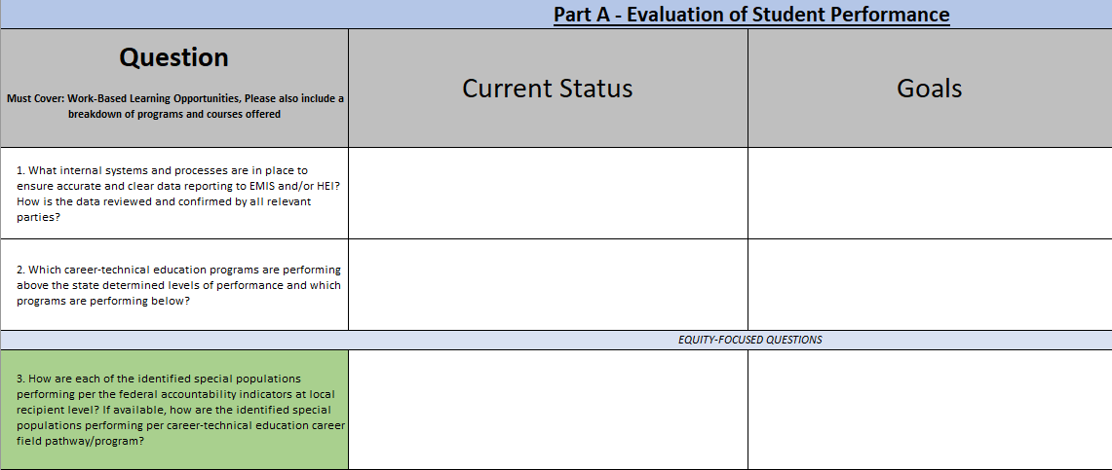
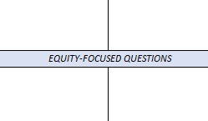
Equity & the CLNA
In addition to all of the questions within Part E: Improving Equity & Access, Parts A-D each have at least one Equity-Focused Question to complete.
Notes:
BRENNA & ALYSSA

Slide 53
Equity is a through-line, not an add-on.
Notes:
BRENNA & ALYSSA

Slide 54
Equity & the CLNA Worksheet
Start to consider potential strategies for pursuing this goal.
Questions as pulled directly from the CLNA.
Guidance within the Equity Lab Workbook.
Use identified root causes to brainstorm goals.
Use data to indicate and corroborate Current Status.
Page 22, 23-27
Notes:
BRENNA & ALYSSA

Slide 55
Work with your team to begin addressing the equity questions!
Notes:
BRENNA & ALYSSA

Slide 56
Lasting Considerations for Equity
Continue with all the great things you are already doing; we are simply adding tools to the tool box!
Equity work is additive.
As you continue to engage stakeholders, remember to recognize and include those this work is intended to serve.
Don’t forget student voice!
Numbers tell you what, they will not tell you why.
Continue doing the work to inform the data you are observing.
Notes:
BRENNA & CRYSTAL

Slide 57
Lasting Considerations for Equity
Our goal is to ensure each child is challenged, prepared, and empowered.
Barriers can be real and perceived.
Students will always be able to make their own choices. Our efforts are to ensure we have provided them what they need in order to make those choices.
Equity work is not about determining the outcomes.
Notes:
BRENNA & CRYSTAL

Slide 58
Final Questions?
Notes:
BRENNA & CRYSTAL
Last-minute announcements

Slide 59
Post-Lab Survey
Notes:
BRENNA & CRYSTAL

Slide 60
Thank You!
Notes:
BRENNA & CRYSTAL

Slide 61
@OHEducation

Slide 62
Share your learning community with us!
#MyOhioClassroom
Celebrate educators!
#OhioLovesTeachers

