Slide 1
This is a sample presentation for you to customize.
Notes are provided for guidance and should be modified based on your audience.
Notes:
This workshop is a train-the-trainer model
The expectation is that you will pick up this material and replicate the session to fit the needs of your partner districts and schools
For example, you may be working with schools counselors on advising students on career pathways that include options to earn a high school diploma, industry credentials and college credit
You may be working with curriculum supervisors or department heads to integrate linkages to career fields within local curricula
Lastly, you may be leading training or directly supporting various career-related strategies that promote student success (i.e., placement in job shadow, internship or part-time jobs, career and college fairs, career field exploration)

Slide 2
Career Connections
May 2015
Notes:
Additional background – if necessary. You should approach this presentation however best reflects the needs of your audience/community. Make it relevant and relatable.
Make it real. Make it relevant. Build in personal connections. Build in your own hook:
“21st Century Skills”
Everyone remembers when this idea came out, along with STEM and inquiry-based. These strategies or campaign were being driven by demand and needs across our economy.
Innovation, creativity and problem-solving: these really are critical for everyone’s future
Industry is changing; global competition is growing; if we want to continue to have incredible opportunities for our children, we have to stimulate their minds and embrace innovation in education
This is one example – think about using a business-related example that connects to your community. What major employer exists that everyone will immediately connect with? Think through what their business processes are and how you can pull in an example such as this:
How many of us have a printer at home? We can scan, email and print right from our own house. Think about how ridiculous that would have sounded 20 years ago. Remember taking film from your camera to the drug store, putting it in the envelope and waiting 7-10 days to see the exposures? Now we can view the picture immediately from our digital device, we can share it instantaneously, or print it from our wireless printer at home.
The next generation will continue to focus upon improving existing processes and designing more efficient ways of doing business.
Most of us have seen a 3-D printer – or at least heard about it. Think about what automated machining will look like in the next 10 years. Students will be able to design and 3-d print/manufacture their own iPhone 16 cases right at home.
Another hook if needed…
We have 1 million Ohioans without a high school diploma or GED. That number grows by 24,000 annually as current high school students continue to disconnect and disengage from school. In 2010, Ohio had a dropout rate of 4.2 percent. Which is above the national average of 3.4 percent (U.S. census data).
WHY:
Create relevance and purpose in the classroom
Identify career interests for making informed decisions, based on research and experiences; structured and supported environment for planning
Promote post-secondary options, access, and completion
Maintain engagement, focus, and motivation
Research shows that a consistent factor in the reason for students dropping out early in high school is a lack of motivation due to the perceived irrelevance of school.
Thus, students aren’t seeing the connection to what they are doing in the classroom and the purpose and relevance is has with the real world or world of work.
Career Connections is Ohio’s vehicle for increase students’ awareness of the connections between the classroom and their career pathways.
In order to do this we have to help them realize their career interests. Using tools to develop and increase their career maturity which will lead to more informed decision making.
We have to be sure that students are making decisions based on data and information. This means that they need experiences throughout high school so that they can determine not a specific career but a pathway. Students who enroll in college as undecided often times continue as undecided. They may not receive or seek out the support they need to make a decision about a major. Ultimately this increases the likelihood of them dropping out or accumulating unnecessary debt.

Slide 3
Goals
  Understand the background supporting the need for career advising in Ohio.
  Learn Ohio’s policy on career advising.
  Understand the components and key topics of the career advising policy
Notes:
Career Connections is an all-hands-on-deck initiative and we can’t expect that any one district, school or organization can provide a comprehensive menu of services to students all on their own
This isn’t a career-tech thing
This isn’t a school counselor thing
This is a whole-student initiative and crosses many areas and aspects of the educational system
Each school should designate a lead or key point of contact (which may be a career tech staff member, school counselor or curriculum supervisor)
The lead will be coordinating efforts across the community that engage business and industry, families and school staff in expanding opportunities for students to link their learning to career fields
Your job is to take notes on what I’m sharing with you and begin to think through how you will make this your own – critique my message as we go so that you can make the adjustments necessary for your own workshop.

Slide 4
Why This Matters in Ohio
Preparing all students for successful futures.
Notes:
So why are we here? You may have said to yourself on your drive here today, we’re already doing this & I hope you did. A large part of what I want you to walk away with is an organized outline of what you’re already doing so that you can zero in on those additional opportunities – areas to grow and expand.
Sidebars…if needed:
Response to “We’re already doing this”
The thing is, this isn’t happening enough – at least not the way it needs to be in order to build buy-in, awareness, and create value and investment from all stakeholders. Think through this in terms of how do I change the message I’m currently delivering to have an impression and invoke the change in behavior that’s necessary to grow this work.
Be mindful that not everyone will be willing and listening – however, it is your responsibility to provide the necessary supports and assistance that:
expands and enhances career connections for students
allows students to prepare for their futures
assists teachers and school counselors in developing and growing students’ capacity
Response to “How will we do this with all of these districts/schools?” for those very large districts.
No one will be working alone. The first idea you have to embrace is that this is a collaborative effort. No one person, department, school or district is being asking to do this work in isolation or in a silo. There should very much be a team approach where each stakeholder understands their role and responsibilities. There will need to be a lead in this approach and the lead will need to determine how formal or informal these understandings need to be (i.e., verbal understanding or memo of understanding).

Slide 5
Career Connections
Aligns district efforts to ensure consistent and ongoing opportunities for all students
Embeds curriculum strategies that help students link their learning to future careers
Engages students in opportunities to discover their career interests, explore pathways and make plans for their future
Notes:
Career Connections is about creating authentic learning situations for students of grades K-12 where they have opportunities to develop the skills and knowledge needed to prepare for global competition, rigorous post-secondary education and training, and high-skill high-wage careers.
Organized to foster connections between what students are learning in the classrooms and the expectations and demands of the workplace – think: critical thinking, problem solving, collaboration, leadership, innovation, creativity, etc.

Slide 6
Framework
Career Awareness
Kindergarten through Grade 5
Career Exploration
Grades 6 through 8
Career Planning
Grades 9 through 12 and beyond
Notes:
How do we bring these ideas into education? Where do we start?
Developmentally appropriate
It is community focused and student centered.
Shared Reading (15 minutes)
Get together in groups of three. Each person chooses a section to focus on and quickly becomes the table expert (read front and back for their grade levels). Note any ideas or works that surprise or especially interest you and discuss at your table.
Large group share out is provide one example per grade band – post its.
Circle or highlight what you already have in place – go ahead, write on the document.
Background
The Career Connections Framework provides an overview for districts when developing local plans. The Framework is organized by career development phases that align with developmentally appropriate grade levels. One thing to recognize is that as students progress through school the items referenced continue – for example, career awareness is lifelong. We continue to learn about career options and explore new careers.
Awareness: exposure to more than what they are familiar with through their every day lives; provide examples where teachers can explain why school is relevant to their future and how it connects to the world of work – students should be able answer “why do we go to school” by 3rd grade; “what am I good at” in 4-5th
Exploration: opportunities to see and hear first-hand where their interests connect to the work place (involve community business partners – answer “what businesses and jobs exist in our community” “why type of jobs exist in our community”)
Planning: meaningful, deeper experiences (internships, shadowing, pre-apprenticeships, research employers, interview professionals) research the options and what it takes to get there “how do I prepare for the career I’m interested in” “what connections can I make to better prepare me for that field”
Developmentally appropriate; this isn’t apprenticeships in elementary grades. Some of this work will already be in place in your schools. Other schools will need some help getting started. All schools will be approaching this from a different level and perspective priorities and resources vary, so this isn’t punitive. Ultimately, students need to be exposed to career pathway options earlier and more consistently. Families need to have access to tools and resources to support students with making informed decisions and start conversations sooner.

Slide 7
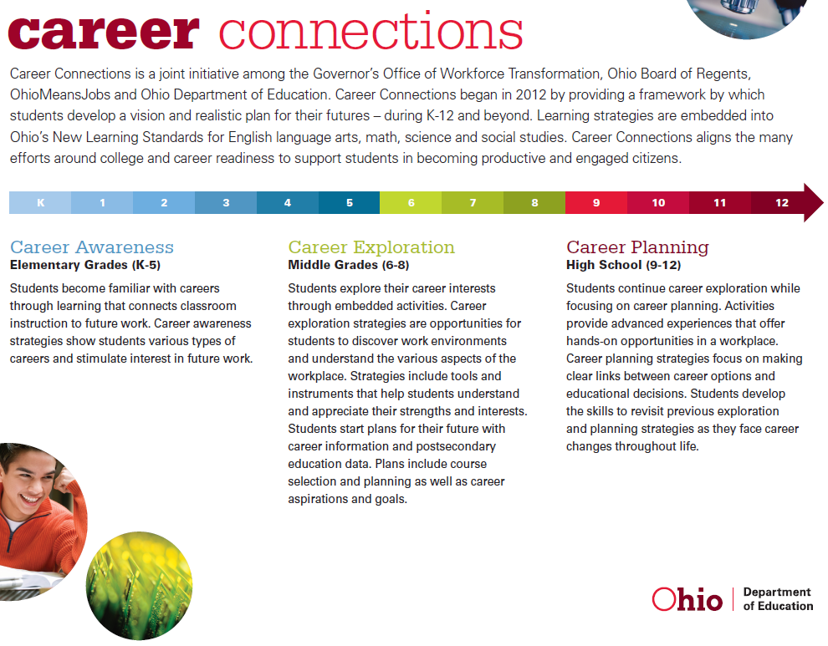
Notes:
Looking at your handout – or the electronic document online at education.ohio.gov – career connections – you’ll see the summaries on page one explaining the three levels. Recognizing that they building upon one another and create an ongoing continuum that doesn’t end in high school, but rather prepares students to implement and apply throughout their careers.
How do we bring these ideas into education? Where do we start?
Developmentally appropriate
It is community focused and student centered.
Shared Reading (15 minutes)
Get together in groups of three. Each person chooses a section to focus on and quickly becomes the table expert (read front and back for their grade levels). Note any ideas or works that surprise or especially interest you and discuss at your table.
Large group share out is provide one example per grade band – post its.
Circle or highlight what you already have in place – go ahead, write on the document.

Slide 8
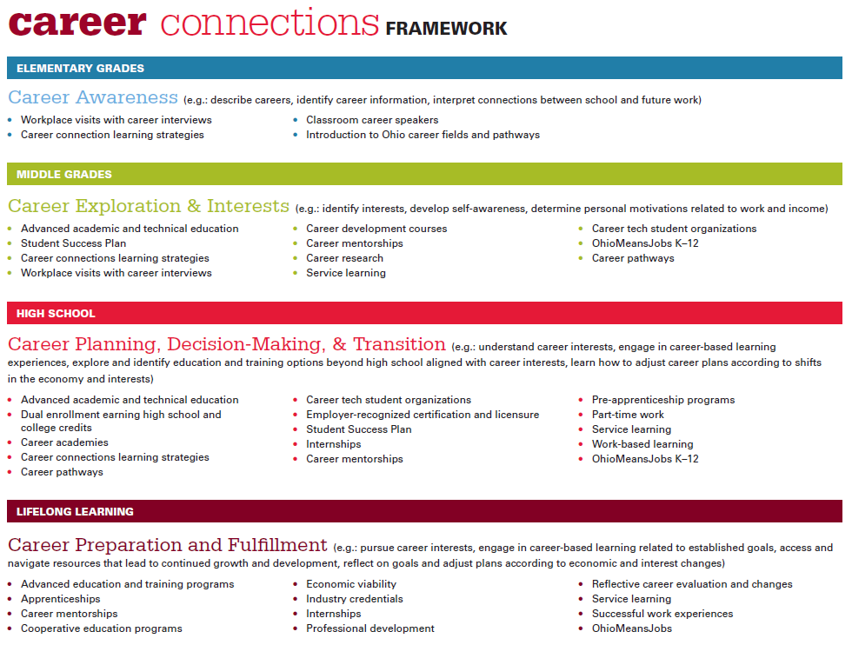
Notes:
Page two includes strategies at each level that include academic curriculum, experiential learning, and career education. Students need opportunities within a structured and supported environment to explore their options and try things out to find out more about what they like and don’t like.
College is expensive – any way you look at it. Regardless of a families ability to pay for education beyond high school, the cost is high. Career Connections is about providing kids opportunities to sample more things and get a better idea of the career fields that interest them. This is not about nailing down exact career choices - we know that isn’t realistic. But students should recognize before they leave high school that engineering is science-intense curriculum, becoming a veterinarian requires 8-10 years of schooling and that there are viable career options that require less than a four-year degree. This happens in classrooms across the state every day – this is about gelling all of the efforts to create a cohesive experience for students.

Slide 9
District Career Advising Policy
Linking learning to career fields
Career advising for grades 6-12
Training staff on pathways including high school diploma, career and academic options, earning college credits and industry credentials
Notes:
Beginning in the 2015-2016 school year each local board of education for city, local, exempted village and joint vocational school districts will adopt a policy on career advising that addresses each of the eight components in state law: http://codes.ohio.gov/orc/3313.6020
Policies must be sent to CareerConnections@education.ohio.gov by Sept 30, 2015.
The overall themes fall into pathways, planning and learning.
Linking learning to careers
Advising all students beginning in grade 6
Identifying students at-risk of dropping out and developing student success plans accordingly
Training for staff on pathways and online tools
Multiple pathways to earn a high school diploma
Credit flex and other ways to earn both academic and career tech credit
Documentation of advising, available to student, parent, current and future schools the student may be enrolled
Supports and interventions needed for successful postsecondary transitions

Slide 10
Career pathway system
Student exploration and planning
Classroom linkages to career fields
OhioMeansJobs K-12
Notes:
Implementation themes of advising
Classroom linkages to career fields (curriculum, teacher guide, examples)
Hook/lead in; speaker/presenter
Project-based
Culminating experience
Student planning and exploration (success plan documentation, reflections, etc.)
Journal/essay/research
Worksheets on goals, scheduling
Career pathway system (academic and tech courses, experiential learning, etc.)
Comprehensive course offerings (on and off campus options)
Job shadow, internship, pre-apprenticeship
Varies by community and capacity
Who are your partners?
What value can they add and what can you leverage from them?
We’ve got to get community involved in education. They need to realize what today’s classroom looks like, how learning happens and we need to hear from them about what the great needs are in order for our students to be prepared for the economy.
Write down one person, organization or company that you know you can call and someone will be willing to think through this with your team. For example, Jane Smith, curriculum director at Jones Schools or Mike Ford, branch manager at PNC Bank.

Slide 11
Delivery Vehicles
Advisory Program
Integrated curriculum
Stand-alone courses
Notes:
Delivery vehicles or models (not mutually exclusive – could have varying levels of more than one – mix and match) – How does this roll out? Where does it all fit in?
Standalone course(s)
Career tech courses
Beginning in middle grades, includes Career Connections, FCS, CBI; one course each year and required for all students
Early exploration and preparation later in high school
Career field programs that lead to credentials
Integrated into your existing courses (we’ll look more at this idea later)
Advisory program/model
Modified bell schedule
Planned curriculum; scope and sequence
Student assignments to staff
Comprehensive school counseling curriculum
Planned curriculum; scope and sequence
1 on 1, small group and classroom-based delivery

Slide 12
Career Advising and Student Success Plan
Information
Career Fields/Clusters
Occupations – high need, skill, and wage
Interests
Skills
Aspirations
Assessment
Education and Training Options
Reflective Analysis
One-on-one conversations with students
Documentation of activities
Notes:
Counseling and advising – either counselor lead or through advisory programs
Reflective Analysis or Phenomenology is the study of structures of consciousness as experienced from the first-person point of view. The central structure of an experience is its intentionality, its being directed toward something, as it is an experience of or about some object. (Google)

Slide 13
Formats
Stand-alone projects, lessons and activities
Stand-alone courses
Sequence of courses
Integrated curriculum
Comprehensive Advisory Program
Notes:
Stand-alone lessons – ongoing, designated times for career curriculum (i.e., Future Fridays)
Stand-alone courses – CTE or other courses that are not required nor integrated into a sequence or pathway
Integrated curriculum – projects, lessons and activities woven into courses and classes at intentional points of times to make relevant connections and reinforce content using real-world, relevant scenarios or situations
Sequence of courses – CTE or other courses that follow a curriculum where students progressively build upon knowledge and experiences through a continuum of courses
Comprehensive Advisory Program – bell schedule designed with integrated, ongoing designated times for career curriculum delivered consistently across classes and grade levels (all staff have small groups “homeroom” – teachers as advisors model)

Slide 14
Sample Delivery Strategies
Academic Teachers
School
Counselors
Embedded into Curriculum
Co-teaching and planning
Stand-alone courses
Pull-out lessons
One-on-one or Small group
Career Tech Teachers
Stand-alone courses
Co-teaching and planning
Co-teaching and planning
Embedded into Curriculum
Comprehensive Advisory Program
Comprehensive Advisory Program
Comprehensive Advisory Program
Notes:
- Content-Area Teachers (ELA, Math, SS, Science) – co-plan/teach with CTE or School Counselors; deliver content embedded into content-area curriculum
- CTE Teachers – deliver content embedded in career field/program curriculum; stand-alone CTE courses on career planning, exploration, and decision-making; co-teach/plan with content-area teachers
- School Counselors – co-plan/teach with content-area teachers; deliver stand-alone courses based on career counseling curriculum; deliver lessons via pull-out of a content-area class (sequenced where each year builds upon the previous); one-on-one or small group lessons (sequenced where each year builds upon the previous)

Slide 15
Tools and Resources
Notes:
Ohio Department of Education offers many resources to guide districts through planning and implementing the policy.
OhioMeansJobs K-12
Career Connections Learning Strategies
Career Pathways
Presenter: explain each of these briefly, the ask participants to organize into three groups based on these resources. Each group will strategize how the resource can support both students and educators (professional learning). Each group will share out and post their ideas on a chart – capturing the collective conversation around how to use these tools.
Note: if your district offers additional tools, you may want to include those in this conversation as well. It will provide structured time to discuss and explore the resource while also strategizing how the tool can be leveraged to support various aspects of the work.

Slide 16
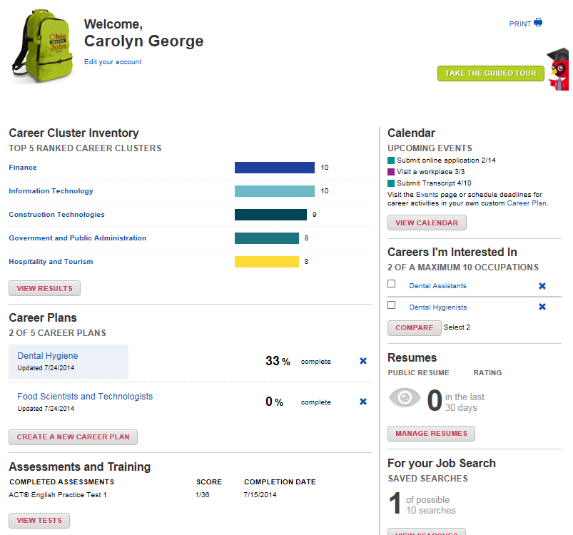
Student Success Plan & Backpack
Notes:
OhioMeansJobs K-12 is a new online career exploration system available to all districts at no cost. The Backpack is an individual account for each student that can serve as the backdrop of the Student Success Plan and also capture documentation necessary for the career advising policy. A best practice would be for all students beginning in middles grades to create a Backpack that they will build through middle and high school.
Students will create a Backpack to save their information, but this also allows them to create a career plan, build a résumé and access a host of assessment prep tools such as ACT, SAT, ASVAB, COMPASS, ACCUPLACER, and much more.
Yes, this is available at no costs to all Ohioans – public, private, libraries, etc. everyone will have access. The system launched Fall 2014 and schools continue to be notified through ongoing ODE communications (Facebook, Twitter, Superintendent newsletter, etc.). Make sure you’re signed up to receive these communications (like the page, follow, and sign up for emails).
Thinking through these components and resources available – where do you get started? What’s one thing you can do when you get back to school? This year?

Slide 17
Classroom Linkages to Career Fields: Career Connections
Learning Strategies
Model Curriculum with embedded strategies aligned to Ohio’s New Learning Standards
Guide for Teachers with strategies to integrate in to local curriculum
Notes:
Everyday students attend classes during their school days where they don’t see the relevance or application of what they are learning outside of the classroom. Coordinating with teachers, counselors and administrators across the state in regional work groups – ODE compiled sample strategies that are embedded in the standards for English language arts, mathematics, science and social studies.
An example has been provided for you but you’ll find the strategies in their entirety on the ODE website – located on the content area webpage and the Career Connections webpage.
Want to see what this looks link in practice? Consider sharing this video example from Edutopia:
http://youtu.be/7t30ZMX8uGw?list=PLGC_ueCYV2llcOeZMfqY_Vl3qBsS43Xl6
This video highlights science teachers leveraging project-based learning and service learning to establish context for their learning. Notice how the teachers work together, students see the rewards of their efforts and apply their learning within a project that has relatable impact for themselves and their school community.

Slide 18
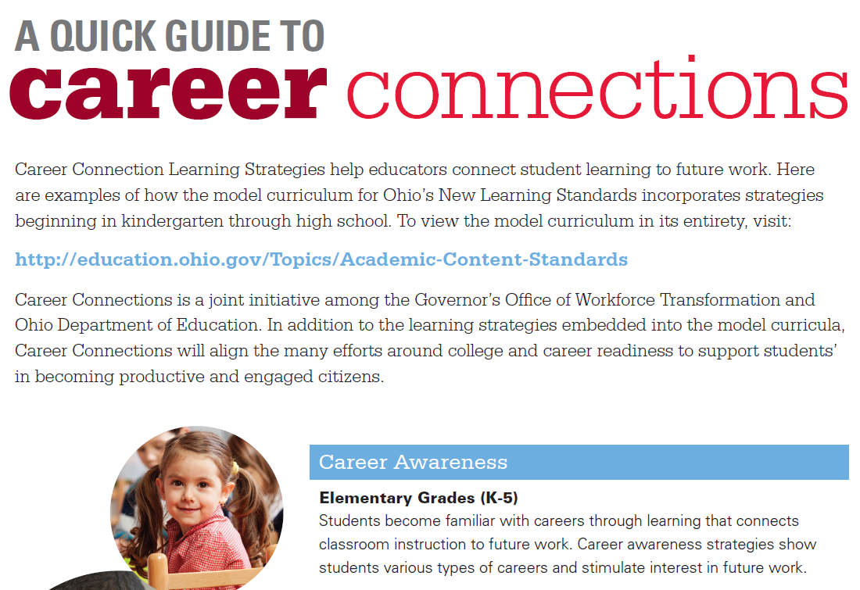
Notes:
Here is the cover page of the compiled document you’ll find on the Career Connections page – all strategies for grades K-12 and each of the four core content areas.
Available online at: http://education.ohio.gov/Topics/Career-Tech/Career-Connections/Resources-for-Teachers

Slide 19
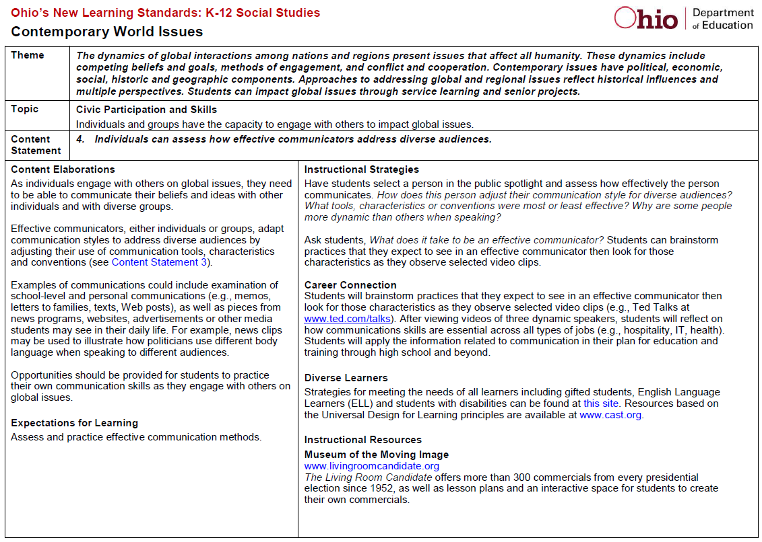
Notes:
Embedded into the model curricula for ELA, Math, Science, Social Studies;
The idea with the sample strategies is to show teachers how to extend what they are already doing in their classroom curriculum and make deliberate connections for students to the workplace. These connections are often obvious to educators, but unless we point them out to students it could be a missed opportunity to engage students and motivate their interests in the content.
The argument for the learning strategies is that it’s not asking teachers to do anything differently – it’s the same curriculum. But it’s being intentional about how students see the relevance of the content and learning expectations. When we consider the competing initiatives such as 3rd grade reading guarantee and evaluation systems – it has to be recognized that career connections is supporting the same outcomes. Preparing students to be successful through higher education and careers.
Available online at: http://education.ohio.gov/Topics/Career-Tech/Career-Connections/Resources-for-Teachers

Slide 20
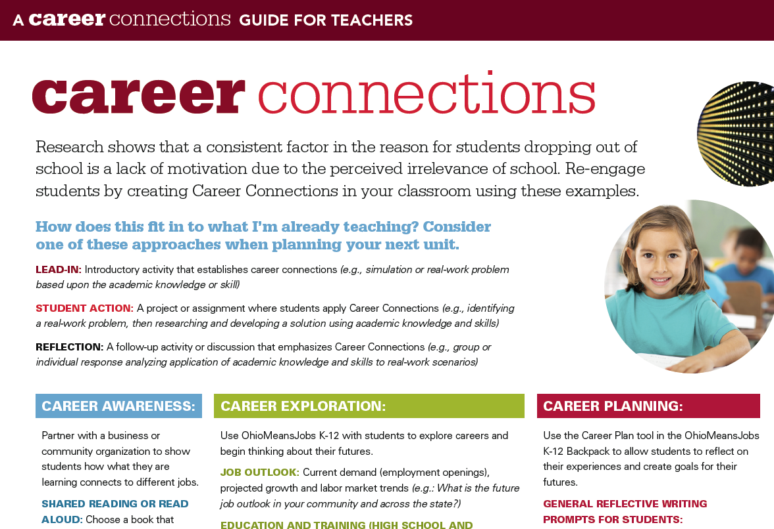
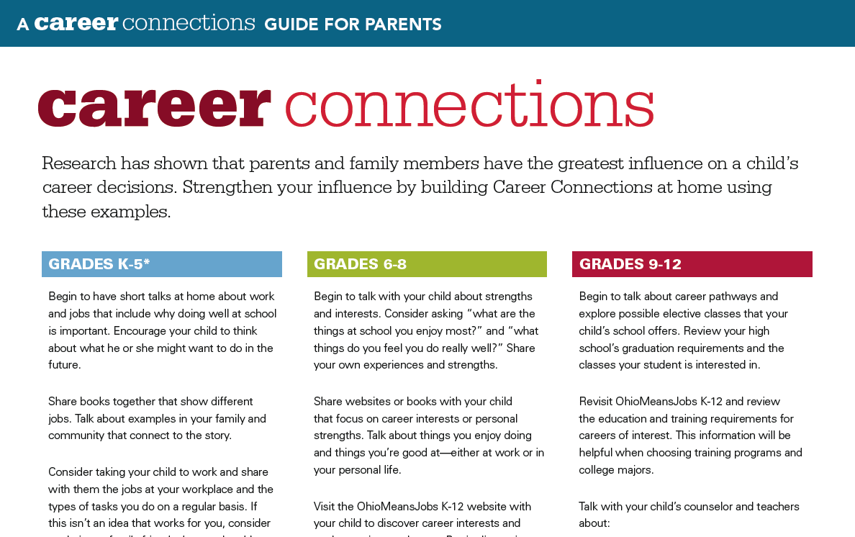
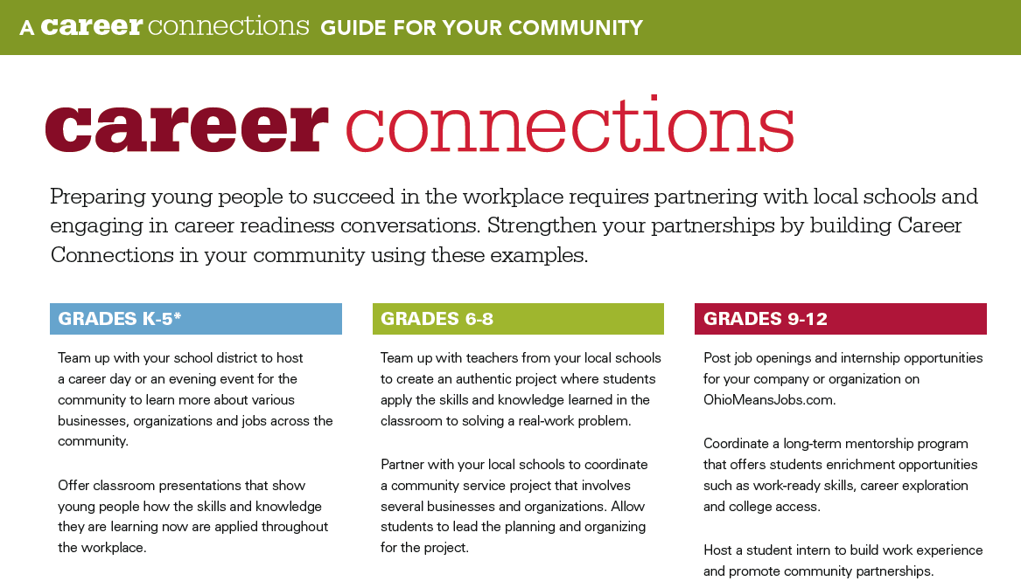
Notes:
Guides for teachers and counselors, parents and community members provide ideas for creating career connections across their respective reach. For example, if you lead advisory periods or coordinate events for students – the guide includes reflective questions to guide conversations and topics for presenters or students when interviewing professionals. Parents can discuss careers at home and help students think about their futures. Community and business members can partner with schools to offer students opportunities for learning more about the workplace and jobs in their region.
Available online at: http://education.ohio.gov/Topics/Career-Tech/Career-Connections/Resources-for-Teachers and http://education.ohio.gov/Topics/Career-Tech/Career-Connections

Slide 21
Curriculum Strategies
Who are your existing partners?
How do you leverage community involvement in order to add value to student learning?
Notes:
Examples – department heads, teacher-based teams, or building leadership teams coordinate with business and industry to share expectations for student learning and engage in dialogue to learn how knowledge and skills are applied in various contexts. Consider including multiple stakeholders who represent many perspectives:
Healthcare: hospital administration, care providers, dental hygienists
Finance and Insurance: underwriters, agents, financial analysts
Business, Marketing and Communications: human resource managers, technical writers, accountants
Engineering, Manufacturing and Transportation: electrical engineers, machinists, mechanics
Agriculture and Environmental Systems: food scientists, food production specialists, forest and parks supervisors

Slide 22
What is a Career Pathway?
Tool: Facilitate communication and advising
Way of thinking: Shift how students experience high school
Customizable for any ambition: Whether a student is interested in going to college, getting a certificate or working right after high school
Notes:
Various Ohio policies mention the importance and role of pathways – college credit plus for postsecondary pathways; graduation requirements for pathways to earn a high school diploma and career advising for career pathways to explore options and begin planning for the future.
ODE, in partnership with OBR, OMJ and OWT, has developed sample pathways that can be adapted and customized to district, school or individual students.
These pathways represent a continuum of education and training and occupation – showing various “on and off ramps” that an individual can pursue based upon personal aspiration and commitment levels. While it’s important to be prepared, these examples recognize credentials that may be earned beginning in high school and reflect more of a “stackable” approach where education and training are ongoing, life-long ventures.
Video resource, Success in the New Economy: https://vimeo.com/67277269
This video provides a great overview for why career exploration and planning is necessary. Knowing about what options are available and evaluating those options against interest and skill support informed decisions. It’s a great backdrop for the career pathways and helping to reinforce the role that career information such as “in-demand” jobs has in planning. Take note of the 1:2:7 ratio…great transition to the next slide. Think Dentist (1): Hygienist (2): Assistant and other office staff (7).

Slide 23
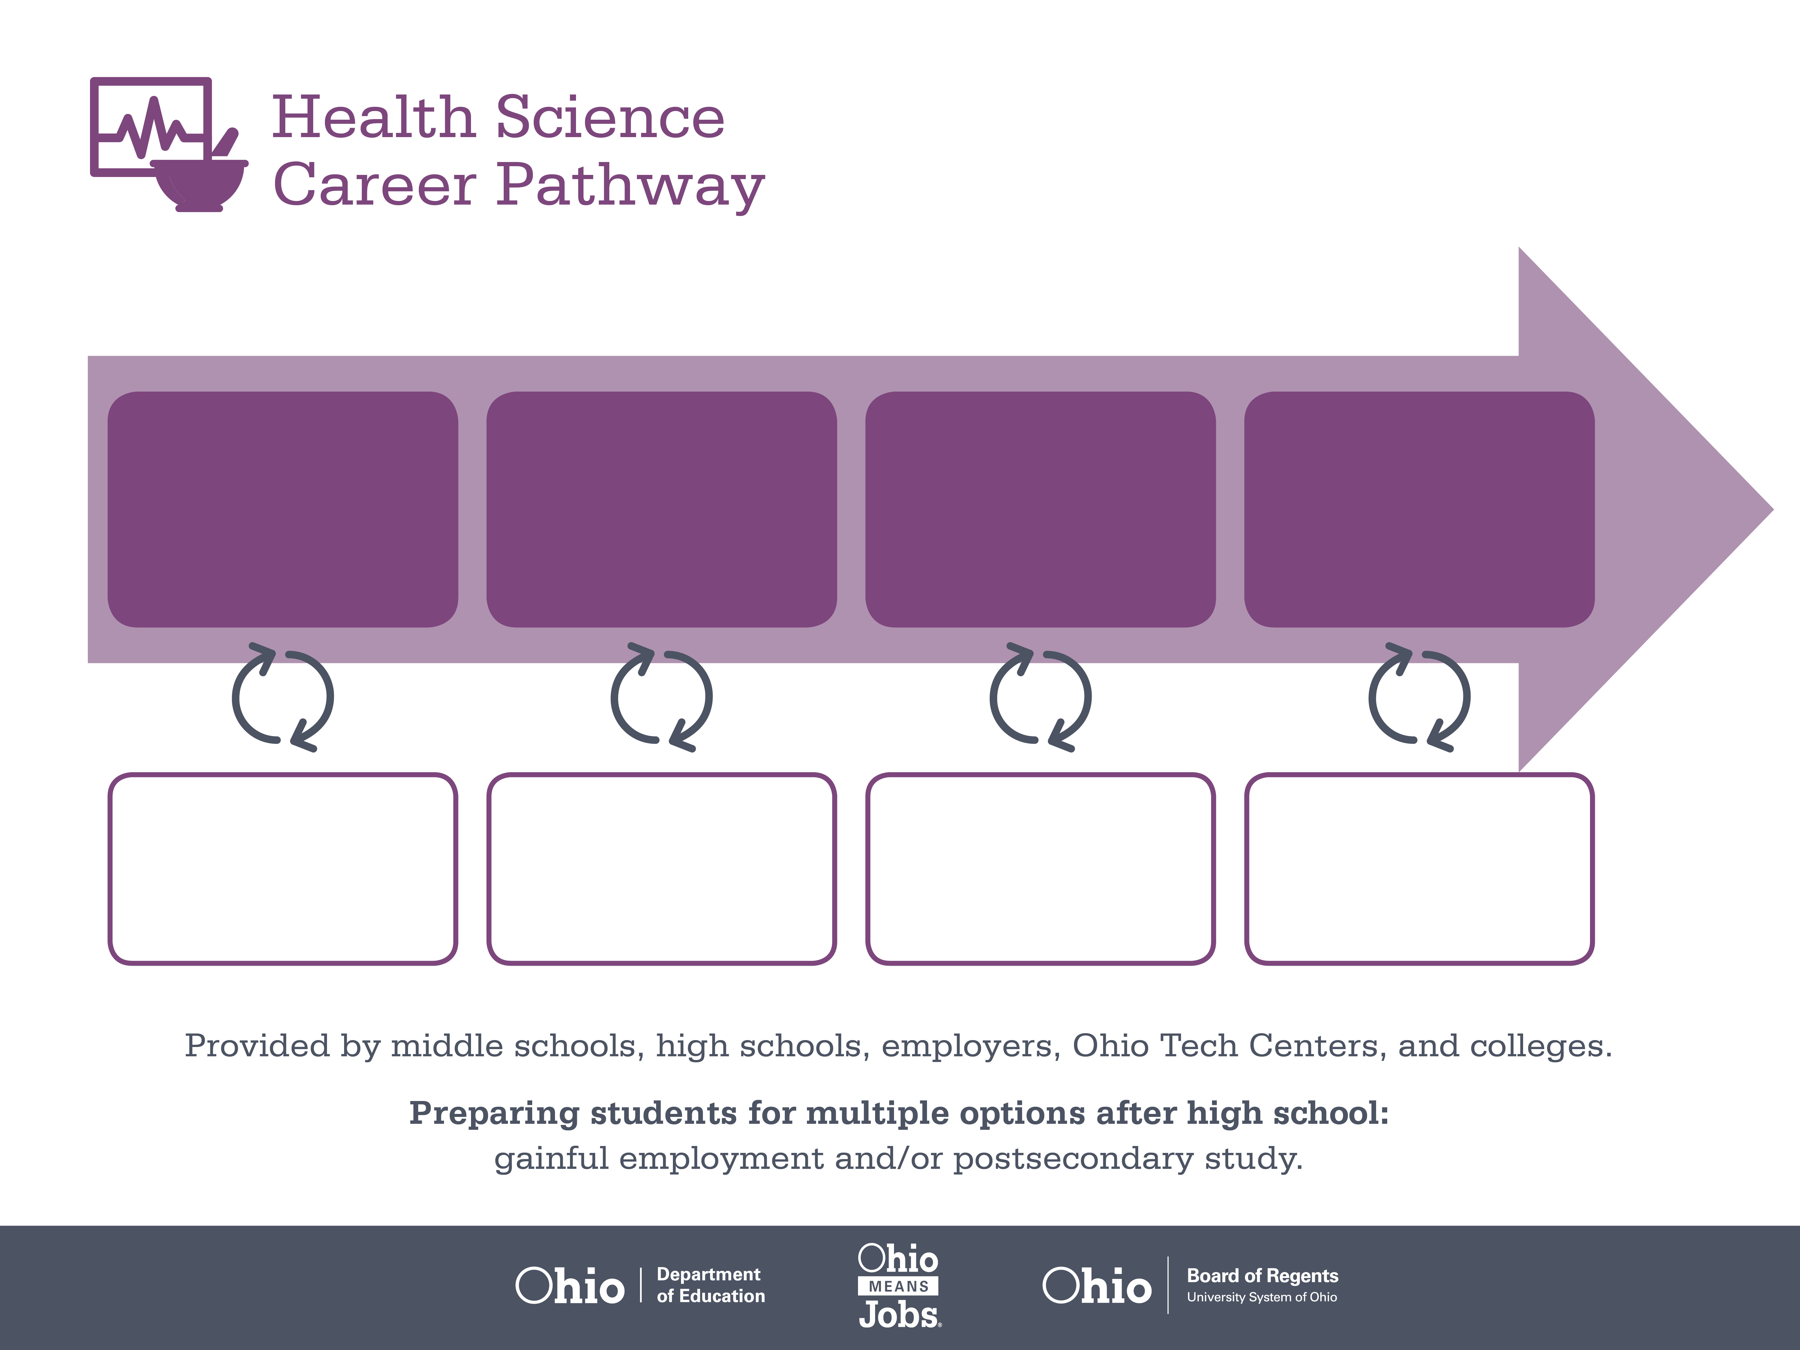
Certificate,
Dental Assisting
Associate or Bachelor’s
Degree, Dental Hygiene
Doctoral Degree,
Dentistry
Start Pre-Health
As early as grade 7
(based on readiness)
Dental Assistant
Median Salary: $33,690
Job Growth (10 yr): 20.5%
Annual Openings: 416
Average Tuition (1 yr): $0 –$3,900/yr
Dental Hygienist
Median Salary: $65,510
Job Growth (10 yr): 26.3%
Annual Openings: 345
Average Tuition (2 yrs): $3,900/yr
Average Tuition (4 yrs): $9,600/yr
Dentist
Median Salary: $158,460
Job Growth (10 yr): 9.5%
Annual Openings: 186
Average Tuition (4 yrs): $35,000/yr
Workplace Visits
Job Shadow
Internship
Work
Supervised Experience
---
Work
Supervised Experience
Internship
---
Work
Internship
---
Work
Ohio In-demand Occupations
Data reflects 2014 Ohio labor statistics and public institutions of higher education for 2013-2014. For specific tuition costs, visit ohiohighered.org.
Notes:
The dental pathway demonstrates how a student may begin, if ready, as early as grade 7. Grade 7 is when, in Ohio, students may begin exploring or “trying on” various career pathways through middle grades career tech courses. As apart of Ohio’s goal with expanding career tech and offering options earlier – there are now more options for students to participate in these courses in middle grades.
The first occupation in this sample is dental assistant – note that dental assisting is a one-year certificate program. It’s an industry recognized credential that’s also aligned to an in-demand job in Ohio (indicated with the “orange thumbs up”). These in-demand occupations have been identified as high growth, high wage and high annual openings across the state. The importance in identifying them and sharing the information with students and families is so we build awareness of where Ohio’s economy is in greatest need but also where there are opportunities for employment in Ohio.
Along the continuum you’ll see dental hygienist and dentists. The idea within these occupations is to demonstrate a potential pathway an individual may progress through within a particular field. While this isn’t always a linear process, it shows one possible route with related occupations with progressive education and training requirements.

Slide 24

Secondary Pathway: Allied Health and Nursing |  |  |  | Postsecondary Program: Dental Hygiene
An Example of Courses with Secondary and Postsecondary Credits
Secondary | 7 8 | English I | Algebra I | Physical Science | Social Studies | Fine Arts | Health Science & Technology
 | 9 10 | English II | Geometry | Biology | World History | Health (.5) PE (.5) | Principles of Allied Health | World Languages
 | 11 | English III | Algebra II | Chemistry | U.S. History | Dental Technology | Medical Terminology | World Languages
 | 12 | English IV | Trigonometry/ Calculus | Anatomy & Physiology | U.S. Government | Dental Radiography | Oral Diagnosis & Treatment Planning
Postsecondary | Year 1 1st Semester | College Seminar | Human Patho-physiology | Dental Anatomy & Physiology | Dental Hygiene Pre-Clinic | Intro to Dental Hygiene | Periodontology I | Preventive Concepts | Techniques I
 | Year 1 2nd Semester | English | Intro to Microbiology | Techniques II | Clinic I | Oral Pathology | Periodontology II | Community Health Concepts | Dental Radiography
 | Year 2 1st Semester | Interpersonal Communication | Community Health | Techniques III | Clinic II | Sociology | Pharmacology | Dental Materials | Pain Management
 | Year 2 2nd Semester | Oral Communication | College Algebra | Techniques IV | Clinic III | Psychology | Dental Hygiene Case & Concepts | Humanities Elective
 |  | High School Career-Technical Education Program Courses
 |  | High School Courses for Postsecondary Credit (Including Apprenticeship Hours) and the Corresponding Postsecondary Courses
 |  | Required Courses
 |  | Recommended Electives
Visit education.ohio.gov/CareerConnections for reference information.
Course titles and sequences will vary between schools.
11/2014
Notes:
The second page of the career pathway samples provides one scenario of courses involved in the related area of study. Highlighted in the table are opportunities for college credit, career tech and required versus elective courses. These models will vary upon local school offerings but helps students and families realize what the academic and technical demand might be along this pathway. Whether the student is scheduling high school courses or projecting what they might do after high school these examples provide context for what types of courses will be most important according to the types of skills and knowledge in the career field.
These samples begin as early as grade 7 and span up to two years of postsecondary. These are not exhaustive and represent just one example of related coursework.
Where do we make the connection – this data was compiled using OhioMeansJobs.com. OhioMeansJobs is the dynamic tool students and teachers can begin using to explore career interests, in-demand jobs, Ohio schools and programs and more.

Slide 25
Going Deeper into Planning
Notes:
The following slides may provide a foundation for training staff on pathways – high school, career and post secondary.
This may also be a separate session for deeper learning and understanding.

Slide 26
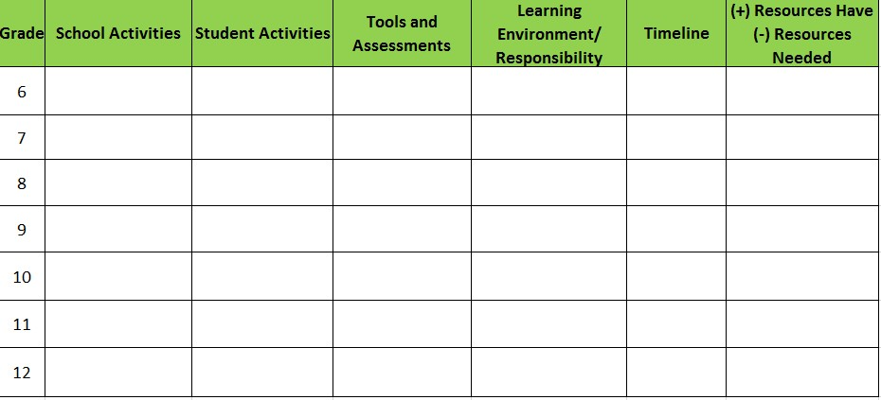
Career Advising District Plan

Slide 27
Career Advising Audit
We have a model career advising policy.
We have a model student success plan.
We have an early warning system in place to identify students who are struggling.
We have an intervention response system in place to bridge the gap with struggling students.
We have an enrichment program in place for students who perform above grade level expectations.
Our students are actively using OhioMeansJobs K−12 Backpack online tools.

Slide 28
Career Pathways
"A career pathway is not a program, but a systemic framework for a new way of doing business in our high schools, colleges, and communities."
Agrawal, 2007: Career Pathways as a Systemic Framework

Slide 29
Career Pathways
Continuum of rigorous academic instruction with a demanding technical curriculum and career-based learning
Intended to prepare students for high-demand, high-opportunity career fields while meeting local employers and growing labor market needs

Slide 30

Ohio’s In-Demand Jobs
Developed around Ohio’s career areas of greatest need and opportunity, according to the list of “In-Demand Occupations”

Slide 31
What is a Career Pathway?
Tool: Facilitate communication and advising
Way of thinking: Shift how students experience high school
Customizable for any ambition: Whether a student is interested in going to college, getting a certificate or working right after high school
Notes:
Various Ohio policies mention the importance and role of pathways – college credit plus for postsecondary pathways; graduation requirements for pathways to earn a high school diploma and career advising for career pathways to explore options and begin planning for the future.
ODE, in partnership with OBR, OMJ and OWT, has developed sample pathways that can be adapted and customized to district, school or individual students.
These pathways represent a continuum of education and training and occupation – showing various “on and off ramps” that an individual can pursue based upon personal aspiration and commitment levels. While it’s important to be prepared, these examples recognize credentials that may be earned beginning in high school and reflect more of a “stackable” approach where education and training are ongoing, life-long ventures.
Video resource, Success in the New Economy: https://vimeo.com/67277269
This video provides a great overview for why career exploration and planning is necessary. Knowing about what options are available and evaluating those options against interest and skill support informed decisions. It’s a great backdrop for the career pathways and helping to reinforce the role that career information such as “in-demand” jobs has in planning. Take note of the 1:2:7 ratio…great transition to the next slide. Think Dentist (1): Hygienist (2): Assistant and other office staff (7).

Slide 32
Certificate,
Dental Assisting
Associate or Bachelor’s
Degree, Dental Hygiene
Doctoral Degree,
Dentistry
Start Pre-Health
As early as grade 7
(based on readiness)
Dental Assistant
Median Salary: $33,690
Job Growth (10 yr): 20.5%
Annual Openings: 416
Average Tuition (1 yr): $0 –$3,900/yr
Dental Hygienist
Median Salary: $65,510
Job Growth (10 yr): 26.3%
Annual Openings: 345
Average Tuition (2 yrs): $3,900/yr
Average Tuition (4 yrs): $9,600/yr
Dentist
Median Salary: $158,460
Job Growth (10 yr): 9.5%
Annual Openings: 186
Average Tuition (4 yrs): $35,000/yr
Workplace Visits
Job Shadow
Internship
Work
Supervised Experience
---
Work
Supervised Experience
Internship
---
Work
Internship
---
Work
Ohio In-demand Occupations
Data reflects 2014 Ohio labor statistics and public institutions of higher education for 2013-2014. For specific tuition costs, visit ohiohighered.org.
Notes:
The dental pathway demonstrates how a student may begin, if ready, as early as grade 7. Grade 7 is when, in Ohio, students may begin exploring or “trying on” various career pathways through middle grades career tech courses. As apart of Ohio’s goal with expanding career tech and offering options earlier – there are now more options for students to participate in these courses in middle grades.
The first occupation in this sample is dental assistant – note that dental assisting is a one-year certificate program. It’s an industry recognized credential that’s also aligned to an in-demand job in Ohio (indicated with the “orange thumbs up”). These in-demand occupations have been identified as high growth, high wage and high annual openings across the state. The importance in identifying them and sharing the information with students and families is so we build awareness of where Ohio’s economy is in greatest need but also where there are opportunities for employment in Ohio.
Along the continuum you’ll see dental hygienist and dentists. The idea within these occupations is to demonstrate a potential pathway an individual may progress through within a particular field. While this isn’t always a linear process, it shows one possible route with related occupations with progressive education and training requirements.

Slide 33
Secondary Pathway: Allied Health and Nursing |  |  |  | Postsecondary Program: Dental Hygiene
An Example of Courses with Secondary and Postsecondary Credits
Secondary | 7 8 | English I | Algebra I | Physical Science | Social Studies | Fine Arts | Health Science & Technology
 | 9 10 | English II | Geometry | Biology | World History | Health (.5) PE (.5) | Principles of Allied Health | World Languages
 | 11 | English III | Algebra II | Chemistry | U.S. History | Dental Technology | Medical Terminology | World Languages
 | 12 | English IV | Trigonometry/ Calculus | Anatomy & Physiology | U.S. Government | Dental Radiography | Oral Diagnosis & Treatment Planning
Postsecondary | Year 1 1st Semester | College Seminar | Human Patho-physiology | Dental Anatomy & Physiology | Dental Hygiene Pre-Clinic | Intro to Dental Hygiene | Periodontology I | Preventive Concepts | Techniques I
 | Year 1 2nd Semester | English | Intro to Microbiology | Techniques II | Clinic I | Oral Pathology | Periodontology II | Community Health Concepts | Dental Radiography
 | Year 2 1st Semester | Interpersonal Communication | Community Health | Techniques III | Clinic II | Sociology | Pharmacology | Dental Materials | Pain Management
 | Year 2 2nd Semester | Oral Communication | College Algebra | Techniques IV | Clinic III | Psychology | Dental Hygiene Case & Concepts | Humanities Elective
 |  | High School Career-Technical Education Program Courses
 |  | High School Courses for Postsecondary Credit (Including Apprenticeship Hours) and the Corresponding Postsecondary Courses
 |  | Required Courses
 |  | Recommended Electives
Visit education.ohio.gov/CareerConnections for reference information.
Course titles and sequences will vary between schools.
11/2014
Notes:
The second page of the career pathway samples provides one scenario of courses involved in the related area of study. Highlighted in the table are opportunities for college credit, career tech and required versus elective courses. These models will vary upon local school offerings but helps students and families realize what the academic and technical demand might be along this pathway. Whether the student is scheduling high school courses or projecting what they might do after high school these examples provide context for what types of courses will be most important according to the types of skills and knowledge in the career field.
These samples begin as early as grade 7 and span up to two years of postsecondary. These are not exhaustive and represent just one example of related coursework.
Where do we make the connection – this data was compiled using OhioMeansJobs.com. OhioMeansJobs is the dynamic tool students and teachers can begin using to explore career interests, in-demand jobs, Ohio schools and programs and more.

Slide 34
1. Technical Courses
A series of courses aligned to state and industry standards, leading to credentials and college degrees
  What technical courses do your students have access to in grades 7-12?
Q:

Slide 35
2. Academic Courses
Rigorous academic curriculum, aligned to Ohio’s Learning Standards
Offer higher-level learning experiences that may be inquiry, problem or project based
What options do your students currently participate in?
Q:

Slide 36
3. Career Exploration Options
Experiences and events where students are exposed to various career fields; more rigorous in high school with programs such as internships, pre-apprenticeship and part-time jobs.
What options do your students currently have access to?
Q:

Slide 37
Course Offering Audit
The school has audited our 6−8 curriculum and identified possible areas of compacted curriculum (offering middle grades students opportunities to earn high school credit).
The school works with career-tech, higher education and regional secondary partners to offer multiple courses and options for students to earn academic and technical credits leading to credentials and college degrees.
What gaps and teaching resources are needed to continue developing pathways?
Q:

Slide 38

Three Pathways to a Diploma
18 points on state tests
College readiness score on national test
In-demand industry credential and passing score on WorkKeys
See more details about Ohio’s requirements for earning a high school diploma.

Slide 39
Advanced Standing Programs for College Credit
College Credit Plus
Advanced Placement (AP) Courses
International Baccalaureate diploma courses (IB)
Early College High School Programs

Slide 40
Experiential Learning
  Career-related experiences that allow students to experience careers through hands-on activities, both short-term and long-term
  Service learning, internships, job shadowing, paid or unpaid work experiences
  Related to Ohio’s in-demand jobs
  Takes place in work place, community or school setting
Notes:
Learning in authentic situations that allows students to applying their knowledge and understanding to real-world problems or situations
Edutopia video

Slide 41
Why Experiential Learning?
Teaches students the competencies needed to be successful in real-world work
Motivates students to see the connection
Creates self-directed learners: presented with problem, need to solve it
Q:
What do you already have in your schools?

Slide 42
Experiential Learning Audit
      We have worked with our local economic development agency to identify local economic and workforce data.
      We have communicated local economic data with students, teachers and families.
      We have integrated our work-based learning program with our model student success planning.

Slide 43
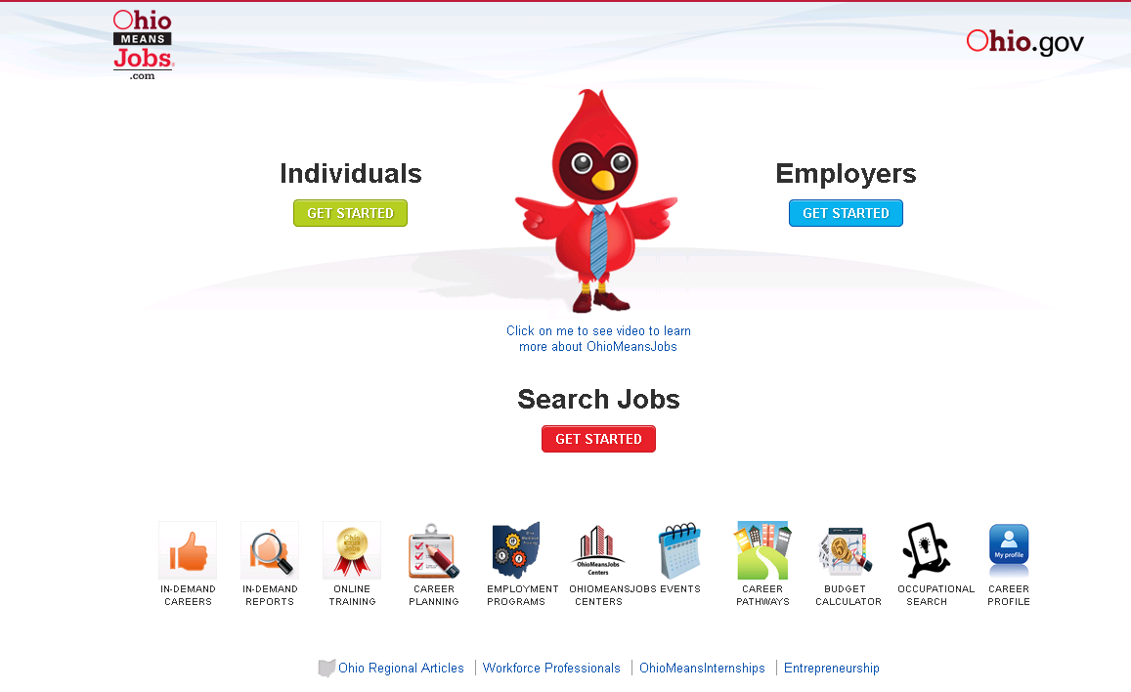
OhioMeansJobs.com Home Page
Notes:
This new no-cost resource was launched Fall 2014. It’s a resources available to all Ohioans and development is overseen by the Ohio Department of Education.
The concept for OMJ K-12 is to serve as an online career planning system that allows students to explore their career interests with inventories, research career options, and evaluate education and training programs.
All users begin at www.OhioMeansJobs.com; to access the K-12 portal click “Individuals” and the K-12 icon from the next page. You can also access the portal directly at: https://jobseeker.k-12.ohiomeansjobs.monster.com/seeker.aspx
NOTE: icons shown on this page are only for adult job seekers and are not connected to the OhioMeansJobs K-12 portal.

Slide 44

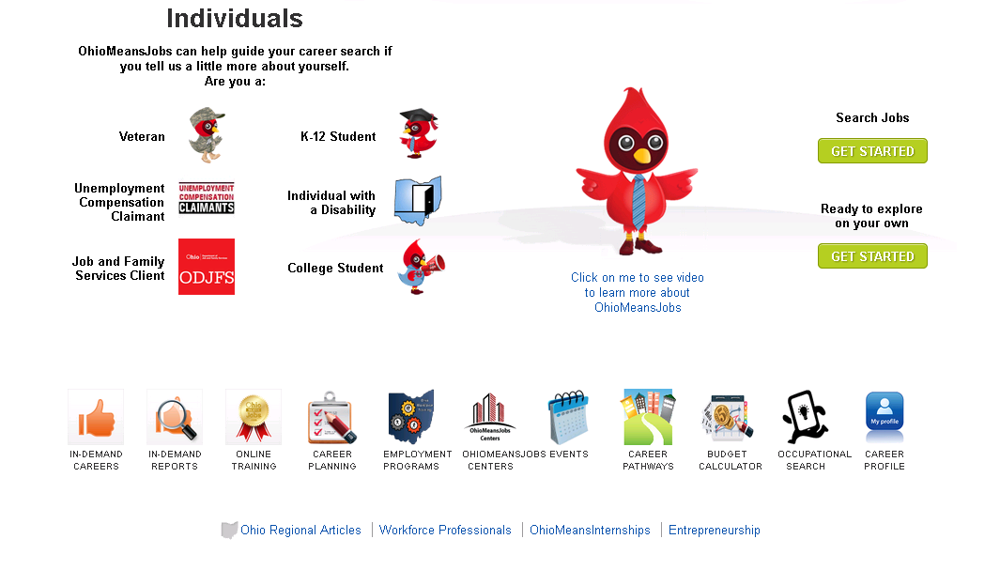
OhioMeansJobs.com: Choose K-12 Student
Notes:
All users will be directed to OhioMeansJobs.com and then instructed to choose K-12 (cardinal with the grad cap “OWEN”) to get started with OMJ K-12.
Note: OMJ is a hub for all members of the community – adult job seekers, veterans, employers, K-12 students and a new portal for higher education students (in development).

Slide 45
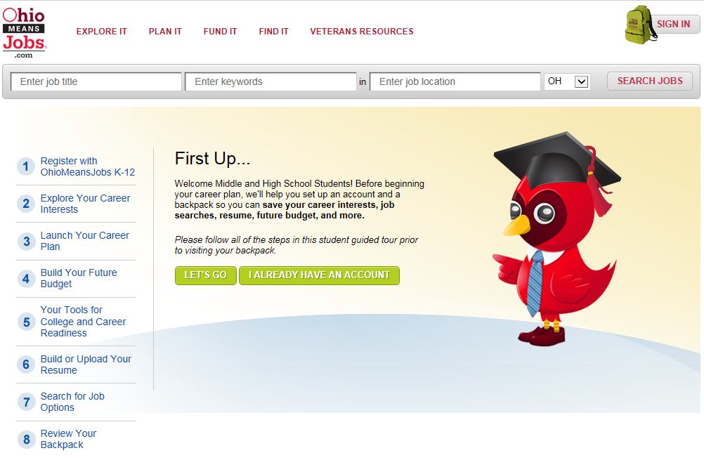
OhioMeansJobs K-12: Guided Tour “First Up”
Notes:
The online guide, “First Up” will guide students step by step through the registration, career exploration and planning process as well as help keep track of their progress. The first step is registration which has been customized to meet the needs of students, teachers and parents. While this feature follows a sequence, it also allows students to begin with the resources that meet their immediate needs. If a student would rather just to #4 and begin a budget, they don’t have to go through #1-3 prior to doing so.

Slide 46
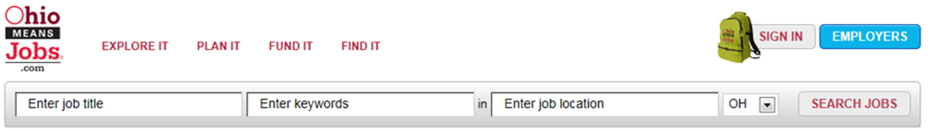
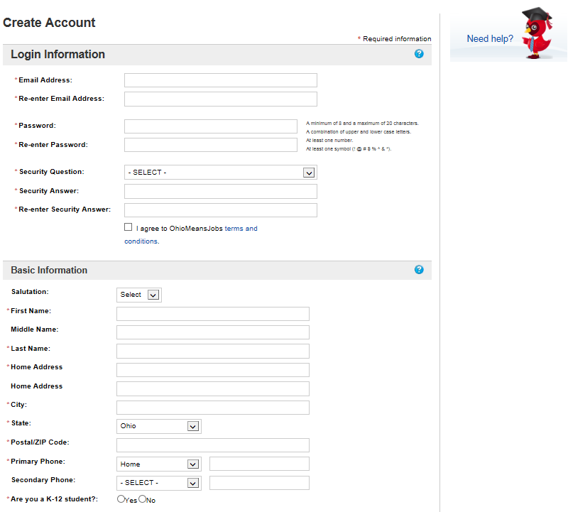
Registration – customized for students, teachers, and parents
Notes:
The online guide, “First Up” will steer students step by step through the registration, career exploration and planning process as well as help keep track of their progress. The first step is registration which has been customized to meet the needs of students, teachers and parents.
All accounts are synchronized among the OhioMeansJobs database and the Monster database which will allow users to move seamlessly through the many tools available – it will also prevent multiple accounts from being created for one user email account.

Slide 47
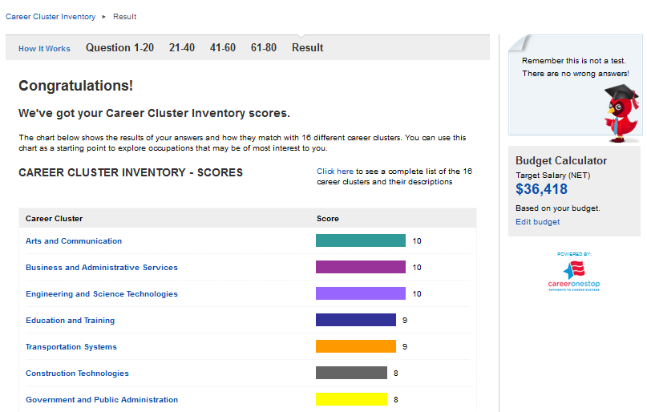
Career Cluster Inventory
Notes:
After registration, the second step is exploring career interests which will prompt students to complete a brief interest survey to identify which industries line up most closely with their interests. From there, students can explore which occupations are part of those industries. There will also be information available on which occupations are in-demand for each industry. In-demand occupations are selected by meeting a minimum requirement for annual growth rate, number of open positions and salary/wages.
Career Cluster Inventory – currently available in OCIS
Interest Profiler – O*NET tool, abbreviated version customized for OMJ

Slide 48
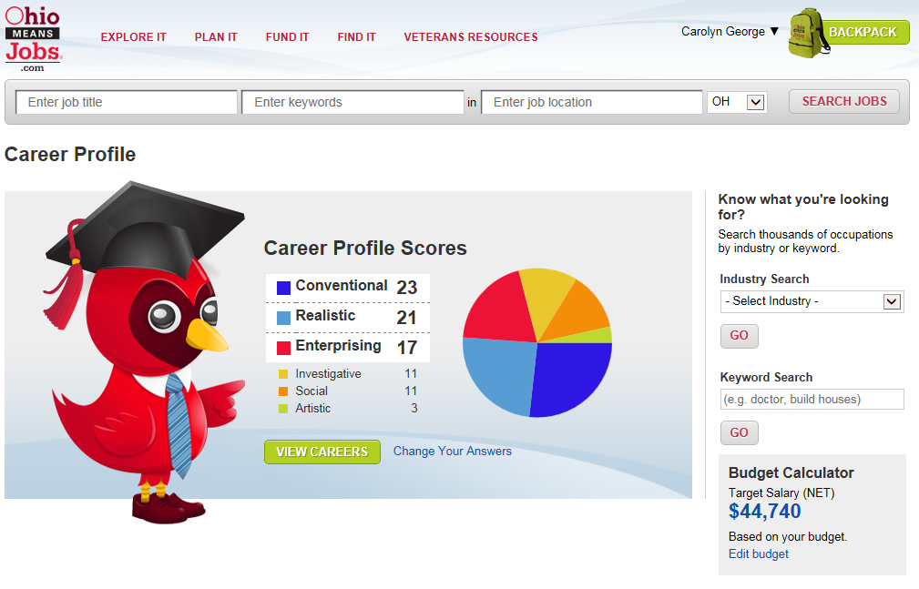
Career Profile
Notes:
After registration, the second step is exploring career interests which will prompt students to complete a brief interest survey to identify which industries line up most closely with their interests. From there, students can explore which occupations are part of those industries. There will also be information available on which occupations are in-demand for each industry. In-demand occupations are selected by meeting a minimum requirement for annual growth rate, number of open positions and salary/wages.
Career Cluster Inventory – currently available in OCIS
Interest Profiler – O*NET tool, abbreviated version customized for OMJ

Slide 49
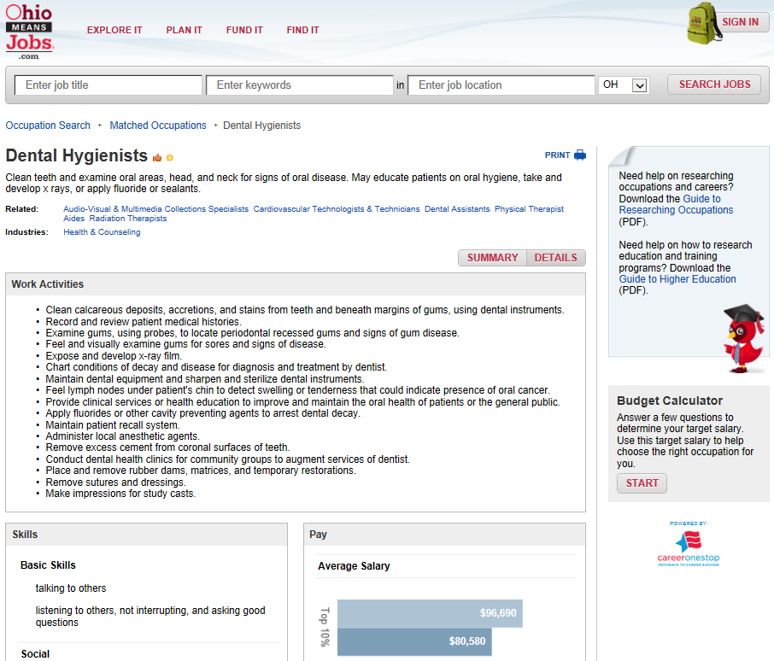
Career Information
Notes:
OMJ K-12 will offer seamless access to national and state labor market information – including career profiles, wages and trend data and education and training opportunities.

Slide 50
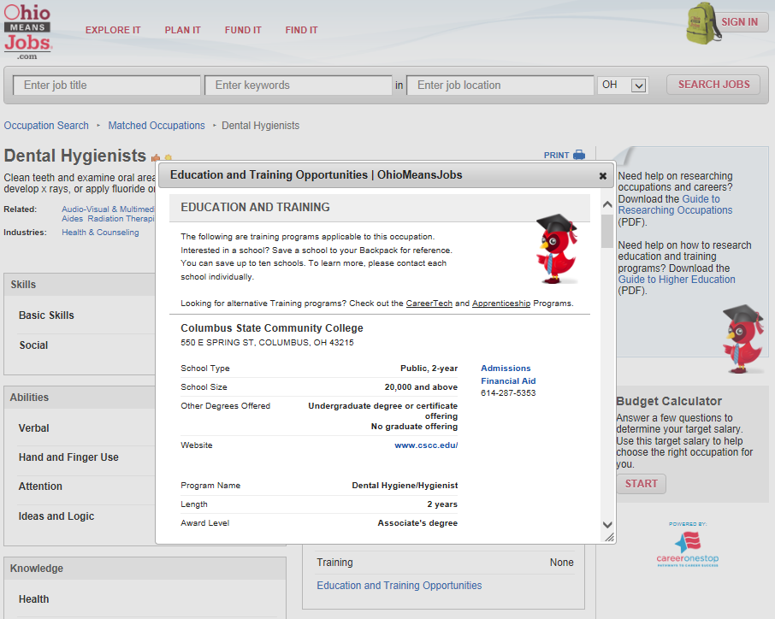
Education and Training Options
Notes:
Each occupation offers an embedded link for immediately viewing what programs and schools provide pathways that support getting a job in this field.

Slide 51
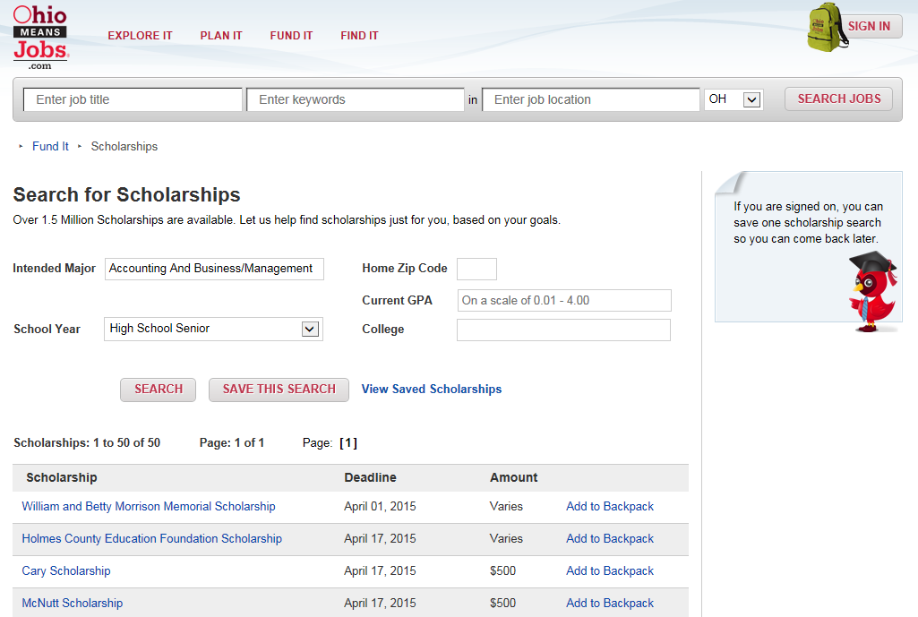
Scholarships
Notes:
Each occupation offers an embedded link for immediately viewing what programs and schools provide pathways that support getting a job in this field.

Slide 52
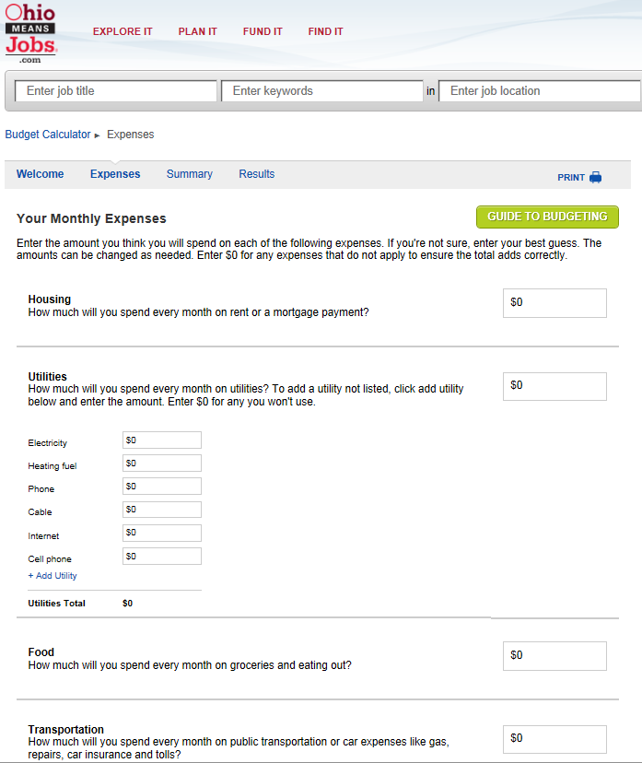
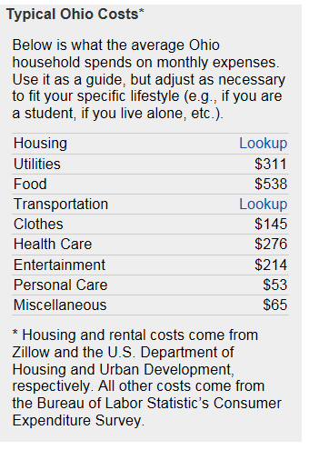
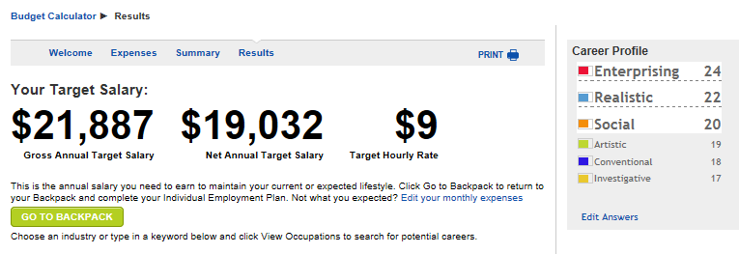
Budgeting For Your Future
Notes:
After career exploration, the third step is finding a target salary by using the budget calculator tool. This tool will prompt students to estimate living expenses and enter the information to identify the minimum salary required to cover their projected expenses. This information will also be helpful in deciding which occupation(s) students want to pursue as a career. The process of determining a target salary will also be helpful for students to give them an increased understanding of what types of expenses they can anticipate when they eventually live on their own.

Slide 53
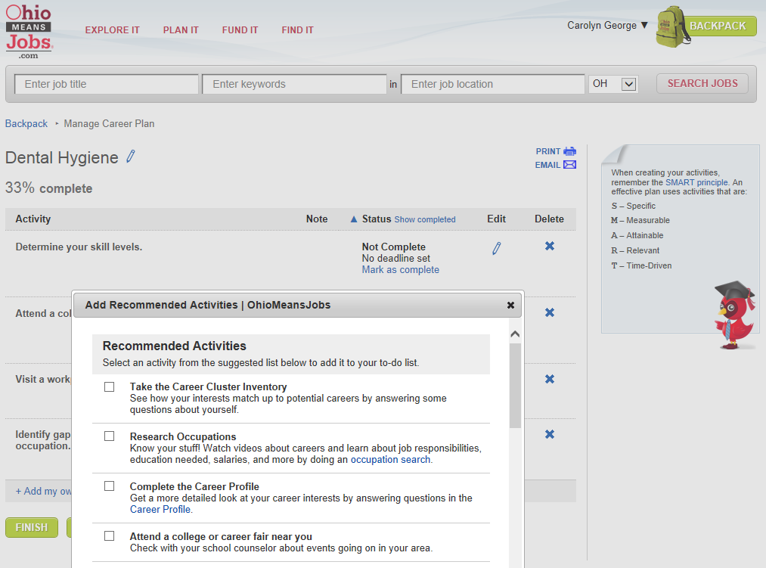
Career Plan
Notes:
After target salary, the fourth step is launching a career plan by using the career planning tool. This tool will prompt students with recommended activities to develop their career plan like researching what type of training/education will be needed to qualify for the different occupations. The tool will also recommend looking into different education/training programs and schools as well as possible scholarships, programs and financial aid for which students may be eligible to fund their training/education expenses. The calendar feature allows students to save tasks with deadlines and track their progress carrying out their career plans.

Slide 54
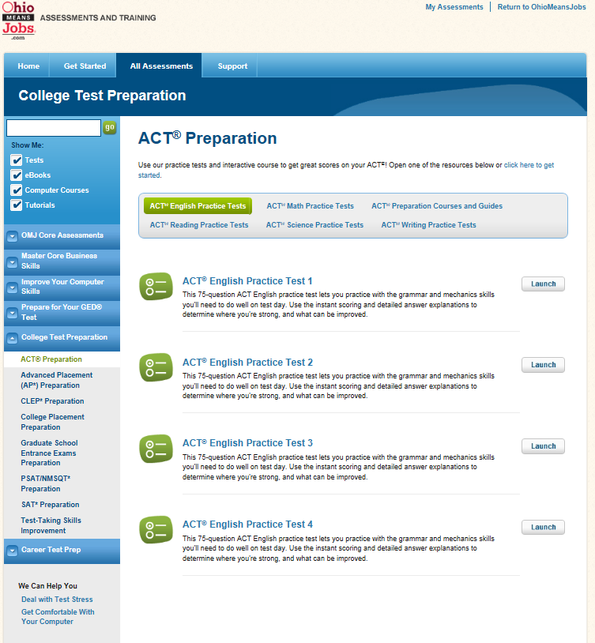
Tools for College and Career Readiness
Notes:
The online training center offers study guides and practice tests for college and career readiness. Students can prepare for college entrance exams like the ACT, PSAT and SAT or prepare for many career-based tests for their Commercial Driver’s License, Emergency Medical Technician certification or Real Estate License, etc.
The online training center offers a number of practice tests and tips for college entrance testing like the ACT and other tests as you’ll see on this sample page.

Slide 55
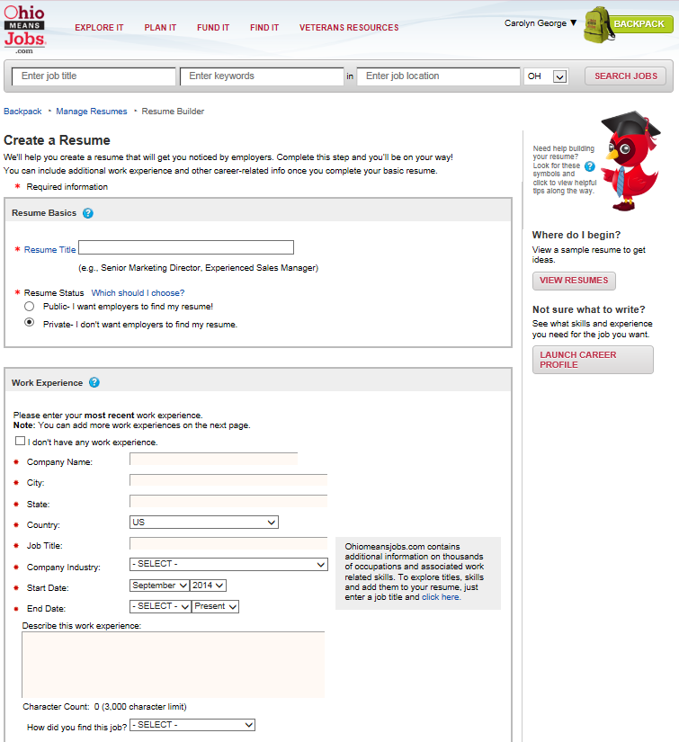
Upload or Build a Résumé
Notes:
After tools for college and career readiness, the sixth step is creating a resume by using the resume building tool. This custom tool will prompt students to either upload an already created resume or enter information like extracurricular activities, volunteer experience, work experience and Grade Point Average (GPA) to create a resume. There will also be a feature available to upload other important documents like transcripts, writing samples, references, etc. There will also be a tool to have the students resumes rated to learn how their resumes would likely compete with other job seekers. The resume rater also provides specific and practical tips on how each resume can be improved.

Slide 56
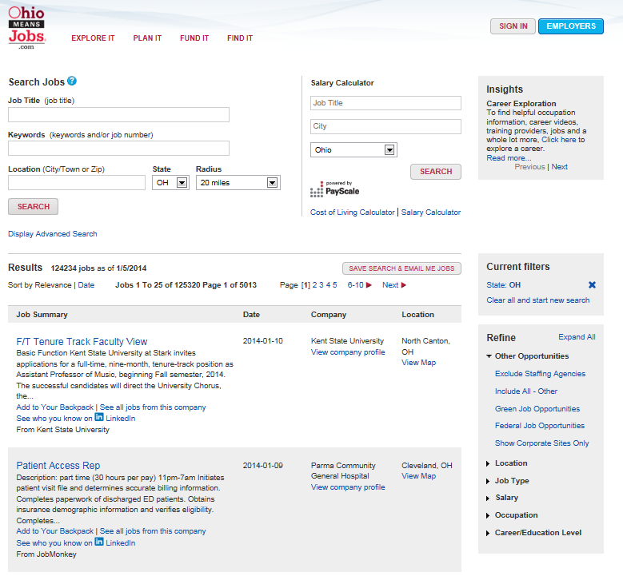
Job Search
Notes:
After resume builder, the seventh step is searching for job options. This tool will prompt students to enter key word or job titles and a job location to learn more about what types of job opportunities may be available in each occupation. Students can also perform searches to learn more about internships and co-ops available or even look for a seasonal or part-time position to apply for now. This tool can also help students identify which companies hire employees in the occupations they are considering, the number of openings available as well as the salary ranges for those positions.

Slide 57
Backpack – Ongoing Individualized Planning
Notes:
Students will create a Backpack to save their information, but this also allows them to create a career plan, build a résumé and access a host of assessment prep tools such as ACT, SAT, ASVAB, COMPASS, ACCUPLACER, and much more.
Yes, this is available at no costs to all Ohioans – public, private, libraries, etc. everyone will have access. The system launched Fall 2014 and schools continue to be notified through ongoing ODE communications (Facebook, Twitter, Superintendent newsletter, etc.). Make sure you’re signed up to receive these communications (like the page, follow, and sign up for emails).
Thinking through these components and resources available – where do you get started? What’s one thing you can do when you get back to school? This year?

Slide 58
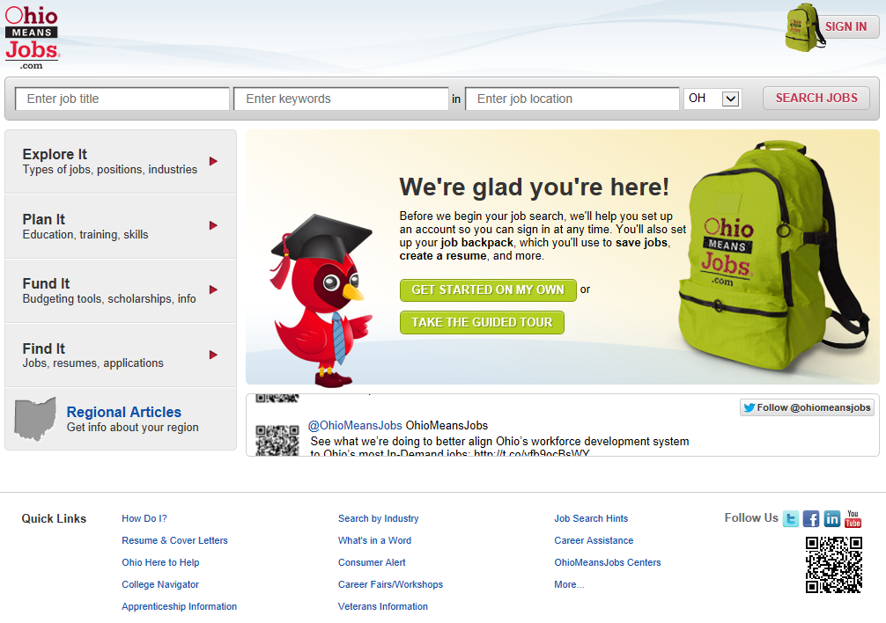
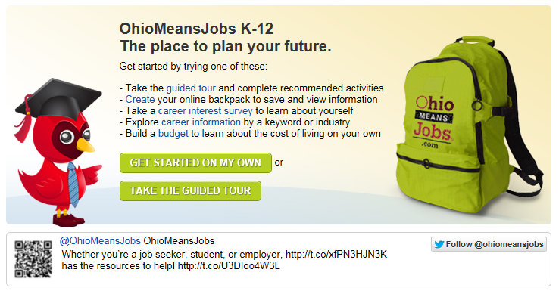
Self-Directed Exploration
Notes:
OhioMeansJobs is the premier résumé and job bank website in Ohio. Through a joint partnership between the Ohio Department of Education and the Ohio Department of Job and Family Services, this free and easy to use site has been expanded to include career exploration tools resources designed specifically for middle and high school students and their teachers. OhioMeansJobs K-12 will help teachers meet state requirements for career-related curricula and help students explore and plan careers.
Benefits for different stakeholders:
Educators: OhioMeanJobs K-12 will have tools and lesson plans to help educators engage students in career exploration.
Parents: OhioMeanJobs K-12 is designed to help you guide your children in the career exploration and planning process. This new site will also highlight which occupations are in-demand in each industry based on projected openings, growth rate, and salary. It can also help you plan your own career goals and search for your dream job.
Students: OhioMeanJobs K-12 is designed just for you. It can help you explore careers, create a budget to decide what type of salary you’ll need living on your own, decide what type of education/training you’ll need to achieve your career goals, identify ways to fund that education/training like scholarships, financial aid and other funding sources, create a resume and search for internships and jobs.
Businesses: OhioMeansJobs K-12 will help better prepare the future workforce and guide students towards in-demand occupations. Businesses can also benefit by advertising jobs, internships and co-ops at no cost as well as searching millions of résumés through OhioMeansJobs (a private public partnership with Monster.com) to find the best qualified job candidates.
Workforce and Human Service Professionals: OhioMeansJobs K-12 will be a valuable tool to help engage disadvantaged youth in career exploration and planning to help ensure that they become productive, self-sufficient adults. This site also has a budget calculator tool to give youth a better idea of what expenses they will need to cover once they are out living on their own to identify how much salary they will need to earn.
OhioMeansJobs K-12 also has a self-directed area available where students and teachers can:
Explore careers, occupations, regional information (articles, job fairs, workshops, etc.),
Look for funding opportunities like scholarships, financial aid and state and federal workforce programs
Research education and training programs for careers
Use the online training center to prepare for careers and/or college with study guides and practice tests
Create a resume
Search for internship and job opportunities
Estimate future expense to come up with a target salary to cover the cost of living expenses.
Develop a career plan with goals and target dates for completing tasks.

Slide 59
Next Steps:
Map what your school is already doing (who, what, when, where, how)
Identify champions at your school that will expand and enhance current efforts (administrators, colleagues, and community members)
Strategize what small steps your school will take initially, that will make a big impact overtime
Notes:
How do you get started – look at what you’re already doing. You’ll feel much more comfortable once you realize that you’re not starting from scratch. This will also give you an overview of the landscape – who’s already doing what and where.
Through this work you’ll identify some champions – the people that you won’t have to convince, because they already see the value. But you also have to bring together those with influence. Sometimes this is an administrator, parent – the ones with a loud voice and people hear when they speak. The other piece of your team needs to include your community members – business and industry, community organizations, higher education and career-tech. Those people that will realize a mutually beneficial partnership – developed workforce which leads to economic development.
Then you’ll strategize. Start small but with a big vision. Determine what impact you want to see and how you’re going to measure it. What data points will help to tell the story. How will you know you’re successful. Examples might include, 100% of 8th graders have begin a career plan; initiate an advisory program among freshman; provide quarterly career presentations for 4th graders. Start small but think big impact overtime.

Slide 60

education.ohio.gov/CareerConnections
Notes:
You’ll find information on the ODE website:

Slide 61





Social Media
Ohio Families and Education
Ohio Teachers’ Homeroom
ohio-department-of-education
storify.com/ohioEdDept
@OHEducation
OhioEdDept
Notes:
You can stay connected with ODE through these social media outlets:

Slide 62
Questions?
Carolyn George
Carolyn.George@education.ohio.gov | 614-995-5042
Tisha McGlaughlin
Tisha.McGlaughlin@education.ohio.gov | 614-466-5756
Career Connections
Office of Career-Technical Education
25 S. Front Street, Columbus, Ohio 43215 | 800-700-6247
Notes:
If you have questions, feel free to contact me:

Slide 63
Resources
Career Connections K-12 Framework
Career Connections Learning Strategies
OhioMeansJobs K-12
Notes:
The first component created for Career Connections were the curriculum strategies (SB 316). However, the framework drives the big picture – looking at all efforts across K-12 and aligning them to build a continuous experience for students. Notice I said K-12, this isn’t a high school thing this involves all educators – including teachers, counselors and administrators. Building a continuum for students so that each year there are purposeful experiences planned that support students with recognizing the linkages from the classroom to the workplace.
The third component is OhioMeansJobs K-12; this new tool launched fall 2014 and is available to all Ohioans at no cost. The portal is intended for students in grades 6-12.
I’m going to discuss these components in a little more detail, and please feel free to ask questions as we progress.

Slide 64
Research shows that a consistent factor in the reason for students dropping out of high school is a lack of motivation due to the perceived irrelevance of school.
Notes:
We have 1 million Ohioans without a high school diploma or GED. That number grows by 24,000 annually as current high school students continue to disconnect and disengage from school. In 2010, Ohio had a dropout rate of 4.2 percent. Which is above the national average of 3.4 percent (U.S. census data).
WHY:
Create relevance and purpose in the classroom
Identify career interests for making informed decisions, based on research and experiences; structured and supported environment for planning
Promote post-secondary options, access, and completion
Maintain engagement, focus, and motivation
Research shows that a consistent factor in the reason for students dropping out early in high school is a lack of motivation due to the perceived irrelevance of school.
Thus, students aren’t seeing the connection to what they are doing in the classroom and the purpose and relevance is has with the real world or world of work.
Career Connections is Ohio’s vehicle for increase students’ awareness of the connections between the classroom and their career pathways.
In order to do this we have to help them realize their career interests. Using tools to develop and increase their career maturity which will lead to more informed decision making.
We have to be sure that students are making decisions based on data and information. This means that they need experiences throughout high school so that they can determine not a specific career but a pathway. Students who enroll in college as undecided often times continue as undecided. They may not receive or seek out the support they need to make a decision about a major. Ultimately this increases the likelihood of them dropping out or accumulating unnecessary debt.

Slide 65
Background
Career Connections is a joint initiative among the Governor’s Office of Workforce Transformation, Ohio Board of Regents, and Ohio Department of Education
Governor’s Office of Workforce Transformation
2014 Strategic Plan workforce.ohio.gov
Notes:
Career Connections:
Initiated by Governor Kasich; established the Office of Workforce Transformation which focuses on making Ohio’s workforce efforts more efficient and effective.
Priorities set in the 2014 State of the State by Governor Kasich: create more opportunities for students to connect to careers
Partnered with Gov’s Office of Workforce Transformation to focus on developing our future workforce

Slide 66
State Initiatives
Career Exploration Internship and Community Connectors: Funding to expand mentorship and internship programs for students
OhioMeansJobs K-12 Resources: Provide career decision-making materials and OhioMeansJobs K-12 information through school newsletters to parents
Career Advising Policy and Student Success Plans: Requirement for all districts, specifically targeting students who are at-risk of dropping out of school
Notes:
Growing emphasis on career advising from both state and national levels – business and industry are struggling to fill positions because students aren’t attracted to these high-demand areas.
Funding Opportunities:
Community Connectors-- http://communityconnectors.ohio.gov/
Career Exploration Internship -- http://codes.ohio.gov/orc/122.177 -- http://development.ohio.gov/bs/bs_oceip.htm
New Laws:
April 1, 2015; Provide info about OhioMeansJobs K-12 in school newsletter and website: http://codes.ohio.gov/orc/6301.15
September 2015; Adopt a policy on career advising: http://codes.ohio.gov/orc/3313.6020

