Slide 1
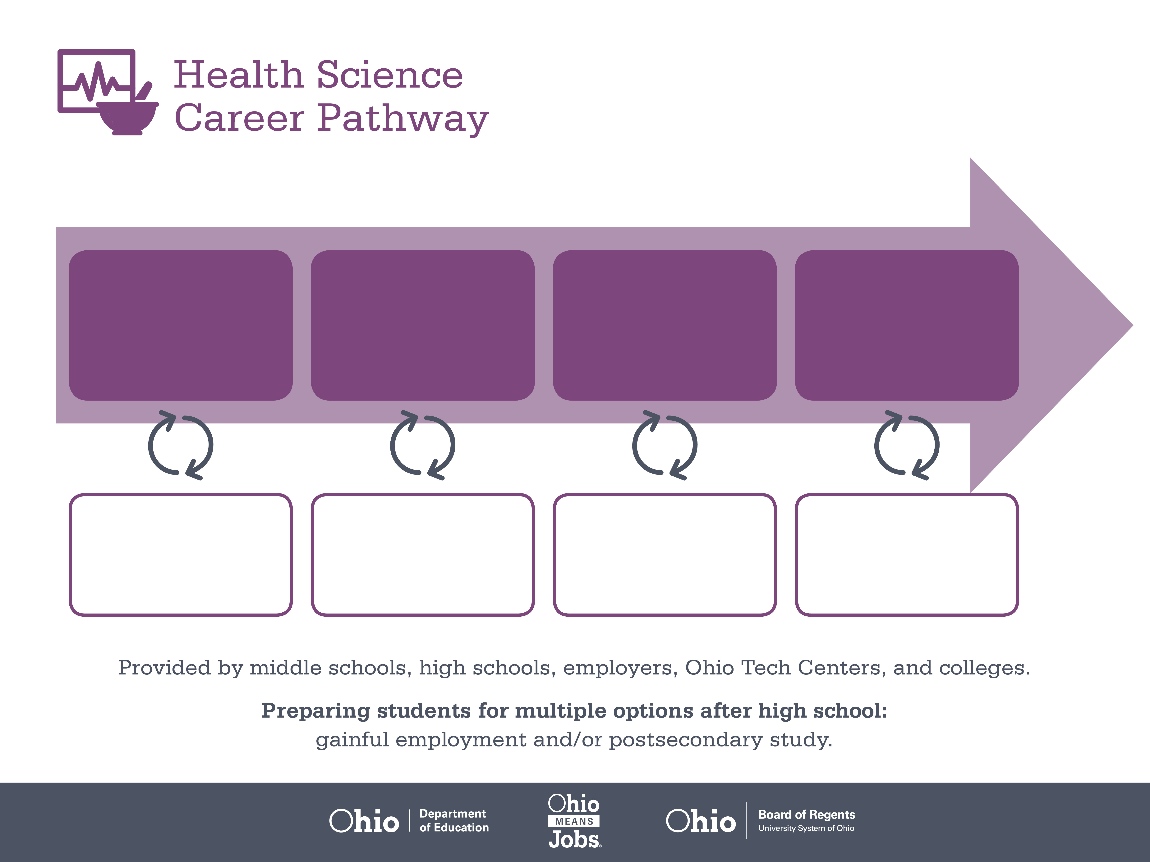
Certificate,
Patient Care
Bachelor’s Degree,
Respiratory Therapy
Doctoral Degree,
Medicine
Start Pre-Health
As early as grade 7
(based on readiness)
Patient Care Technician
Median Salary: $37,420
Job Growth (10 yr): 18.5%
Annual Openings: 264
Average Tuition (1 yr): $0 –$3,900/yr
Respiratory Therapist
Median Salary: $52,490
Job Growth (10 yr): 23.6%
Annual Openings: 245
Average Tuition (4 yrs): $9,600/yr
General Practitioner
Median Salary: $150,230
Job Growth (10 yr): 20.3%
Annual Openings: 176
Average Tuition (4 yrs): $35,000/yr
Workplace Visits
Job Shadow
Internship
Work
Supervised Experience
---
Work
Supervised Experience
Internship
---
Work
Internship
---
Work
Ohio In-demand Occupations
Data reflects 2014 Ohio labor statistics and public institutions of higher education for 2013-2014. For specific tuition costs, visit ohiohighered.org.

Slide 2

Secondary Pathway: Allied Health and Nursing |  |  |  | Postsecondary Program: Respiratory Care
An Example of Courses with Secondary and Postsecondary Credits
Secondary | 7 8 | English I | Algebra I | Physical Science | Social Studies | Fine Arts | Health Science & Technology
 | 9 10 | English II | Geometry | Biology | World History | Health (.5) PE (.5) | Principles of Allied Health | World Languages
 | 11 | English III | Algebra II | Chemistry | U.S. History | Medical Terminology | Human Patho-physiology | World Languages
 | 12 | English IV | Trigonometry/ Calculus | Anatomy & Physiology | U.S. Government | Patient Centered Care | Pharmacology
Postsecondary | Year 1 1st Semester | English | College Seminar | Algebra | Intro to Clinical Experience | Human Anatomy | Intro to Respiratory Care | Medical Terminology
 | Year 1 2nd Semester | Organic & Biochemistry | Human Physiology | Therapeutic Procedures I | Clinical Practice I | Patient Assessment I | Respiratory Pharmacology | Respiratory Equipment | Cardio Anatomy & Physiology
 | Year 2 1st Semester | Microbiology | Respiratory Patho-physiology I | Therapeutic Procedures II | Clinical Practice II | Patient Assessment II | Sociology | Respiratory Equipment II
 | Year 2 2nd Semester | Clinical Practicum | Respiratory Patho-physiology II | Therapeutic Procedures III | Clinical Practice III | Ethics
 |  | High School Career-Technical Education Program Courses
 |  | High School Courses for Postsecondary Credit (Including Apprenticeship Hours) and the Corresponding Postsecondary Courses
 |  | Required Courses
 |  | Recommended Electives
Visit education.ohio.gov/CareerConnections for reference information.
Course titles and sequences will vary between schools.
11/2015

