Slide 1
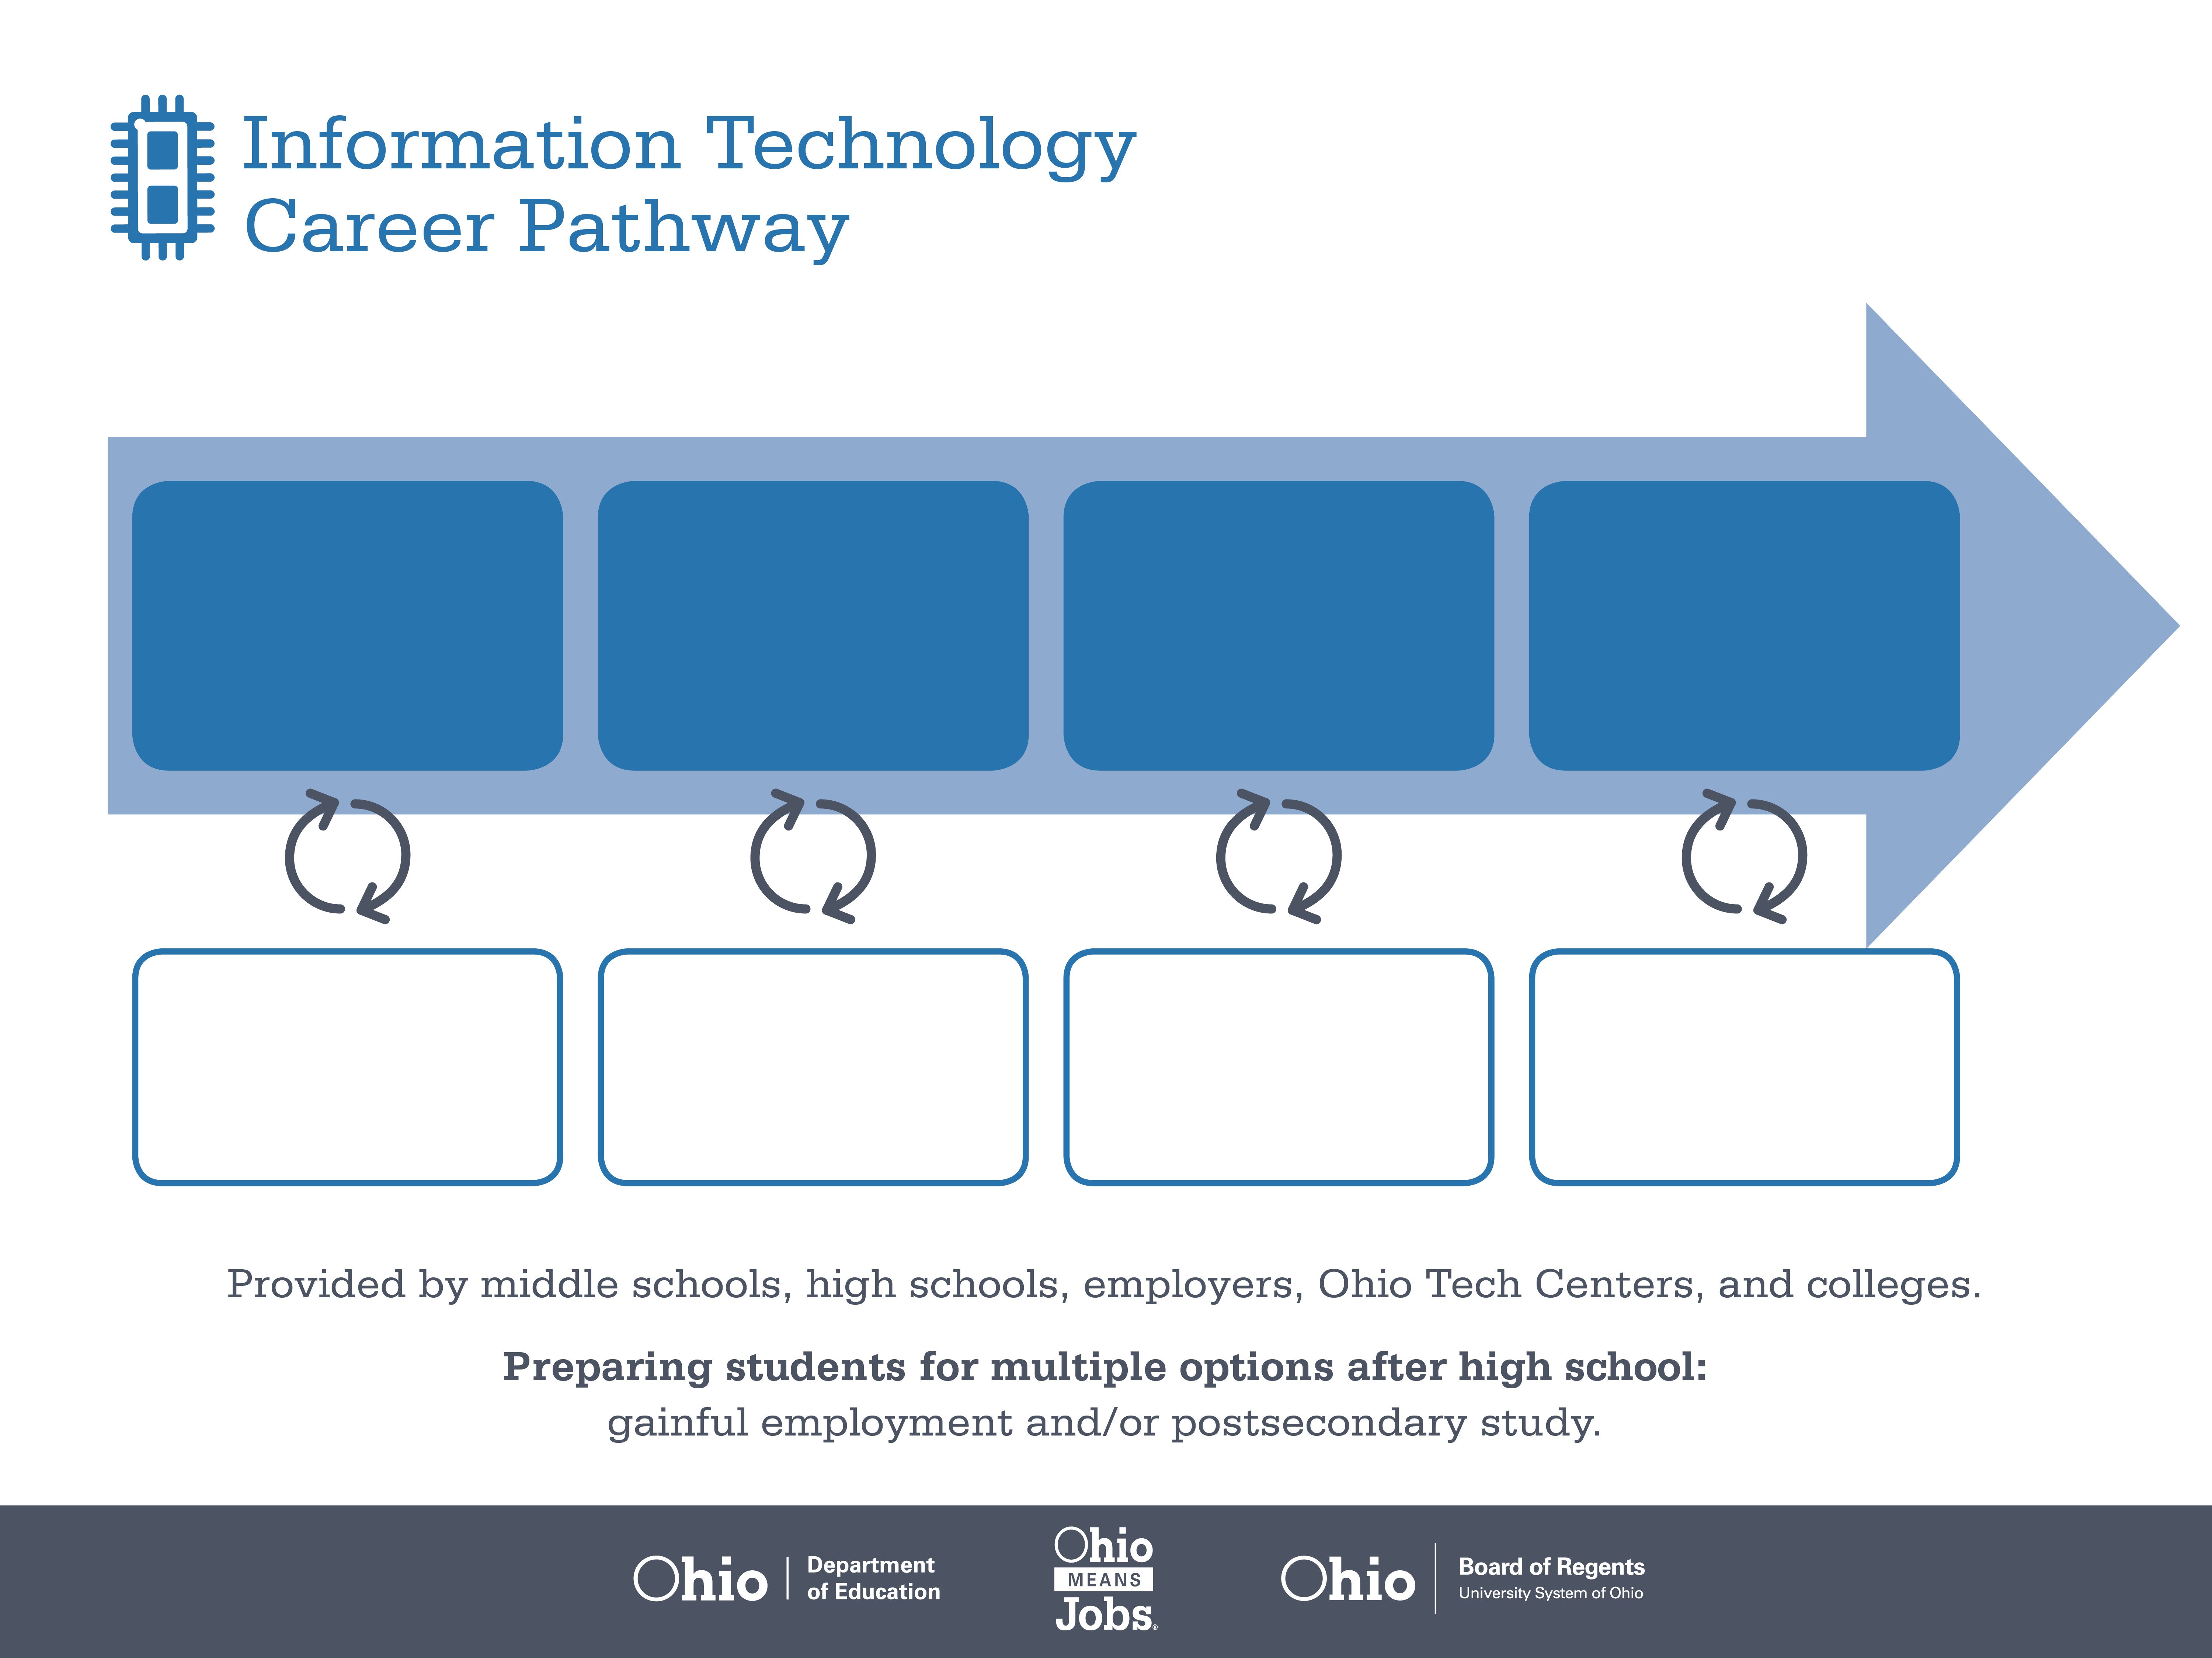
Certificate,
CompTIA A+, Network+
Associate Degree,
Computer Information
Systems
Bachelor’s Degree,
Computer Engineering
Start Pre-IT
As early as grade 7
(based on readiness)
Computer User Support Specialist
Median Salary: $42,750
Job Growth (10 yr): 13.4%
Annual Openings: 949
Average Tuition (1 yr): $0 –$3,900/yr
Network and Computer Systems Administrator
Median Salary: $65,150
Job Growth (10 yr): 23.1%
Annual Openings: 586
Average Tuition (2 yrs): $3,900/yr
Computer Network Architect
Median Salary: $91,710
Job Growth (10 yr): 15.7%
Annual Openings: 313
Average Tuition (4 yrs): $9,600/yr
Workplace Visits
Job Shadow
Internship
Work
Supervised Experience
---
Work
Supervised Experience
Internship
---
Work
Internship
---
Work
Ohio In-demand Occupations
Data reflects 2014 Ohio labor statistics and public institutions of higher education for 2013-2014. For specific tuition costs, visit ohiohighered.org.

Slide 2

Secondary Pathway: Network Systems |  |  |  | Postsecondary Program: Computer Networking
An Example of Courses with Secondary and Postsecondary Credits
Secondary | 7 8 | English I | Algebra I |  | Physical Science | Social Studies | Fine Arts | Information Technology | Networking
 | 9 10 | English II | Geometry |  | Biology | World History | Health (.5) PE (.5) | Network Operating Systems | Network Management | World Languages
 | 11 | English III | Algebra II |  | Chemistry | U.S. History | Network Security | World Languages
 | 12 | English IV | Trigonometry/ Calculus |  | Physics | U.S. Government | Routing & Switching
Postsecondary | Year 1 1st Semester | Operating Systems & Software | Computer Hardware Support |  | Cisco I: Networking Technologies | Networking Fundamentals
 | Year 1 2nd Semester | English | TCP/IP |  | Cisco II: Basic Router Technologies | Network Administration
 | Year 2 1st Semester | Intro to Business | Technical Writing |  | Cisco III: LAN Switching & Wireless | Math | Natural Science Elective
 | Year 2 2nd Semester | Professional Success Strategy | Networking Capstone |  | Cisco IV: WAN Technologies | Arts & Humanities Elective | Social Science Elective
 |  | High School Career-Technical Education Program Courses
 |  | High School Courses for Postsecondary Credit (Including Apprenticeship Hours) and the Corresponding Postsecondary Courses
 |  | Required Courses
 |  | Recommended Electives
Visit education.ohio.gov/CareerConnections for reference information.
Course titles and sequences will vary between schools.
11/2014

