Slide 1
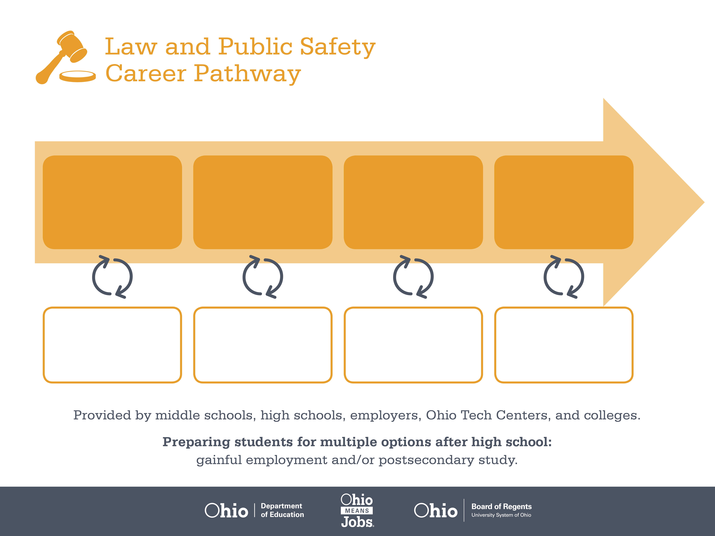
Certificate
Associate Degree,
Criminal Justice
Bachelor’s Degree,
Criminology
Start Pre-Law and Public Safety
As early as grade 7
(based on readiness)
Security Guard
Median Salary: $26,000
Job Growth (10 yr): 11.8%
Annual Openings: 846
Average Tuition (1 yr): $0 –$3,900/yr
Security Supervisor
Median Salary: $41,040
Job Growth (10 yr): 4.2%
Annual Openings: 63
Average Tuition (2 yrs): $3,900/yr
Loss Prevention Manager
Median Salary: $91,960
Job Growth (10 yr): 2.9%
Annual Openings: 537
Average Tuition (4 yrs): $9,600/yr
Workplace Visits
Job Shadow
Internship
Work
Supervised Experience
---
Work
Supervised Experience
Internship
---
Work
Internship
---
Work
Ohio In-demand Occupations
Data reflects 2014 Ohio labor statistics and public institutions of higher education for 2013-2014. For specific tuition costs, visit ohiohighered.org.

Slide 2

Secondary Pathway: Criminal Justice |  |  |  |  | Postsecondary Program: Criminal Justice
An Example of Courses with Secondary and Postsecondary Credits
Secondary | 7 8 | English I | Algebra I | Physical Science | Social Studies | Fine Arts | American Criminal Justice System
 | 9 10 | English II | Geometry | Biology | World History | Health (.5) PE (.5) | Security & Protective Services | World Languages
 | 11 | English III | Algebra II | Chemistry | U.S. History | Police Work & Practice in Public Safety | Investigations & Forensics | World Languages
 | 12 | English IV | Trigonometry/ Calculus | Psychology | U.S. Government | Correctional System & Services | Homeland Security | Law & Public Safety Capstone
Postsecondary | Year 1 1st Semester | English Composition I | College Algebra | Psychology | Criminal Justice | Ethics in Criminal Justice | Basic Investigations
 | Year 1 2nd Semester | English Composition II | Basic Chemistry | Abnormal Psychology | Public Administration | Constitutional Law & Courts | Criminal Law & Procedure
 | Year 2 1st Semester | Communication | Intro to Sociology | Human Diversity | Criminology | Correctional System | Victimology
 | Year 2 2nd Semester | Homeland Security | Correctional Management | Juvenile Process | Probation & Parole | Current Issues in Criminal Justice | Criminal Justice Practicum
 |  | High School Career-Technical Education Program Courses
 |  | High School Courses for Postsecondary Credit (Including Apprenticeship Hours) and the Corresponding Postsecondary Courses
 |  | Required Courses
 |  | Recommended Electives
Visit education.ohio.gov/CareerConnections for reference information.
Course titles and sequences will vary between schools.
6/2015

