Slide 1
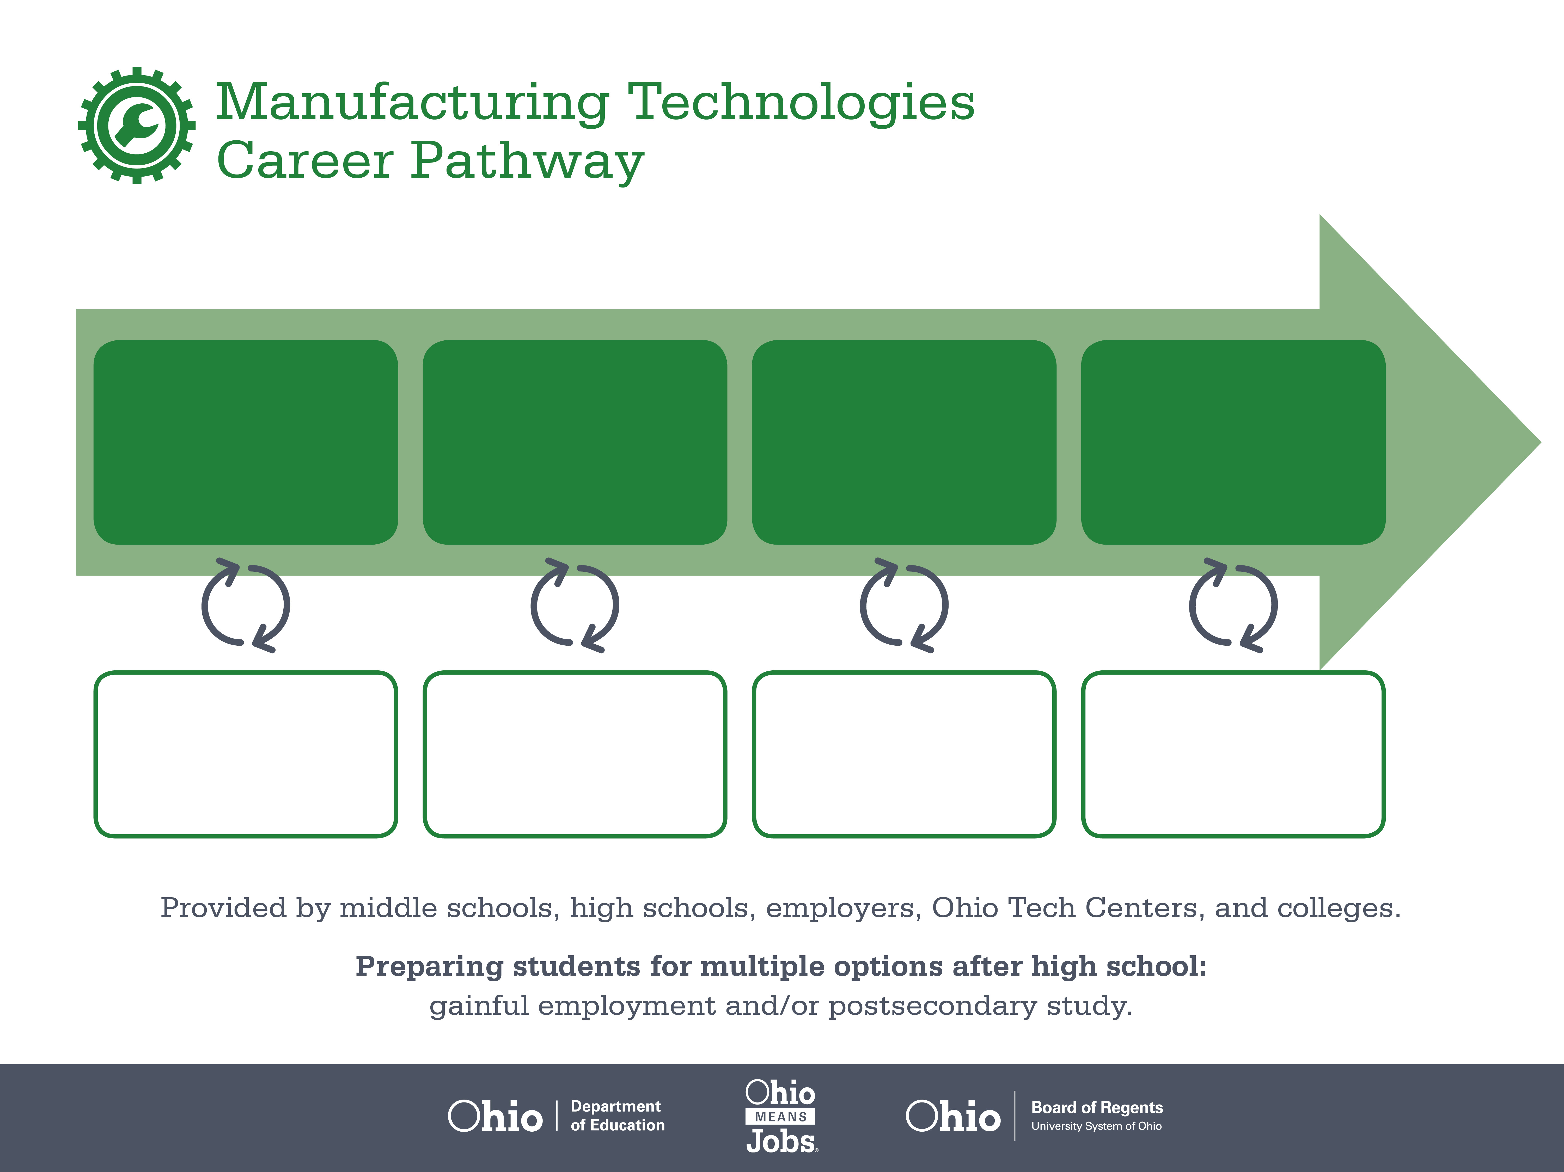
Certificate
Associate Degree,
Avionics Technology
Bachelor’s Degree,
Aerospace Engineering
Start Pre-Manufacturing
As early as grade 7
(based on readiness)
Assembly Team Worker
Median Salary: $29,350
Job Growth (10 yr): 4.9%
Annual Openings: 1,513
Average Tuition (1 yr): $0 –$3,900/yr
Avionics Technician
Median Salary: $55,160
Job Growth (10 yr): 0%
Annual Openings: 6
Average Tuition (2 yrs): $3,900/yr
Aerospace Engineer
Median Salary: $99,500
Job Growth (10 yr): -1.4%
Annual Openings: 77
Average Tuition (4 yrs): $9,600/yr
Workplace Visits
Job Shadow
Internship
Work
Supervised Experience
---
Work
Supervised Experience
Internship
---
Work
Internship
---
Work
Ohio In-demand Occupations
Data reflects 2014 Ohio labor statistics and public institutions of higher education for 2013-2014. For specific tuition costs, visit ohiohighered.org.

Slide 2

Secondary Pathway: Manufacturing Operations |  |  |  | Postsecondary Program: Avionics Technology
An Example of Courses with Secondary and Postsecondary Credits
Secondary | 7 8 | English I | Algebra I | Physical Science | Social Studies | Fine Arts | Pre-Engineering Technologies
 | 9 10 | English II | Geometry | Biology | World History | Health (.5) PE (.5) | Manufacturing Operations | World Languages
 | 11 | English III | Algebra II | Chemistry | U.S. History | CNC Technology | Machine Tools | World Languages
 | 12 | English IV | Trigonometry/ Calculus | Physics | U.S. Government | Computer Integrated Manufacturing | Robotics
Postsecondary | Year 1 1st Semester | English Composition | Intro to Aviation | Aircraft Weight & Balance | Aircraft Materials | AMT Regulation & Inspection | Ground Operation & Servicing | Manufacturing Operations
 | Year 1 2nd Semester | College Algebra | AMT Electricity | Aircraft Metallic Structures | Aircraft Electrical Systems | Aircraft Fuel Systems | Aircraft Non-Metallic Structures | Communication & Navigation Systems
 | Year 2 1st Semester | Physics | Turbine Engine Maintenance | Reciprocating Engine Maintenance I | Machine Tools | Aircraft Environmental Controls | Landing Gear & Fluid Power
 | Year 2 2nd Semester | Ethics | Powerplant Inspection | Reciprocating Engine Maintenance II | Propellers | Hazardous Materials Maintenance | Aircraft Inspection
 |  | High School Career-Technical Education Program Courses
 |  | High School Courses for Postsecondary Credit (Including Apprenticeship Hours) and the Corresponding Postsecondary Courses
 |  | Required Courses
 |  | Recommended Electives
Visit education.ohio.gov/CareerConnections for reference information.
Course titles and sequences will vary between schools.
6/2015

