Slide 1
Career Readiness Leaders Network Meetup
October 10, 2023

Slide 2
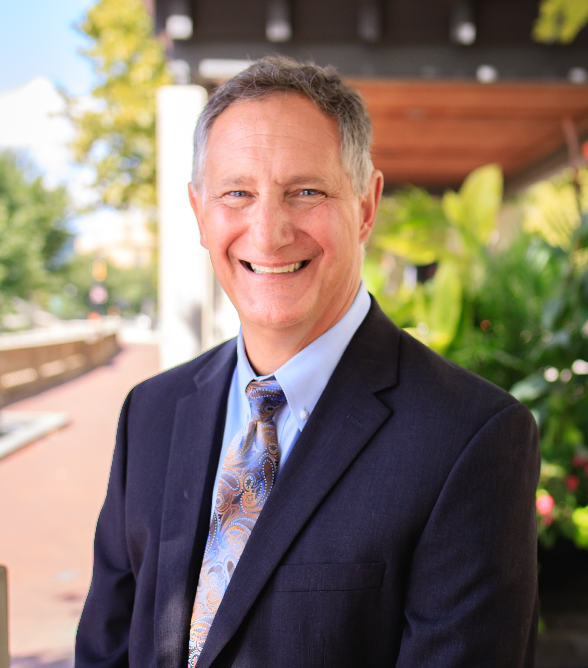


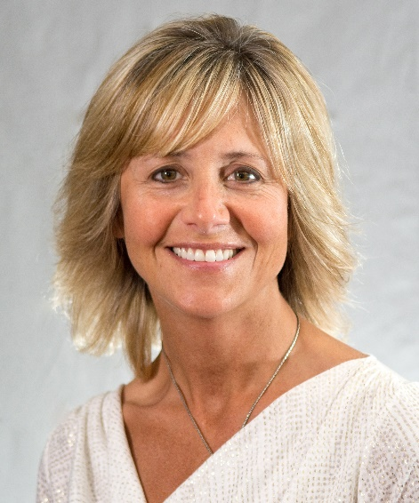
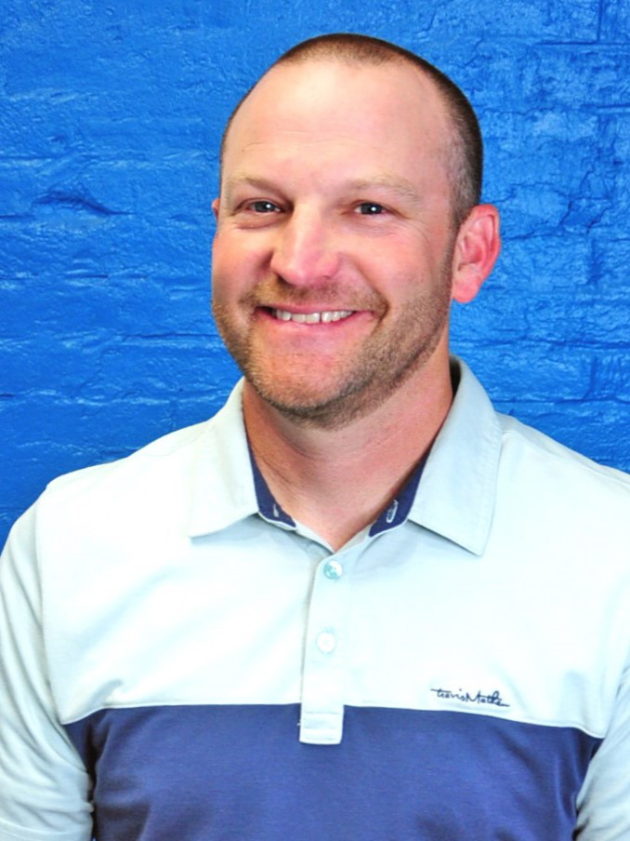





Network Leads
Dennis Haft
Pathways Implementation Specialist
Kayla Mack
Education Program Specialist
Career Advising
Michelle Washington
Business & Education Program
Specialist
Tippi Foley
ESC of Northeast Ohio
Jeremy Ward
Building Bridges to Careers
Travis Taylor
Program Administrator
Sara Watson
Program Assistant
Brenna Bartlett
Office of Career-Technical Education
John Hambrick
ESC of Central Ohio
Emma Waymire
Office of Career-Technical Education
Notes:
Tasha

Slide 3
Agenda
Topic: Career Exploration Continuum
2:30 pm Introductions – Sara Watson
2:35 pm Micro Credentials in Middle School
  Dave Leone & Joe Wargo – Auburn Career Center
2:55 pm Career Tech in Middle School as Career Advising
  Chelsea Canterbury – Office of Career Technical Education
3:05 pm Student Success Plan
  Kayla Mack – Office of Graduate Success
3:10 pm Discussion Around Credentialing for Graduation
  Josh Miller & Emma Waymire – Office of Career Technical Education

Slide 4
OpenSpace
This year we will be utilizing OpenSpace to keep track of all the resources shared in meetups.
  Join the community of Ohio’s Career Readiness Leaders to connect and share best practices!
Bullet points, lines and shapes
Sequences and timelines
Images and text
Numbers

Slide 5
November 14th Meetup
Our November meetup will take place in person at the ESC of Central Ohio from 1 – 3:30p!
  2080 Citygate Dr, Columbus, OH 43219
The topic will be Staffing for Career Readiness for all grades!
  Join us for a panel discussion, networking opportunities, and more!
  Sign up here!

Slide 6














MIDDLE SCHOOL CAREER READINESS

Slide 7
Career Clusters
Agriculture & Environmental Systems/Construction Technologies
Human Services/ Hospitality & Tourism
Business Administration/ Information Technology/ Engineering Technology
Manufacturing/ Engineering & Science Technologies
Education & Training
Transportation Systems
Health Sciences
Law & Public Safety
ACC offers Career Exploration for any MS grade

Slide 8
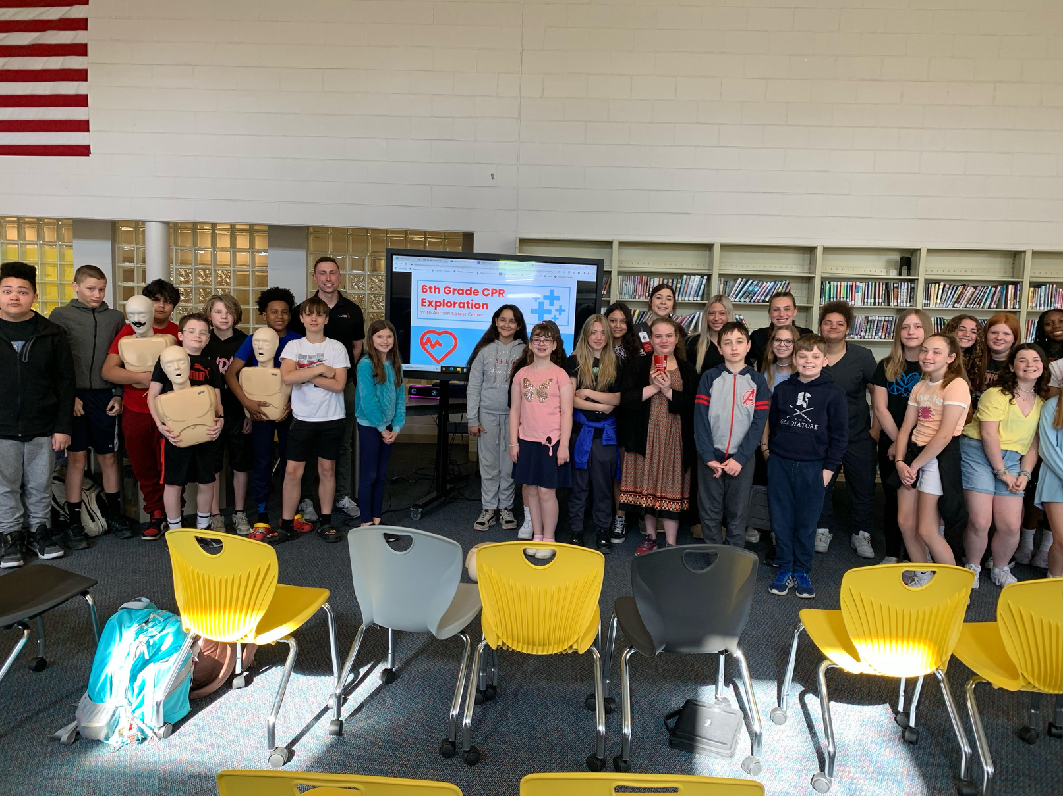

6TH GRADE - CPR
Why We Learn CPR?
You Could save a LIFE!
If performed immediately, CPR can double or triple the chance of survival from an out of hospital cardiac arrest.
Health Sciences
Law & Public Safety

Slide 9
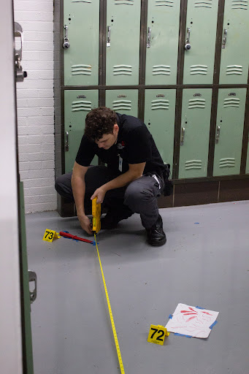
7TH GRADE - TAPE & RULE
  Precision Measurement: Tape & Rule
      ACC Guided, Associate School Led
        Aligned to 7th Grade Math Standards
        Teaches basic measurement skills and how those relate to future careers/real-world
        Students can earn Starrett/Snap-on Precision Measuring: Tape & Rule and Angle Measurement Credential (1 point)
Manufacturing/ Engineering & Science Technologies
Transportation Systems

Slide 10
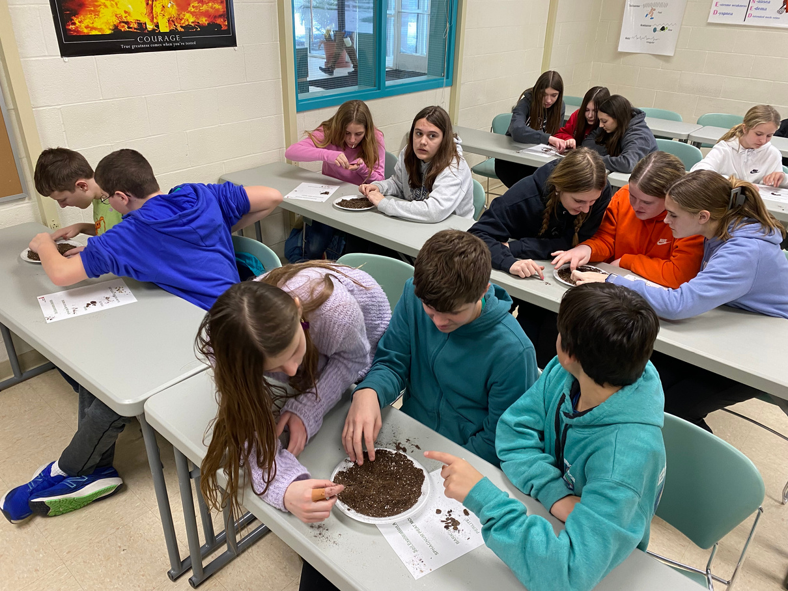

7TH GRADE - EXPERIENCE
  7th Grade Experience - ACC Lead at ACC
      3-way rotation for students
        Horticulture Rotation
        Criminal Justice Rotation
        Quality Precision Measurement Lab Rotation
Law & Public Safety
Manufacturing/ Engineering & Science Technologies
Agriculture & Environmental Systems/Construction Technologies

Slide 11
8TH GRADE
  Multimeter
Manufacturing/ Engineering & Science Technologies
      ACC Guided, Associate School Led
        Aligned to 8th Grade Science Standards
        Teaches basic measurement relating to electricity and how those skills relate to future careers/real-world applications
        This is a preview of a larger credential - Snap-on Multimeter Certification (3 points)
Transportation Systems
  8th Grade Tour
      Exposes students to all Career Clusters offered by ACC through hands-on stations

Slide 12
QUESTIONS?

Slide 13
Career Tech in Middle School as Career Advising
Chelsea Canterbury
October 2023

Slide 14
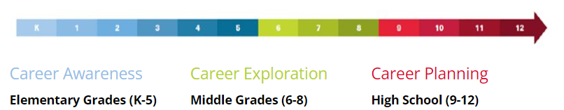
Career Connections Framework
Notes:
Advanced academic and technical education
Student Success Plan
Career connections learning strategies (Updated resources coming soon)
Workplace visits with career interviews
Career courses
Career mentorships
Career research
Service learning
Career-tech student organizations
OhioMeansJobs K-12
Career pathways

Slide 15

Career Advising Best Practices
Most Effective & Least Used*
Connecting students with CTE coursework and career pathways as a career advising and development strategy.
Providing or facilitating work-based learning experiences for students.
Engaging and partnering with industry and community.
*Advance CTE: 2021
Notes:
Only 27% of middle school counselors report that they connect students with CTE coursework or career pathways, even though this strategy is rated one of the more effective among those who use it, with 87% of the school counselors who use it in middle school labeling it as effective or extremely effective. Additionally, while only 23% of middle school counselors provide or facilitate work-based learning opportunities for students, 56% of those who do find it to be an extremely effective strategy

Slide 16
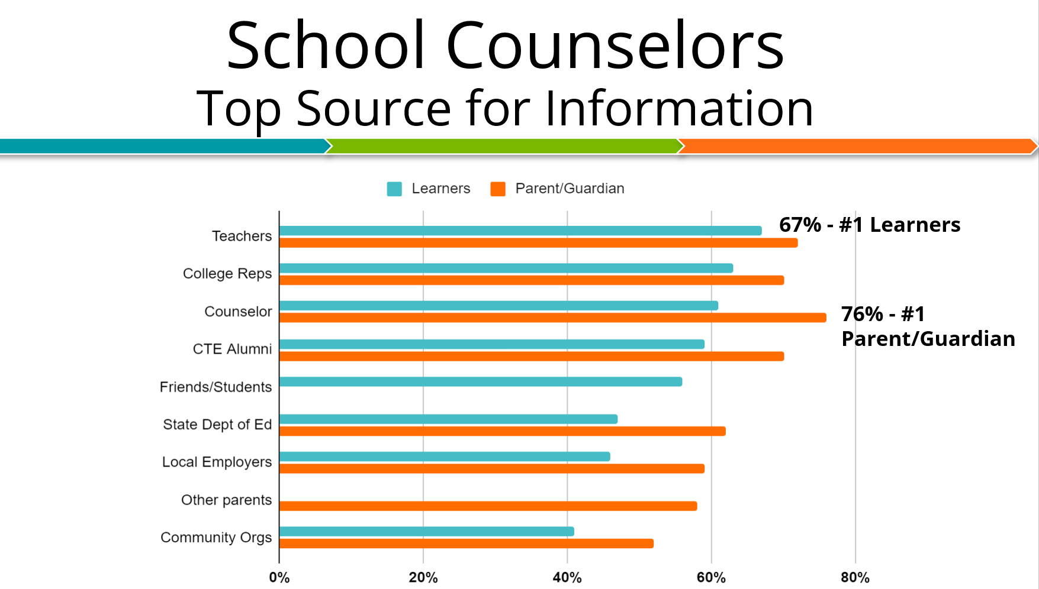
Notes:
Top source of information for career advising and post-secondary choices

Slide 17
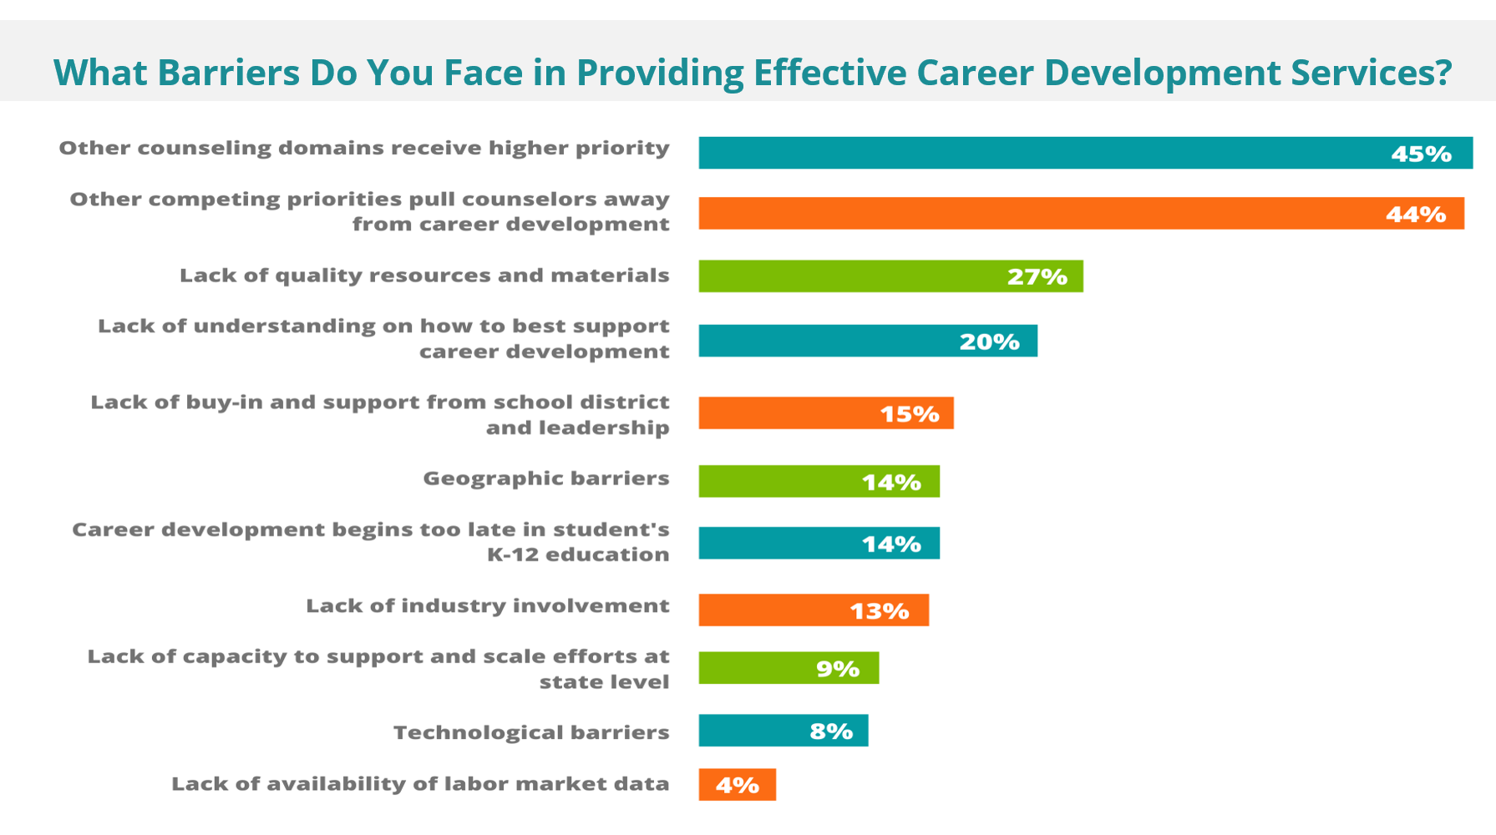
Notes:
There was a major disconnect in state and local responses
Few states believe their systems are fully aligned throughout K-12
Career advising and development efforts are much more common at the high school level
Effectiveness of strategies is a ‘mixed bag’

Slide 18
CTE Continuum
Grades 7-10
Introductory CTE Courses
Grades 9-12
CTE Pathway Courses
Grades 9-12
Work-Based Learning
Grades 7-9
Career Connections
Grades 7-8
CTE Pathway Courses
Grades 9-12
Industry Credentials
Notes:
One course in a possible continuum; career connections allows students to make informed decisions about next steps; valuable to start career advising early
All career connections courses should be aligned with options available in the district; you as the counselor are the voice to help students decide where they want to jump onto this continuum in a way that fits best for them.

Slide 19

Why Middle Grades Programming?
Increase student engagement
Informed decision-making for students into pathways
Determine student interest & need for program growth/fluctuation years in advance
Pique interest for in-demand jobs

Slide 20

Why Middle Grades Programming?
Provide students with greater opportunities and expanded vision for their future
Grow understanding of CTE
Create a cohesive career advising strategy available to all students
Starting early allows students to enter post-secondary plans more prepared!

Slide 21

Middle Grades CTE Delivery Models
Stand-alone electives
Electives in a rotation
Electives in a series
Complementary course enrollment: content offered with separate credit, but delivered in collaboration with other subject areas to enhance both courses
Integrated/simultaneous coursework
  Academic core courses (middle school or high school-level)
  Specials and electives (middle school or high school-level)
  Project Lead the Way

Slide 22
Building Meaningful Learning Systems
Biomedical Technologies
Animal and Plant Biotechnology
Animal and Plant Science
Career Connections

Slide 23
Student Success and Graduation Plans
"Self and career awareness breeds purpose and meaning, enhancing the self-direction and hope of youth"
Dr. Patrick Akos, School of Education, University of North Carolina at Chapel Hill
Starting Early: Career Development in the Early Grades, Akos, Patrick, Association for Career and Technical Education, 2020, https://files.eric.ed.gov/fulltext/ED610366.pdf

Slide 24
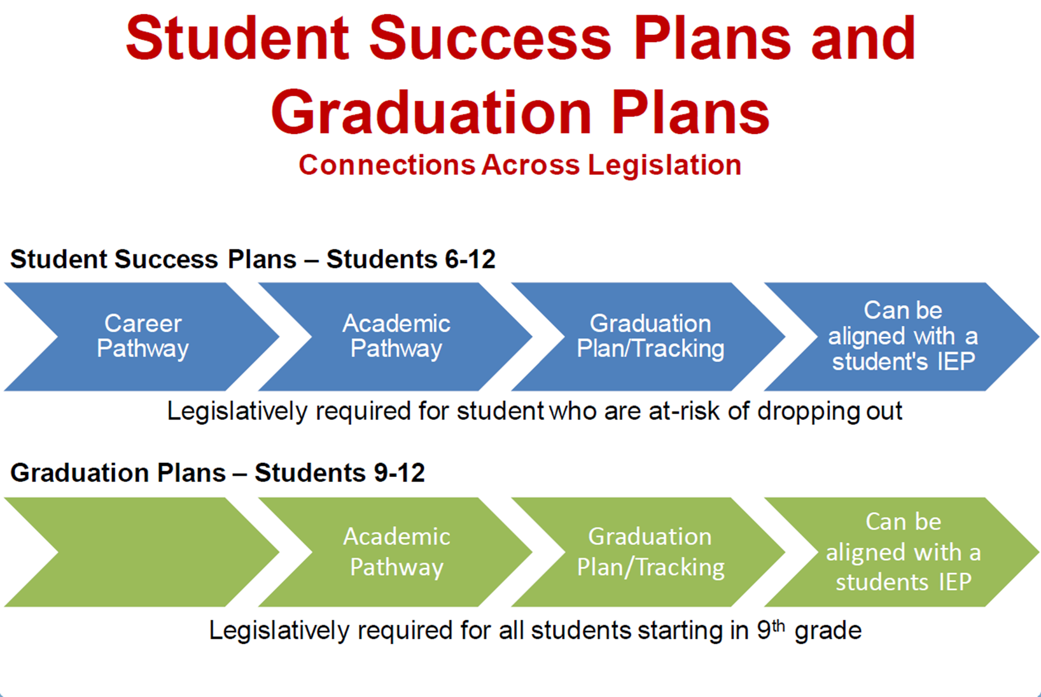

Slide 25
Industry-Recognized Credential Incentives
Districts receive reimbursement for the examination fee of every successfully earned credential.
Students learn job-specific skills they will need to perform day-to-day tasks when working in the industry.
Industry-recognized credentials help employers validate the knowledge and skills of potential employees

Slide 26
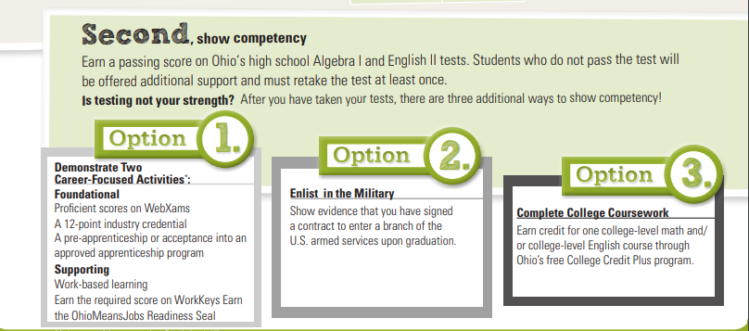
Ohio Graduation Requirements
Provide an alternative pathway to demonstrate competency for Ohio Graduation
  Earn “Industry-Recognized Credential Seal”.
Some industry-recognized credentials can be used as evidence of prior learning and can be awarded college credit through the Industry-Recognized Credential Transfer Assurance Guide (ITAG) program
Notes:
- If student has taken

Slide 27
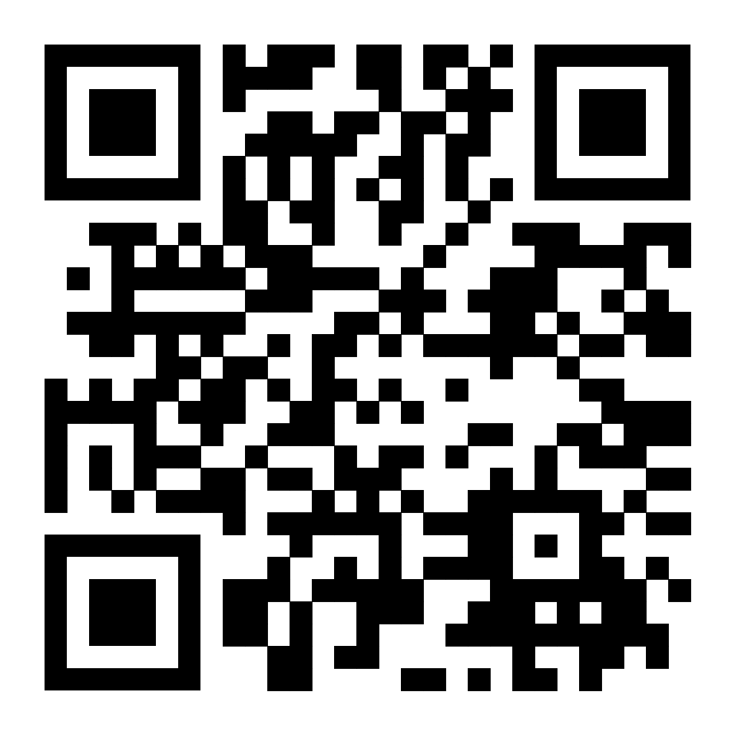
Feedback
Please consider leaving feedback on today's session!
Feedback Link or scan the QR code!

Slide 28






@OHEducation

