Slide 1
Career Readiness Leaders Network Meetup
September 12, 2023

Slide 2
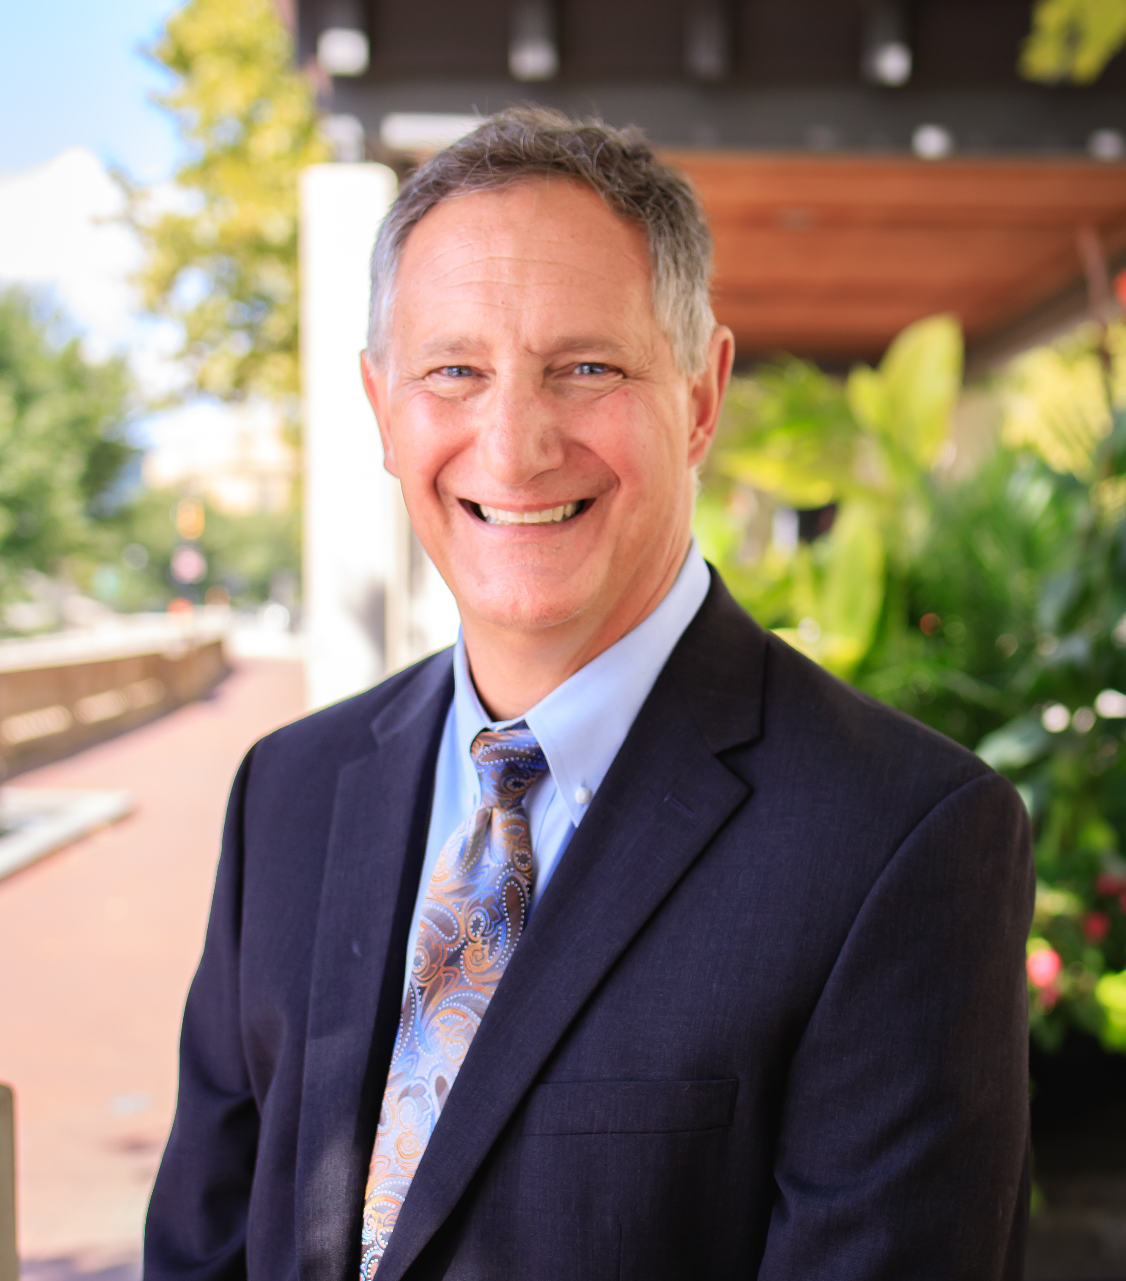
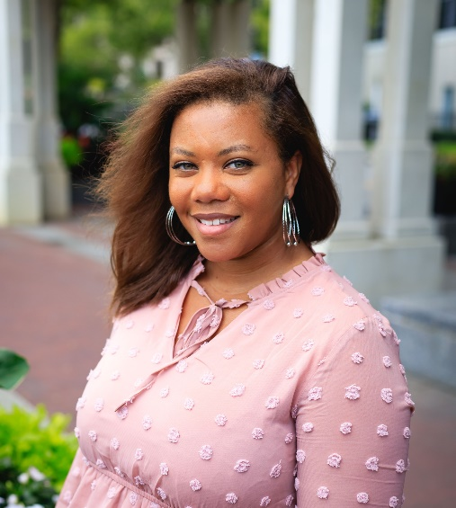
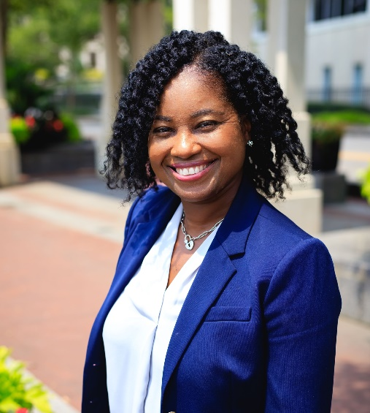
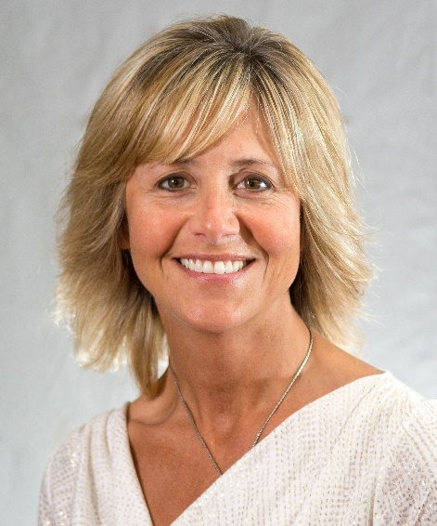
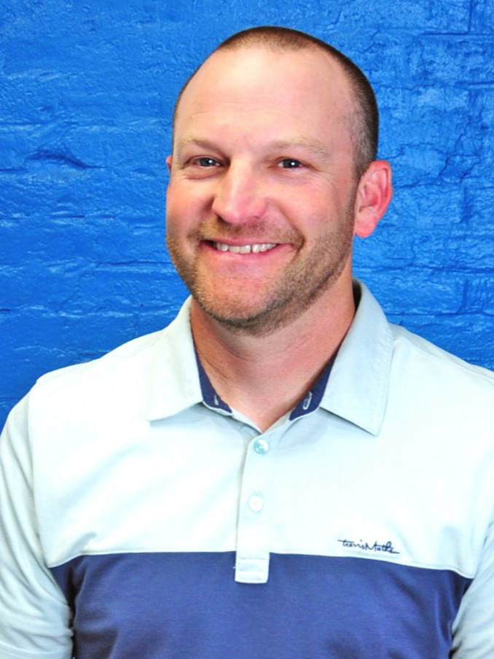
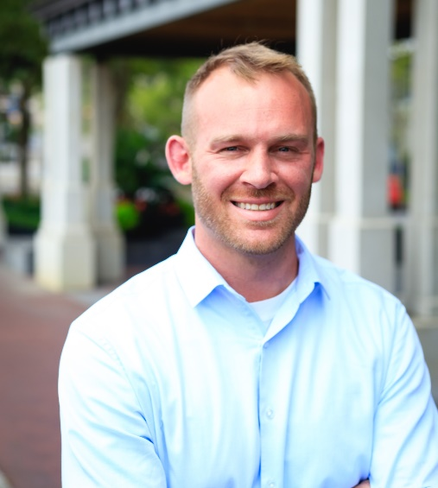
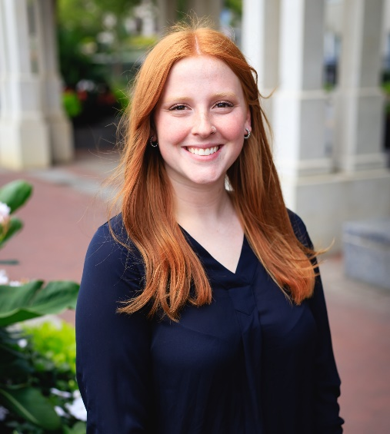
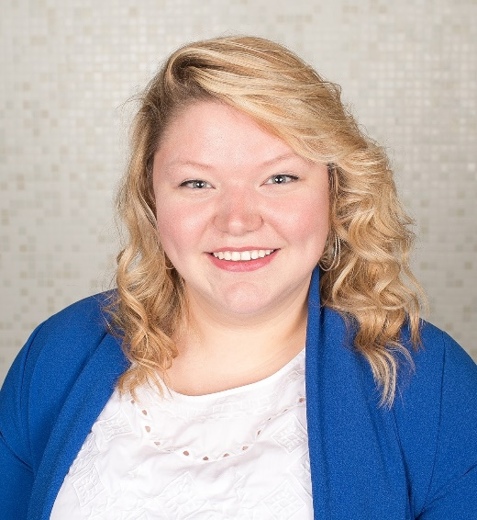
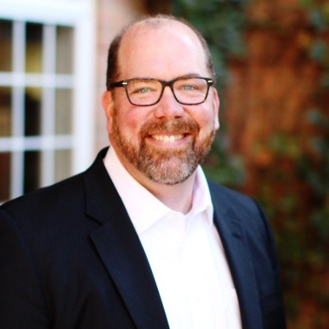
Network Leads
Dennis Haft
Pathways Implementation Specialist
Kayla Mack
Education Program Specialist
Career Advising
Michelle Washington
Business & Education Program
Specialist
Tippi Foley
ESC of Northeast Ohio
Jeremy Ward
Building Bridges to Careers
Travis Taylor
Program Administrator
Sara Watson
Program Assistant
Brenna Bartlett
Office of Career-Technical Education
John Hambrick
ESC of Central Ohio
Emma Waymire
Office of Career-Technical Education
Notes:
Tasha

Slide 3
Bringing together Ohio's Career Readiness Leaders to discuss important topics, share ideas, resources, stay up to date on current research, and learn together.
We will continue every 2nd Tuesday of the month!
Purpose
Notes:
Amy

Slide 4
Agenda
Topic: Introduction to the Career Readiness Leaders Network!
2:40p – Introduction Activity – OpenSpace
2:50p – Housekeeping for Meetups
2:55p – Department of Education and Workforce Updates
3:10p – CTE Equipment Grant
3:20p – Future Meetups

Slide 5
Introduction Activity
This year we will be utilizing OpenSpace to keep track of all the resources shared in meetups.
Join the community of Ohio’s Career Readiness Leaders to connect and share best practices!
Bullet points, lines and shapes
Sequences and timelines
Images and text
Numbers

Slide 6
Housekeeping for Meetups
Feel free to turn your camera
on – we would love to see you!
Use the chat and raise hand function whenever you have a comment!
Feedback is always welcome
and appreciated – more info at the end of the meetup.

Slide 7
Department of Education and Workforce Updates
During the first week in October, the Department of Education will be renamed the Department of Education and Workforce and will become a cabinet-level agency reporting to the Governor of Ohio. Further, the legislation created a new agency, the Department of Children and Youth, to provide services more efficiently to children and their families in the areas of prevention, early education and support.
The current powers and duties of the State Board of Education will be divided between the State Board of Education and Department of Education and Workforce.
Sequences and timelines
Images and text
Numbers

Slide 8
Department of Education and Workforce Updates
We remain committed to Ohio’s students throughout these organizational changes. We are dedicated to continuing to provide spaces, like these meetups, where educators can gather to learn and collaborate on career-connected education. Our priority of workforce readiness is only enhanced!

Slide 9
CTE Equipment Grant
Funding to implement or expand career-technical education or industry-recognized credential programs
Credentials must be included on the Innovative Workforce Incentive Program Credential List
Two application windows
RFA and further information coming soon

Slide 10
2023 Meetups
October 10, 2023
November 14, 2023 – In Person!
December 12, 2023
Notes:
[When presenting, this slide requires multiple clicks to reveal each element]

Slide 11
November 14th Meetup
Our November meetup will take place in person at the ESC of Central Ohio from 1 – 3:30p!
2080 Citygate Dr, Columbus, OH 43219
The topic will be Staffing for Career Readiness for all grades!
More to come…
Sign up here!

Slide 12
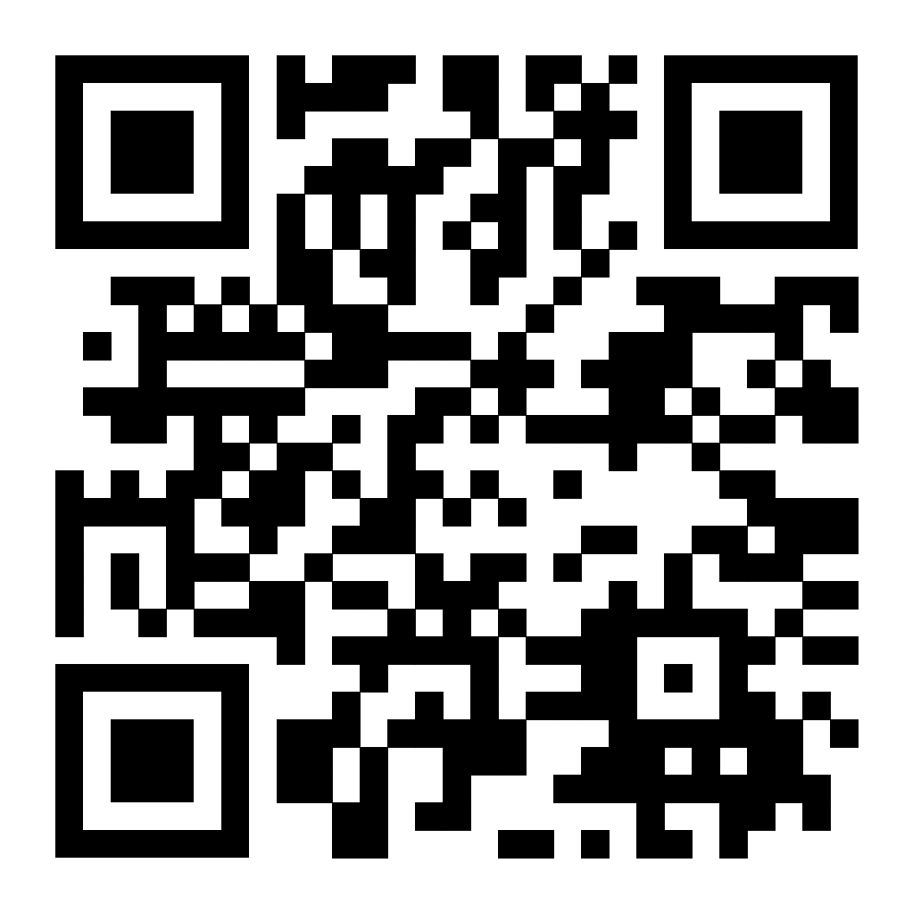
Feedback
Please consider leaving feedback on today's session!
Feedback Link or scan the QR code!

Slide 13
@OHEducation

