Slide 1
The power of 17: Career gears @ graham
Kirk Koennecke, Superintendent
Chad Miller, Graham Elementary
Chad Lensman, Graham Middle
Ryan Rismiller, Graham High School
@GrahamSchools

Slide 2
max verstappen
Red Bull hired the 17 Year old Dutchman in F1 racing after 1 season in F3.
While preparations for his rookie season were “predictably intense”, Max won in May.

Slide 3
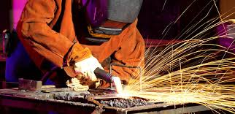
Welding example
Ryan Burroughs was a 17 Year old at Ohio Hi-Point Career Center with over 400 hours of work experience.
He was already working with “dangerous” tools in a safe environment in a high-demand field

Slide 4
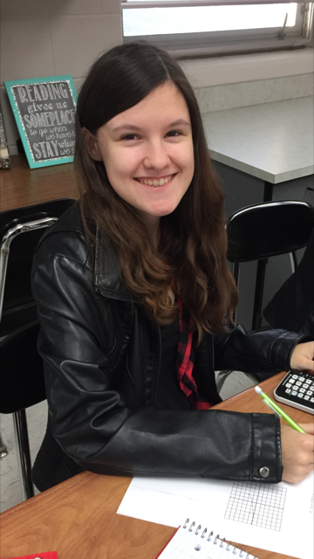
Abby Urquhart, volunteer
Abby walked into the Saint Paris city building and asked to volunteer.
Abby works for the city government 3 days a week now
Abby saves the city hundreds of personnel hours annually, and thousands of dollars, and impacts others
Why doesn’t Abby benefit now, before she graduates?

Slide 5
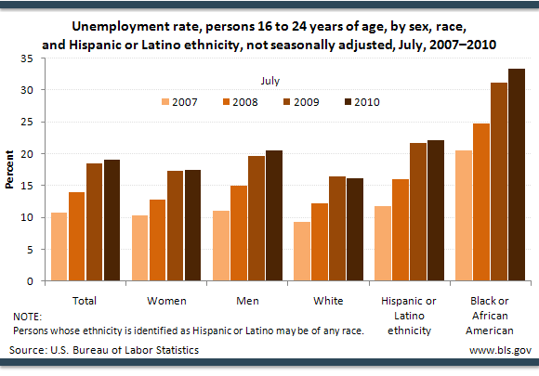
Competition drives the engine
20 million educated 17 year olds currently in pathways, employable, and career-ready.
The Craft Apprentice era drove American economic development in the 18th century
Minority adults and teenagers worked to drive the economy in America during both World Wars.

Slide 6
Success TODay, prepared for tomorrow
Graham2020’s prime goal is to personalize education through experiences
My job as a superintendent is to increase our impact on community through partnerships, awareness, and through intentional communications to plan for our community’s future together.

Slide 7
Board Policy work:
4 months seeking input, feedback, and holding focus group meetings
Vetted by ODE staff, other colleagues, industry/agency partners
3 extra work sessions, 2 retreats with BOE members
Public readings, principal presentations at two successive meetings
Passage 4-1
2 new model policies requiring service learning and job shadow experiences at all three levels of schooling prior to graduation

Slide 8
Career GEARS @ Graham:
GHS has developed MOUs with:
Clark State
Urbana
Sinclair CC
Edison CC
Wittenberg
to work on expansion of CCP, co-teaching, blended models, and distance learning to provide paths.

Slide 9
Career GEARS @ Graham
We have listened to our industry partners…

Slide 10
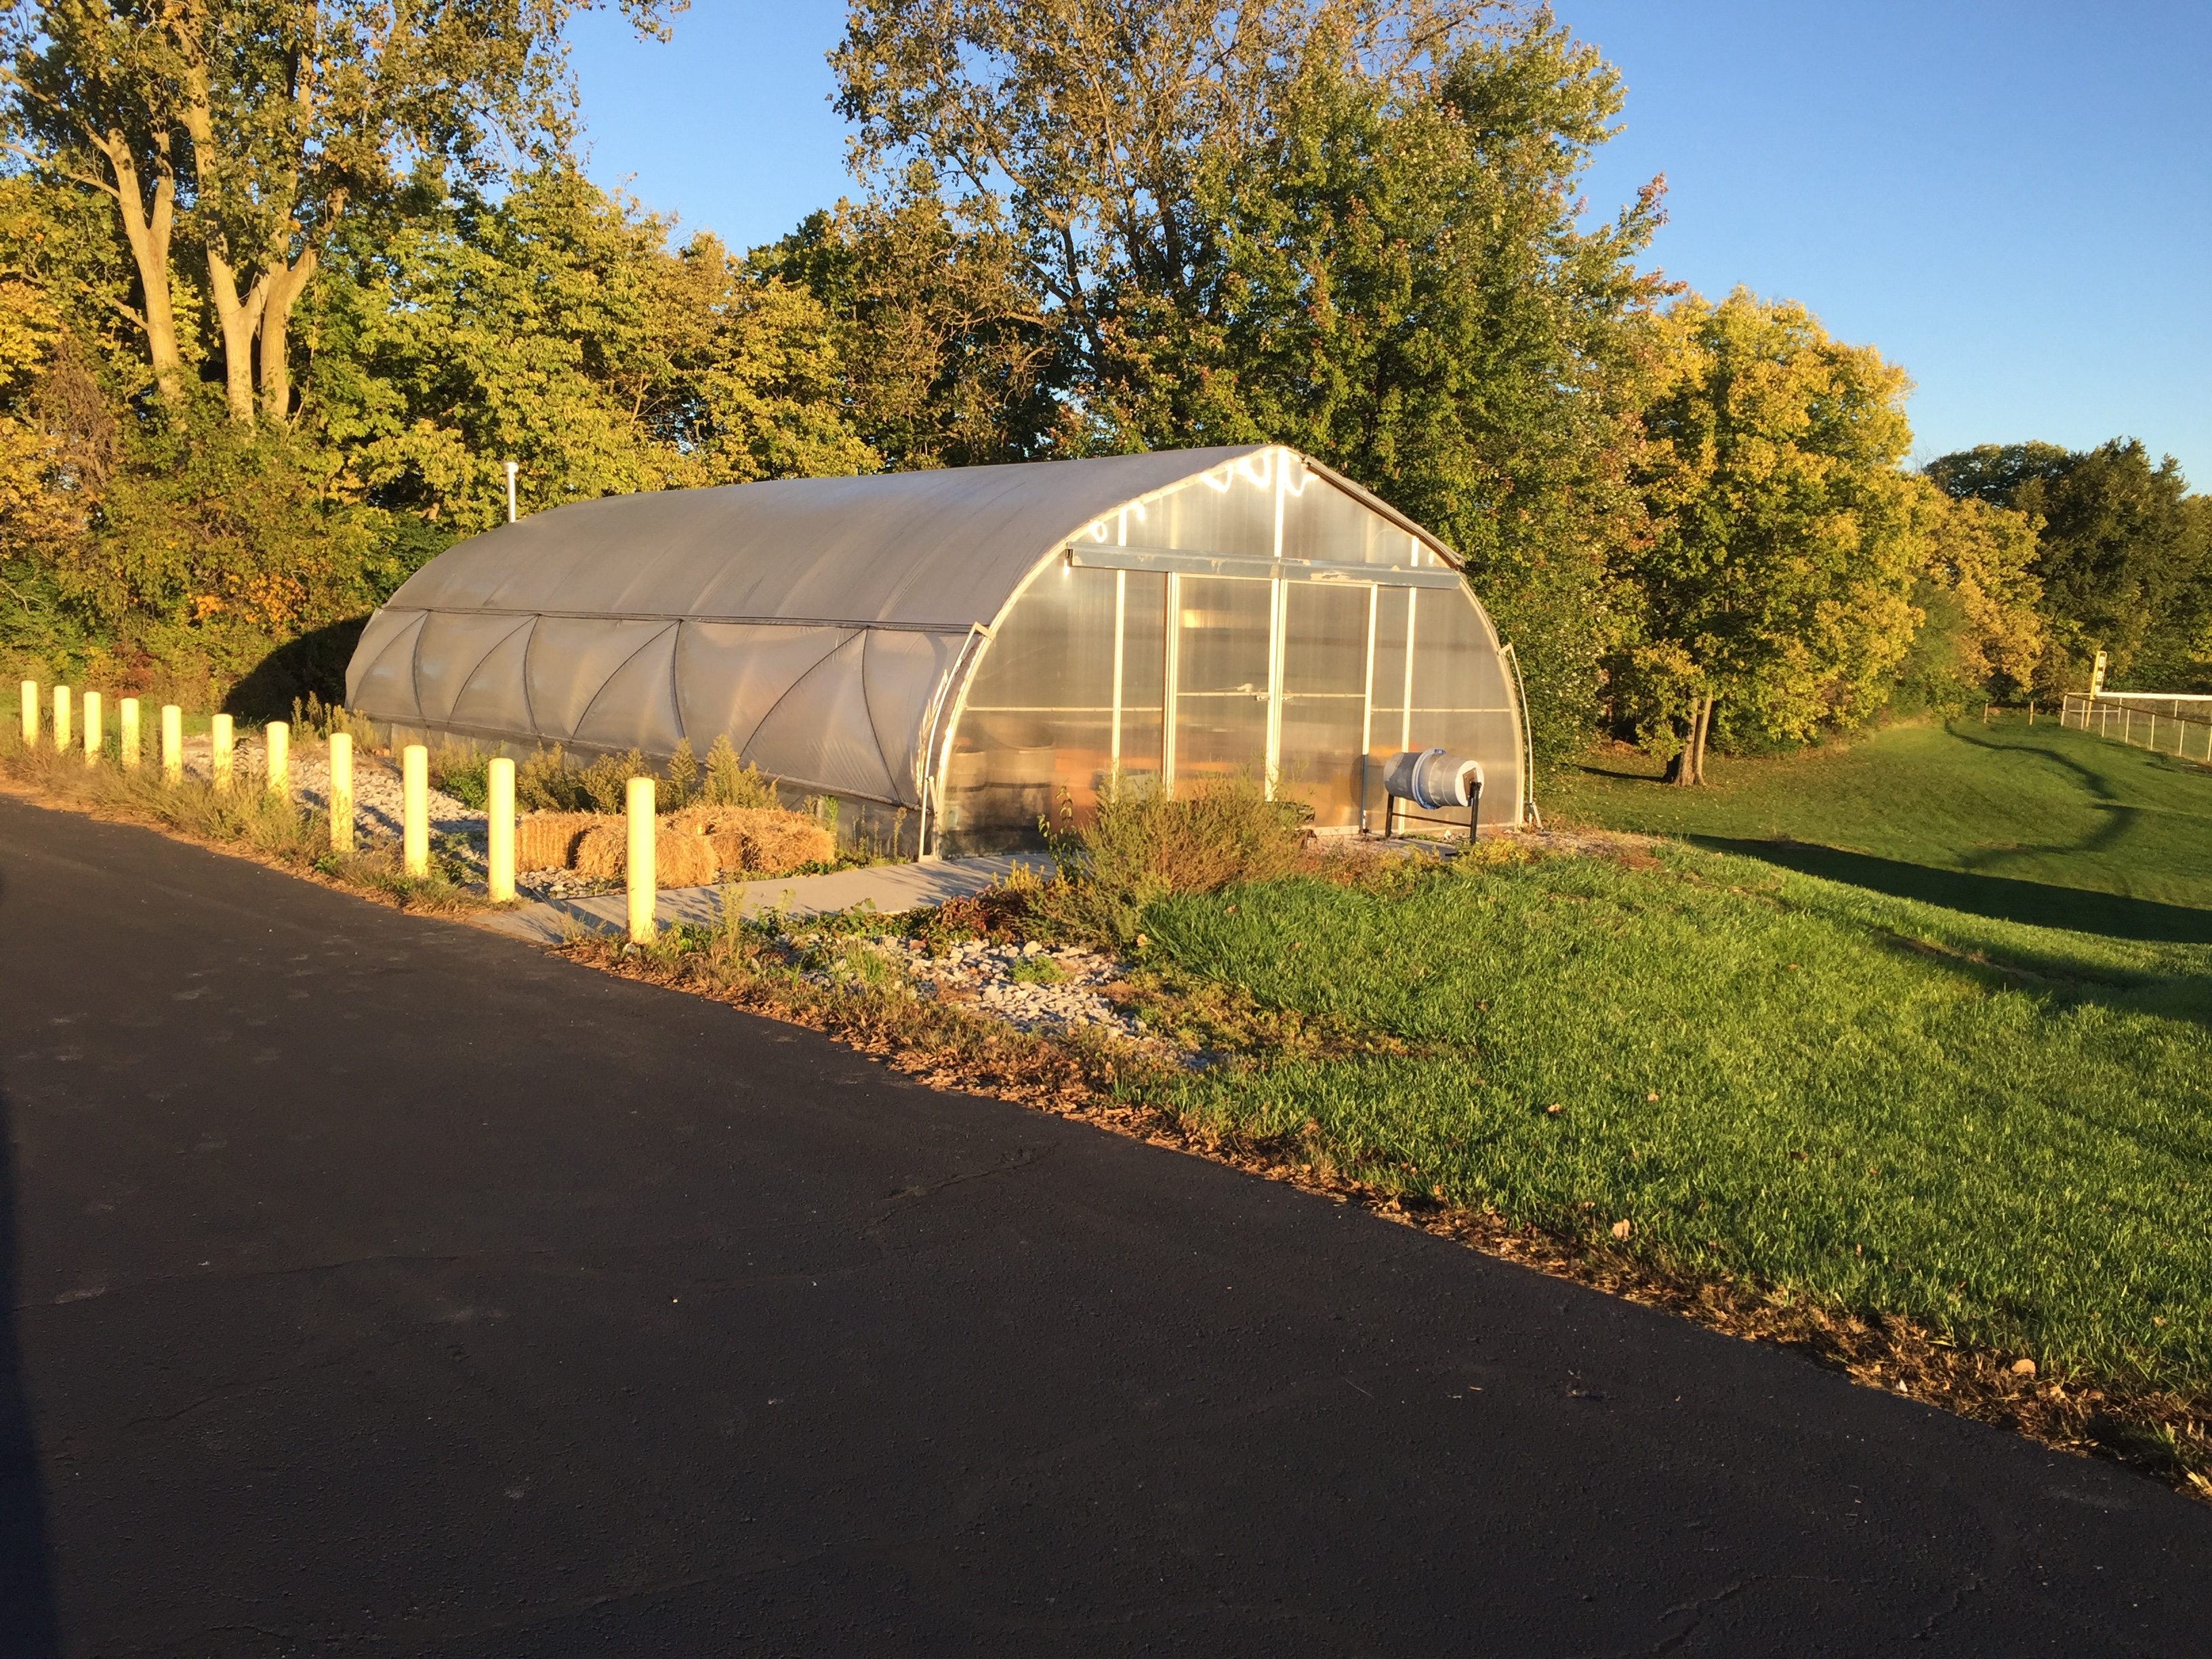
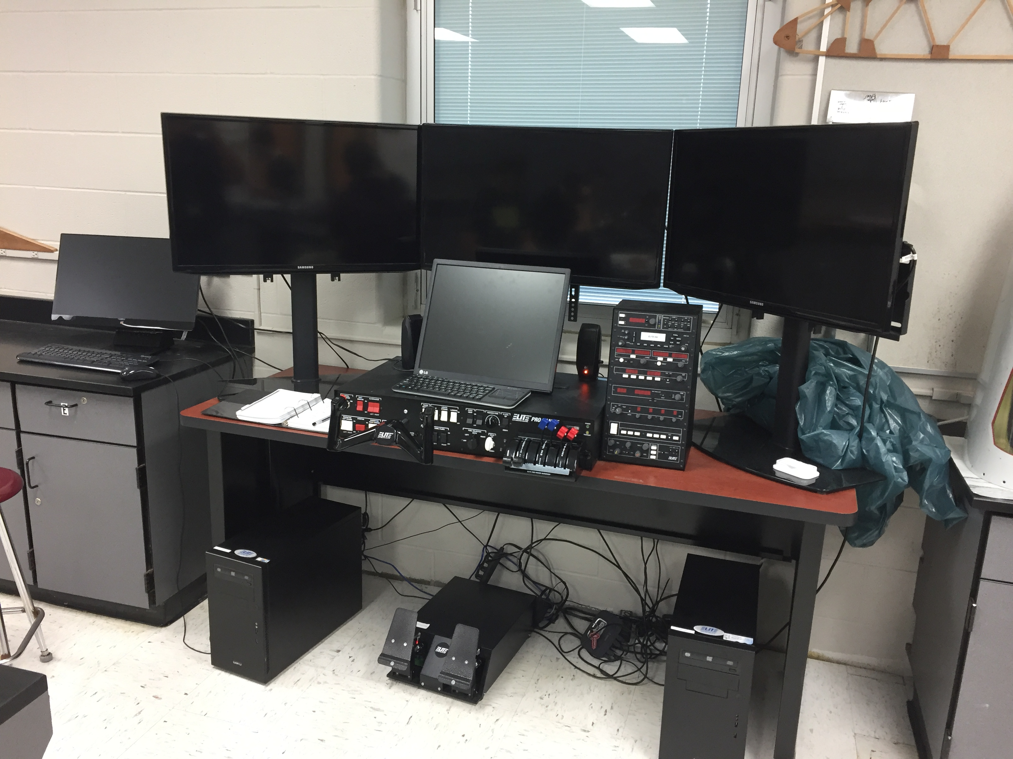
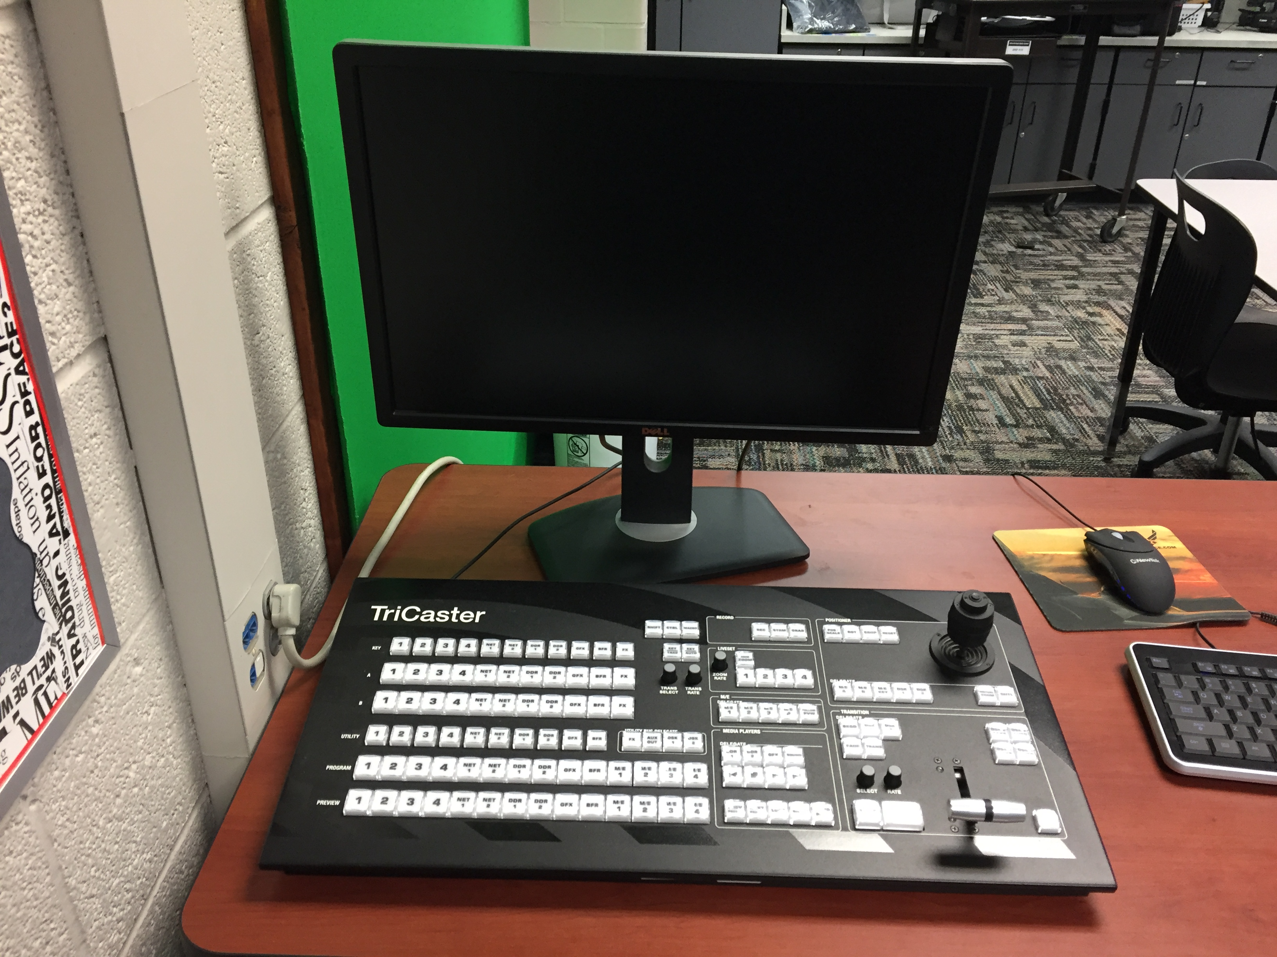
Career GEARS @ Graham:
GHS accounts for 14% of Ohio Hi-Point attendance on site, and hosts 8 programs on our campus
Added Business Logistics pathway for job-ready certification
Added Precision Ag Early College Program

Slide 11
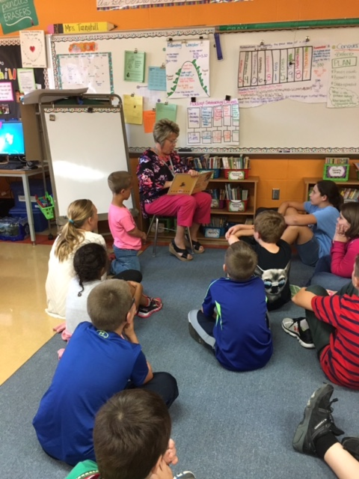
Career GEARS @ Graham:
GHS is working with Urbana University to develop a unique Teacher Prep Model:
Early college experiences & work study while students are in high school to address a national teacher shortage crisis.

Slide 12
Career GEARS @ Graham:
Use of Naviance counseling tool for students Grades 7-12
Building a Resume:
Work Keys Testing option
ACT Preparations
Career Interest Surveys
Student Interviews
Intern opportunities

Slide 13
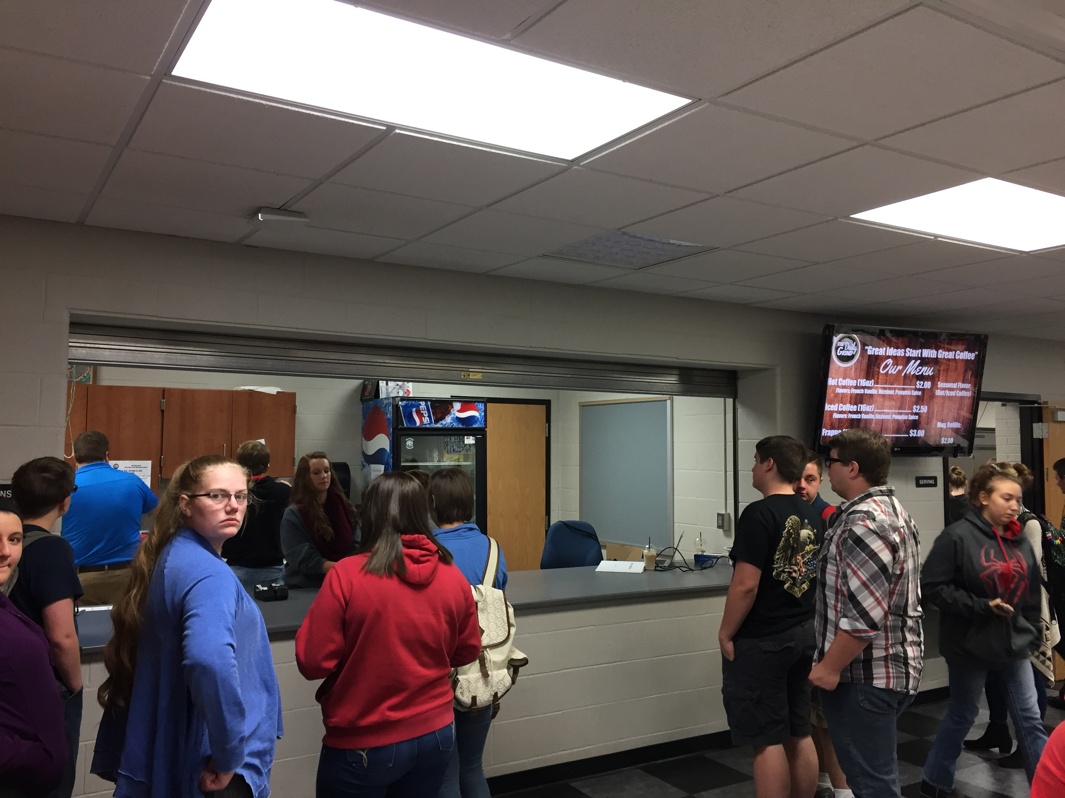
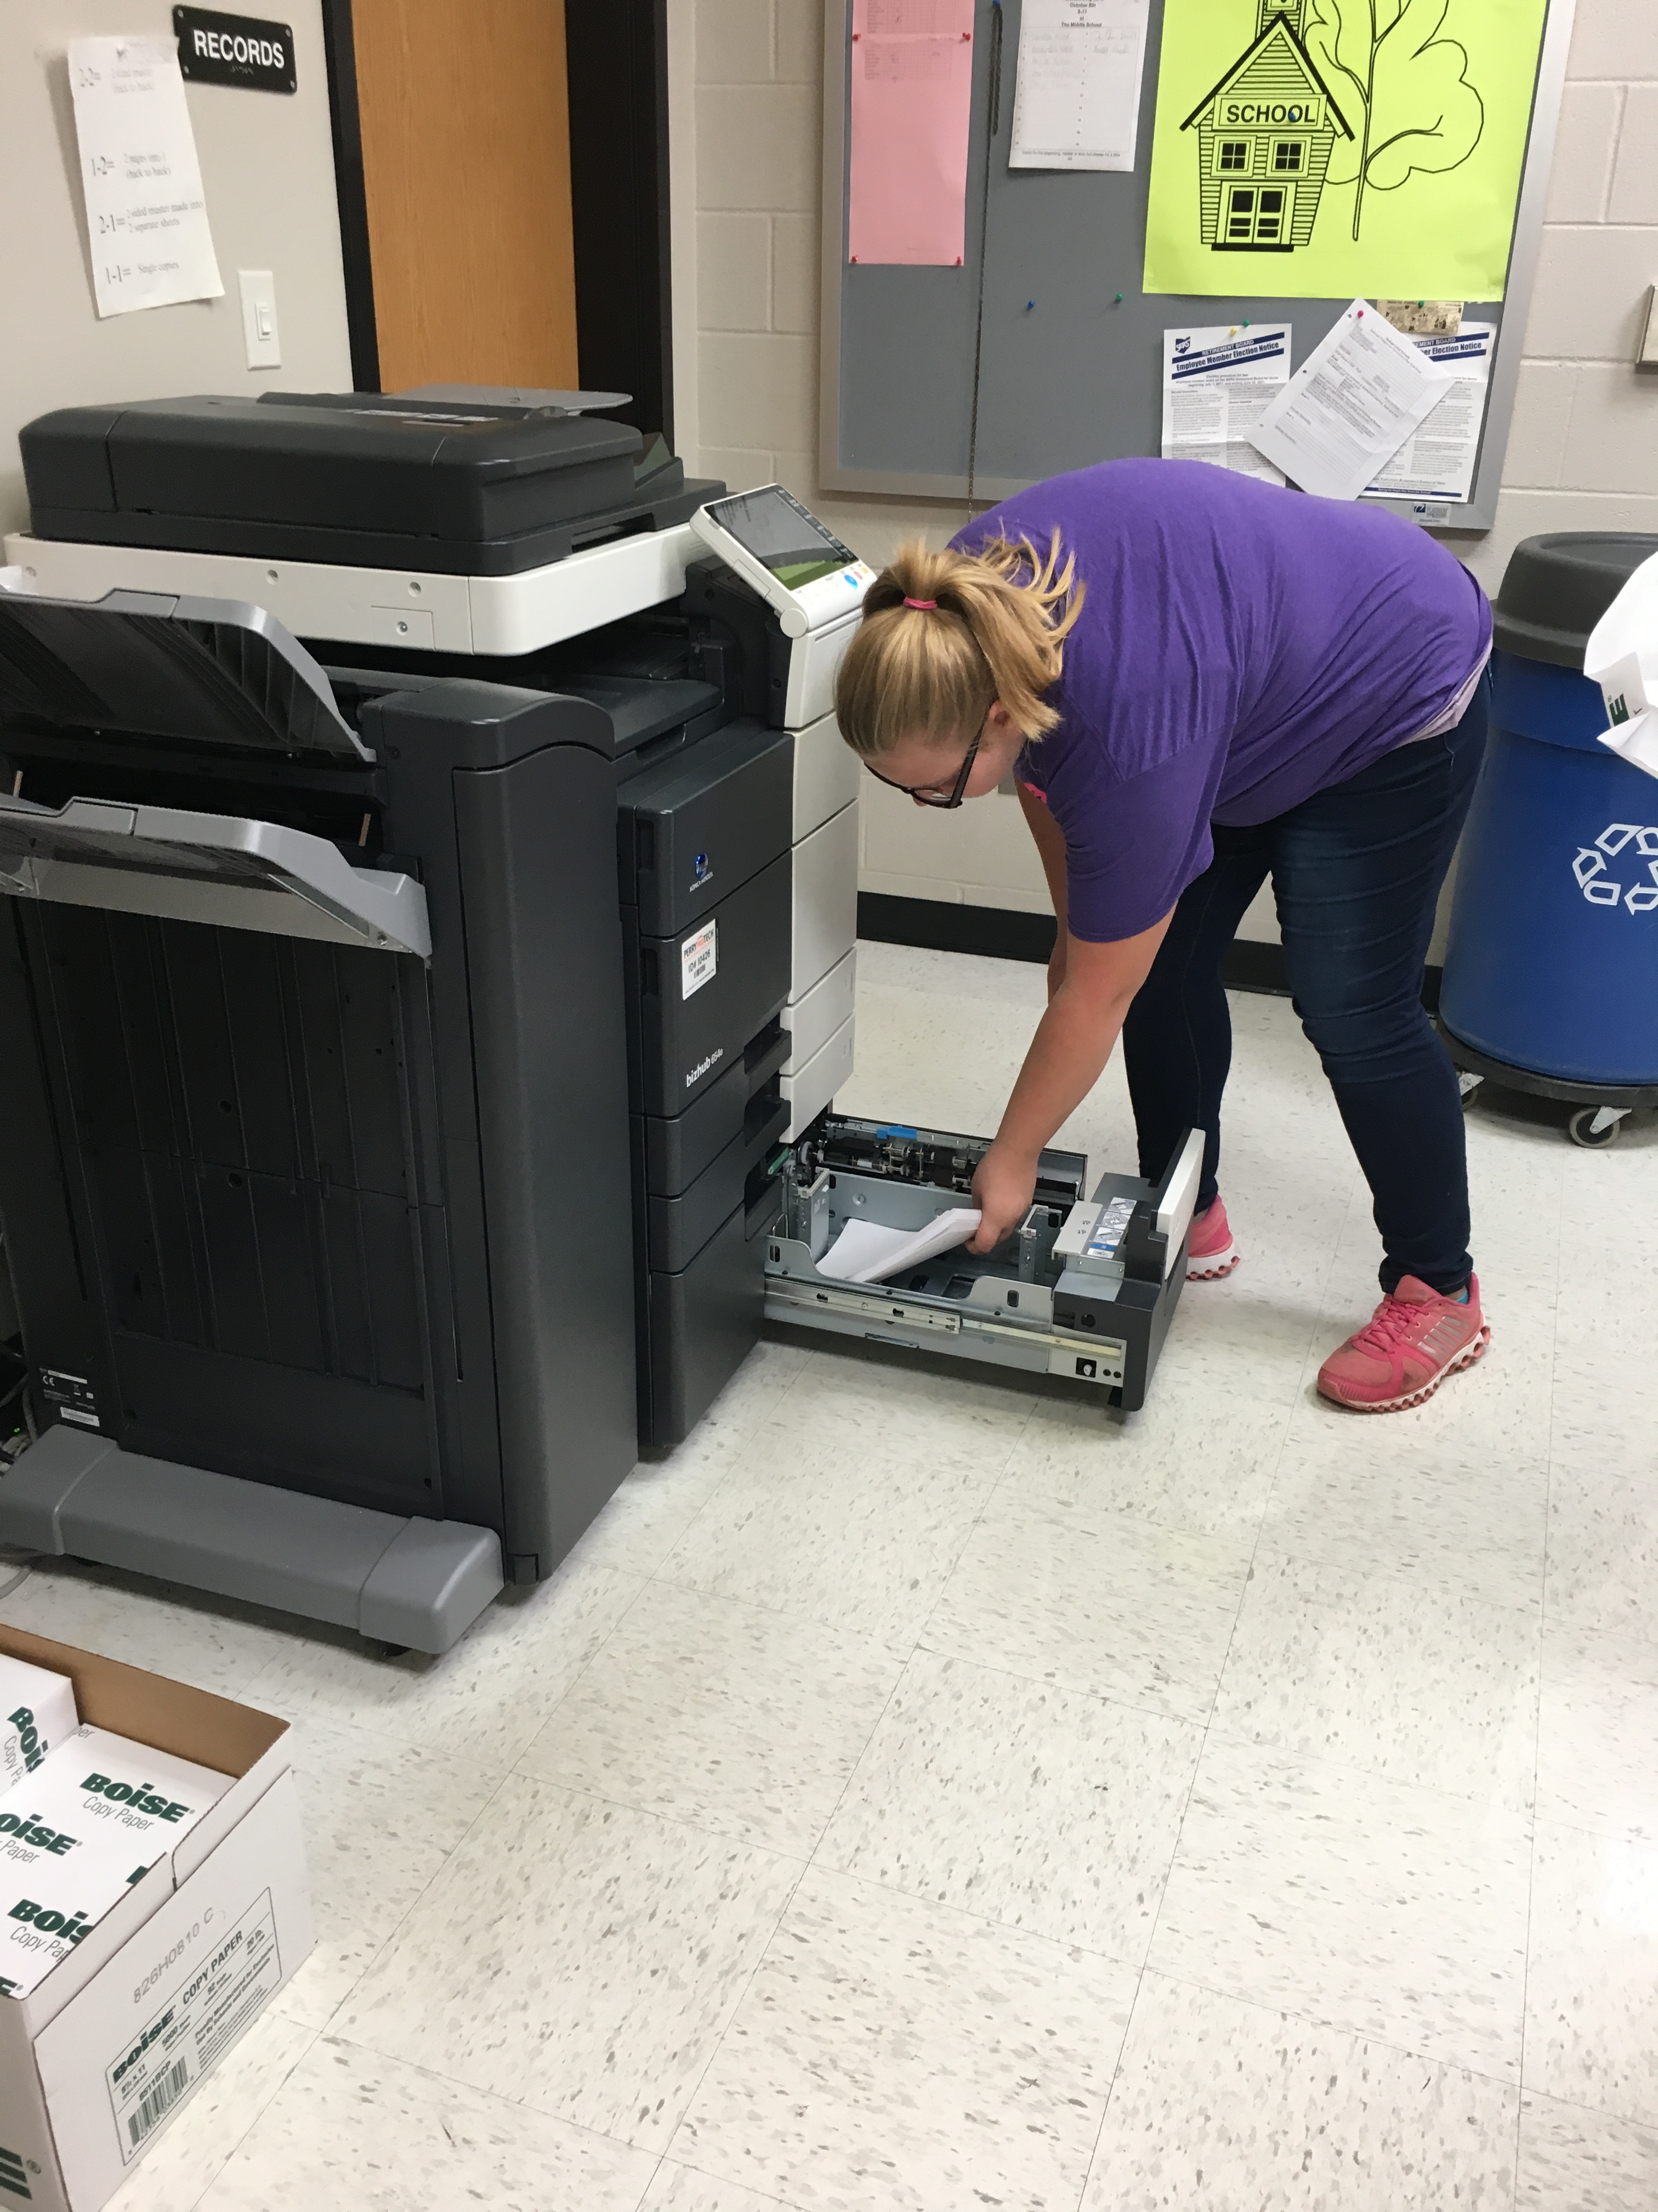
Career GEARS @ Graham:
The Daily Grind: student-led capstone business within Graham High School
Working with OOD task force to develop unique
and replicable transitions services model for Work Study

Slide 14
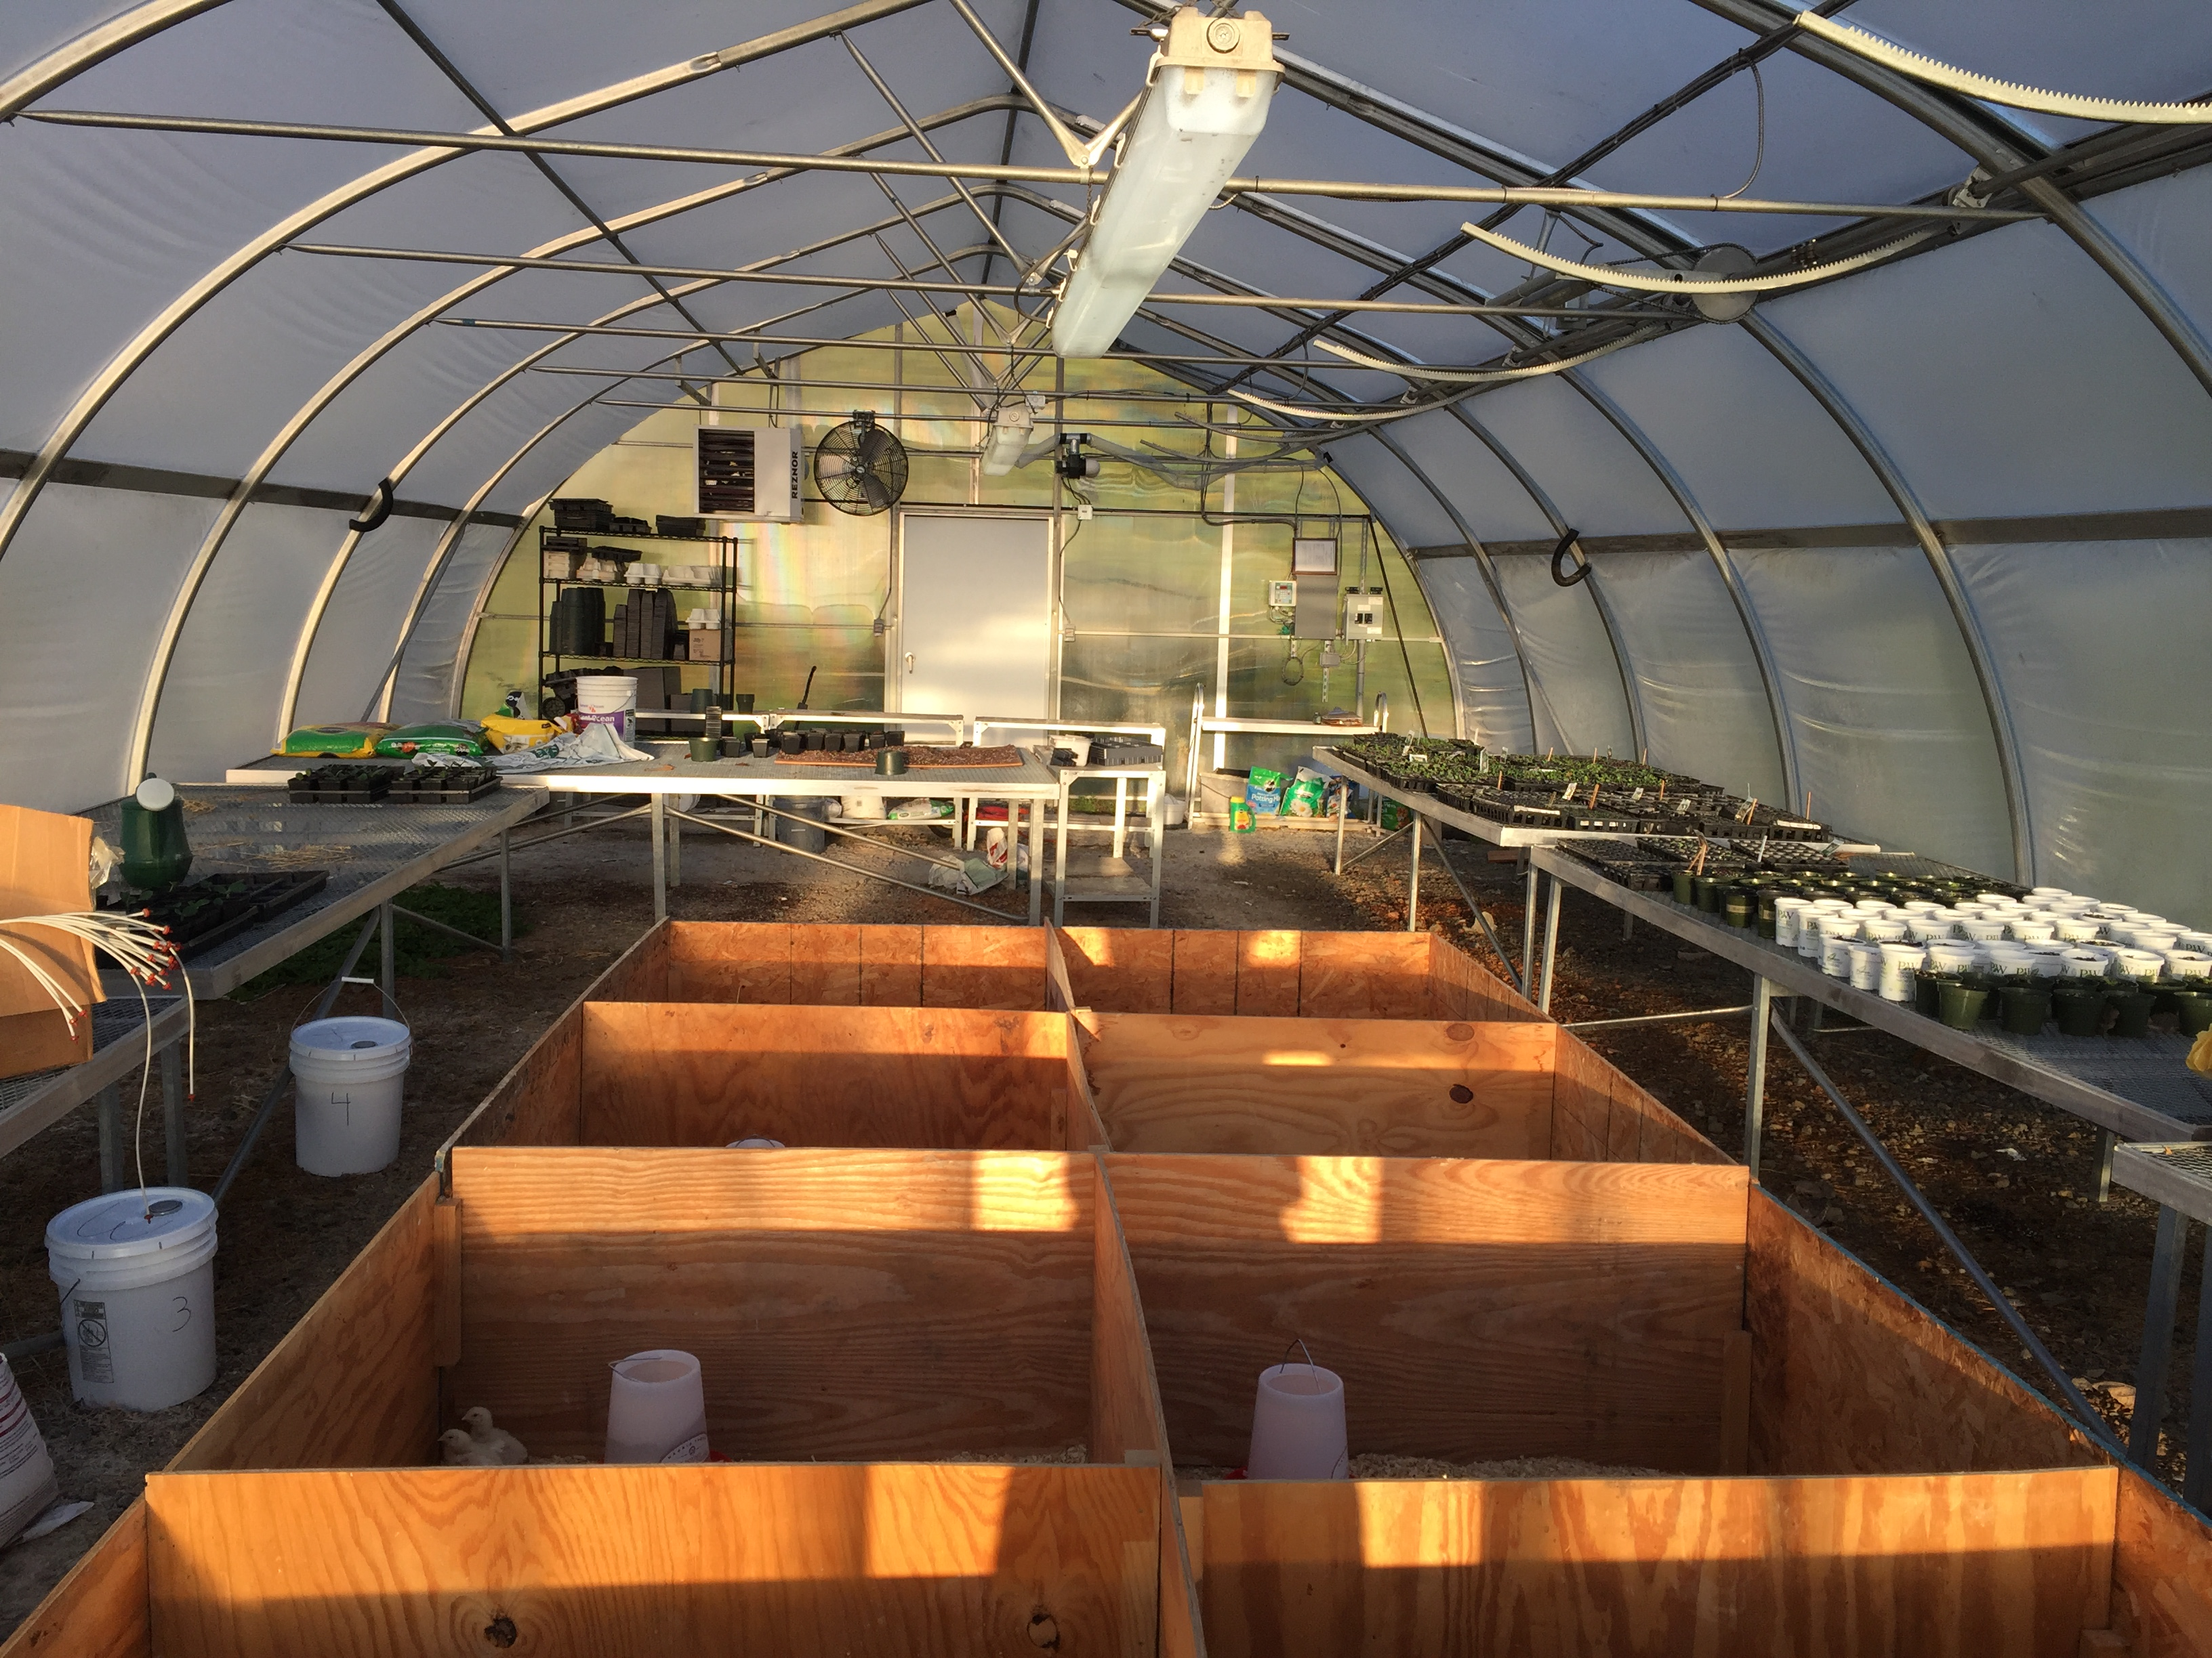
Career GEARS @ Graham:
Outdoor Education Components:
Falcon Farms: student-run Agricultural tract on district property
Land Lab: Experiences for Grades K-5
Farm to Table PBL Labs for Grades 6-8
PBIS Route for Wellness and Leadership Development; Ropes courses
Greenhouse projects for MS/HS courses and clubs

Slide 15
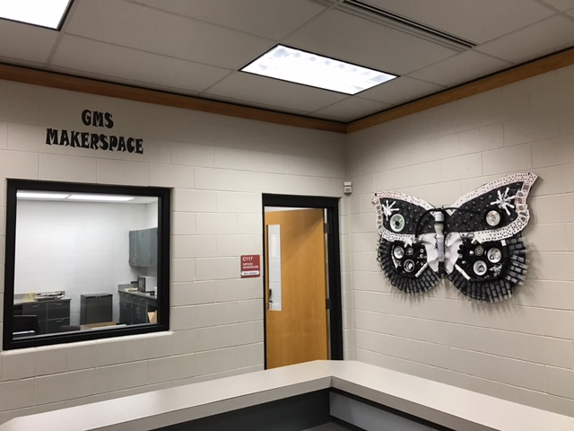
Career GEARS @ Graham:
STEAM Culture
Developing middle level model with PLTW, PBL culture to pathways
“Project Lead The Way” is a nationally recognized problem-solving curriculum
Precision design, coding, and building skills courses
Design labs part of each building

Slide 16
Graham steam : How to become “future ready”
STEAM Boot Camps prof development
Ohio STEM Learning Network affiliation
FIRST Lego League Clubs
Field Trips
Outdoor education challenges
STEAM Fairs
Summer Session activities

Slide 17
Career GEARS @ Graham
LEAN Six Sigma Training Cohorts:
Unique partnership between Clark State’s Workforce Development Department, Industry Partners, and Graham
Blended Training environment with employees and students leading to a credential, mentoring
Resume building experience recognized by ODE for points toward graduation

Slide 18
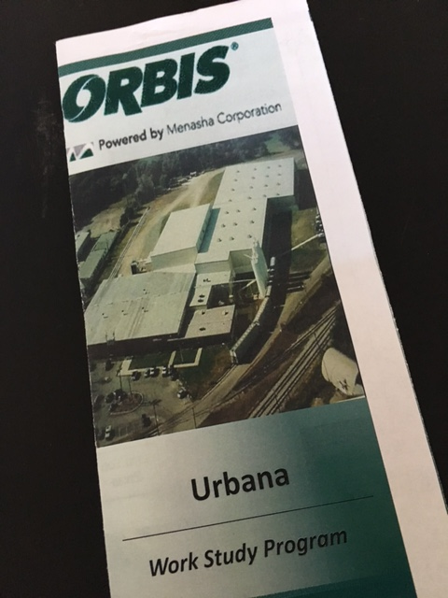
Career GEARS @ Graham
Workforce Internship Course:
20 Internships with 20 community partners
6 week Job Readiness curriculum with credentialing
Taught by college, industry leaders with teacher support as Credit Flex option
12 week internship
Certificate, Letters of Rec
Reverse Job Fair

Slide 19
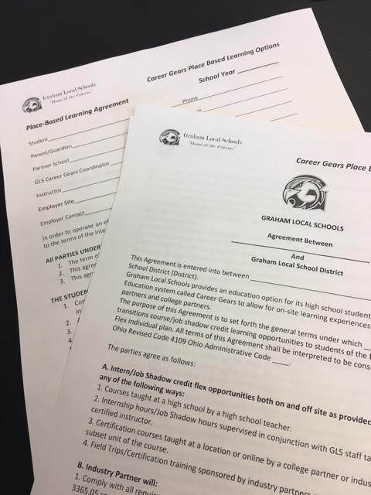
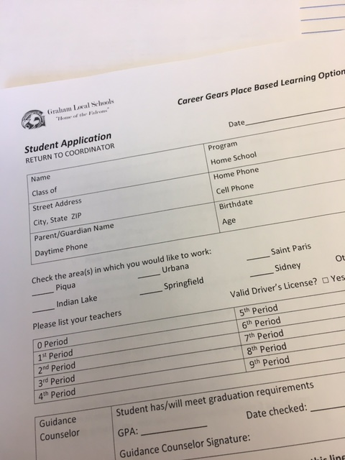
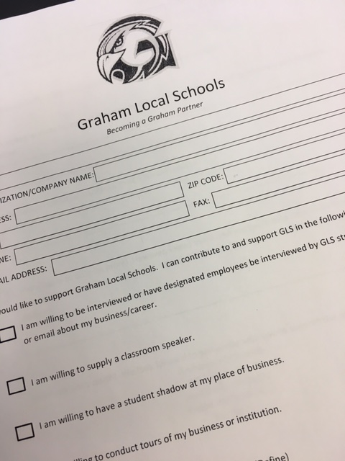
Career GEARS @ Graham
Partnerships formalized
Input from Advisory Board
Ongoing flexibility to meet your needs

Slide 20
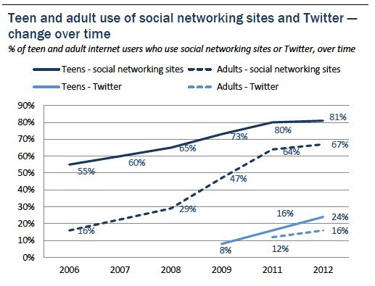
Insurance vs. Assurance
Teenagers account for Billions in Marketing and Advertising campaigns.
Why won’t we hire them now?
Ohio’s liability laws are over 100 years old and based on antiquated actuarial tables.

Slide 21
Small Changes Not enough
http://education.ohio.gov/getattachment/Topics/Career-Tech/STEM/Ohio-Schools-with-STEM-Designation-updated-June-2016.pdf.aspx
30 school buildings out of over 600 districts….
Manufacturer’s Day October 2016…. How many students took part? Estimates are less than 14% of Ohio students.
Lakota Schools, Mad River, Marion CSD, Shelby County….we’ve studied them

Slide 22
Small Changes Not enough
http://scholar.lib.vt.edu/ejournals/JITE/v40n3/lakes.html
10 Students celebrated as a state model….not a public school model

Slide 23
Small changes not enough
Ohio Career Pathway Network Meeting
You are invited to the inaugural Ohio Career Pathway Network meeting on Wednesday, Oct. 12, 2016, from 9 a.m.-3 p.m., at Columbus State CC.
The Ohio Department of Education and Columbus State are joining together to sponsor this event.
**The goal is to build a network of innovative educators and industry representatives who want to learn how to implement Career Pathways. The pathways provide students an overview of various career opportunities in Ohio, as well as guidance about customized education and training after graduation.

Slide 24
SMall changes not enough
http://www.marioncityschools.org/domain/353
Marion City Schools has intentionally built community partnerships, placed a staffing emphasis on engagement, planned professional development with EdWorks, and changed their curriculum to meet local needs.
http://www.forbes.com/sites/nicholaswyman/2015/09/01/why-we-desperately-need-to-bring-back-vocational-training-in-schools/#672d9877465c

Slide 25
Small changes not enough
“We need radical change to support student success- like structured pathways- and presidents need their Board's support” @clarkstatepres
“Apprenticeship systems in Germany, Switzerland, and Austria - widely credited for maintaining low youth unemployment rates even at the height of the Great Recession - have been an inspiration to many. Since 2011, the Obama administration has made historic investments of over $200million aimed at expanding both the number of American apprentices and the number of industries using Registered Apprenticeships to build their workforce.”

Slide 26
Laws are obsolete:
http://www.com.ohio.gov/documents/laws_mllposter.pdf
http://codes.ohio.gov/orc/4109
https://www.dol.gov/general/topic/youthlabor/agerequirements

Slide 27
Ohio Small & Rural Collaborative:
Mr. Koennecke created a unique collaborative of small & rural school leaders in Ohio to address barriers and team up for services.
Members from all levels of education at the table.
Regional and national ties to AASA, NREA
Funding influence
Professional Development opportunities.
Crowdstruction 2.0 2017

Slide 28
Other resources:
http://www.sreb.org/publication/credentials-all-imperative-sreb-states
http://www.sreb.org/readiness-courses-literacy-math
http://education.ohio.gov/Topics/Career-Tech/SREB-Advanced-Career-AC-Grant-for-2015-16-FY2016
http://www.grantcareer.com/

