Slide 1
Career Readiness Leaders Network
Career Awareness: December 14th, 2021
Career Exploration: Getting Creative with Options for Middle School Students

Slide 2
How are you feeling today?
Pick "Dog" that portrays how you're feeling today.
Drop your number in the chat!
Notes:
Emcee – John Hambrick

Slide 3
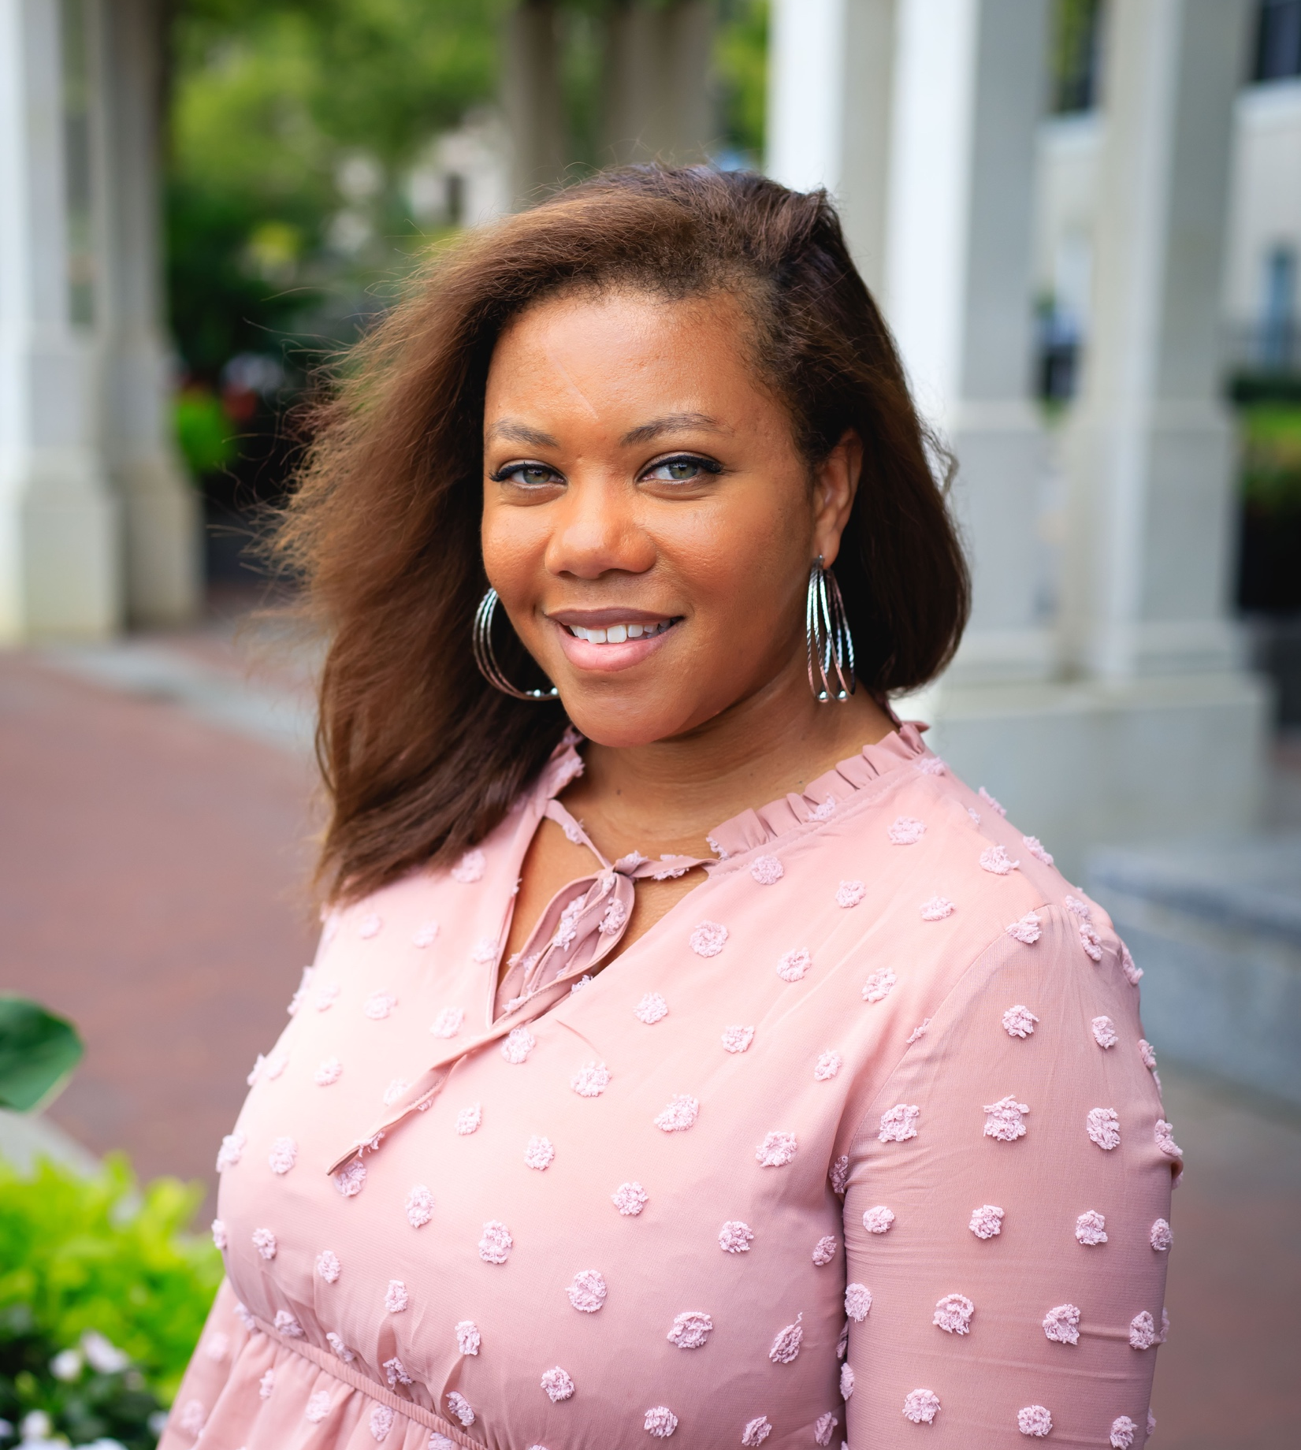
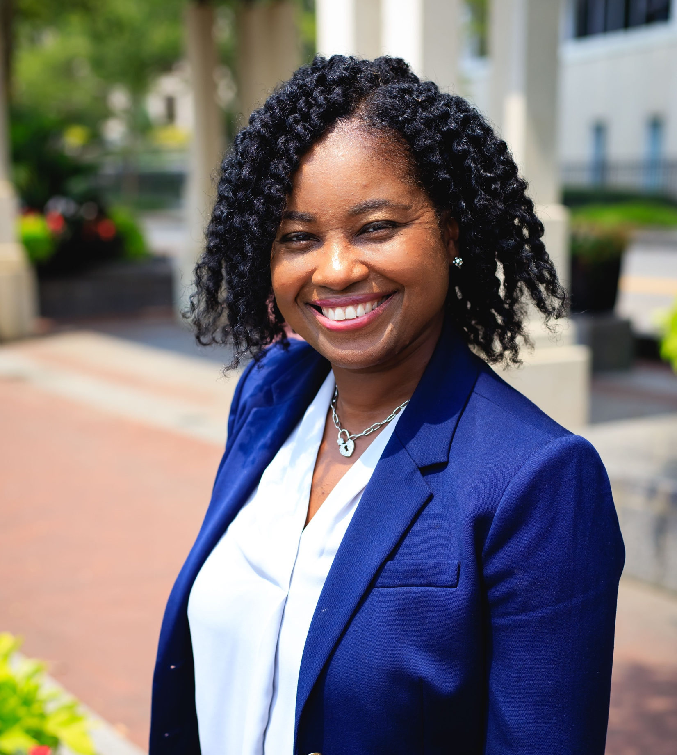
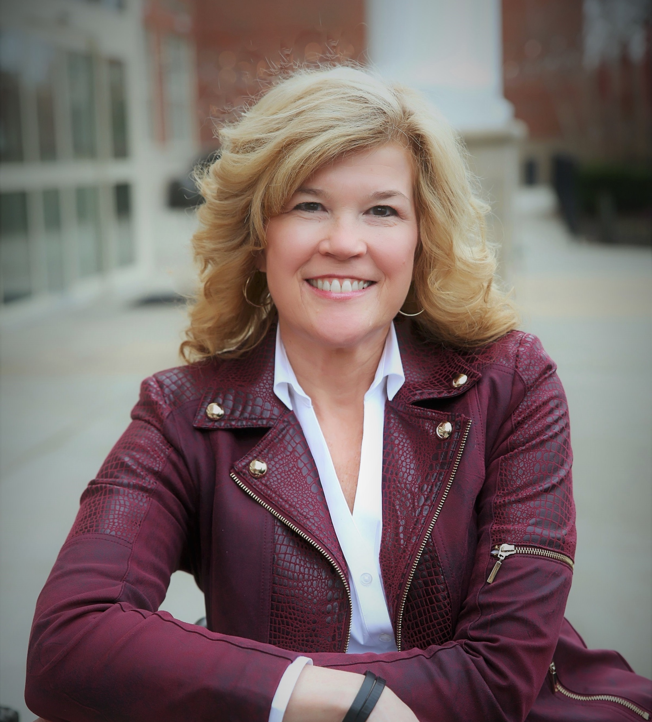
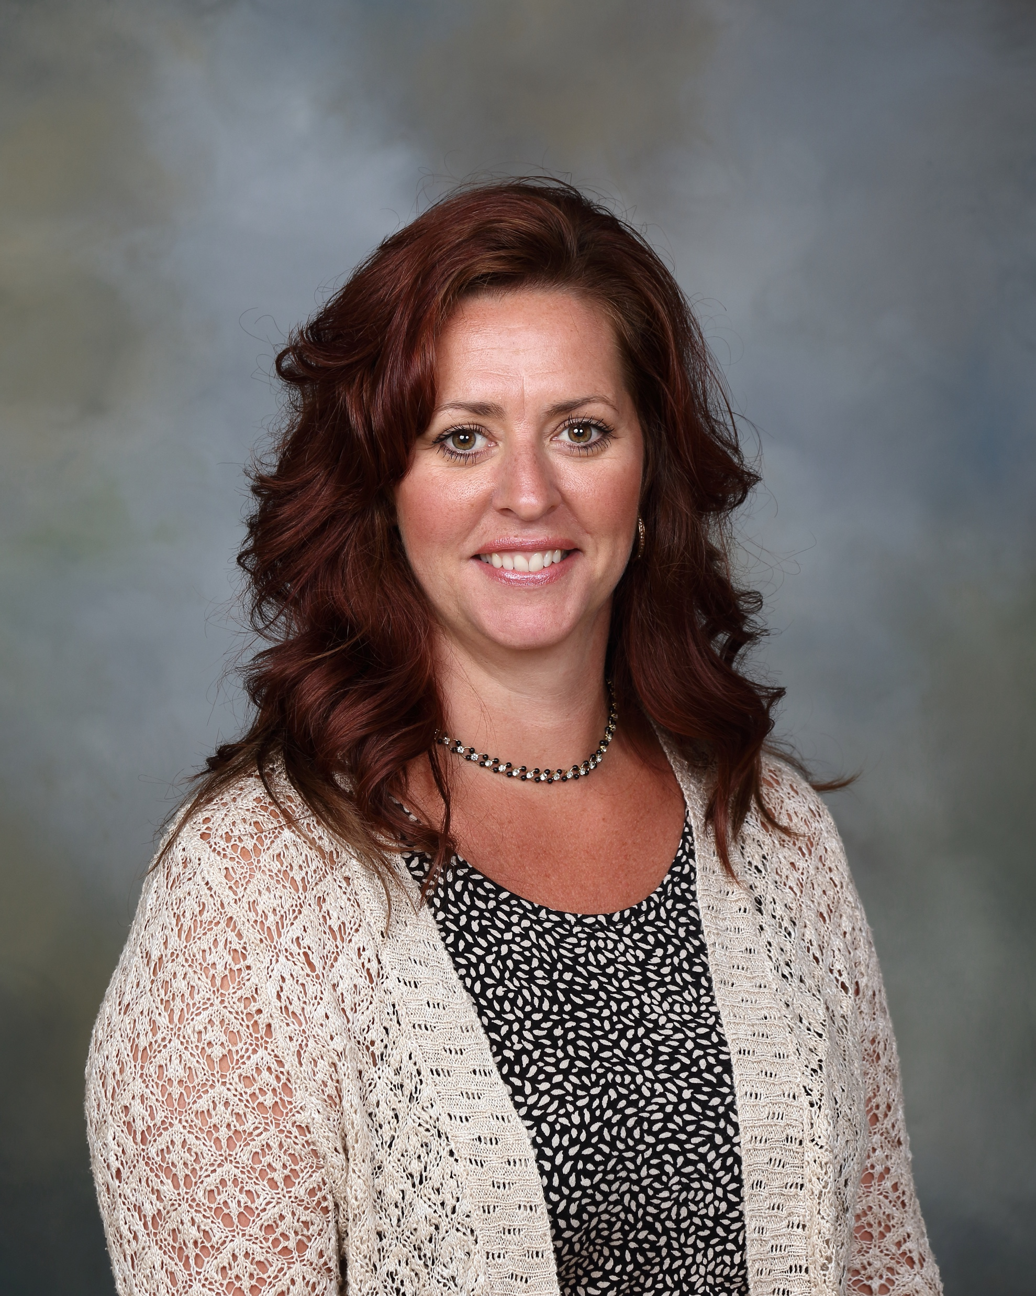
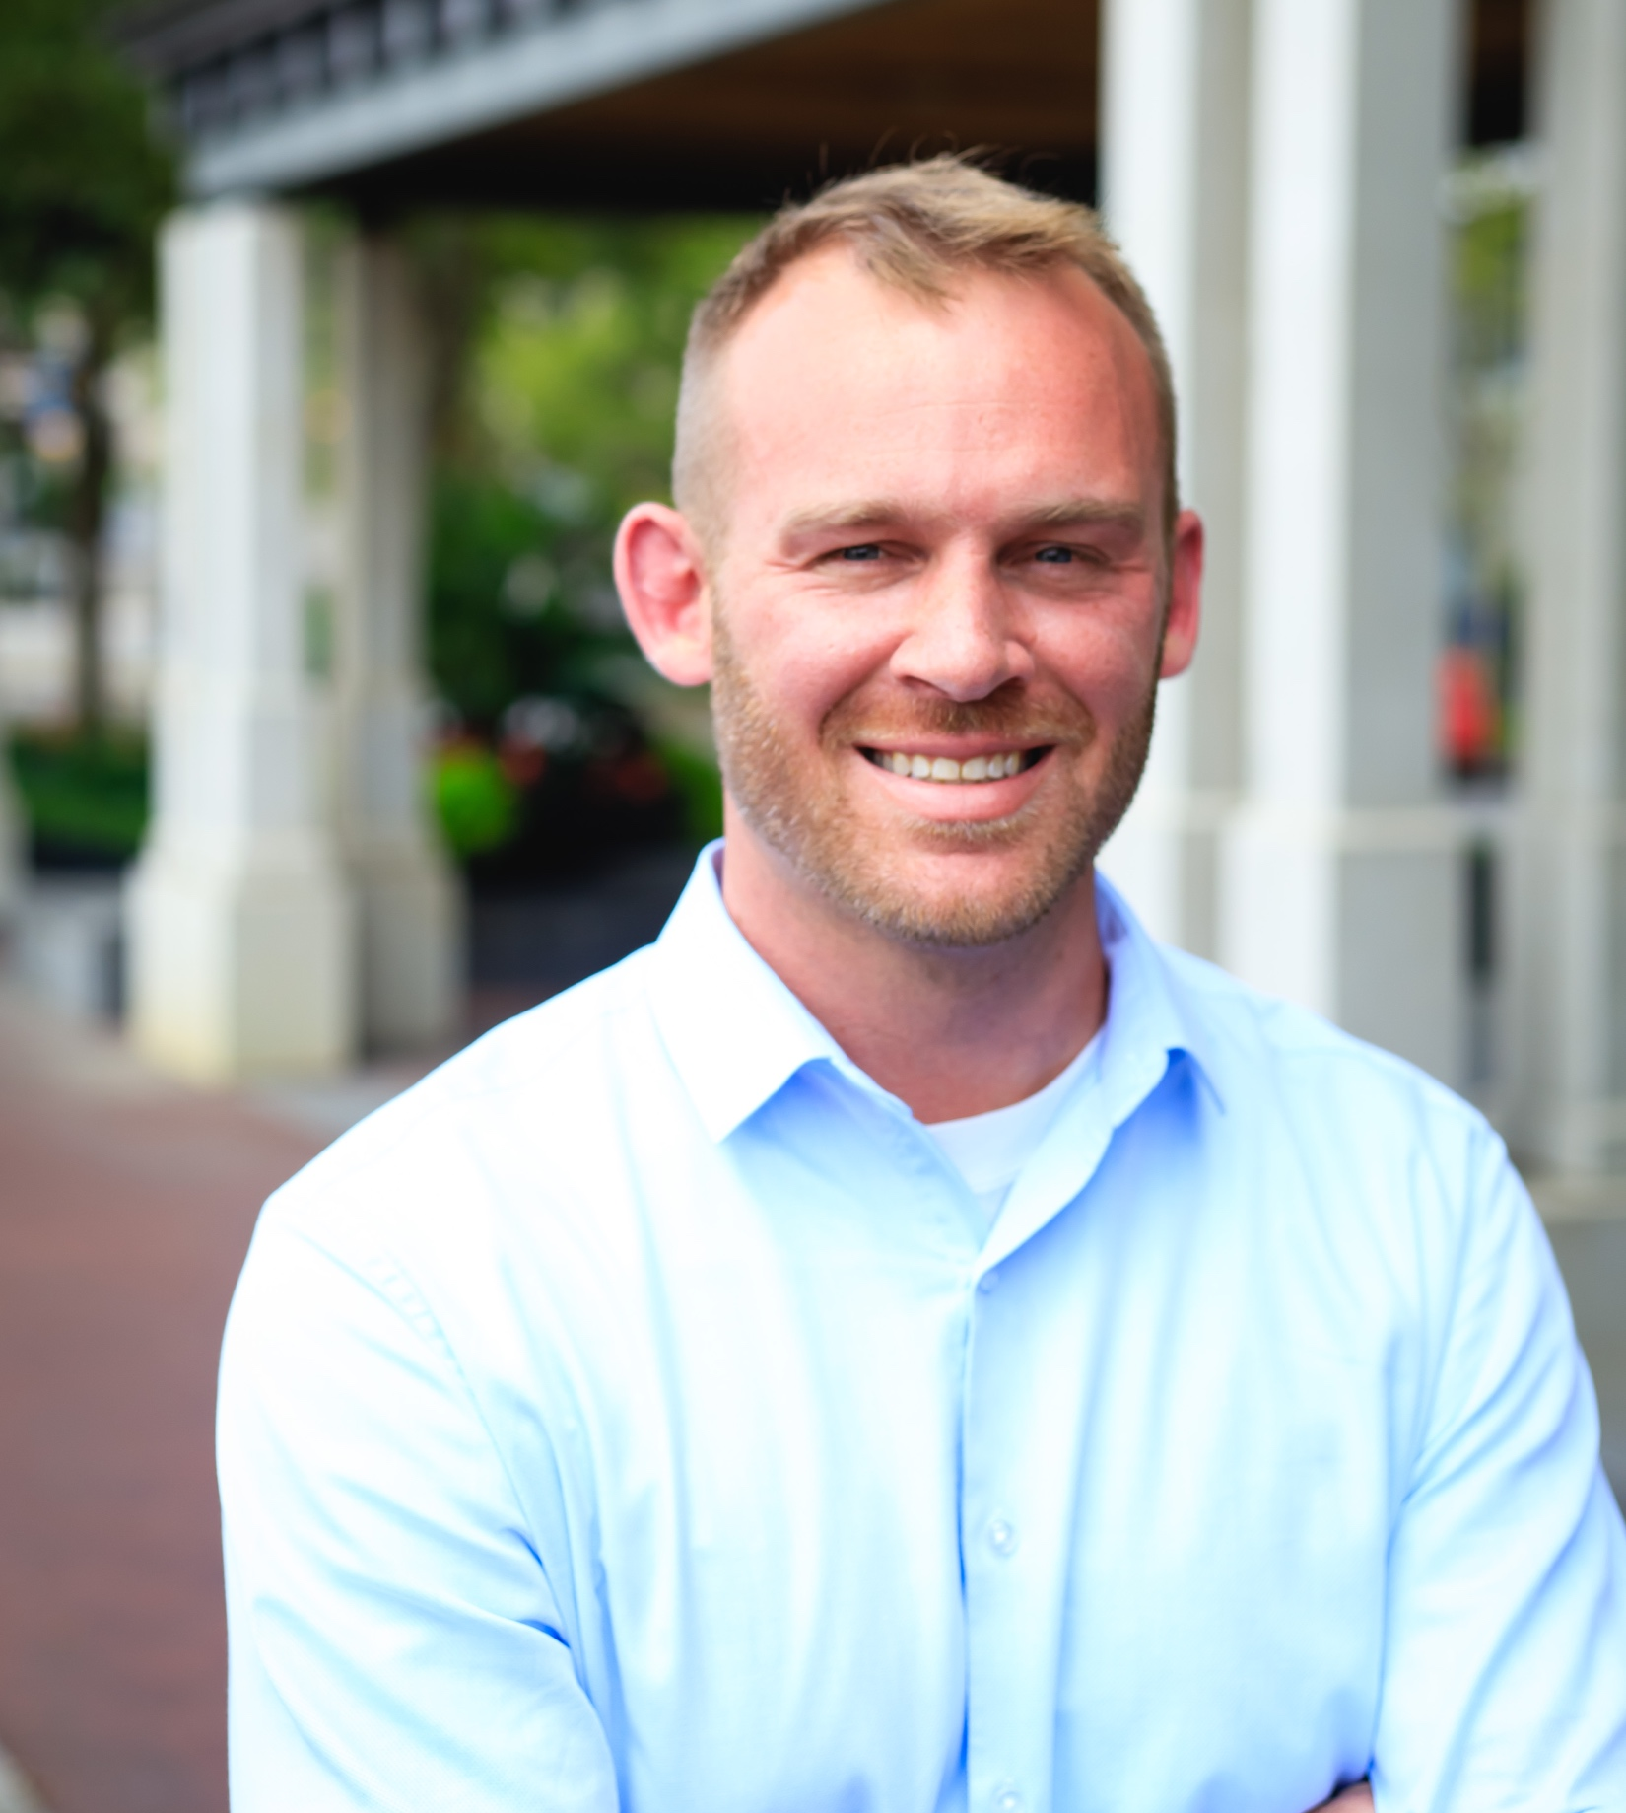
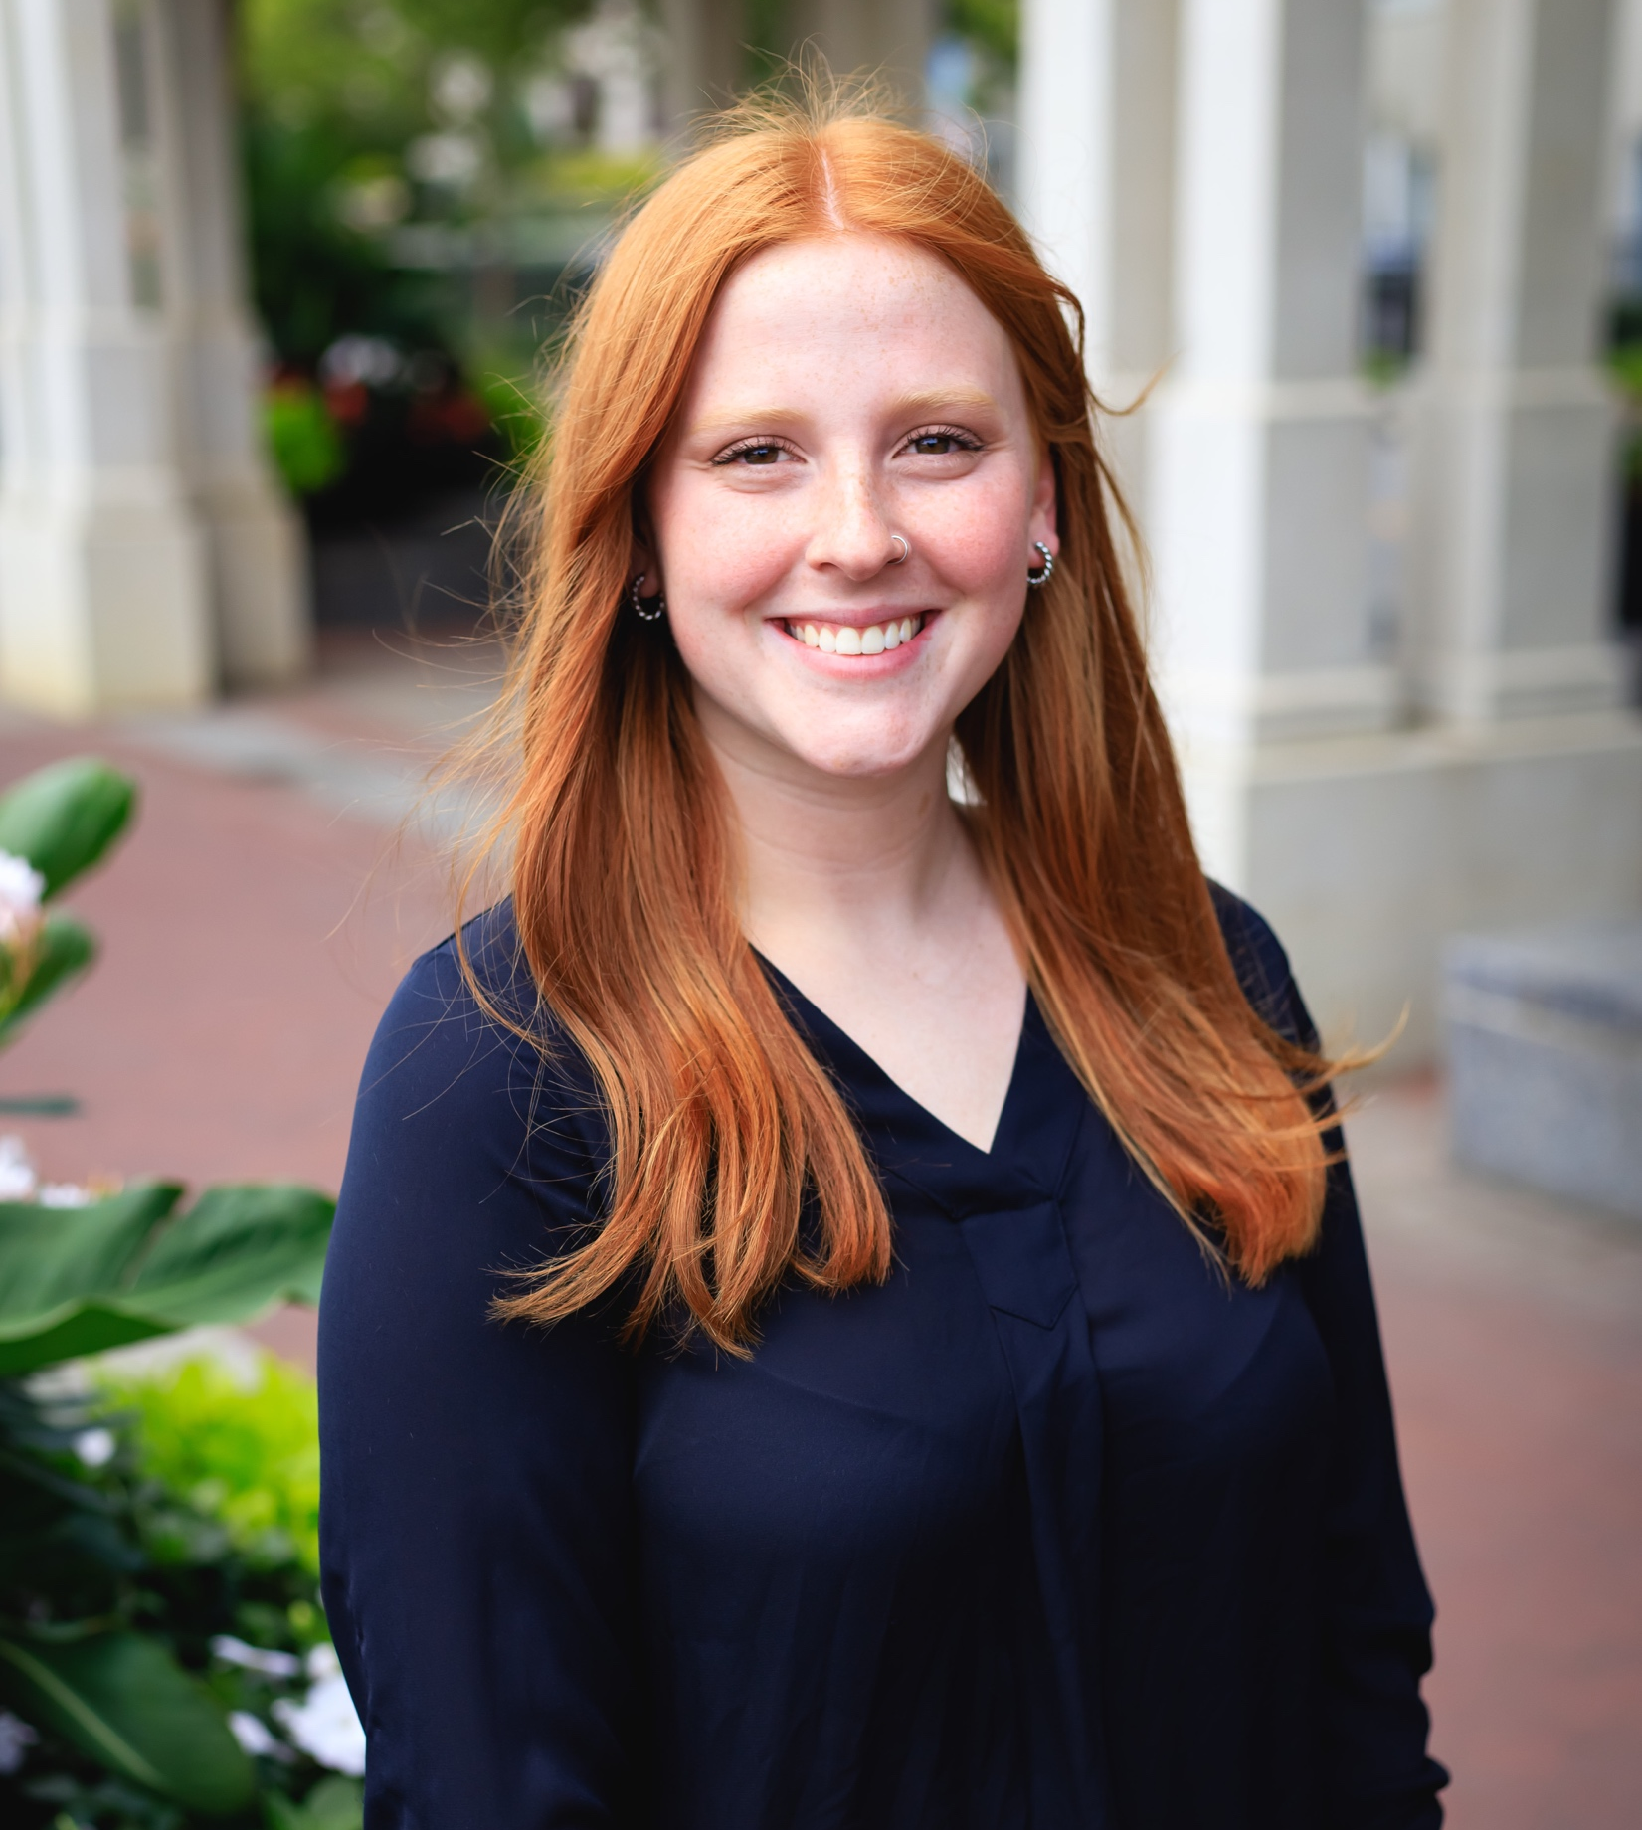
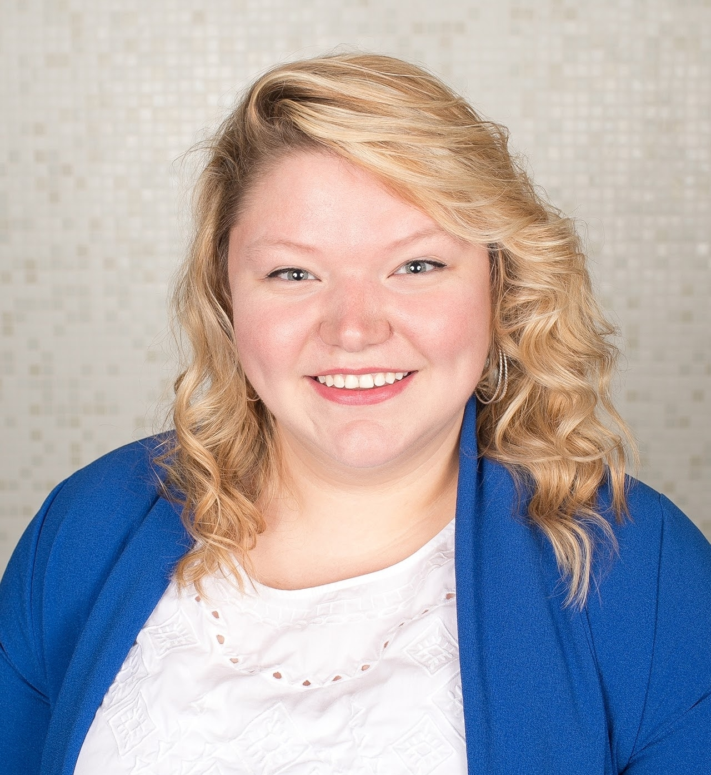
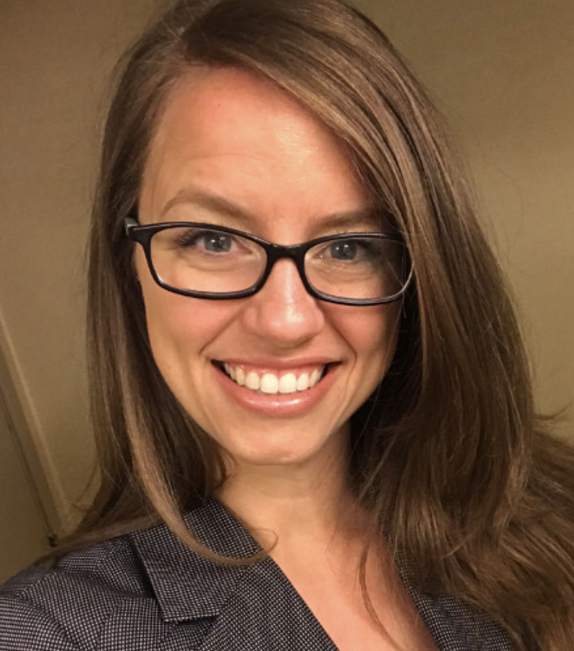
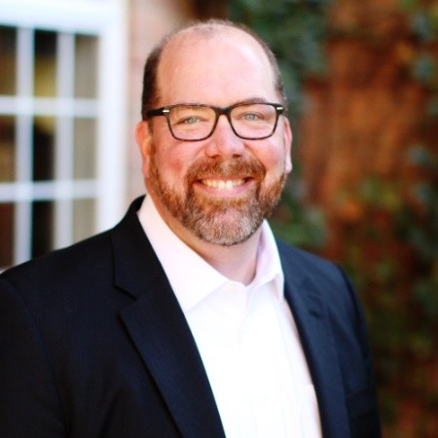
Network Leads
Cassie Palsgrove
Director
Kayla Mack
Education Program Specialist
Career Advising
Michelle Washington
Business & Education Program Specialist
Amy Harker
ESC of Northeast Ohio
Tasha Werry
Building Bridges to Careers
Travis Taylor
Program Administrator
Sara Watson
Program Assistant
Brenna Bartlett
Office of Career-Technical Education
Crystal Dortch
Office of Career-Technical Education
John Hambrick
ESC of Central Ohio
Notes:
Tasha

Slide 4
Agenda
2:30p – Introductions: Breakout Room
Discussion Question: What experiences throughout your educational journey contributed to your career choice?
2:45p – Main topic: Career Exploration in Middle School
#ThinkCCThursday Career Chats - Virtual Middle School Pathway Engagement
Jenny Meade & Bri Lohse – Columbus City Schools
3:15p – Pain Point & Future Discussions: Cassie Palsgrove
Creative Funding:
Career Awareness & Exploration Funding
3:30 – Closure: John Hambrick
Additional Resources for Middle School Career Exploration
Time to complete survey - Share your feedback here
Notes:
John

Slide 5
Introduction Activity
Introduce yourself in your room and answer:
Discussion Question: What experiences throughout your educational journey contributed to your career choice?
BREAKOUT ROOM FACILITATORS:
Sara Watson – Room 1
John Hambrick – Room 2
Cassandra Palsgrove – Main Room
Amy Harker – Room 3
Kayla Mack – Room 4
Notes:
John

Slide 6
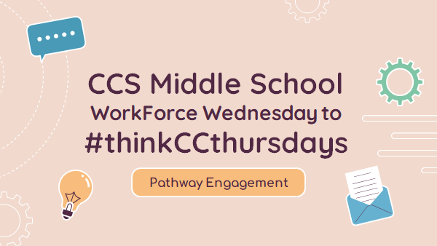
#thinkCCthursdays

Slide 7
#thinkCCthursdays

Slide 8
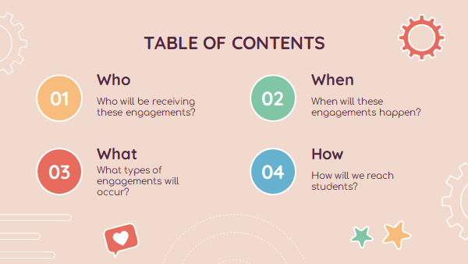
#thinkCCthursdays

Slide 9
#thinkCCthursdays

Slide 10
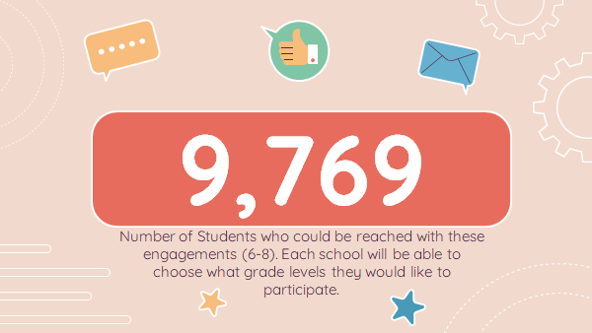
#thinkCCthursdays

Slide 11
#thinkCCthursdays

Slide 12
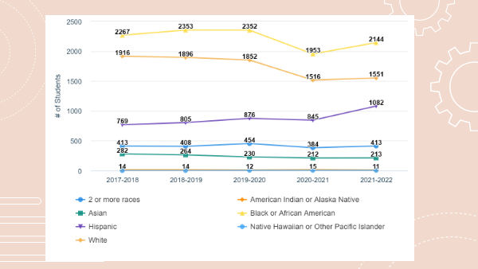
#thinkCCthursdays

Slide 13
#thinkCCthursdays

Slide 14
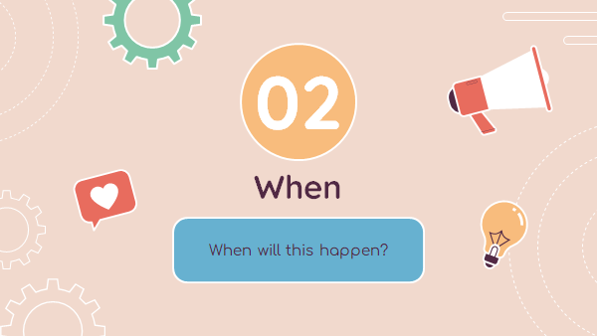
#thinkCCthursdays

Slide 15
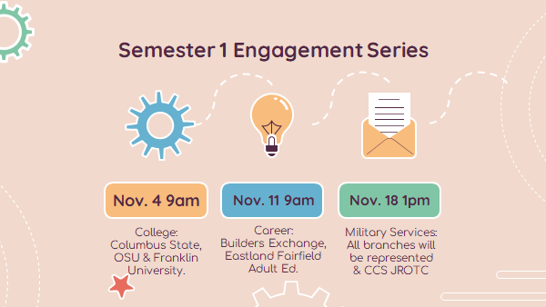
#thinkCCthursdays

Slide 16
#thinkCCthursdays

Slide 17
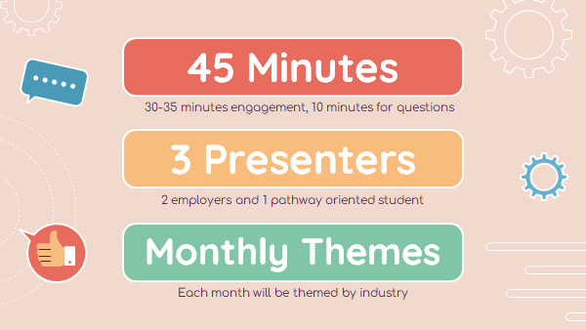
#thinkCCthursdays

Slide 18
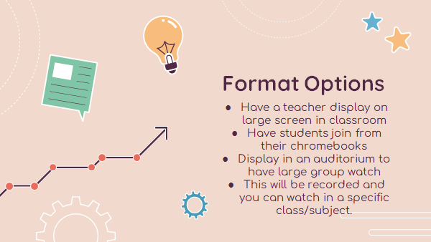
#thinkCCthursdays

Slide 19
#thinkCCthursdays

Slide 20
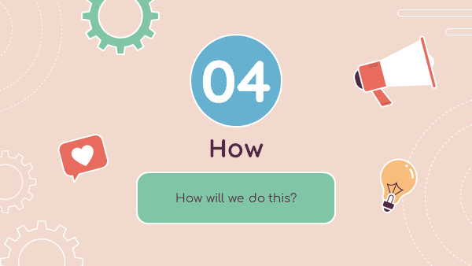
#thinkCCthursdays

Slide 21
#thinkCCthursdays

Slide 22
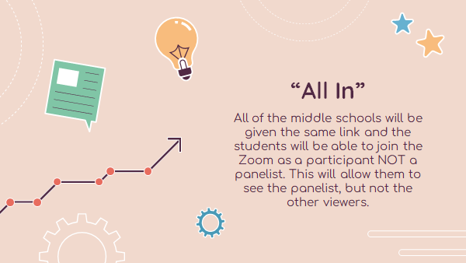
#thinkCCthursdays

Slide 23
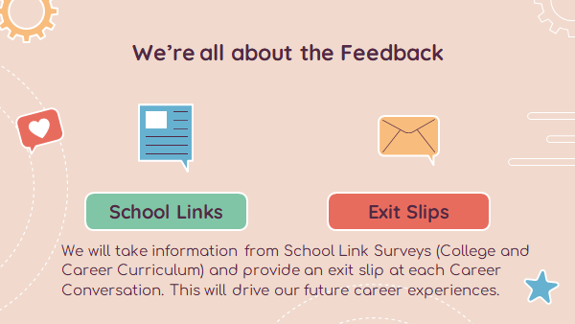
#thinkCCthursdays

Slide 24
Pain Points: future discussion topics
Notes:
John

Slide 25
Purpose of Funds
1
2
3
Career awareness programs to students in K-12
Curriculum to students
Assistance to teachers in providing career development

Slide 26
Purpose of Funds
4
5
Development of a career development plan for each student
Opportunities for students to engage in career-focused
activities

Slide 27
Allocated Amounts
Year 1 = $2.50/student (K-12)
Year 2 = $5.00/student (K-12)
Notes:
[When presenting, this slide requires multiple clicks to reveal each element]

Slide 28
Sequence of Payments
CTPD works
with schools to make plans
ODE transfer funds to CTPD lead
All schools generate
funds

Slide 29
Additional Reading
Career Exploration in Middle School – Setting Students on the Path to Success (ACTE)
Career Exploration Lessons for Sixth and Seventh Grades – Discover.org
This Photo by Unknown Author is licensed under CC BY-SA-NC
Notes:
Sara

Slide 30
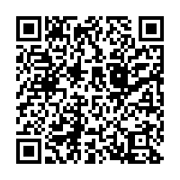
Key Takeaways
Let us know in the chat box – what was your one big takeaway from today’s discussion?
Share your feedback here.

