Slide 1
2023 Ohio’s Schools Report Cards Webinar
September 2023

Slide 2
Agenda
Introductions
Report Card Resources
Overview of 2022-2023 Report Cards
Report Card Details

Slide 3
Meet the Accountability Team
Rachel Wakefield, Interim Director of Accountability
Lindsay Popa, Assistant Director of Accountability
Amy Dutton, Data Impact & Policy Administrator
Andrea Spitnale, Education Program Specialist
Taylor Fustin, Education Program Specialist
Jessica Lauric, Education Program Specialist
Notes:
Lindsay is our relatively new Assistant Director. She comes with a wealth of experience and we’re thrilled to have her. She’ll be managing the polls today and putting links in the chat. Amy is the Data Impact & Policy Administrator and is leading the work with Regional Data Leads and the Ohio Education Data Professionals Network. Andrea and Taylor are the amazing people that usually answer the emails in the accountability inbox. They are phenomenal. Today, they’ll be helping to answer any participant questions that are put in the chat. And Jessica Lauric is our newest member of the Accountability team who just started last week. If you run into any technology issues today, Jessica will be helping out with that. (ask to have her email in the chat box in case anyone has technical issues)

Slide 4
Goals of this Webinar
Explaining how state report cards are calculated and what they measure
Highlighting best practices and strategies for using state report card data to drive improvement
Providing resources and tools for accessing and analyzing state report card data
Notes:
We all are coming at this from different levels. For some of you, you may be able to give this presentation yourself and even better than I can! For others, this may be the first time you are hearing some of this information. So I ask that we all be patient with each other, and I hope that at minimum, you can gain just one useful tidbit of information.

Slide 5

Procedures
Cameras off and mute
Chat is disabled
Post general questions in the Padlet
Email specific school/district questions to accountability@education.ohio.gov
Recording will be provided in late fall
As we know better, we do better
Notes:
Chat is disabled not because we don’t want to hear from you; we learned from our last webinar that having the chat caused many distractions for the participants.
PADLET –
After each section, I’ll pull up the padlet and answer a few questions. We’ll be using this to help develop Q&A for our website.
As I know better, I do better. Meaning I would truly love your input. We’re going to have a survey at the end, and we’d really love your feedback as to how best we can provide useful, helpful information about report cards.

Slide 6
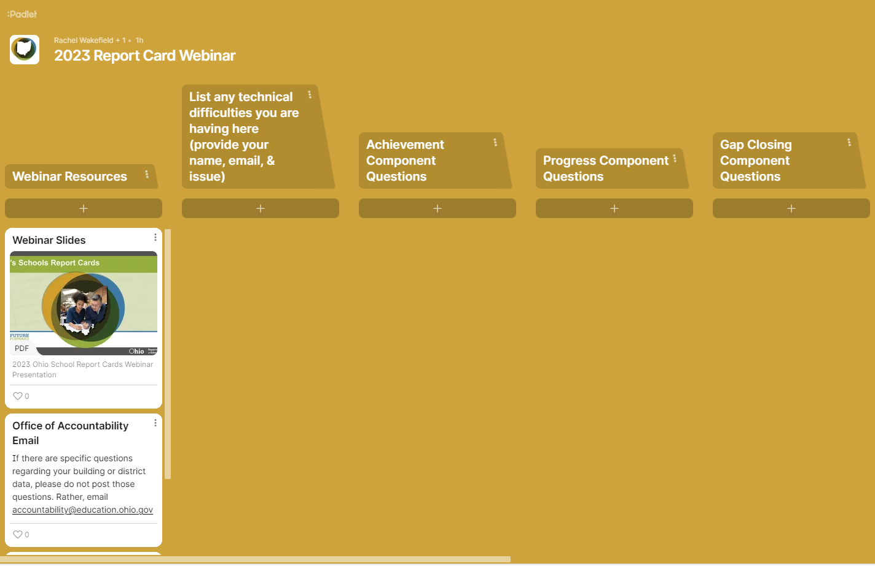
Procedures
Click the + button to type in a question
Use this scroll bar to see additional columns
Notes:
Chat is disabled not because we don’t want to hear from you; we learned from our last webinar that having the chat caused many distractions for the participants.
PADLET –
After each section, I’ll pull up the padlet and answer a few questions. We’ll be using this to help develop Q&A for our website.

Slide 7
Agenda
Introductions
Report Card Resources
Overview of 2022-2023 Report Cards
Report Card Details

Slide 8
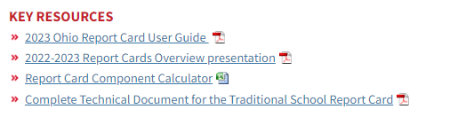
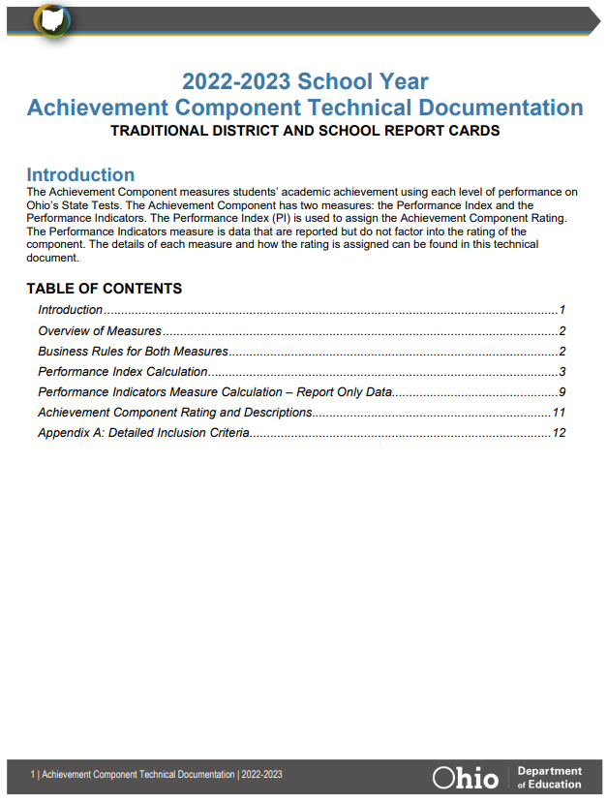

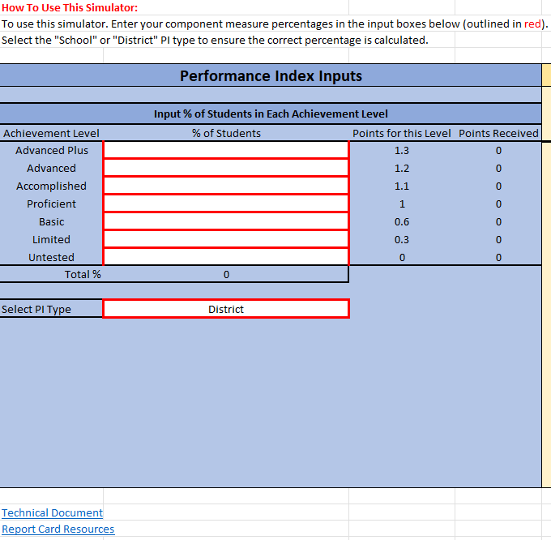

Key Resources
*Click pictures below for the links to the documents

Slide 9
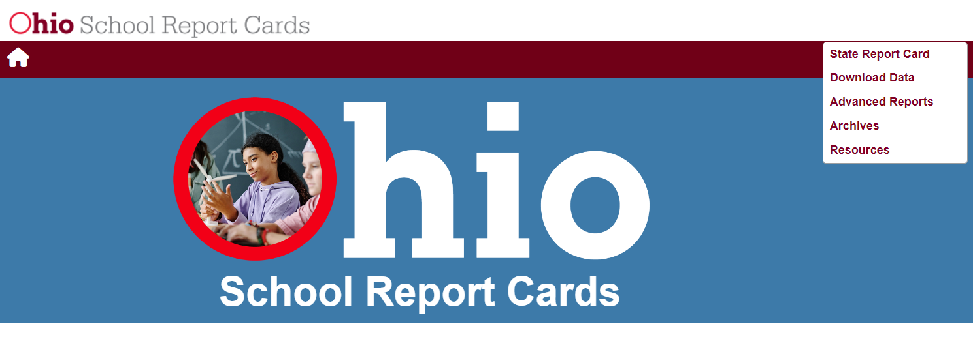
Report Card Resources
http://reportcard.education.ohio.gov

Slide 10
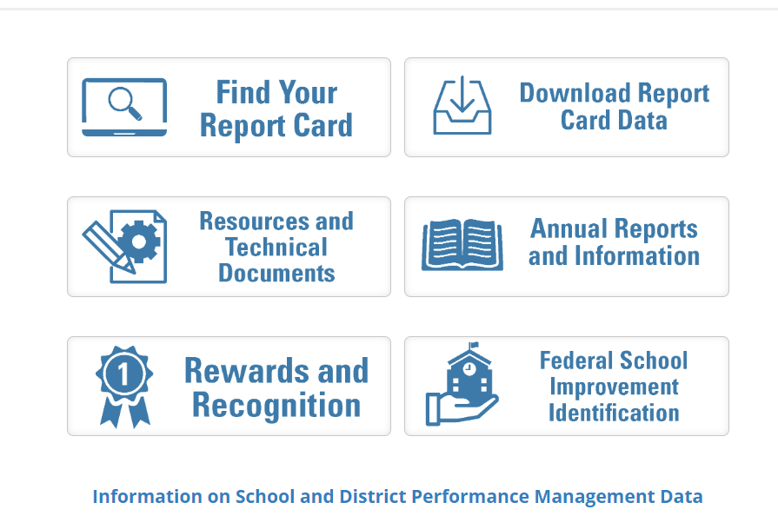
Report Card Resources
For detailed information about each report card component calculation, please visit the Report Card Resources and Technical Documents Website.

Slide 11
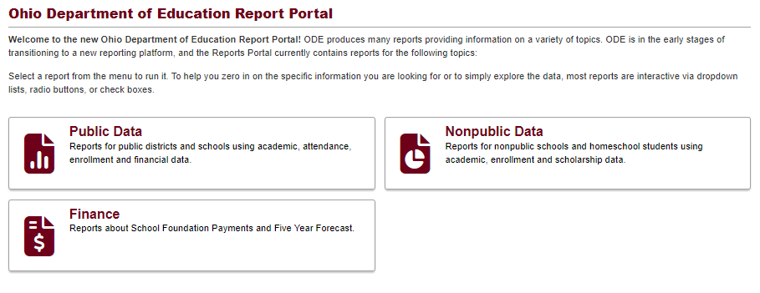
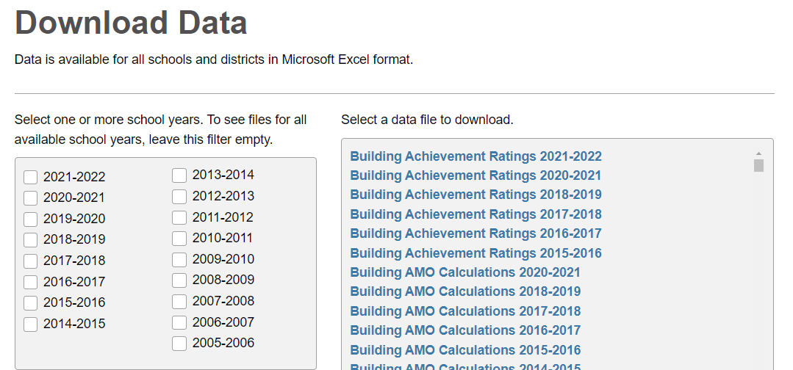
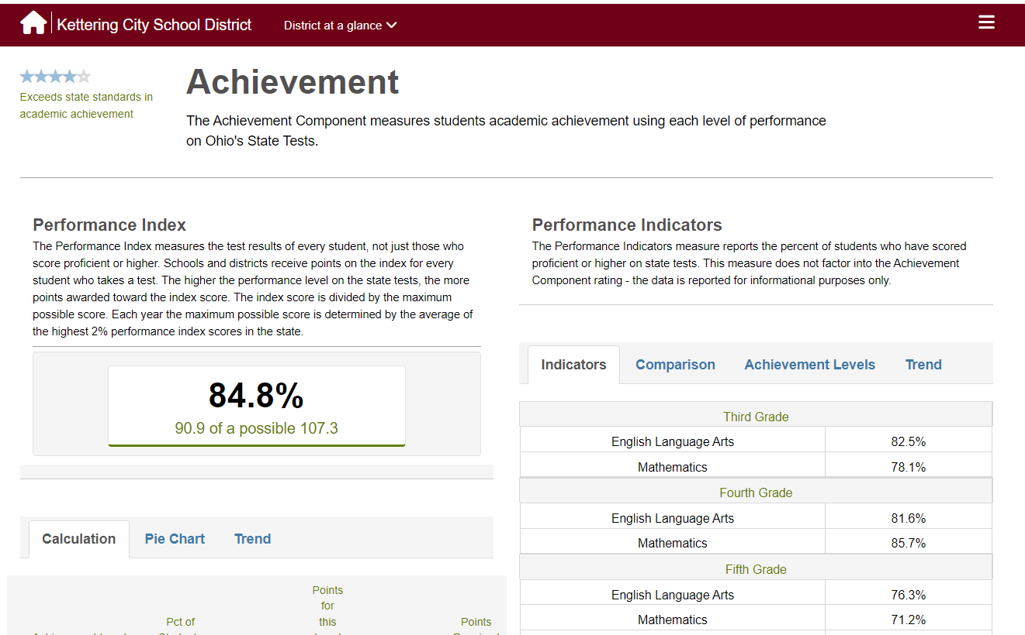
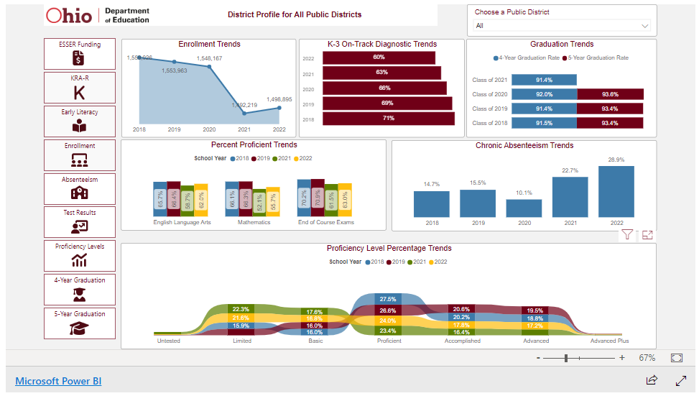
Advanced Reports: Report Portal
Download Data
Report Card Page
Student Recovery Dashboard

Slide 12
Agenda
Introductions
Report Card Resources
Overview of 2022-2023 Report Cards
Report Card Details

Slide 13
Changes to the 2022-2023 Report Cards
Calculation Updates
  Overall Star Rating
  Chronic Absenteeism is included on the Gap Closing Component
  Progress Component has up to two years of data
Report-Only Updates
  Student Opportunity Profile
Website Layout Changes
  Early Literacy
  College, Career, Workforce and Military Readiness

Slide 14


Slide 15
Districts
Schools

Slide 16
District-Level Rating Distributions
 | 1 Star | 2 Stars | 3 Stars | 4 Stars | 5 Stars
Achievement | 1.2% (7) | 11.7% (71) | 34.3% (208) | 37.2% (226) | 15.7% (95)
Progress | 11.5% (70) | 25.4% (154) | 28.7% (174) | 22.7% (138) | 11.7% (71)
Gap Closing | 0.3% (2) | 6.8% (41) | 18.9% (115) | 29.0% (176) | 45.0% (273)
Early Literacy | 6.4% (39) | 18.8% (114) | 43.8% (265) | 21.8% (132) | 9.1% (55)
Graduation | 4.8% (29) | 11.2% (68) | 17.5% (106) | 27.7% (168) | 38.8% (235)
School-Level Rating Distributions of Components (Traditional and Community School)
 | 1 Star | 2 Stars | 3 Stars | 4 Stars | 5 Stars
Achievement | 12.1% (380) | 22.1% (692) | 25.3% (792) | 26.0% (814) | 14.4% (450)
Progress | 7.4% (224) | 21.4% (643) | 36.7% (1,106) | 22.0% (663) | 12.5% (375)
Gap Closing | 4.6% (152) | 12.4% (408) | 18.0% (594) | 26.6% (877) | 38.3% (1,262)
Early Literacy | 28.6% (496) | 20.3% (351) | 29.2% (505) | 15.8% (273) | 6.2% (107)
Graduation | 15.3% (124) | 11.6% (94) | 15.7% (127) | 23.4% (189) | 33.9% (274)

Slide 17
Agenda
Introductions
Report Card Resources
Overview of 2022-2023 Report Cards
Report Card Details

Slide 18
2022-2023 Report Cards
Overall Rating – Rated on a 1 through 5-star scale in half-star increments
  Five Rated Components – Rated on a 1 through 5-star scale in full-star increments
    Achievement Component
    Progress Component
    Gap Closing Component
    Early Literacy Component
    Graduation Component
  College, Career, Workforce and Military Readiness Component – REPORT ONLY
  Additional Report-Only Data is found within many of the components

Slide 19
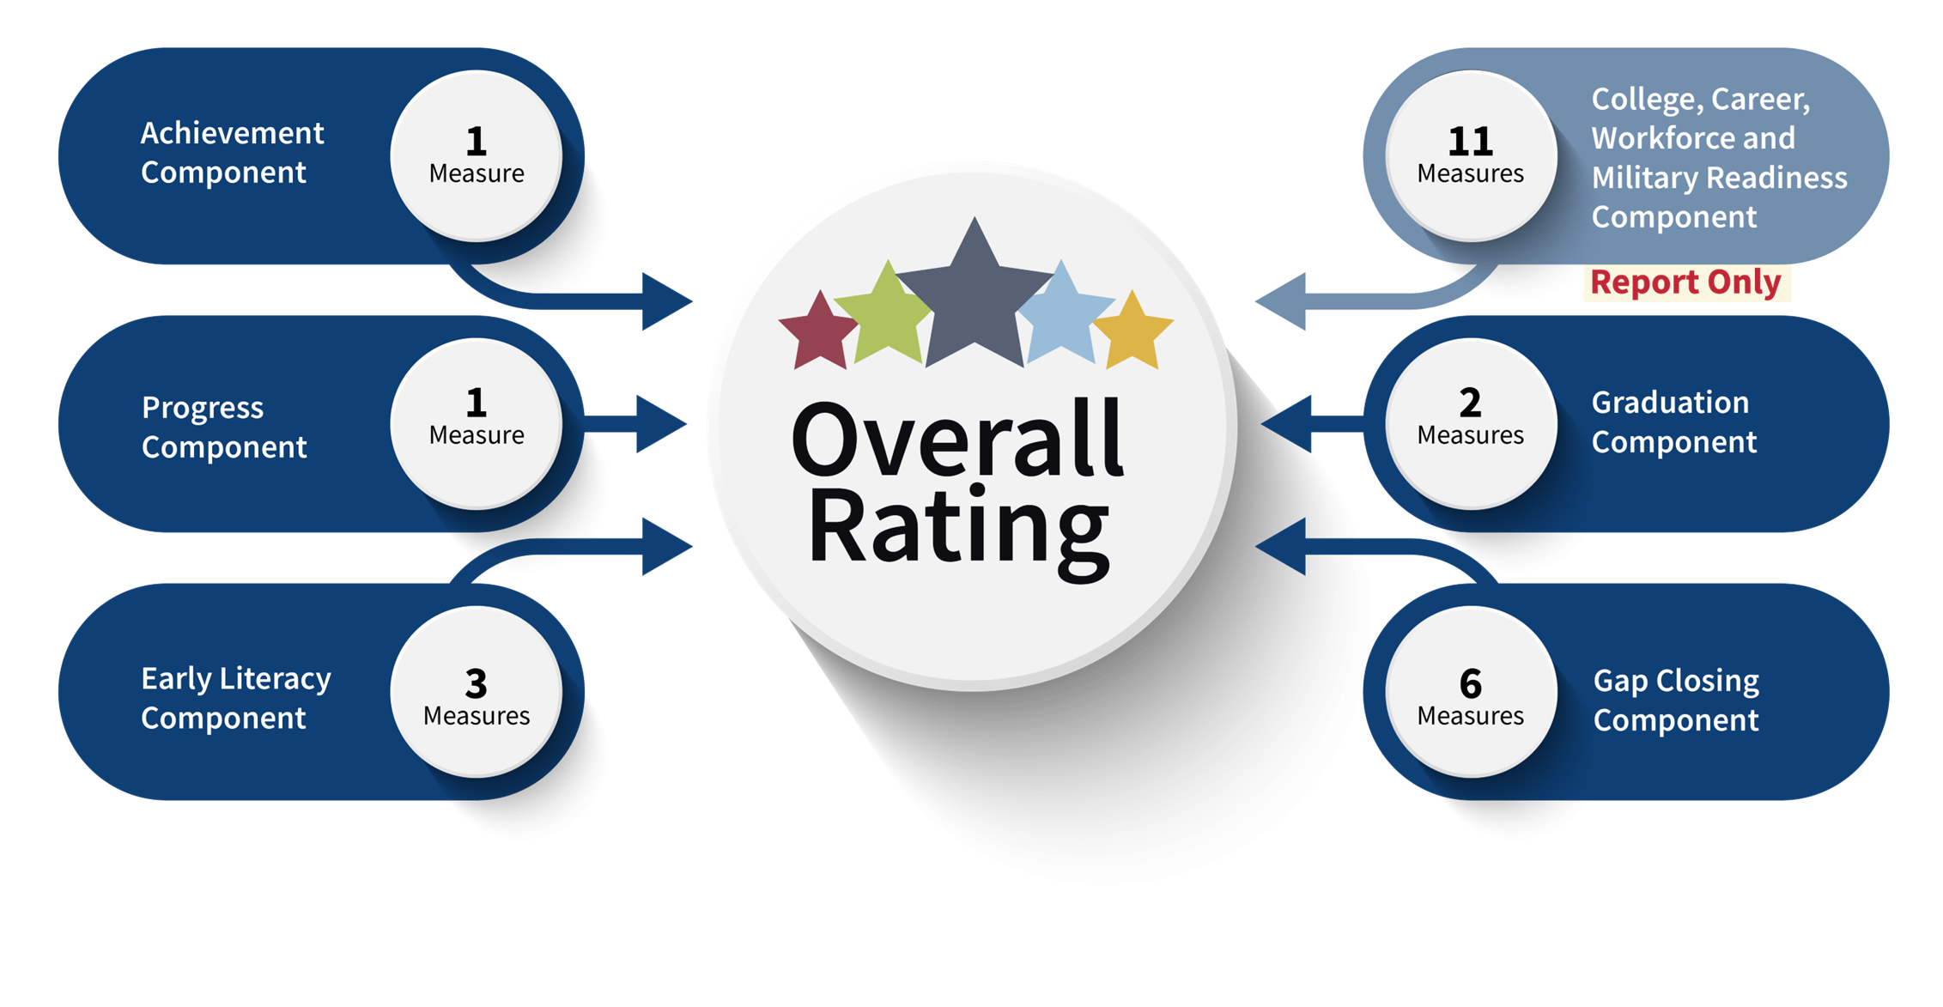

Slide 20
2022-2023 Report Cards
Overall Rating – Rated on a 1 through 5-star scale in half-star increments
  Five Rated Components – Rated on a 1 through 5-star scale in full-star increments
    Achievement Component
    Progress Component
    Gap Closing Component
    Early Literacy Component
    Graduation Component
  College, Career, Workforce and Military Readiness Component – REPORT ONLY
  Additional Report-Only Data is found within many of the components

Slide 21

Achievement Component
Here’s What.
So What?
Now What?
Here’s the data.
So what does the data tell us?
Now what do we do?

Slide 22
Test Your Knowledge:
Achievement Component
True or False
The performance indicators count towards the achievement component star rating.

Slide 23

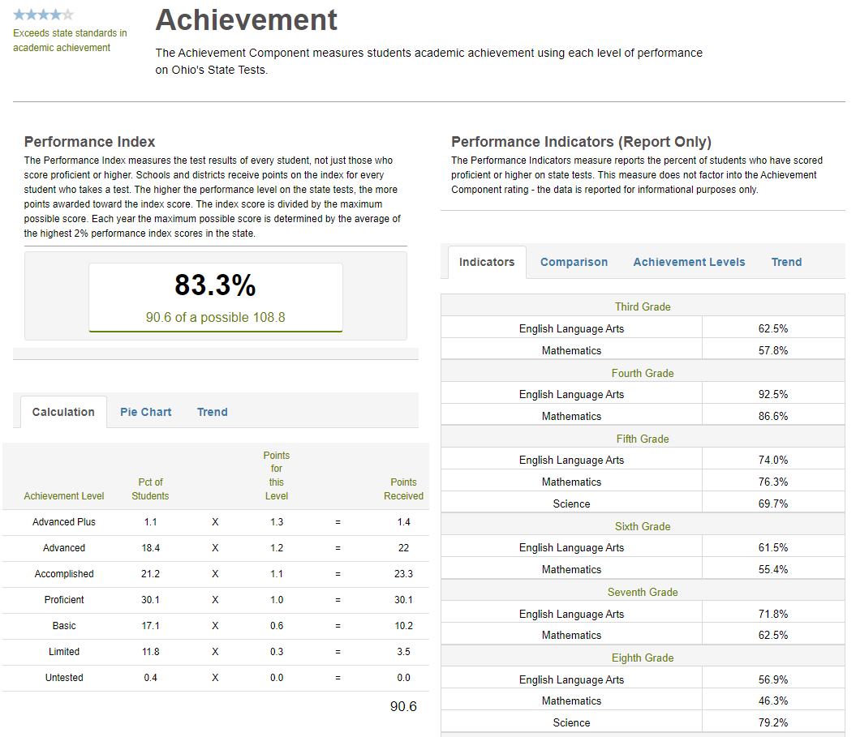
Here’s What
100% of the Achievement Component
Report-Only: 0% of the Achievement Component

Slide 24
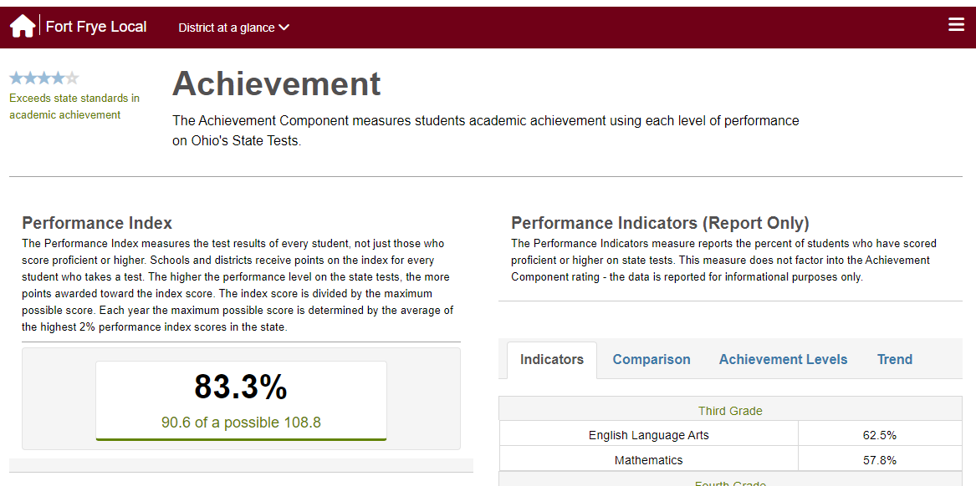
Component Percentage used to assign star rating
Performance Index Score (comparable to prior years)
2023 Max Score for DISTRCITS
Notes:
The Achievement Component measures students’ academic achievement using each level of performance on Ohio’s State Tests.
Rating based only on Performance Index, “Indicators Met” are report-only
Resets the maximum performance index score as the average of the highest 2% of PI scores achieved for that year. The max score is used as the denominator in the calculation. This max score is to be set this way for buildings and districts.

Slide 25
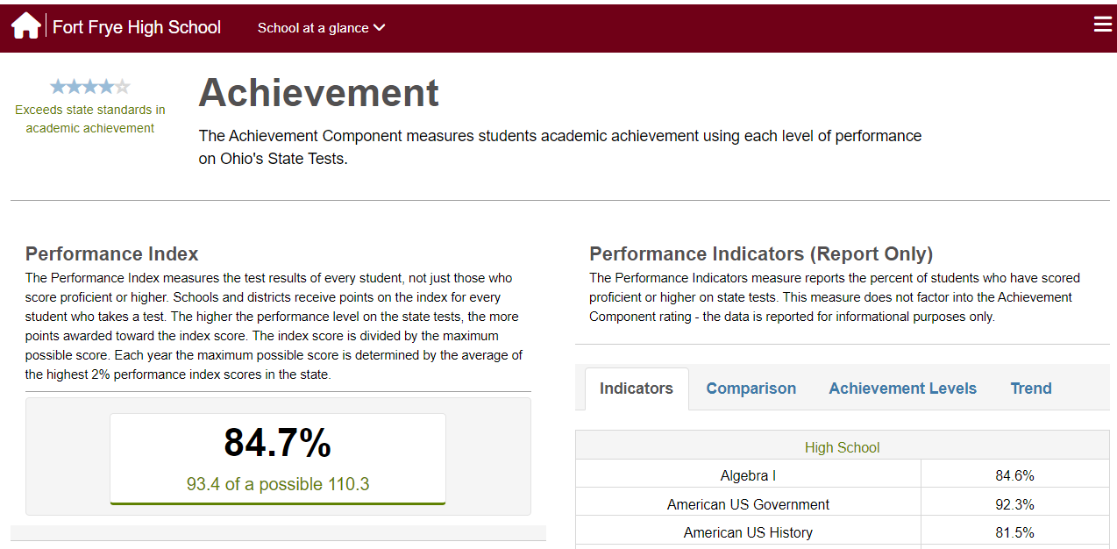
Component Percentage used to assign star rating
Performance Index Score (comparable to prior years)
2023 Max Score for BUILDINGS
Notes:
The Achievement Component measures students’ academic achievement using each level of performance on Ohio’s State Tests.
Rating based only on Performance Index, “Indicators Met” are report-only
Resets the maximum performance index score as the average of the highest 2% of PI scores achieved for that year. The max score is used as the denominator in the calculation. This max score is to be set this way for buildings and districts.

Slide 26
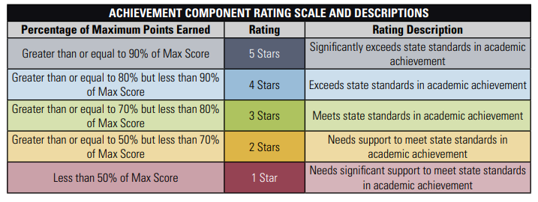
Achievement Component
2022-2023 Achievement Component Technical Documentation

Slide 27
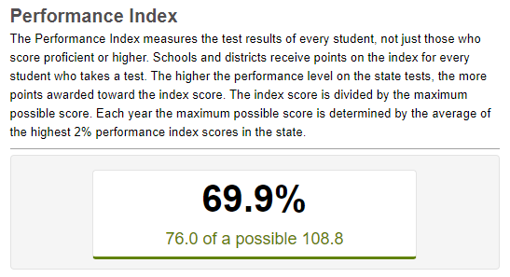
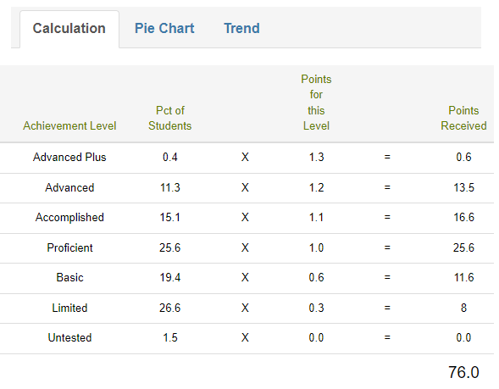
Performance Index

Slide 28
Performance Index
So What?
% Proficient or Higher | % Limited Range | % of Untested | % Advanced Plus
52.04% | 26.6% | 1.5% | 0.4%
Across all subjects/grades…
Around 50% of the students are proficient or higher.
1 in 4 students are REALLY struggling.
We have students in the Advanced Plus range. How do students get in the Advanced Plus range?
We are not testing 1.5% of our students. What if we had tested those students? How would that have impacted our overall ranking?
Notes:
Rachel

Slide 29

Performance Index
70.2%
28.1
8.4
0.0
76.4
Notes:
Rachel

Slide 30
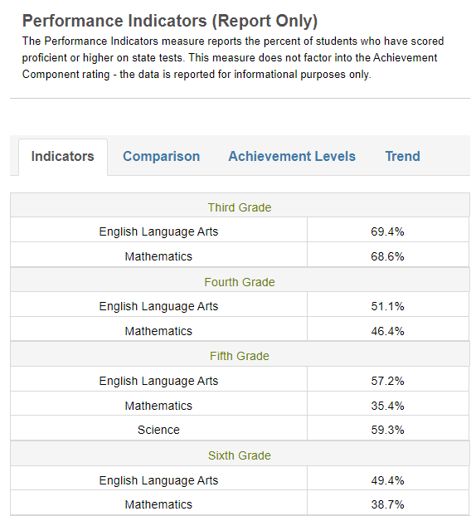
Performance Indicators (Report Only)
Here’s What
Performance indicators are NOT part of the Achievement Component calculation. This data is for information purposes.
Performance indicators detail the % of students proficient or higher in each grade and subject.
Notes:
Taylor

Slide 31
Performance Indicators (Report Only)
So What?
We can’t intervene our way out of a Tier 1 problem.
Until we are at 80% proficiency, we need to first examine Tier 1 - Core Instruction.
Even after 80% proficiency, the first look needs to be at Tier 1 - Core Instruction.

Slide 32
Performance Indicators (Report Only)
Questions to consider:
Is this a curriculum issue?
Is this an instruction issue?
Is this a chronic absenteeism issue?
Is this a combination of issues?

Slide 33
Performance Indicators (Report Only)
Is this a curriculum issue?
  How do our curricular materials rate on Ohio Materials Matter?
  If our curriculum is not listed on Ohio Materials Matters, have we used the EdReports rubric to determine the strengths/weaknesses of our curriculum?

Slide 34
Performance Indicators (Report Only)
Is this an instruction issue?
  Even if we have a High-Quality Instructional Materials (HQIM), are our teachers using them?
  What types of training and resources are needed to help with implementation of HQIM?

Slide 35
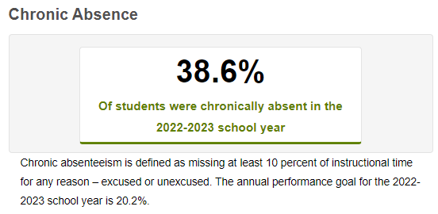
Performance Indicators (Report Only)
Is this a chronic absenteeism issue?
*The Chronic Absence rate can be found under the Gap Closing Component on the Report Card

Slide 36
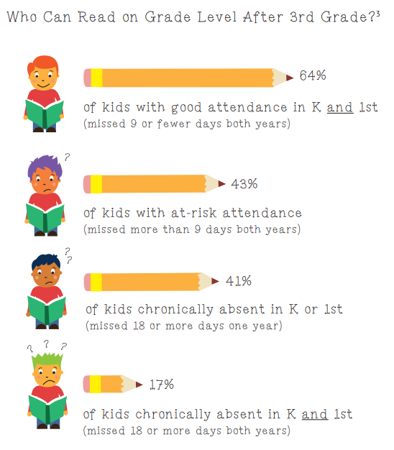
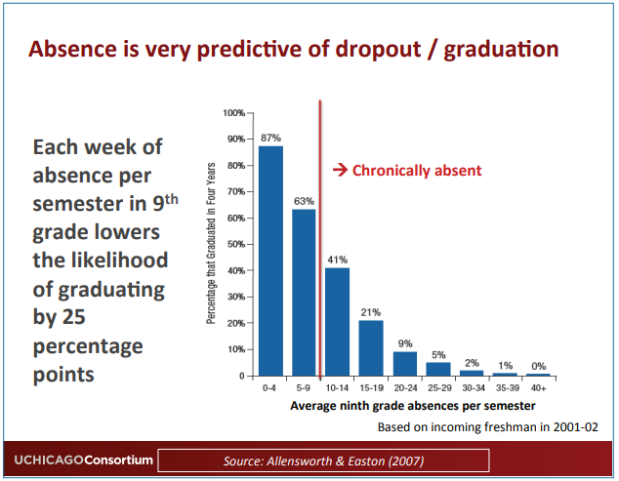
Performance Indicators
Is this a chronic absenteeism issue?
Notes:
Infographic - Attendance Works

Slide 37
Performance Index & Indicators
Now What?
Spend more time on…
Examining proficiency trends in grade levels and subjects
Ohio Materials Matter Reviews
Ohio Curriculum Support Guide
Ohio’s Plan to Raise Literacy
Read Ohio
Ohio’s Attendance Guide
Ohio Statewide Family Engagement Center
Think best instructional practices, effective interventions, and ways to get all students into complex texts

Slide 38
Performance Index & Indicators
Now What?
Follow the research and evidence!
  Performance Index
    Subject and/or grade level acceleration
    Untested Students
    % in Limited/Basic
  Performance Indicators
      How is Tier 1/core across the board? Are we at 80% or higher?
      Is it a curriculum issue? Instruction? Chronic absenteeism? Combination? Something else?
      What trends do we notice across grade levels?
  EMIS

Slide 39
Padlet Questions:
Achievement Component

Slide 40
Overview of 2022-2023 Report Cards
Overall Rating – Rated on a 1 through 5-star scale in half-star increments
  Five Rated Components – Rated on a 1 through 5-star scale in full-star increments
    Achievement Component
    Progress Component
    Gap Closing Component
    Early Literacy Component
    Graduation Component
  College, Career, Workforce and Military Readiness Component – REPORT ONLY
  Additional Report-Only Data is found within many of the components

Slide 41
Progress Component
Here’s What.
So What?
Now What?
Here’s the data.
So what does the data tell us?
Now what do we do?
Notes:
Rachel

Slide 42
Test Your Knowledge:
Progress Component
True or False
Retakes for end-of-course exams are included in the calculations for the progress component.
Notes:
For the progress component, are end of course retake tests included?
Yes/No

Slide 43
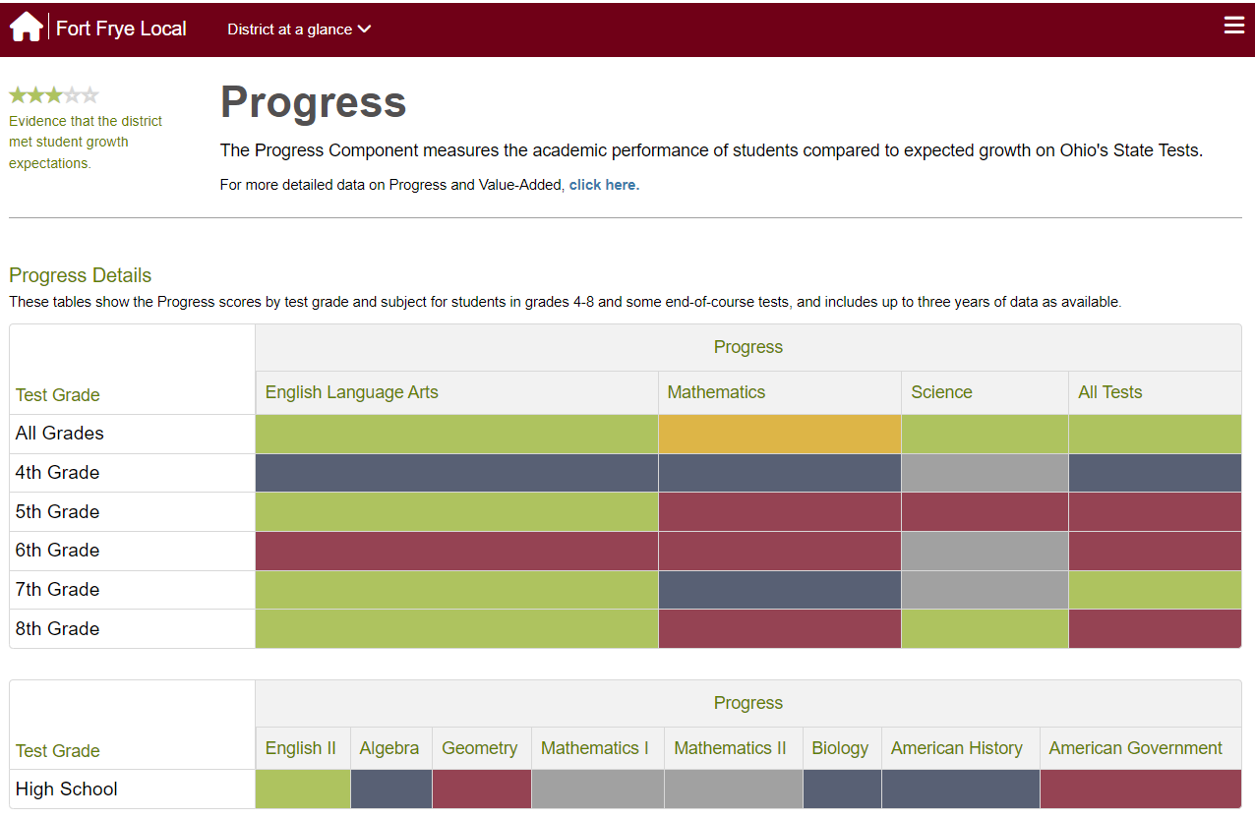
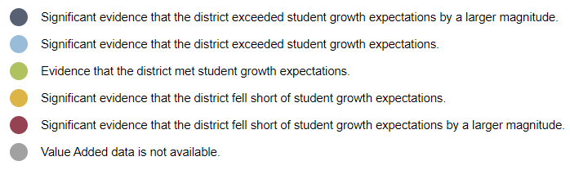
Here’s What
The anticipated release date for 22-23 data to be on the SAS EVAAS website is October 18, 2023
Main Progress Component page has high level overview by grade level and content area.

Slide 44
Two Steps to Assign Component Rating
Step 1
  Use the growth index value to determine if there is statistical evidence that the observed growth was indeed above or below the growth expectation
  Every measure starts at 3 stars, and then either stays at 3, or moves to 2 or 4 at this step.
Step 2
  Use the effect size to determine if the magnitude of growth was large enough for…
    Schools and districts showing above expected growth to be considered 5 stars.
    Schools and districts showing below expected growth to be considered 1 star.

Slide 45
Rating
Progress Component Rating
Calculations
2022-2023 Overall Value-Added Progress
Measures
2022-2023 Overall Value Added
(67%)
2021-2022 Overall Value Added
(33%)

Slide 46
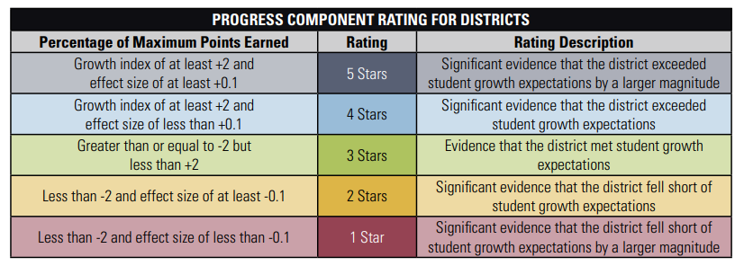
Progress Component
2022-2023 Progress Component Technical Documentation

Slide 47
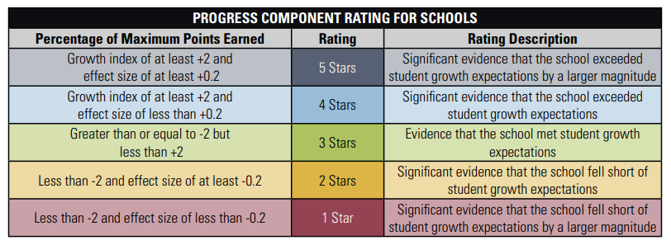
Progress Component
2022-2023 Progress Component Technical Documentation

Slide 48
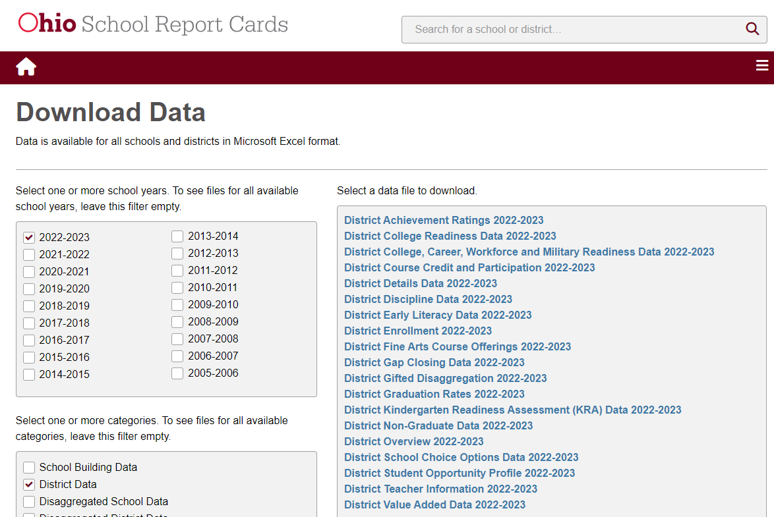
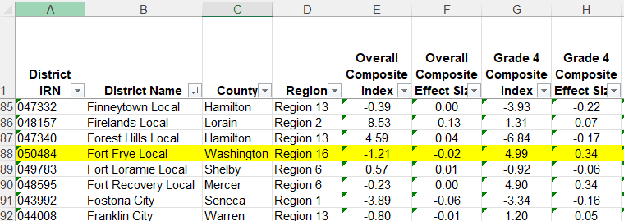
For additional public data on the Progress Component, visit the Download Data page and find Building, District, or Community School Value Added Data
Growth Index (Overall Composite Gain) and Effect Size (Overall Composite Effect Size) are values used to assign component rating.
Notes:
Download Data Page: reportcard.education.ohio.gov/download

Slide 49
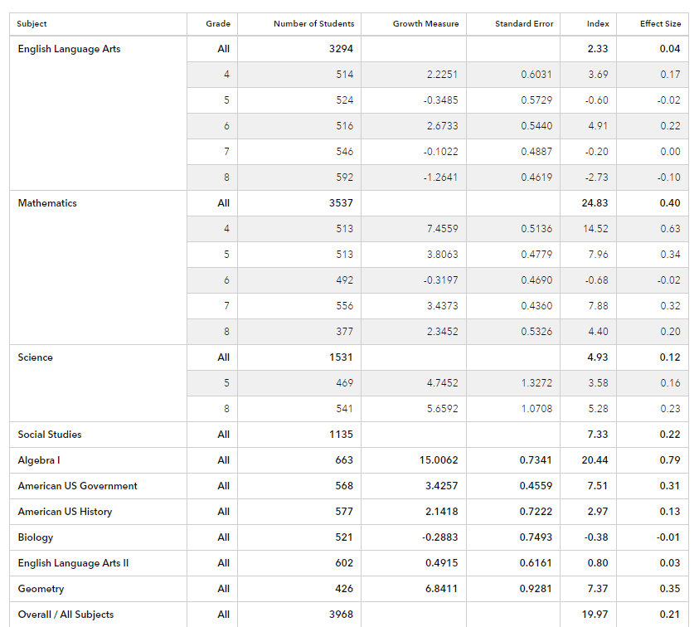
So What?
Progress Component
Do we notice any trends?
Are there any grade levels that are doing very well? Any grade levels that are struggling?
How does this match up with our achievement data?
What are the year over year trends with progress?

Slide 50
Progress Component
Now What?
Follow the research and evidence!
  Explore the same main areas that you would explore for achievement:
      How strong is the core curriculum?
      When/where/how are students receiving interventions?
      Is it a curriculum/instruction issue, a chronic absenteeism issue, or both?
      What trends do you notice across grade levels?

Slide 51
Padlet Questions:
Progress Component

Slide 52
Overview of 2022-2023 Report Cards
Overall Rating – Rated on a 1 through 5-star scale in half-star increments
  Five Rated Components – Rated on a 1 through 5-star scale in full-star increments
    Achievement Component
    Progress Component
    Gap Closing Component
    Early Literacy Component
    Graduation Component
  College, Career, Workforce and Military Readiness Component – REPORT ONLY
  Additional Report-Only Data is found within many of the components

Slide 53
Gap Closing Component
Here’s What.
So What?
Now What?
Here’s the data.
So what does the data tell us?
Now what do we do?
Notes:
Rachel

Slide 54
Test Your Knowledge:
Gap Closing Component
True or False
For the gap closing component, the total number of possible points change based on whether there are enough students in a subgroup.
Notes:
For the gap closing component, the total number of possible points changes based on whether there are enough students in a subgroup.
True/False

Slide 55
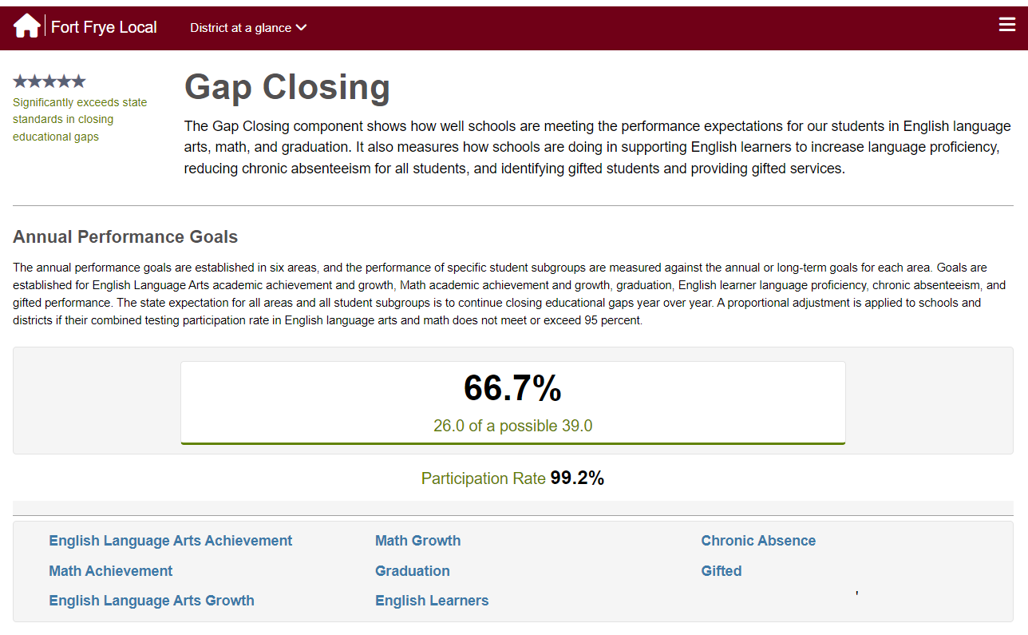
Here’s What
Component Percentage used to assign star rating

Slide 56
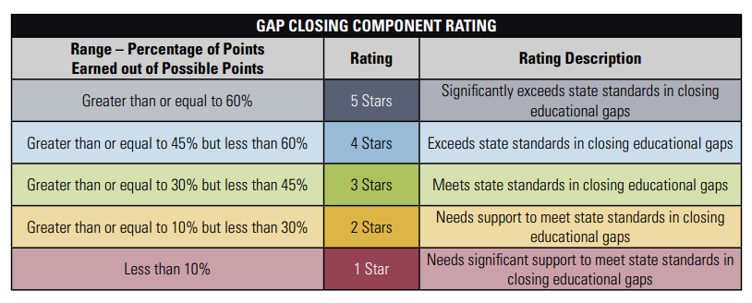
Gap Closing Component
2022-2023 Gap Closing Technical Documentation

Slide 57
Point Assignments for Measures/Indicators
Measure/Indicator | Details | Possible Points
Gifted Performance Indicator | Gifted Performance Index | 0 or 5
 | Gifted Progress (Growth) | 0 or 5
 | Gifted Identification and Services | 0 or 5
Chronic Absenteeism Indicator | Meet annual goal or show improvement from prior year | 0 or 5
English Learner Proficiency Improvement Indicator | Meet annual goal or show improvement from prior year; English learners’ performance on OELPA | 0 or 5
Graduation | Meet annual goal; at individual subgroup level | Up to 10
English Language Arts – Achievement | Meet annual goal; at individual subgroup level | Up to 10
English Language Arts – Progress (Growth) | Meet annual goal; at individual subgroup level | Up to 10
Mathematics – Achievement | Meet annual goal; at individual subgroup level | Up to 10
Mathematics – Progress (Growth) | Meet annual goal; at individual subgroup level | Up to 10
Total Possible: |  | 75

Slide 58
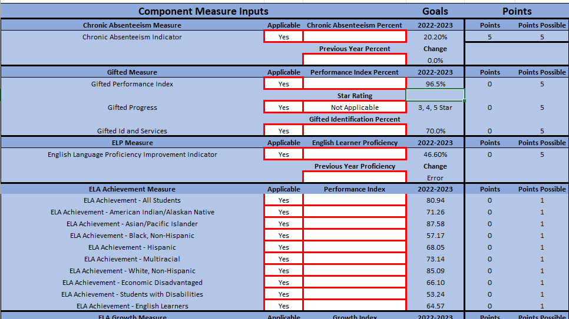
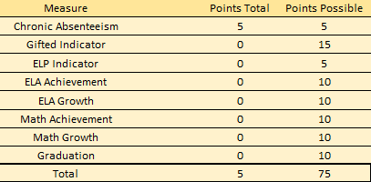
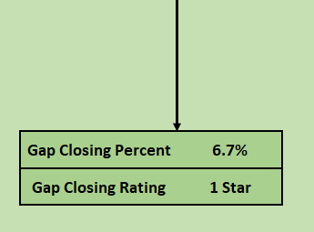
Gap Closing Calculator
Report Card Component Calculator

Slide 59
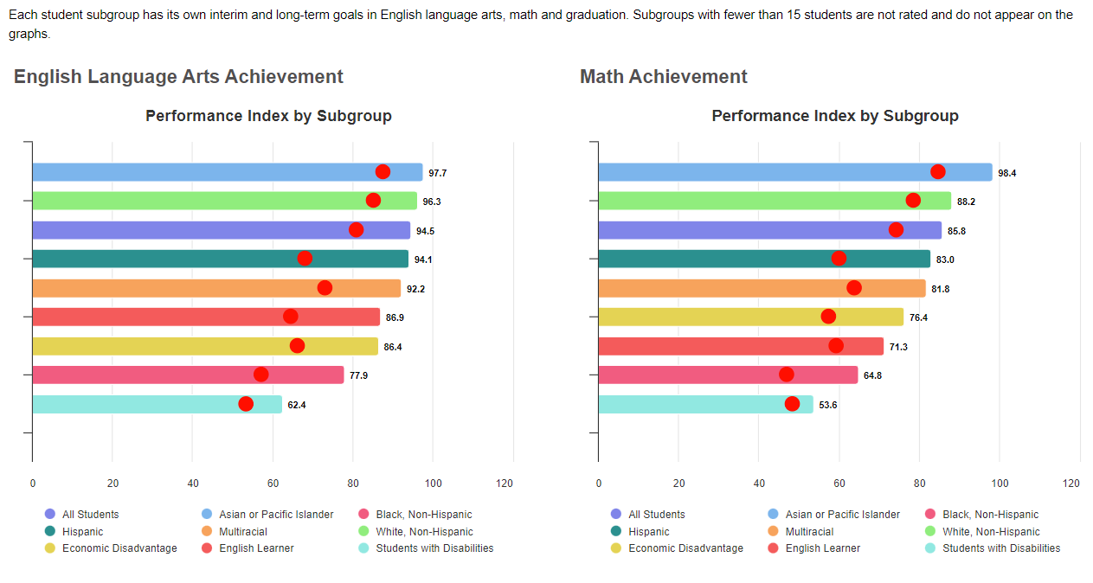
So What?
Note: Yearly Performance Index goals can be found on the Gap Closing Technical Documentation
Underlying measure data is comparable to prior year’s performance. Based on performance goals in Ohio’s ESSA plan, meeting or exceeding by student subgroup.
Red Dot = Individual Subgroup Goal
Bar = Individual Subgroup Performance

Slide 60
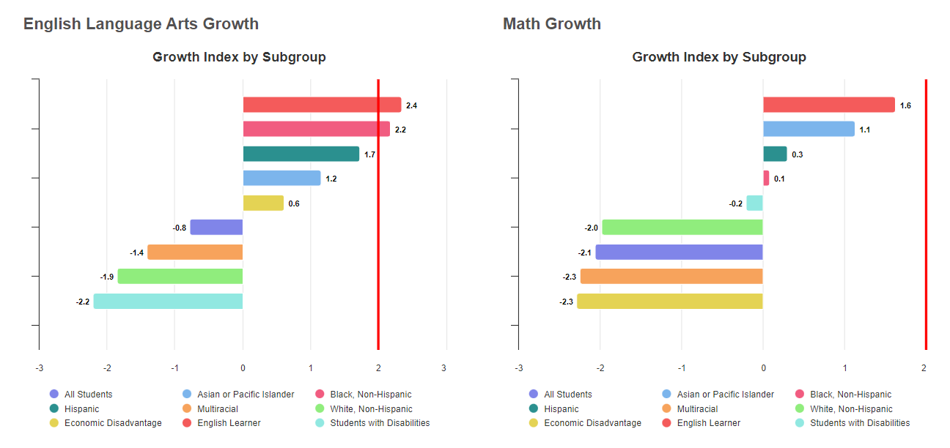
Red Line = Goal for all subgroups is
Growth Index of at least 2.
Bar = Individual Subgroup Performance

Slide 61
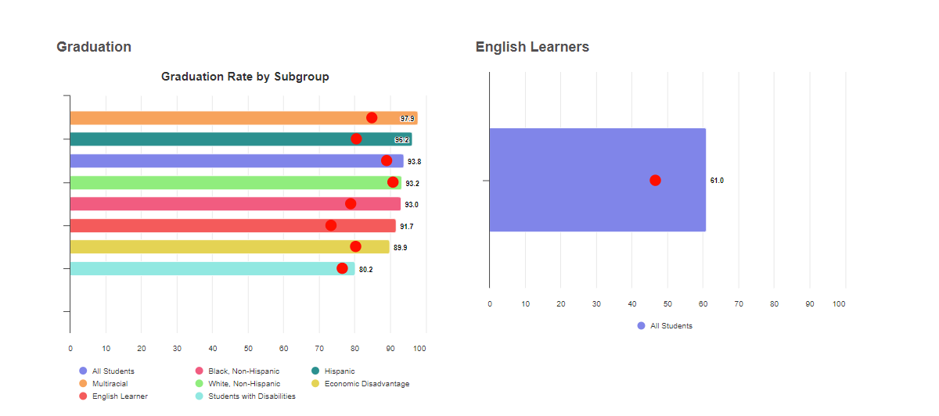
Red Dot = Individual Subgroup Goal
Bar = Individual Subgroup Performance

Slide 62
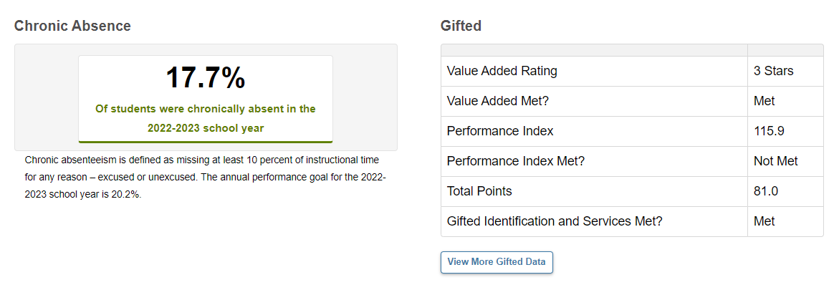
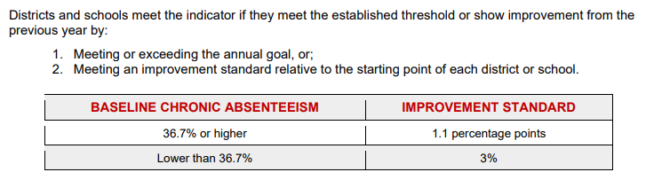
Gifted Performance Indicator has 3 elements; points can be earned for each ‘met’ status.

Slide 63
Gap Closing Component
Now What?
Resources:
Ohio’s Ready School Guide for Language and Literacy
School Leader’s Implementation Guide (Emergent Readers)
School Leader’s Implementation Guide (K-5)
School Leader’s Implementation Guide (6-12)
Ohio’s Attendance Guide
Assisting Students Struggling with Mathematics
Gifted Education
English Learners
OCALI
  Achievement
  Progress
  Chronic Absenteeism
  Gifted
  EMIS

Slide 64
Padlet Questions:
Gap Closing Component

Slide 65
Overview of 2022-2023 Report Cards
Overall Rating – Rated on a 1 through 5-star scale in half-star increments
  Five Rated Components – Rated on a 1 through 5-star scale in full-star increments
    Achievement Component
    Progress Component
    Gap Closing Component
    Early Literacy Component
    Graduation Component
  College, Career, Workforce and Military Readiness Component – REPORT ONLY
  Additional Report-Only Data is found within many of the components

Slide 66
Early Literacy Component
Here’s What.
So What?
Now What?
Here’s the data.
So what does the data tell us?
Now what do we do?
Notes:
Rachel

Slide 67
Test Your Knowledge:
Early Literacy Component
True or False
The early literacy component has Reading Improvement and Monitoring Plan (RIMP) deductions.

Slide 68
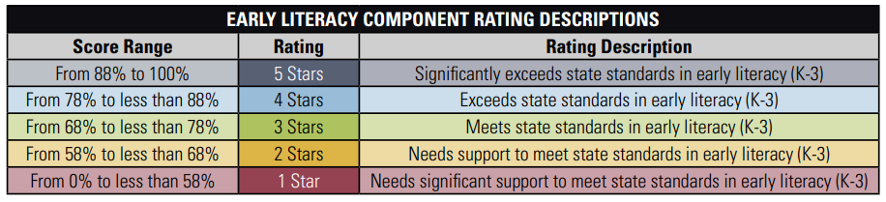
Early Literacy Component
Here’s What
2022-2023 Early Lite racy Component Technical Documentation

Slide 69
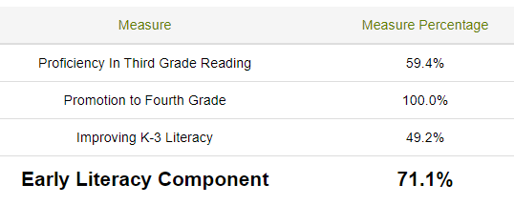
Early Literacy Component
Weight
Weighted %
X
=
23.8%
40%
X
=
35%
35.0%
X
=
25%
12.3%
71.1%
Notes:
Taylor

Slide 70
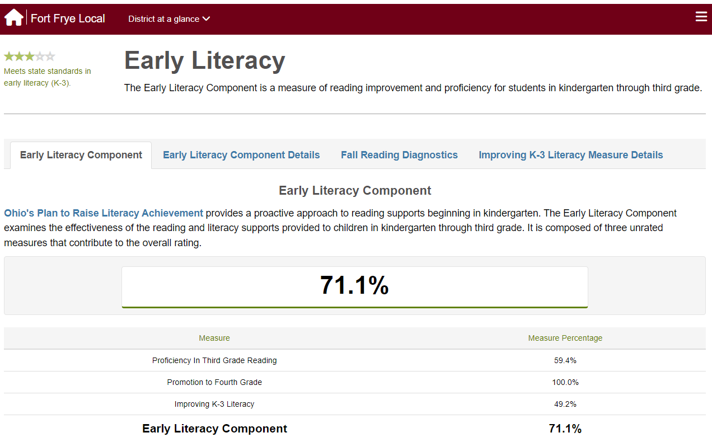
Notes:
Taylor

Slide 71
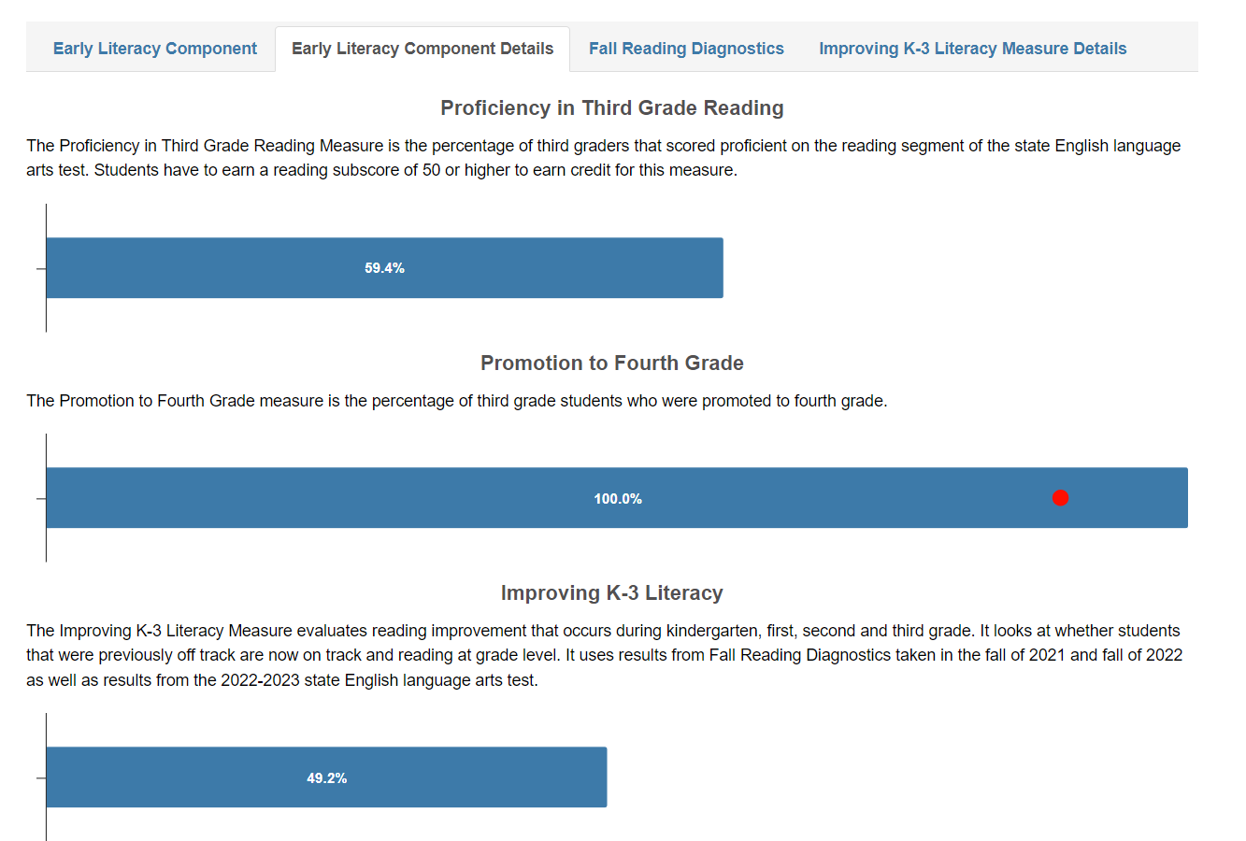
Layout Changes
Notes:
Taylor

Slide 72
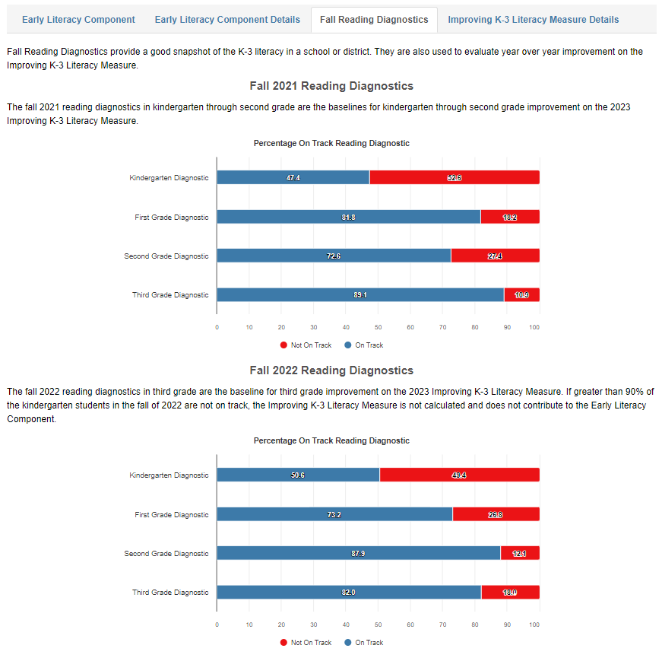
Layout Changes
Notes:
Taylor

Slide 73
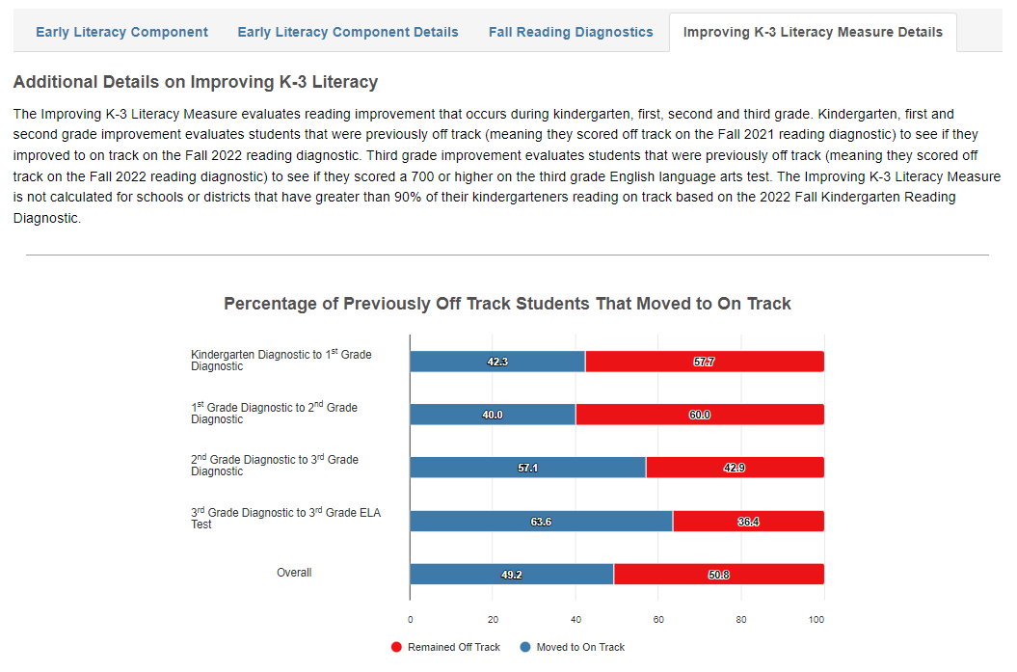
Layout Changes
Notes:
Taylor

Slide 74
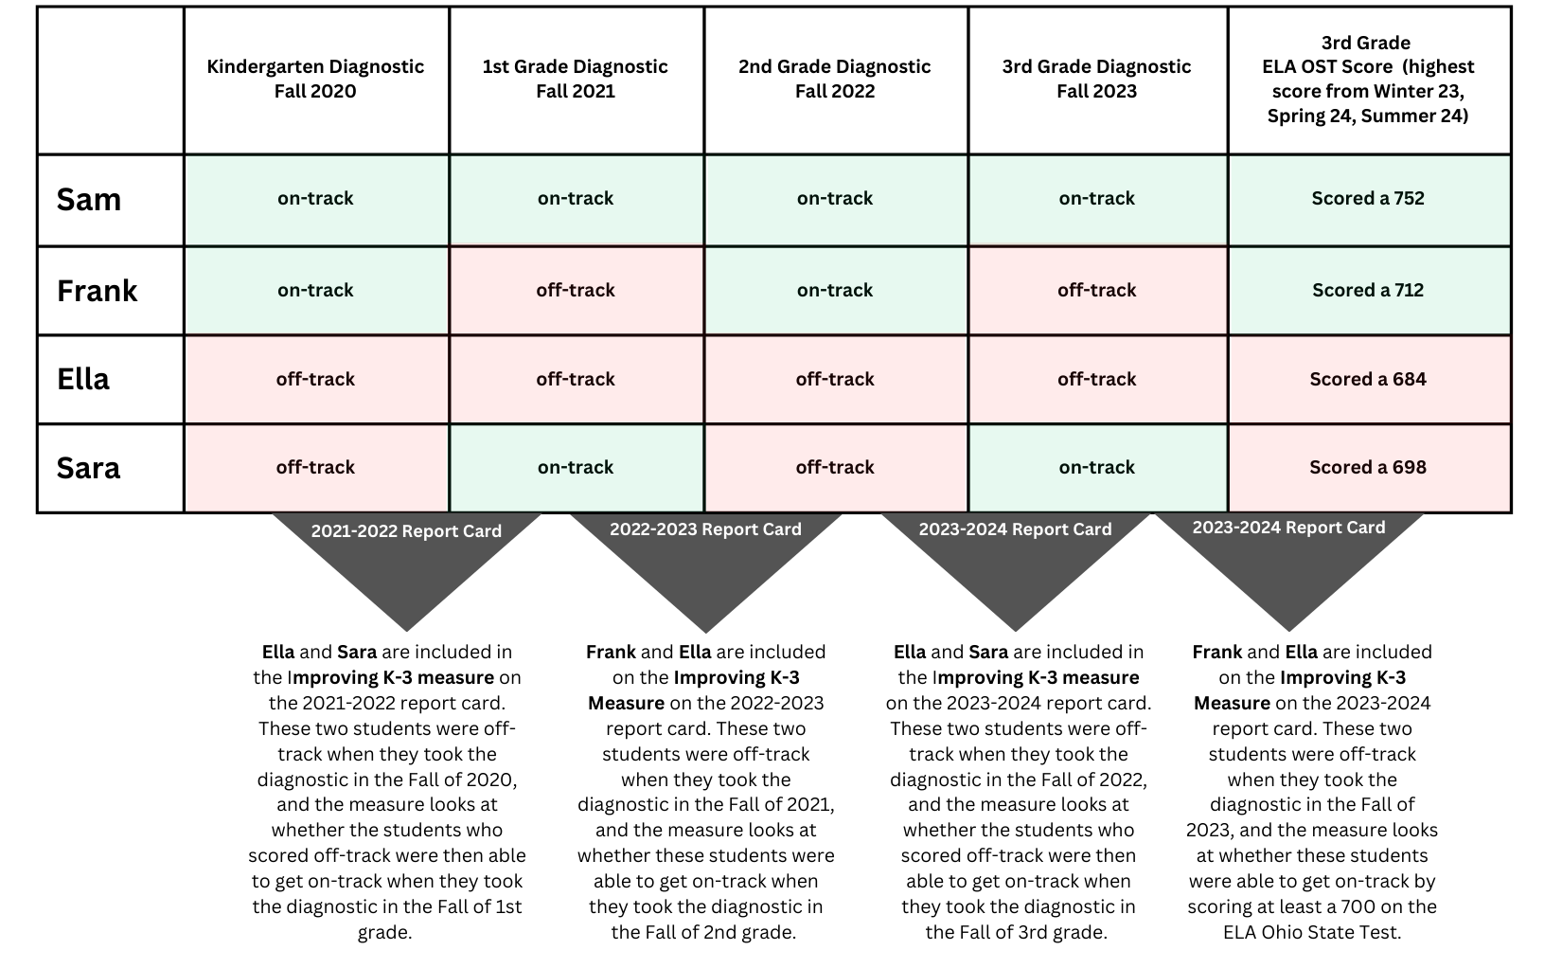
Layout Changes
Notes:
Taylor

Slide 75
So What?
Here’s What….So What?
  Validity of Screener
  Tier 1
      Is it a curriculum/instruction issue, a chronic absenteeism issue, or both?
  Intervention effectiveness and the different grade levels
  EMIS
  Connecting early literacy to overall achievement
Notes:
Taylor

Slide 76
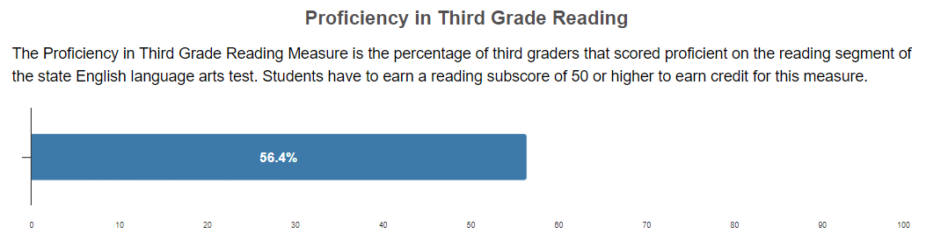
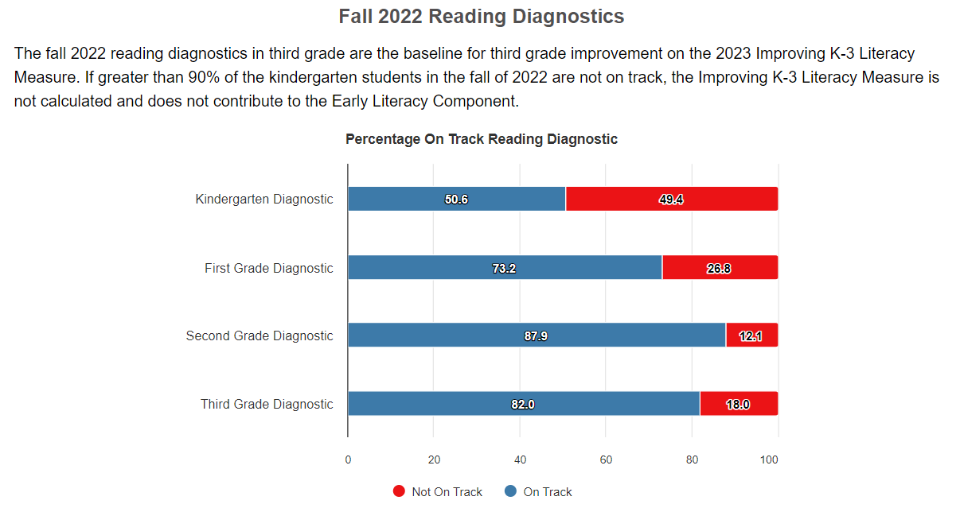
How Valid is My Screener?
Notes:
Taylor

Slide 77
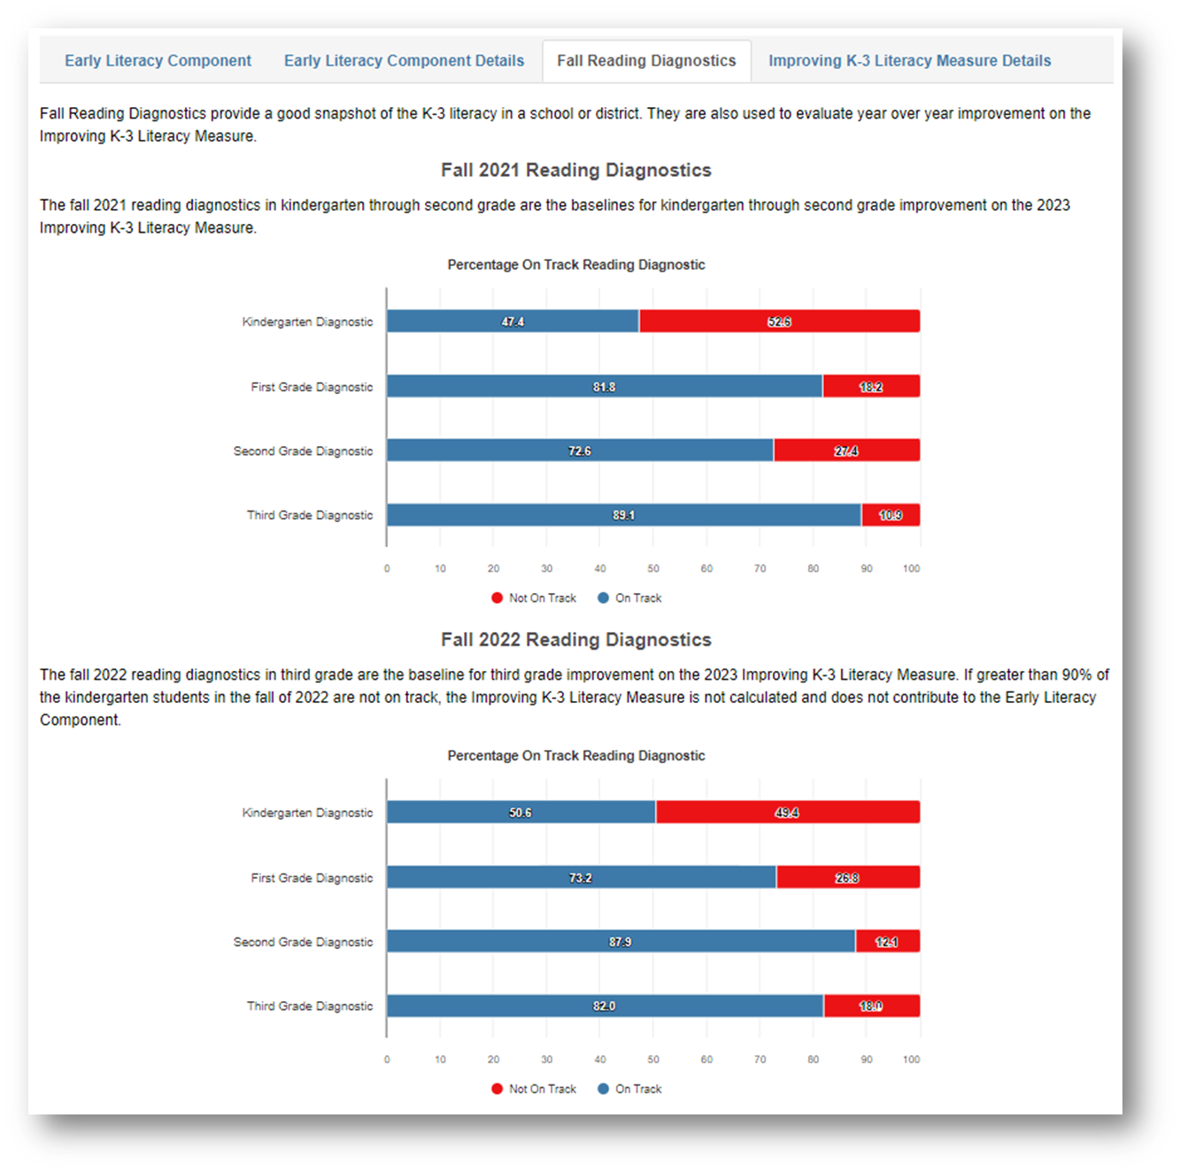

Fall Reading Diagnostics: Tier 1 - Core
Ohio Materials Matter Reviews
Ohio’s Plan to Raise Literacy
Read Ohio
Literacy Academy on Demand
Implementing Ohio’s Plan to Raise Literacy Achievement: Resources for School Leaders

Slide 78
Tier 1 - Core
Intervention
Notes:
Taylor

Slide 79
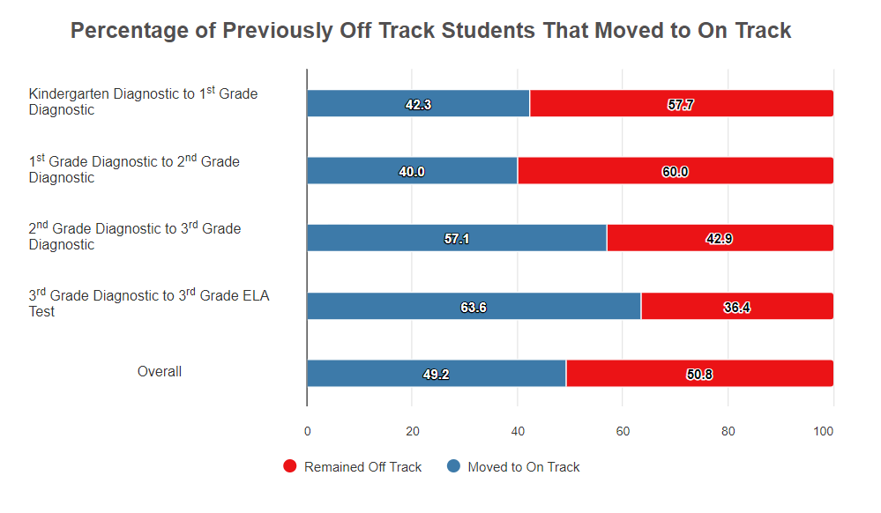
Intervention
Ohio Materials Matter Reviews
Ohio’s Plan to Raise Literacy
Ohio’s Dyslexia Guidebook
RIMP Intervention Codes & RIMP Intervention Videos
Read Ohio
Notes:
Taylor

Slide 80
Now What?
Here’s What...So What…Now What?
  Possible questions:
    What has been the focus to improve achievement?
    What does the data say in terms of how that has worked so far?
    Where are the bright spots? What is happening there?
    What is happening at Tier 1?
    What is happening for Intervention?
    Who is at the table discussing these things? Who might be missing from the table who needs to be there?
    In what ways can we shift our focus from admiring the problem to implementing best instructional practices?
Notes:
Taylor

Slide 81
Padlet Questions:
Early Literacy Component

Slide 82
Graduation Component
Here’s What.
So What?
Now What?
Here’s the data.
So what does the data tell us?
Now what do we do?
Notes:
Rachel

Slide 83
Overview of 2022-2023 Report Cards
Overall Rating – Rated on a 1 through 5-star scale in half-star increments
  Five Rated Components – Rated on a 1 through 5-star scale in full-star increments
    Achievement Component
    Progress Component
    Gap Closing Component
    Early Literacy Component
    Graduation Component
  College, Career, Workforce and Military Readiness Component – REPORT ONLY
  Additional Report-Only Data is found within many of the components

Slide 84
Test Your Knowledge:
Graduation Component
For the 2022-2023 Report Card, the 4-year graduation rate applies to students who are in the class of:
2022 or 2023

Slide 85
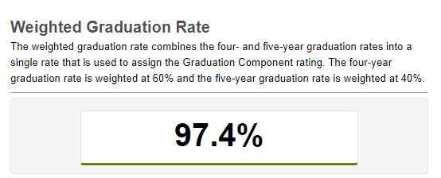
Graduation Component
Here’s What

Slide 86

Graduation Component
2022-2023 Graduation Component Technical Documentation

Slide 87


Graduation Component
So What?

Slide 88
Graduation Component
Now What?
    Graduation Resources
    Attendance Support
    Guide to 2023 Ohio School Report Cards

Slide 89
Padlet Questions:
Graduation Component

Slide 90
Overview of 2022-2023 Report Cards
Overall Rating – Rated on a 1 through 5-star scale in half-star increments
  Five Rated Components – Rated on a 1 through 5-star scale in full-star increments
    Achievement Component
    Progress Component
    Gap Closing Component
    Early Literacy Component
    Graduation Component
  College, Career, Workforce and Military Readiness Component – REPORT ONLY
  Additional Report-Only Data is found within many of the components

Slide 91
College, Career, Workforce and Military Readiness Component Summary
Component used to be called Prepared for Success
Name changed as well as structure of calculation
  Expanded list of elements (measures)​
    Elements (Measures) are equal in the calculation​
Report-only data during transition years (2021-2022, 2022-2023, and 2023-2024)​
  Component will be rated in 2024-2025

Slide 92

College, Career, Workforce and Military Readiness Component Summary

Slide 93
College, Career, Workforce and Military Readiness Calculation
Count of students demonstrating readiness on at least one measure
Count of students in the four-year graduation cohort
%
College, Career, Workforce, and Military Readiness Component

Slide 94

College, Career, Workforce and Military Readiness Calculation

Slide 95
Padlet Questions:
CCWMR Component

Slide 96
Overview of 2022-2023 Report Cards
Overall Rating – Rated on a 1 through 5-star scale in half-star increments
  Five Rated Components – Rated on a 1 through 5-star scale in full-star increments
    Achievement Component
    Progress Component
    Gap Closing Component
    Early Literacy Component
    Graduation Component
  College, Career, Workforce and Military Readiness Component – REPORT ONLY
  Additional Report-Only Data is found within many of the components

Slide 98
Overall Ratings
Published in 2022-2023 school year
Includes half-star ratings; whereas components receive only full-star ratings
Components are assigned points and weighted to calculate the overall ratings for schools and districts
Overview of Components
Overview of Overall Rating
Project Timeline
Stakeholder Engagement

Slide 99

Weighting for Five Components
Graduation Component (14.266%)
Gap Closing Component (14.266%)
Achievement Component (28.601%)
Progress Component (28.601%)
Early Literacy Component (14.266%)

Slide 100

Overall Rating
2022-2023 Overall Rating Technical Documentation

Slide 101
Padlet Questions:
Overall Rating

Slide 102
Feedback
Thank you for joining us! Please submit feedback on today's webinar:
  https://forms.office.com/g/rgz0YEwdRw

Slide 103
Contact
Please contact the Office of Accountability with additional questions: accountability@education.ohio.gov

Slide 104






@OHEducation

