Slide 1
Welcome to Kindergarten
Notes:
Welcome to Kindergarten! This is an exciting milestone in your child’s development.

Slide 2

Early Learning
and School Readiness
Birth – Age 5
Notes:
Your child has been preparing for this moment since birth. Early learning and preparing for school readiness takes place from birth to age five.

Slide 3
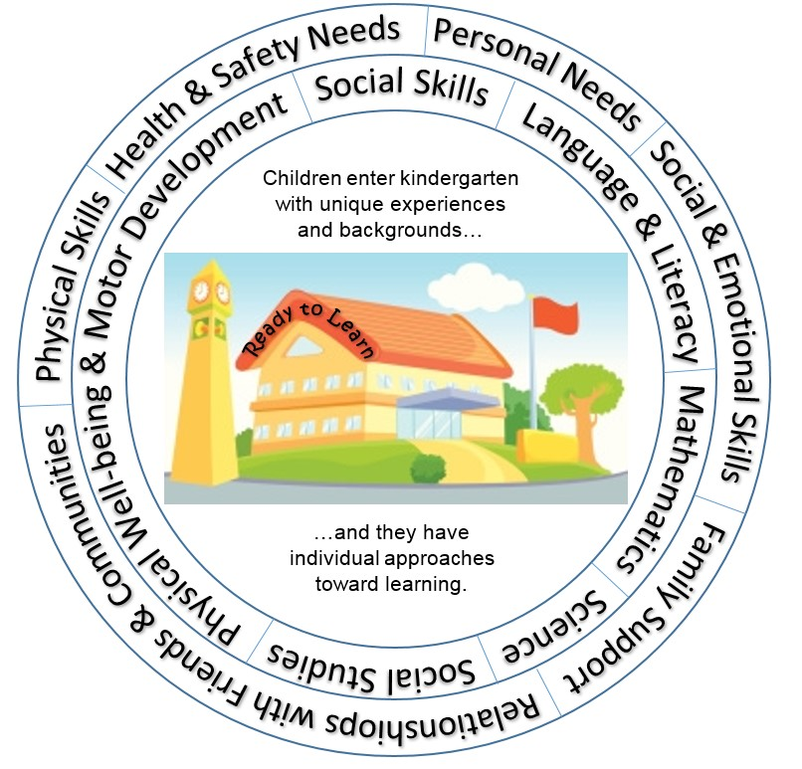
Physical Skills
Ready to Learn
Social and Emotional Skills
Personal Needs
Notes:
To be ready to learn, families and communities focus on developing the whole child. Children need to be supported and nurtured in all areas of development so that they are physically, socially, and emotionally ready for school. Children need to know how to cope with being separated from their family, how to get along with other children, how to follow rules, how to perform self-care tasks like washing hands, toileting and putting on and taking off outerwear like coats and boots.

Slide 4

Individual approaches toward learning
Notes:
Children come from very unique backgrounds with different experiences. Some children will have experiences that will make them very successful in some areas and others will need support to be more independent. This is an example of individual approaches toward learning.

Slide 5


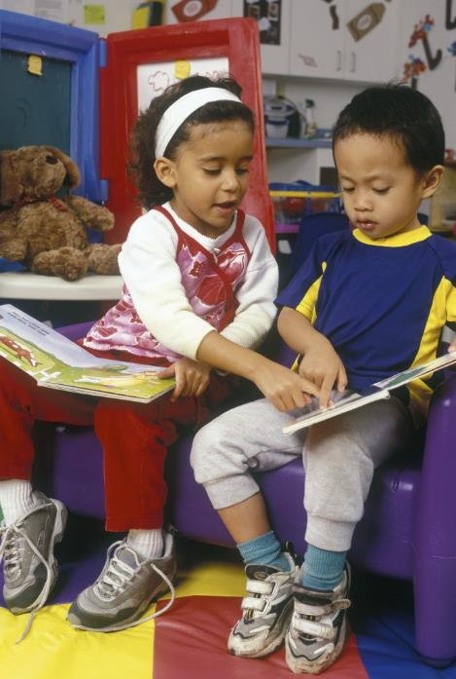
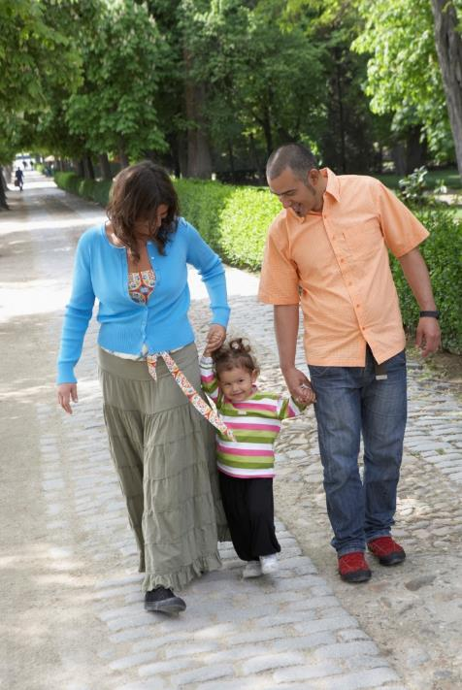
Working Together
Families
Communities
Preschools
Other Organizations
Notes:
Families, Communities, Preschools and other organizations can work together to support positive development during these early years to help prepare children for kindergarten.

Slide 6
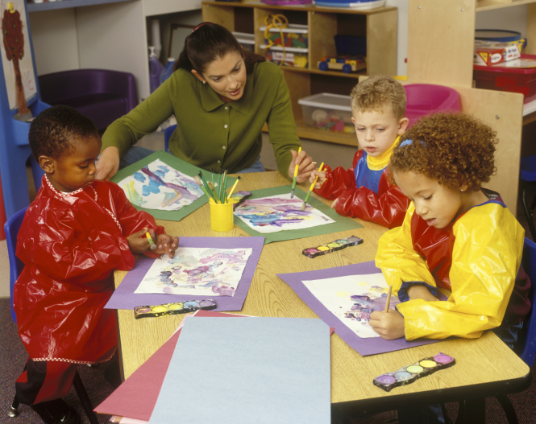
Getting to know
your child
Using different strategies
Kindergarten Readiness Assessment
Notes:
When your child begins kindergarten in your school, your child’s teacher will spend a lot of time at the beginning of the school year getting to know your child and helping your child get comfortable in the learning environment, the classroom. Teachers use many different tools and strategies to get to know kindergarten children. One way that is consistent across the state of Ohio is the use of the Kindergarten Readiness Assessment (the KRA).

Slide 7


Not a test
Measures knowledge and abilities
Uses activities and experiences
Supports growth and development
Notes:
The KRA is for all children enrolled in a public school and begins on the first day of kindergarten. It is important to note that the KRA is NOT a test! It is an assessment that measures your child’s knowledge and abilities in social foundations, language and literacy, mathematics, science, and physical well-being and motor development.
Some of these activities and experiences may look or feel like a game and others may appear to be typical activities or experiences in the course of a regular kindergarten day. For example, your child may interact with some questions on a computer or tablet, or your child may be working in a small group with other children and the teacher doing a guided activity, or your child may simply be playing on the playground. In each case, your child’s teacher is able to collect information that will help the teacher modify the learning environment to support your child’s growth and development. A change determined by the KRA could be providing individual learning time for your child in some areas or adding more movement to your child’s learning day to support kinesthetic learning.

Slide 8

Notes:
All kindergarten teachers receive training on how to administer the assessment and how to use the results to plan appropriate instruction for student learning. Let’s hear what one Ohio kindergarten teacher has to say about using the assessment in her classroom.

Slide 9
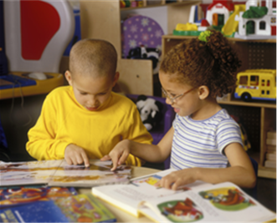
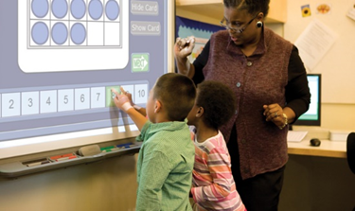

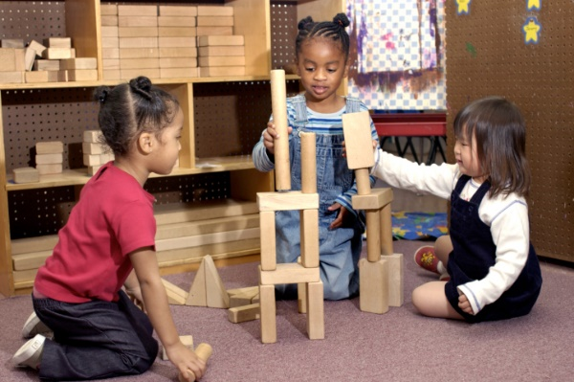

Looks at a student’s readiness
Data for teachers and families
Everyday activities
Showing what they know and can do
Notes:
The KRA is one way to assess kindergarten children. Because the KRA is based on the Ohio Early Learning and Development Standards that span birth through age five, it provides a comprehensive view of a student’s readiness for kindergarten instruction. The results give teachers and families informative and actionable data that supports opportunities for intervention and enrichment. Teachers are observing children in everyday activities, asking children to provide responses to prompts, and setting up activities for children to show what they know and what they can do.
The assessment tool does not rank children by ability. The assessment tool does not identify students with disabilities or gifted students! Young children change so fast! If they cannot do something this week, you may see them do it a couple of weeks later

Slide 10
Notes:
Teachers use the information collected by observing children to make decisions about individual student learning needs, as well as the learning needs for the entire class. Listen to what these two teachers have to say about how they use the assessment results to plan classroom instruction and support student learning.

Slide 12

Families and teachers work together
Help all children succeed
Notes:
Families, communities, schools and teachers support all kindergarten students’ learning. The information collected from the assessment is beneficial for families and teachers to work as partners to help children succeed in kindergarten.

Slide 13

education.ohio.gov
Search keyword: Kindergarten
ELSR@education.ohio.gov
Notes:
For additional resources to help understand how you can support your child’s kindergarten success, visit www.education.ohio.gov and search the keyword “Kindergarten,” or send your question to ELSR@education.ohio.gov.

