Slide 1


Slide 2

the Ohio School Bus Safety Working Group Recommended that
The Ohio Department of Education and Workforce should work with the Ohio Department of Public Safety to create and offer wellness programming specific to school bus drivers.
“Because school bus transportation is a stressful and, at times, dangerous profession, wellness programs can be an important tool for bus driver health. In addition to regularly encountering aggressive and distracted drivers, bus drivers also must mediate high-risk interactions with students and parents. These recurring stressors can adversely impact bus drivers’ mental and emotional well-being and threaten driver retention. The Ohio School Bus Safety Working Group recommends the Ohio Department of Education and Workforce make wellness programming available to bus drivers to equip them with strategies to react to and recover from high-stress situations. The agency should partner with the Ohio Department of Public Safety to create programming similar to the wellness support programs developed for law enforcement officers.”
Notes:
The Governor’s School Bus Safety Working Group Report resulted from a fatal crash in August 2023 that claimed the life of a Clark county student. Ohio strives to be the safest among the nation in school bus transportation with the most stringent construction standards for school buses.

Slide 3


Let’s look at Wellness support programming for school bus drivers- why it’s important
School bus drivers play a crucial role in student safety and wellness. But their mental health and well-being is just as important.
As part of the Governor’s School Bus Safety Working Group recommendations, the Department of Education and Workforce and the Department of Public Safety are working together to provide mental health and wellness resources, along with strategies and stress relief exercises aimed toward school bus drivers.
Notes:
Collaboration with Lieutenant Molly Harris of the Ohio State Highway Patrol MAT Team, and Program Administrator Heather Free with Ohio Department of Education and Workforce’s Office of Pupil Transportation.

Slide 4

How stressful is it being a school bus driver?
Have you ever been in a situation where you needed to make a quick decision?
  Managing a bus accident
  Dealing with unruly students (fights, bullying, rowdiness)
  Managing an unauthorized passenger
  Handling parent complaints
  Dealing with other motorists and traffic flow
There are plenty of tense situations a bus driver may deal with multiple times throughout their day. School bus drivers are ultimately responsible for the safety and well-being of their passengers. All while navigating busy streets and highways, unpredictable traffic, inclement weather conditions, and ensuring that students are on time for class or their nonroutine events such as field trips.

Slide 5
Stress and burnout
Stress and burnout continue to be a problem among transportation professionals, leading to anxiety and depression. Burnout may adversely affect drivers’ health and is a risk factor for poor physical and mental well-being.
It is sometimes difficult to recognize how stress is affects us. It’s important to identify what factors lead to stress and what causes associated negative outcomes.

Slide 6

Let’s talk about BURN out- what is it?
Burnout is physical, emotional, or mental exhaustion accompanied by decreased motivation, lowered performance, and negative attitudes toward oneself and others.
Burnout results from performing at a high level until stress and tension, take their toll.
This can happen more quickly if a person experiences extreme and prolonged physical or mental exertion or an overburdening workload.

Slide 7

Long term effects of burnout
There is increasing evidence that burnout as a negative stress response represents a risk factor not only for depression but also for cardiovascular and other somatic disease (pain, fatigue, weakness, shortness of breath).
Studies have shown burnout has three similar components:
emotional exhaustion, which can lead to loss of energy;
isolation, which leads to detached responses to other people around us; and
reduced personal accomplishment.

Slide 8

But I love my job, I love my kids….
Compassion Fatigue:
The burnout and stress-related symptoms experienced by caregivers and other helping professionals in reaction to working with traumatized people over an extended period of time.
May be conceptualized as a function of bearing witness to the suffering of others, which results in the loss of a caregiver’s ability to empathize with clients and others for whom they care.
Is a unique type of burnout for caregiving professionals. Key dimensions may include reduced feelings of empathy, changes in cognition or mood, interpersonal conflicts, and negative physical symptoms.

Slide 9
Understanding toxic stress
Some stress is normal – when an individual encounters a challenge, threat, or problem the body releases stress hormones that cause a number of physiological changes. ( Such as a rollercoaster ride, job interview, etc.)
This type of stress helps us deal with the challenge, threat, or problem and helps to keep us safe.
However, stress that is prolonged, severe, or chronic can cause significant health problems and impact a person’s functioning. This type of stress is toxic stress. (Students that may have a difficult homelife, student behaviors, such as being rude or disrespectful, driving stressors, etc.)

Slide 10
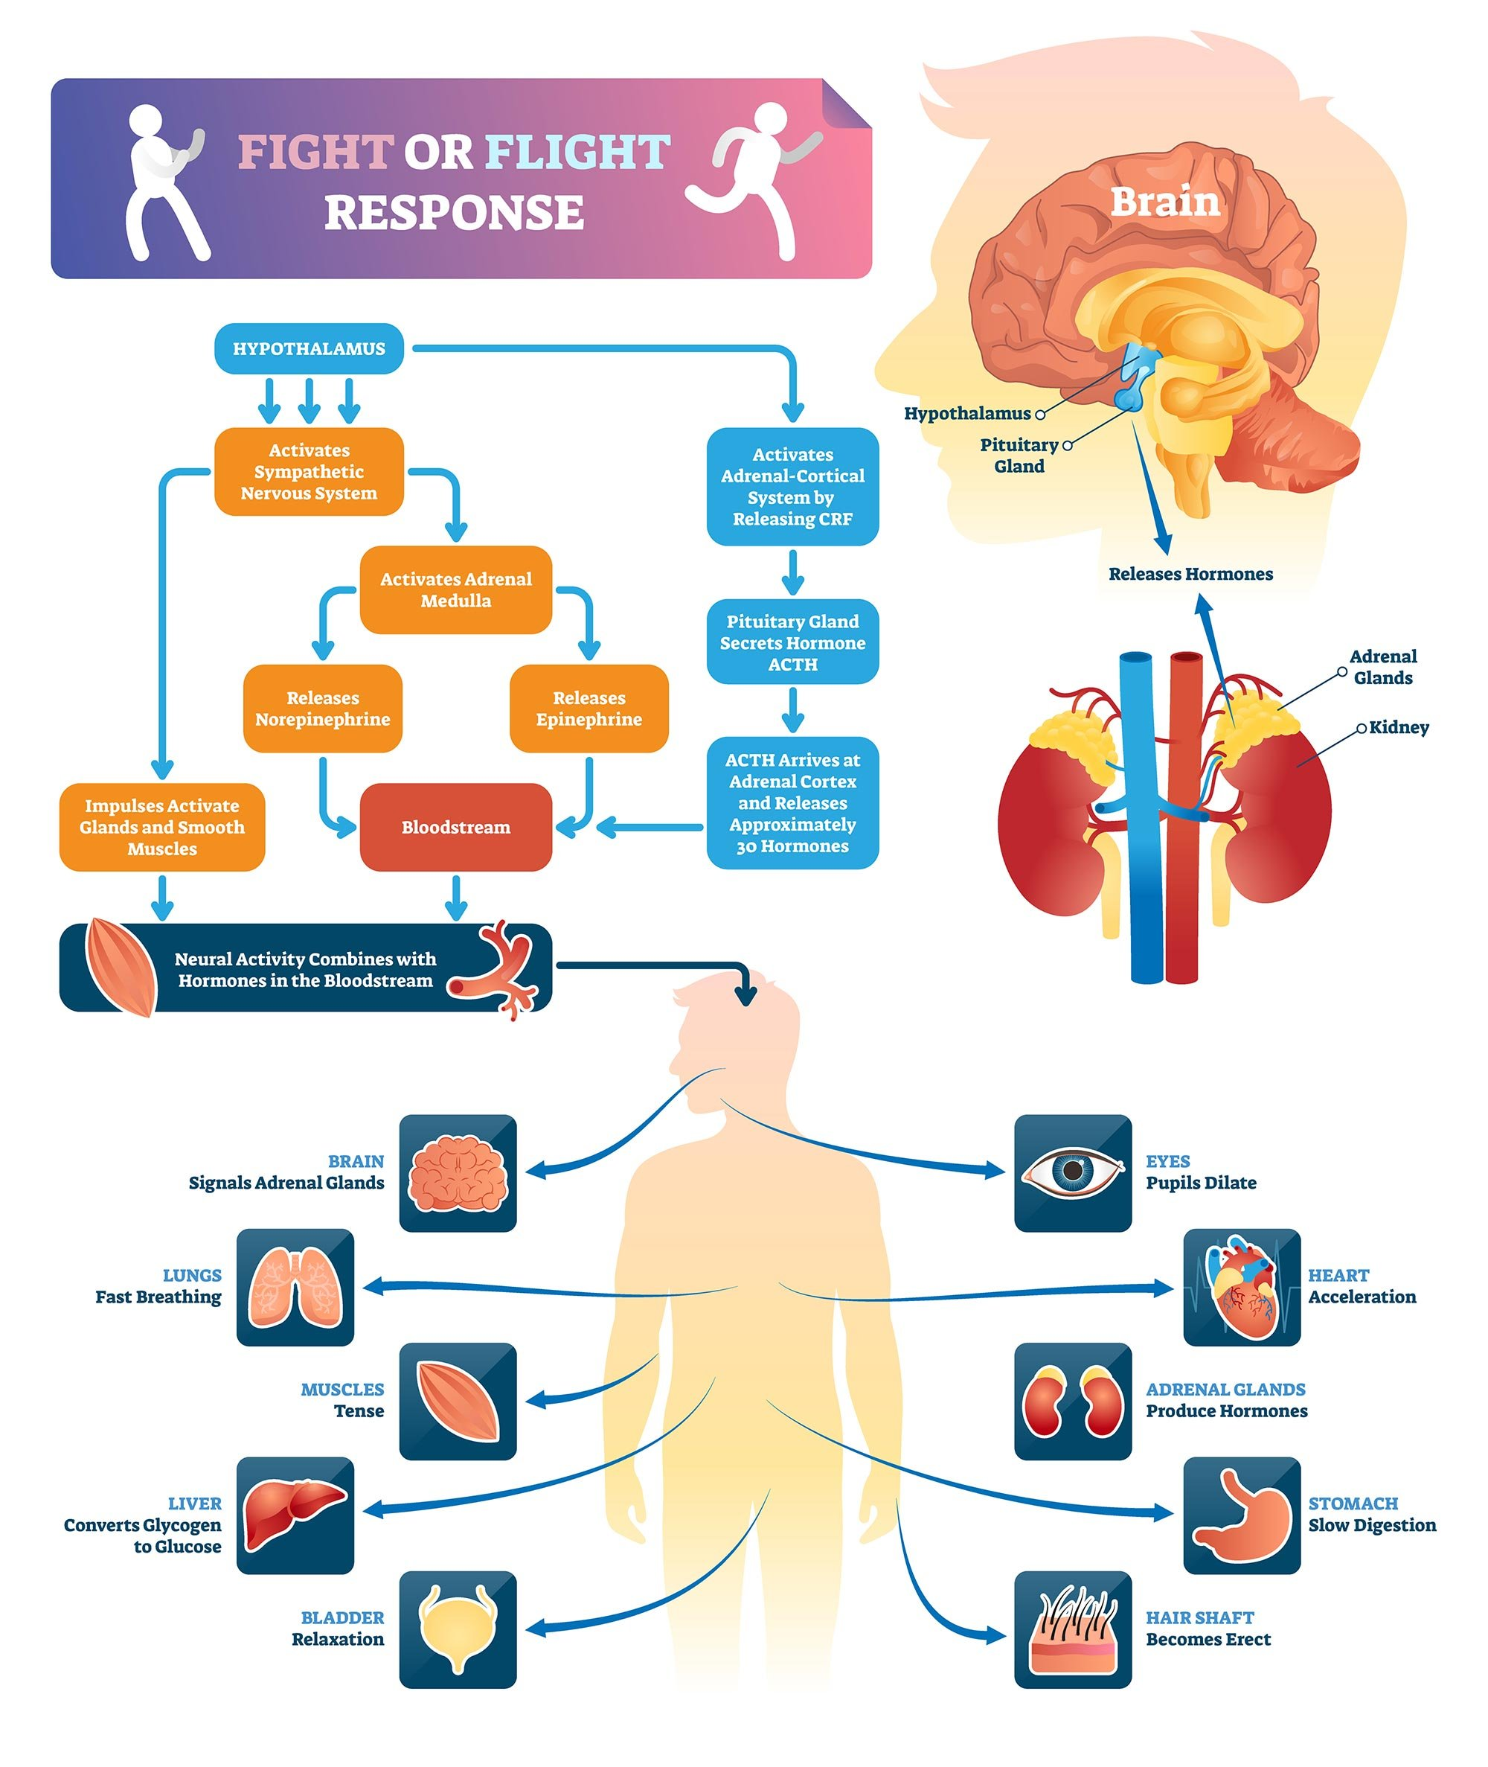
What stress does to your body
Fight-or-flight mode is the body’s response to perceived threats or stress. Chemical changes occur in the body to get it ready for physical action, the “fight”. Sometimes these changes can also make a person prepare to run, known as “flight.” During dangerous situations, our body’s chemical responses can help us to survive. Some people also experience a “freeze” response.
However, if that fight-or-flight response is triggered by trauma or loss, an increased level of cortisol can change a person’s metabolism. Long-term effects of a change in metabolism can include obesity, diabetes or high blood pressure.
Many people also experience stress in their gut with symptoms of an upset stomach, irritable bowel syndrome, diarrhea or severe constipation. High blood pressure and heart problems are also conditions caused by high chronic stress levels.

Slide 11

how do we combat stress? Let’s talk about it
Supportive Relationships
Balanced Nutrition
Physical Activity
Quality Sleep
Mindfulness Practices
Experiencing Nature
Mental Healthcare

Slide 12

SUPPORTIVE RELATIONSHIPS
Reconnect with people. Trying to find a way to connect with people and ground oneself against this internal world of stress can be very healing and therapeutic. Also, there have been studies that show a 30-second hug does the most for stress reduction of any sort of physical contact. Spending time with family and friends is an important buffer against stress. It can be helpful to share your problems with people who care for you.

Slide 13

The science behind stress: oxytocin, the stress hormone
Notes:
Starting point 7:37 run through the end.

Slide 14

QUALITY SLEEP
A good night's sleep makes you able to tackle the day's stress more easily. When you’re tired, you’re less patient and more easily agitated, which can increase stress. Most adults need 7 to 9 hours of sleep each night. Practicing good sleep hygiene along with stress-lowering tactics can help improve your quality of sleep.

Slide 15

Sleep Hygiene Optimization
Sleep hygiene refers to the daily habits and routines that help you fall asleep more easily and stay asleep through the night. Good sleep hygiene sets the foundation for deep, restorative sleep— naturally.
Maintain a consistent sleep-wake schedule, even on weekends
Limit screen time (phones/tablets/TVs) at least one hour before bed
Eliminate all light, natural & artificial light
Create a cool sleeping environment (60-69 degrees F)
Avoid caffeine at least 3-6 hours before bed
Avoid food & alcohol at least 3 hours before bed
Encourage a relaxing wind-down routine such as meditation, breathwork, or light stretching

Slide 16

BALANCED NUTRITION
Junk food and refined sugars low in nutritional value and high in calories can leave us feeling out of energy and sluggish. A healthy diet, low in sugar, caffeine, and alcohol, can promote health and reduce stress.

Slide 17
NUTRITION- Food for thought!
Snacks should provide a balance of carbohydrates (for quick energy) and protein (for sustained energy). This pairing helps keep you full longer and helps regulate your blood sugar. Keep in mind portion sizes when choosing snacks and avoid foods high in added sugar. A healthy snack should contain about 200 calories, provide 5-20 g of protein, and offer up to 30 g of carbohydrates (with less than 10 g coming from added sugar).
The amount of fluid an individual needs each day varies, however, the Institute of Medicine has established a Dietary Reference Intake (DRI) for fluid:
  13 cups (104 fluid ounces) for men, 9 cups (72 fluid ounces) for women
The USDA and HHS protein recommendation is .8 g/kg body weight for adults. A diet high in protein contains 1.2 to 2.0 g/kg body weight. 1.6 g/kg body weight of protein is considered the gold standard by providing the most health benefit in relation to quantity of protein.
  Outside of quantity of protein, having equal doses of protein throughout the day and choosing high quality protein sources can provide further benefits. To get started:
  Prepare meals with 20 – 30 g protein spaced evenly throughout the day.
  Choose minimally processed meats including chicken breast, chicken thigh, sirloin, eggs, lamb, fish, or shellfish instead of processed meats like hot dogs, bacon and sausage, lunch meats, or frozen breaded chicken nuggets.
  Focus on food protein sources versus supplements with protein.
  Choose high protein carbohydrates like quinoa, lentils, beans, teff, sorghum, and farro.

Slide 18

PHYSICAL ACTIVITY
Movement can help you blow off steam, reducing stress. In addition, flexible, loose muscles are less likely to become tight and painful in response to stress. If you have an exercise routine, it’s best to conduct that at least 2 hours before bedtime so your body temperature returns to normal.

Slide 19
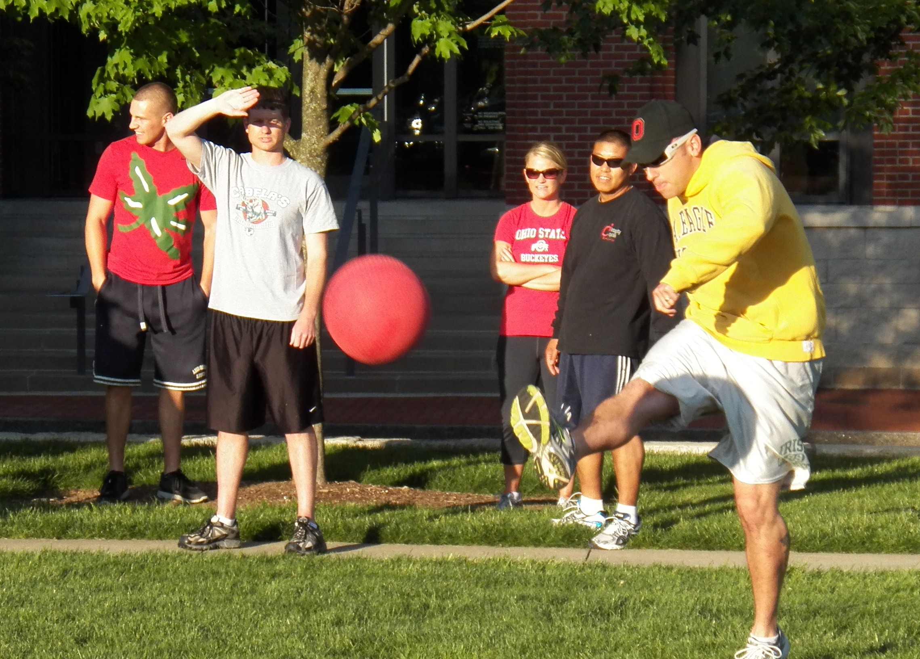
Just a few extra steps throughout your day….
Playing baseball, soccer, kickball or other activities with your children or grandchildren
Walking to your mailbox instead of stopping the car as you pull in your driveway
Playing fetch with your dog
Taking the stairs instead of the elevator

Slide 20

MINDFULNESS PRACTICES
Learn to relax. Practice things like yoga, mediation and deep breathing. Try taking a warm bath and turning off electronics to help you wind down before bed. What we think, how we think, what we expect, and what we tell ourselves often determine how we feel and how well we manage rising stress levels. You can learn to change thought patterns that produce stress.

Slide 21
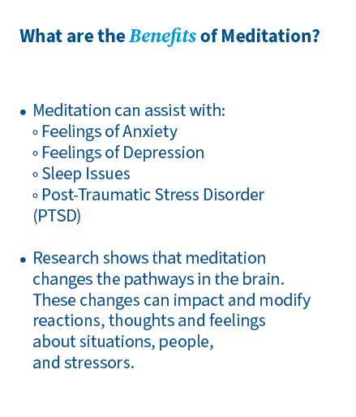
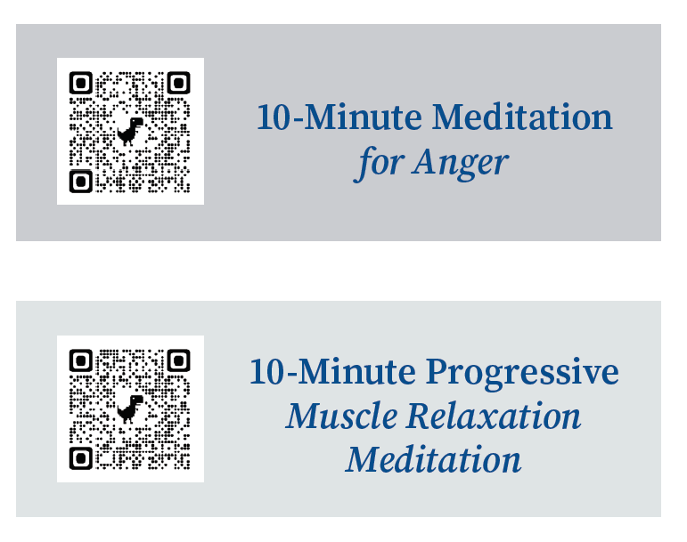
https://youtu.be/wkse4PPxkk4?si=iP-Xm5euNUZ6JVJK
https://youtu.be/2IJUD-e14FY?si=tuBVZgO6bhIDoIWe

Slide 22
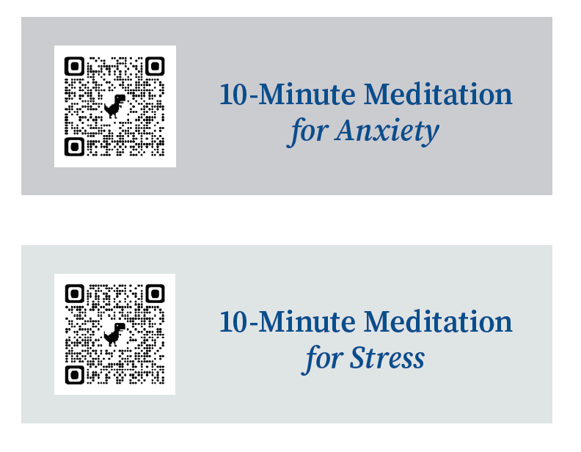
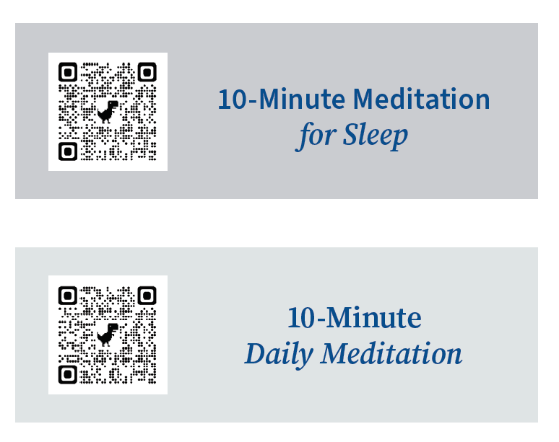
https://youtu.be/O-6f5wQXSu8?si=rOVzqZPTDVboSVc5
https://youtu.be/aEqlQvczMJQ?si=9y8DOb_QRswDH4Zu
https://youtu.be/z6X5oEIg6Ak?si=u8dAaATp8dFb8eCW
https://youtu.be/aEqlQvczMJQ?si=G_MWh-VBRu6_4qkW

Slide 23

EXPERIENCING NATURE
Spending time in nature can help relieve stress and anxiety, improve your mood and boost feelings of happiness and well-being. If you’re able to, get back to nature to energize your mind and body. Research has shown spending 120 minutes a week in nature improves health and well-being.
For example, sitting on a porch or park bench, stepping outside the bus and doing breathing exercises, enjoying a swing at the park are ideas that you can do during the day or after work to improve your mental health.

Slide 24

MENTAL HEALTHCARE
The month of May is dedicated to mental health awareness, but it is an important piece of our well being year-round. Often, the symptoms of mental health can be “invisible” to the world around you — or even to yourself. So, it’s important to acknowledge when you’re feeling your mental health taking a hit. Lifestyle changes, medications, support groups and other therapies can help you feel at your best. Taking care of your mental health can improve your overall happiness, your well-being, give you a positive image, improve relationships, minimize brain fog, and improve your physical health.

Slide 25
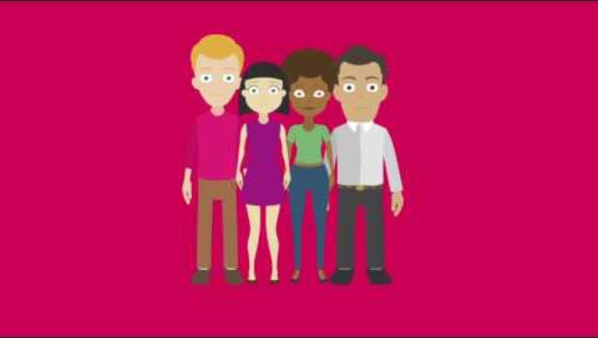
What is mental health?

Slide 26

Mental Wellness isn’t a suggestion….. it’s a necessity.

Slide 27
REDUCING STRESS: HANDLING CRuCiAL CONVERSATIONS
Techniques for having difficult conversations and achieving a positive resolution.

Slide 28

CRUCIAL CONVERSATIONS
Tools for Talking When the Stakes are High
Notes:
Patterson, Grenny, McMillan and Switzler are four gentlemen that came together based on some research that was initially done by Patterson for doctorate research and some of their personal experiences.
So, Kerry Patterson, Joseph Grenny, Ron McMillan and Al Switzler decided to research people and organizations to see who had master crucial conversations – who could get things done at work, home and in the community and at the same time build relationships. For 25 years they research 20,000 people and 100’s of organizations.
Kerry Patterson – began his research at Stanford Univ. during his doctoral work. He has used Crucial Conversations with hundreds of Fortune 500 companies including: Ford Motor Co; Allstate; Intermountain Health Care.
Joseph Grenny cofounded the California Computer Corp; and Unitus – a nonprofit organizations that helps 3rd world countries achieve economic independence.
Ron McMillan holds advanced degrees in sociology and organizational behavior. He cofounded the Covey Leadership Center and was VP for research and development for seven years. He has taught teamwork, personal vitality and leadership to unions, first level managers to CEO’s and his clients include Saturn Div. of GM; Procter and Gamble, Disney, Aetna, Nike and Lennox.

Slide 29
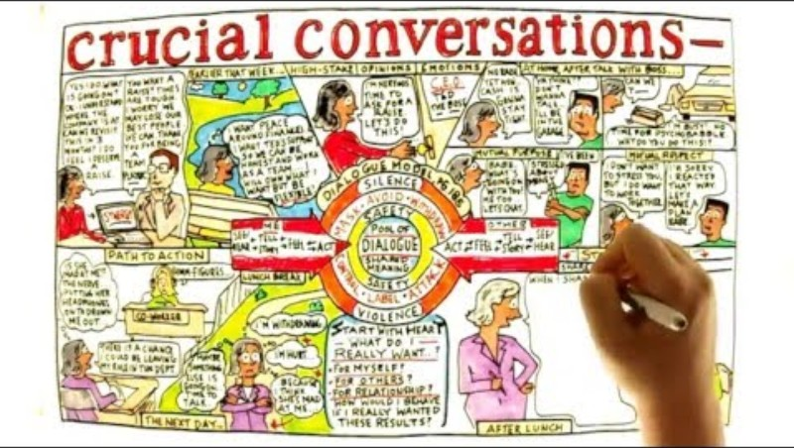
The power of effective communication during difficult conversations
Notes:
Patterson, Grenny, McMillan and Switzler are four gentlemen that came together based on some research that was initially done by Patterson for doctorate research and some of their personal experiences.
So, Kerry Patterson, Joseph Grenny, Ron McMillan and Al Switzler decided to research people and organizations to see who had master crucial conversations – who could get things done at work, home and in the community and at the same time build relationships. For 25 years they research 20,000 people and 100’s of organizations.
Kerry Patterson – began his research at Stanford Univ. during his doctoral work. He has used Crucial Conversations with hundreds of Fortune 500 companies including: Ford Motor Co; Allstate; Intermountain Health Care.
Joseph Grenny cofounded the California Computer Corp; and Unitus – a nonprofit organizations that helps 3rd world countries achieve economic independence.
Ron McMillan holds advanced degrees in sociology and organizational behavior. He cofounded the Covey Leadership Center and was VP for research and development for seven years. He has taught teamwork, personal vitality and leadership to unions, first level managers to CEO’s and his clients include Saturn Div. of GM; Procter and Gamble, Disney, Aetna, Nike and Lennox.

Slide 30

The three ingredients of crucial conversations
What makes a conversation crucial?
Opposing Opinions, Strong Emotions and High Stakes
1. Two things happen when the conversation turns crucial:
  The stakes rise – permanently changes perceptions of each other and the relationship we have with other people in the conversation.
  We behave like animals.
2. It is natural to look outwardly when things get crucial – we focus on the other person instead of ourselves.
3. Learn to focus on yourself – it is the only person you can change
Notes:
What makes a conversations crucial? Opposing Opinions, Strong Emotions and High Stakes
Two things happen when the conversation turns crucial:
The stakes rise – permanently changes perceptions of each other and the relationship we have with other people in the conversation.
We behave like animals.
It is natural to look outwardly when things get crucial – we focus on the other person instead of ourselves.
Learn to focus on yourself – it is the only person you can change

Slide 31
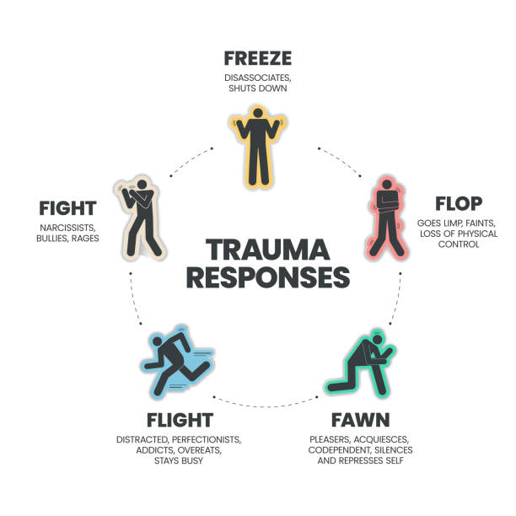
How do we usually handle
Crucial Conversations?
  Avoid them
  Face them and handle them poorly
  Face them and handle them well
When conversations move from casual to crucial, we’re usually at our worst.
Our bodies experience a fight, flight or freeze response
  Adrenaline
  Blood diverts from the brain to the extremities
Notes:
Student Handout-p5: Continues to next slide

Slide 32

Heated discussions
People in heated discussions fall into three (3) categories:
  Those who digress into threats and name calling
  Those who revert to silent fuming
  Those who speak openly, honestly, and effectively

Slide 33
We are not designed to handle crucial conversations And Here’s Why.
We are under pressure.
  Most often spontaneous, so you’re caught by surprise.
We are stumped.
  We haven’t had communication training. We didn’t have a good role model who communicated well, so we make it up as we go along.
  Communication is a skill and needs to be practiced.
We act in self-defeating ways.
  We’re doped-up by chemicals released in the body and dumbed-down from our brains moving away from the cognitive part of our brain and moves to the emotional part. Our emotions are strong.
  We NAG and complain, pushing people away.

Slide 34
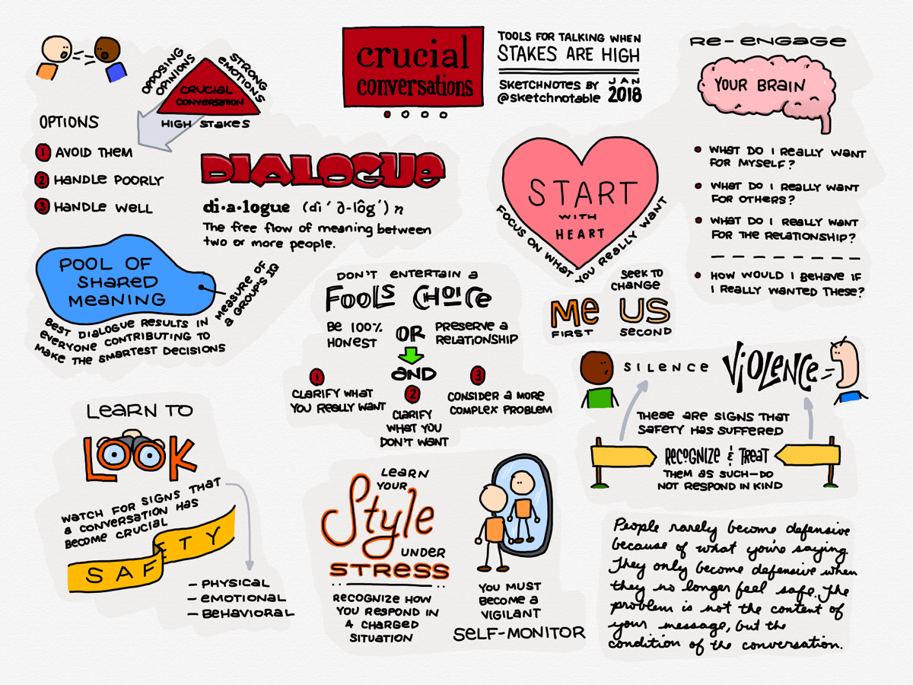
The seven principles to master crucial conversations
  Start with Heart. It’s easy to give in to our emotional impulses and make poor choices in the heat of the moment. Know and focus on what you truly want. Have the right focus.
  Stay in Dialogue. When emotions run high, it's easy to slip into silence or violence. Become aware of non-verbal conversation cues (including your personal cues) that suggest a dialogue is breaking down, so you can bring it back on track.
  Make it Safe . Once you see signs that you or others feel unsafe, the best approach is to step out of the current conversation, restore safety, then resume the dialogue. To make people feel safe with you, they need to know you care about their concerns (mutual purpose), and you care about them(mutual respect).
  Master Your Stories. Don’t get hooked by emotion; Circumstances may trigger different responses in different people.
  State Your Path. Now that you have your emotions in check, you need to master the art of sharing your views persuasively.
  Explore Others’ Paths. Besides managing our own emotions, we must help others to retrace their path.
  Move to Action. Finally, we must convert the agreement into results, through specific decisions and follow up.

Slide 35
What is success to you?
Prioritize YOU.
Eliminate who you are not, first.
Eliminating “stuff” to reduce our stress and live our best lives
  Negative people
  Negative habits
  Unhealthy things

Slide 36
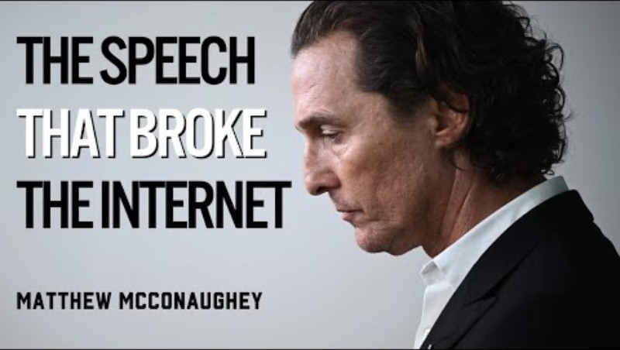

Slide 37
Interested in having better communication?
See the resources on the next few slides.

Slide 38
Resources for drivers
Disclaimer: The contents of this presentation were developed by the Department of Education and Workforce and Department of Public Safety. However, the contents do not necessarily represent the policy of the Department of Education and Workforce or Department of Public Safety, and you should not assume that any materials or resources are endorsed by the Department of Education and Workforce or the Department of Public Safety. The information shared in this presentation is intended to assist school transportation drivers in addressing personal well-being and should not be construed as mental health advice or treatment. Transportation employees are strongly encouraged to contact their human resources professional with any questions or concerns about personal wellness as it relates to job performance.
Sources for this presentation include the following: American Heart Association; Healthcare Today; Psychology Today; Cleveland Clinic .
Other resources you may consider through your medical insurance provider; or your Employee Assistance Program (EAP).
Please visit: Crucial Conversations from Crucial Learning to download the course overview. Crucial Conversations may be purchased on several outlets online, audiobooks, Kindle, and by hard copy.

Slide 39
Resources for drivers
Ohio Department of Mental Health and Addiction Services -Suicide and crisis lifeline support.
Welcome to Ohio School Safety Center - The Center is responsible for assisting local schools and law enforcement with preventing, preparing for, and responding to threats and acts of violence, including self-harm, through a holistic, solutions-based approach to improving school safety. The OSSC provides regional supports, training, technical assistance with violence prevention and grants, and a statewide anonymous reporting system. To find out more, view the OSSC website.
Trauma-Informed, Resilience-Oriented Schools Toolkit - National Center for School Safety- The Trauma-Informed, Resilience-Oriented (TR) Schools Toolkit outlines a framework for implementing trauma-informed, resilience-oriented approaches in any school or school district. The primary audience for this toolkit includes school administrators, school board members, teachers, and student support staff, parents and families, and community partners.
Home | OSWI- The Department of Education and Workforce's Mental Health and Trauma Training Library contains training videos from Department led conferences and webinars to help support the ongoing education of school staff on various topics such as: Trauma Sensitive Schools, Classroom Strategies for Supporting Students, School Wellness, Safety and more. ​Access the library

Slide 40
Resources for drivers
Military and First Responders Center — Pegasus Farm - Pegasus Farm serves over 500 individuals annually. These individuals may face emotional, behavioral, cognitive, developmental or physical challenges or a combination of these conditions.
LOSS Community Services – Grief Support for Survivors of Suicide Loss- LOSS provides support for people coping with the shock, grief, and complex emotions that often accompany the loss of a loved one to suicide. We want you to know you are not alone and that we care. LOSS offers many different events and support groups, both virtually and in our offices.
Narcotics Anonymous - NA meetings are run by and for addicts. If you're looking for help for a loved one, you can contact Narcotics Anonymous near you.
26 Best Drug Rehabs in Ohio (2025)i- Search Ohio addiction treatment centers including 766 outpatient rehabs, 324 inpatient rehabs and 301 detox clinics. We'll also answer common drug rehab FAQs including how much addiction treatment costs, substance abuse statistics, and important drug laws.s
Have a problem with alcohol? There is a solution. | Alcoholics Anonymous - Alcoholics Anonymous is a fellowship of people who come together to solve their drinking problem. It doesn’t cost anything to attend A.A. meetings. There are no age or education requirements to participate. Membership is open to anyone who wants to do something about their drinking problem.
f recovery is built on the simple foundation of one alcoholic sharing with another. If your drinking is out of

