Slide 3
This presentation contains examples and resource materials that are provided for the user’s convenience. The inclusion of any material is not intended to reflect its importance, nor is it intended to endorse any views expressed, or products or services. These materials may contain the views and recommendations of the presenter as well as hypertext links, contact addresses and websites to information created and maintained by other public and private organizations. The opinions expressed in any of these materials do not necessarily reflect the positions or policies of the U.S. Department of Education or Ohio Department of Education and Workforce. The U.S. Department of Education and Ohio Department of Education and Workforce do not control or guarantee the accuracy, relevance, timeliness, or completeness of any outside information included in these materials. Mentions of specific programs or products in these examples are designed to provide clearer understanding and are not meant as endorsements.

Slide 4

Leading Systemic change
Focus is a Prerequisite for Improvement
Daryl
Michel
Ph.D.
Educator, Author, Consultant
daryl.michel5@gmail.com
X: @DarylAMichel
LinkedIn: darylamichel

Slide 5
Session objectives
Explore nine characteristics of high-performing schools
Understand the role(s) of an instructional leader and leading complex change
Learn about and know the four-phases of the Collaborative Problem-Solving Process
See an example of a sustained professional learning plan that is focused on a priority/focus

Slide 6
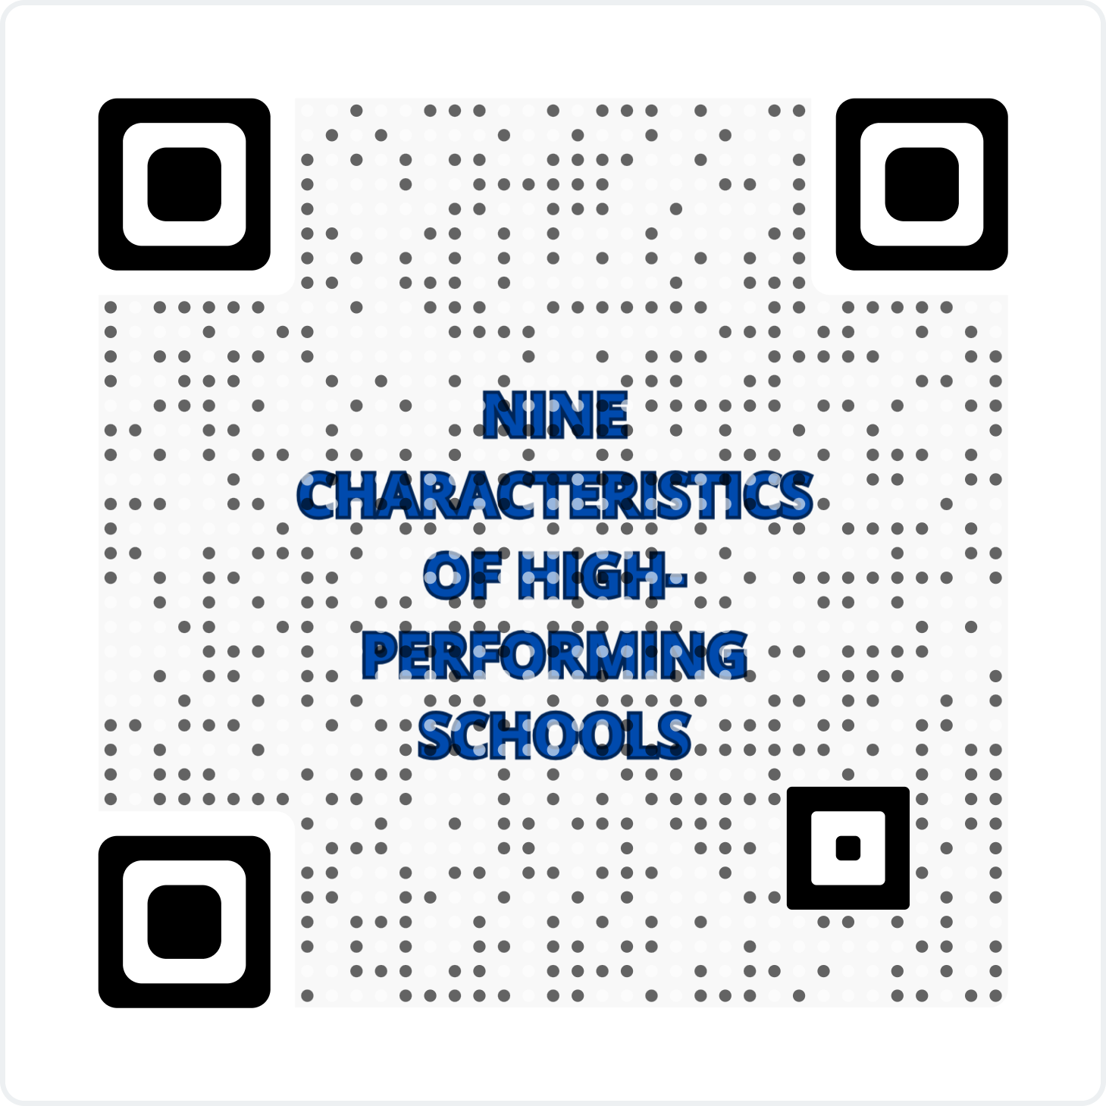
Nine Characteristics of High-Performing Schools: Focus for today’s presentation
Clear and Shared Vision and Purpose
High Standards and Expectations for All Students
Effective Instructional and Administrative Leadership
High levels of Teamwork and Staff Collaboration
Aligned Curriculum and Instruction with Standards and Assessments
Closely Monitored Teaching and Learning
Focused Professional Development of High Need Areas
Supportive Learning Environment
A High Level of Community Involvement
Anderson, 2025; Ash, 2021; Goeas, 2017; Knuckles, 2024; Shannon & Bylsma, 2007
Notes:
https://files.eric.ed.gov/fulltext/ED499819.pdf

Slide 7
Clear and Shared Vision and Purpose
What is your school/district/organization shared vision/focus?
  Who took part in this decision?
  What is it based on?
How, if at all, has this vision been communicated to all stakeholder groups?
How, if at all, does this vision create a consistent direction for all stakeholder groups?
“While focus alone is not a sufficient strategy for school improvement, focus is a prerequisite for improvement” (Reeves, 2011, p. 4).

Slide 8
High Standards and Expectations for All Students
Do all educators and administrators believe that all students can achieve high standards? What is your evidence? What if they don’t?
  Deficit thinking
  Asset-based approach
  Appreciative inquiry

Slide 9
“Effective leaders advocate, nurture, and sustain a school culture and instructional program conducive to student learning and staff professional growth.”
Leaders vs. Managers
Leadership
Management
  Transformational
  People oriented: influence and motivate others to contribute to the organization's success
  Listen and empower – build capacity in others
  Emotional intelligence
  Lead change through innovation
  Disrupt status quo
  Transactional
  Task oriented: control a group of individuals to achieve goals
  Instruct people
  Cognitive intelligence
  Planning and organizing resources to manage tasks and deliver results
  Status quo

Slide 10
High levels of Teamwork and Staff Collaboration
One way to plan for sustained learning is through a professional learning community (PLC). The concept of a PLC has been around for decades (Hord, 1997; Leithwood, Leonard, & Sharratt, 1997) and, more recently, Hattie (2023) said:
A PLC needs to relate to the evidence of impact on the students from professional learning….they are more effective when problematic beliefs are challenged, when there is testing of the efficacy of competing ideas, when high expectations for all are developed, and when discussions are grounded in artifacts representing growth and challenges in student learning. (p. 235)

Slide 11
High levels of Teamwork and Staff Collaboration
“A PLC is a larger organization and not the individual teams that comprise it. While collaborative teams are an essential part of the PLC process, the sum is greater than the individual parts….we believe it is helpful to think of the school or district as the PLC and the various collaborative teams as the building blocks of the PLC….The PLC process is much more than a meeting….the process requires people to act on the new information.”
DuFour et al., 2016, p. 10

Slide 12
Aligned Curriculum and Instruction with Standards and Assessments
Evidence-based curriculum and instructional practices
  Are curriculum and instructional practices evidence-based?
  Are curriculum and instructional practices aligned to enhance student learning?
Evidence-based assessments
  Be evidence-informed, not numbed by the numbers. Decide what you need and use it judiciously. (Hargreaves & Fullan, 2012)

Slide 13
Closely Monitored Teaching and Learning
Who monitors teaching (e.g., certified and non-certified staff)? What are their qualifications (e.g., took part in the professional development, certified evaluators)?
Principals who spend additional time coaching teachers and/or help to develop the educational program see greater achievement in student scores. “Time on classroom observations [walkthroughs] is more negatively associated with student achievement gains when not used for professional development.”
Grissom, Loeb, & Master, 2013, p. 438

Slide 14
Focused Professional Development of High Need Areas
Professional Development
Professional Learning
Online webinar
College/university course
Conference session
Specialized training
Formal education
Reading and discussing professional literature
Analyzing data with colleagues
Collaboratively Planning Curriculum
Hargreaves & O’Connor, 2018b, Boston Consulting Group Study, 2014

Slide 15
“A one-day professional development session rarely results in sustained improvement.” Joyce & Calhoun, 2010; Hasbrouck & Michel, 2022
Learning about and implementing a new skill or strategy requires (Joyce and Showers, 1982):
20-30 hours of additional study about the skill or strategy,
15-20 demonstrations or more to observe the skill or strategy being taught with diverse learner populations, and
10-15 times to practice the new skill or strategy with colleagues or small groups.
Element | Effects on knowledge | Effects on short-term use | Effects on long-term use
Study of rationale | Very positive | 5%-10% | 5%-10%
Rationale plus demonstrations | Very positive | 5%-20% | 5%-10%
Rational plus demonstrations and planning | Very positive | 80%-90% | 5%-10%
Above elements and peer coaching | Very positive | 90%+ | 90%+
Joyce and Calhoun (2010)

Slide 16
“Even if teachers have both the why and the what, a radical shift in practice can be challenging. Many teachers will also need the how: ongoing support in adapting a curriculum to the needs of their students and delivering it effectively, from someone who understands it well [not necessarily an instructional coach or coaching dosage].”
Wexler, 2023

Slide 17
GUSKEY'S MODEL OF TEACHER CHANGE, 2002, p. 383
Change in
teachers’ classroom
practices
Change in
student
learning outcomes
Change in
teachers’ beliefs and attitudes
Professional Development

Slide 18
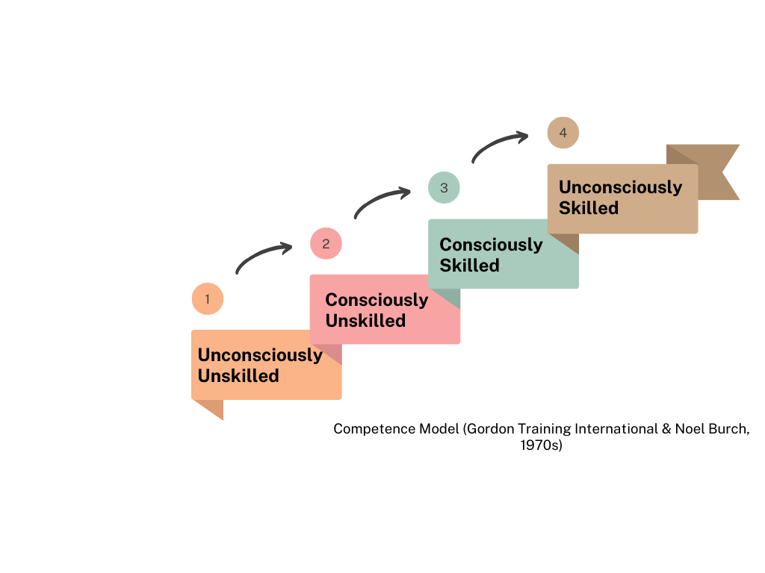
Individuals have developed a high level of competence and can perform the skill and apply the knowledge without concentrating. They can perform it with automaticity.
Individuals are aware of their lack of knowledge or skill for a specific area.
Individuals aren’t aware of their lack of knowledge or skill level for a specific skill.
Individuals have developed the knowledge and skills, but they need to concentrate to perform them.
Adams, 2011

Slide 19
Supportive Learning Environment
Positive Experiences | Negative Experiences
Which items from your two lists are evident in your daily work?

Slide 20
A High Level of Community Involvement
In what way(s), if at all, are all stakeholder groups involved in decision-making?
How, if at all, are all stakeholder groups involved in learning (e.g., your focus)?

Slide 21
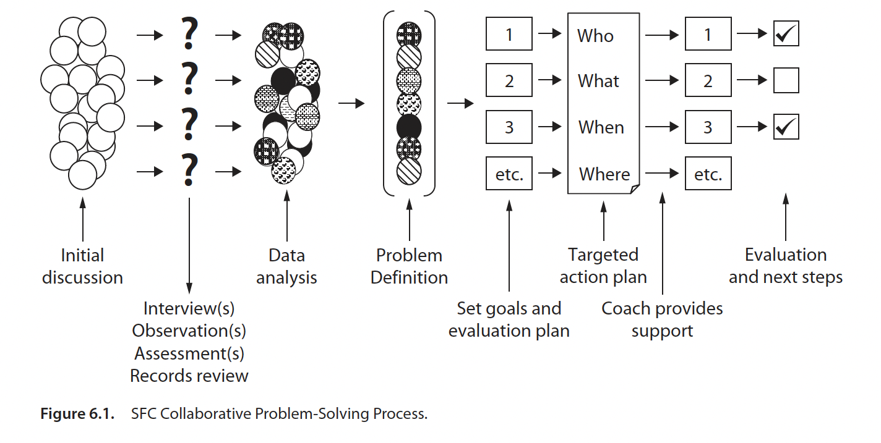
the Collaborative problem-solving process: a way to connect with the characteristics
Hasbrouck & Michel, 2022

Slide 22
Focus: General academic vocabulary
Set standards and expectations
Stay focused on learning and professional growth; build capacity in others
Determine how PLCs could be ongoing learning opportunities
Spend time analyzing the alignment between/among curriculum, instruction, and/or assessment
Monitor teaching and learning and provide feedback
Schedule sustained professional learning for all stakeholder groups

Slide 23
Focus: General academic vocabulary
Learn together
  Expressive and Receptive Vocabulary
  General-academic (e.g., analyze) versus Content-specific Vocabulary (e.g., igneous)
  Word features (e.g., semantic—meaning, phonological—pronunciation, or orthographic—spelling)
  Words to Teach (Tier 1, Tier 2, Tier 3)
  Explicit Vocabulary Instruction/Routine
  Vocabulary Connections to Comprehension and Writing

Slide 24
Change is often Complex!
Complicated
Complex
Tend to be technical in nature and can be solved through processes, procedures, and systems in a step-by-step way.
Can’t be solved through computation because there are too many variables and interrelated factors that cannot be represented through rules or processes.
Not predictable and require innovative responses
“Transforming education requires a new focus on collective leadership that empowers educators to lead complex change.” -Michel & Brookhart, In press

