Slide 1
Literacy academy 2025

Slide 2
From Foundations to Futures:
Accelerating Adolescent Literacy
Mitchell Brookins, Ph.D.
June 2025

Slide 3
College and Career Readiness
“The level of preparation students need in order to be ready to enroll and succeed without remediation in credit-bearing entry-level coursework at a two- or four-year institution, trade school, or technical school.”
(ACT Inc., 2006)

Slide 4
An educational initiative has a typical lifespan of 18-48 months.
(Borman et al., 2003; Lathan, 1988)

Slide 5
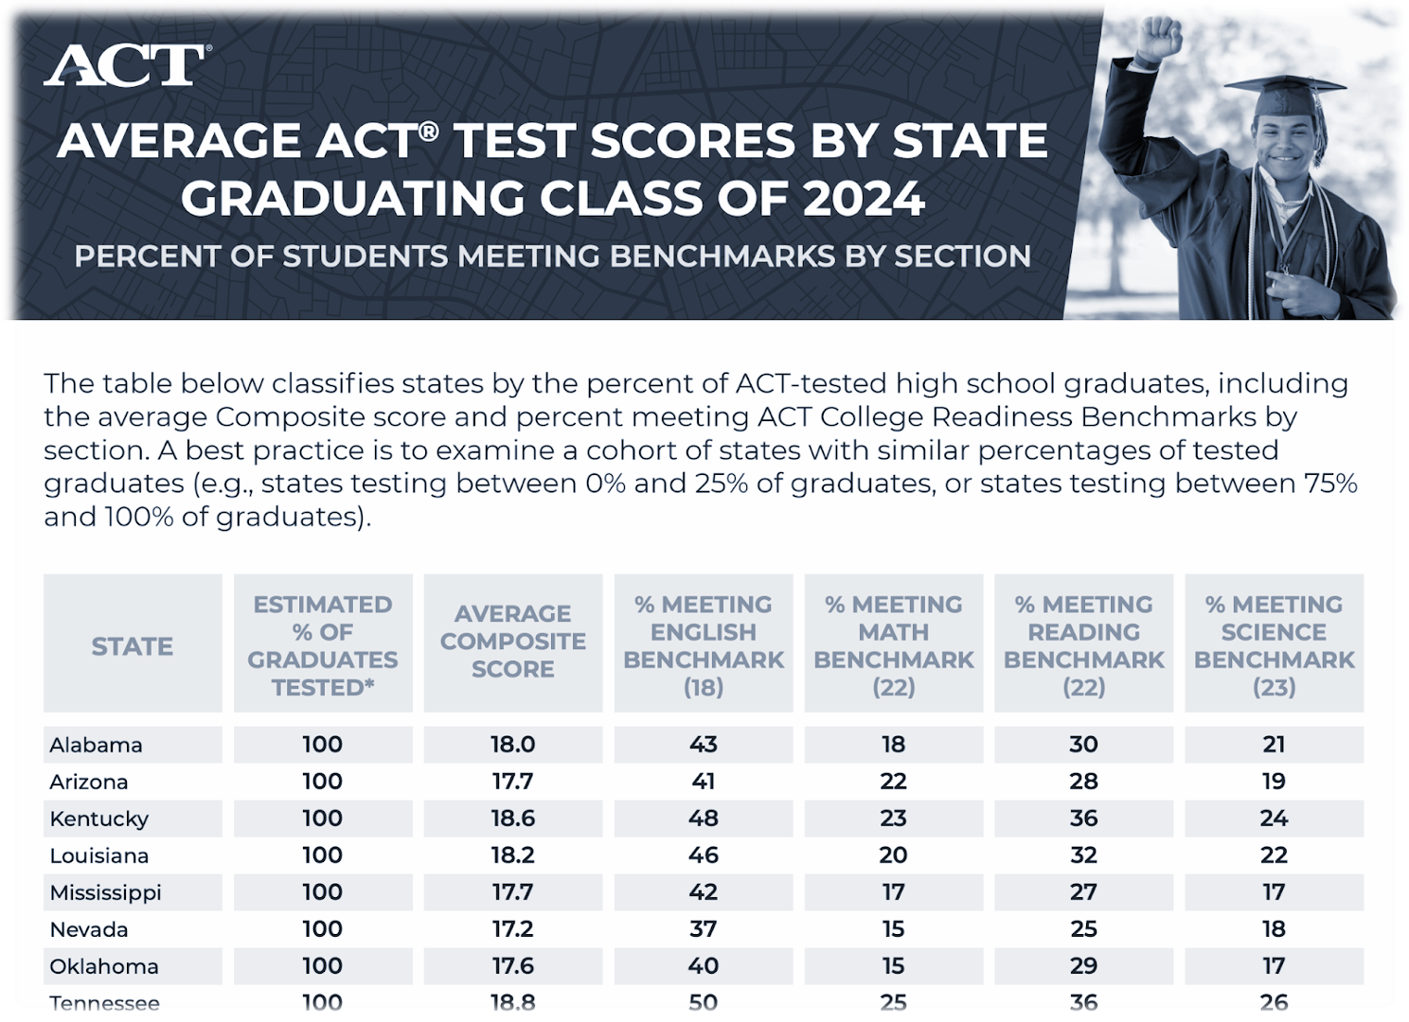
(ACT Inc., 2024)
51
40
PERCENT
PERCENT
Notes:
https://www.act.org/content/dam/act/unsecured/documents/2024-Average-ACT-Scores-by-State-Percent-Meeting-Benchmarks.pdf

Slide 6
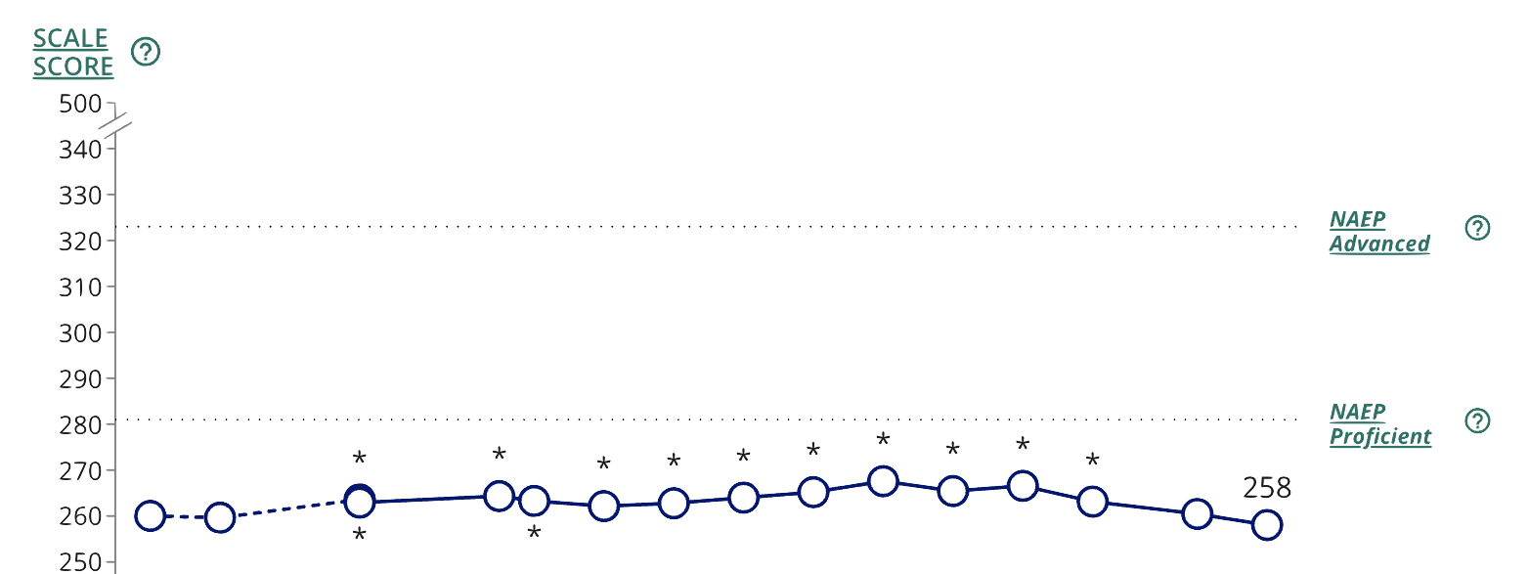
2024 8th Grade NAEP Item Map
Recognize
Simple
Inference
Recognize Important
Paragraphs
Recognize
Explicitly Stated
Reasons
Choose
Main Purpose
(IES, 1992-2024)
Notes:
SOURCE: U.S. Department of Education, Institute of Education Sciences, National Center for Education Statistics, National Assessment of Educational Progress (NAEP), various years, 1992–2022 Reading Assessments.
https://www.nationsreportcard.gov/reading/?grade=8
item map
https://www.nationsreportcard.gov/itemmaps/?subj=RED&grade=8&year=2022&jurisdiction=NT&variable=SDRACE

Slide 7
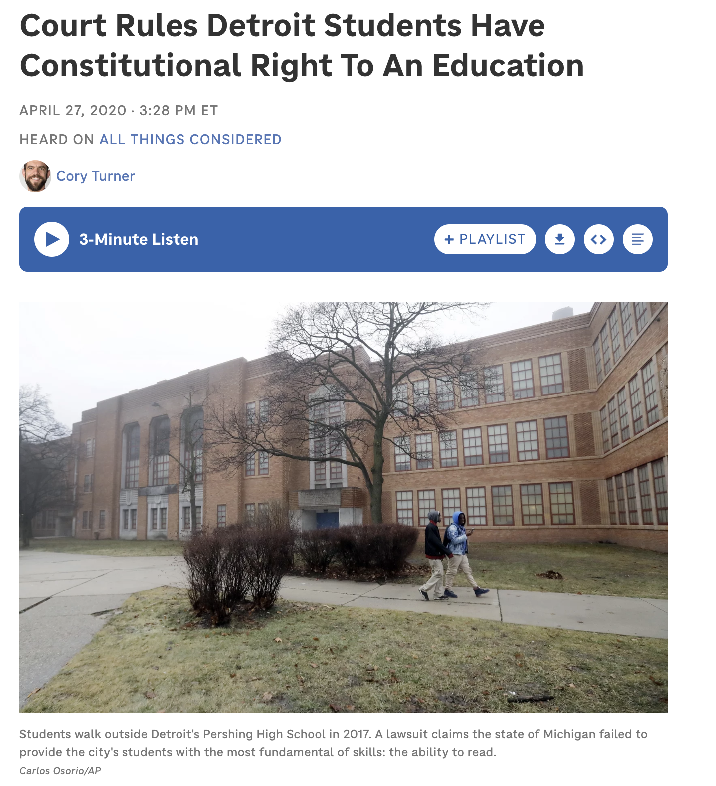
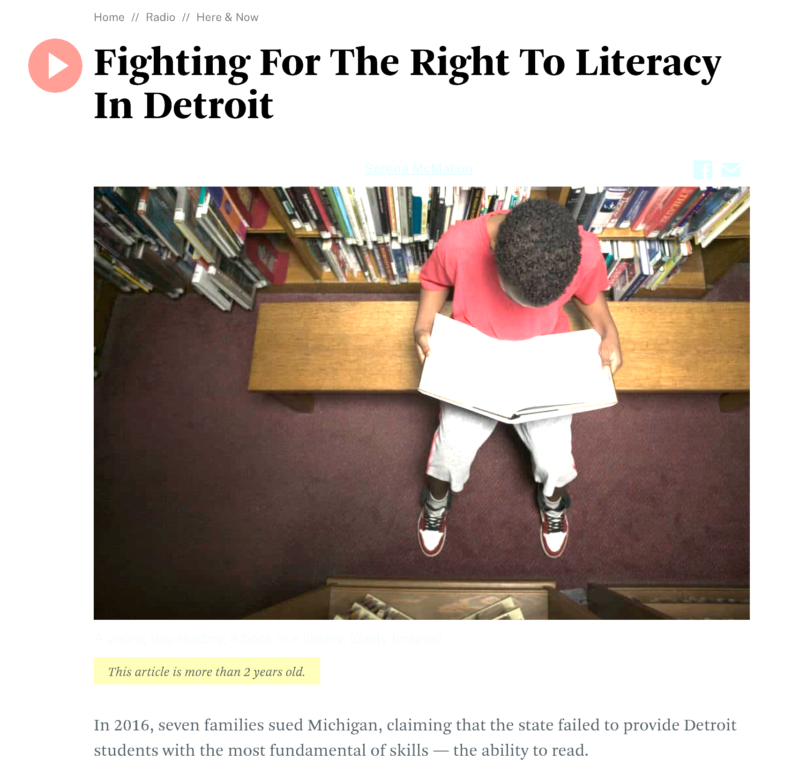
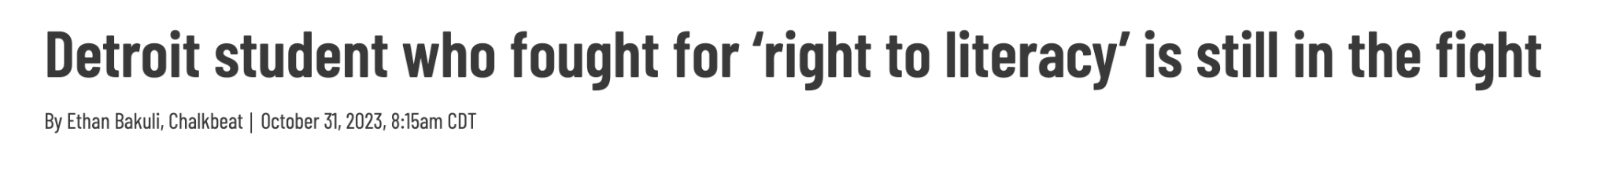
Articles
Notes:
https://www.chalkbeat.org/detroit/2023/7/7/23787399/detroit-public-schools-right-to-read-settlement-whitmer-emergency-management/
-50 to a class
-rodents
- no textbooks
-LOW TEST SCORES
-INEFFECTIVE TEACEHRS
2016
$96M

Slide 8
“There comes a point where we need to stop just pulling people out of the river. We need to go upstream and find out why they’re falling in.”

Slide 9
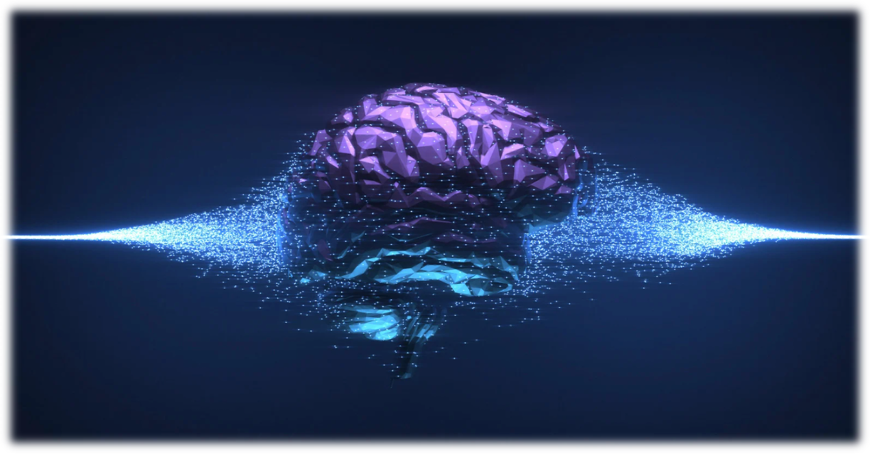
Picture slide
Notes:
HEADLINE:

Slide 10


MULTICOMPONENT INTERVENTIONS ARE CRITICAL
(Kim et al., 2017; Scammacca et al., 2007; Vaughn et al., 2019)
Vocabulary
(.15 to .46)
Fluency
(.37 to .65)
Writing about Reading
(.40 to .65)
Process Writing
(.82 to 1.2)
Strategies
(.30 -1.72)
(Elleman et al., 2009; Graham & Hebert, 2010; National Reading Panel, 2000; Peng et al., 2024;Scammacca et al., 2007; Wanzek et al., 2013)

Slide 11
(Elleman et al., 2009; Graham & Hebert, 2010; National Reading Panel, 2000; Peng et al., 2024;Scammacca et al., 2007; Wanzek et al., 2013)
Writing about Reading
(.40 to .65)
Fluency
(.37 to .65)
Vocabulary
(.15 to .46)
Strategies
(.30 -1.72)
Process Writing
(.82 to 1.2)

Slide 12
The early predictors of later word reading accuracy were phonological skills; the skills that predicted later reading comprehension were those that aid the construction of a coherent and integrated representation of the meaning of a text—inference and integration, comprehension monitoring, and knowledge and use of story structure.
(Cain & Oakhill, 2012, p. 116)

Slide 13
Cognitive Processes for Constructing Meaning
Macro Processes
“Comprehension is obviously a dynamic process that occurs moment by moment as the reader extracts and constructs meaning” (Hennessy, p. 30).
“What am I taking away?”
Elaborative
“The Reader’s Input”
Metacognitive
“What is this text saying?”
Integrative
“Connecting Sentences”
Microprocesses
“Lifting the words off the page”

Slide 14
Scaffolding Complex Text 1
Knowledge
Revelant, Funds of Knowledge
Vocabulary
Text Critical Words
Syntax
Language Structures
Text Structure
Organizational Patterns
Writer’s Craft
Techniques to Convey Meaning

Slide 15
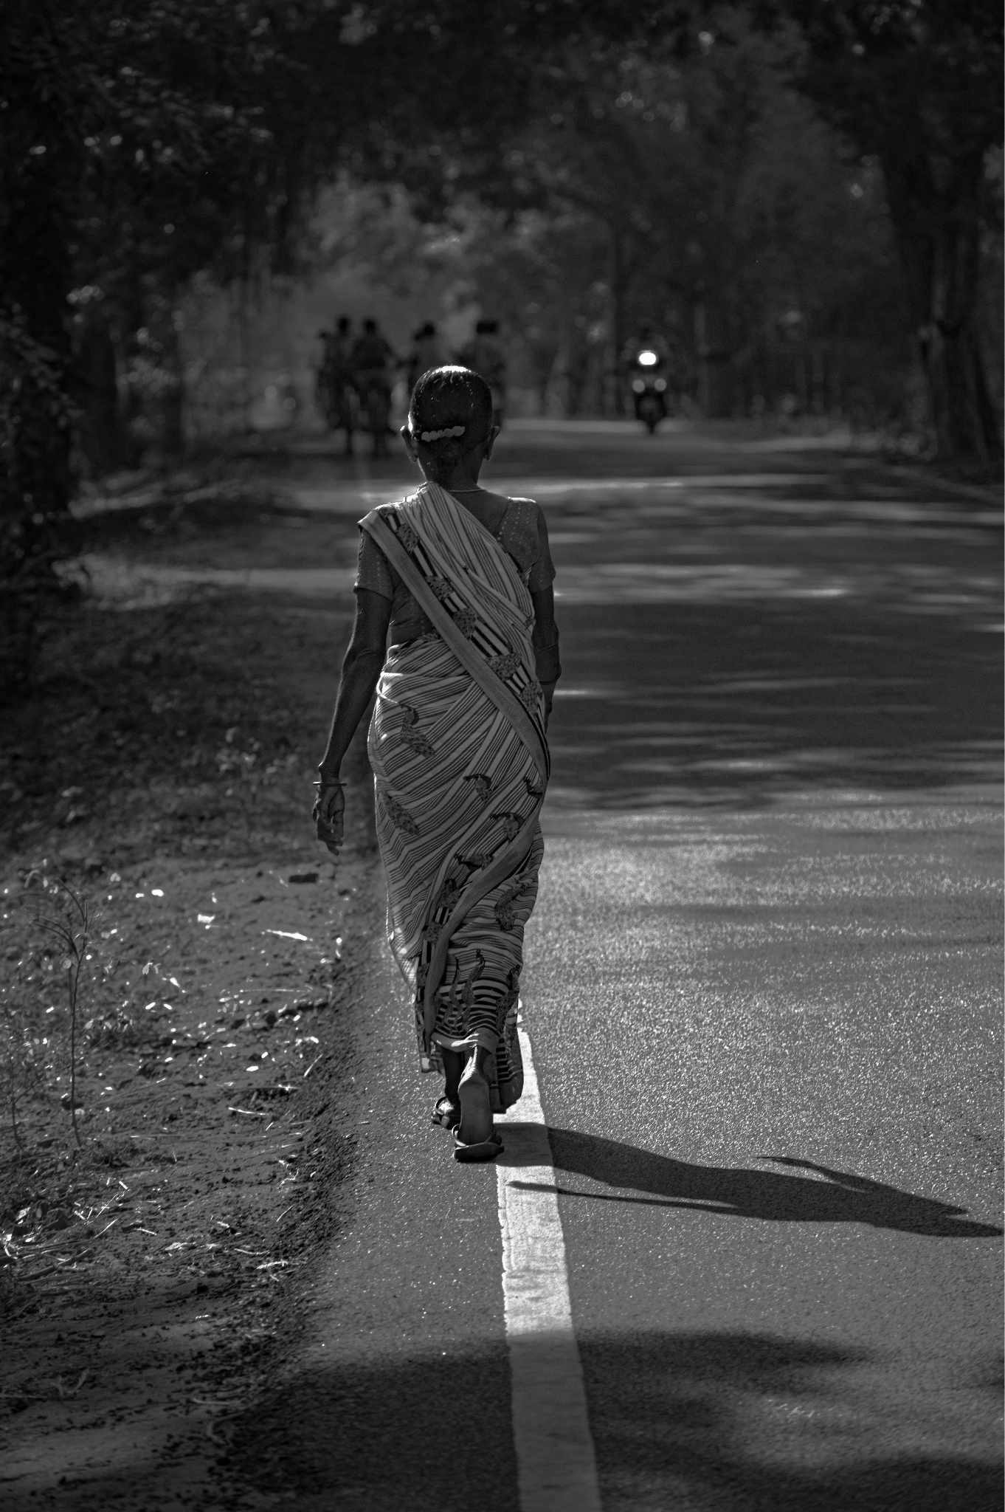
Her Story
by
Padma Venkatraman slide 15

Slide 16

Which aspect of text complexity do you think would be a challenge for your students?
Vocabulary
B. Sentence Structure
C. Conceptual Understanding
D. Density of Information
Teacher PROs

Slide 17

Text Selection
955-1155
770-980
Text Complexity Grade-Bands
450-790
K-1
(National Governors Association Center for Best Practices & Council of Chief State School Officers., 2010)

Slide 18

85 WCPM = 3rd BOY
132
Notes:
HEADLINE:

Slide 19
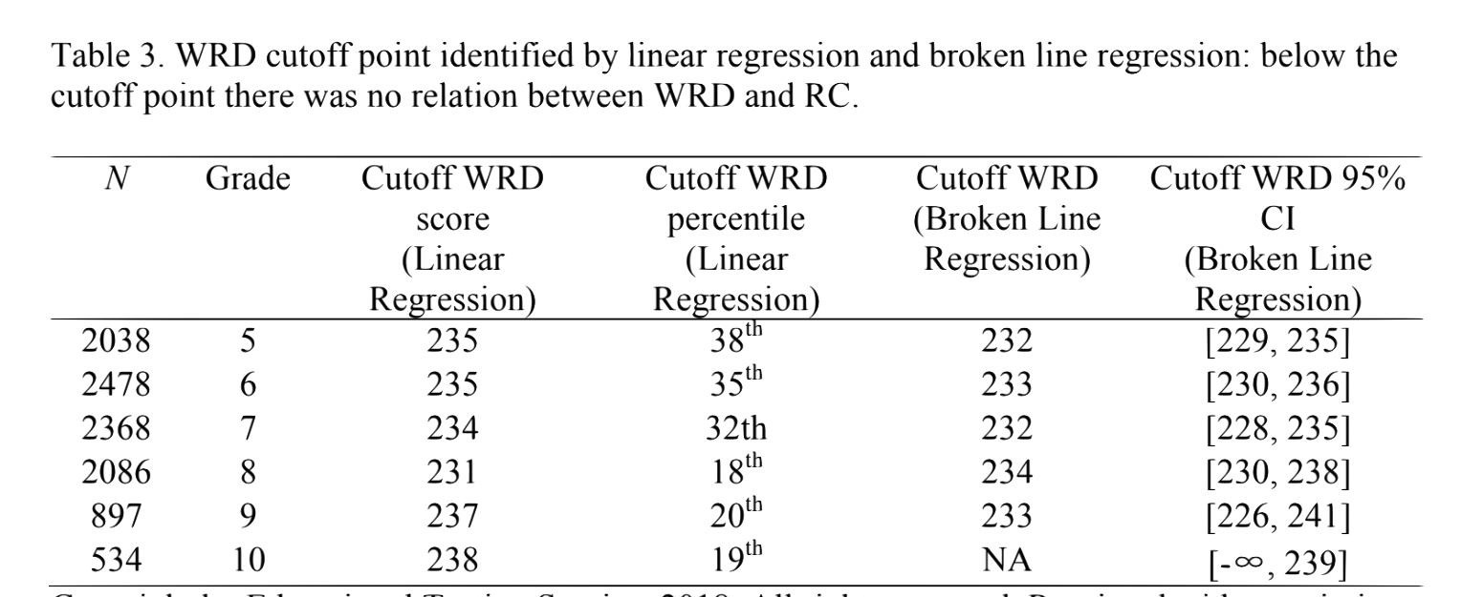
Decoding Threshold
(Wang et al., 2019)

Slide 20




How Do We Build Word Recognition?
Phonology
Decoding
Encoding
Fluency
interject
Hear it, say it, read it, spell it, and automate it!

Slide 21


Deconstruct It!
Division Rules
Morphophonemic Analysis
instinct
Vowels
Affixes & Roots
blends digraphs
vowel teams r-controlled
VCV
VC-CV
“to” + “to prick, pierce”
Teacher PROs

Slide 22
85 WCPM = 3rd BOY
(second slide)
132
Notes:
HEADLINE:

Slide 23

Repeated Reading
Choral Reading
Partner Reading
K-1
Echo Reading
Independent Reading

Slide 24

Her Story
Are there critical Tier 2 and 3 vocabulary words that illustrate the central idea?
Does the excerpt illuminate the central idea of the text?
Does the excerpt highlight multiple aspects of text difficulty?
Is there a kernel sentence with multiple clauses?

Slide 25
Selecting the VIP for Repeated Reading
A
B
C
We were already at our desks, and she gave me a half-wave as she slipped into the seat next to mine. I stared at my desk and pretended I hadn’t seen her hesitant hand. For years and years, I’d tried to blend in and be as American as I could be and here, suddenly, came this new girl, looking like my grandmother might have done when she was fresh off the boat. She was everything I was frightened to admit might be lurking inside me — personified standing outside me.
The school called an assembly and made this great big announcement that they would be starting a whole new anti-bullying training program at our school next year.
There were rumors that Jacques and his friends had waited for Vaishali after school one day. Things had escalated and turned violent. Who knows what they might have done?
Word traveled that Vaishali had the presence of mind to call 911 and Jacques and his buddies had been caught on a school security camera. We hadn’t seen any of them on campus since. He and his gang were facing suspension – maybe more.
Shadows are strange things. We nearly never notice them, although they’re always attached to our bodies. They creep along behind us, lurking in wait for those brief moments when, unexpectedly, the light shifts and they leap ahead of us, forcing us to acknowledge their existence.
K-1
K-1

Slide 26

Her Story Continued
Fluency Drill
Shadows are strange things. We nearly never notice them, although they’re always attached to our bodies. They creep along behind us, lurking in wait for those brief moments when, unexpectedly, the light shifts and they leap ahead of us, forcing us to acknowledge their existence.
Teacher Read Aloud
Echo Reading
Choral Reading
Partner Reading
Independent Reading

Slide 27
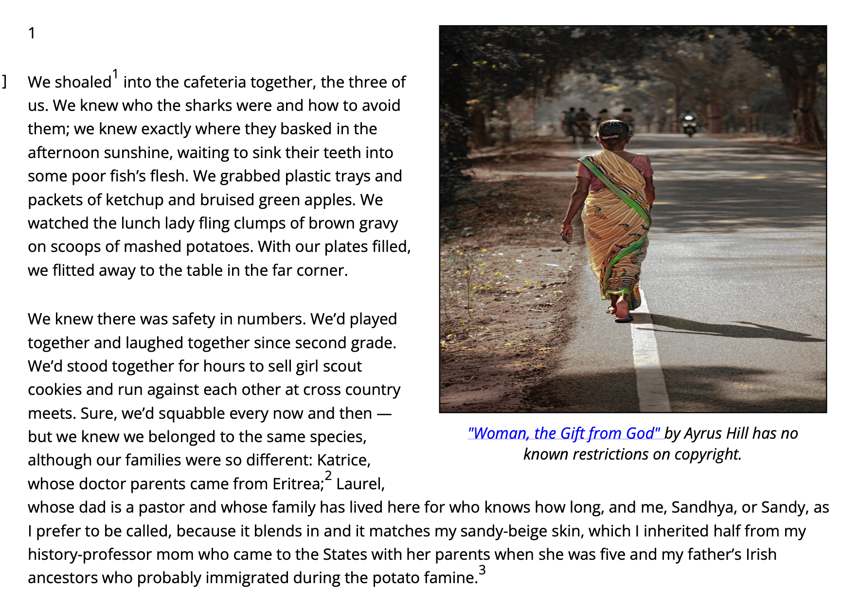
Apply It!
Division Rules
1
2
Critical Sentence
Repeated
Reading
Self-preservation is an instinct, as hard to suppress as a shark’s thirst for blood
What do you know about this word’s meaning?
How does that knowledge deepen your understanding of how the author illustrates self-preservation in this text?
3
Apply
the
Meaning
Teacher PROs

Slide 28
Assessment System 1
Diagnostic
What are the instructional needs in my building?
Screener
What’s the status of proficient readers in my building?
CBMs or Probes
How are students in my building responding to instruction?

Slide 29
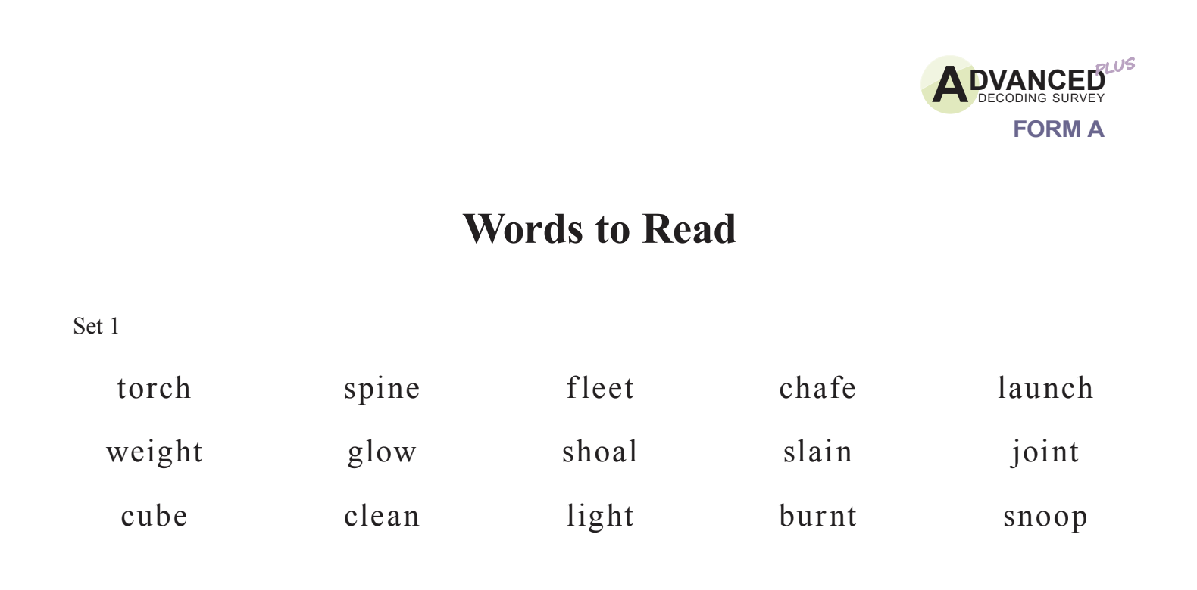
95% Advanced Decoding Survey Plus
ee
oa
ai
oi
(Wang et al., 2019)

Slide 30


questions
Revolution
Organism
Colonial
Ecosystem
Notes:
HEADLINE:

Slide 31
Scaffolding Complex Text 2
Knowledge
Revelant, Funds of Knowledge
Vocabulary
Text Critical Words
Syntax
Language Structures
Text Structure
Organizational Patterns
Writer’s Craft
Techniques to Convey Meaning

Slide 32
Words to Teach
Text Critical: words and phrases essential to students’ understanding of a particular text or excerpt.
Academic: “high-utility” words that can be used across disciplines and are likely to be encountered in other texts; often abstract, with multiple meanings
3
heretic
isotope
emerge
accessible
criteria
2
inconclusive
life
ideas
start
wide
people
1
think

Slide 33
Her Story
by
Padma Venkatraman slide 33

Slide 34



Introducing Words with Visual Images 1
homed in
A
B
“focused attention”

Slide 35


Introducing Words with Visual Images 2
lurking
A
B
“hiding”

Slide 36
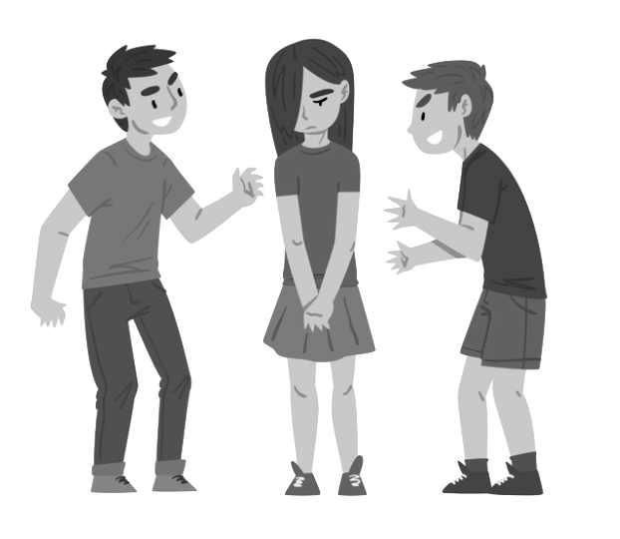
Her Story 1
By the end of her first week it was easy for us to pretend Vaishali didn’t exist. We might have forgotten about her altogether and not needed to pretend at all, if it hadn’t been for the way the sharks homed in on her.
We didn’t snigger when Marina called her Sasquatch, but we didn’t tell her to knock it off either. When Jacques, leader of the cool gang, walked past her table and threw a handful of bacon bits over her rice, we looked at each other and then looked away.
Self-preservation is an instinct, as hard to suppress as a shark’s thirst for blood.

Slide 37

Her Story 2
By the end of her first week it was easy for us to pretend Vaishali didn’t exist. We might have forgotten about her altogether and not needed to pretend at all, if it hadn’t been for the way the sharks homed in on her.
We didn’t snigger when Marina called her Sasquatch, but we didn’t tell her to knock it off either. When Jacques, leader of the cool gang, walked past her table and threw a handful of bacon bits over her rice, we looked at each other and then looked away.
Self-preservation is an instinct, as hard to suppress as a shark’s thirst for blood.

Slide 38

Her Story 3
Shadows are strange things. We nearly never notice them, although they’re always attached to our bodies. They creep along behind us, lurking in wait for those brief moments when, unexpectedly, the light shifts and they leap ahead of us, forcing us to acknowledge their existence.

Slide 39
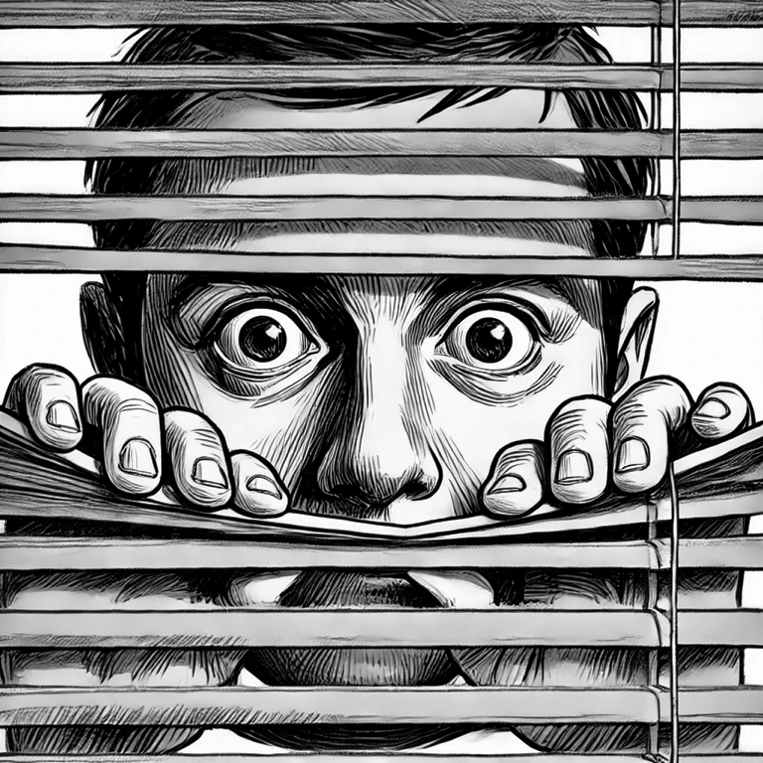

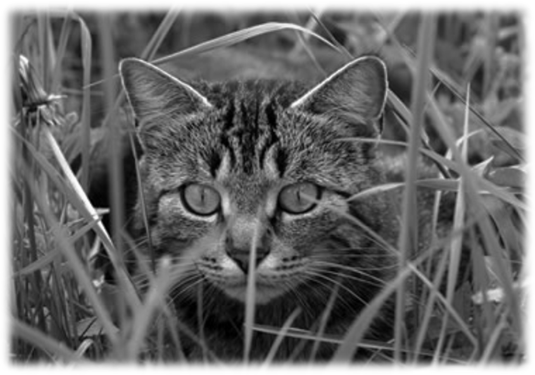
Which image would support students’ understanding of lurking?
B.
C.
A.
Teacher PROs

Slide 40
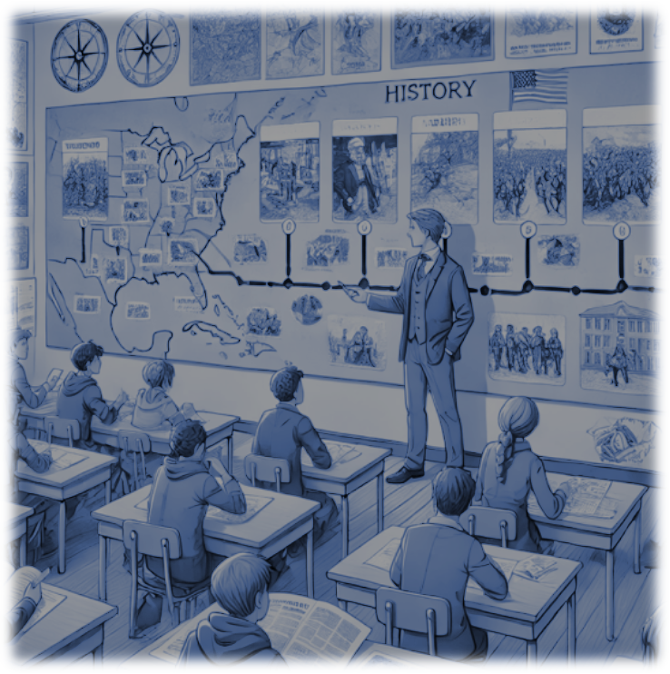
Dual Code Theory
“The more often you use two systems together, the stronger the trace in your memory and the better you will remember and thus will learn.”
(Clark & Paivio, 1991))
Notes:
HEADLINE:

Slide 41
Assessment System 2
Diagnostic
What are the instructional needs in my building?
Screener
What’s the status of proficient readers in my building?
CBMs or Probes
How are students in my building responding to instruction?

Slide 42
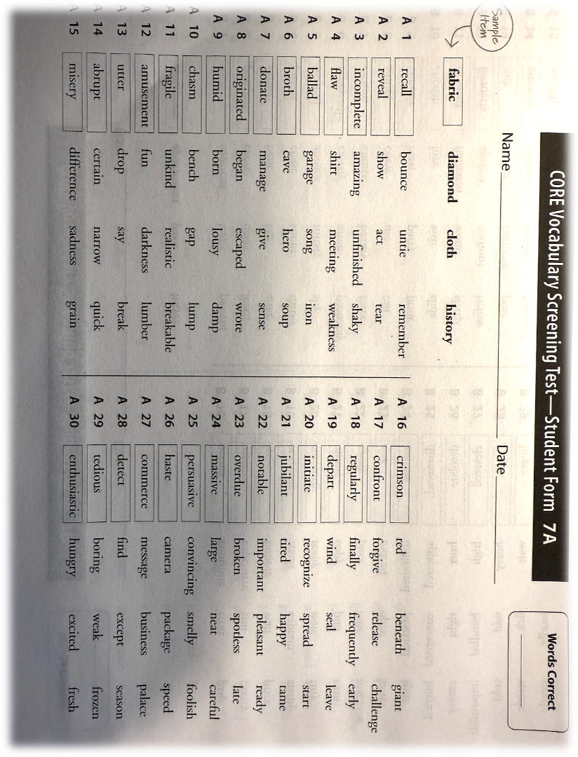
CORE Vocabulary Screening Test
(Clark & Paivio, 1991))
Notes:
HEADLINE:

Slide 43
Depth of Word Knowledge
Breadth + Depth = Lexical Quality
WORD
Semantics
Orthography
Syntax
Phonology
Morphology
Etymology
Teacher PROs

Slide 44
Scaffolding Complex Text 3
Knowledge
Revelant, Funds of Knowledge
Vocabulary
Text Critical Words
Syntax
Language Structures
Text Structure
Organizational Patterns
Writer’s Craft
Techniques to Convey Meaning

Slide 45
Cause Problem Solution Organizer 1
Cause | Problem | Solution/Resolve | End Emotion

Slide 46

Cause Problem Solution Organizer 2
Cause | Problem | Solution/Resolve
The bullies homed in and picked on her for being different. | The the three girls didn’t stop the bullies because their instinct was to protect themselves. | The memory of the treatment of Vaishali lurks in the girl’s mind
Quick Jot
Vocabulary

Slide 47


#dontunderstand
Notes:
HEADLINE:

Slide 48
Scaffolding Complex Text 4
Knowledge
Revelant, Funds of Knowledge
Vocabulary
Text Critical Words
Syntax
Language Structures
Text Structure
Organizational Patterns
Writer’s Craft
Techniques to Convey Meaning

Slide 49
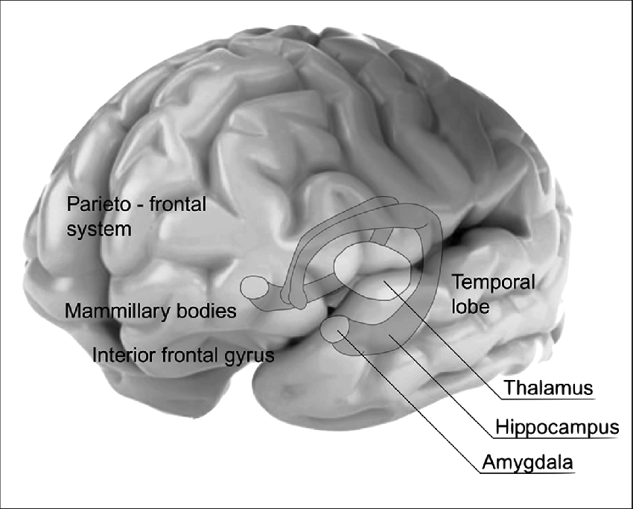
Background Knowledge Database
Short - Term Memory
Long-Term Memory
Memory Consolidation
(Brodziak et al., 2013; Hammond, 2014)

Slide 50
Scaffolding Conceptual Understanding
Synthesize Your Understanding
What overarching idea emerges?
4
Analyze Textual Clues
3
Which sentence should be deconstructed?
2
Connect to Prior Knowledge
What funds of knowledge should be activated to support in internalizing the abstract concept?
1
Internalize the Concept
What abstract concept is illustrated in the text?
Teacher PROs

Slide 51
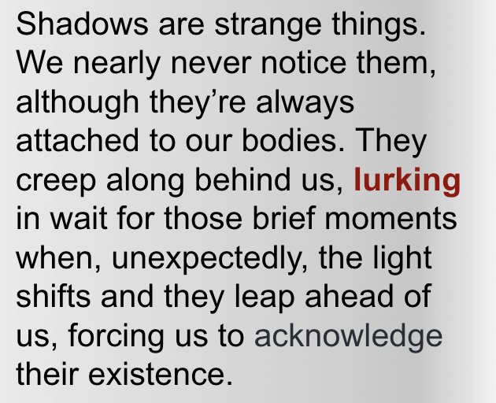
Selecting Excerpts
Bystander
Guilt
Does the excerpt illuminate the central idea of the text?
What could possibly be lurking in the main character’s mind as she remembers the girl who was bullied?

Slide 52

Internalize It: Whole-Class Concept Mapping 1
Bystander
guilt

Slide 53

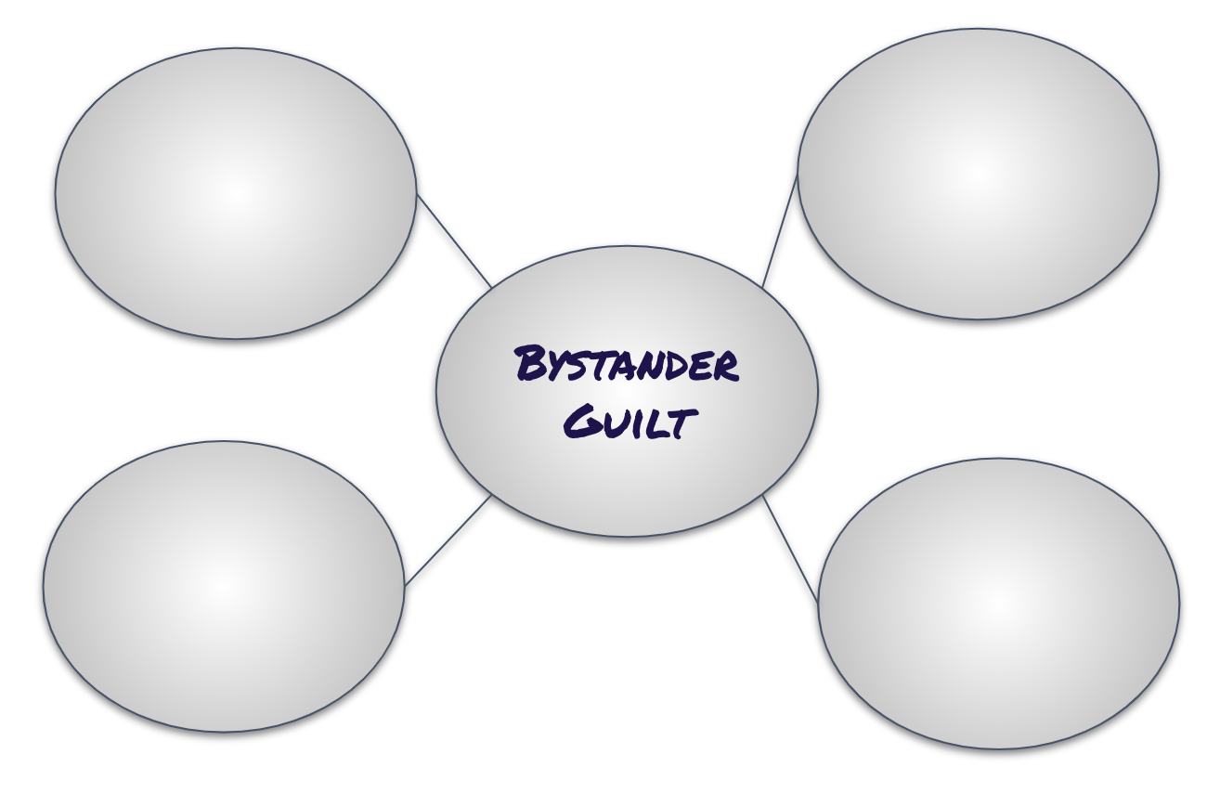
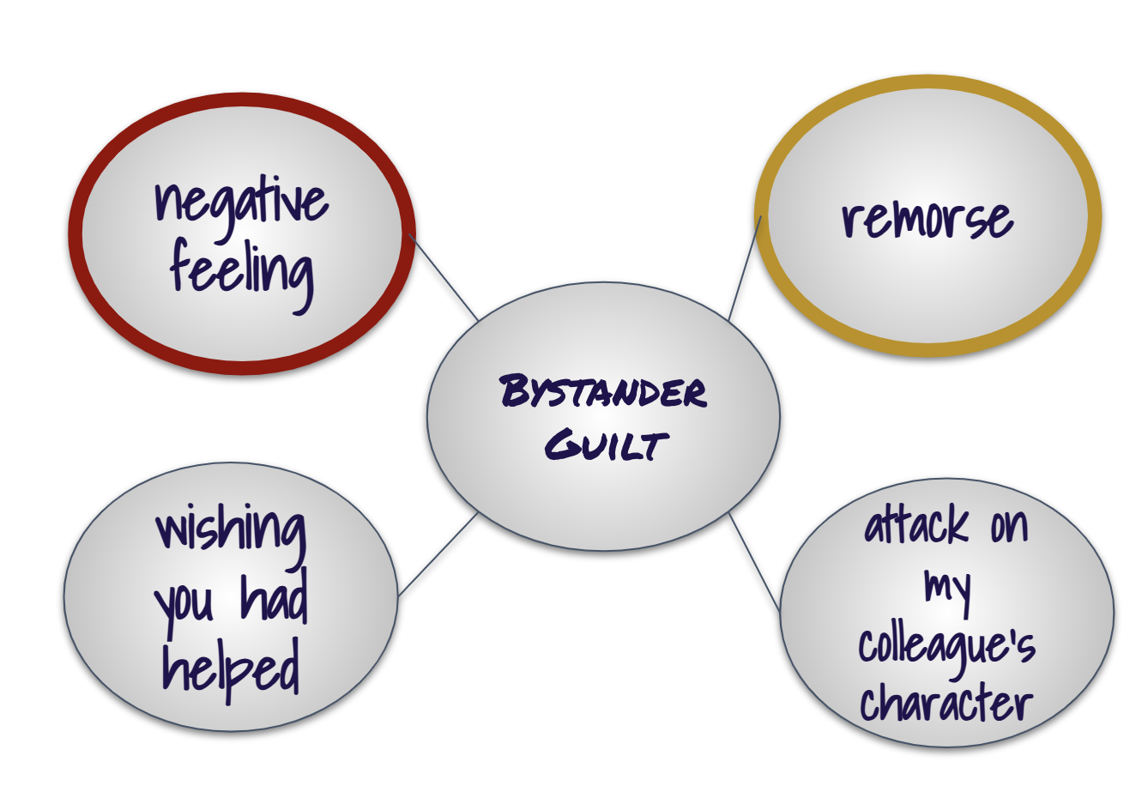
Concept Mapping

Slide 54
Internalize It: Whole-Class Concept Mapping 1
wishing you had stopped the traumatic event
remorse for not interceding
Bystander
guilt
wishing you had helped
attack on my colleague’s character

Slide 55

Analyze It: Search for Textual Clues
Shadows are strange things. We nearly never notice them, although they’re always attached to our bodies. They creep along behind us, lurking in wait for those brief moments when, unexpectedly, the light shifts and they leap ahead of us, forcing us to acknowledge their existence.
Bystander
Guilt
wishing you had stopped the traumatic event
remorse for not interceding

Slide 56
Analyze It: Connecting Clues to Ideas
How does this illustrate our shared understanding of the meaning of bystander guilt?
Shadows are strange things. We nearly never notice them, although they’re always attached to our bodies. They creep along behind us, lurking in wait for those brief moments when, unexpectedly, the light shifts and they leap ahead of us, forcing us to acknowledge their existence.
“guilt lingers in your thoughts”
“guilt forces you to face your inaction”
remorse for not interceding

Slide 57
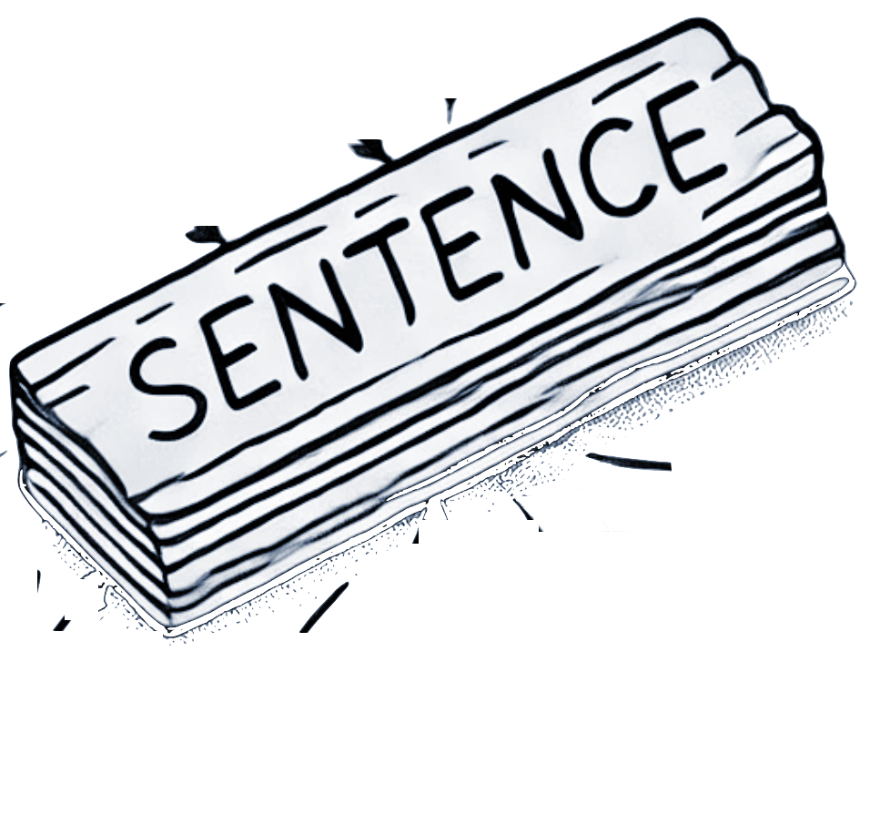

Sentence
Notes:
HEADLINE:

Slide 58
Scaffolding Complex Text 5
Knowledge
Revelant, Funds of Knowledge
Vocabulary
Text Critical Words
Syntax
Language Structures
Text Structure
Organizational Patterns
Writer’s Craft
Techniques to Convey Meaning

Slide 59
Children who are exposed to a variety of increasingly sophisticated written sentence constructions have better comprehension and more syntactic knowledge. Correspondingly, children with highly developed syntactic knowledge are better able to comprehend text that has more complex syntactic constructions.
(Wolf, Gottwald et al., 2009)

Slide 60
Do You Remember Diagramming Sentences?
children
Mexican
American
schools
inferior
separate

Slide 61
Instructional Routine for Sentence Deconstruction
Literal Understanding: Use the 5Ws questioning technique to establish literal understanding
1
Sentence Deconstruction: Break the sentence apart by clauses with an emphasis on critical vocabulary
2
Arrangement of Ideas: Discuss the connection and importance of the order of ideas
3

Slide 62
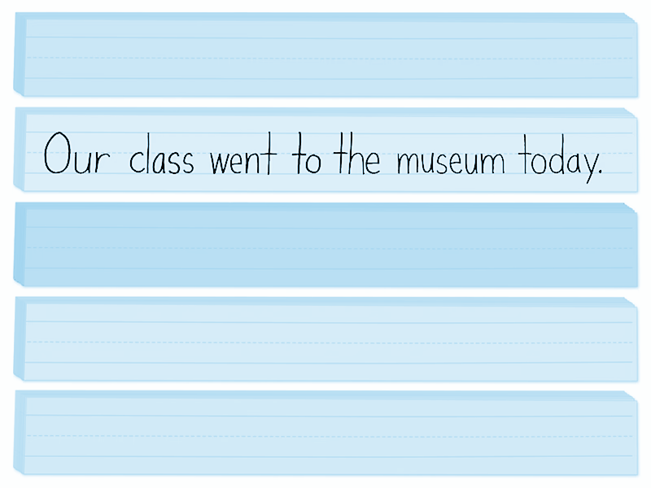

Deconstruct It: Interpret the Clause 1
They creep along behind us,
They creep along behind us,
Bystander guilt slowly takes over your thoughts…

Slide 63

Deconstruct It: Interpret the Clause 2
lurking in wait for those brief moments when,
They creep along behind us,
Bystander guilt can sit in the back of your mind…

Slide 64

Deconstruct It: Interpret the Clause 3
unexpectedly, the light shifts and they leap ahead of us,
They creep along behind us,
Bystander guilt can quickly emerge in your thoughts..

Slide 65

Deconstruct It: Interpret the Clause 4
forcing us to acknowledge their existence.
They creep along behind us,
Bystander guilt forces you to face your inaction

Slide 66

Synthesize It: Distilling the Essential Meaning
1 | 2 | 3 | 4
They creep along behind us, | lurking in wait for those brief moments when, | unexpectedly, the light shifts and they leap ahead of us, | forcing us to acknowledge their existence.
slowly takes over | back of your mind | quickly emerge | face your inaction
Bystander guilt can consume your mind to the point you will face your wrong-doing.

Slide 67
Scaffolding Complex Text 6
Knowledge
Revelant, Funds of Knowledge
Vocabulary
Text Critical Words
Syntax
Language Structures
Text Structure
Organizational Patterns
Writer’s Craft
Techniques to Convey Meaning

Slide 68
Literary Device Analysis Organizer 1
Text | Imagery | Your Knowledge | Empathy | Writer’s Effectiveness
What critical text excerpt illustrates the literary technique?
What mental image comes to mind?
What relevant knowledge do you have about this concept?
How are you feeling about the character’s situation?
Was the author’s use of this device effective in getting you to have empathy for the character?

Slide 69

Literary Device Analysis Organizer 2
Text | Imagery | Your Knowledge | Empathy | Writer’s Effectiveness
 |  | -hide -not always visible -creepy -uneasy | #unsettling | It was an effective use of imagery that allowed me to understand how bystander guilt can become unsettling and consuming.

Slide 70
Assessment System 3
Diagnostic
What are the instructional needs in my building?
Screener
What’s the status of proficient readers in my building?
CBMs or Probes
How are students in my building responding to instruction?

Slide 71

Writing Prompt
What message is the author conveying through the reference to the shadow at the end of the story?
Use evidence from the text to support your analysis.

Slide 72
Text-Based Thinking Rubric
Level 2 | Level 3 | Level 4
Key Details | Key Ideas | Essential Meaning

Slide 73
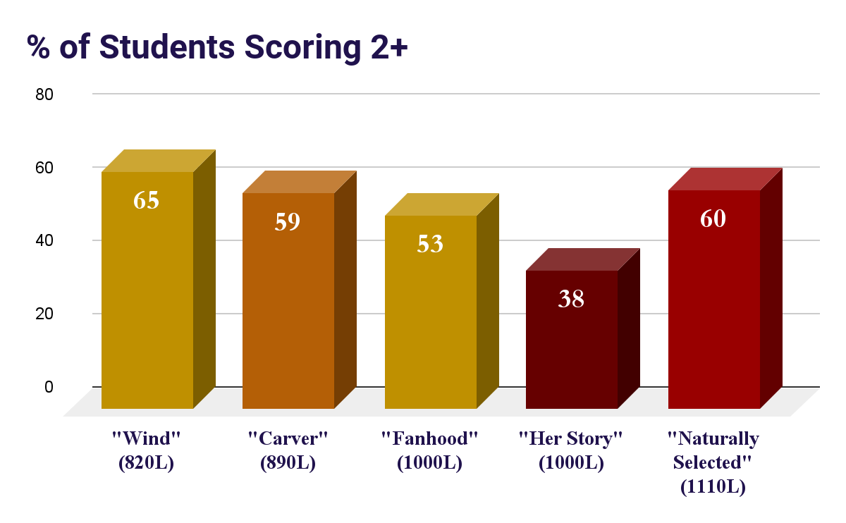
Student Writing Results: New Orleans Middle School
Text Complexity
Low
Med
High
Very High

Slide 74



Caution
Notes:
HEADLINE:

Slide 75





Retrieval Practice: Make the Content Stick
Brain
Dump
True vs. False
Multiple Choice
Category Sort
Sentence
Combining
because
A
B
but
yet
C
although
which

Slide 76

Moving Beyond Do Nows: Retrieval Practice That Works!
Notes:
HEADLINE:

Slide 77
Scaffolding Complex Text 7
Knowledge
Revelant, Funds of Knowledge
Vocabulary
Text Critical Words
Syntax
Language Structures
Text Structure
Organizational Patterns
Writer’s Craft
Techniques to Convey Meaning

Slide 78
Questions?

Slide 79
Ohio Heart of it All

