Slide 3
This presentation contains examples and resource materials that are provided for the user’s convenience. The inclusion of any material is not intended to reflect its importance, nor is it intended to endorse any views expressed, or products or services. These materials may contain the views and recommendations of the presenter as well as hypertext links, contact addresses and websites to information created and maintained by other public and private organizations. The opinions expressed in any of these materials do not necessarily reflect the positions or policies of the U.S. Department of Education or Ohio Department of Education and Workforce. The U.S. Department of Education and Ohio Department of Education and Workforce do not control or guarantee the accuracy, relevance, timeliness, or completeness of any outside information included in these materials. Mentions of specific programs or products in these examples are designed to provide clearer understanding and are not meant as endorsements.

Slide 4

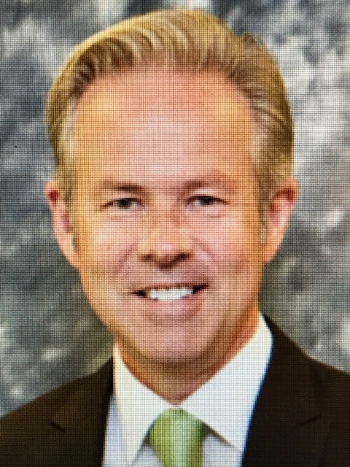
Getting the Most out of ohio’s science of reading courses
Jeremy Luke
Roger Howard
Literacy Learning Specialist, Ohio Department of Education and Workforce - Jeremy.Luke@education.ohio.gov
Adolescent Literacy Specialist, State Support Team 3 – Roger.Howard@escneo.org
Notes:
INSERT HEAD SHOTS

Slide 5
LEARNING OBJECTIVES
Participants in the session will be able to:
  Identify learning and resources from Ohio’s Science of Reading Course to meet building and district staff training needs
  Evaluate current approaches to learning implementation to plan improvements
  Utilize key resources to guide the implementation of learning
Notes:
Jeremy

Slide 6
Turn and talk
Answer the following question with a neighbor (or two):
How do educators at your district utilize professional learning in the Science of Reading in their instruction?
Notes:
Jeremy

Slide 7
Professional Learning in the Science of reading

Slide 8
Requirements and options: Ohio’s science of reading course
By June 30, 2025, all educators must be trained in the Science of Reading
Educators may take a course developed by the Department or a similar training
Eligible educators can receive a $400 or $1,200 stipend
Seven course pathways are available based on role, grade band, and previous training
Notes:
Jeremy

Slide 9
Course pathways
Course pathways
Pathway A: All K-5 teachers, intervention specialists, English learner teachers, reading specialists, instructional coaches
Pathway B: Educators eligible for Pathway A who completed approved Dyslexia training
Pathway C: All 6-12 English Language Arts teachers, intervention specialists, English learner teachers, reading specialists, instructional coaches
Pathway D: 6-12 educators eligible for Pathway C who completed approved Dyslexia training
Pathway E: 6-12 content teachers
Pathway F: K-12 administrators
Pathway G: Pre-kindergarten teachers, intervention specialists, reading specialists, instructional coaches
Notes:
Jeremy

Slide 10
Course content
Components of literacy: Phonemic Awareness, Phonics, Vocab, Fluency, Comprehension, Writing
Instructional practices: Explicit and Systematic
Literacy Systems: MTSS, Teaming, Decision Rules
Assessment and Intervention: Screening, Diagnostic, Progress Monitoring
Leading Literacy: Implementation, Scheduling, Building Systems
Notes:
Jeremy

Slide 11
Models of professional Development
Joyce & Showers (1980, 2002)
Professional Learning | Impact on Knowledge | Impact on Skill | Impact on Practice
Theory | 10% | 5% | 0%
Theory + Modeling | 30% | 20% | 0%
Theory + Modeling + Practice | 60% | 60% | 5%
Theory + Modeling + Practice + Coaching | 95% | 95% | 95%
Professional learning alone demonstrated no impact on classroom instruction!
Notes:
The state, districts, and individual educators have poured countless resources into SoR training. But if educators do not receive continued support, including modeling, practice, and coaching, they will retain very little of the learning from the course. They will also likely not implement any of the training or resources provided by the course. Therefore, school leaders and coaches play a huge role in making sure that learning impacts classroom instruction.
Joyce, B., & Showers, B. (1980). Improving in-service training: The messages from research. Educational Leadership, 37, 379-385.
Joyce, B. R., & Showers, B. (2002). Student achievement through staff development (3rd ed.). Alexandria, VA: Association for Supervision & Curriculum Deve (ASCD).

Slide 12
Optimizing professional learning

Slide 13
Determine Needs with Data
Deliver Professional Learning
Reinforce with Coaching and Teams Support
Assess Implementation with Walkthroughs
Assess Students Learning Outcomes
Revise, Intensify, or Identify New Approach
PROFESSIONAL LEARNING SHOULD BE A CYCLICAL PROCESS

Slide 14
Quality professional learning
Typical Professional Learning | Optimal Professional Learning
Free standing Short-term Nonsystematic Infrequent Sit-and-forget “Smattering” “Smorgasbord” | Aligned with district literacy plan Guided by carefully crafted learning objectives Modeling and practice embedded Collaboration and reflection Follow up and feedback (learning walks) Sustained connection between learning and implementation
Turn and Talk: What elements of “Typical” and “Optimal” professional learning do you currently see in your building or district?
Notes:
Jeremy

Slide 15
Guskey’s five levels of professional learning
Level 1: Participants' Reactions
Level 2: Participants' Learning
Level 3: Organizational Support and Change
Level 4: Participants' Use of New Knowledge and Skills
Level 5: Student Learning Outcomes
Notes:
Jeremy

Slide 16
Reinforcing learning from the course
Data Analysis: Use data to identify areas of need for learning
Content: Revisit key modules and lessons
Practice and Modeling: Coaches, teacher leaders, and peers demonstrate strategies and resource use
Coach: Provide guidance, conversations, and feedback on implementation
Document: Science of Reading Course Learning and Resource Guide
Notes:
Jeremy
Utilize Course Content Resource Guide

Slide 17
Utilizing team meetings to reinforce learning
Peer Coaching: Use team time to model, observe, and reflect together
Alternate meetings: Provide time in one meeting to review lessons and time in the next meeting to discuss learning
Discussion: Share Response Notebook entries
Resource Bank: Gather and share tools and resources from the course
Notes:
Jeremy

Slide 18
Learning walks
Learning walks provide the opportunity for educators to:
Observe high-quality implementation of learning and resources
Receive and provide feedback on practice
Plan and problem-solve during team time
High Quality Learning Walks:
Focus on a specific strategy or resource
Are non-evaluative
Link closely to previous professional learning
Well-understood by all participants
Handout: Learning Walk Template
Notes:
Provide blank walkthrough guide

Slide 19
Implementing Professional Learning

Slide 20
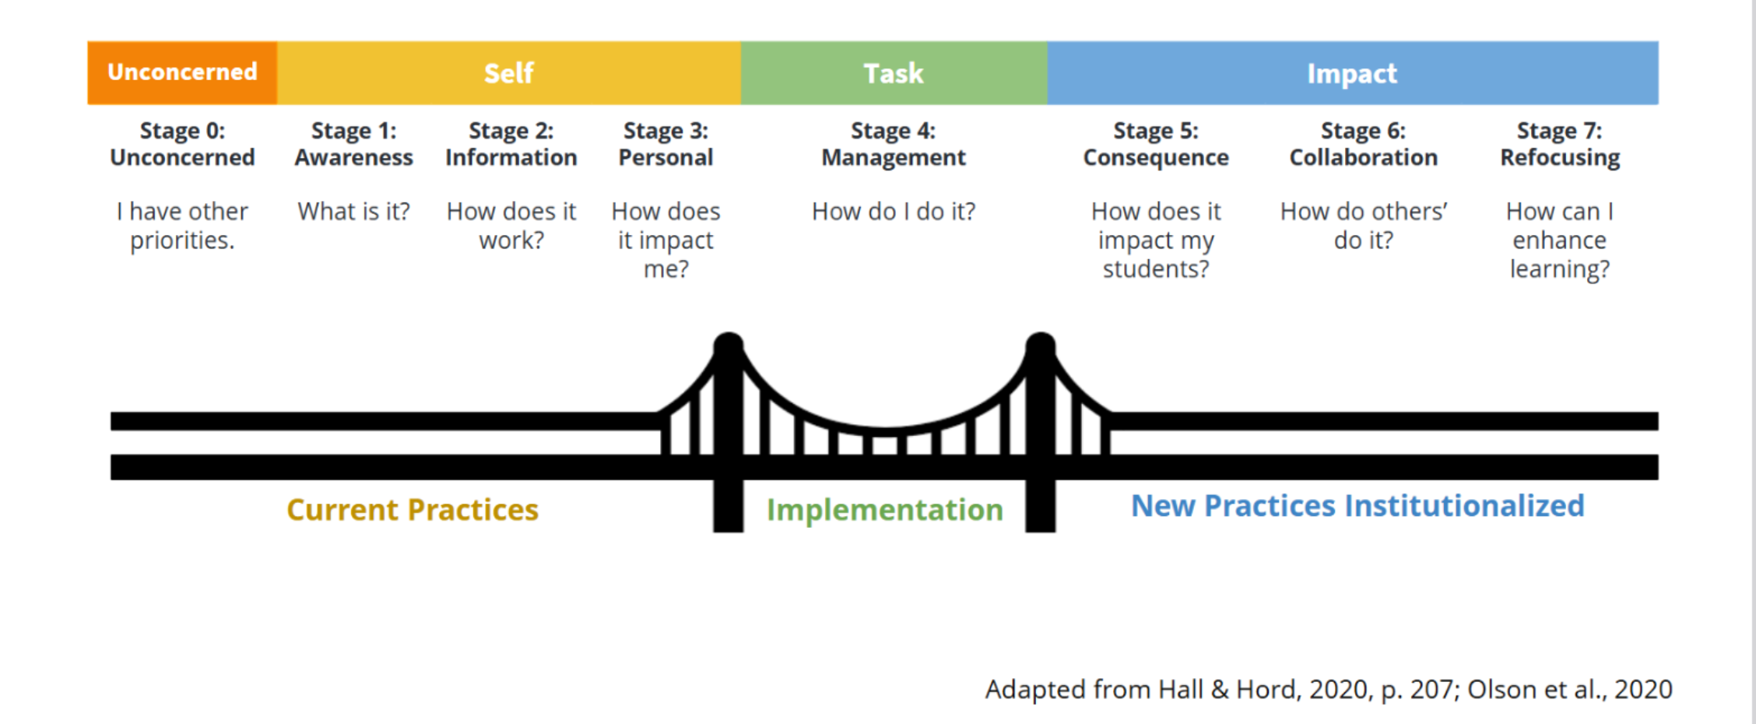
Change is a Process
Notes:
Roger

Slide 21
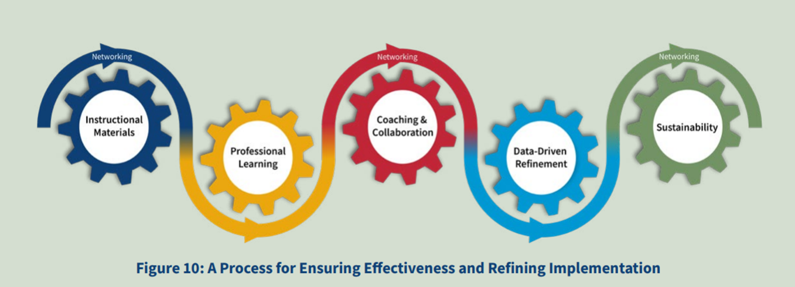
Ensuring effectiveness and refining implementation
Evidence Based Practices - HQIM's
(Ohio's Plan to Raise Literacy Achievement, Page 38)
Notes:
Roger

Slide 22
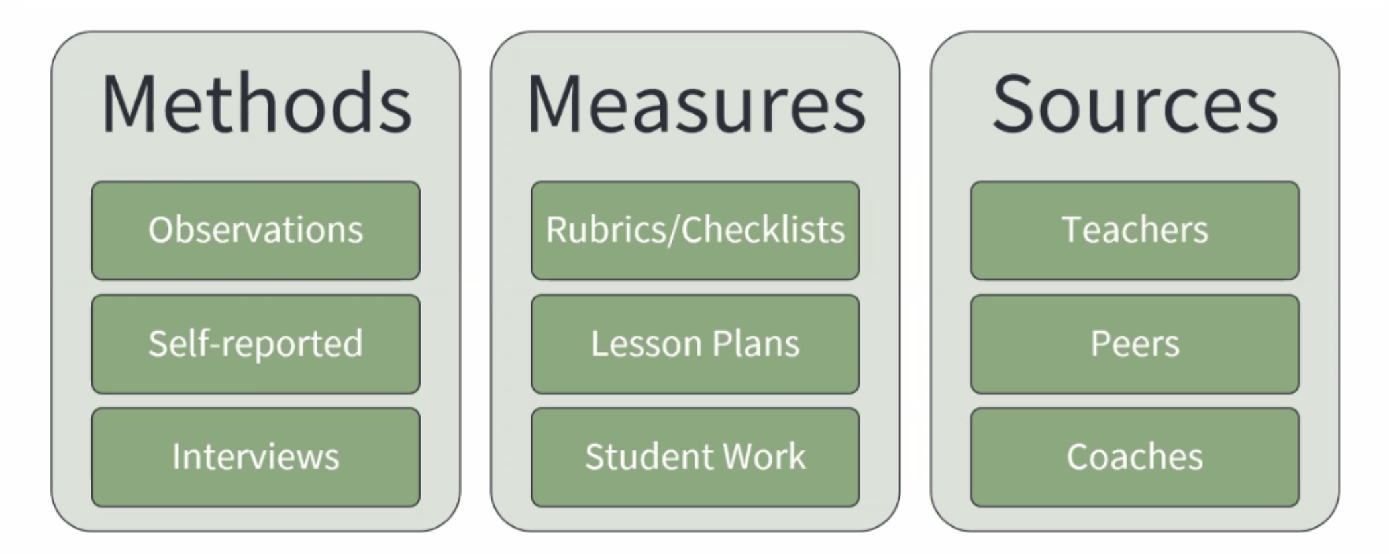
Data collection to support sustainability
Notes:
Roger

Slide 23
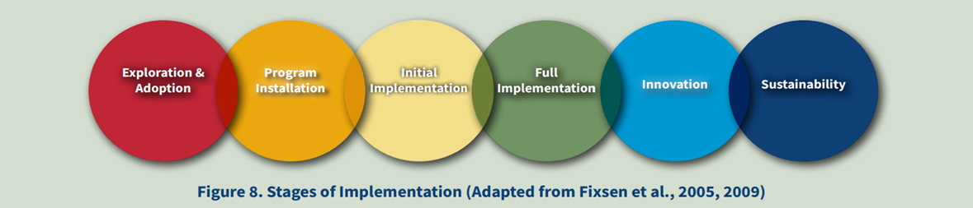
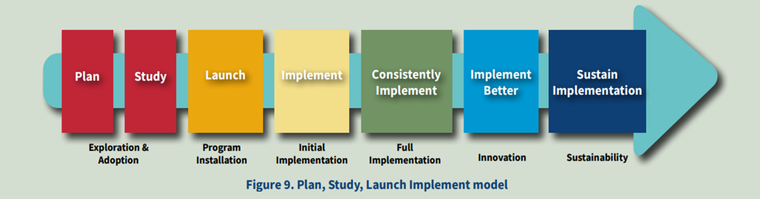
Using implementation science
(Ohio's Plan to Raise Literacy Achievement, Page 37)
Notes:
Roger

Slide 24
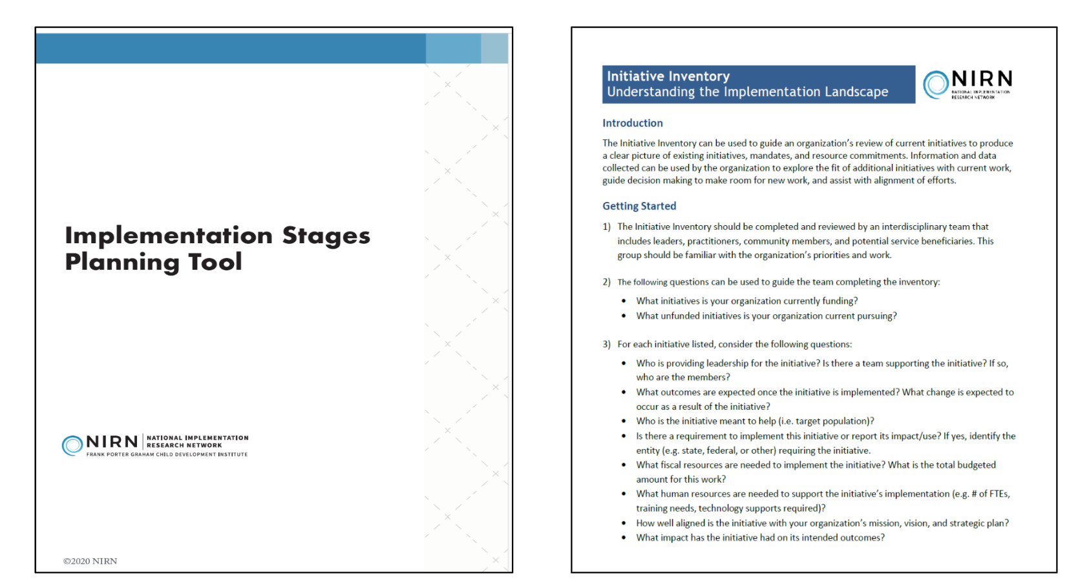
National implementation research network (nirn) tools
Tool: Initiative Inventory – AI Hub
Implementation Stages Planning Tool
NIRN SISEP Video Series AI Hub
Notes:
Roger

Slide 25
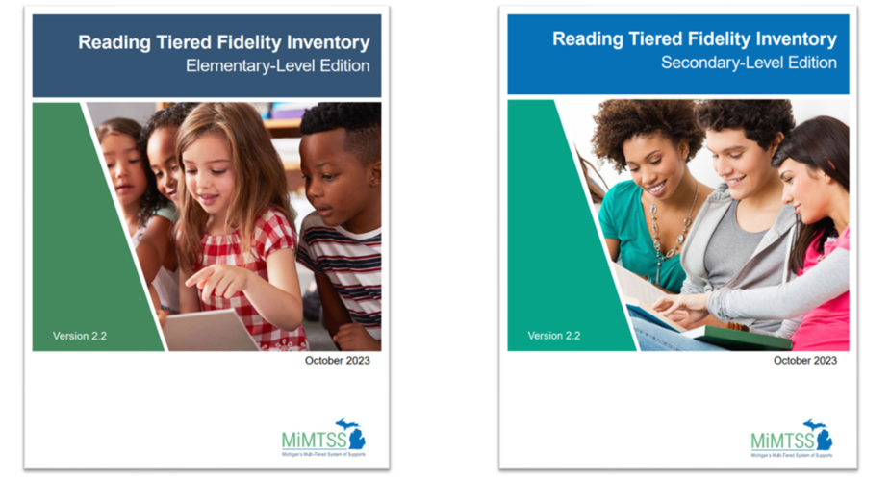
Using The Reading Tiered Fidelity Inventory as "road Map" for implementation of SOR
Reading Tiered Fidelity Inventory (R-TFI) | TA Center
Notes:
Roger

Slide 26
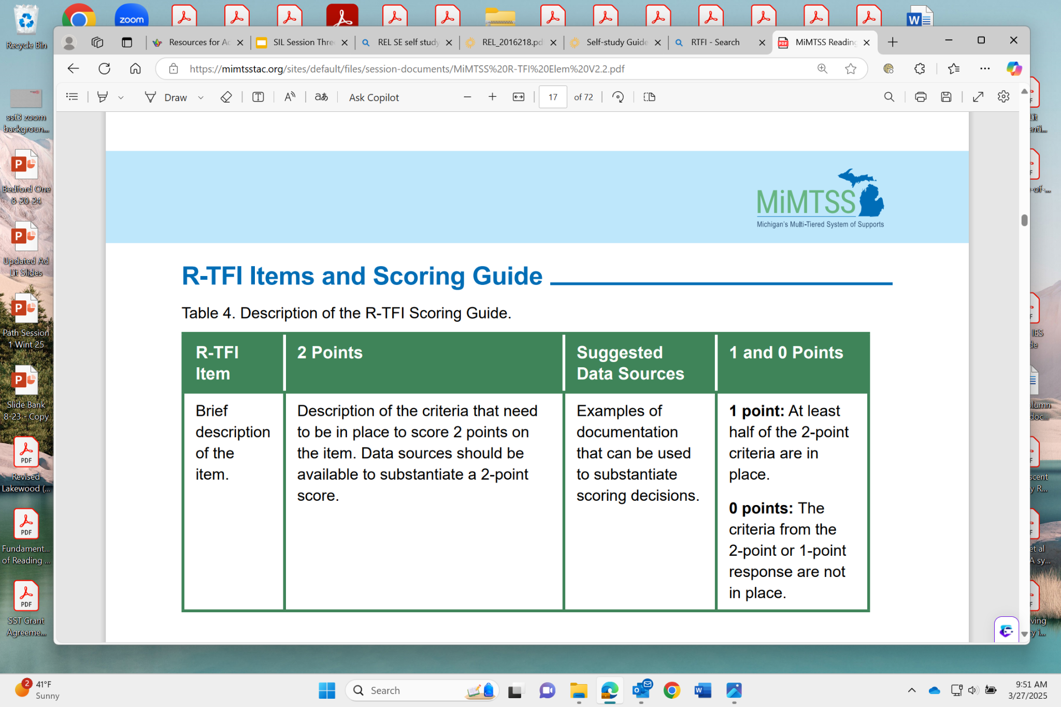
R-tfi collaborative scoring process
Notes:
Roger

Slide 27
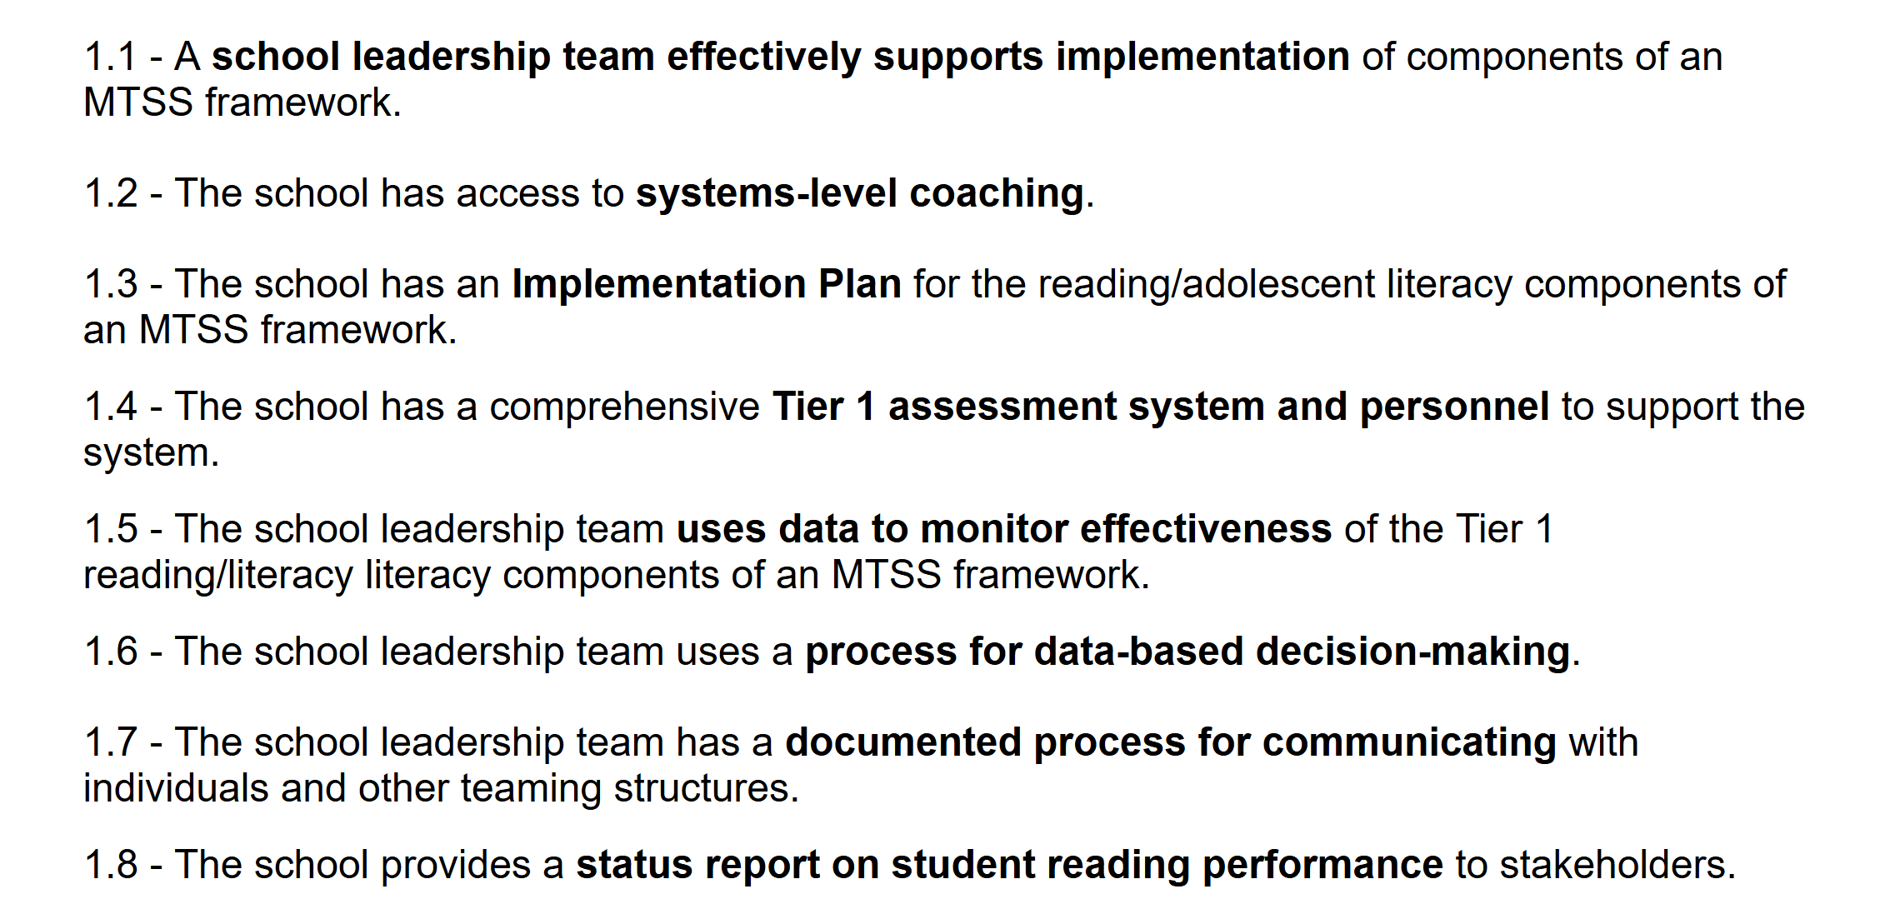
Tier One R-TFI Items common to both elementary and secondary versions
Notes:
Roger

Slide 28
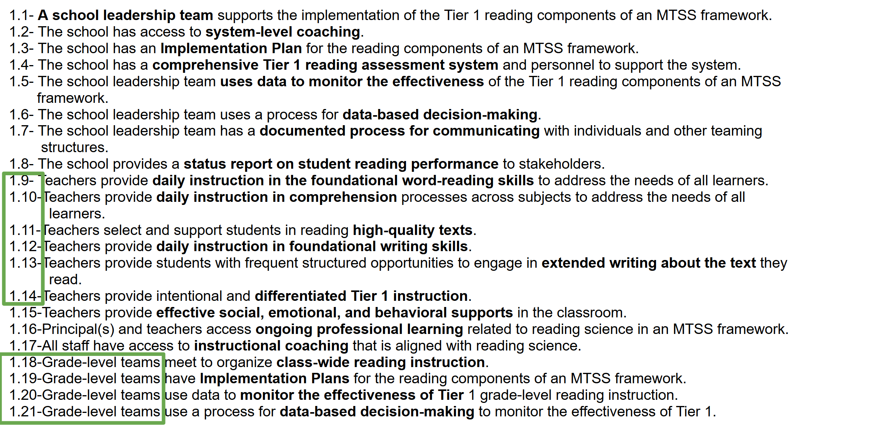
R-tfi tier one items for elementary version
Notes:
Roger

Slide 29
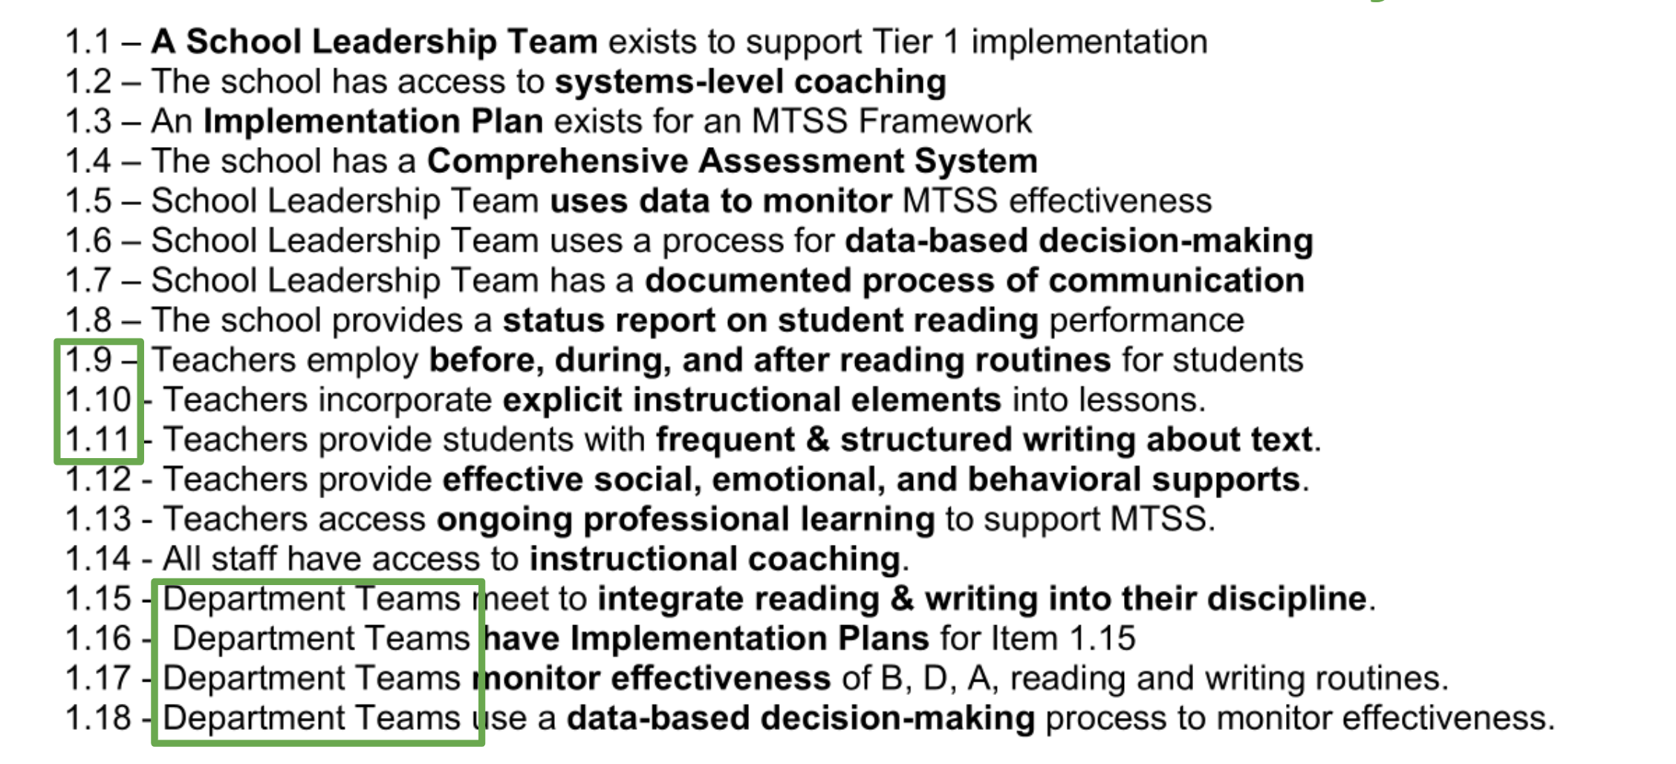
R-tfi tier one items for secondary version
Notes:
Roger

Slide 30
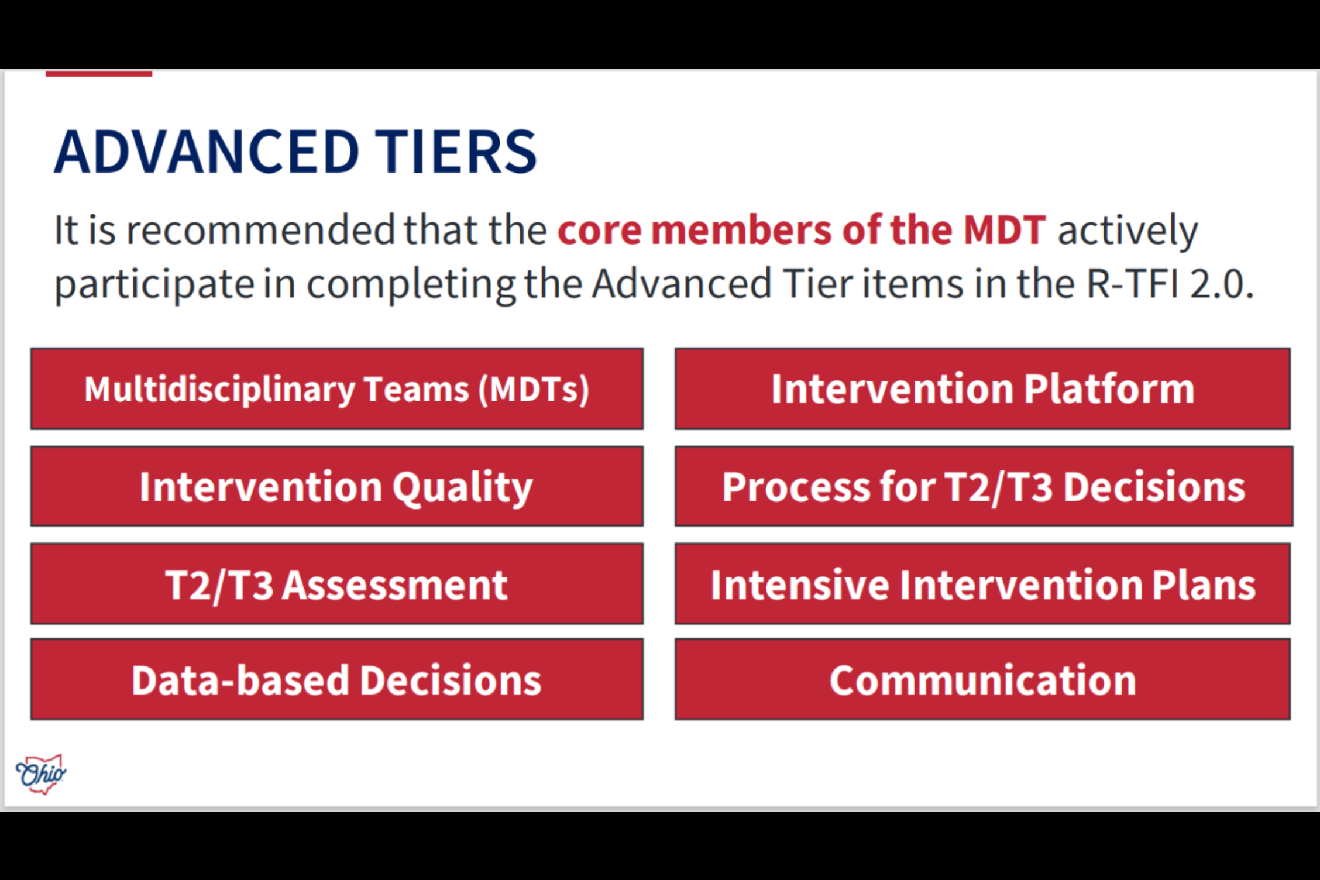
R-TFI Items for the Advanced MTSS Tiers are identical for both elementary and secondary versions
Notes:
Roger

Slide 31
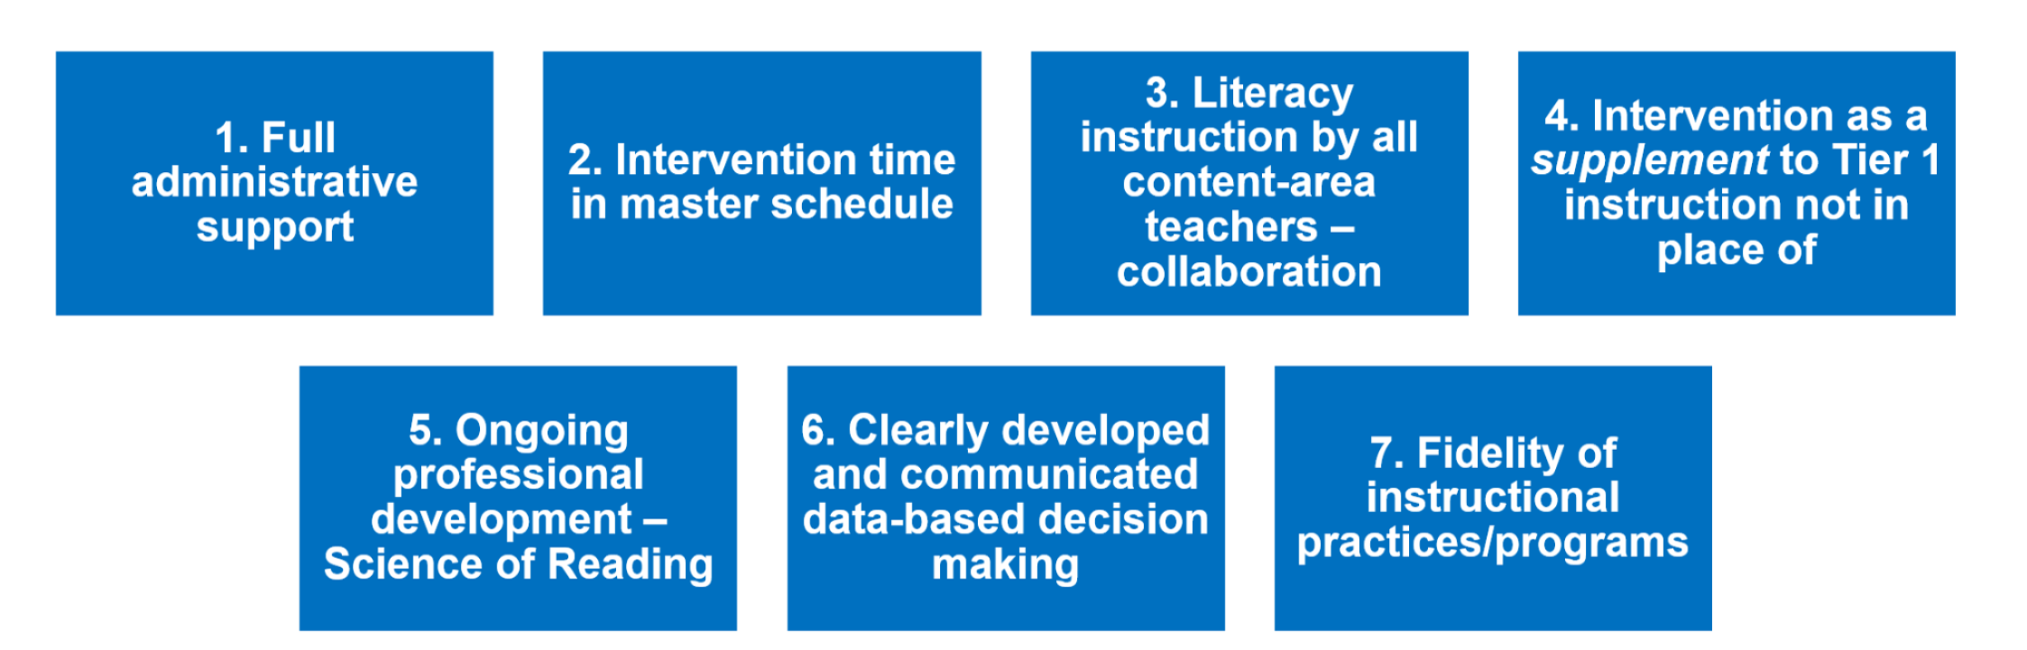
non-negotiables for effective multi-tiered systems of supports
How-To-Build-An-Elementary-Master-Schedule-That-Unlocks-Opportunities-To-Raise-Achievement-and-Improve-Equity.pdf
ImplementingMTSSinSecondarySchools_2022_RC6_003.pdf
Notes:
Roger

Slide 32
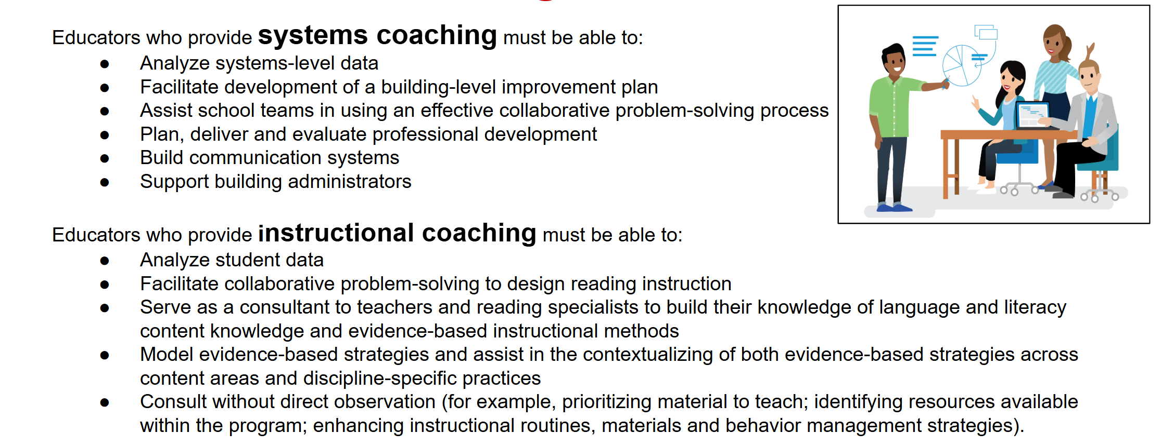
Providing both systems-level coaching and instructional coaching
(Implementing Ohio's Plan to Raise Literacy Achievement, 2023)
Notes:
Roger

Slide 33
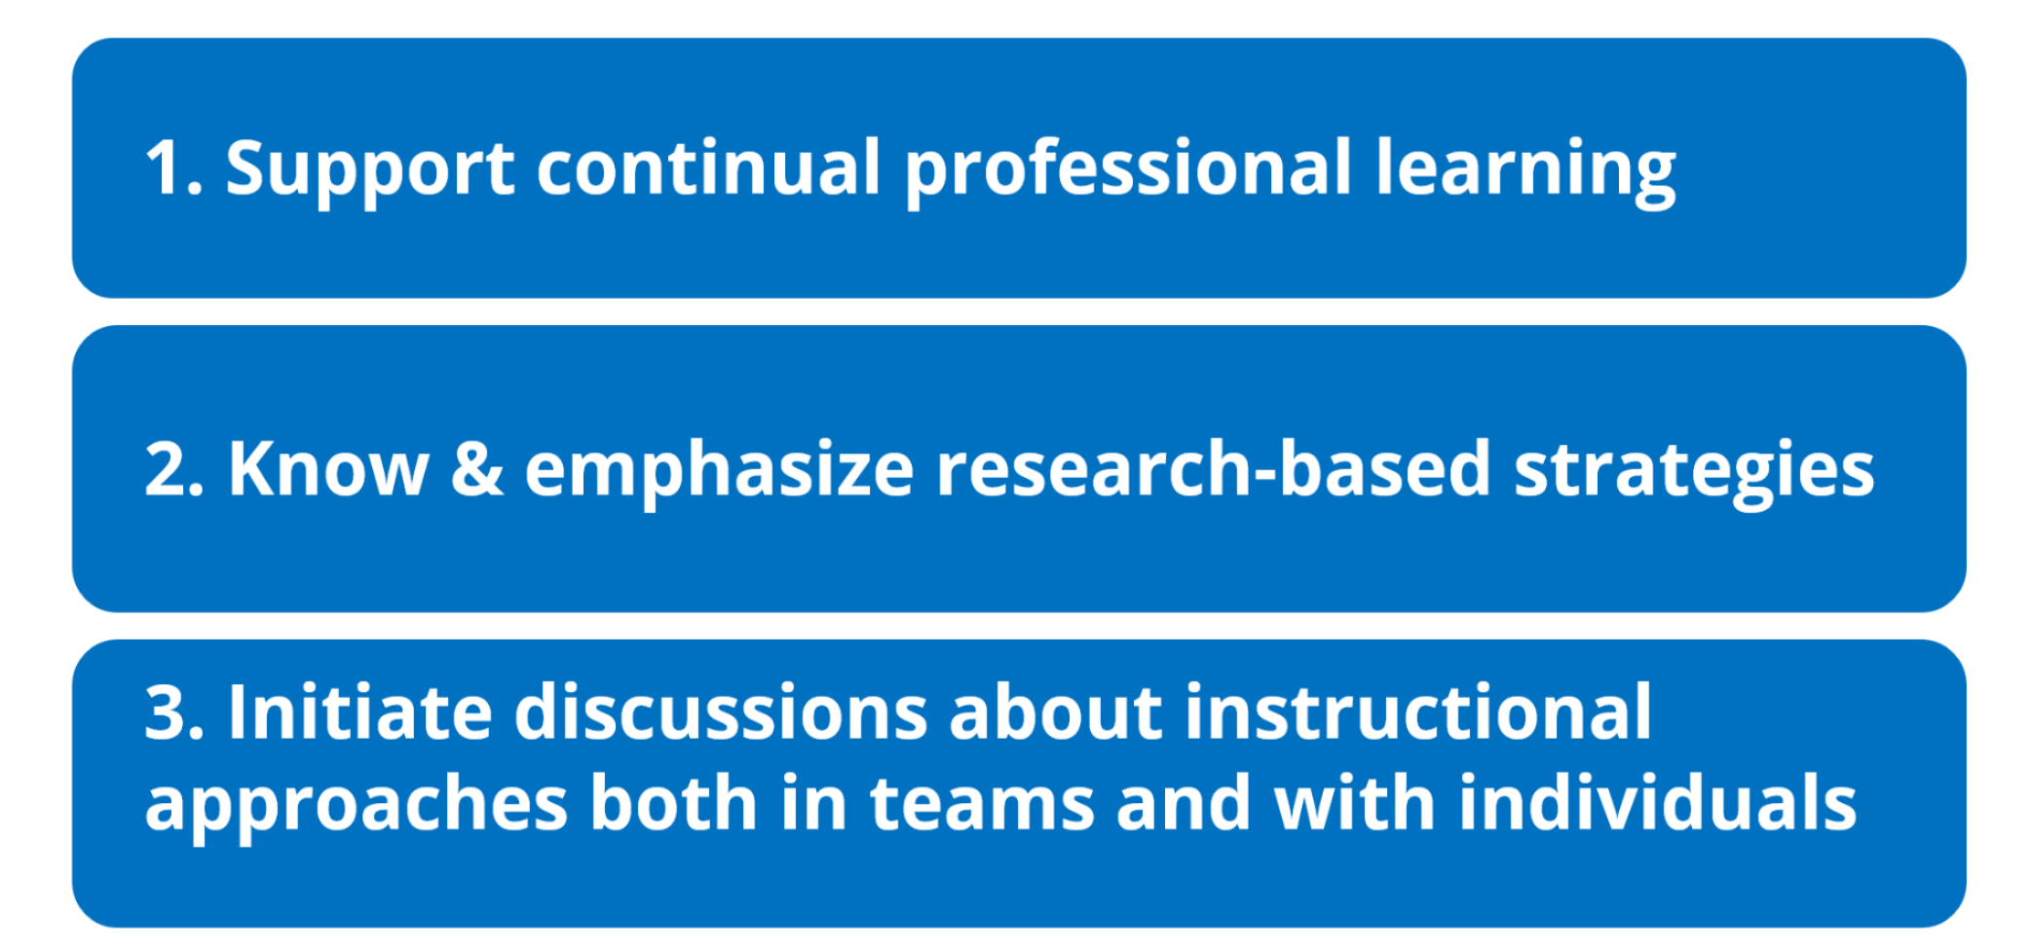
Three actions of effective leaders
How Principals Affect Students and Schools (Wallace Foundation, 2021)
Intro to Science of Reading for Administrators
Notes:
Roger

Slide 34
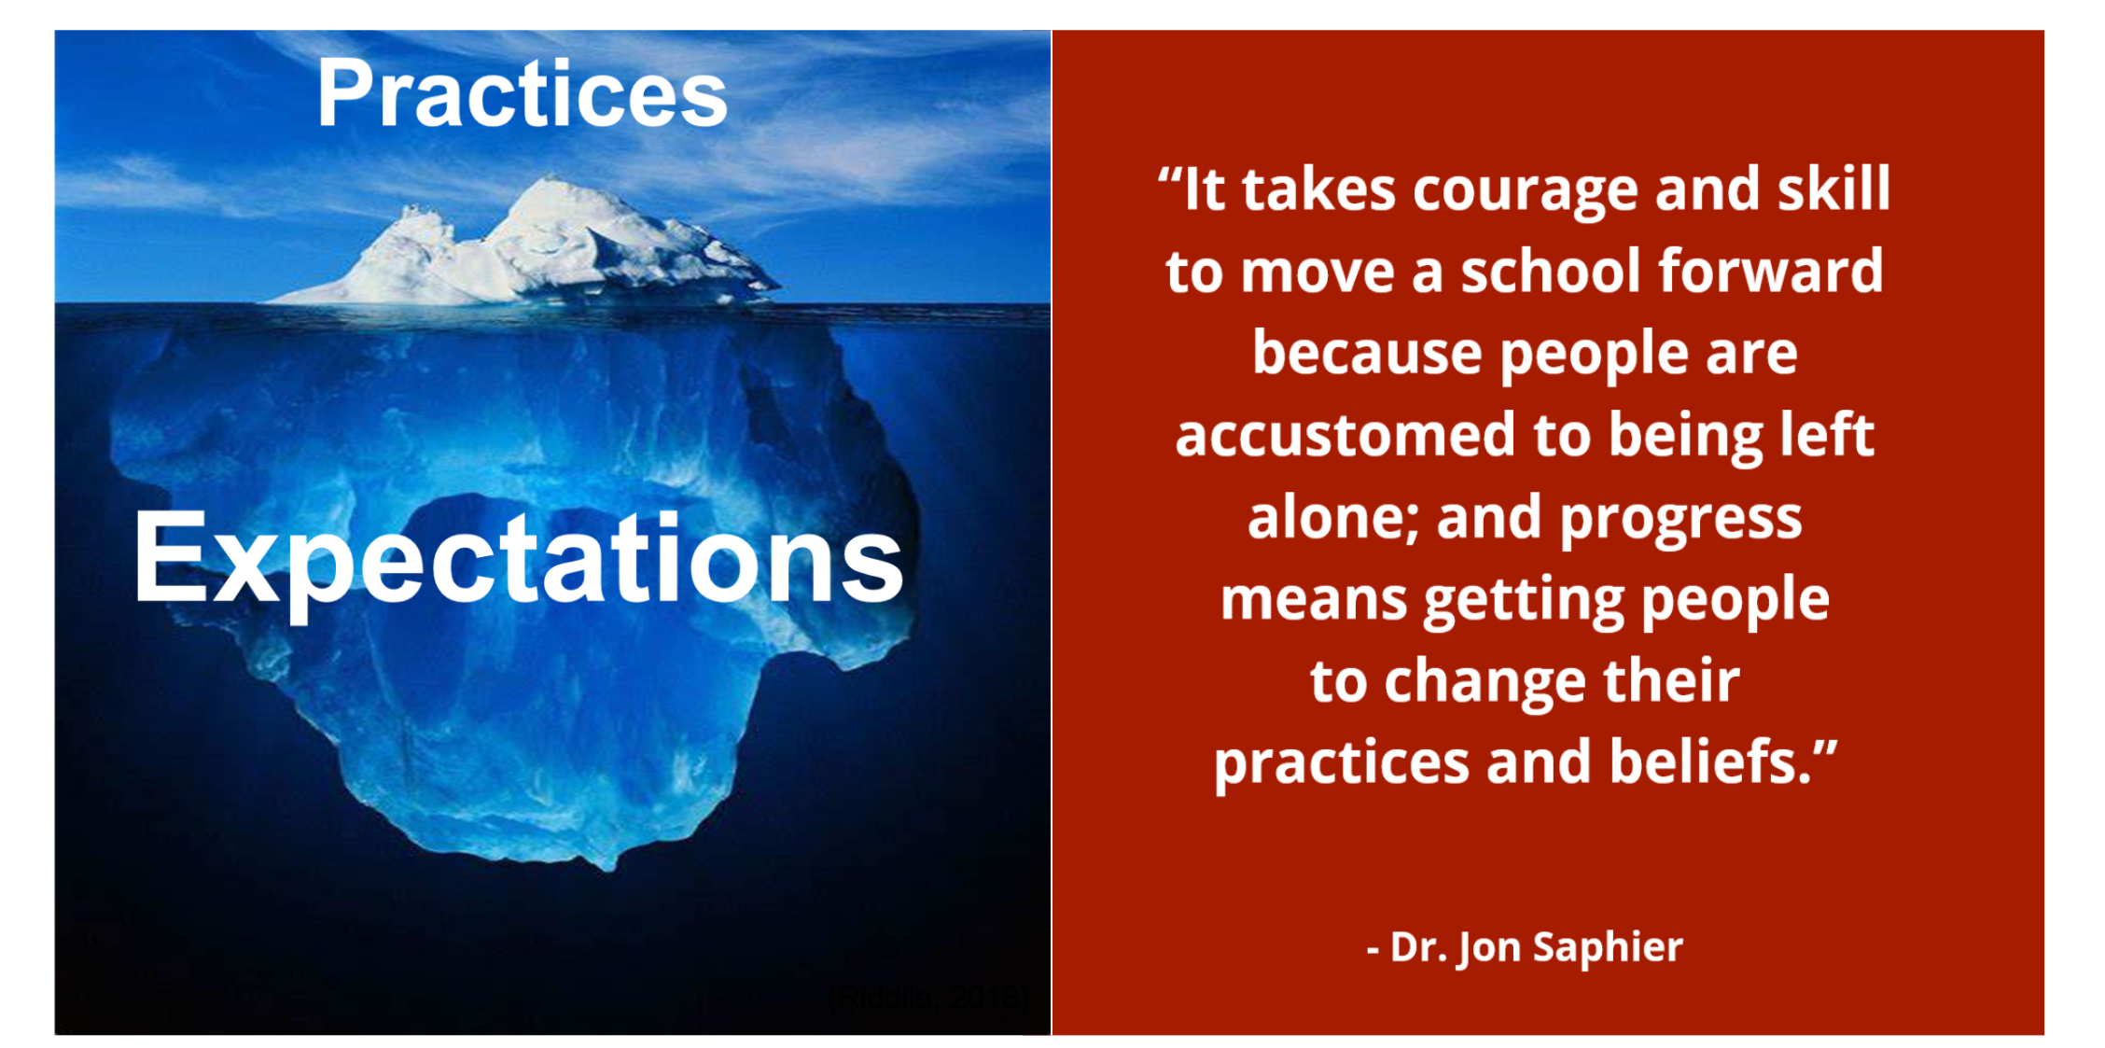
The Opportunity Makers - TNTP
Notes:
Roger

