Slide 1
Ohio Heart of it All logo - beginning

Slide 2
ReadOhio Literacy Academy 2025 - start

Slide 3
Disclaimer
This presentation contains examples and resource materials that are provided for the user’s convenience. The inclusion of any material is not intended to reflect its importance, nor is it intended to endorse any views expressed, or products or services. These materials may contain the views and recommendations of the presenter as well as hypertext links, contact addresses and websites to information created and maintained by other public and private organizations. The opinions expressed in any of these materials do not necessarily reflect the positions or policies of the U.S. Department of Education or Ohio Department of Education and Workforce. The U.S. Department of Education and Ohio Department of Education and Workforce do not control or guarantee the accuracy, relevance, timeliness, or completeness of any outside information included in these materials. Mentions of specific programs or products in these examples are designed to provide clearer understanding and are not meant as endorsements.

Slide 4
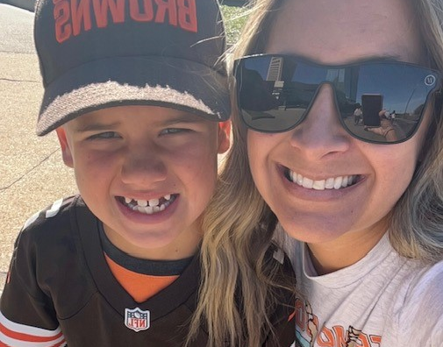
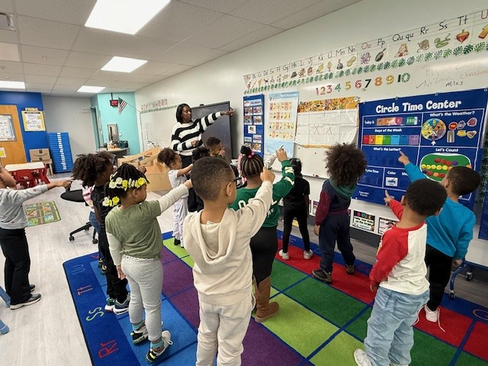


Implementing and sustaining Evidence-based Practices in the preschool classroom
Presenter: Rita Kroeger, Regional Literacy Specialist
Featuring: Arnita Washington, Preschool Teacher

Slide 5
Norms
Listen with an Open Mind
Stay Positive
Participate and Share Ideas
Put Electronic Devices Aside

Slide 6
Objectives
Understand how to utilize the Ready School Tool
Review the non-negotiables of a Language and Literacy Ready School
Explore implementation of evidence-based language and literacy practices in the preschool classroom

Slide 7



Guiding documents

Slide 8
Turn and Talk
On a scale of 1-3, how familiar are you with our guiding documents?
  Ohio’s Ready School Guide and Tool
  Implementing Ohio’s Plan to Raise Literacy Achievement: A Guide for Early Care and Education Leaders
  The Institute of Education Science Practice Guide: Preparing Young Children for School

Slide 9
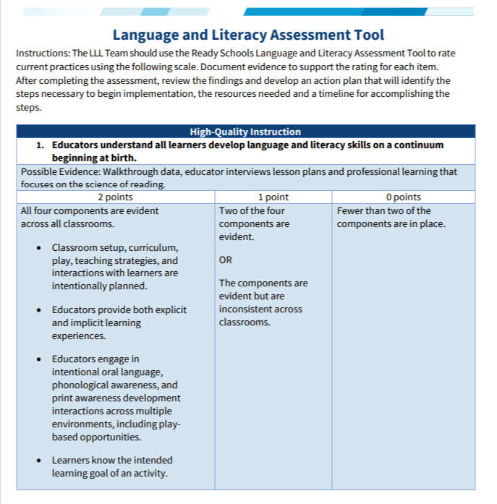
Ohio’s ready school guide and tool
Warrensville Heights Early Childhood Center Ready School Tool Results
Ohio’s Ready School Guide for Language and Literacy

Slide 10
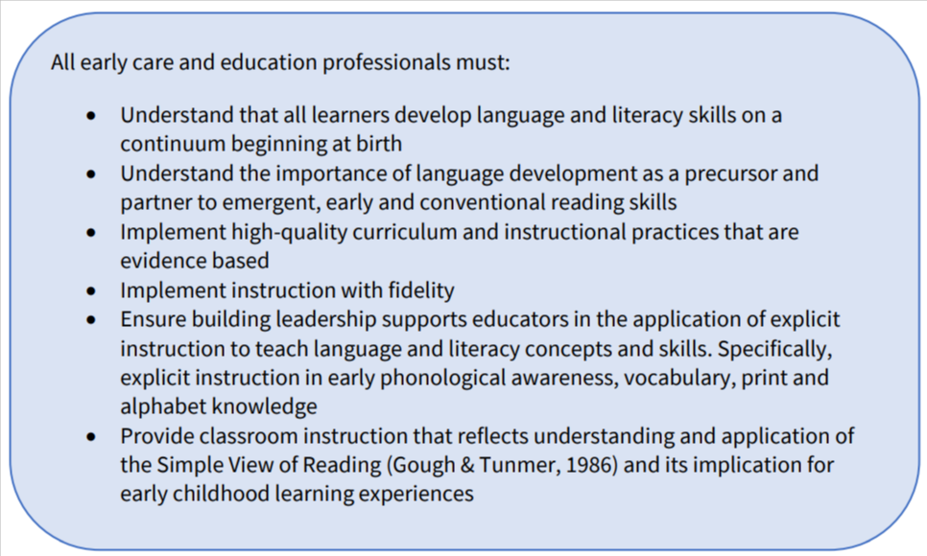
Birth-5 Implementation guide
Nonnegotiable #1: High Quality Instruction
Notes:
Highlight the most one that resonates most with you.

Slide 11
Birth-5 Implementation guide
Essential Emergent Literacy Skills Vocabulary and Oral Language Phonological Awareness and Phonemic Awareness Print Knowledge Intentional instruction and responsive adult-child interaction in early learning programs can focus on these key skills that make students more likely to become readers in elementary school.
Notes:
Activity with pages 9-16 and call out look fors on page 17

Slide 12
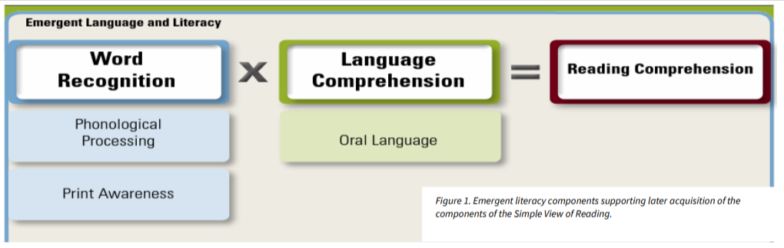
The Simple View of Reading

Slide 13
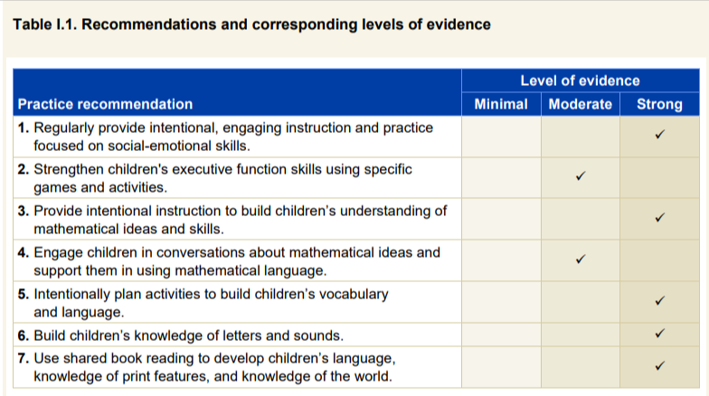
IES Practice Guide Recommendations and Evidence

Slide 14
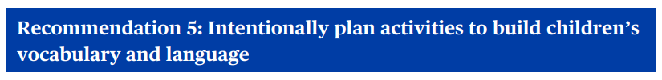
Recommendation 5
“The best activity for exposure to vocabulary and unfamiliar words is reading children’s books, which have many more unfamiliar words than typical child-directed conversations.” (Massaro, 2016).
“Reading storybooks is a cornerstone in early childhood classrooms. The evidence suggests that it is important to have a process for selecting vocabulary words-and a routine for teaching them.” (Schickedanz & Collins, 2013; Weitzman & Greenberg, 2010)

Slide 15
Recommendation 5 cont’d
Choose 3-5 unique words to focus on each week and include review of those words in other weeks
Introduce the words and their meanings
Choose activities and materials that will offer children opportunities to practice using the target vocabulary words
Engage in interactive conversations with children to reinforce or solidify understanding of vocabulary words

Slide 16
Recommendation 5 – cont’d
Explicit Vocabulary Instruction Routine
Say the word and provide a child-friendly definition or explanation using multi-sensory connections (e.g., a gesture cue, a picture, and the printed word).
Have the children repeat the word.
Provide other contexts for the word to reinforce its meaning.
Have the children describe the word meaning to a shoulder buddy. (Adapted from Beck et al., 2013)
Notes:
Give examples and non-examples, ask “yes” “no” questions

Slide 17
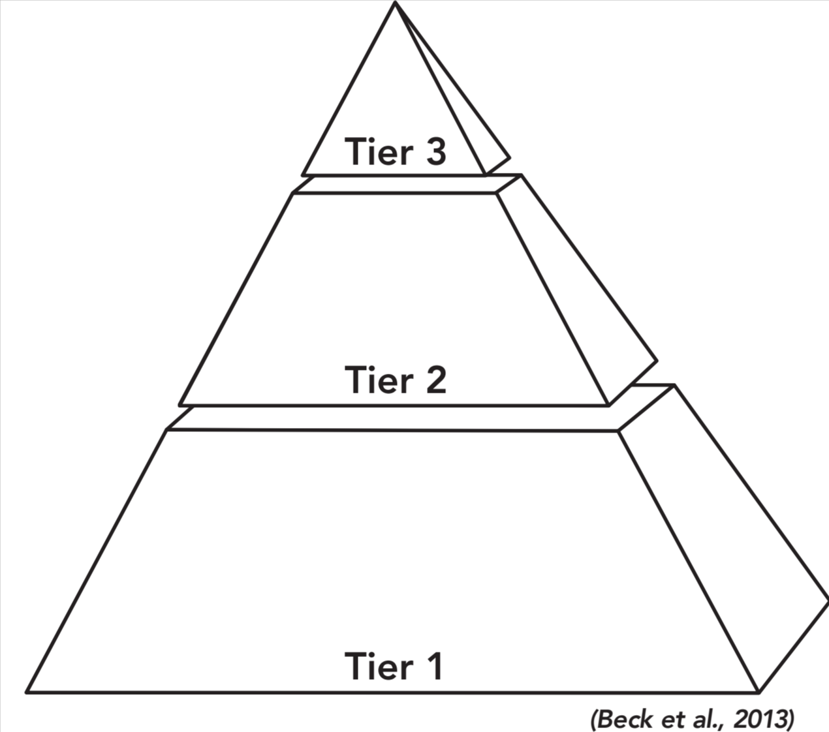
Recommendation 5 – cont’D 4
Vocabulary Selection
Identify the words children are unlikely to know.
Select a small target set of tier 2 vocabulary words that are necessary for comprehension and usable in children’s lives. There should be other opportunities to teach these words across the curriculum and relate them to other vocabulary being taught.
Determine which methods will best support children’s acquisition of the selected vocabulary. Either directly teach the word’s meaning if there are no meaning clues in the text, or teach a word-learning strategy if there are meaning clues in the text.
Notes:
Discuss tiers-handout and practice!

Slide 18
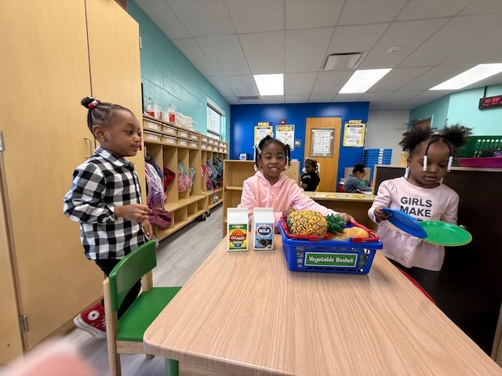
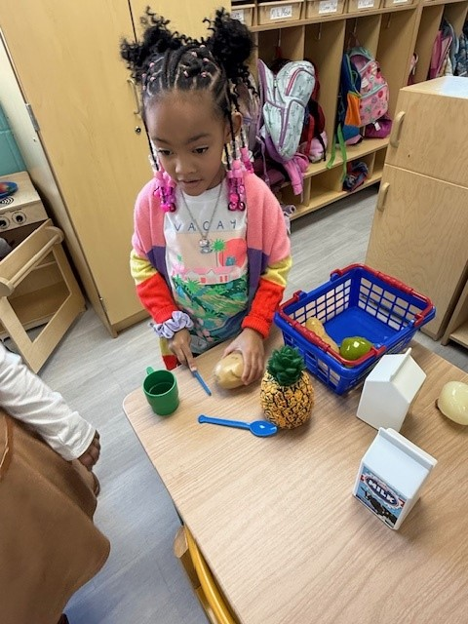
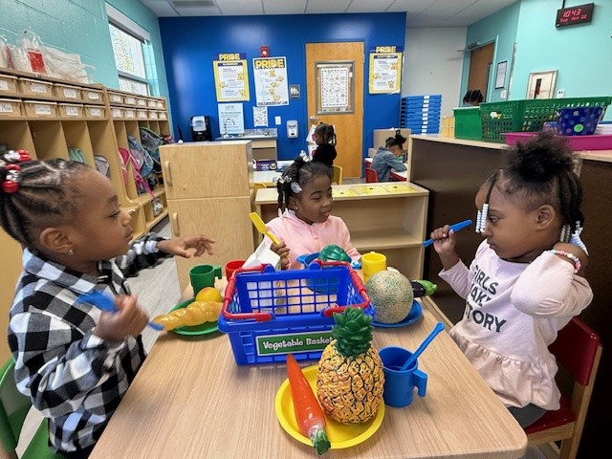
Classroom Spotlight

Slide 19

Recommendation 6 - 1
Intentionally focus on listening for sounds in words
Intentionally introduce a new letter and its sound
Use materials and activities that allow children to practice identifying letters and their corresponding sounds
Include print throughout the classroom to provide additional opportunities to discuss letters and their sounds
Notes:
Discuss routine for letter/sound introduction

Slide 20
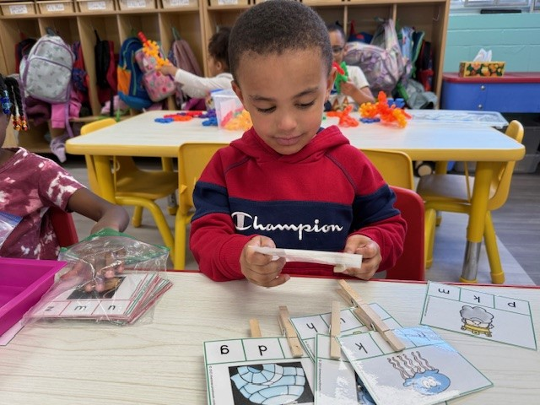
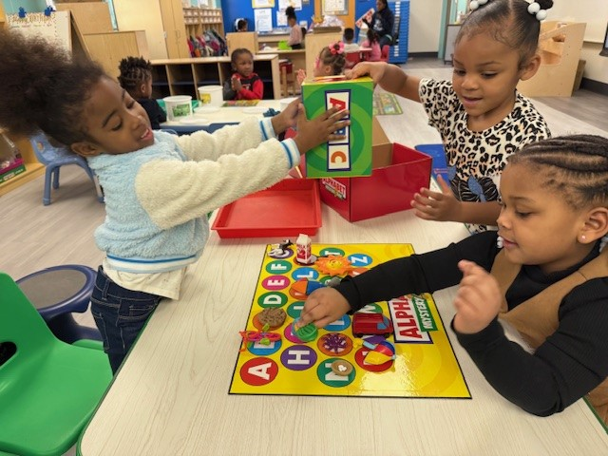
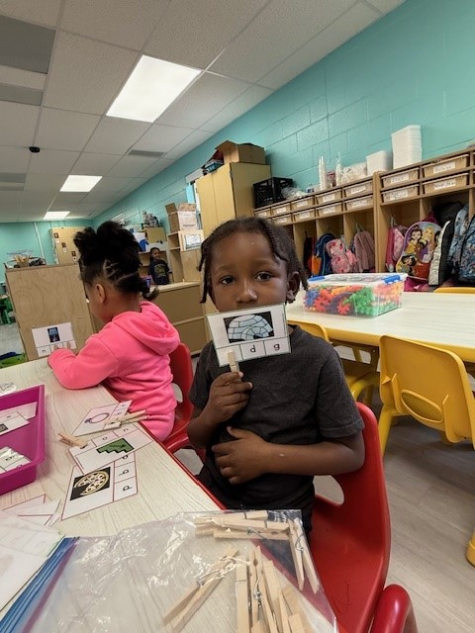
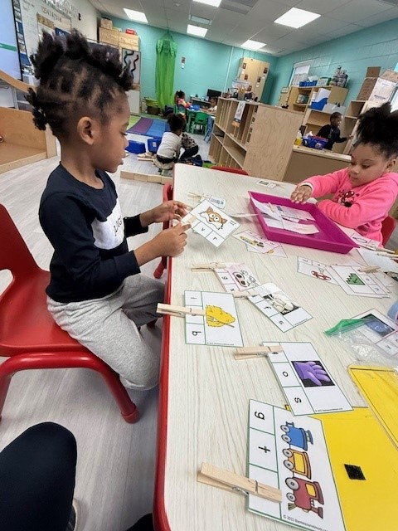
Classroom Spotlight

Slide 21
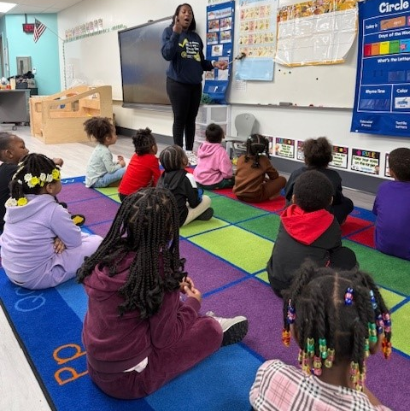
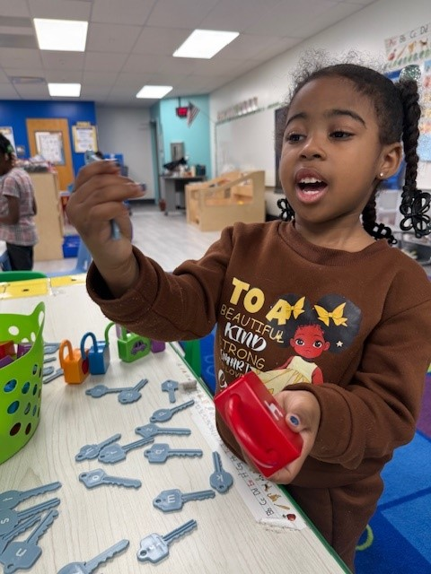
Classroom Spotlight

Slide 22

Recommendation 7
Select a variety of informational and narrative books that are appropriate for 3-, 4-, and 5- year olds
Prior to the lesson, plan the purpose for reading the book and determine when to discuss certain topics with children
Prepare children for listening to and discussing the content of the book before reading the book aloud
Align literacy activities with the focus of the shared reading book

Slide 23
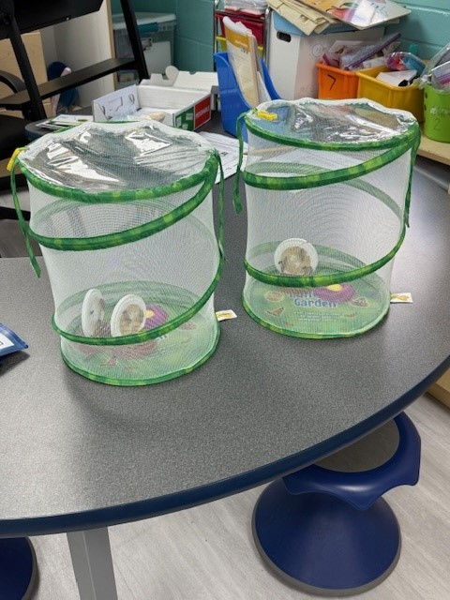
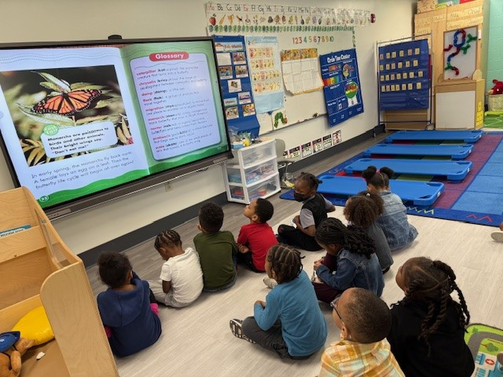
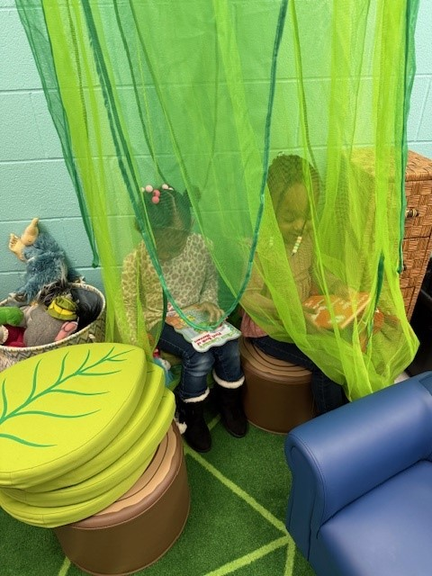
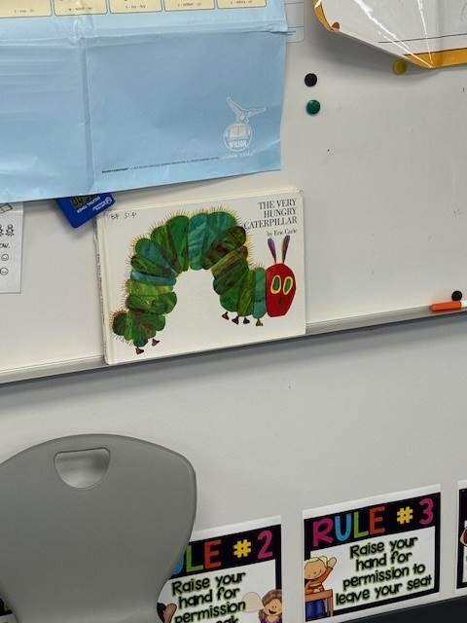
Classroom Spotlight

Slide 24
Jigsaw Activity
Review the “obstacles” for each of the 3 recommendations we focused on in the IES guide. How can get ahead of these possible obstacles?
Groups Share Out

Slide 25
Audience Takeaways
What will you start doing?
What will you stop doing?
What will you continue doing?

Slide 26
Questions?

Slide 27
Ohio The Heart of it All logo

Slide 28
ReadOhio Literacy Academy 2025 logo - end

