Slide 1
ReadOhio Literacy Academy 2025

Slide 2
Disclaimer
This presentation contains examples and resource materials that are provided for the user’s convenience. The inclusion of any material is not intended to reflect its importance, nor is it intended to endorse any views expressed, or products or services. These materials may contain the views and recommendations of the presenter as well as hypertext links, contact addresses and websites to information created and maintained by other public and private organizations. The opinions expressed in any of these materials do not necessarily reflect the positions or policies of the U.S. Department of Education or Ohio Department of Education and Workforce. The U.S. Department of Education and Ohio Department of Education and Workforce do not control or guarantee the accuracy, relevance, timeliness, or completeness of any outside information included in these materials. Mentions of specific programs or products in these examples are designed to provide clearer understanding and are not meant as endorsements.

Slide 3

Intensifying Interventions:
The Power of Practice
Managing Cognitive Load Through Instructional Design
Jamey
Peavler
Assistant Professor and Program Facilitator
Mount St. Joseph University – Graduate Reading Science Program
Jamey.Peavler@MSJ.edu

Slide 4
© 2023 Jamey Peavler
The materials in this presentation are only for the use of the course instructor and the students enrolled in this course for purposes associated with this course. Some of these presentation materials may be subject to copyrights held by third parties. None of these materials may be reproduced, further disseminated, used to train others, accessed by, or made available to others. Questions about the permissibility of using materials in this presentation are advised to consult the course instructor.

Slide 5
Session Objectives
Define proficiency stages (Instructional Hierarchy)
  How do we know if a skill is truly mastered?
Review the Cognitive Load Theory
  Why do some students experience difficulty making progress despite receiving evidence-based instruction?
Outline forms of practice
  What role does practice serve in developing skill proficiency?
Examine recommendations for instructional design
  How can I maximize learning for my students across Tiers?

Slide 6
How do we know if a skill has reached proficiency?
Instructional Hierarchy
Haring, et al., 1978
Daly et al., 1996

Slide 7
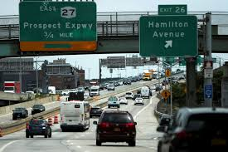
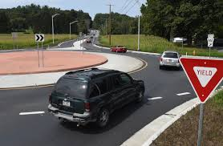
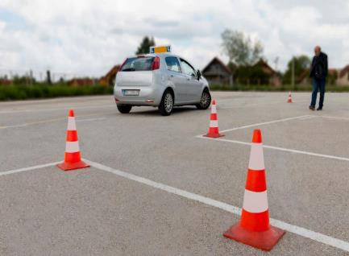

Instructional Hierarchy
(Haring & Eaton, 1978)
Proficiency occurs along a continuum of phases.
  Acquisition
  Fluency
  Generalization
  Adaptation

Slide 8
Instructional Hierarchy Objectives
Acquisition | Increase accuracy Provide massed practice to increase repetition Use controlled (blocked) practice to reduce cognitive load Support retrieval through verbal and visual prompts
Fluency | Increase automatic retrieval without compromising accuracy through massed practice Support discrimination of skill among similar skills through interleaved practice
Generalization | Support retention of skill over time (distributed practice) Integrate skill with previously mastered skills Apply the skill across settings without losing accuracy and automaticity
Adaptation | Apply the skill in authentic contexts Engage in multistep processes to apply the skill

Slide 9
How can I implement these evidence-based practices?
Instructional Design
Archer and Hughes, 2011
Hultberg et al., 2018
Jimerson, 2016

Slide 10

Explicit Instruction
“Explicit instruction breaks up learning into smaller parts. This lightens the “cognitive load,” or how much brain resources a student needs to process information. A lighter cognitive load frees up working memory. That’s important because learning new skills requires a lot of working memory.”
Understood.org

Slide 11

What do we mean by practice?
Each form of practice accomplishes a different purpose
More practice isn’t as effective as providing the right practice
Lesson design should consider how practice fits within a gradual release support structure

Slide 12
Forms of Practice Serve Different Purposes
Organization is how the material is presented and affects cognitive load
  blocked - reduces load
  interleaved/mixed - increases load
Frequency is how often the material is practiced and affects retention
  massed - quick learning, but also quick forgetting
  spaced/distributed - slow learning, but long-term retention
Notes:
Forms of practice relate to the physical presentation of materials and affect cognitive load.
Blocked practice reduces cognitive load and supports accuracy. It removes distractors and allows students to focus on the targeted content.
Interleaved, or mixed practice, increases cognitive load but supports important discrimination skills.
The frequency of practice affects retention.
Massed practice provides high concentrations repetition in a short period. It supports quick learning but also quick forgetting.
Distributed, or spaced practice, spreads repetition out over time, by incorporating periods of rest between practice sessions. It results in slower learning but increases remembering.

Slide 13
Blocked Practice Versus Interleaved/Mixed Practice
ai | ay
wait paid raid claim drain quaint | pay say day play stray gray
strainer stern slope calmly cloak brainy trays | roaming stream scorned sheath bloat soapy traits

Slide 14
Instructional Hierarchy Objectives
Acquisition | Increase accuracy Provide massed practice to increase repetition Use controlled (blocked) practice to reduce cognitive load Support retrieval through verbal and visual prompts
Fluency | Increase automatic retrieval without compromising accuracy through massed practice Support discrimination of skill among similar skills through interleaved practice
Generalization | Support retention of skill over time (distributed practice) Integrate skill with previously mastered skills Apply the skill across settings without losing accuracy and automaticity
Adaptation | Apply the skill in authentic contexts Engage in multistep processes to apply the skill

Slide 15
Acquisition Stage – Explicit Instruction
Review Concept – Target prerequisite skills (warm-up) and/or most recently taught skills using interleaving
Introduce a New Concept - Set the purpose
Model – demonstrate while narrating the steps
Support– blocked practice with feedback
Review – prompted retrieval to check for understanding

Slide 16
Blocked Practice – Acquisition Stage
Visibly groups similar items together
  Reduces cognitive load
  Improves accuracy and automaticity
But… may result in a false sense of security
sh
shop shell ship shed sham | wish mash fish cash dash

Slide 17
Advanced: Blocked Practice
visible vision visual visualize visit visitor | revise supervise invisible advise television supervision
vis

Slide 18
Instructional Hierarchy Objectives
Acquisition | Increase accuracy Provide massed practice to increase repetition Use controlled (blocked) practice to reduce cognitive load Support retrieval through verbal and visual prompts
Fluency | Increase automatic retrieval without compromising accuracy through massed practice Support discrimination of skill among similar skills through interleaved practice
Generalization | Support retention of skill over time (distributed practice) Integrate skills with previously mastered skills Apply the skill across settings without losing accuracy and automaticity
Adaptation | Apply the skill in authentic contexts Engage in multistep processes to apply the skill

Slide 19
Interleaved/Mixed Practice – Fluency Stage
Mixes a variety of items
  Increases cognitive load through more effortful retrieval
  Improves skill retention and generalization
More accurate performance measure
had jog hum rag sit red | box rip jet map bus dig

Slide 20
Advanced: Interleaved Practice
projector inspection inverting supervisor misaligned contradicted | transform restructuring retraction misinformed emerge proactive

Slide 21
When to Move From Blocked to Interleaved?
Provide blocked and massed practice until the skill has reached 95% accuracy
Then promote the interleaved and massed practice until responses are automatic and less effortful
Match this structure for both decoding and encoding

Slide 22
Instructional Hierarchy Objectives
Acquisition | Increase accuracy Provide massed practice to increase repetition Use controlled (blocked) practice to reduce cognitive load Support retrieval through verbal and visual prompts
Fluency | Increase automatic retrieval without compromising accuracy through massed practice Support discrimination of skill among similar skills through interleaved practice
Generalization | Support retention of skill over time (distributed practice) Integrate skill with previously mastered skills Apply the skill across settings without losing accuracy and automaticity
Adaptation | Apply the skill in authentic contexts Engage in multistep processes to apply the skill

Slide 23
Generalization Stage – Controlled Application
Once high levels of accuracy and automaticity are reached, provide:
  distributed practice, incorporating periods of rest between trials to ensure retention
  opportunities for application in more complex structures
  Phrase, sentence, or passage-level reading

Slide 24
Interleaved & Distributed Practice – Generalization Stage
the big cat if I can | tap the box mix it up
The big cat did jump.
Kim is at the shop.

Slide 25
Instructional Hierarchy Objectives
Acquisition | Increase accuracy Provide massed practice to increase repetition Use controlled (blocked) practice to reduce cognitive load Support retrieval through verbal and visual prompts
Fluency | Increase automatic retrieval without compromising accuracy through massed practice Support discrimination of skill among similar skills through interleaved practice
Generalization | Support retention of skill over time (distributed practice) Integrate skill with previously mastered skills Apply the skill across settings without losing accuracy and automaticity
Adaptation | Apply the skill in authentic contexts Engage in multistep processes to apply the skill

Slide 26
Application – Adaptation Stage
When a skill has reached the generalization stage, students are ready to apply the skill to read connected text
Connected text passages are not the only option for fluency practice
  Phrases are best for students with difficulty with whole-word reading
  Sentences are effective when few phonetically irregular words or inflected endings are known

Slide 27
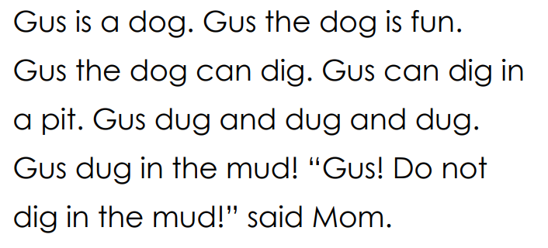
Connected Text Passage

Slide 28
Massed Versus Spaced
Massed Practice
Repetition occurs within a short time
Think of cramming for a test
Spaced Practice
Repetition is spread over time
Periods of rest occur between practice sessions
Rest can be created by manipulating timing or by manipulating format (interleaved)

Slide 29
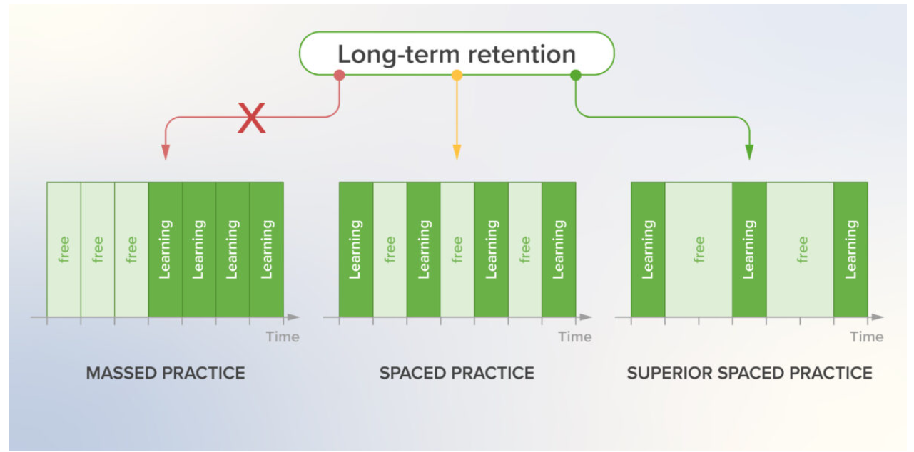
Massed Versus Spaced/Distributed Practice
Foy, R. L.,, Sya’ban, S.N., Horneffer, P., 2021

Slide 30
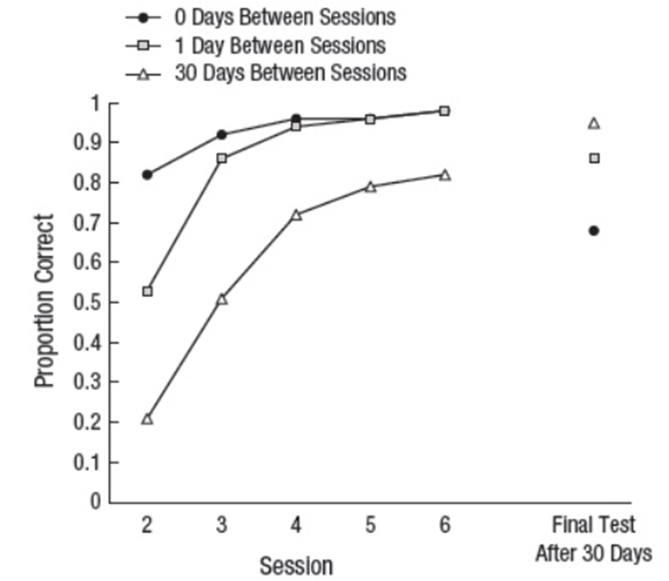
Timing: Frequency
Provide massed practice until accurate and automatic
Then, incorporate periods of rest between sessions
If fluency remains high, increase periods of rest
Karpicke, J.D. & Roediger, H.L. (2007)
Notes:
Cognitive scientists and neurologists have found that repeated practice supports retention and recall of information.
· We also know form their work that the number of repartitions individuals need varies.
· Many of our most at-risk learners require a significantly larger number of repetitions to improve their retention and retrieval of information.
· Brief (5-10 min), daily small-group lessons can be effective for providing these students the additional repetitions they need
· We also know that this spacing (of daily, or every 2 days) over time is more effective than increasing their practice (by min) each day
Practice:
One of the greatest benefits of small-group instruction is the ability to provide immediate feedback to students.
· Remember Anita Archer’s catchphrase? retrieve respond, retain
· Validation of correct responses builds confidence and supports students to retain information
· Corrective feedback is just as important, as it prevents students from developing misconceptions or retaining misinformation

Slide 31
How We Teach Matters
How we teach is just as important as what we teach.
Archer, 2011
National Center on Intensive Intervention

Slide 32
Active Participation
“One of the most consistent findings of educational research in recent years is the positive correlation between active student response and academic achievement: Students' acquisition and maintenance of academic subject matter increase as a function of time spent actively engaged in directly related learning tasks.”
Barbetta et al., 1993, p. 111

Slide 33
Active Participation
(Barbetta et al., 1993; Gardner et al., 1994; Greenwood et al., 1984)
When we increase opportunities for students to respond, we increase student engagement
Responses can be verbal or written
  Turn and Talk
  Choral responses
  Response cards
  Fill-in-the-blank
  Interactive Polls

Slide 34
Immediate Feedback
“In terms of feedback time, the academic performance of immediate feedback was significantly better than that of delayed feedback. The reason may be that, compared with delayed feedback, immediate feedback increases the germane cognitive load while reducing the external cognitive load.”
(Taxipulati & Hai-Dong Lu, 2021, p. 12)

Slide 35
Immediate Feedback
(Opitz et al., 2011)
Student outcomes showed statistically significant improvement when receiving immediate versus delayed feedback
Most effective forms
  Visual models and verbal prompts for self-checking
  Validating and corrective feedback
  Video or audio feedback (if delayed)
  (Hattie & Timperley, 2007)

Slide 36
Effective Instructional Design
  Provides Purposeful Practice
  Blocked and massed for new content
  Interleaved and massed practice for reviewing content
  Spaced practice to ensure retention over time
  Increased opportunities to respond
Reduces Cognitive Load
Consistent language and instructional routines
Concrete examples with validating and corrective
feedback

Slide 37
References
Archer, A. & Hughes, C. (2011). Explicit instruction: Effective and Efficient Teaching.
New York : Guilford Press.
Barbetta, P. M., Heron, T. E., & Heward, W. L. (1993). Effects of active student
response during error correction on the acquisition, maintenance, and generalization of sight words by students with developmental diabilities. Journal
of Applied Behavior Analysis, 26(1), 111–119.
https://doi.org/10.1901/jaba.1993.26-111
Chen, O., Castro-Alonso, J.C., Paas, F., & Sweller, J. (2018). Extending cognitive load
theory to Incorporate working memory resource depletion: Evidence from spacing effect. Educational Psychology Review, 30, 483- 501.

Slide 38
References
Chen, O., Past, F., & Sweller, J. (2021). Spacing and interleaving effects require
distinct theoretical bases: a systematic review testing the cognitive load and discriminative-contrast hypotheses. Educational Psychology Review, 33(4), 1499- 1522. https://doi.org/10.1007/s10648-021-09613-w
Daly III, E. J., Lentz Jr., F. E., & Boyer, J. (1996). The Instructional Hierarchy: A
conceptual model for understanding the effective components of reading interventions. School Psychology Quarterly, 11(4),369.
Gardner, R., Heward, W. L., & Grossi, T. A. (1994). Effects of response cards on
student participation and academic achievement: A systematic replication with inner-city students during whole-class science instruction. Journal of Applied Behavior Analysis, 27(1), 63–71. https://doi.org/10.1901/jaba.1994.27-63

Slide 39
References continued
Gillingham, A. & Stillman, B. (1997). Gillingham Manual: Remedial Training for
Children with Specific Disability in Reading, Spelling and Penmanship (8th ed.). Cambridge, MA: Educators Publishing Service.
Gordon, K. (2020). The advantages of retrieval-based and spaced practice:
Implications for word learning in clinical and educational contexts. Language, Speech, and Hearing Services in Schools, 51(4), 955–965.
Greenwood, C. R., Delquadri, J. D., & Hall, R. V. (1984). Opportunity to respond and
student academic achievement. In W. L. Heward, T. E. Heron, D. S. Hill, & J. Trap- Porter (Eds.), Focus On Behavior Analysis In Education (pp. 58-88). Columbus, OH: Merrill.
Hattie, J. & Timperley, H. (2007). The power of feedback. Review of Educational
Research, 77(1), 81-112.

Slide 40
References cont’d
Haring, N.G., Lovitt, T.C., Eaton, M.D., & Hansen, C.L. (1978). The Fourth R: Research
in the classroom. Columbus, OH: Charles E. Merrill Publishing Co.
Heron, T. E., Heward, W. L., Cooke, N. L., & Hill, D. S. (1983). Evaluation of a
classwide peer tutoring system: First graders teach each other sight words. Education & Treatment of Children, 6, 137-152.
Hultberg, P., Calonge, D. S., & Lee, E. (2018). Promoting long-lasting learning
through instructional design. Journal of the Scholarship of Teaching & Learning, 18(3), 26–43 https://doi.org/10.14434/josotl.v18i3.23179
Jimerson, S. R., Burns, M. K., & VanDerHeyden, A. M. (2016). Handbook of Response
to Intervention: The Science and Practice of Multi-Tiered Systems of Support, 2nd Edition. Springer.

Slide 41
Reference cont’d
Karpicke, J.D. & Roediger, H.L. (2007). Expanding retrieval practice promotes short-
term retention, but equally spaced retrieval enhanced long-term retention. Journal of Experimental Psychology, 33(4), 704- 719.
Krug, D., Davis, T. B., Glover, J. A. (1990). Massed versus distributed repeated
reading: A case of forgetting helping recall? Journal of Educational Psychology, 82, 366-371.
Opitz, B., Ferdinand, N. K., & Mecklinger, A. (2011). Timing matters: the impact of
immediate and delayed feedback on artificial language learning. Frontiers in Human Neuroscience, 5, 8. https://doi.org/10.3389/fnhum.2011.00008
Orton, J. L. (1964). A Guide to Teaching Phonics. Cambridge, MA: Educators
Publishing Service.

Slide 42
References continued
Rome, P. & Osman, J. (1972). The Language Tool Kit. Cambridge, MA: Educators
Publishing Service.
Sheffield, B. (1991). The Structured Flexibility of Orton-Gillingham. Annals of
Dyslexia, 41, 41- 53.
Sweller, J., (2011). Cognitive Load and Theory. Psychology of Learning and
Motivation, 55, 37-76. https://doi.org/10.1016/B978-0-12-387691-1.00002-8
Taxipulati, S., & Lu, H. D. (2021). The Influence of Feedback Content and Feedback
Time on Multimedia Learning Achievement of College Students and Its Mechanism. Frontiers in Psychology, 12, 706-821.
https://doi.org/10.3389/fpsyg.2021.706821

Slide 43
Figures and Resources
Load Types: Rogers, B. (2018), Why Bar-Model Works #2: Reducing Cognitive Load.
Reading for Learning. Retrieved 08.24.2023 from: https://readingforlearning.org/2018/03/28/why-bar-model-works-2-reducing- intrinsic-load/
Wimmer, G.E. & Poldrack, R.A. (2017). Retrieved 08.25.2023 from: https://www.biorxiv.org/content/10.1101/158964v1.full
Karpicke, J.D. & Roediger, H.L. (2007). Expanding retrieval practice promotes short-
term retention, but equally spaced retrieval enhanced long-term retention. Journal of Experimental Psychology, 33(4), 704- 719.
Cognitive Load Theory for Teachers (2019). Key Stage 2 Math. https://youtu.be/MeIx4FVgPsk?si=ekOf6YYY3FHcDHE9

Slide 44
questions

Slide 45
ReadOhio Literacy Academy 2025 logo

Slide 46
ReadOhio Literacy Academy 2025

