Slide 1
Ohio The Heart of It All Logo Placeholder

Slide 2
Read Ohio Literacy Academy 2025

Slide 3
Disclaimer
This presentation contains examples and resource materials that are provided for the user’s convenience. The inclusion of any material is not intended to reflect its importance, nor is it intended to endorse any views expressed, or products or services. These materials may contain the views and recommendations of the presenter as well as hypertext links, contact addresses and websites to information created and maintained by other public and private organizations. The opinions expressed in any of these materials do not necessarily reflect the positions or policies of the U.S. Department of Education or Ohio Department of Education and Workforce. The U.S. Department of Education and Ohio Department of Education and Workforce do not control or guarantee the accuracy, relevance, timeliness, or completeness of any outside information included in these materials. Mentions of specific programs or products in these examples are designed to provide clearer understanding and are not meant as endorsements.

Slide 4
Writing Development for Multilingual Students
Elsa Cárdenas-Hagan, Ed.D.
Valley Speech Language and Learning Center
info@valleyspeech.org

Slide 5
Learning Objectives
Identify the stages of spelling and writing development in multilingual learners.
Understand the role of oral language in the development of written language for multilingual students.
Integrate students' home language knowledge with academic English development.
Apply explicit, systematic strategies for teaching spelling, grammar, and sentence construction to multilingual students.
Implement instructional routines that incorporate cross-linguistic transfer.
Analyze student writing samples to determine developmental spelling stages, language transfer influences, and instructional needs.
Differentiate instruction for multilingual learners based on language samples.

Slide 6

Demographics of English Learners
English language learners represent 10.6% of the school population
There are more than 5.3 million English language learners attending public schools in the United States
The majority of these students speak Spanish in their home (76.4%)
Other home languages represent less than 2% of the EL population (Arabic, Chinese, Vietnamese, Portuguese)
States like California and Texas have more than a million English language learners attending public schools
National Center for Educational Statistics (2024)

Slide 7

National Academies of Sciences, Engineering and Medicine
Consensus Study Report
Promoting the Educational Success of Children and Youth Learning English (2017)
  Developing literacy among English Learners
  Provide explicit instruction in literacy components that include phonemic awareness, phonics, oral reading fluency, vocabulary, reading comprehension and writing

Slide 8

Guidelines for Educating
Kindergarten – 5th Grade
Provide explicit instruction in literacy components
Develop academic language during content area instruction
Provide visual and verbal supports to make core content comprehensible
Encourage peer-assisted learning opportunities.
Capitalize on students’ home language, background knowledge, and cultural assets
Screen for language and literacy challenges and monitor progress
Provide small-group academic support in literacy and English language development for students
Promoting the Educational Success of Children and Youth Learning English: Promising Futures. The National Academy of Sciences (2017)

Slide 9
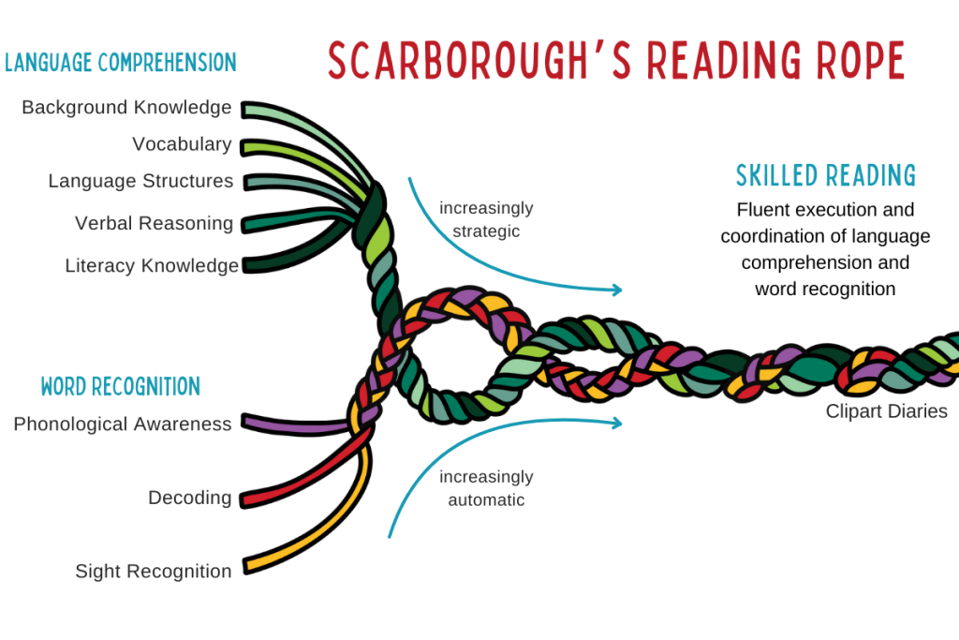
Scarborough’s reading rope
(2001)

Slide 10
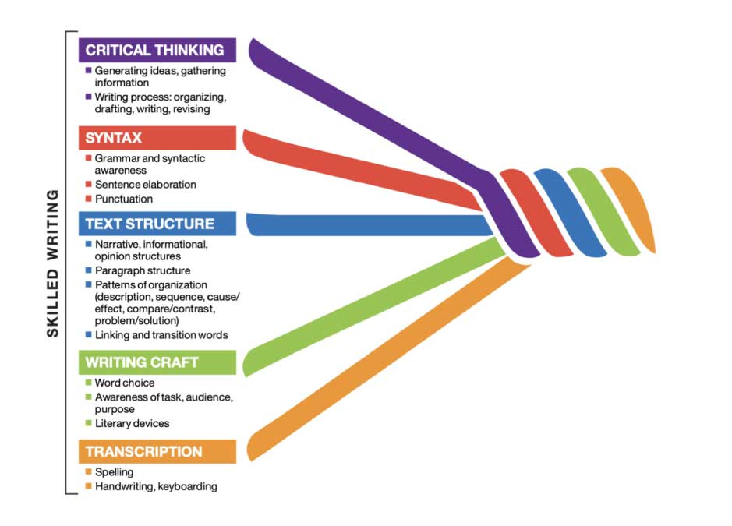
The writing rope
The Writing Rope
(Sedita, 2019)
Notes:
In, 2023, Joan Sedita published a book called the Writing Rope examining the basic skills of transcription with the higher order skills of writing craft, text structure, syntax, and critical thinking.
The critical thinking strand focuses on executive functioning skills, as well as the ability to develop background knowledge about a writing topic. In this strand, writing tasks are to include written summaries, writing personal responses to narrative text, writing responses to prompts based on sources and research-writing tasks. Later in this presentation, we can review how we can use AI tools to address this critical writing strand.
The second strand, is syntax which focuses on communicating information and ideas and writing. One must understand the stem and arrangement of words, phrases, and clauses that make up a sentence.
The next strand focuses on text structure. Students will benefit from explicit instruction for the different levels of the text structure. For example, the first bullet point can focus on introduction, body development and conclusion.
The second bullet point can organize these parts around the main idea and supporting details.
We also want to understand that paragraph can be organized for a specific purpose. In which, we can use specific graphic organizers to meet the needs of our monolingual and multilingual students.
We want to use words or phrases to link sentences, paragraphs of text.
The Writing craft will focus on writing style, text, structure, and choice of words. We want teachers to share examples of text that show how authors use techniques, and students are able to imitate them in their own writing. We want our students to be mindful on choice, voice, and literary devices.
Finally, we have our transcription component in which we want to address spelling and handwriting and/or keyboarding skills. We want our students to become automatic and fluent with these skills as they move into the later grades.

Slide 11

Logo for structured multiliteracy multilanguage foundation
Cárdenas-Hagan (2024)

Slide 12
Oral language considerations for multilingual students
Oral Language Considerations for Multilingual Students
Provide authentic and purposeful exposure to language
Use first language knowledge for the development of second language

Slide 13
Authentic Purpose Exposure to Language
A formal Language Sample: Model and Practice
Collect 50 utterances
Write down each utterance
Count the number of words spoken per utterance
Get a grand total of words spoken
Divide the grand total by 50
This gives you the mean length of utterance (MLU)
Now determine the features of spoken language that need to be addressed
Discuss a plan for how they will be addressed

Slide 14
Formal Language Sample
No like 2.0 Like bowl 2.0 Beach 1.0 Agua cold 2.0 Eat 1.0
Book 1.0 Ball go 2.0 Play 1.0 Pool big 2.0 Taco 1.0
Like movie 2.0 Inside ball 2.0 Games 2.0 Float 1.0 Cheese 1.0
Batman 1.0 Friend 1.0 Uno 1.0 Swim 1.0 Tomato 1.0
Car varoom 2.0 Pins 1.0 Abuela 1.0 Dive in 2.0 Drink Tea 2.0
Robin 1.0 Pins fall 2.0 Mom 1.0 Jump ball 2.0 Lemon 1.0
Robin friend 2.0 Win 1.0 Dad too 2.0 Win game 2.0 Ice cream 2.0
Fight 1.0 Mom 1.0 Baby no 2.0 Get towel 2.0 Chocolate 1.0
Win 1.0 Tomas 1.0 Cry 1.0 Dry it 2.0 Vanilla 1.0
No 1.0 Dad 1.0 Sleep 1.0 Hungry too 2.0 Yummy 1.0

Slide 15
Design Instruction
1. What is the mean length of utterance score for the student?
2. What specific goals are necessary to expand his oral language skills?

Slide 16
Design Instruction
Noun – Verb
Noun – Verb – Object
Noun – Verb – Article – Object
Noun – Verb – Article – Adjective – Object
Noun – Verb – Article – Adjective – Object – Conjunction – Noun – Verb – Article – Adjective – Object
Noun – Verb – Preposition – Noun – Preposition – Article – Noun

Slide 17
Oral language considerations for multilingual students – second part
Oral Language Considerations for Multilingual Students
Provide word learning strategies to expand vocabulary
Incorporate cognate and morphological awareness across the content areas
Exposure to authentic text and sample writings can facilitate academic language development and inspire writing

Slide 18
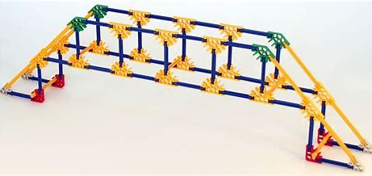
Word Learning Connections
Cognate Awareness
Morphological Awareness
Making Connections
Multiple Opportunities for Use
Ramirez, G. et al., (2009)
Dressler, C. et al., (2011)

Slide 19
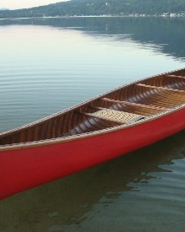
Cognate Awareness
The ability to identify words from other languages that share similar spellings and meanings
English shares cognates with many languages
One example:
canoe (English/Catalan)
canoa (Spanish/Italian/Portuguese)
canoė (French)
kanu (German)
каное (Ukrainian)

Slide 20


Cross-Linguistic Example
The word is author in English. Say the word.
The word in Spanish is autor. Say the word.
How many syllables are in the Spanish word? How many are in the English word? How many sounds in Spanish? How many sounds in English?
How many morphemes or meaning units? Let’s discuss the meaning of the word author. Let’s describe and then compare and contrast an author with an architect.
Is the word a noun? Can it be used as a verb?
Can you use the word in a sentence?
Can you describe the similarities and differences in the spelling of author in English and Spanish?
Adapted from Working with English Language Learners (WELLS) 2
Copyright © 2016 Elsa Cárdenas-Hagan

Slide 21
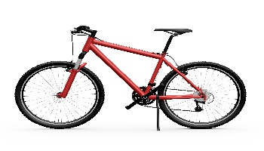
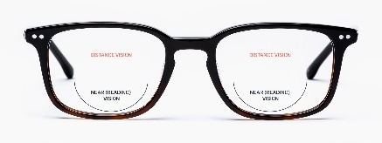
Sample Lesson
We will learn a prefix today. A prefix is found at the beginning of a word and can change the meaning.
Say bicycle, bilingual, bifocals.
What did you hear that was the same?
Look at the words as I write them. How do we spell this prefix? Do any of these words look familiar to you in your first language? Tell me about this. Say the words in your language.
How many wheels does a bicycle have? two
How many languages does a bilingual person speak? two
How many lenses do my bifocals have? two
So, what does the prefix bi- mean? Two Yes, prefix bi- means two.
Can you think of other words with the same prefix? For example, if you are a person that represents two cultures you are bicultural. If something has two colors, it is bicolored. Do you know these words in your home language? Tell me about this.
We will create a word wall for our word parts including prefixes, roots, and suffixes.
We will also add this prefix to your vocabulary journal. Good job.
As you listen to people or as you read, please listen carefully to words with the prefix, bi-We will add them to our word wall. Remember prefix bi- means two.
(Adapted from WOW 1- Cárdenas-Hagan, 2014)

Slide 22
Teaching writing to multilingual students
Teaching Writing to Multilingual Students
Multilingual students must achieve oral language proficiency to achieve written language proficiency
Foundational skills of writing such as spelling and grammar must be addressed with a particular lens of cross-linguistic transfer
Multilingual students must have opportunities to expand world knowledge and be exposed to the writing process using culturally and linguistically responsive teaching
Instructors must be prepared to provide both the oral and written language instruction that is differentiated for multilingual learners

Slide 23
Foundational skills of spelling for multilingual students
Foundational Skills of Spelling for Multilingual Students
Provide students with explicit and systematic spelling instruction
Teach the spelling patterns and 5 spelling rules
Use cross-language approach by teaching the similarities and differences across languages

Slide 24
Similarities and differences between English and Spanish spelling
English | Spanish
5 vowels with short or long sounds | 5 vowels that have only 1 sound
The vowel letters – A, E, I, O, U Similar vowels are short E, and long O Silent letters such as final E | The vowel letters – A, E, I, O, U Vowels E, O are connected to English Silent letter H
Diphthongs such as AI, AY, OI, OY, IE, EU Diphthongs that are similar - OI, OY, EI | Diphthongs such as AI, AY, OI, OY, IE, EU Diphthongs that are similar - OI, OY, EI
C before A, O, U, and consonants as /k/ | C before A, O, U, and consonants as /k/
C before E, or I as soft sound /s/ G before A, O, U and consonants as /g/ | C before E, or I as soft sound /s/ G before A, O, U and consonants as /g/
G before E, or I as sound /j/ Add – ES if word ends in S, SH, CH, V, X, Z | G before E or I as sound like /h/ Add –ES when a word ends in a consonant.
Similarities and Differences between English and Spanish Spelling
Cárdenas-Hagan, 2017, 2020

Slide 25
Foundational skills of grammar for multilingual students
Foundational Skills of Grammar for Multilingual Students
Provide students with explicit and systematic grammar instruction
Teach the parts of speech to for sentence construction
Build on sentence construction for the development of paragraph writing
Use cross-language approach by teaching the similarities and differences across languages

Slide 26
Similarities and differences between English and Spanish capitalization, punctuation, and syntax
English | Spanish
Nouns name a person, place or thing. | Nouns name a person, place or thing.
Nouns have gender when something is male or female. | Nouns are masculine or feminine.
Subject dropping is not allowed. | Subject dropping is allowed.
Proper nouns are capitalized. | Proper nouns are capitalized except common nouns such as days of the week and months of the year.
Verbs are words used to describe action. | Verbs are words used to describe action.
Verbs have a present and past tense. | Verbs have present tense, but past tense has six forms.
Adverbs are word that modify verbs. | Adverbs are words that modify verbs.
Adverbs are comparative superlative. | Adverbs are comparative superlatives.
Adjectives are words that modify a noun. | Adjectives are words that modify a noun.
Adjectives appear before the noun. | Adjectives appear after the noun.
Exclamation point is used at the end of a sentence to alert the reader that something exciting has been stated. | Exclamation point is used at the beginning and the end of a sentence to alert the reader that something exciting has been stated.
Question mark is used at the end of questions. | Question mark is used at the beginning and at the end of questions.
Similarities and Differences between English and Spanish Capitalization, Punctuation, and Syntax
Cárdenas-Hagan 2020

Slide 27

Be Diagnostic and prescriptive with writing instruction
Be diagnostic and prescriptive with writing instruction

Slide 28
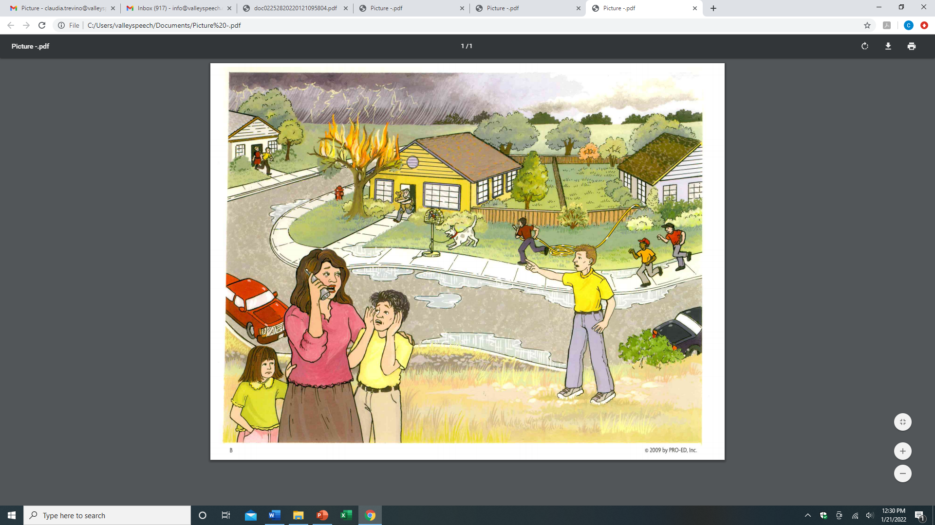
storytime

Slide 29
English Learner Writing Sample
It was a stormi day.
The litll girl name is Sandi.
The tree is on fire en the men has a holl to put the faire out.
Bikus the haus kut burn and thers a storm heting to the toun.
Pipll or going to ther hom bikus the children cut get sik.
Notes:
Now let’s analyze and come to an agreement of how we will describe the spelling errors . You can work with a partner and we will discuss as a whole group.

Slide 30
Kinds of Errors
  Use of native language syntax structure
  Use of native language word choice
  Use of native language spelling pattern
1
  Run-on sentences
  Phrases used in place of specific vocabulary
2
  Complete thoughts in English
  Incorrect usage of punctuation and capitalization
3
  Overgeneralization of spelling and/or syntax rules
4
Cárdenas-Hagan (2017, 2024)
Notes:
This is a writing rubric to determine the types of errors in the written sample.
1 relects use of the native language for word choice, syntax and spelling.
2 reflect run on sentences or phrases use in place of specific vocabulary.
3 reflects complete thought in English but also noted uncorrect usage of punctuation and captilaization.
4 is overgeneralization of spelling and/or syntax rules.

Slide 31
Instruction for Student
It was a stormi day.
Notes:
Now let’s see if you agree with the analysis. Provide your rationale.

Slide 32
Instruction for Student
It was a stormi day. 3
Teach English words don’t end in i, they end in y
Notes:
Now let’s see if you agree with the analysis. Provide your rationale.

Slide 33
Instruction for Student
The litll girl name is Sandi.
Notes:
Now let’s see if you agree with the analysis. Provide your rationale.

Slide 34
Instruction for Student
The litll girl name is Sandi. 3
Teach doubling medial consonant, -le
Notes:
Now let’s see if you agree with the analysis. Provide your rationale.

Slide 35
Instruction for Student
The tree is on fire en the men has a holl to put the faire out.
Notes:
Now let’s see if you agree with the analysis. Provide your rationale.

Slide 36
Instruction for Student
The tree is on fire en 1 the men has a holl 1 to put the faire 3 out.
Teach discrimination of vowels, vocabulary word with ending of /z/ and vowel-consonant-e syllable for long I sound
Notes:
Now let’s see if you agree with the analysis. Provide your rationale.

Slide 37
Instruction for Student
Bikus the haus kut burn and thers a storm heting to the toun.
Notes:
Now let’s see if you agree with the analysis. Provide your rationale.

Slide 38
Instruction for Student
Bikus 2 the haus 3 kut 1 burn and thers 3 a storm heting 1 to the toun. 3
Teach the irregular word because.
Teach the ou vowel pair and final se.
Teach contraction for there is.
Teach the difference between /d/ and /t/

Slide 39
Spelling Instruction for Student
Pipll or going to ther hom bikus the children cut get sik.

Slide 40
Instruction for Student
Pipll 3 or 2 going to ther 2 hom 3 bikus 2 the children cut 2 get sik. 3
Teach irregular word people
Teach high frequency word are
Teach possessive word their
Teach vowel- consonant – e pattern
Teach irregular word because
Teach high frequency word could and discrimination of /d/ and /t/
Teach final /k/ as ck in a one syllable word after the short vowel.

Slide 41

treatment
An AI-generated image of small group instruction

Slide 42

Language example
heting
for
heading
/ă/ and /ě/
/d/ and /t/
/ē/ and / ě /
D or T

Slide 43
example between Spanish and english
litll
for
little
rab
lit
muf
stif
+ it
+ -le
+ in
+ en
= rabbit
= little
= muffin
= stiffen

Slide 44

Six Types of Syllables in the English Language
name
theme
five
rope
cube
Vowel-Consonant-e Syllable
A vowel-consonant-e syllable ends in one vowel, one consonant, and a final e.
The e is silent.
The vowel is long.

Slide 45
Words with final /k/ as ck
back
deck
sick
rock
luck
Final /k/ in a 1-syllable word after the short vowel is ck

Slide 46
Irregular Words
because
(becuz)
English- the reason that, since Part of speech-conjunction
Spanish porque

Slide 47








Resources
Multitiered System of Supports for English Learners https://www.mtss4els.org/
National Center for Improving Literacy https://www.improvingliteracy.org/
The Meadows Center https://meadowscenter.org/
Center for the Success of English Learners https://www.cselcenter.org/
¡Colorín Colorado! https://www.colorincolorado.org/
Reading Universe https://readinguniverse.org/
Evidence Advocacy Center - Resource Menu https://evidenceadvocacycenter.org/
International Dyslexia Association https://dyslexiaida.org/

Slide 48


summary
Errors informs Instruction
Now use it!
website:
www.valleyspeech.org
email:
info@valleyspeech.org

Slide 49
questions

Slide 50
Ohio the heart of it all logo

Slide 51
ReadOhio Literacy Academy 2025

