Slide 1
Ohio: The Heart of it All. Ohio.org

Slide 2
Literacy Academy 2025

Slide 3
Disclaimer
This presentation contains examples and resource materials that are provided for the user’s convenience. The inclusion of any material is not intended to reflect its importance, nor is it intended to endorse any views expressed, or products or services. These materials may contain the views and recommendations of the presenter as well as hypertext links, contact addresses and websites to information created and maintained by other public and private organizations. The opinions expressed in any of these materials do not necessarily reflect the positions or policies of the U.S. Department of Education or Ohio Department of Education and Workforce. The U.S. Department of Education and Ohio Department of Education and Workforce do not control or guarantee the accuracy, relevance, timeliness, or completeness of any outside information included in these materials. Mentions of specific programs or products in these examples are designed to provide clearer understanding and are not meant as endorsements.

Slide 4
Using an Evidence-Based Comprehension Building Practice to Improve Comprehension and Content Knowledge for Secondary Students: An Overview and Considerations for Varying Implementation Intensity
Jade
Wexler
PhD
This research is supported by the following: Grant R324A200012 (AIM IES) and Grant H326M200015 (AIM OSEP). The contents of this presentation were developed under a grant from the Department of Education. However, those contents do not necessarily represent the policy of the Department of Education, and you should not assume endorsement by the Federal Government.

Slide 5
PACT Plus Booster Session Overview
PACT Plus Background
  Critical Reading
  Implementation suggestions
Resources
Review

Slide 6
Session Objectives
Participants will learn how to implement Critical Reading in two ways.
Participants will understand the importance of and methods to vary intensity of implementation of Critical Reading using an explicit instruction continuum.
Participants will learn how to access several practical resources they can use to aide in implementation of these practices.

Slide 7
PACT Plus Background

Slide 8
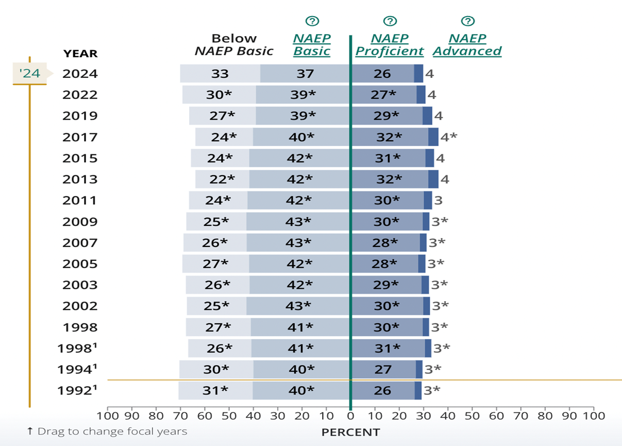
Many Middle School Students
Struggle with Reading
NAEP Proficient
locate information
identify main idea
identify order of events
make simple inferences
Identify one or both sides of an argument in informational text
interpret meaning of a word as it is used in text

Slide 9

School-Wide Literacy Models Provide for Struggling Readers in an Efficient Way
1
Science
1
Social Studies
1
ELA

Slide 10
IES Recommendations Based on Strong or Moderate Scientific Evidence
Provide explicit vocabulary instruction.
Strong
Gradual Release of Responsibility
Provide explicit comprehension
strategy instruction.
Strong
Opportunities to Respond and Practice
Provide opportunities for extended discussion of text meaning and interpretation.
Moderate
Increase student motivation and
engagement in literacy learning.
Moderate
Corrective Feedback
Make available intensive interventions for struggling readers.
Strong

Slide 11

PACT Plus Practices
Content and curriculum agnostic; text-based
Comprehension Canopy | Essential Words | Critical Reading
Building background knowledge | Building vocabulary knowledge | Facilitating text comprehension and content acquisition through reading and text-based discussion

Slide 12
Sample lesson schedule

Slide 13
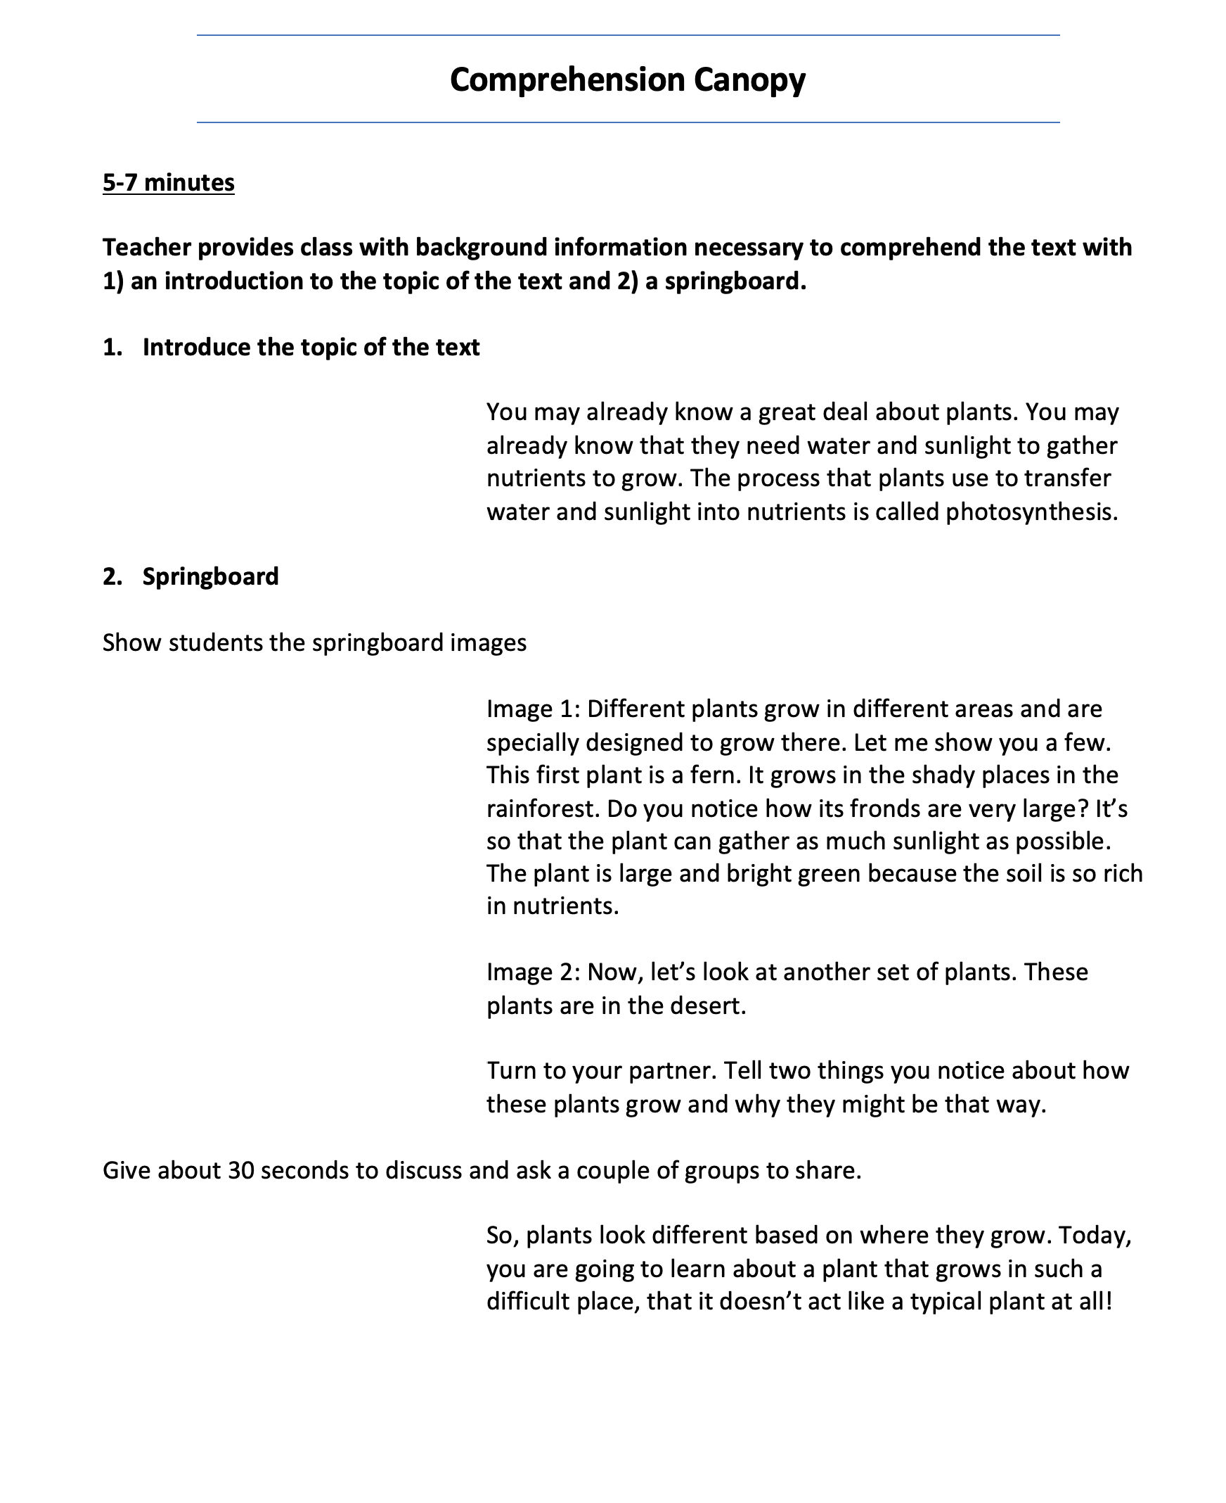


Introduction and Prior Knowledge
Science Lesson 1

Slide 14
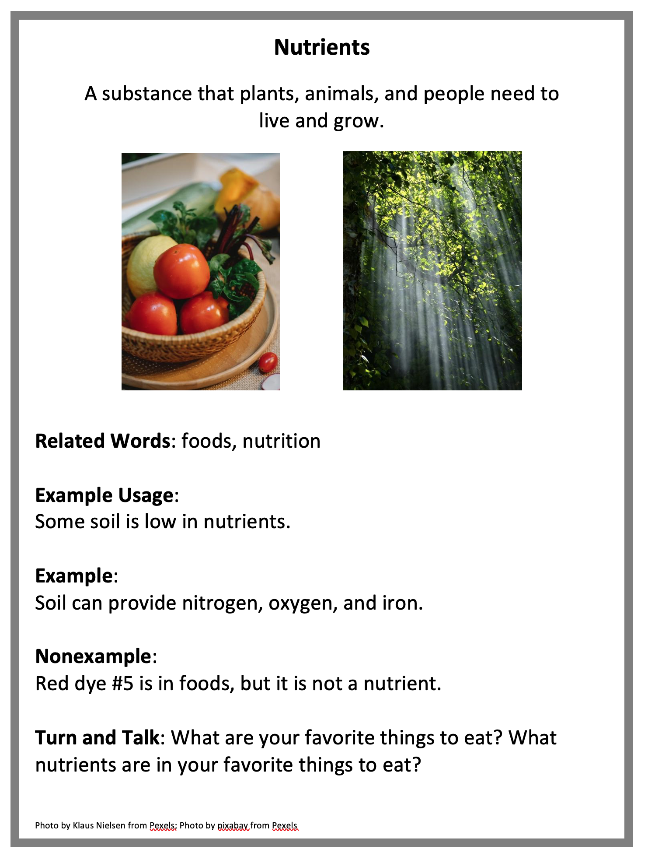
Essential Word Components

Slide 15
Critical Reading

Slide 16
Two Options for Critical Reading
Critical Reading with Get the Gist
Focus on main idea
High support
Peer-Mediated Critical Reading with Comprehension Questions
Focus on text-dependent questions
Low support
Can include peer-mediated practice
Always includes peer-mediated practice
We recommend beginning with Get the Gist and then moving toward Comprehension Questions as students demonstrate proficiency with Get the Gist.

Slide 17
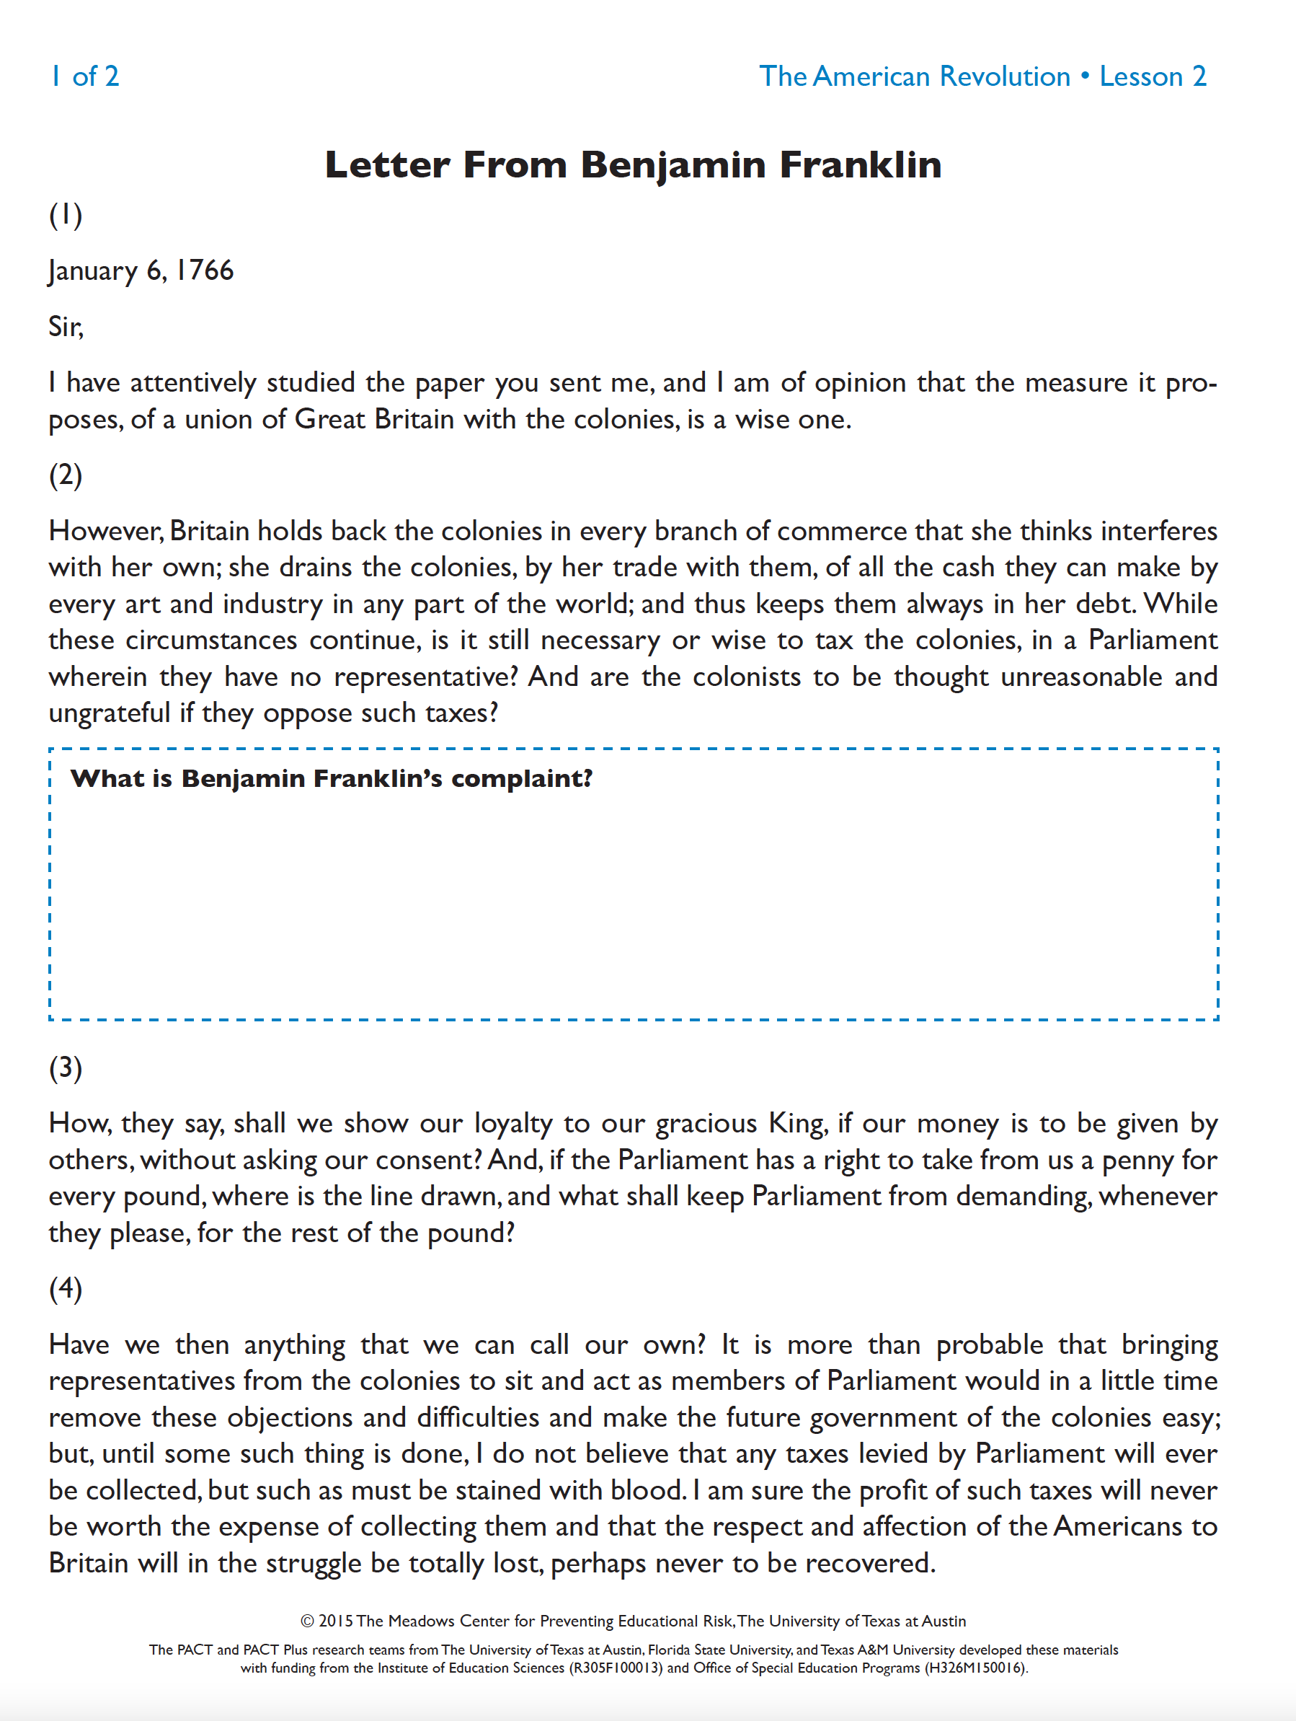
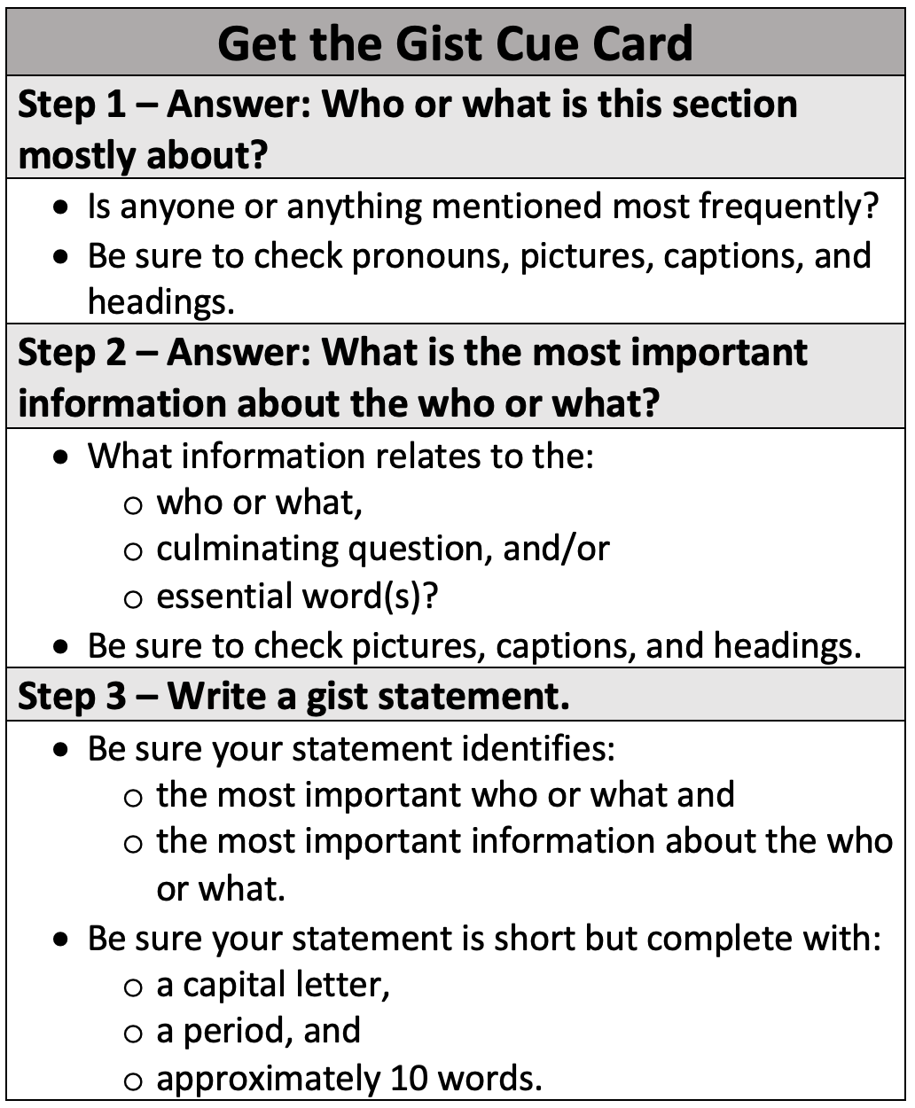
Embedded Explicit Strategy Instruction Option

Slide 18
Critical Reading with Get the Gist

Slide 19
Get the Gist Steps
1. Answer: Who or what is this section mostly about?
2. Answer: What is the most important information about the who or what?
3. Write a gist statement.

Slide 20
Critical Reading with Get the Gist Structure
Introduce the Passage
Teach (or Review) Get the Gist
Model Get the Gist
Practice Get the Gist
Answer the Culminating Question

Slide 21
Critical Reading with Get the Gist Structure: introduce the passage
Introduce the Passage
Teach (or Review) Get the Gist
Model Get the Gist
Practice Get the Gist
Answer the Culminating Question

Slide 22

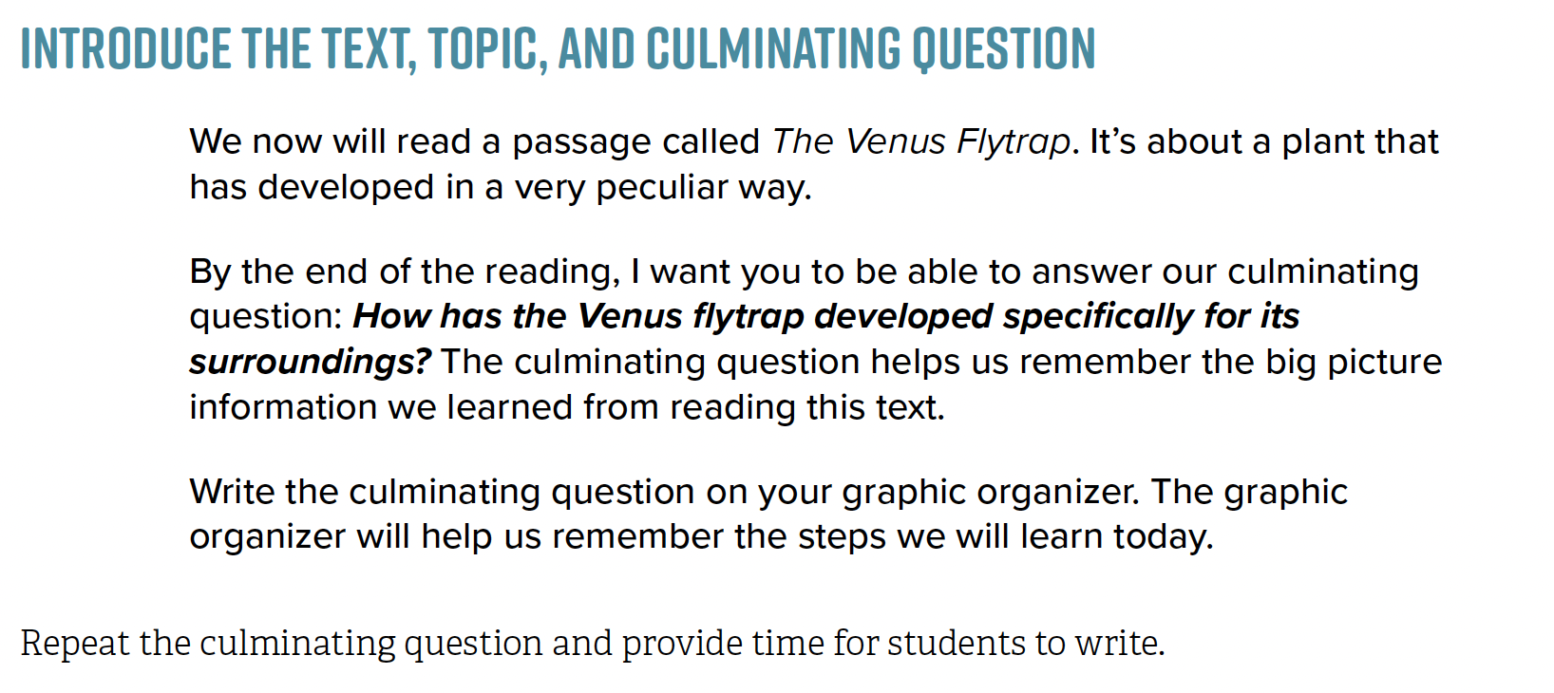

Science Lesson 1: Venus Flytrap
1. Introduce the text and what the text is about
2. Introduce the culminating question

Slide 23
Critical Reading with Get the Gist Structure: Teach and model
Introduce the Passage
Teach (or Review) Get the Gist
Model Get the Gist
Practice Get the Gist
Answer the Culminating Question

Slide 24
Introduce the Step: Main who/what
1. Answer: Who or what is this section mostly about?

Slide 25
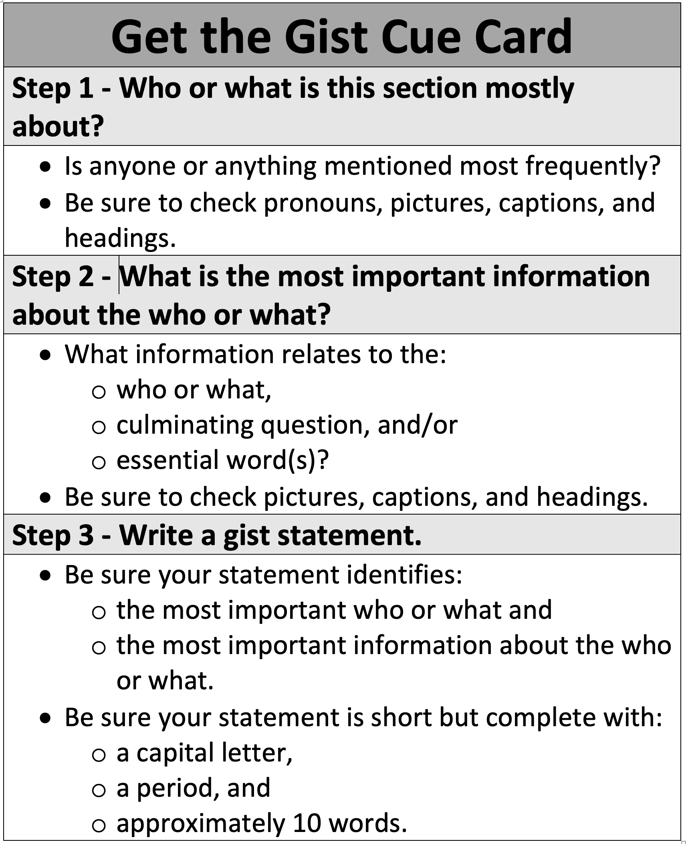
Introduce the
Gist Pointers: Step 1
HO3

Slide 26
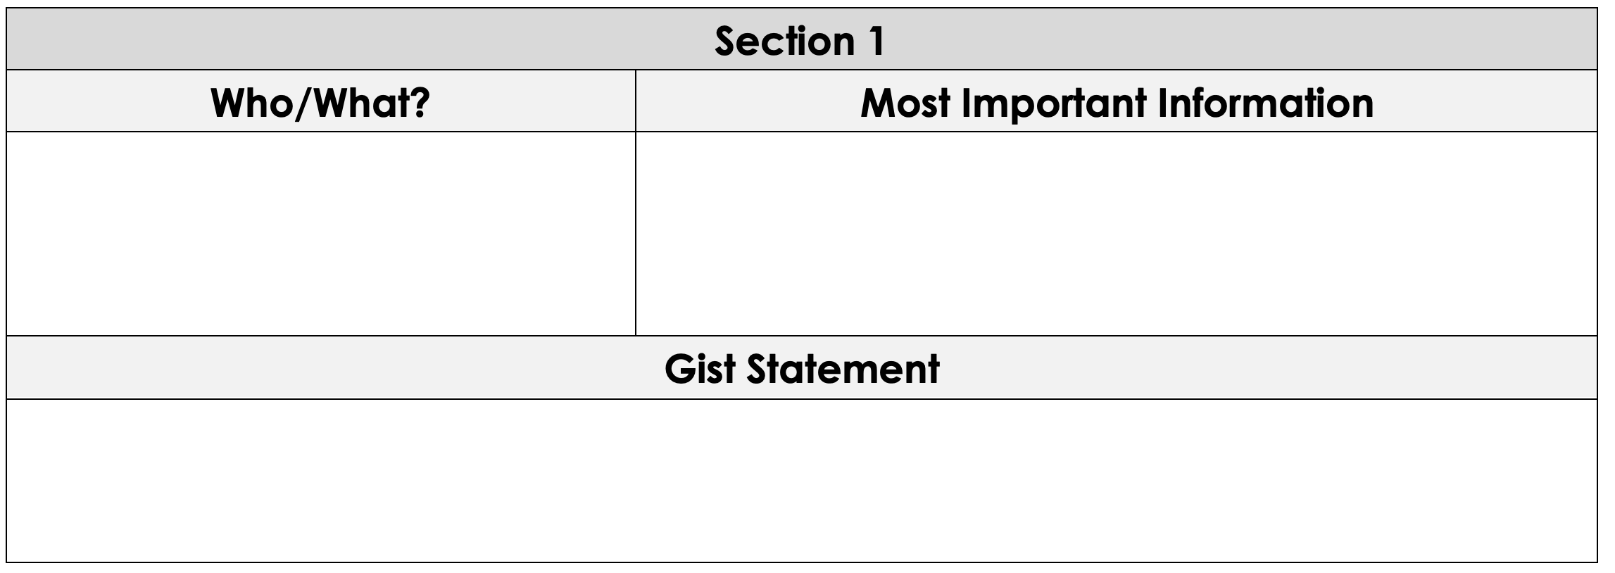
Model the Step: Step 1
The Venus flytrap is an insect-eating plant that lives mostly on the East Coast. Found primarily in swampy parts of the United States, like North and South Carolina, the Venus flytrap has colorful pink and green hues. Like most other plants, Venus flytraps get some nutrients from the soil, but since swampy areas tend to have soil that is nutrient-poor, it is hard for the plant to get nutrients from there. As a result, the flytrap has evolved to not only rely on the soil to survive. The Venus flytrap is a carnivorous plant because it catches insects and eats them to get the nutrients that it can’t get from the soil.
Venus flytrap

Slide 27
Introduce the Step: Most important information
1. Answer: Who or what is this section mostly about?
2. Answer: What is the most important information about the who or what?

Slide 28
Introduce the
Gist Pointers: Step 2

Slide 29
Model the Step: Step 2
The Venus flytrap is an insect-eating plant that lives mostly on the East Coast. Found primarily in swampy parts of the United States, like North and South Carolina, the Venus flytrap has colorful pink and green hues. Like most other plants, Venus flytraps get some nutrients from the soil, but since swampy areas tend to have soil that is nutrient-poor, it is hard for the plant to get nutrients from there. As a result, the flytrap has evolved to not only rely on the soil to survive. The Venus flytrap is a carnivorous plant because it catches insects and eats them to get the nutrients that it can’t get from the soil.
Venus flytrap
Eats insects to get nutrients
Lives in swamps
Gets little nutrients from soil

Slide 30
Introduce the Step: write a gist statement
1. Answer: Who or what is this section mostly about?
2. Answer: What is the most important information about the who or what?
3. Write a gist statement.

Slide 31
Introduce the
Gist Pointers: Step 3

Slide 32

Model the Step: step 3
Does my gist statement name the most important “who” or “what”?
The Venus flytrap is an insect-eating plant that lives mostly on the East Coast. Found primarily in swampy parts of the United States, like North and South Carolina, the Venus flytrap has colorful pink and green hues. Like most other plants, Venus flytraps get some nutrients from the soil, but since swampy areas tend to have soil that is nutrient-poor, it is hard for the plant to get nutrients from there. As a result, the flytrap has evolved to not only rely on the soil to survive. The Venus flytrap is a carnivorous plant because it catches insects and eats them to get the nutrients that it can’t get from the soil.
Eats insects to get nutrients
Lives in swamps
Gets little nutrients from soil
Venus flytrap
The Venus flytrap eats insects because it gets few nutrients from soil.

Slide 33
Model the Step: step 3 (cont.)
Does my gist statement name the most important information about the who” or “what”?
The Venus flytrap is an insect-eating plant that lives mostly on the East Coast. Found primarily in swampy parts of the United States, like North and South Carolina, the Venus flytrap has colorful pink and green hues. Like most other plants, Venus flytraps get some nutrients from the soil, but since swampy areas tend to have soil that is nutrient-poor, it is hard for the plant to get nutrients from there. As a result, the flytrap has evolved to not only rely on the soil to survive. The Venus flytrap is a carnivorous plant because it catches insects and eats them to get the nutrients that it can’t get from the soil.
Eats insects to get nutrients
Lives in swamps
Gets little nutrients from soil
Venus flytrap
The Venus flytrap eats insects because it gets few nutrients from soil.

Slide 34
Model the Step: step 3 (cont.)
Is my gist statement a short but complete sentence?
The Venus flytrap is an insect-eating plant that lives mostly on the East Coast. Found primarily in swampy parts of the United States, like North and South Carolina, the Venus flytrap has colorful pink and green hues. Like most other plants, Venus flytraps get some nutrients from the soil, but since swampy areas tend to have soil that is nutrient-poor, it is hard for the plant to get nutrients from there. As a result, the flytrap has evolved to not only rely on the soil to survive. The Venus flytrap is a carnivorous plant because it catches insects and eats them to get the nutrients that it can’t get from the soil.
Eats insects to get nutrients
Lives in swamps
Gets little nutrients from soil
Venus flytrap
The Venus flytrap eats insects because it gets few nutrients from soil.

Slide 35
Critical Reading with Get the Gist: Practice
Introduce the Passage
Teach (or Review) Get the Gist
Model Get the Gist
Practice Get the Gist
Answer the Culminating Question
Skipping for the sake of time

Slide 36
Critical Reading with Get the Gist Structure: culminating question
Introduce the Passage
Teach (or Review) Get the Gist
Model Get the Gist
Practice Get the Gist
Answer the Culminating Question

Slide 37
Answer the Culminating Question
1. Re-introduce the culminating question
2. Prompt students to review gist statements
3. Facilitate turn-and-talk
Ask probing questions
Write or not!
4. Prompt students to share out

Slide 38
Culminating Question Model
Culminating Question: How and why has the Venus Flytrap developed specifically for its surroundings?
Gist Statements:
The Venus flytrap eats insects because it doesn’t get a lot of nutrients from soil.
The trap has leaves that close on big insects.
The Venus flytrap takes 5–12 days to squeeze insects tightly to dissolve their insides.
The trap opens only a few times and can catch few bugs before dying.
Respond to the culminating question.

Slide 39
Culminating Question Model (continued)
Culminating Question: How and why has the Venus Flytrap developed specifically for its surroundings?
Gist Statements:
The Venus flytrap eats insects because it doesn’t get a lot of nutrients from soil.
The trap has leaves that close on big insects.
The Venus flytrap takes 5–12 days to squeeze insects tightly to dissolve their insides.
The trap opens only a few times and can catch few bugs before dying.
Exemplar Response: The Venus flytrap developed to trap and eat insects for nutrients. This is important because the Venus flytrap grows in poor soil with little nutrients.

Slide 40
Peer-Mediated Critical Reading with Get the Gist

Slide 41
Background Info on Partner Reading
Evidence of effectiveness at the secondary level
(Wexler, Reed, Pyle, Mitchell, & Barton, 2015)
Students have more time with “eyes on text”
Every student receives immediate corrective feedback
Every student participates in discussion

Slide 42
Peer-Mediated Get the Gist Structure
Establish Pairs
Introduce the Passage
Teach (or Review) Get the Gist
Model Get the Gist
Facilitate Partner Reading with Get the Gist
Answer Culminating Question
Students can choose to use the Gist Pointers here if needed.

Slide 43
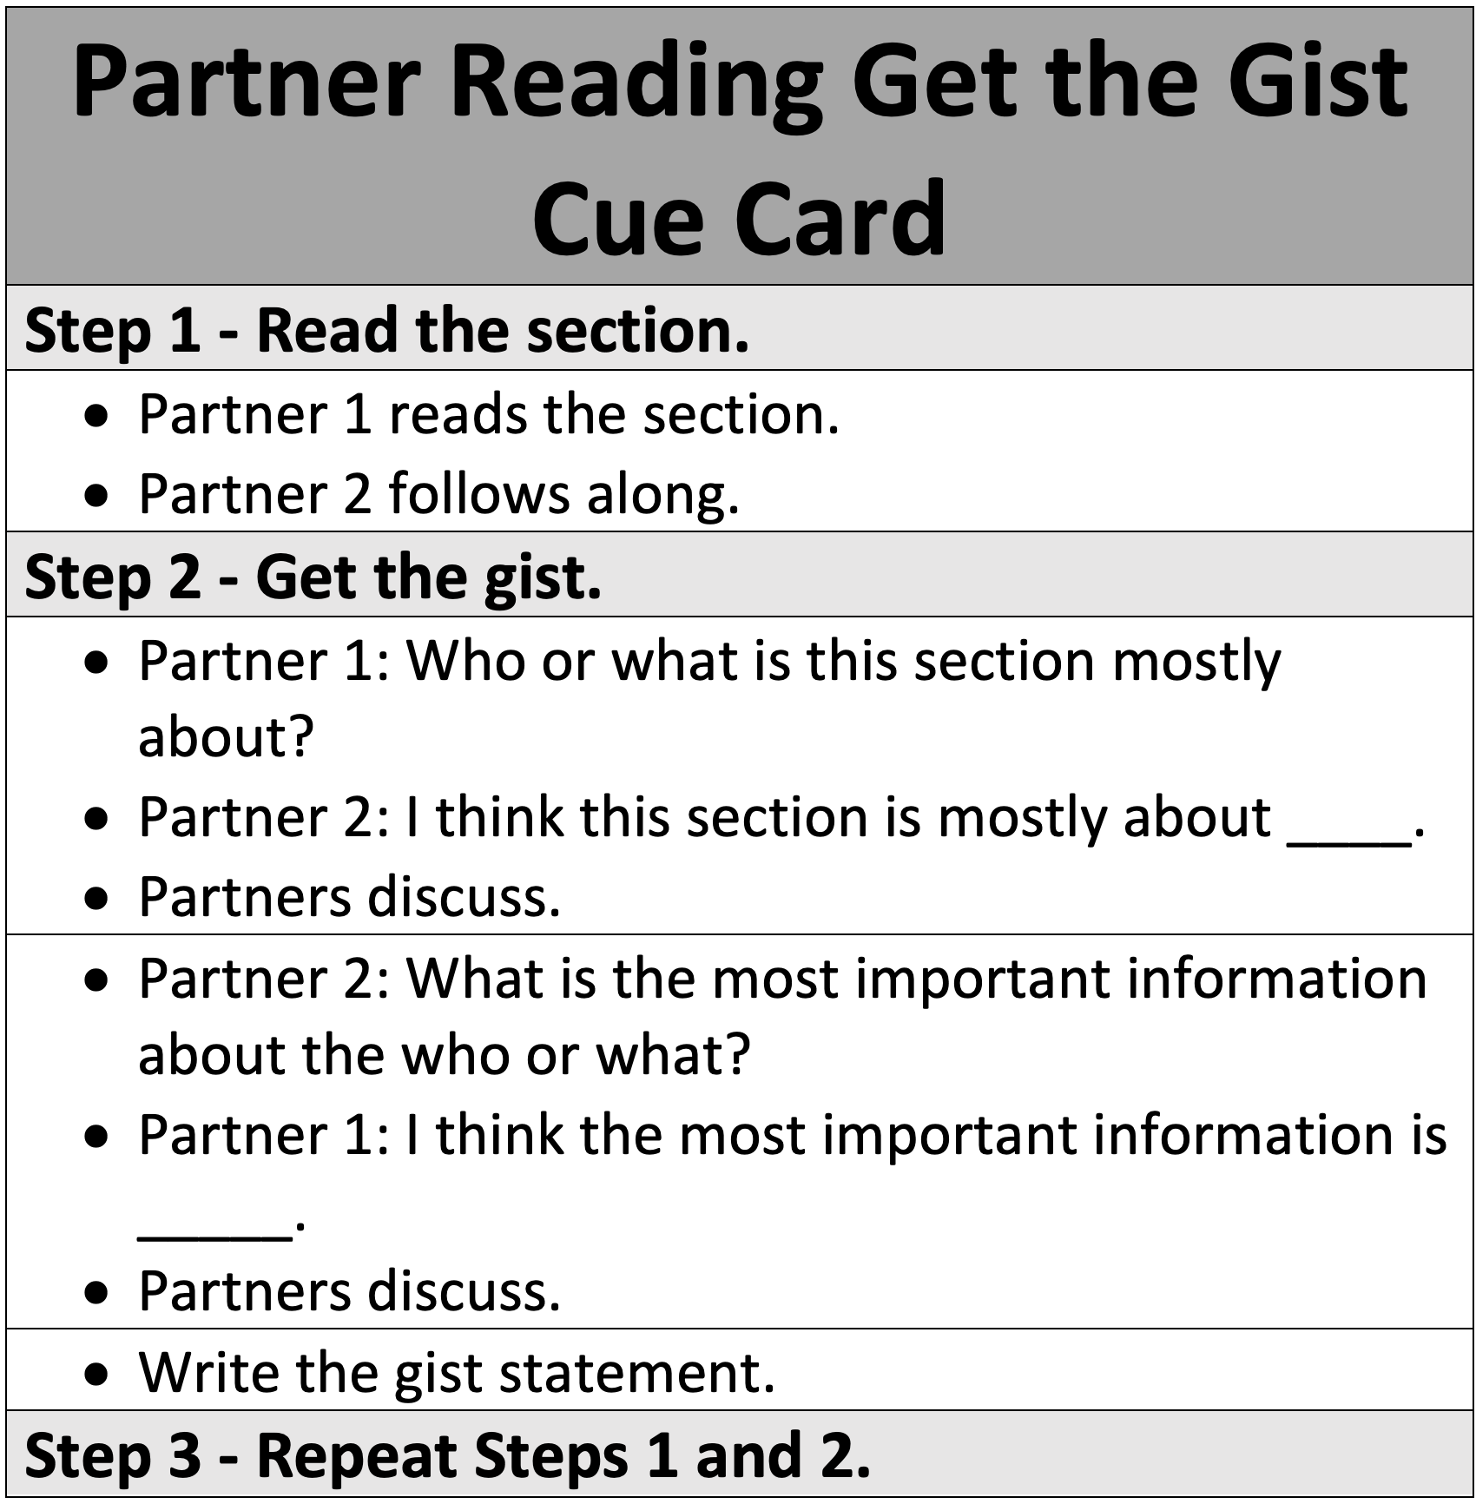
Partner reading with get the gist
Students can choose to use the Gist Pointers here if needed.

Slide 44
A Reminder: Two Options for Critical Reading
Critical Reading with Get the Gist
Focus on main idea
High support
Peer-Mediated Critical Reading with Comprehension Questions
Focus on text-dependent questions
Low support
Can include peer-mediated practice
Always includes peer-mediated practice
We recommend beginning with Get the Gist and then moving toward Comprehension Questions as students demonstrate proficiency with Get the Gist.

Slide 45
Critical Reading Text-Based Discussion Approach:
An Explicit Instruction Continuum
Strategy Instruction Approach: Get the Gist
Content Approach: Comprehension Questions
Teaching students how to learn and use information through specific strategies
Characterizes written content as the vehicle for instruction, engaging students in building coherent representations of the ideas presented in print.
Construction-Integration Model (Kintsch, 1998) operationalizes this approach
Students read text to construct and link understandings
Integrate these new ideas from text with previously learned content (their prior knowledge)
Instructionally
Includes a focus on discourse about text

Slide 46
Peer-Mediated Critical Reading with Comprehension Questions

Slide 47
Peer-Mediated Critical Reading with Comprehension Questions Structure
Introduce the Passage
Ask 1–2 Comprehension Questions Per Section
Answer the Culminating Question

Slide 48
Peer-Mediated Critical Reading with Comprehension Questions Structure
Introduce the Passage
Ask 1–2 Comprehension Questions Per Section
Answer the Culminating Question

Slide 49
Science Lesson 1: Venus Flytrap
HO2
1. Introduce the text and what the text is about
2. Introduce the culminating question
Same as before!

Slide 50
Peer-Mediated Critical Reading with Comprehension Questions Structure
Introduce the Passage
Ask 1–2 Comprehension Questions Per Section
Answer the Culminating Question

Slide 51
Ask 1–2 Comprehension Questions
After students read a section of text in pairs:
1. Ask an open-ended comprehension question
2. Facilitate a turn-and-talk of the question
3. Facilitate a class discussion of the question
4. Repeat previous steps for a 2nd question

Slide 52
Ask 1–2 Comprehension Questions
After students read a section of text in pairs:
1. Ask an open-ended comprehension question
require students to use information from the section to answer
present 1 question at a time
encourage students to annotate and take notes

Slide 53
Comprehension Question
The Venus flytrap is an insect-eating plant that lives mostly on the East Coast. Found primarily in swampy parts of the United States, like North and South Carolina, the Venus flytrap has colorful pink and green hues. Like most other plants, Venus flytraps get some nutrients from the soil, but since swampy areas tend to have soil that is nutrient-poor, it is hard for the plant to get nutrients from there. As a result, the flytrap has evolved to not only rely on the soil to survive. The Venus flytrap is a carnivorous plant because it catches insects and eats them to get the nutrients that it can’t get from the soil.
Why do Venus flytraps eat insects?

Slide 54
Ask 1–2 Comprehension Questions
After students read a section of text in pairs:
1. Ask an open-ended comprehension question
2. Facilitate a turn-and-talk of the question
should take 1–2 minutes
encourage students to use annotations and notes

Slide 55
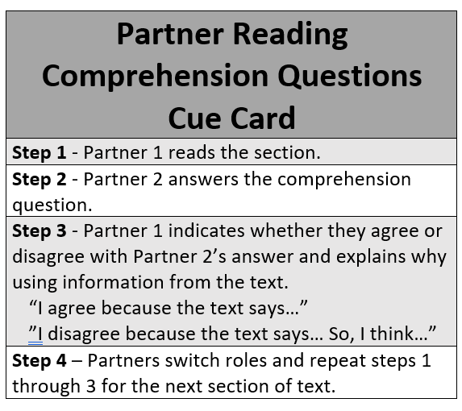
Turn-and-Talk

Slide 56
Your Turn
Turn-and-Talk
The Venus flytrap is an insect-eating plant that lives mostly on the East Coast. Found primarily in swampy parts of the United States, like North and South Carolina, the Venus flytrap has colorful pink and green hues. Like most other plants, Venus flytraps get some nutrients from the soil, but since swampy areas tend to have soil that is nutrient-poor, it is hard for the plant to get nutrients from there. As a result, the flytrap has evolved to not only rely on the soil to survive. The Venus flytrap is a carnivorous plant because it catches insects and eats them to get the nutrients that it can’t get from the soil.
Why do Venus flytraps eat insects?

Slide 57
Ask 1–2 Comprehension Questions
After students read a section of text in pairs:
1. Ask an open-ended comprehension question
2. Facilitate a turn-and-talk of the question
3. Facilitate a class discussion of the question
prompt students to share out
ask follow-up questions

Slide 58
Ask Follow-Up Questions
Elaborate
Cite Evidence
Invite Others
Why?
How?
What does the text say?
How do you know?
Can someone add to that response?
Who (dis)agrees? Why?

Slide 59
Your Turn
Class Discussion
The Venus flytrap is an insect-eating plant that lives mostly on the East Coast. Found primarily in swampy parts of the United States, like North and South Carolina, the Venus flytrap has colorful pink and green hues. Like most other plants, Venus flytraps get some nutrients from the soil, but since swampy areas tend to have soil that is nutrient-poor, it is hard for the plant to get nutrients from there. As a result, the flytrap has evolved to not only rely on the soil to survive. The Venus flytrap is a carnivorous plant because it catches insects and eats them to get the nutrients that it can’t get from the soil.
Why do Venus flytraps eat insects?

Slide 60
Ask 1–2 Comprehension Questions
After students read a section of text in pairs:
1. Ask an open-ended comprehension question
2. Facilitate a turn-and-talk of the question
3. Facilitate a class discussion of the question
4. Repeat previous steps for a 2nd question

Slide 61
Peer-Mediated Critical Reading with Comprehension Questions Structure
Introduce the Passage
Ask 1–2 Comprehension Questions Per Section
Answer the Culminating Question

Slide 62
Answer the Culminating Question
1. Re-introduce the culminating question
2. Prompt students to review responses to comprehension questions
3. Facilitate turn-and-talk
Ask probing questions
Write or not!
4. Prompt students to share out

Slide 63
Implementation Suggestions

Slide 64
Critical Reading Text-Based Discussion Approach:
An Explicit Instruction Continuum
Strategy Instruction Approach: Get the Gist
Content Approach: Comprehension Questions
Overt use of Get the Gist
with gist pointers and
a graphic organizer
Covert use of Get the Gist
without gist pointers and
a graphic organizer
Lower-order (e.g., literal questions)
Higher-order (e.g., inferential questions)
Teacher modeling
Peer-mediated instruction
Whole-class

Slide 65
Sample Progression for Critical Reading
Critical Reading with Get the Gist
Gist pointers
Graphic organizer
Critical Reading with Get the Gist
Peer-Mediated Critical Reading with Comprehension Questions
Critical Reading with Get the Gist
Graphic organizer
Peer-Mediated Critical Reading with Get the Gist

Slide 66
Sample Progression for Critical Reading
Critical Reading with Get the Gist
Gist pointers
Graphic organizer
Peer-Mediated Critical Reading with Get the Gist
Critical Reading with Get the Gist
Peer-Mediated Critical Reading with Comprehension Questions

Slide 67
Sample Progression for Critical Reading
Critical Reading with Get the Gist
Gist pointers
Graphic organizer
Peer-Mediated Critical Reading with Comprehension Questions
Peer-Mediated Critical Reading with Get the Gist

Slide 68
How do I know students are demonstrating proficiency?
Consider students’:
Annotations related to gist pointers or comprehension questions
Graphic organizers (i.e., gist statements, responses to culminating questions)
Written answers to comprehension questions
Responses during text-based discussions
Performance related to PACT Plus in other classes
Reading assessment data

Slide 69
Resources

Slide 70


Aim coaching website

Slide 71
Review

Slide 72
Review
PACT Plus is a set of evidence-based comprehension building practices that are content and curriculum agnostic.
Teachers can vary the intensity of instruction when implementing Critical Reading keeping in mind the use of a strategy approach in service of a content approach.
Make sure to check out the online modules on PACT Plus including how to plan for Critical Reading.
Let me know if you have questions or feedback!!

Slide 73
Thank you! jawexler@umd.edu

Slide 74
questions

Slide 75
Questions continued

Slide 76
Ohio

Slide 77
Ohio Literacy Academy

