Slide 1
ReadOhio Literacy Academy 2025

Slide 2
disclaimer
This presentation contains examples and resource materials that are provided for the user’s convenience. The inclusion of any material is not intended to reflect its importance, nor is it intended to endorse any views expressed, or products or services. These materials may contain the views and recommendations of the presenter as well as hypertext links, contact addresses and websites to information created and maintained by other public and private organizations. The opinions expressed in any of these materials do not necessarily reflect the positions or policies of the U.S. Department of Education or Ohio Department of Education and Workforce. The U.S. Department of Education and Ohio Department of Education and Workforce do not control or guarantee the accuracy, relevance, timeliness, or completeness of any outside information included in these materials. Mentions of specific programs or products in these examples are designed to provide clearer understanding and are not meant as endorsements.

Slide 3

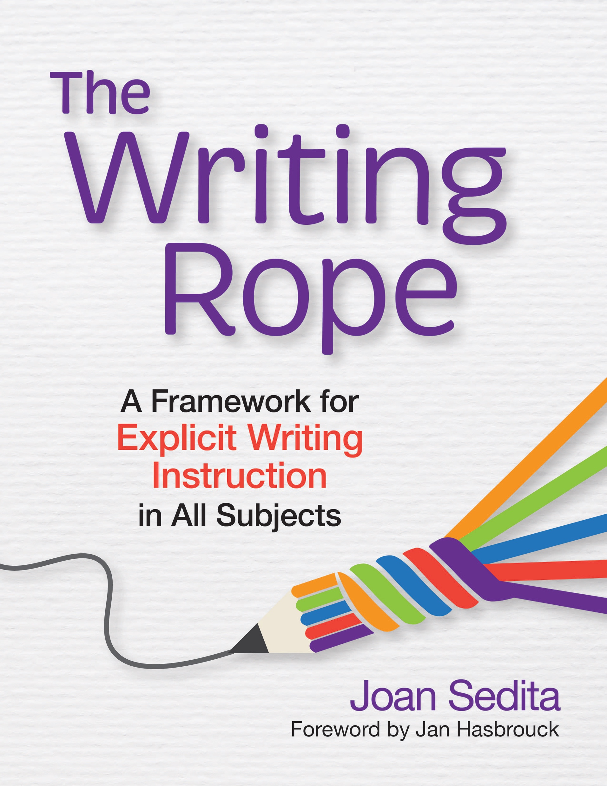

Adolescent Writing:
The Writing Rope Framework
Using writing to support Learning
Joan Sedita
Founder, CEO, Keys to Literacy

Slide 4

Learning Objectives
Become familiar with The Writing Rope framework
Identify the stages of the writing process
Learn ways to use writing to learn: quick writes, responding to narrative, note taking, summarizing, writing prompts
Review factors affecting motivation & engagement
A topic or activity that is part of the OHIO SOR
6-12 Course.

Slide 5


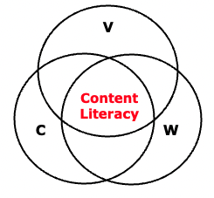
Why focus on adolescent Literacy?
Literacy is the ultimate gatekeeper for students!
Reading & Writing
Speaking & Listening
Tier I Content Literacy:
Vocabulary, Comprehension, Writing Combined
It is the foundation for learning in all subjects!

Slide 6
Why teach writing in all subjects?
Writing leads to better learning of content.
When writing precedes discussion, there is more thoughtful participation and increased diversity of student voices.
Writing is a form of formative assessment.
Archer, 2015

Slide 7
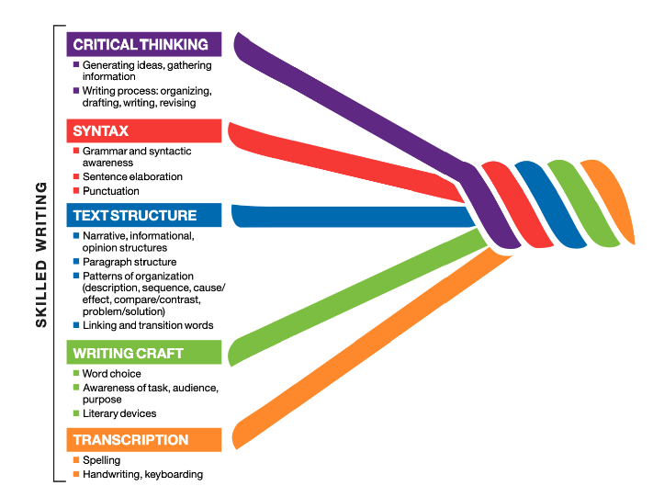

The writing rope
The
Writing Rope
The Strands That Are Woven Into Skilled Writing
https://keystoliteracy.com/
free-resources/

Slide 8
Teaching Principles
Explicit Instruction of Writing Strategies – I, We, You
Differentiated Instruction & Scaffolds
Opportunities for Collaboration
Mentor Text as Models for Writing
Increasing Amount Students Write in All Subject

Slide 9
Levels of Instruction
Disciplinary Writing | advanced writing | TIER I
Content Writing | writing to communicate & learn
Basic Writing Skills | learning to write | TIER II & III
Notes:
Levels of Instruction
Disciplinary: Advanced (specialized writing skills and techniques unique to subject areas)
Content Writing: Writing to learn and communicate (text structure for the 3 types of writing, stages of the writing process, summarizing, note taking, elaborated sentence writing, patterns of organization & related transitions, awareness of TAP, writing craft)
Basic Writing Skills Learning to Write (intervention for basic skills including spelling, handwriting/keyboarding, sentence & paragraph writing
Tier I: Provide accommodations, modifications, scaffolds that ensure struggling learners can access the same essential content knowledge as their non-struggling peers
Tier II & III: Remediate to develop basic skills

Slide 10
Writing tips
Quick Writes | Content Learning | Formal Writing
< Ten min Related to content Objective: process, reflect on, or assess content learning No revision Informally evaluated, not graded | One or more sessions Related to content Objective: deepen understanding & reflection, assess content learning May be revised May be informally evaluated, may be graded | Multiple sessions Related to content Objective: more deeply learn content, develop authentic writing skills, assess writing skills, prepare for on-demand writing Revised, formally evaluated, grade
Sedita, 2020

Slide 11
Examples of Content Writing Tasks
General Academic | Authentic, Real-World | Subject Specific
Summary Essay, composition Short answer test question Description, explanation Sequence, chronology, compare/contrast, cause/effect, problem/solution | Letter Article Editorial Brochure, poster Info-graphic Blog post Proposal Advertisement Book, movie review Resume, cover letter | Science: lab report Social Studies: writing about historical events Math: describe, explain a graph ELA: literary analysis, poem Art: developing an artist’s statement or analysis of an art work
Sedita, 2020

Slide 12
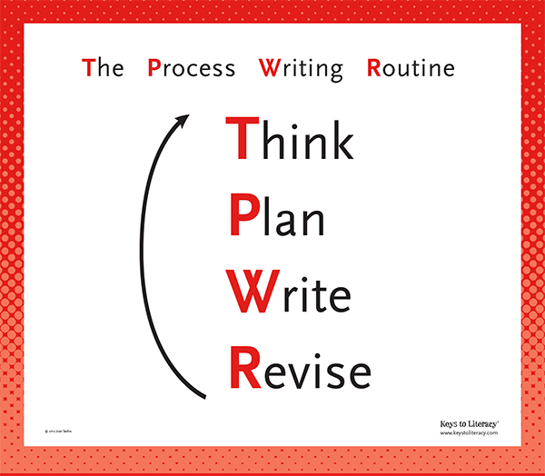
Stages of the Writing Process
Teach and remind students to follow all stages of the writing process whenever they write.
View the Guiding Questions

Slide 13

The Critical Thinking Strand:
Using Writing to Learn

Slide 14

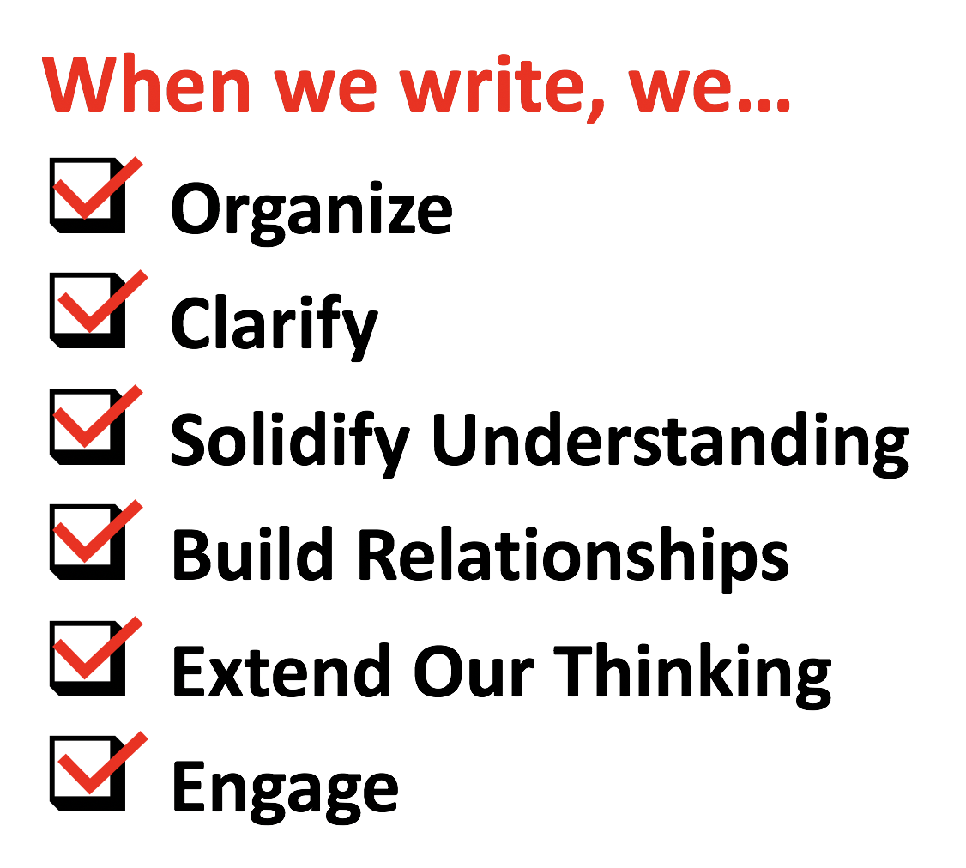
Writing is Thinking!
Even quick writing is powerful for processing, understanding, remembering.

Slide 15

Writing to Read
Recommendation #1
Students’ comprehension of content area texts is improved when they write about what they read.
Have students:
  respond to a text in writing (personal reactions, analyzing & interpreting the text)
  write summaries
  write notes about a text
  answer questions about a text in writing, or create and answer questions

Slide 16
1. QUICK WRITES
Short, informal, “sketching” with words
Frequent, easily shared, informally assessed
Any point in a lesson to help remember, organize, manage information
Use for formative assessment
Admit, exit tickets
Notes
List of facts, steps, ideas
Instructions, directions
Free-writing
Generate a question
Complete a graphic organizer
Write a definition
Short-answer questions
1- to 2-sentence reflections

Slide 17

2. Responding to Narrative Text
Writing personal responses to narrative text
or writing a personal experience related to it.
Example: Response Journal – students write their feelings, reactions, and questions during or after reading
Helps students clarify and organize what they are reading and become aware of their reactions to the text

Slide 18
Guiding questions
Overall Personal Response
Response to Theme
Response to Characters
Response to Setting
Response to Author
View the Questions
Assign a few based on teaching goals.

Slide 19
Taking notes about reading
3. Take Notes About Reading: Two-Column
Simple format
Easy to study
Good for lectures
Versatile
Promotes active learning of what is read, said, done
Topic ___________________________
Big ideas
Supporting details
Sedita, 2015
Notes:
19

Slide 20
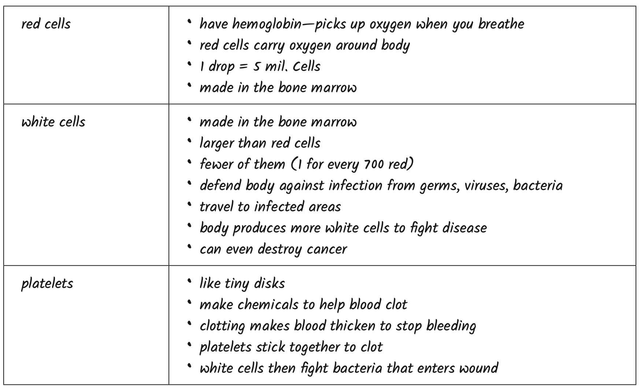
Explain the role of human blood cells.
Sedita, 2023

Slide 21
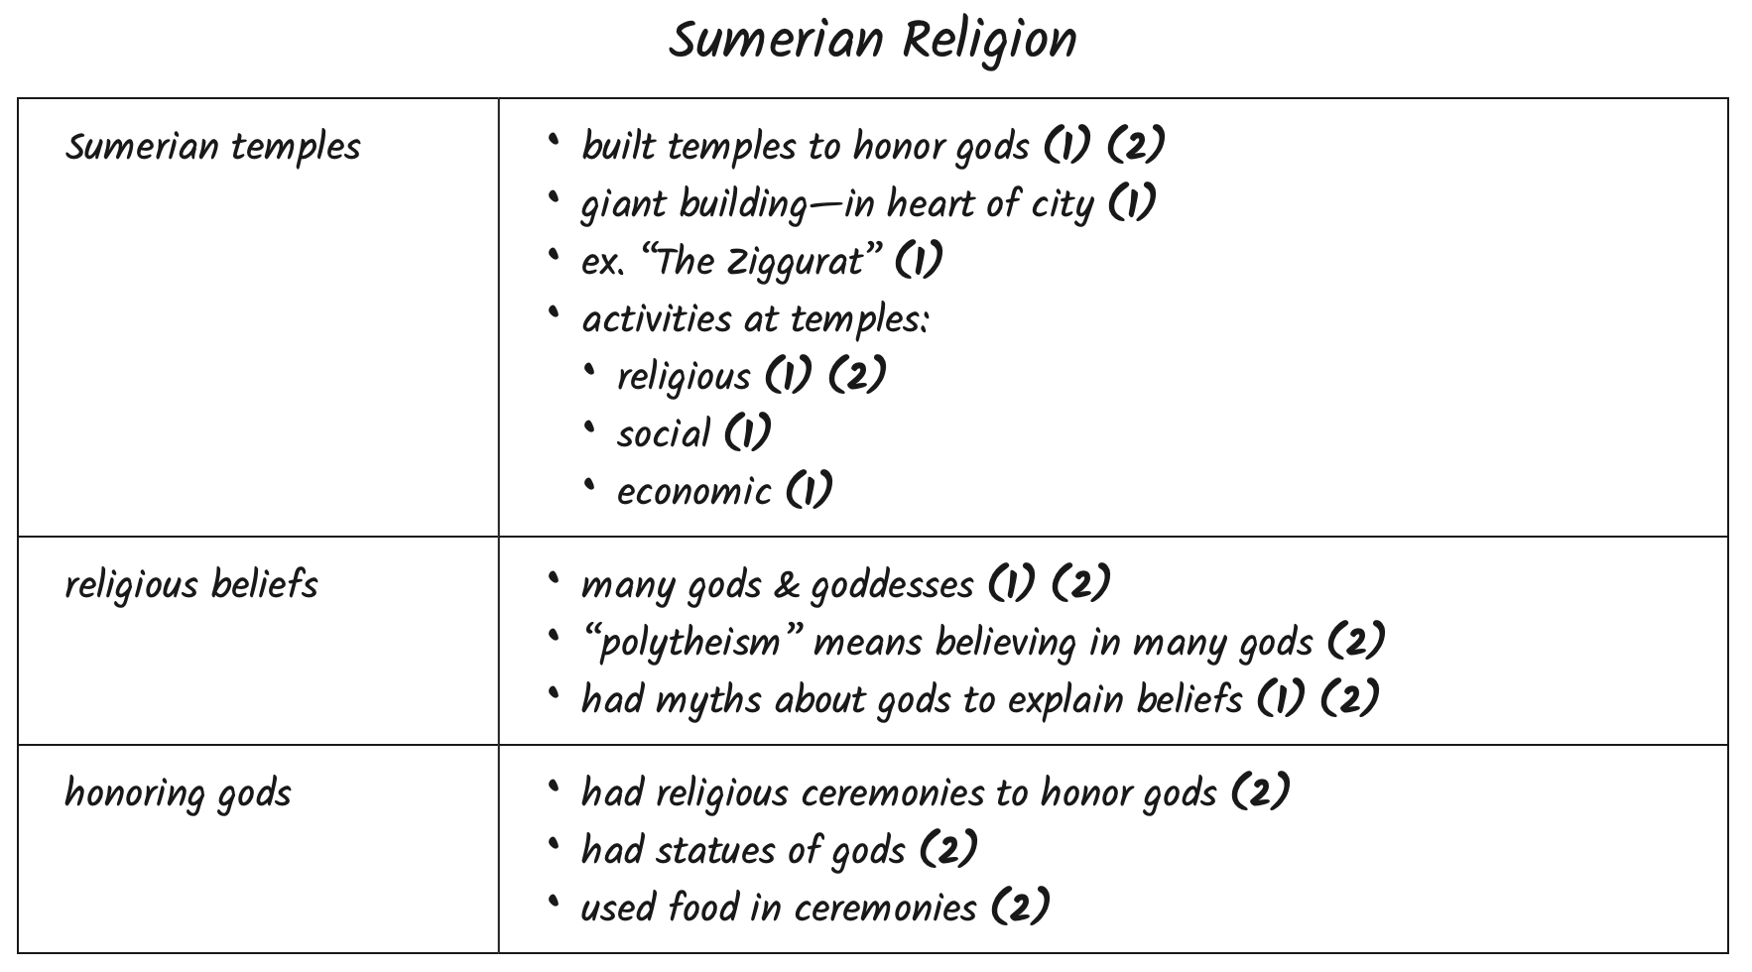
Tracking More Than One Source
Sedita, 2023

Slide 22

Summarizing text
4. Summarizing Text
A shorter, condensed statement of the main ideas or events from something read, said, or done; includes only a few essential details
Different from retell, paraphrase, and other writing tasks
Length will vary depending on source
Can be used as formative assessment
An important “life skill”
Sedita, 2015
Notes:
22

Slide 23
How to teach summarizing
Teach students:
  What a summary is, how it is different from othe rwriting
  How to identify main ideas
  How to generate summaries from text and non-text
I, We, You: model and use think aloud
Provide scaffolds

Slide 24
Scafold: How To Write a Summary
Distinguish main ideas from details.
Write in phrase form.
Begin with an introductory statement.
Turn main ideas into sentences and include a few details.
Combine the sentences.
Incorporate transition words.
Proofread.
MIST
Main ideas listed
Introductory sentence
Sentences with main ideas
Transitions added
Notes:
24

Slide 25
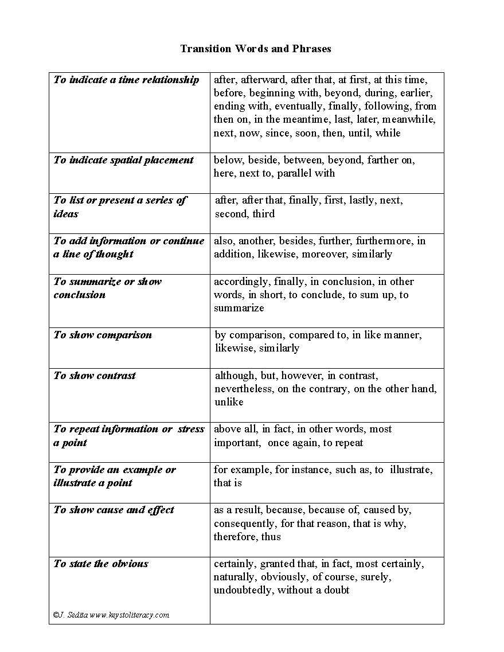
Scaffold:
List
of Transitions
purpose
Notes:
25

Slide 26
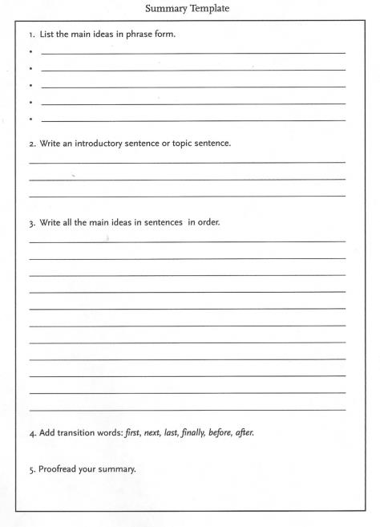
Scaffold:
Summary Template
Notes:
26

Slide 27
5. Writing Prompts
Grade 6: The population of the bullfrog in our state has declined since 1982. Write a short article that identifies and explains two possible reasons for this decline. Cite relevant and specific evidence from the text source.
Grade 8: Based on the two articles about human sleep requirements, write a response that answers this question: What are the benefits of napping?
Grade 10: Take a position in an argument piece that answers this question: Did working in the textile mills of New England improve the lives of 19th-century women, or were these workers mistreated and exploited by the factories that employed them? Use information from our textbook and the two primary sources to support your position.
Sedita, 2023

Slide 28
Aligned to stages of the writing process
Think
Plan
Write
Revise
Analyze
Notes
Select
Write
Edit and Revise

Slide 29

Writing to Learn: Student goals
To process and learn content
To grow writing skills
To learn how to integrate information from multiple, varied sources
To develop strategies to prepare for writing assessments

Slide 30

Writing to Learn Skills
Annotating text sources
Gathering information, evidence into notes
Planning, organizing information
Turning notes and plan into sentences, paragraphs
Knowledge of text structure, text features
Revising and editing skills

Slide 31
Student Motivation & Engagement
Assign writing for a real purpose and audience.
Make writing relevant to students’ lives; incorporate current events.
Teach students writing strategies so they feel competent about writing.
Provide procedural scaffolds to keep students engaged.
Emphasize successes at each stage of the process, rather than focusing only on the finished product.
Provide opportunities for peer collaboration.
Give actionable, user-friendly feedback.
Create and maintain a supportive, nonthreatening classroom environment.
Hidi & Boscolo, 2006; Boscolo & Gelati, 2007)

Slide 32
The Writing Rope View
Teach multiple components
All teachers can play a role
Use explicit instruction, I/We/You, mentor models
Avoid assumptions!
https://keystoliteracy.com/
free-resources/

Slide 33
Questions

Slide 34
ReadOhio Literacy Academy 2025

