Slide 1

Reaching All Students Through Language and Literacy:
Informational Session
Jeremy Luke, Ph.D., 9-12 Literacy Specialist
Katie Dean, Grants Manager
Notes:
Hi, this recording will provide information on Reaching All Students Through Language and Literacy. We’ll provide an overview of the project, requirements for participants, information on filling out the application, and project deadlines. We‘ll also provide contact information at the end of the presentation for questions and clarifications.

Slide 2
Reaching All Students Through Language and Literacy
Funded by ARP ESSER to accelerate learning:
“for activities and interventions that respond to students’ academic, social, and emotional needs and address the disproportionate impact of COVID-19 on underrepresented student subgroups, including each major racial and ethnic group, children from low-income families, children with disabilities, English learners, gender, migrant students, students experiencing homelessness, and children and youth in foster care… aimed specifically at addressing learning loss”
-U.S. DEPARTMENT OF EDUCATION FACT SHEET American Rescue Plan Act of 2021 ELEMENTARY AND SECONDARY SCHOOL EMERGENCY RELIEF FUND (ARP ESSER)
Notes:
Reaching All Students Through Language and Literacy is developed through the Elementary and Secondary School Emergency Relief, or ESSER, Fund. ESSER funds activities and interventions that respond to students’ academic, social, and emotional needs and address the disproportionate impact of COVID-19 on underrepresented student subgroups, including each major racial and ethnic groups, children from low-income families, children with disabilities, English learners, gender, migrant students, students experiencing homelessness, and children and youth in foster care. The use of ESSER funds should be aimed specifically at accelerating learning for Ohio students.

Slide 3
Reaching All Students Through Language and Literacy
Project Goal:
Accelerate learning for groups hit hardest by the pandemic, especially students of color, English learners and students from rural areas of Ohio
Establish a two-year network of sites throughout the state to work toward improving literacy instruction for these groups
Sites must be within the K-12 grade range
Notes:
The primary goal of Reaching All Students Through Language and Literacy is to accelerate learning for the student groups hit hardest by the pandemic related learning losses. These groups include African American, Hispanic, and Native American students, English learners, and students from rural regions of the state.
The Reaching All Students project will create a two-year network of elementary and secondary sites throughout Ohio, under the guidance of a nationally-recognized vendor, who will work together to improve literacy instruction for these groups of students.
Participation in all network meetings is a requirement for project participation and receiving funding.

Slide 4
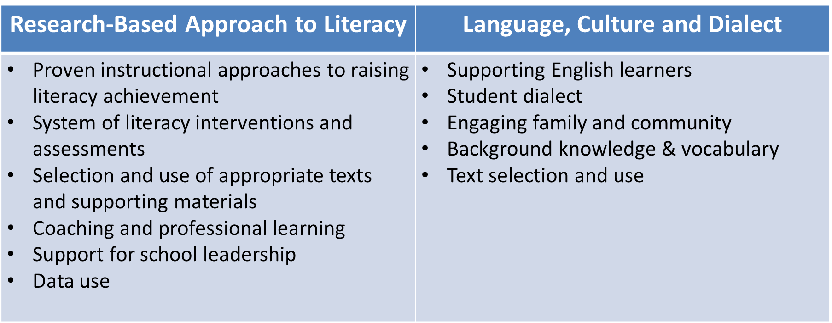
Reaching All Students Through Language and Literacy
Notes:
We will provide professional learning and guidance to all participants to help raise literacy achievement in their buildings and districts. This professional learning will focus on two broad areas with the goal of addressing the reading needs of the student groups mentioned in the last slide.
First, the project will draw on structured approaches to literacy instruction. You may have also heard the term “Science of Reading.” These approaches generally fall under the term “Science of Reading” because they are backed by evidence that they improve students’ literacy outcomes. Some of these approaches include:
Evidence-based instructional approaches including explicit and systematic instruction in areas such as phonemic awareness, phonics, comprehension and vocabulary
A well-aligned system of literacy interventions and assessments within a multi-tiered system of supports
The selection of evidence-based, appropriate texts and support materials
Ongoing coaching to improve educator practice
Support to enhance principals' ability to lead literacy efforts
And the robust and accurate use of data to drive improvement efforts
Next, the project will draw on approaches that support learning for students of color, English learners, and rural students, including approaches to language, culture and dialect. These approaches include
Supporting English learners with the most up to date and effective instructional practices
Effective approaches to accounting for student dialect in learning to read and assessing reading
Engaging family and community to provide a robust support system for all students
Understanding and utilizing the ways that students’ community and culture shape their background knowledge and vocabulary to improve reading outcomes
And selecting texts that ensure all students are reflected and included in curriculum and classroom libraries

Slide 5
Reaching All Students Through Language and Literacy
Project Activities:
Participate in a monthly 3-hour network meeting (remote & in-person)
Receive professional learning from national experts
Consult with Department, vendor and other participants on identifying and addressing a problem of practice related to literacy work
Undertake an individual site project related to addressing the problem of practice
Notes:
This project consists of several required activities for participants. These activities include:
Participation in a monthly network meeting. These meetings will run from October 2022 to May 2023 and October 2023 through May 2024. Meetings will be remote and hosted on a virtual platform such as Zoom or Microsoft teams. There will be an all-day, in-person meeting in February of each year of the network.
Part of each network meeting will include professional provided by nationally-recognized experts. Participants will also be provided with tools and resources to support literacy improvements at their buildings and districts.
Participants will work with the vendor and other participants to identify a problem of practice related to their literacy instruction. A problem of practice is a clearly defined problem, which, if solved, would lead to significant improvements in reading outcomes for students. Participants will draw on student and adult data, experiences at their site, and research to define their problem of practice.
After participants have identified their problem of practice, they will undertake an individual site project that will address the problem of practice. This will be addressed in more detail in the next slide.

Slide 6
Reaching All Students Through Language and Literacy
Individual Project:
Participants will receive support to identify a problem of practice and conceptualize a project to address it
Projects will be implemented in year 2 (2023-24)
Projects should address following areas:
      Shared leadership - Educator Capacity
      MTSS - Family Engagement
      Community Engagement
Notes:
Each participating site will receive up to $200,000 to develop a project that will address their identified problem of practice. Funds for projects can be budgeted at the end of year one and projects will be implemented throughout year two. These projects should focus on one or more of the following areas:
Shared leadership, including the development and improvement of district, building and/or teacher-based teams.
Educator capacity, including professional learning, resources and tools to support instruction.
Developing or bolstering a Multi-Tiered System of Supports, including purchasing assessment and intervention materials and/or professional learning to support intervention and assessment.
And family and community engagement to support broad involvement in students’ instruction and enhanced connections to students’ families and communities.

Slide 7
Reaching All Students Through Language and Literacy
Project Purchases:
Project purchases will be made in consultation with Department & Vendor
Project purchases may include:
  Professional learning - Consultation & coaching
  Interventions & assessments - Salaries & benefits
  Curricular materials
  Classroom materials and resources
Notes:
Project purchases are subject to rules related to allowable and unallowable expenses. A list of unallowable expenses can be found on pages 7 & 8 of the Request for Applications document.
Each participating site will receive up to $200,000. The majority of this amount will be spent on purchases to support the individual site project.
Please note that participants should not identify items and services in their application. Purchases will be determined in consultation with the vendor and the Department at the end of year one of the project. Site needs, student and adult data analysis, and capacity to implement will be factors in determining the most appropriate purchases.
Some examples of recommended purchases include but are not limited to:
Professional learning for all or some staff
Interventions and assessments
Non-core curricular materials such as text sets
Classroom materials and resources
Consultation and coaching from experts in language and literacy
And salaries and benefits for support staff such as paraprofessionals and literacy coaches

Slide 8
Reaching All Students Through Language and Literacy
Project Sites and Teams:
Teams should consist of 4-5 members
Team lead must be designated and attend all meetings
Suggested roles include:
Principals & assistant principals | Curriculum directors
Literacy & instructional coaches | DLT & BLT leaders
Teacher leaders | School psychologists
Intervention specialists | ESC & SST partners (Not site lead)
SPED | Higher Ed partners (Not site lead)
Notes:
Each participating site is required to establish a team of 4-5 educators who are leading or connected to the work to improve literacy at the site. These team members will attend each network meeting and work with the vendor, the Department and other sites to improve their literacy instruction over the two-year period. Each site must designate a team lead who is required to attend all network meetings and be the primary point of contact for the project. In the event that a team lead cannot attend a network meeting, they will need to identify a designee from their team to act as the team lead in their absence. Some suggested roles for team membership include but aren’t limited to:
Principals and assistant principals
Literacy & instructional coaches
Teacher leaders
Intervention specialist
Special education teachers or coordinators
Curriculum directors
Team leaders
And school psychologists.
Project teams may include partners from Educational Service Centers, State Support Teams and Higher education. However, these members may not act as team leads.

Slide 9
Reaching All Students Through Language and Literacy
Funding:
Each participating site will receive up to $200,000 to be used on:
  Providing stipends for team’s work outside of contract hours
  Costs associated with travel including transportation, meals and lodging (two in-person meetings)
  Purchases related to individual site project (bulk of cost)
Notes:
As mentioned before, each site will receive up to $200,000 to be used on
- Stipends for work done by team members outside of regular contract hours. This will require a written justification for why each member must perform work outside of typical contract hours.
- Costs associated with travel including transportation, lodging and meals for each of the two in-person meetings. These will take place in February 2023 and February 2024.
- Purchases related to individual site projects. This was described above and will constitute the majority of the costs associated with site participation.

Slide 10
Reaching All Students Through Language and Literacy
Application Overview:
  Each site must fill out an application by 4:59 on Thursday, September 15
  Make sure to carefully read the application instructions in the Request for Applications document and on the webpage
  Application Template
  Editable Forms and Appendices
Notes:
Each site must fill out and submit their application to the CCIP by 4:59 p.m. on Thursday. September 15.
You will find several helpful resources on the Reaching All Students webpage.
There is An optional Application Template that can guide you through each section of the application. This template can be saved as a pdf and uploaded to the CCIP.
A "Forms and Appendices" document contains several documents that must be submitted with your application. These documents include a checklist to help you make sure you are submitting all required forms, a site identification cover page, a statement of assurances indicating willingness to participate in all required activities, and a budget narrative guide. You’ll also find a list of necessary appendices in this form. These include Appendix 1: Assurances from an authorized representative; Appendix 2: Programs and Practices; Appendix 3 outlining support from educators at your site; and Appendix 4 Assurances for participation in an ESSER funded project.

Slide 11
Reaching All Students Through Language and Literacy
Application Overview:
The application consists of five sections. Please note that each section is weighted differently
Application sections include:
      Site and Student Needs Profile
      Readiness
      Capacity to Implement the Project
      Project Team
      Budget Narrative
Notes:
The application consists of five sections. Please note that each section is weighted differently. Application sections include
Site and Student Needs Profile
Readiness
Capacity to Implement the Project
Project Team
And Budget Narrative
We’ll go into more detail on each section in the next few slides.

Slide 12
Not Addressed or Poorly Developed/0-1 Points The response is not provided or the response is significantly incomplete. It is missing required appendices or otherwise raises substantial concerns about the applicant’s ability to successfully participate in the project.
Marginally or Adequately Developed/2-3 Points The response meets some established criteria but contains substantial gaps and otherwise raises concerns about the applicant’s capacity to successfully undertake the project. The difference between a score of 2 and a score of 3 will be determined by the extent of gaps in understanding and key information (2 = significant gaps; 3 = moderate gaps).
Well Developed/4 Points The response meets most of the established criteria, but requires some additional information, explanation or detail in one or two areas.
Fully Developed/5 Points The response demonstrates the applicant’s thorough understanding of key issues by providing specific, clear and accurate information. The response presents a clear, realistic picture of the applicant’s ability to participate in the project successfully and sustain and improve upon key elements of the project after its completion.
Notes:
Each application will undergo a scoring process by a team with expertise in language and literacy. Sections will be scored on a 0-5 scale.
A score of 0 or 1 indicates that a section is not addressed entirely in the application or was poorly developed. Criteria for poorly developed include missing large necessary sections or answers not being connected to the requirements in the application.
A score of 2 or 3 indicates that a section is marginally or adequately developed. A score of 2 indicates that there are significant gaps in explanation or understanding while a score of 3 indicates that there are moderate gaps.
A score of 4 indicates that a section is well developed. The required criteria are all met with the exception of one or two minor areas.
And, a score of 5 indicates that a section is fully developed, meeting all necessary criteria for the section and presenting specific, clear and accurate information.

Slide 13
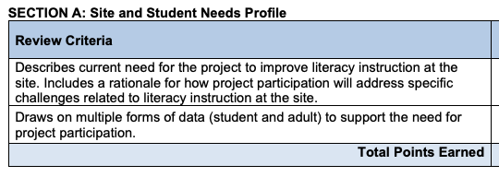
Notes:
Section A focuses on site and student needs. This section provides a justification for why a site will benefit from participation in the project.
A fully developed application for this section will describe the site’s need for this project in detail, drawing on concrete examples and specific data points. This section should outline where the site is at now in terms of student literacy learning and the specific concerning gaps in student and adult data.
The following forms of data are recommended but are not required:
• Student assessment data including Ohio’s State Tests and district-administered assessments including screeners, diagnostics and progress monitoring;
• Adult implementation data including data from the Ohio Teacher Evaluation System, Ohio Principal Evaluation System, walkthroughs, professional learning opportunities and coaching.
• Data related to systems (including the Reading Tiered Fidelity Inventory, equity evaluations, or data gathered and used in the Ohio Improvement Process;
• Longitudinal data to demonstrate trends in student literacy outcomes.
• Other relevant data points including student and community demographic and income data; student mental and emotional health measures and early warning indicators such as absenteeism and retention in grades/courses.

Slide 14
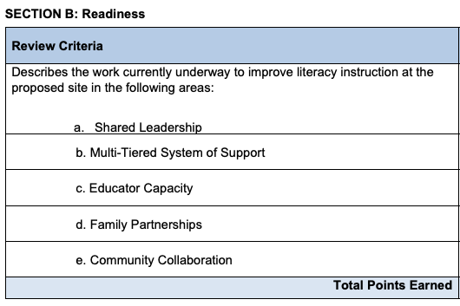
Notes:
Section B focuses on readiness to participate in key areas that are vital for consistent and sustainable success in students’ literacy learning. Please note that this section will be scored based on the quality of explanation about where your site is in terms of developing these areas. NOT in terms of how well developed these areas currently are. So, a site that can clearly describe where they still need to grow in each area will be scored higher than a site that unclearly describes how they have already mastered each area. The goal of this project is to work with sites that have the willingness and capacity to grow, not to work with sites that are already doing very well in all areas.
A fully developed application will describe, in detail, the extent to which work is underway and the quality of work to improve literacy instruction at the proposed site in the following areas:
Shared Leadership including team structures and participants, frequency and focus of meetings, process for removing barriers to meetings and team effectiveness, if applicable, the use of the Ohio Improvement Process (OIP), communications plans and participation of building-level instructional leadership.
b. Multi-Tiered System of Supports: Including Instruction, curriculum, intervention, assessment and decision rules related to identifying children in need of literacy interventions or other support services.
c. Educator Capacity will describe the ways that educators are supported to develop and deliver better literacy instruction, including the existence and quality of core reading curriculum, intervention materials, professional learning for all educators and administrators, the availability of instructional or peer coaching and collaborative planning
d. Family Partnerships including how you identify student and family needs, the inclusion of family engagement in school improvement planning and the implementation of specific programming to engage families.
And Community Collaboration including an explanation of partnerships that work collaboratively to address challenges, provide opportunities to problem-solve and time to consult to strengthen local literacy plans and community improvement efforts.

Slide 15
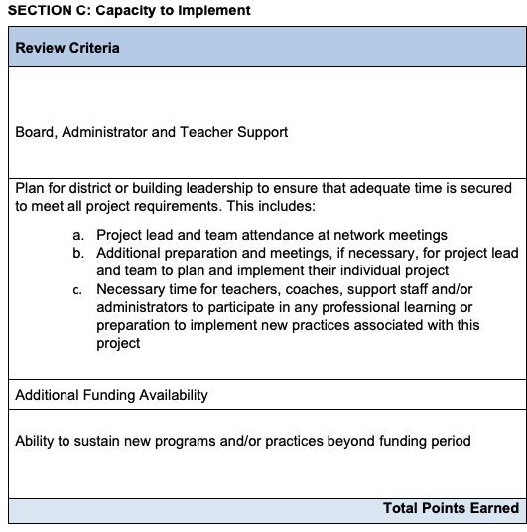
Notes:
Section C describes the site’s capacity to implement including:
Evidence of board, administrator and teacher support;
A plan and commitment for ensuring that adequate time is provided to team members to perform all tasks associated with the project including attendance at meetings; preparation for meetings; and time for educators throughout the site to participate in site-wide improvement efforts.
The existence of additional funding from other sources including federal, state, and local general funds to improve on and sustain strategies and resources implemented during this project

Slide 16
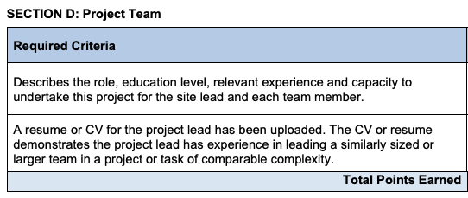
Notes:
Section D describes the project team including a description of the role, education level, relevant experience and capacity to undertake this project for each member of the team. You should also upload an up-to-date resume or CV for the project lead that demonstrates their experience leading a similar team-based project of comparable complexity.

Slide 17
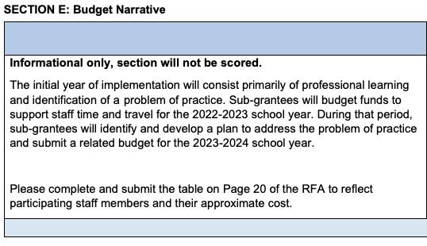
Notes:
The budget narrative section of the application is informational only and will not be scored. This is because your true budget for the project will be developed over the course of the 2022-2023 school year as you participate in professional learning and develop your problem of practice and your plan to address it. Your primary cost for the 2022-2023 school year will be in staff time, including work performed outside of contract hours or substitutes needed to replace team members during the day, when trainings will take place. Additionally, some travel costs may be incurred for the two in-person meetings. For this reason, we ask that you complete the section of the applications providing information on members of your team, whether they require substitutes, and their hourly stipend for work outside of contract hours.

Slide 18
Reaching All Students Through Language and Literacy
Application and Timeline
Notes:
Now that we have gone over the content of the application, we want to talk a little bit about the timeline. You can see this chart on page 12 of the RFA for reference as needed. The RFA has been posted, and we have notified everyone who submitted an Intent to Apply that applications will not be open in CCIP until August 31st. We would encourage you to be working on these applications prior to August 31st. There is only one number that actually needs to be entered into CCIP as well as approvals from your fiscal representative and authorized representative. Everything else you can be working on now, upload into CCIP and not need to do much work in the system once it is open. The application is due at 4:59 PM Eastern Time on September 15 which is a Thursday. In order to be considered for review the application needs to be approved by your fiscal representative and authorized representative. It MUST be in authorized representative approved status, in order to be reviewed, by 4:59 on September 15. The following week we will review applications, the week after that will be finalist interviews, and the week after that we will notify applicants who were selected or not selected. This is a very quick process, and we are trying to keep everything within this timeframe. To do that, as soon as applications are submitted we will notify you with a time for a finalist interview. We will follow up by September 23 to let you know if you have been selected for a finalist interview and whether you will be using that slot that we asked you to reserve. Please keep an eye out for those requests.

Slide 19
Reaching All Students Through Language and Literacy
Log in to CCIP for the applicant organization
Select the “Funding” dropdown on the left-side menu, then select “Funding Applications” in the dropdown.
After August 31:
  Make sure the Year 2023 is selected
  Click “Reaching All Students” in the Competitive Funding Applications table
Notes:
When the application is available in CCIP, after August 31, you will need to log into CCIP for the applicant organization through your OH|ID account. To do this, you will need a “data entry funding” or “data entry planning” CCIP role in OEDS. If you need assistance with this, please contact us at reachingallstudents@education.ohio.gov. Once you are in CCIP, select the “Funding” item on the left-side menu to display a dropdown. Select “Funding Applications” from the dropdown. On the funding applications page, make sure the year selected in the top dropdown menu is 2023. You should see two tables.

Slide 20
Reaching All Students Through Language and Literacy
From the Sections Page, navigate to “Upload/View documents” and upload:
Application Checklist
Cover Page | Appendix 3: Support from Educators
RFA Narrative Responses (Sections A-E including budget narrative table) | Appendix 4: ESSER Assurances
Reaching All Students Assurances | Community Schools: Proof of Support from Governing Authority for Applicant and each partner
Appendix 1 Commitments
Appendix 2 Programs & Practices (Excel)
Notes:
The “Reaching All Students” item should take you to the sections page of the Reaching All Students application. From the sections page, navigate to the “Upload/View documents” page and upload the required items including the Cover Page, RFA Narrative Response, Reaching All Students Assurances, Appendix 1, Appendix 2, Appendix 3, and Appendix 4. Community Schools will also need to upload proof of support from the governing authority for each applicant and partner. All items except for Appendix 2 may be uploaded as one PDF file. Appendix 2 should be uploaded as an excel spreadsheet. You may also upload each item individually if you choose. Please label each item clearly.

Slide 21
Reaching All Students Through Language and Literacy
Navigate to the Budget page:
  Enter “$200,000” in the field for Object Code: Salaries, Purpose Code: Instruction
Navigate to the Contacts page:
  Add a grant contact
On the Sections Tab, select “Draft Complete”
Notes:
The required components other than uploaded documents are a budget and contact. Navigate to the Budget page from Sections page, or by clicking on the “Go To” dropdown at the top of a page, hovering over Reaching All Students, and selecting budget. Enter $200,000 in the top left field under Object Code Salaries and Purpose Code Instruction. Navigate to the contacts page from the Sections page or the “Go To” dropdown, and select a grant contact. When you have all items uploaded and the budget item and contact entered, select “Draft Complete” on the Sections tab.

Slide 22
Reaching All Students Through Language and Literacy
On the Sections page, select “Draft Complete”
On the Sections page, the Treasurer/Fiscal Representative must select “Fiscal Representative Approved”
On the Sections page, the Superintendent/Authorized Representative must select “Authorized Representative Approved”
The budget must be in Authorized Representative Approved Status by 4:59pm on September 15
Notes:
When you have marked the application as “Draft Complete” on the Sections Page, the treasurer or CCIP fiscal representative of the organization must log into CCIP, access the Reaching All Students application, and select “Fiscal Representative Approved” on the Sections page. The superintendent or CCIP authorized representative for the organization must do the same thing to mark the application “Authorized Representative Approved”. The steps must happen sequentially, the fiscal representative may not approve before the draft is complete, and the authorized representative may not approve before the fiscal representative. Note that in some organizations, the individual entering the application may be the same person as the fiscal or authorized representative. This person will need to approve the application at each stage. The application must be in Authorized Representative Approved status by 4:59pm on Thursday September 15. We encourage you to enter the application and complete all approvals well before this time to avoid technological or other complications.

Slide 23
Reaching All Students Through Language and Literacy
Questions:
ReachingAllStudents@education.ohio.gov
Notes:
If you have any questions, please email us at ReachingAllStudents@Education.ohio.gov

