Slide 1
Thank you for joining!
The webinar will begin at 1 p.m.
Audio for this session is delivered through your computer speakers. Thank you for checking to ensure audio levels are set to appropriate listening levels.

Slide 2
Reading Achievement Plans
October 10, 2017

Slide 3
Navigating the Webinar
Submit comments to the presenters using the instant messenger.
?
You may submit questions at any time.
Thank you!
We appreciate your participation in today’s session!
For more information,
visit education.ohio.gov.

Slide 4
Today’s Presenter
Melissa M. Weber-Mayrer, Ph.D.
Early Literacy Administrator
Center for Curriculum and Assessment
Melissa.Weber-Mayrer@education.ohio.gov
(614) 728-8095

Slide 5
Today’s Focus: Reading Achievement Plans
History and Requirements of Legislation
RAP Template and Guidance Document
Developing a High Quality Plan
Why are districts and community schools completing these plans?
What must be included in a Reading Achievement Plan?
Identifying instruction of specific skills that change over the course of time / grade levels.

Slide 6
Legislation (History and Requirements)
Deadline: Dec. 31
Requires State Board of Education to adopt rules prescribing the content of and deadlines for the RAP
Requires the Department to post the submitted plans in a prominent location on the department’s website

Slide 7
State Board of Education Rule (History and Requirements)
OAC 3301-56-02
Outlines minimum components of the RAP
Requires department to develop a template for the plan and make it available to districts and schools by July 1, 2016

Slide 8
Who Submits a RAP?
Required for districts that meet the following criteria for two consecutive school year (i.e. 2014-2015 and 2015-2016):
The district or community school received a grade of “D” or “F” on the K-3 Literacy Improvement Measure; and
Fewer than 60 percent of the district’s or community school’s students scored proficient or higher on the state’s grade 3 English language arts test

Slide 9
The Plan Template
District Leadership Team/RAP writing team
Alignment of the RAP and district improvement efforts
Why a RAP is needed in our district or community school (Thorough data analysis)
Literacy mission and vision statements
Measurable student performance goals
Action plan map(s)
Plan for monitoring progress
Expectations for supports for students and schools

Slide 10
Sequence of Activities
Sept. 14 Report Cards released
Receive Reading Achievement Plan development support
Due To ODE Dec. 31, 2017
Conduct a comprehensive needs assessment
Oct. 2 and 3 Letters to districts
Participate in the ODE Webinar Oct. 10
Develop a writing team
Write your plan

Slide 11
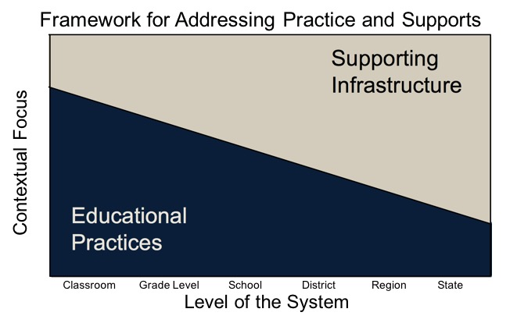
McIntosh and Goodman (2016)

Slide 12
Simple View of Reading
Decoding (Word -level Reading)
Language Comprehension
Reading Comprehension
The ability to transform print into spoken language
The ability to understand spoken language
Gough, 1986

Slide 13
Simple View of Reading
Decoding (Word -level Reading)
Language Comprehension
Reading Comprehension
Background Knowledge
Academic Language Skills
Academic Vocabulary
Inferential Language Skills
Narrative Language Skills
Gough, 1986

Slide 14
Simple View of Reading
Decoding (Word -level Reading)
Language Comprehension
Reading Comprehension
Decoding Skills
Print Concepts
Fluency
Phonological
Awareness
Phonics and Word Recognition
Word Knowledge
Gough, 1986

Slide 15
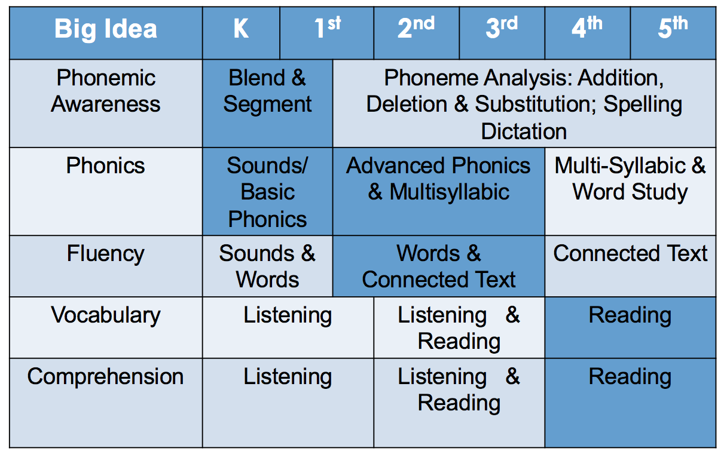
Changing Emphasis of Big Ideas

Slide 16
Activity
Review the Simple View of Reading slides and the Changing Emphasis of Big Ideas
Define each of the two domains in the Simple View of Reading
Explain why the Simple View of Reading is written as a multiplication fact to your partner
A staff member states “specific big ideas for reading are assigned to particular grade levels.” You know this is not accurate. Explain the changing emphasis of instruction regardless of grade level.

Slide 17
The Plan Template
District Leadership Team/RAP writing team
Alignment of the RAP and district improvement efforts
Why a RAP is needed in our district or community school (Thorough data analysis)
Literacy mission and vision statements
Measurable student performance goals
Action plan map(s)
Plan for monitoring progress
Expectations for supports for students and schools

Slide 19
Comprehensive Data Analysis
At XXX, 31 out of 52 assessed (60%) kindergarteners started the year at risk in Initial Sound Fluency. At this point in kindergarten students should be able to hear and produce 10 initial sounds and by the middle of the year it should be 30 initial sounds. At the same time, in the middle of the year, kindergarteners should be able to segments 33 sounds in words, and identify at least 19 correct letter sounds (CLS) in words.
In first grade beginning of the year, 62 of 65 (95%) students are at risk in phoneme awareness as measured by Phoneme Segmentation Fluency (PSF). This is a significant concern since phoneme awareness is CRUCIAL to learning to read and spell.
In the beginning of the year in first grade 59% of students assessed were identified at risk in basic phonics as measured by Nonsense Word Fluency (NWF-CLS).
At the beginning of the year in first grade 63% of students assessed were unable to read 1 of the three sound words as a whole word as measured by Nonsense Word Fluency (NWF-WRC).
At the beginning of second grade 67% of second graders were unable to quickly and accurately match sound to symbol (NWF-CLS) and 44% were unable to meet the goal of reading 13 whole words (NWF-WRC)

Slide 20
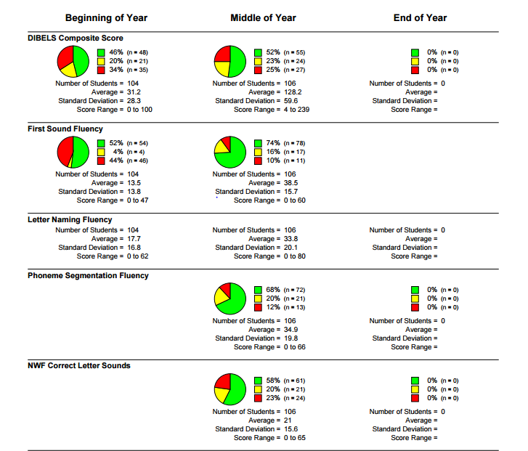
Sample Dibels Next Report

Slide 21
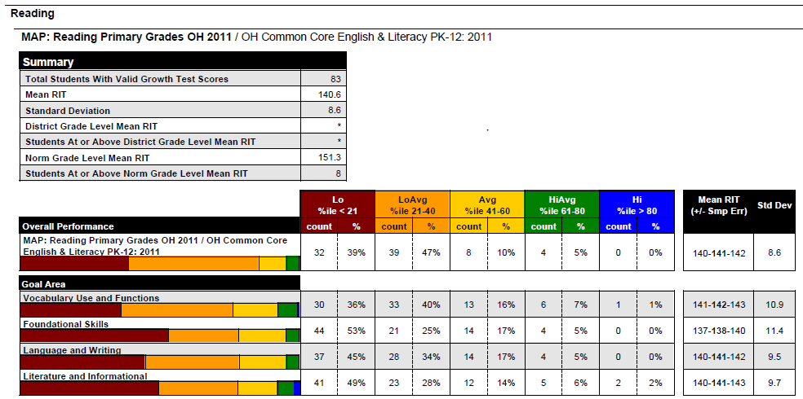
Sample NWEA MAP Report

Slide 22
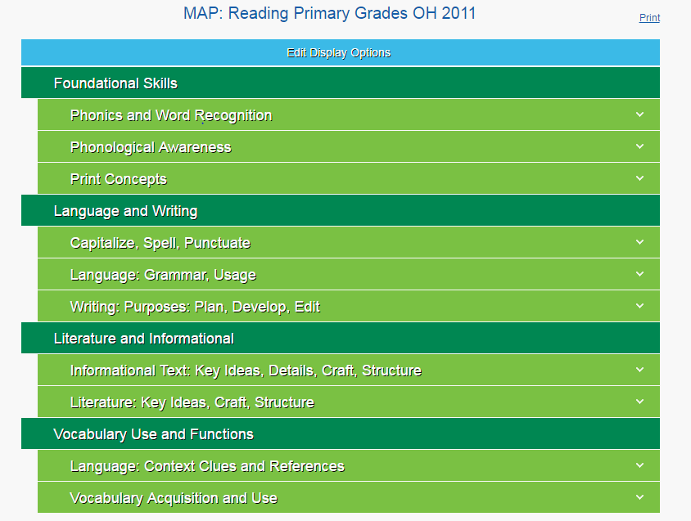
Sample NWEA MAP Report

Slide 23
Template

Slide 24
Guidance Document
education.ohio.gov
Search keywords: Reading Achievement Plan

Slide 25
Is the plan data driven

Slide 26
Using data to inform:
District Leadership Team
Measurable Student Performance Goals
Action Plan Maps
Plan for Progress Monitoring
Expectations and Supports
for Students and Schools

Slide 27
Reading Achievement Plan Leadership Team
SECTION 1: District leadership team membership, development process and plan for monitoring implementation.
Insert a list of all district leadership team members, roles and contact information.
Describe how the district leadership team developed the plan, how the team will monitor the plan and how the team will communicate the plan.
The district leadership team develops the Reading Achievement Plan. A district leadership team should include members to inform reading instruction and improvement in the district.

Slide 28
Team Selection

Slide 29
Sample Team

Slide 30
Activity
Using the Reading Achievement Plan planning template:
List your current DLT
Based on your data – who would you add to your team?

Slide 32
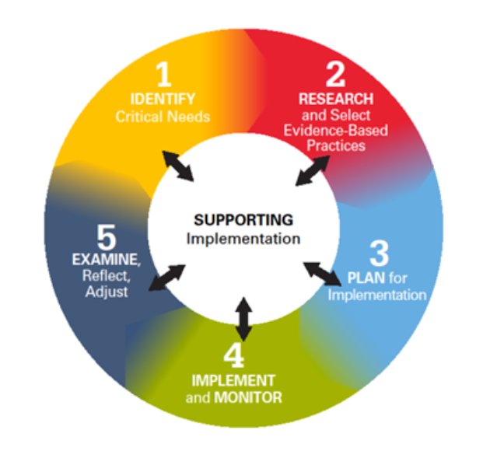
Ohio Improvement Process

Slide 34
Grade-level Student Performance Goals
Grade level goals that align with the skills that are predictive of future reading success will help your schools and grade levels focus their efforts for problem-solving and planning

Slide 35
Goals of the Plan
Measurable Student Performance Goals
SECTION 5: Measurable Student Performance Goals.
Describe the measurable student achievement goals that the Reading Achievement Plan is designed to support progress toward.
Are the goals:
Specific?
Measurable?
Achievable?
Realistic?
Time-bound?
Student Performance Data (General Grade Level Trends)
Student Performance Data (Specific Literacy Skills)
Additional factors (e.g., high teacher turnover, newly identified curriculum, high % of EL students)

Slide 36
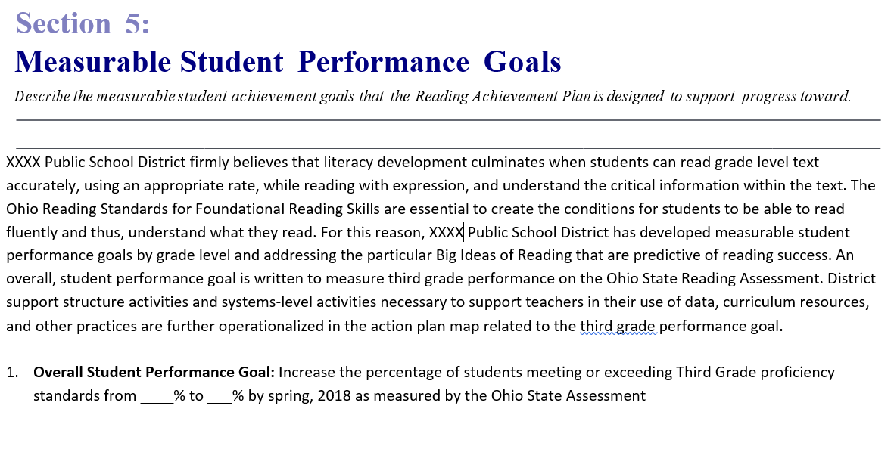

Slide 37
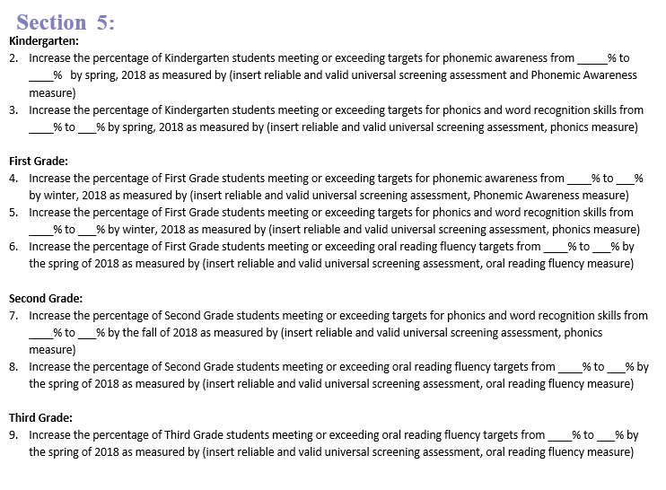

Slide 38
Action Plan Maps
Action plan maps should have elements of data, systems, and practices since all are needed to improve student outcomes
Too often, people jump right to practices / programs
The systems will allow all students to benefit from the preventative reading supports and intervention supports
Data will guide successes and opportunities for improvement

Slide 39
Overarching Goal

Slide 40
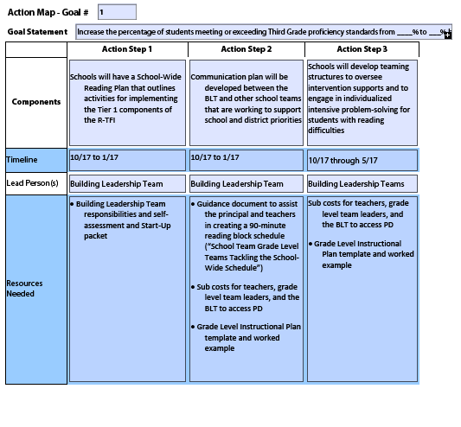

Slide 41
Goal 1 continued

Slide 42
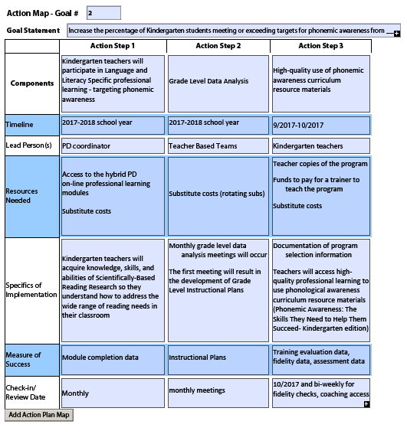
Sub-goals Specific to Grade Levels

Slide 43
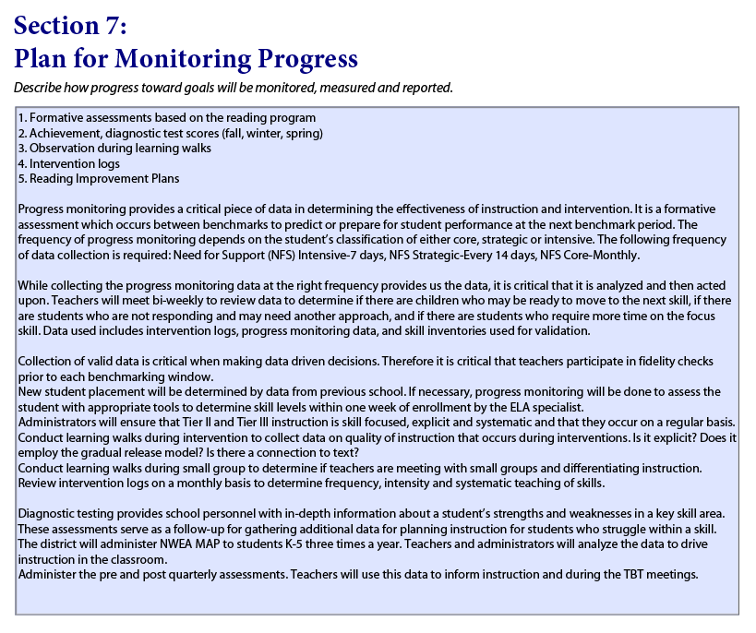

Slide 45
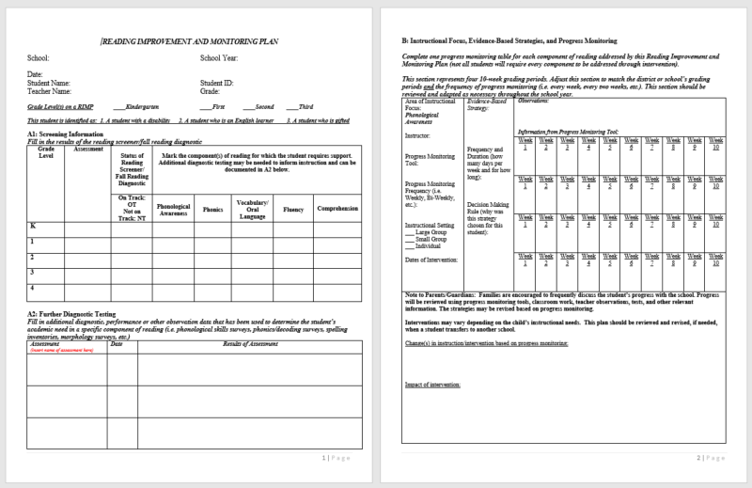
Reading Improvement Monitoring Plans

Slide 48
Activity
Professional Development in Your District
How does your professional learning plan align with your goals?
How does it align with the five essential components of reading?
What’s your evaluation plan? How will you evaluate success toward professional learning and goals?
How can you support and sustain implementation of new skills and knowledge gained from professional learning?
How does your Reading Achievement Plan for professional learning fit into a long term plan for your building and district?

Slide 49
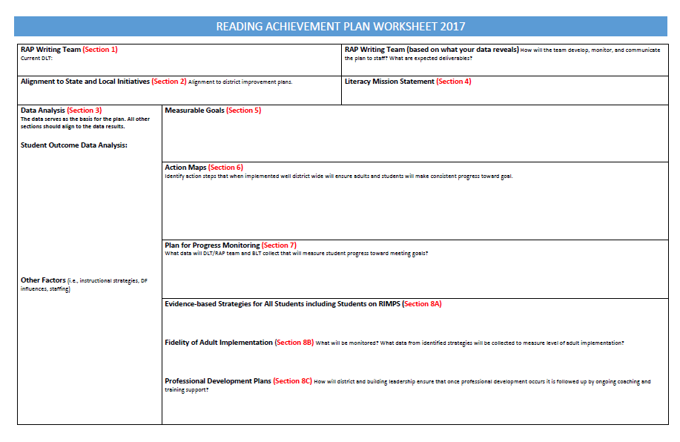
Reading Achievement Plan Worksheet

Slide 50
Dec. 31, 2017 Plans are Submitted

Slide 51
What’s Next?
Plans are reviewed for compliance
Plans are posted on ODE website along with feedback memo
Districts have 30 days to address issues
Plans are reviewed
Compliance letters are sent.
Review Team is assembled
Feedback is sent to each district

Slide 52
Feedback Memo
Districts: Memo will be sent to both the Superintendent and the contact who submitted the plan
Community Schools: Memo will be sent to school leadership and school’s sponsor
Memo will be posted on the Department’s website alongside the submitted plan

Slide 53
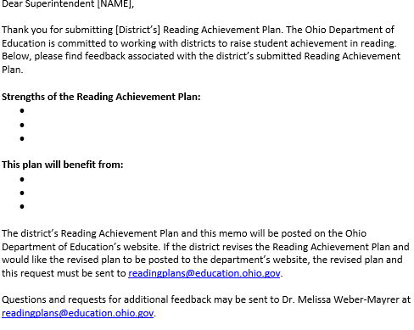
Feedback Memo

Slide 54
Equation to Success
Effective Instruction
Effective Implementation Methods
Enabling Context
Improved Outcomes for all Children

Slide 56
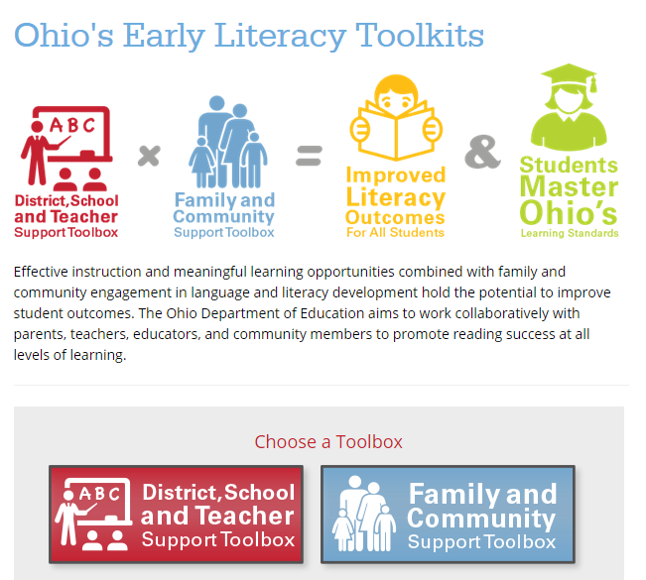

Slide 57
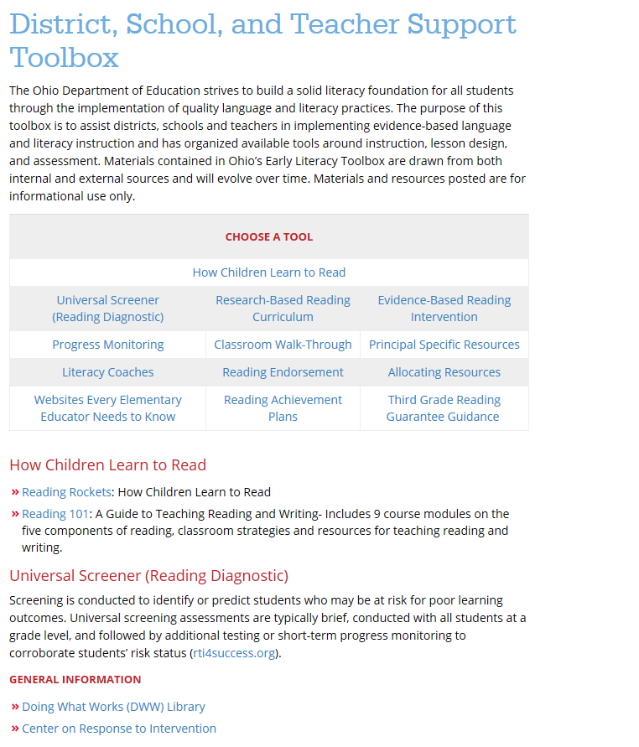
District, School, and Teacher Support Toolbox

Slide 58
Contact Information
Reading Achievement Plans: ReadingPlans@education.ohio.gov
Third Grade Reading Guarantee: ThirdGradeGuarantee@education.ohio.gov

Slide 59
Survey and Audience Questions

Slide 60
Join the Conversation
OHEducation
@OHEducation
@OHEducationSupt
OHEducation
OhioEdDept
education.ohio.gov/text

