Slide 1
Reading Achievement Plans
Presenter(s)

Slide 2
Received a grade of “D” or “F” on the Improving At-Risk K-3 Reading Measure for the past 2 consecutive report cards issued to that district or community school or a performance rating of less than three stars on the Early Literacy measure; and
Reading Achievement Plans are required for districts or community schools that:
1
2
51% or fewer of students scored proficient on Ohio’s State Test for grade 3 English language arts test
Notes:
[When presenting, this slide requires multiple clicks to reveal each element]

Slide 3
Ohio’s Language and Literacy Vision
The Department is urging districts and schools to use evidence-based systems and high-quality instruction, select high-quality instructional materials and employ culturally responsive practices.

Slide 4
Reading Achievement Plans must include these sections:
Culturally Responsive Practice*
Development process and plan for monitoring implementation*
Alignment between Reading Achievement Plan and Overall Improvement Efforts*
Why a Reading Achievement Plan is Needed*
An asterisk (*) indicates that a section is required.
Measurable Learner Performance Goals*
Action Plan Map(s) for Action Steps*

Slide 5
Culturally Responsive Practice
Defined as an approach that recognizes and encompasses students’ and educators’ lived experiences, cultures and linguistic capital to inform, support and ensure high-quality instruction.
More information can be found on the Department’s Culturally Responsive Practice program page.

Slide 6
Section 1: District Leadership Team Membership, Stakeholders, Development Process and Plan for Monitoring Implementation*

Slide 7
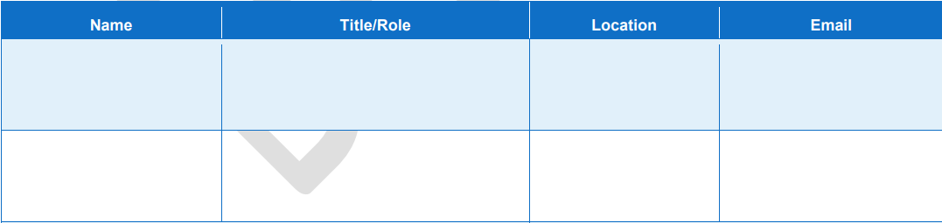
Section 1, Part A: Leadership Team Membership and Stakeholders*
Includes a list of all leadership team members, stakeholders, roles, and contact information. Inclusion of early childhood providers that feed into the district encouraged.

Slide 8
Section 1, Part B: Developing, Monitoring, and Communicating the Reading Achievement Plan
Describe how the district leadership team developed the plan and how the team will monitor and communicate the plan.

Slide 9
Section 2: Alignment Between Reading Achievement Plan and Overall Improvement and Equity Efforts*
Describe how the Reading Achievement Plan is aligned to and supports the overall continuous improvement and equity efforts of the district or community school.

Slide 10
Section 3: Why a Reading Achievement Plan is Needed in District or Community School*

Slide 11
Section 3, Part A: Relevant Learner Performance Data*
Insert disaggregated student performance data from sources that must include, but are not limited to:
  The Kindergarten Readiness Assessment,
  Ohio’s State Test for English language arts assessment for grades 3-8,
  K-3 Reading diagnostics (include subscores by grade level),
  The Ohio English Language Proficiency Assessment (OELPA)
  The Alternative Assessment for Students with Significant Cognitive Diasabilities

Slide 12
Section 3, Part B: Internal and External Factors Contributing to Underachievement in Reading*
Insert internal and external factors believed to contribute to low reading achievement in school district or community school

Slide 13
Section 3, Part C: Root Cause Analysis
Insert a root cause analysis of the provided learner performance data and factors contributing to low reading achievement

Slide 14
Section 4: Measurable Learner Performance Goals and Adult Implementation Goals*
Describe the measurable learner performance goals addressing specific needs based on student performance goals by grade band (K-3).
Describe measurable adult implementation goals based on internal and external factor analysis by grade band (K-3).
May have overarching goal and subgoals.
Goals should be strategic/specific, measurable, ambitious, realistic and time-bound.
Goals should be inclusive and equitable.

Slide 15
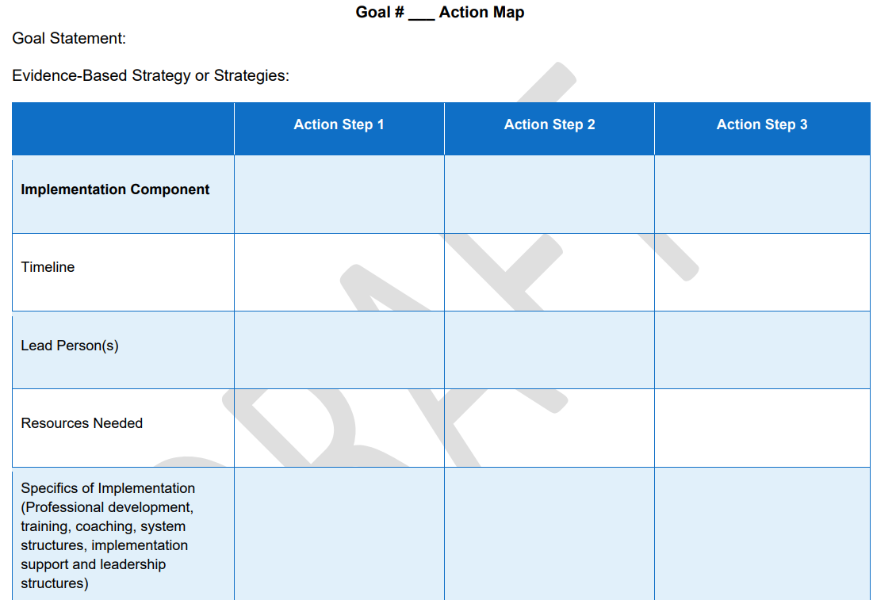
Section 5: Action Plan Map(s) for Action Steps*
Each action plan map describes how implementation of the Reading Achievement Plan will take place for each specific literacy goal the plan is designed to address.
For Grades K-3, at least one action step in each map should address supports for students who have RIMPs.
Include a description of the professional development activities for each goal.
Action Plan Map will include additional information, which can be found in the Reading Achievement Plan Document

Slide 16






@OHEducation

