Slide 1
MP 6: Attend to Precision
Brian Bickley ∙ April 26, 2022

Slide 2

Welcome

Slide 3


Slide 4
Virtual Meeting Norms
Be respectful.
Recognize that everyone has expertise.
Assume positive intent.
Seek clarification in language and ideas.
Share experiences.
Use the chat feature when you have a question.
Mute your microphone when not speaking.

Slide 5

Each Child Our Future

Slide 6

Each Child Our Future
Our Vision
In Ohio, each child is challenged to discover and learn, prepared to pursue
a fulfilling post-high school path and empowered to become a resilient,
lifelong learner who contributes to society.

Slide 7
Math Practices
Make sense of problems and persevere in solving them.
Reason abstractly and quantitatively.
Construct viable arguments and critique the reasoning of others.
Model with mathematics.
Use appropriate tools strategically.
Attend to precision.
Look for and make use of structure.
Look for and express regularity in repeated reasoning.

Slide 8

How do you integrate MP 6 into your classroom?
Click here to go JamBoard Activity
Notes:
Link: https://jamboard.google.com/d/1ngCc_Yll-xQ6URmbkhz_RR2qy96tTJfZQTW2qg-Vvy8/edit?usp=sharing

Slide 9

Share Out

Slide 10

Breakout Rooms
View Google Slides 2-12
Notes:
Break out room slide
http://bit.ly/VPDSMP6

Slide 11
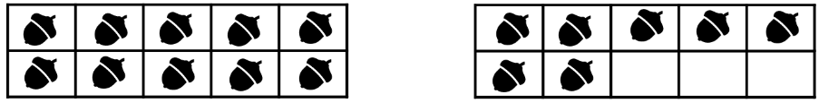
Grades K-2 Problems For MP 6
Continue counting on to 100 starting at 57.
How many acorns are there? How do you know?
Show me 9 buttons. (When given a collection of more than 9 buttons as manipulatives)
True or False? Circle the expressions that are true.
1 + 5 = 6 | 5 – 1 = 6 | 6 = 6 | 5 = 11 – 6
6 = 5 + 1 | 5 + 1 = 4 + 2 | 6 + 2 = 9 | 6 = 1 - 5
Tasks taken from Illustrative Math (tasks.illustrativemathematics.org)
Notes:
Task from Illustrative Mathematics is aligned to 1.OA.7
http://tasks.illustrativemathematics.org/content-standards/1/OA/D/7/tasks/466

Slide 12

Grades K-2 Problems For MP 6
How many dots do you see? How do you see them?
Solve using mental math.
Kindergarten | Grade 1 | Grade 2 | Grade 3
2 + 2 2 + 3 3 + 3 3 + 4 | 7 + 7 7 + 6 7 + 8 8 + 8 | 50 + 50 49 + 49 48 + 49 48 + 48 49 + 51 | 128 + 34 119 + 36 56 + 129 126 + 49
Tasks taken from Number Talks: Whole Number Computation, Grades K-5 by Sherry Parrish
Notes:
Tasks taken from: Number Talks: Whole Number Computation, Grades K-5 by Sherry Parrish

Slide 13
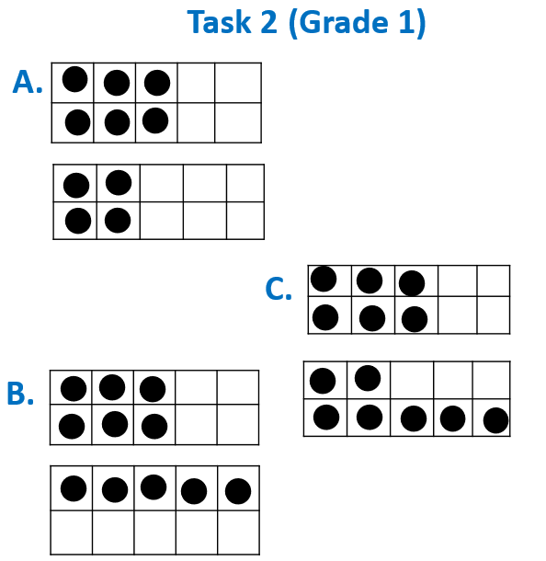

Grades K-2 Problems For MP 6
How many dots do you see? How do you see them?
Task 1 (Kindergarten)
A.
B.
C.
Tasks taken from Number Talks: Whole Number Computation, Grades K-5 by Sherry Parrish
Notes:
Where in the task are their opportunities for students to show their understanding of MP 6?
As a teacher, how would you highlight this with your instruction?
Tasks taken from Number Talks: Whole Number Computation, Grades K-5 by Sherry Parrish

Slide 14
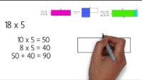
Grades 3-5 Problems For MP 6
Notes:
Boaler video: https://www.youtube.com/watch?v=&t=151s

Slide 15
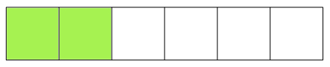
Grades 3-5 Problems For MP 6
Mrs. Frances drew a picture on the board.
Then she asked her students what fraction it represents.
Emily said that the picture represents 26. Label the picture to show how Emily's answer can be correct.
Raj said that the picture represents 23. Label the picture to show how Raj's answer can be correct.
Alejandra said that the picture represents 2. Label the picture to show how Alejandra's answer can be correct.
Tasks taken from Illustrative Math (tasks.illustrativemathematics.org)
Notes:
Illustrative Mathematics Task is aligned to 3.NF.1
http://tasks.illustrativemathematics.org/content-standards/3/NF/A/1/tasks/833

Slide 16
Grades 3-5 Problems For MP 6
A slab of soap on one pan of a scale balances ¾ of a slab of soap and a ¾ pound weight on the other pan. How much does the full slab of soap weight?
6 × 4 = ___ × 3
Write an expression that records the calculations described below, but do not evaluate.
    Add 2 and 4 and multiply the sum by 3. Next, add 5 to that product and then double the result.
Tasks taken from Number Talks: Fractions, Decimals, and Percentages by Sherry Parrish
Notes:
Illustrative Mathematics Task is aligned to 4.NF.3c.
Illustrative Mathematics task is aligned to 5.OA.2.
http://tasks.illustrativemathematics.org/content-standards/5/OA/A/2/tasks/556

Slide 17



Grades 3-5 Problems For MP 6
Which of these models represent ¼ of the whole? How do you know?
Where should ____ be placed on the number line? How do you know?
$\frac{5}{8}?$
$$\frac{5}{6}?$$
A. |  | B. |  | C.
$$\frac{1}{4}$$
$$\frac{1}{3}$$
Tasks taken from Number Talks: Fractions, Decimals, and Percentages by Sherry Parrish
Notes:
Tasks taken from: Number Talks: Fractions, Decimals, and Percentages by Sherry Parrish

Slide 18
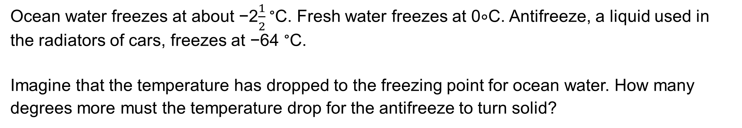
Grades 6-8 Problems For MP 6
Ocean water freezes at about −2$\frac{1}{2}$ °C. Fresh water freezes at 0∘C. Antifreeze, a liquid used in the radiators of cars, freezes at −64 °C.
Imagine that the temperature has dropped to the freezing point for ocean water. How many degrees more must the temperature drop for the antifreeze to turn solid?
Task taken from Illustrative Math (tasks.illustrativemathematics.org)
Notes:
Illustrative Mathematics task is aligned to 7.NS.1
http://tasks.illustrativemathematics.org/content-standards/7/NS/A/1/tasks/314

Slide 19
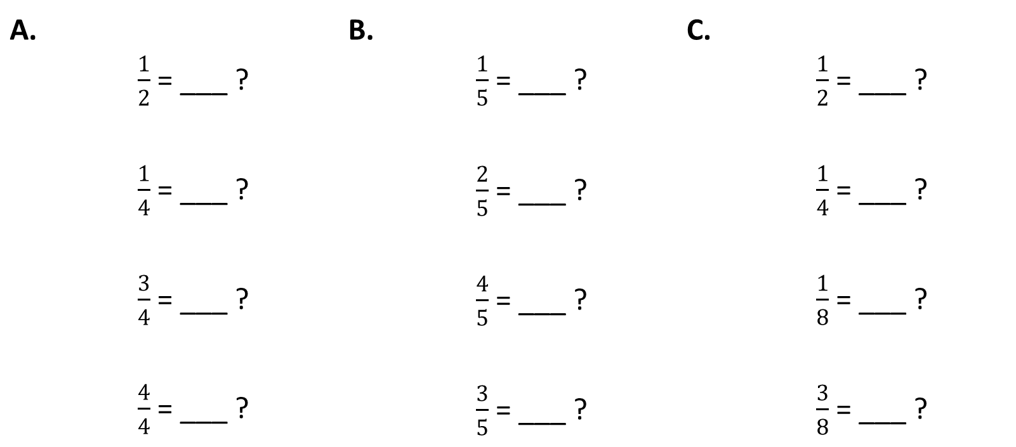
Grades 6-8 Problems For MP 6
What is the percentage equivalent of the fraction ____ ? How do you know? How can you use what we already know to solve the next problem?
A. | $\frac{1}{2}$= ___ ? $\frac{1}{4}$= ___ ? $\frac{3}{4}$= ___ ? $\frac{4}{4}$= ___ ? | B. | $\frac{1}{5}$= ___ ? $\frac{2}{5}$= ___ ? $\frac{4}{5}$= ___ ? $\frac{3}{5}$= ___ ? | C. | $\frac{1}{2}$= ___ ? $\frac{1}{4}$= ___ ? $\frac{1}{8}$= ___ ? $\frac{3}{8}$= ___ ?
Tasks taken from Number Talks: Fractions, Decimals, and Percentages by Sherry Parrish

Slide 20
Grades 6-8 Problems For MP 6
Make up a set of eight numbers that simultaneously satisfy these constraints:
Mean: 10
Median: 9
Mode: 7
Range: 15
Tasks taken from Number Talks: Fractions, Decimals, and Percentages by Sherry Parrish

Slide 21
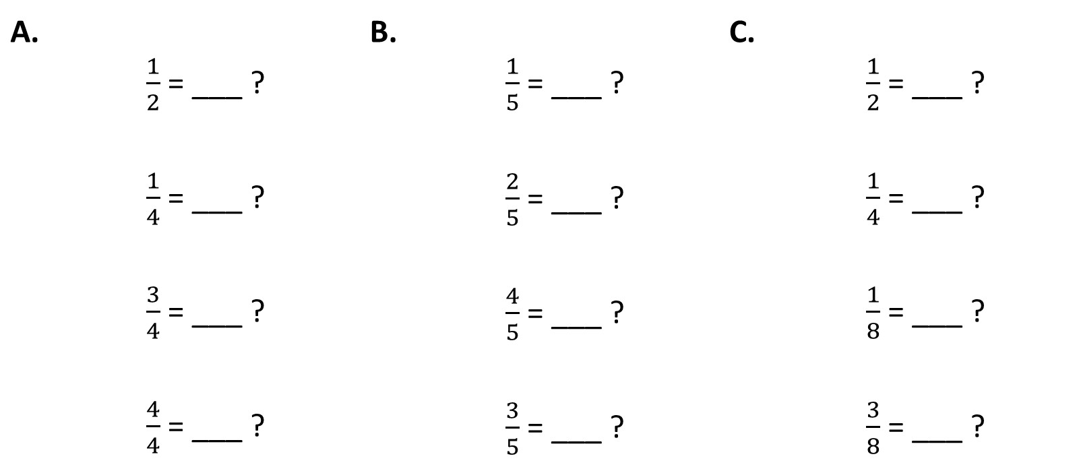
Grades 6-8 Problems For MP 6
What is the percentage equivalent of the fraction ____ ? How do you know? How can you use what we already know to solve the next problem?
A. | $\frac{1}{2}$= ___ ? $\frac{1}{4}$= ___ ? $\frac{3}{4}$= ___ ? $\frac{4}{4}$= ___ ? | B. | $\frac{1}{5}$= ___ ? $\frac{2}{5}$= ___ ? $\frac{4}{5}$= ___ ? $\frac{3}{5}$= ___ ? | C. | $\frac{1}{2}$= ___ ? $\frac{1}{4}$= ___ ? $\frac{1}{8}$= ___ ? $\frac{3}{8}$= ___ ?
Tasks taken from Number Talks: Fractions, Decimals, and Percentages by Sherry Parrish

Slide 22
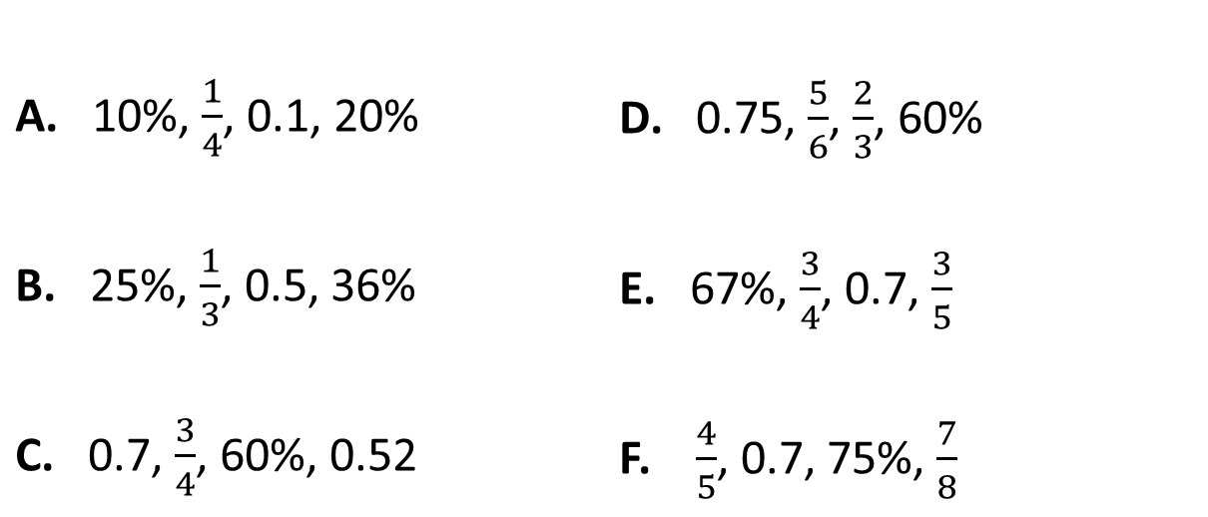
Grades 6-8 Problems For MP 6
Task 1:
How would you order these numbers from least to greatest? How do you know?
Task 2:
Time in Car (hr.) | Distance (mi.)
0.75 | 36
1.5
3
4.5
1
 | 108
A. 10%, $\frac{1}{4}$, 0.1, 20% B. 25%, $\frac{1}{3}$, 0.5, 36% C. 0.7, $\frac{3}{4}$, 60%, 0.52 | D. 0.75, $\frac{5}{6}$, $\frac{2}{3}$, 60% E. 67%, $\frac{3}{4}$, 0.7, $\frac{3}{5}$ F. $\frac{4}{5}$, 0.7, 75%, $\frac{7}{8}$
Task 1 taken from Number Talks: Fractions, Decimals, and Percentages by Sherry Parrish
Task 2 taken from Algebra Problem Strings by Pamela Weber Harris

Slide 23
High School Problems for MP 6
Solve.
(3  3)²
(2²)³
(2³)²
(a⁴)³
(a⁶)²
(3ª)³
(3²)^{b}
(xª)^{b}
(2a²)³
(-3ab¹⁰)²
Task taken from Algebra Problem Strings by Pamela Weber Harris

Slide 24
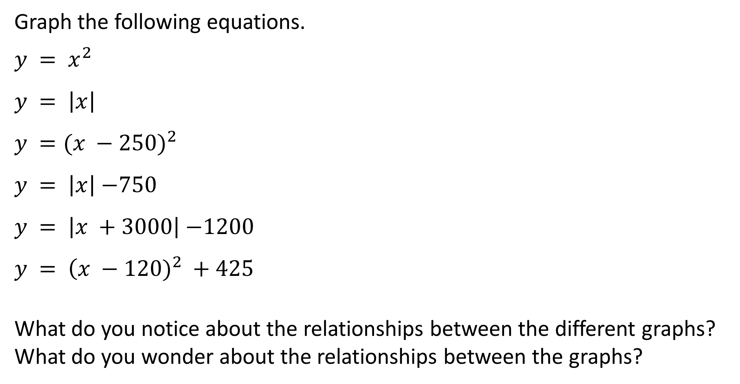
High School Problems for MP 6
Graph the following equations.
$$y = x^{2}$$
$$y = \left|x\right|$$
$$y =({x −250)}^{2}$$
$y = \left|x\right|$ $−750$
$y = \left|x +3000\right|$ $−1200$
$$y = \left(x − \right.{120)}^{2} +425$$
What do you notice about the relationships between the different graphs?
What do you wonder about the relationships between the graphs?
Task taken from Algebra Problem Strings by Pamela Weber Harris

Slide 25
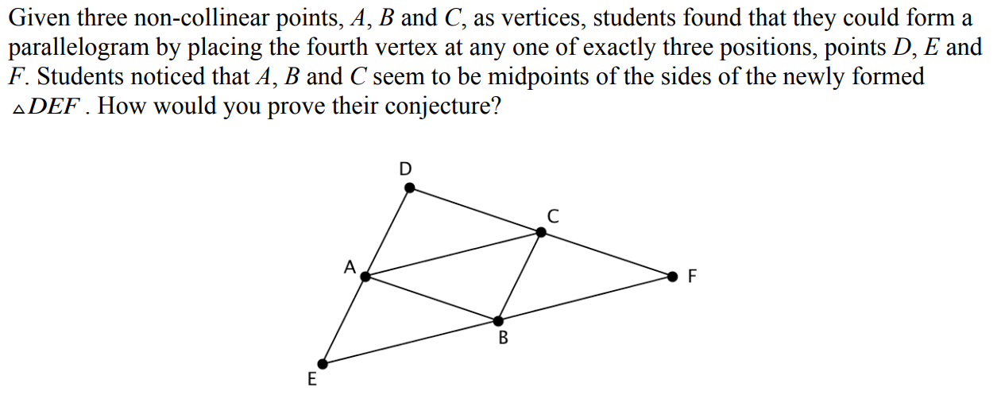
High School Problems for MP 6
Task taken from mathpractices.edc.org

Slide 26
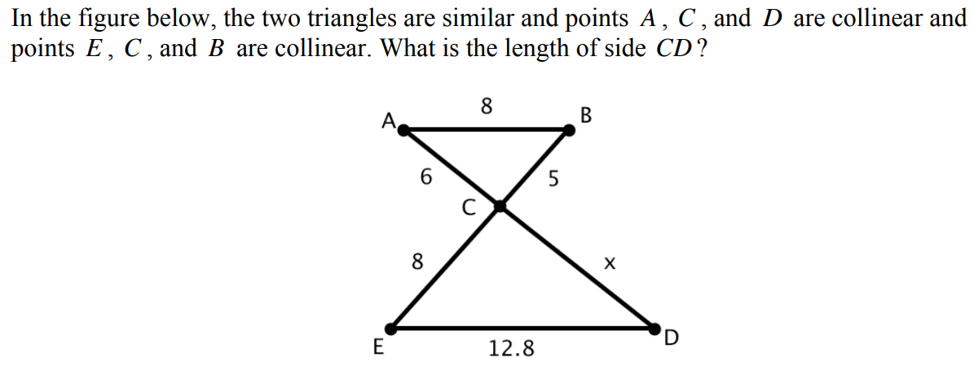
High School Problems for MP 6
Task taken from mathpractices.edc.org

Slide 27

Break out room slide
Break out 10-20 min.
Breakout Room Discussion Share Out

Slide 28
MP 6: Attend to Precision.
Mathematically proficient students try to communicate precisely to others. They try to use clear definitions in discussion with others and in their own reasoning. They state the meaning of the symbols they choose, including using the equal sign consistently and appropriately. They are careful about specifying units of measure and labeling axes to clarify the correspondence with quantities in a problem. They calculate accurately and efficiently and express numerical answers with a degree of precision appropriate for the problem context. In the elementary grades, students give carefully formulated explanations to each other. By the time they reach high school they have learned to examine claims and make explicit use of definitions.
Notes:
The Ohio’s Learning Standards for Mathematical Practice (K-12) describe how students should demonstrate their mathematical proficiency. These standards “describe varieties of expertise that mathematics educators at all levels should seek to develop in their students” (Standards for Mathematical Practice, 2010). This is achieved by giving expectations for the depth of students’ understanding, the skills students should have, and how students should express what they know. Unfortunately, the MPs are written in a manner that makes them difficult for many educators to understand which makes their implementation difficult.

Slide 29

Resource Links
Standards for Mathematical Practice
Kindergarten - Grade 5
Grades 6-8
High School
Notes:
Standards for MP: https://education.ohio.gov/getattachment/Topics/Learning-in-Ohio/Mathematics/Model-Curricula-in-Mathematics/Standards-for-Mathematical-Practice/Standards-for-Mathematical-Practice.pdf.aspx

Slide 30
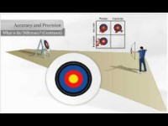
Accuracy vs. Precision
Is it better to be accurate or precise? Defend your reasoning.

Slide 31

MP 6 Progression:
Attend to Precision.

Slide 32
Breakout Rooms
Task: Review the MP progression documents.
Discussion question: What do you think Math Practice 6: Attend to Precision means or looks like at your grade level/course?
Notes:
Break out room slide
Discussion question: What do you think of when MP 2?
Break out time approx. 10-20 min. depending on the number of people

Slide 33
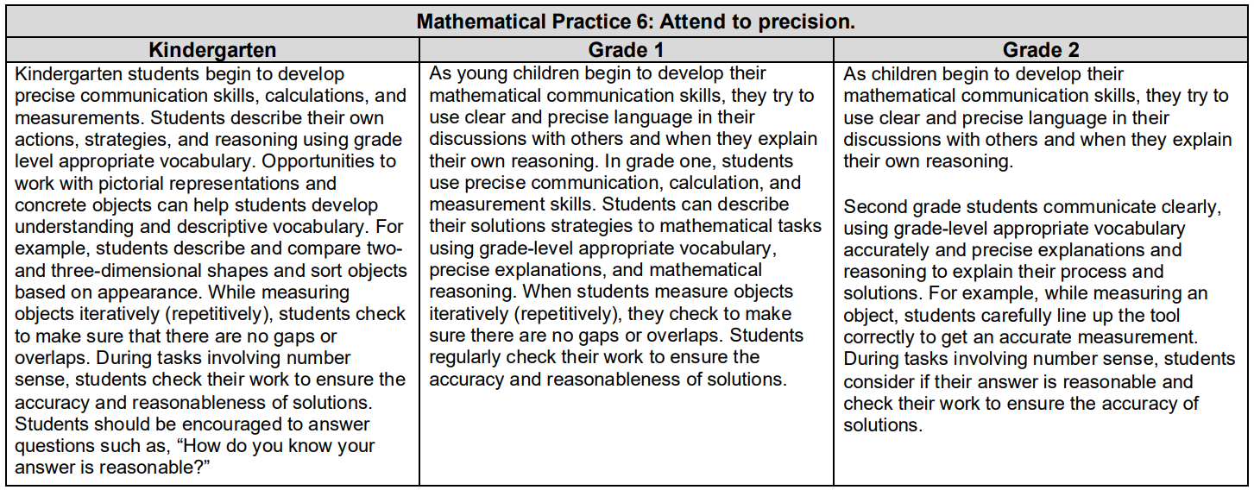

Slide 34
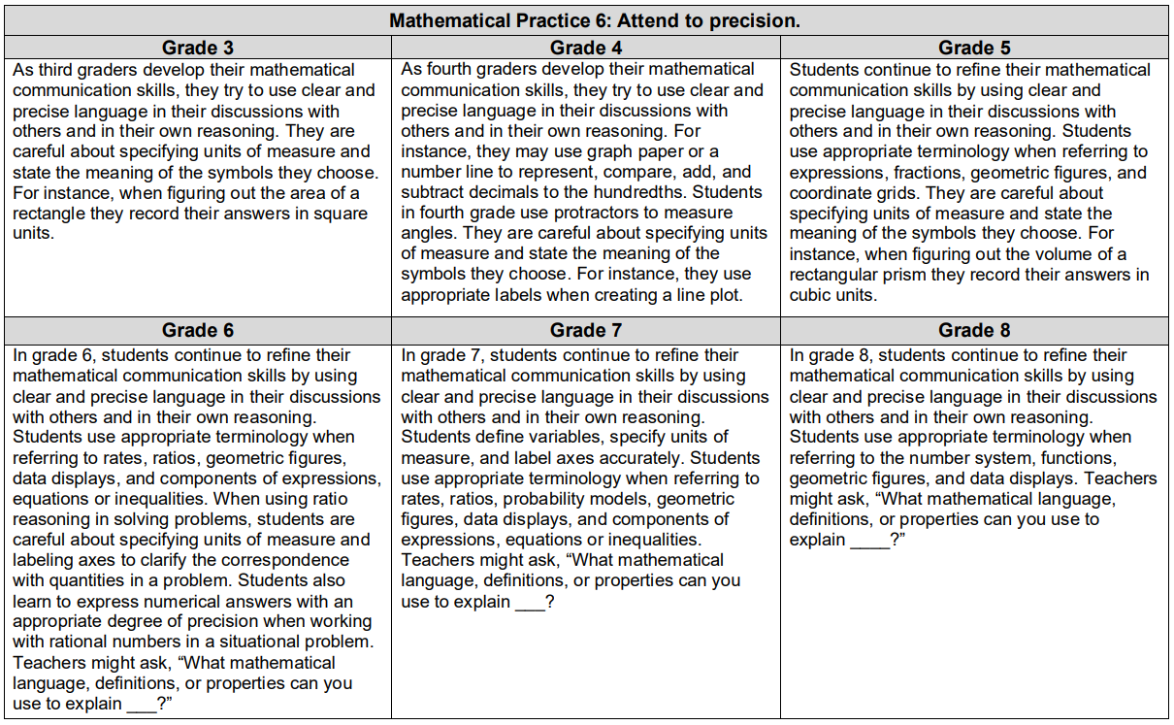

Slide 37
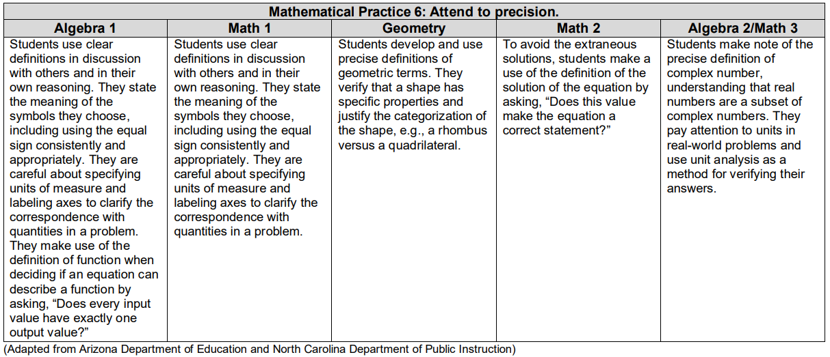

Slide 38

Breakout Room Discussion Share Out
Notes:
Dan

Slide 39

What does MP 6: Attend to Precision Look Like at My Grade Band?

Slide 40
MP 6: Attend to Precision.
Includes both a precision of language and number.
Explaining one’s thinking.
Asking coherent questions.
Notes:
Includes both a precision of language and number. This can be shown by students presenting their work in a way that can be understood.

Slide 41
MP 6: Attend to Precision
Define the variable in a problem.
Correctly label graphs.
Use appropriate unit when expressing quantities.
Connect their words clearly to their representations.

Slide 42
Illustrative Mathematics Elaborations for MP 6 in Grades K-5
Use clear definitions in discussions with others and in their own reasoning.
Craft careful explanations that communicate their reasoning by referring specifically to each important mathematical element, describing the relationships among them.
Notes:
Includes both a precision of language and number. This can be shown by students presenting their work in a way that can be understood. This does not mean students should be given precise vocabulary assignments or expected to recall precise definitions of mathematical terms or concepts.

Slide 43
What does MP 6 look like at K-5?
State the meaning of the symbols they choose, including using the equal sign consistently and appropriately.
Specify units of measure.
Label axes to clarify the correspondence with quantities in a problem.
Notes:
Includes both a precision of language and number. This can be shown by students presenting their work in a way that can be understood. This does not mean students should be given precise vocabulary assignments or expected to recall precise definitions of mathematical terms or concepts.

Slide 44
What does MP 6 look like at K-5?
Calculate accurately and efficiently.
Express numerical answers with a degree of precision appropriate for the problem context.
Give carefully formulated explanations to each other.
Notes:
Includes both a precision of language and number. This can be shown by students presenting their work in a way that can be understood. This does not mean students should be given precise vocabulary assignments or expected to recall precise definitions of mathematical terms or concepts.

Slide 45
Illustrative Mathematics Elaborations for MP 6 in Grades 6-8
Use clear definitions in discussion with others and in their own reasoning.
State the meaning of the symbols they choose, consistently and appropriately, such as inputs and outputs represented by function notation.
Specify units of measure, distinguishing, for example, between linear and area measures.
Notes:
What does it look like in middle school?
http://commoncoretools.me/wp-content/uploads/2014/05/2014-05-06-Elaborations-6-8.pdf

Slide 46
Illustrative Mathematics Elaborations for MP 6 in Grades 6-8
Label axes to display the correct correspondence between quantities in a problem, such as the intervals and frequencies on the axes of a histogram.
Calculate accurately and efficiently, express numerical answers with a degree of precision appropriate for the problem context and make explicit use of definitions.
Accurately apply scientific notation to large numbers and use measures of center to describe data sets.
Notes:
What does it look like in middle school?
http://commoncoretools.me/wp-content/uploads/2014/05/2014-05-06-Elaborations-6-8.pdf

Slide 47

NCTM 8 Effective Teaching Practices

Slide 48
Effective Teaching Practices
Establish mathematics goals to focus learning. Effective teaching of mathematics establishes clear goals for the mathematics that students are learning, situates goals within learning progressions, and uses the goals to guide instructional decisions.
Implement tasks that promote reasoning and problem solving. Effective teaching of mathematics engages students in solving and discussing tasks that promote mathematical reasoning and problem solving and allow multiple entry points and varied solution strategies.
Use and connect mathematical representations. Effective teaching of mathematics engages students in making connections among mathematical representations to deepen understanding of mathematics concepts and procedures and as tools for problem solving.
Facilitate meaningful mathematical discourse. Effective teaching of mathematics facilitates discourse among students to build shared understanding of mathematical ideas by analyzing and comparing student approaches and arguments.

Slide 49
Effective Teaching Practices
Pose purposeful questions. Effective teaching of mathematics uses purposeful questions to assess and advance students’ reasoning and sense making about important mathematical ideas and relationships.
Build procedural fluency from conceptual understanding. Effective teaching of mathematics builds fluency with procedures on a foundation of conceptual understanding so that students, over time, become skillful in using procedures flexibly as they solve contextual and mathematical problems.
Support productive struggle in learning mathematics. Effective teaching of mathematics consistently provides students, individually and collectively, with opportunities and supports to engage in productive struggle as they grapple with mathematical ideas and relationships.
Elicit and use evidence of student thinking. Effective teaching of mathematics uses evidence of student thinking to assess progress toward mathematical understanding and to adjust instruction continually in ways that support and extend learning.

Slide 50
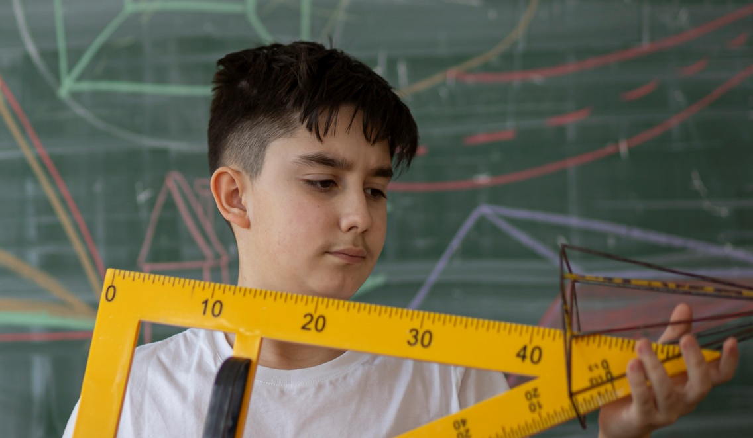



ODE Math Practice Rubric

Slide 51
MP | Needs Improvement | Emerging | Proficient | Exemplary
MP.6 Attend to Precision. | Does not address the question completely or directly; gives incomplete or wrong responses. | Makes an incomplete attempt to answer the question; does not formulate further responses when necessary. | Answers the question of interest thoroughly and precisely; provides carefully formulated explanations; revises responses when necessary. | Answers the question of interest thoroughly and precisely; provides carefully formulated explanations; identifies when others are not addressing the question completely.
 | Fails to communicate; unable to decipher appropriate depth of communication needed, e.g., goes off on tangents or does not provide relevant information. | Communicates with vague or incorrect terminology. | Communicates clearly with a good grasp of the mathematical terminology. uses mathematical vocabulary carefully. | Communicates clearly and concisely examining claims and makes explicit use of mathematical definitions.
 | Calculates inaccurately; forgets to specify the meaning of symbols and units and to provide labels. | Calculates accurately but not precisely, occasionally specifying the meaning of symbols and units and providing labels. | Calculates accurately and efficiently, expressing numerical answers with a degree of precision; states the meaning of symbols, specifying units of measure and providing accurate labels. | Calculates accurately and efficiently and uses proper precision in procedures; states the meaning of symbols, carefully specifying units of measure and providing accurate labels.
 | Does not determine the necessary level of precision. | Determines a level of precision; may not be the best choice. | Determines the necessary level of precision; distinguishes between exact and approximate answers, and determines which is more useful depending on the context. | Determine the necessary level of precision noting error or uncertainty; distinguishes between exact and approximate answers, and determines which is more useful depending on the context.

Slide 52
Robert Kaplinsky’s Readable Version
Math Practice 6: Communicate precisely.
Mathematically proficient students communicate precisely with others. This includes using proper definitions, defining their variables, specifying their units, and labeling axes.
Notes:
Kaplinsky changed the title to “Communicate precisely” because the phrasing “attend to precision” is not particularly common in the United States and people often think this standard is more about calculating than communicating.
Kaplinsky was not concerned about removing the phrase “they calculate accurately and efficiently” because that is certainly a part of other math practice standards such as Math Practice 1.
The words “try to” in the first sentence removed because they felt unnecessary.

Slide 53
Mathematics Questions?
Name | Email
Brian Bickley | Brian.Bickley@education.ohio.gov
Anna Cannelongo | Anna.Cannelongo@education.ohio.gov
Annika Moore | Annika.Moore@education.ohio.gov
Yelena Palayeva | Yelena.Palayeva@education.ohio.gov

Slide 54
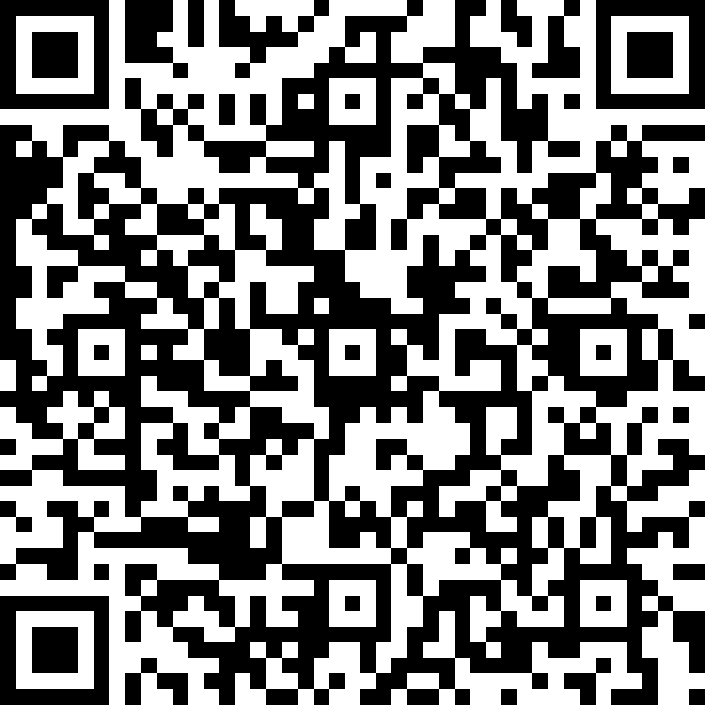
Exit Ticket Survey
https://forms.office.com/g/8S38C0Y3sz
Notes:
https://forms.office.com/g/8S38C0Y3sz

Slide 55

Resource Links
Ohio Department of Education Documents
Standards for Mathematical Practice
Kindergarten - Grade 5
Grades 6-8
High School
University of Arizona Progressions
Standards for Mathematical Practice: Commentary and Elaborations for K-5
Standards for Mathematical Practice: Commentary and Elaborations for 6-8
Other National Resources
Inside Mathematics
Illustrative Mathematics
Robert Kaplinsky: Math CCSS Math Practices Readable

Slide 56
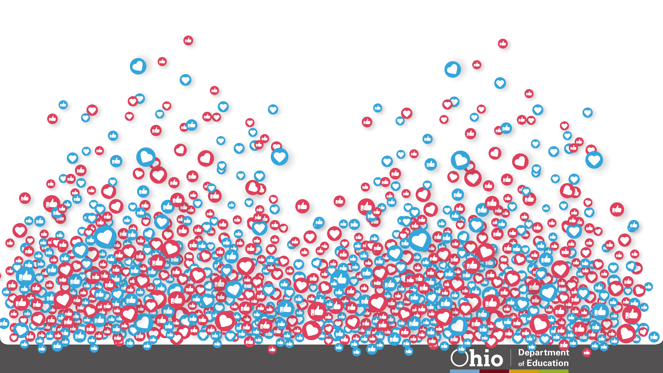





@OHEducation

Slide 57

Share your learning community with us!
#MyOhioClassroom
Celebrate educators!
#OhioLovesTeachers

