Slide 1
Standards for Mathematical Practices
Look for and Express Regularity in Repeated Reasoning
Yelena Palayeva – Feb. 8, 2022

Slide 2
Welcome

Slide 4
Virtual Meeting Norms
Be respectful.
Recognize that everyone has expertise.
Assume positive intent.
Seek clarification in language and ideas.
Share experiences.
Use the chat feature when you have a question.
Mute your microphone when not speaking.

Slide 5
Assign yourself
By grade band
K-2
3-5
6-8
HS

Slide 7
Each Child Our Future
Our Vision
In Ohio, each child is challenged to discover and learn, prepared to pursue
a fulfilling post-high school path and empowered to become a resilient,
lifelong learner who contributes to society.

Slide 8
Why Math?
“How can it be that mathematics, being after all a product of human thought independent of experience, is so admirably adopted to the objects of reality?”
(Einstein 1928, p.28)
Understand and critique the world
Cultivate wonder, joy and beauty
Expand professional opportunities
Foster analytical way of thinking

Slide 9
Analytical Way of Thinking
Applies knowledge fluidly and creatively
Adapts previously mastered definitions and techniques
Reasons by analogy on similar problems
Uses known approaches in novel situations

Slide 10
Developing Analytical Thinking Ability
To go beyond dependency on basic skill
To avoid route memorization
To apply ways of thinking with repeated practice over time
To produce strategies

Slide 11
Focus, Rigor, Coherence
Help better understand the standards
Challenge deficit of access to grade-level work
Promote deeper understanding of content
Help in adoption of instructional resources
Move toward equal access to grade level content

Slide 12
Math Teaching Practices and Standards for Math Practices
From: Emphasis
on Answers
Through: Standards for Math Practices and
Math Teaching Practices
To: Emphasis on Understanding Mathematics

Slide 13
Standards for Math Practices (SMPs)
Make sense of problems and persevere in solving them
Reason abstractly and quantitatively
Construct viable arguments and critique the reasoning of others
Model with mathematics
Use appropriate tools strategically
Attend to precision
Look for and make use of structure (I can use what I know to solve new problem)
Look for and express regularity in repeated reasoning
Notes:
Ohio’s Learning Standards for Mathematics

Slide 14
What comes to your mind when you think about SMP 8: Look for and Express Regularity in Repeated Reasoning?
Post your thoughts in Chat
Notes:
At this time of this session, please use chat feature to write what comes to your mind when you think about Looking for and Expressing Regularity in Repeated Reasoning.

Slide 15
Look for and Express Regularity in Repeated Reasoning
“Mathematically proficient students notice if calculations are repeated and look both for general methods and for shortcuts. Upper elementary students might notice when dividing 25 by 11 that they are repeating the same calculations over and over again, and conclude they have a repeating decimal. By paying attention to the calculation of slope as they repeatedly check whether points are on the line through (1, 2) with slope 3, middle school students might abstract the equation $\frac{y−2}{ x−1 }=$ 3. Noticing the regularity in the way terms cancel when expanding (x – 1) (x + 1), (x – 1)(x² + x + 1), and (x – 1)(x³ + x² + x + 1) might lead them to the general formula for the sum of a geometric series. As they work to solve a problem, mathematically proficient students maintain oversight of the process, while attending to the details. They continually evaluate the reasonableness of their intermediate results”.
Notes:
You can see the exact wording of the Standard for Math Practice 8.
The most important parts of the text is highlighted in yellow

Slide 16
Why SMP.8?
Provides basis for learning math logic
Forms a sense of order
Allows for making educated guesses
Reduces math anxiety
Aids in developing mental math skills
Builds mathematical relationships
Offers insight into the natural world

Slide 17
SMP.8 is about
Regularity
Coherence
Inconsistency
Irrelevance
Similarity

Slide 18
SMP.8 is About
Connections
Exclusions
Generalizations
Shortcuts

Slide 19
NCTM. Catalyzing Change in High School
Math Teaching Practices
Establish mathematics goals to focus learning
Implement tasks that promote reasoning and problem solving
Use and connect math representations
Build procedural fluency from conceptual understanding
Facilitate meaningful mathematical discourse
Pose purposeful questions
Support productive struggle in learning mathematics
Elicit and use evidence of student thinking

Slide 20
SMP.8 and 4-Step Process
Guess
Check
Generalize
Verify

Slide 21
Video: Number of Diagonals and 4-Step Process
https://www.youtube.com/watch?v=xtIUOcK0yH4&t=6s

Slide 22
Breakout Rooms A
Notes:
Now, it the time for the first round of BORs or BOR A.
Breakout Rooms A are randomly arranged . Each BOR has educators from different grade bands. You have about 10 min to stay in BOR.
The intent of your conversation in BORs is, by focusing on 4-step process, work on the problem and discuss teaching practices that can support students in developing SMP.8 skills.

Slide 23
Collatz Conjecture
Pick any whole number
If the number is even, divide it by 2
If the number is odd, multiply it by 3 and then add 1
Take that new number and repeat the process, again and again until the sequence ends
Pick another number and repeat the process
What do you notice?
What do you wonder?

Slide 24
Share Out
Notes:
After BORs’ time is over, join the main room where you have an opportunity to share your thoughts.

Slide 25
Grouping of Standards for Math Practices
Notes:
The entire set of SMPs is a tool kit from which each tool can be used as needed.

Slide 26
Grouping of Standards for Math Practices
SMP.8
SMP.2
SMP.4
SMP.7

Slide 27
Look for and Express Regularity in Repeated Reasoning
How many squares are in the border of an “n x n” grid?
Notes:
In this session, look at this item through the lenses of Repeated Reasoning and 4-step process.

Slide 28
Look for and Express Regularity in Repeated Reasoning: Border Problem
How many squares are in the border of a 10x10 grid?

Slide 29
Envisioning Thinking…

Slide 30
Verbalizing Thinking

Slide 31
Guessing and Checking
How many squares are in the border of an 8x8 grid?
3x3 grid?
12x12 grid?

Slide 32
Generalizing

Slide 33
Verifying

Slide 34
Look for and Express Regularity in Repeated Reasoning: 4-Step Process
Guess
Check
Generalize
Verify

Slide 35
Verification and Equivalence
n + (n – 2) + n + (n – 2)
n + 2(n – 2) + (n – 2)
4(n – 2) + 4
(n – 1)·4
4n – 4
n² – (n – 2)²

Slide 36
SMP.7
and
SMP.8

Slide 37
Standards for Math Practices
Make sense of problems and persevere in solving them
Reason abstractly and quantitatively
Construct viable arguments and critique the reasoning of others
Model with mathematics
Use appropriate tools strategically
Attend to precision
Look for and make use of structure
Look for and express regularity in repeated reasoning

Slide 38
SMP.7 vs. SMP.8
SMP.7 | SMP.8
Focuses on structure in a mathematical object Makes a shift to a big picture or a complex construction Finds a relationship between parts of mathematical situation and simplifies them, if necessary. Reduces the complexity of the expressions Transforms a structure of the model to reveal its phenomena Connects concepts and representations | Recognizes similarity within numbers, objects, operations, problems Helps finding entry point to an unfamiliar situation Focuses on reasoning, not on object Builds mathematics model by abstracting from the concrete examples
Notes:
This is a comparison of two practices that are often used together but they are distinct.

Slide 39
Video: How Long is It from the First Bird to the Last?
https://vimeo.com/103522430?embedded=true&source=video_title&owner=18324331
Notes:
At this time of presentation, please watch the video. The link to this video is on the slide.

Slide 40
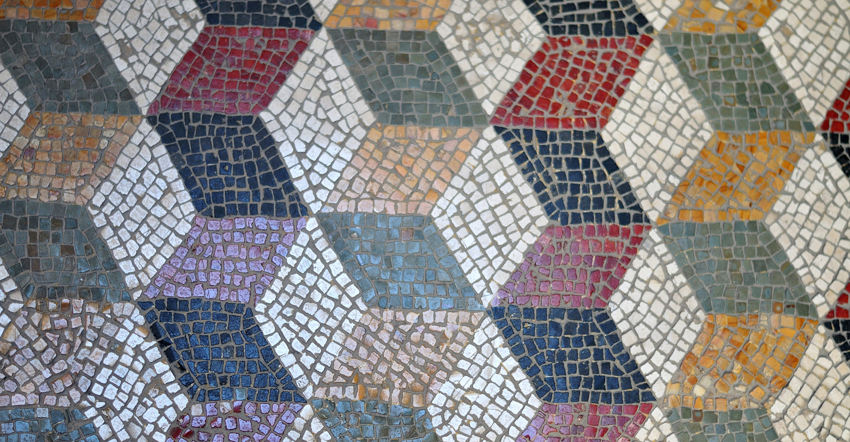
Look for and Express Regularity in Repeated Reasoning
Mathematically proficient students
Recognize similarity within groups of numbers
Recognize patterns within operations
Understand why numbers and operations work the way they do
Recognize similarities between problems and use them efficiently
Identify patterns or strategies and generalize them to other situations

Slide 41
Ohio Learning Standards

Slide 42
Ohio’s Learning Progressions by Topic

Slide 43
From Patterns to Functions
Extend a pattern: oval, oval, square, oval, oval, square, …
1
2
3
4
5
6

Slide 44
From Patterns to Functions
Skip-counting: 1, 4, 7, 10, 13, …
f(x) = 1 + 3x
Times table: 3, 6, 9, 12, 15, …
F(x) = 3x
Exponents: 3, 9, 27, 81, …
ɸ(x) = $3^{x}$

Slide 45
“Mathematics is a study of patterns”
G. H. Hardy

Slide 46
SMP 8 Progression K-HS: Look for and Express Regularity in Repeated Reasoning.
Notes:
Next, is an opportunity to explore the progressions of Standard for Math Practice 8.

Slide 47
Notes:
This slide and the next three slides are Standards for Math Practice 8 Progressions from K to HS.
Not only the Content Standards but Math Practices progress from K to HS.
The link to this document is available in the chat. You will need an access to it while working in the next round of BO rooms.
https://education.ohio.gov/getattachment/Topics/Learning-in-Ohio/Mathematics/Model-Curricula-in-Mathematics/Standards-for-Mathematical-Practice/ohio-standards-for-mathematical-practice-progressions.pdf.aspx?lang=en-US

Slide 51
Breakout Rooms B
Notes:
.
In this round of BOR B, work on the task through the lenses of Standards for Math Practice Progressions document.

Slide 52
The Djinni’s Offer
After opening an ancient bottle, you find on the beach, a Djinni appears. In payment for his freedom, he gives you a choice of either 50,000 gold coins or one magical gold coin. The magic coin will turn into two gold coins on the first day. The two coins will turn into four coins total at the end of two days. By the end or the third day there will be eight gold coins total. The Djinni explains that the magic coins will continue this pattern of doubling each day for one moon cycle, 28 days. Which prize do you choose?
Notes:
This slide can be accessed from Jamboard:
Using this task and Math Practice Progression document as a reference, relate the task to the Progressions.

Slide 53
Share Out
Notes:
After BORs’ time is over, it is an opportunity to share your thoughts.

Slide 54
SMP.8: Avenue of Thinking
Students | Teachers
Is there a number pattern? | Will the same strategy work in order situations?
Are there a repeated calculations? | How would you prove that…?
Are there more efficient computations strategies using number patterns | How do you notice about…?
Is there a shortcut or the general method? | What is happening in this situation?
Do I consider all the details while focusing on the overall process? | What would happen if…?
Do I continually evaluate the reasonableness of my intermediate results? | Is there a mathematics rule for…?
 | What predictions or generations can this pattern support?
 | What mathematical consistencies do you notice?

Slide 55
NCTM “Look Fors”
Notes:
https://www.google.com/search?q=nctm+math+practice+look+fors&rlz=1C1GCEU_enUS820US820&oq=NCTM+math&aqs=chrome.1.69i57j35i39j0i20i263j0l2j69i60l3.3630j0j4&sourceid=chrome&ie=UTF-8

Slide 56
SMP.8: Implementing Standards for Math Practices
Notes:
This is a rubric for the teachers to assess tasks they selected to develop SMP.8.

Slide 57
SMP.8: Student Rubric
Notes:
This rubric is to help teachers to evaluate students’ ability to use SMP.8 or Look for and express regularity in repeated reasoning.
Teachers can rewrite this rubric so that it can become the tool for the students

Slide 58
“The more we observe patterns, the more we connect the dots and make sense out of them, the more we learn.”
Omar Cherif

Slide 59
Mathematics Questions?
Name | Email
Brian Bickley | Brian.Bickley@education.ohio.gov
Anna Cannelongo | Anna.Cannelongo@education.ohio.gov
Annika Moore | Annika.Moore@education.ohio.gov
Yelena Palayeva | Yelena.Palayeva@education.ohio.gov

Slide 60
References
Illustrative Mathematics. (2014, May 6). Standards for Mathematical Practice: Commentary and Elaborations
for 6–8. Tucson, AZ.
Koestler, C., Felton-Koestler, M. D., Bieda, K., & Otten, S. (2013). Connecting the NCTM process standards
and the CCSSM practices. Reston, VA: The National Council of Teachers of Mathematics.
O'Connell, S., & SanGiovanni, J. (2013). Putting the practices into action: Implementing the common core
standards for mathematical practice, K-8. Portsmouth, NH: Heinemann.
.
Boston, M., Dillon, F., Smith, M., & Miller, S. (2017). Taking Action Implementing Effective Mathematics Teaching Practices, Grades 9-12. Reston, VA: The National Council of Teachers of Mathematics
Graham, K., Cuoco, A., & Zimmermann, G., (2010). Focus on High School Mathematics: Reasoning and Sense Making. Reston, VA: The National Council of Teachers of Mathematics
Notes:
The next couple slides show references and resorses I used for this presentation.

Slide 61
References
https://www.louisianabelieves.com/docs/common-core-state-standards-resources/guide--teacher-planning-for-math-practice-implementation.pdf?sfvrsn=2
“The Power of Making Mistakes in Learning Math”
http://mathpractices.edc.org/browse-by-mps.html#overlay-context
https://www.insidemathematics.org/common-core-resources/mathematical-practice-standards
https://www.redlandsusd.net/site/handlers/filedownload.ashx?moduleinstanceid=8304&dataid=8093&FileName=Standards%20for%20Mathematical%20Practice%207.pdf

Slide 62
References
https://education.ohio.gov/getattachment/Topics/Learning-in-Ohio/Mathematics/Model-Curricula-in-Mathematics/Standards-for-Mathematical-Practice/Math-Practices-Rubric.pdf.aspx?lang=en-US
http://www.siam.org/Portals/0/Publications/Reports/gaimme-full_color_for_online_viewing.pdf?ver=2018-03-19-115454-057
http://education.ohio.gov/Topics/Learning-in-Ohio/OLS-Graphic-Sections/Learning-Standards
https://docs.google.com/document/d/1zz8_G_qrdND_Ep2e4zvzICBHcOK_r61vfuwcHnP0oJk/edit

Slide 63
Resource Links
Standards for Mathematical Practice
Kindergarten - Grade 5
Grades 6-8
High School
Notes:
Standards for MP: https://education.ohio.gov/getattachment/Topics/Learning-in-Ohio/Mathematics/Model-Curricula-in-Mathematics/Standards-for-Mathematical-Practice/Standards-for-Mathematical-Practice.pdf.aspx

Slide 64
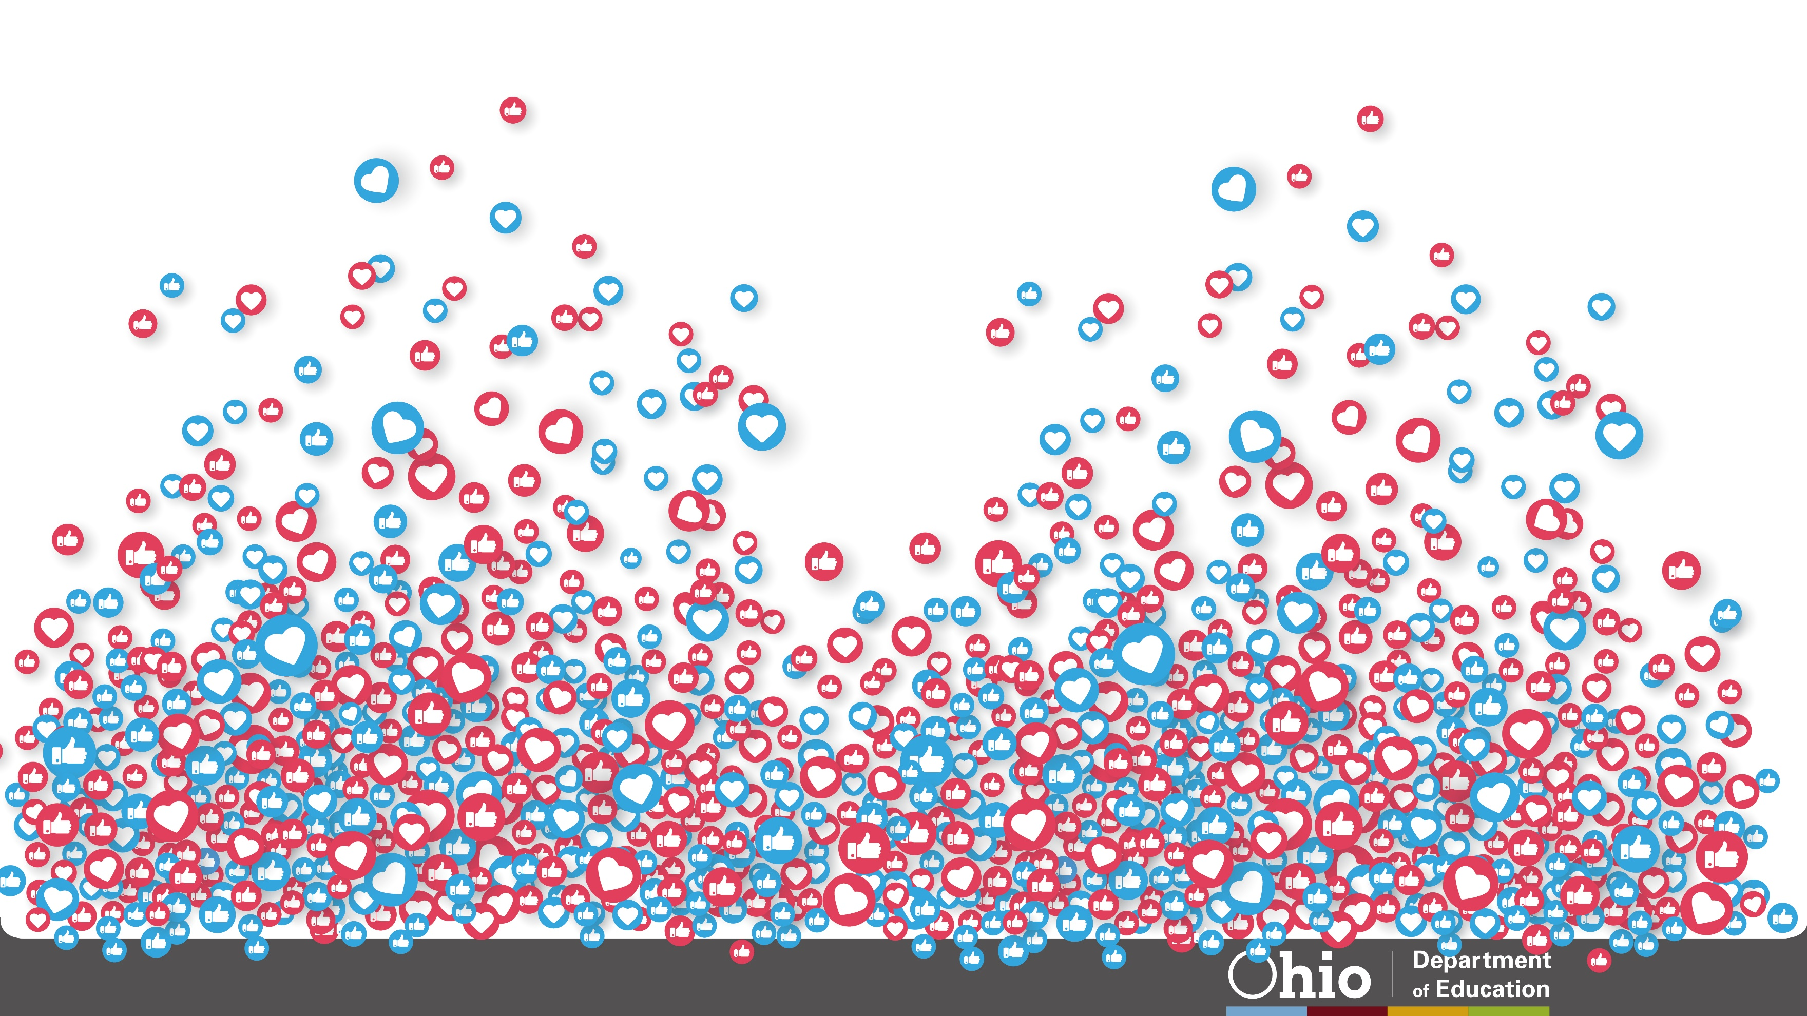
@OHEducation

