Slide 1
Ohio Department of Education and Workforce

Slide 2

MATH PRACTICE 1: MAKE SENSE OF PROBLEMS AND PERSEVERE IN SOLVING THEM.

Slide 3
Welcome

Slide 4
OHIO DEPARTMENT OF EDUCATION AND WORKFORCE PRIORITIES
Literacy
Learning Acceleration
Workforce Readiness
Student Wellness
Notes:
The math plan looks to connect. To department priorities in the following areas:
Literacy Achievement: Building a foundation for lifelong success by ensuring every student is reading at or above grade level.
Learning Acceleration: Empowering each learner to reach their full potential through individualized, evidence-based support.
Student Wellness: Fostering safe and supportive environments that engage students and enable them to thrive.
Workforce Readiness: Preparing students for the future fully equipped with the skills needed to take the next steps in their career journeys.
Our strongest connection to the Department’s priorities is around learning acceleration. In mathematics, we want every student to be able to accelerate their learning. This means they can access the proactive, research-. And evidence-based, and individualized support they need to succeed. To achieve this priority, all students must have the opportunity to engage in grade-level core instruction regardless of ability, which requires replacing remediation (the practice of teaching below grade-level content) with the just-in-time intervention that allows students to complete unfinished learning and access grade-level instruction (or above).

Slide 5
SESSION NORMS
Listen
Listen with the intent to understand. Ask questions!
Focus
Focus on how this applies to your daily work.
Imagine the possibilities!
Create
Create a safe place to air confusion and raise questions.
Support
Support ideas with evidence. Bring your vast experience to the table. Support participation of all.
Notes:
Welcome everyone. We want to take a moment to ground us in our Session Norms.
We want to Listen with the intent to understand. Ask question!
We want to Focus on how this applies to your daily work. Imagine the possibilities!
We want to Create a safe place to air confusion and raise questions.
We went to Support ideas with evidence. Bring your vast experience to the table. Encourage everyone’s participation. Part of Supporting others is to make sure we are providing space for all in group to share. In addition, we have noticed a few participants have invited an AI presence to curate notes for them during the session. While we appreciate the use of productivity tools, unfortunately, MS TEAMS does not know how to deal with these “non-human” participants and this is affecting breakout rooms, so going forward, we will not be admitting AI participants into our community meetings each month. If there are questions or concerns, please contact one of the Dept team on this session. Thank you!

Slide 6
PURPOSE:
Connect
Ohio’s Mathematics Vision from Ohio’s Plan for K-12 Mathematics to the Mathematical Practices.
Explore
MP 8: Look for and Express Regularity in Repeated Reasoning through grade band-aligned instructional tasks.
Identify
Resources to support instruction aligned to Math Practice 8: Look for and Express Regularity in Repeated Reasoning.
Utilize
Resources to help recognize and collect evidence of MP 8: Look for and Express Regularity in Repeated Reasoning in the classroom.

Slide 7
AGENDA
What: | Why: | How:
Welcome and Introductions 5-10 minutes | To establish the session norms and outline the focus of the session | Facilitator presentation
Ohio’s Plan for K-12 Mathematics 5 minutes | To learn about Ohio’s Vision for Mathematics as outlined in Ohio’s Plan for K-12 Mathematics | Facilitator presentation
Resource Exploration and Discussions 45-60 minutes | Explore various Ohio resources aligned to the Standards for Mathematical Practice (MPs) and identify their connections to Ohio’s Mathematics Vision. | Breakout Rooms and Whole Group Discussion
Closing 5-10 minutes | Address lingering questions and provide session feedback | Participant Q&A and Exit Tickets

Slide 8

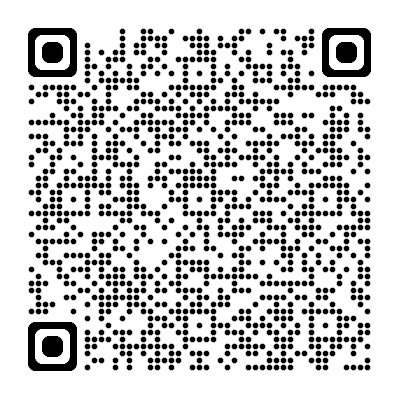
OHIO’S PLAN FOR
K-12 MATHEMATICS
education.ohio.gov/math

Slide 9
STRUCTURE OF OHIO’S PLAN
Why?
What?
How?
Section 1: Why a Comprehensive Mathematics Plan is Needed
Section 2: Ohio’s Mathematics Vision
Section 4: Strategies and Activities
Section 3: Ohio’s Theory of Action
Notes:
This session will connect best with Section 2: Ohio’s Mathematics Vision, which is outlined in Ohio’s Plan for K-12 Mathematics.

Slide 10
SECTION 2: OHIO’S MATHEMATICS VISION
The Importance of Mathematics
A Shift Toward Rigor
Ohio’s Vision for Mathematics Instruction
Notes:
This section defines mathematics and sets the vision
Outlines that across the state, all students must have access to rigorous instruction that advances their growth and confidence in mathematics.
Section 2 sets the foundation and expectations for mathematics instruction, focusing grounded in the effective math teaching practices and student practices.

Slide 11
OHIO’S MATHEMATICS VISION
Ohio’s vision is to empower students with the confidence and ability to apply mathematical concepts, procedures, and reasoning, enabling students to thrive in a variety of contexts, life experiences, and career pathways.
Notes:
Improving mathematics outcomes for all Ohio students — across districts and grade levels and with special attention to those who are furthest behind — requires a thoughtful, multi-pronged strategy. Ohio’s Plan for K-12 Mathematics leverages multiple strands of activity and investment into a single, coherent theory of action. This theory builds upon existing math-related policies and initiatives in Ohio and proposes additional strategies to cultivate rigorous, high-quality mathematics instruction in every classroom and for all students. Ohio’s theory of action combines five interdependent strands of action. It is important to emphasize that these five strands of work are not sequential but should interact with and support one another in service of improved student learning.

Slide 12
A SHIFT TOWARD RIGOR
Learning acceleration
Just-in-time interventions
Access
Notes:
It is not enough for some students to participate in a rigorous math curriculum. To ensure a full array of college and career opportunities for every graduate, all Ohio students must have opportunities to develop and advance their conceptual understanding, procedural skills and fluency, and application of mathematics. That requires a shared commitment to the following principles in all Ohio mathematics classrooms:
Learning acceleration: Every student accelerates their learning in math and has access to the proactive, evidence-based, and individualized support they need to succeed. All students must have the opportunity to engage in grade-level core instruction regardless of ability, which requires replacing remediation (the practice of teaching below grade-level content) with the just-in-time intervention that allows students to complete unfinished learning and access grade-level instruction (or above).
(Note: This term is not equivalent to grade-level or course acceleration, which occurs when advanced learners move ahead an entire grade level in one or more subject areas.)
Just-in-time intervention: Current learning data is used to identify gaps that would prevent students from accessing grade-level instruction, plan scaffolds to provide that access, and then remove those scaffolds as soon as they are no longer needed.
Access: Providing learning “access” means removing or accommodating any barriers that would prevent a student from successfully and equitably engaging with the grade-level curriculum. Ohio commits to providing equitable access to a grade-level (or above) curriculum for learners of all backgrounds and abilities.

Slide 13
OHIO’S VISION FOR MATHEMATICS INSTRUCTION
Recommended Instructional Focus
Standards for Mathematical Practice
Effective Mathematics Teaching Practices
Notes:
The Ohio Learning Standards for mathematics were updated based on a review process led by educators and the Department in 2017. The revised standards define what learners should know and be able to do and guide districts in modifying local curricula, instructional plans, and materials to ensure all students have access to coherent, rigorous, grade-level instruction.
Ohio’s mathematics vision builds on long-accepted research about how students learn mathematics and the instructional practices that cultivate rigor.
Outlined in Ohio’s Vision for Mathematics Instruction, is first and foremost, an alignment to the Standards. In the Math Plan, we identify the recommended instructional focus for Pre-K through High Schools. These major topics or themes are taken from the Ohio Learning Standards and have been around since 2011.
Next, we have encouragement to utilize a more student-centered focus to mathematics learning through the inclusion of the Standards for Mathematical Practice. These outline ways that students can show their understanding of mathematics in every grade level and course.
Last, we highlight the importance of using the evidence-based Effective Mathematics Teaching Practices from the National Council of Teachers of Mathematics or NCTM. These Teaching Practices identify what teachers can do in the delivery of high-quality instruction.

Slide 14
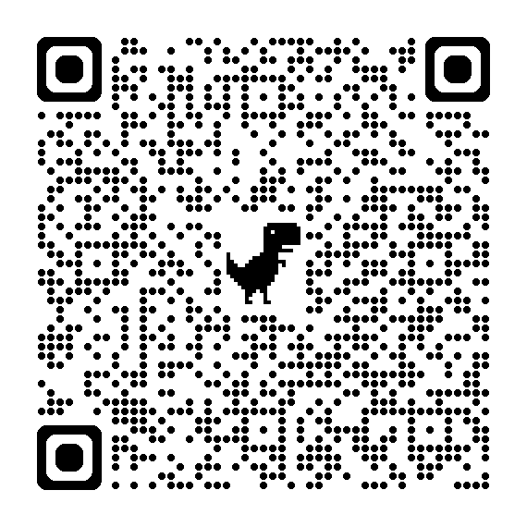
STANDARDS FOR MATHEMATICAL PRACTICE
(What Students Must Do)
Make sense of problems and persevere in solving them.
Reason abstractly and quantitatively.
Construct viable arguments and critique the reasoning of others.
Model with mathematics.
Use appropriate tools strategically.
Attend to precision.
Look for and make use of structure.
Look for and express regularity in repeated reasoning.
Notes:
The eight Standards for Mathematical Practice outlined in Ohio’s Learning Standards for Mathematics describe varieties of expertise that mathematics educators at all grade levels should seek to develop in their students.
These eight practices rest on important “processes and proficiencies” with longstanding importance in mathematics education. This includes the process standards of problem-solving, reasoning, communication, representation, and connections described by the National Council of Teachers of Mathematics and the five strands of mathematical proficiency described by the National Research Council.

Slide 15
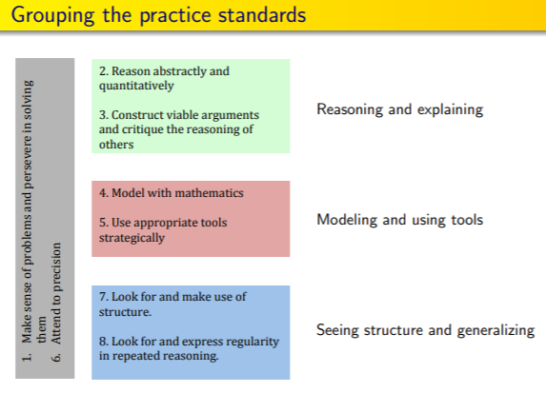
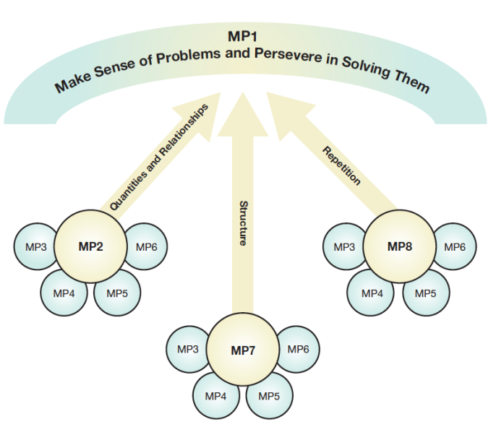

STANDARDS FOR MATHEMATICAL PRACTICE GROUPINGS
Make sense of problems and persevere in solving them.
Reason abstractly and quantitatively.
Construct viable arguments and critique the reasoning of others.
Model with mathematics.
Use appropriate tools strategically.
Attend to precision.
Look for and make use of structure.
Look for and express regularity in repeated reasoning.
There’s no wrong way!
Notes:
As you can see with the images on the slide, there are a variety of ways to group the MPs into a sequence. In the end, there is no wrong way to explore or group the MPs. Select a grouping that makes sense for you as an individual or as a district and get started.

Slide 16
MP 1: Make Sense Of Problems And Persevere
In Solving Them.
Notes:
Mathematically proficient students start by explaining to themselves the meaning of a problem and looking for entry points to its solution. They analyze givens, constraints, relationships, and goals. They make conjectures about the form and meaning of the solution and plan a solution pathway rather than simply jumping into a solution attempt. They monitor and evaluate their progress and change course if necessary. Older students might, depending on the context of the problem, transform algebraic expressions or change the viewing window on their graphing calculator to get the information they need. Mathematically proficient students can explain correspondence between equations, verbal descriptions, tables, and graphs or draw diagrams of important features and relationships, graph data, and search for regularity or trends. Younger students might rely on using concrete objects or pictures to help conceptualize and solve a problem. Mathematically proficient students check their answers to problems using a different method, and they continually ask themselves, “Does this make sense?” They can understand the approaches of others to solving complex problems and identify correspondence between different approaches.

Slide 17
Resource: Putting the practices into action: Implementing the common core standards for mathematical practice, K-8 by O'Connell, S., & SanGiovanni, J. (2013).
UNDERLYING THINKING SKILLS
Choose an Operation
Find a pattern
Draw a picture
Make a table
Use logical reasoning
Make an organized list
Work backward
Guess and check
Notes:
Choose an operation- students understand the meaning of operations. They build appropriate equations to represent situations.
Draw a picture - students visualize problem situations, use models to represent problems, and analyze models to gain insight into problems.
Find a pattern- students recognize the importance of looking for connections between numbers and identify patterns that lead to solutions.
Make a Table- students organize data to more easily identify patterns and functions that lead to solutions. They may continue a pattern or apply a function to find a solution.
Guess and check- students employ trial and error thinking. They may utilize number sense to move closer to an answer. They also make adjustments during the problem-solving process, based on their mathematical reasoning.
Make an organized list- their students identify a starting point and move systematically toward a solution. They may create a model to organize confusing information and simplify a problem. This model could be an organized list, a tree diagram, or something else.
Use logical reasoning- students organize confusing information to simplify a problem. They may make inferences to solve a problem. As a teacher, you may see evidence where students draw conclusions based on clues in the problem. They may also identify relationships using if/then or cause and effect statements,
Work backward- students identify known data and find missing data, regardless of where it might appear in the problem. They could even be using inverse operations to work backwards to find solutions.

Slide 18
QUESTIONS TO GUIDE STUDENT THINKING
What is the question being asked in the problem?
What information do you need to know to be able to solve the problem?
How do you know which information is needed to solve the problem?
What in the problem tells you to use the mathematical operation that you chose?
Could you have solved the problem using a different mathematical operation? Explain why or why not.
How can you state it in your own words?
Where might you find the information, you need to solve the problem?
What could you do with the information in the problem?
What is the expression or the equation that matches the problem you were asked to solve?
How might a diagram or manipulatives be helpful in solving this problem? Explain.
Who can anyone say it differently?
Do you need all the information on the list, table, graph, etc.? Why or why not?
Which mathematical operation should you use? Why?
Is there another way to solve the problem? How do you know?
How are these different problem-solving strategies connected?
Notes:
These question prompts can be used with students to get them to communicate their mathematical thinking. Notice that these questions are typically open-ended questions where a simple “yes” or “no” does not answer the question. In the few examples where a “yes” or “no” can be used to answer the question, there is a follow-up question to get the student(s) to explain or justify why they said “yes” or “no”. This is just a starter list of questions that can be used; there are many, many more that teachers can use with their students. The major theme or takeaway with these questions is that they place the emphasis on mathematical thinking, reasoning, and problem-solving as students develop their abilities to make sense of problems and build perseverance.
.

Slide 19
IF YOU HAVE ALREADY WORKED THE PROBLEM
DO NOT TELL THE ANSWER
Allow for discovery
Allow for the A-ha
Ask good questions
Notes:
Previously approved picture

Slide 20
DISCUSSION
Advance through the Discussion Slides.
Complete the task for the grade band(s) you work with the most.
All tasks selected from Implementing the Mathematical Practice Standards

Slide 21
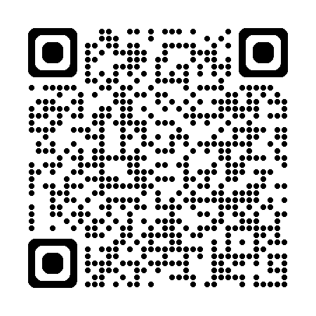
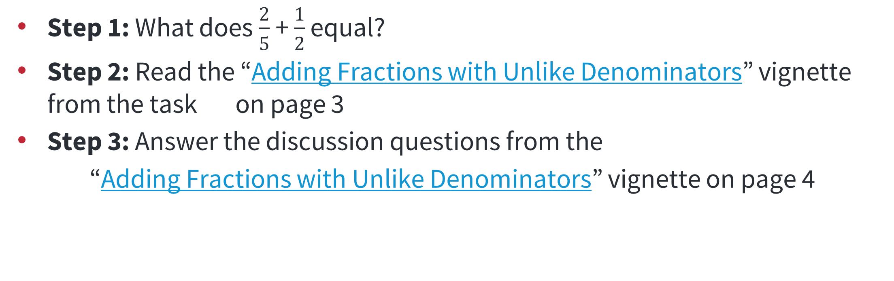
ELEMENTARY SCHOOL TASK
Step 1: What does $\frac{2}{5}$+ $\frac{1}{2}$ equal?
Step 2: Read the “Adding Fractions with Unlike Denominators” vignette from the task on page 3
Step 3: Answer the discussion questions from the
“Adding Fractions with Unlike Denominators” vignette on page 4
Notes:
Microsoft Word - Adding Fractions with Unlike Denominators.docx

Slide 22
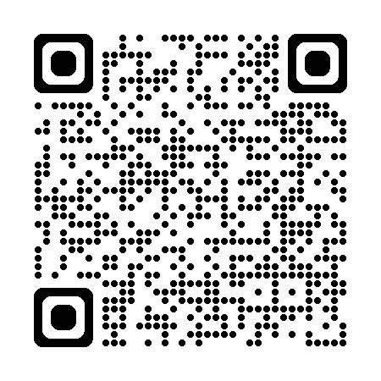
MIDDLE SCHOOL TASK
Step 1: Two vertices of a triangle are located at (0,4) and (0,10). The area of the triangle is 12 square units. Where can the third vertex be located?
Step 2: Read the “Finding Triangle Vertices” vignette from the task starting on page 3
Step 3: Answer the discussion questions from the
“Finding Triangle Vertices” vignette starting on page 7
Notes:
Microsoft Word - Finding Triangle Vertices.docx

Slide 23
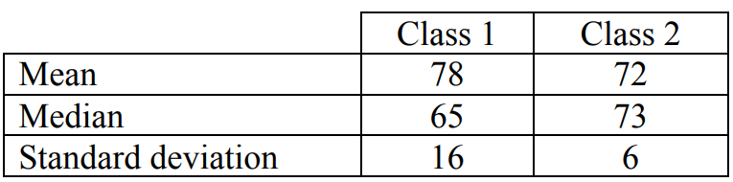
HIGH SCHOOL TASK
Step 1: The following results describe the scores from a pre-test (a test given before a chapter is taught) in two math classes.
  What do the pre-test scores seem to say about how much the students in each class already know about the topic of this test?
Step 2: Read the “Interpreting Statistical Measures” vignette from the task starting on page 3
Step 3: Answer the discussion questions from the
“Interpreting Statistical Measures” vignette starting on page 6
Notes:
Microsoft Word - Interpreting Statistical Measures—Class Scores.docx

Slide 24
DISCUSSION DEBRIEF
How did the teacher in your vignette support their students in making sense of the problem(s) they were given and/or build their students’ perseverance?

Slide 25
DISCUSSION
Notes:
You will go back into Discussions to engage in further discussions around the mathematical task(s) you worked with previously.

Slide 26
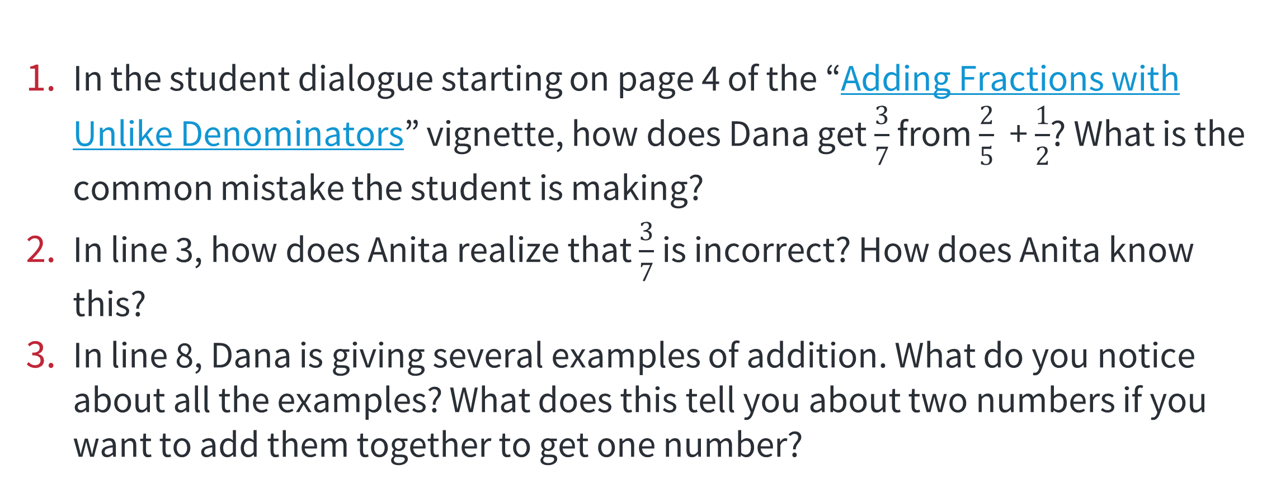
ELEMENTARY SCHOOL TASK
In the student dialogue starting on page 4 of the “Adding Fractions with Unlike Denominators” vignette, how does Dana get $\frac{3}{7}$ from $\frac{2}{5}$ + $\frac{1}{2}$? What is the common mistake the student is making?
In line 3, how does Anita realize that $\frac{3}{7}$ is incorrect? How does Anita know this?
In line 8, Dana is giving several examples of addition. What do you notice about all the examples? What does this tell you about two numbers if you want to add them together to get one number?
Notes:
Microsoft Word - Adding Fractions with Unlike Denominators.docx

Slide 27
MIDDLE SCHOOL TASK
In the “Finding Triangle Vertices” vignette (page 7), have the students in the dialogue found all possible coordinates for the third vertex of the triangle? Why or why not?
What actions or questions would you use to get the students in the dialogue to extend their reasoning and find the second set of possible vertices?
Suppose that the students in the dialogue were working in three dimensions. Given that two vertices are at (0,4,0) and (0,10,0), where could the third vertex of the triangle be located?
Notes:
Microsoft Word - Finding Triangle Vertices.docx

Slide 28
HIGH SCHOOL TASK
In the “Interpreting Statistical Measures” vignette (page 6), what information does Lee use to generate the graphs in line 6? What does that graph tell you about the students in Classes 1 and 2?
What information does Matei use to generate the graphs in line 7? What does it suggest about the students in Classes 1 and 2?
In line 16, Lee points out that Chris has made an assumption about class size. How would class size affect Chris’ thinking? As you think about this question, try creating class sets for classes with 25 students, 30 students, and 50 students that have the given summary statistics.
Notes:
Microsoft Word - Interpreting Statistical Measures—Class Scores.docx

Slide 29
How would you support students to make sense of these problems and persevere in their problem-solving in your classroom(s)?
DISCUSSION
Notes:
What did you have the opportunity to learn?
What about the task gave you that opportunity?

Slide 30
RESOURCES

Slide 31
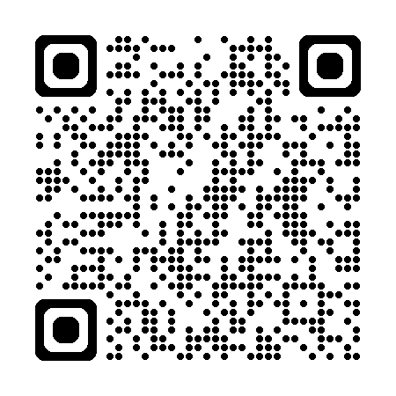
IMPLEMENTING THE MATHEMATICAL PRACTICE STANDARDS
Resources include:
Standards-aligned mathematics tasks
student dialogue
mathematical overview
teacher reflection questions
student materials
Notes:
Mainpage: IMPS | Implementing the Mathematical Practice Standards

Slide 32
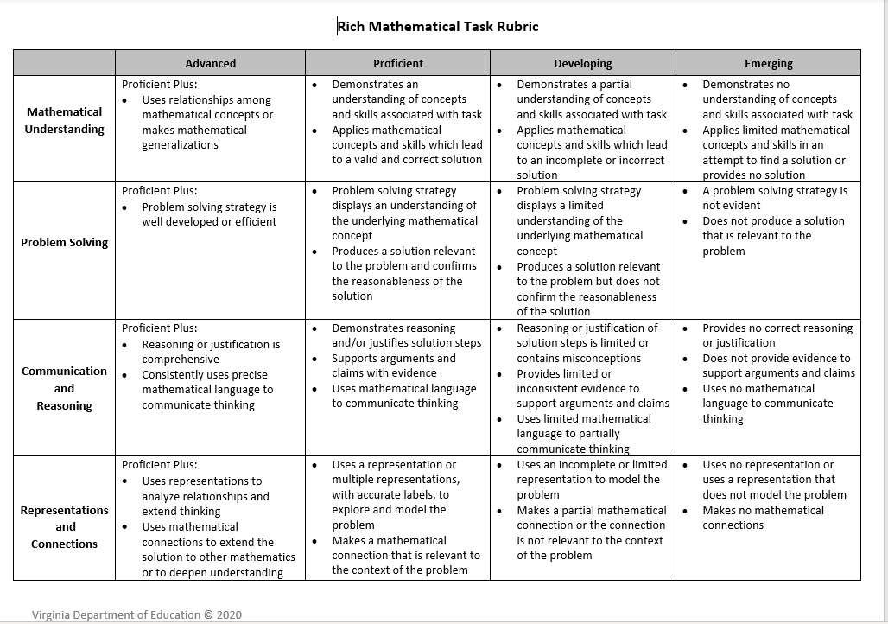
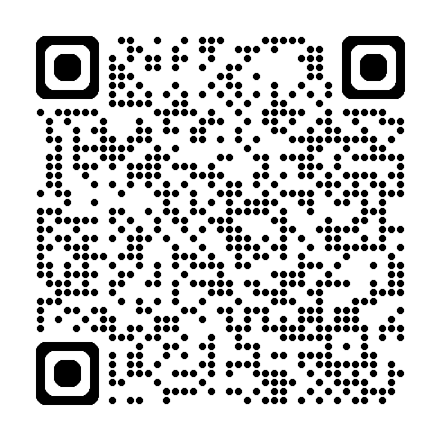
RICH MATH TASK RUBRIC
Notes:
1A-PPT-Handout-Rich-Mathematical-Task-Rubric-VDE.pdf
Handout retrieved from:
https://www.doe.virginia.gov/home/showpublisheddocument/25750/638045667860200000

Slide 33
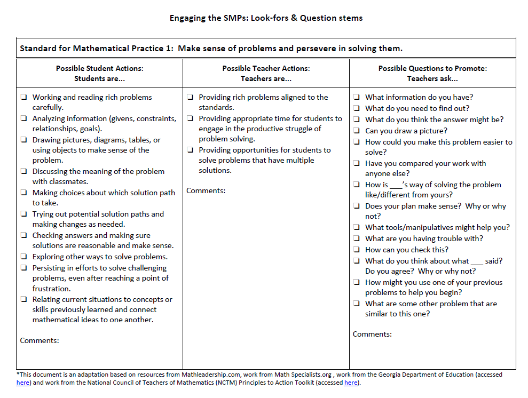
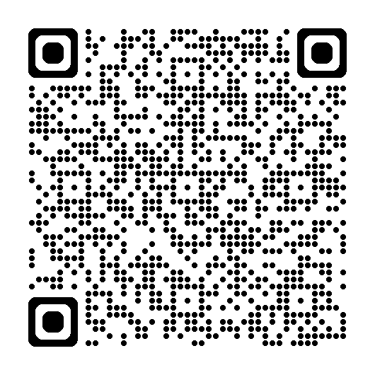
LOOK-FORS &
QUESTION STEMS
Notes:
Engaging_the_SMPs_Look_fors_and_Question_Stems
https://www.education.ky.gov/curriculum/standards/kyacadstand/Documents/SMP_Look_Fors_and_Question_Stems.pdf

Slide 34
RUBRIC
MP | Needs Improvement | Emerging | Proficient | Exemplary
MP.1 Make Sense of Problems and Persevere in Solving Them | Has difficulty working independently or collaboratively; requires continual assistance from teacher or other students. | Works independently and collaboratively with some reliance on the teacher or other students. | Works independently and collaboratively with little reliance on the teacher. | Works independently and leads group in collaboration.
 | Gives up easily; rarely takes initiative to find new information or methodologies to solve a problem. | Gives up occasionally; persists only when comfortable; occasionally takes initiative to find some new information or one methodology to solve a problem. | Generally shows some persistence; may give up when extremely challenged; comfortable seeking new information or exploring one or two methodologies to solve a problem. | Continues working when challenged, regularly taking initiative to find new information; fluid in using multiple methodologies and approaches to solve a problem.
 | Has difficulty getting started on a problem. | Finds an entry point to a problem. | Finds one or two entry points to a problem. | Discovers multiple entry points to problems.
 | Focuses on answers and procedures instead of problem; has difficulty understanding the question of interest being asked; has difficulty analyzing varying aspects of the problem. | Tries to make sense of the problem but may need prompting by classmates or teacher; tries something even if not correct; analyzes some of the aspects of the problem. | Makes sense of the problem; breaks down problems into simpler pieces; articulates the problem into their own words; analyzes information, makes conjectures and plans a solution pathway. | Makes sense and breaks down problems, synthesizing the results when presenting solutions; connects known mathematical ideas and procedures to real-world situations; makes conjectures and plans a solution pathway based on analysis.
 | Struggles or forgets to monitor or evaluate progress; Forgets to check their work or evaluate his or her answer to see if it makes sense. | Occasionally monitors and evaluates the progress; may check and revise work by plugging numbers in; may forget to check for reasonableness. | Regularly monitors and evaluates the progress; checks work and determines reasonableness of solution within context and makes necessary modifications. | Monitors and evaluates the progress, changing course as necessary; checks reasonableness; defends and justifies solution by comparing solution paths.
 | Does not answer the question of interest. | Partially answers the question of interest. | Thoroughly answers the question of interest. | Thoroughly answers the question and poses new question(s); generalizes.

Slide 35
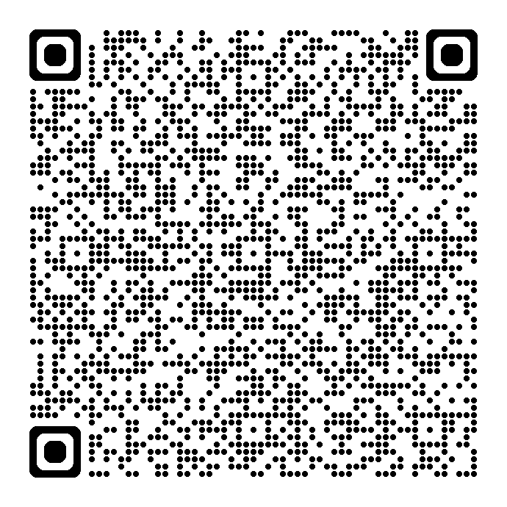
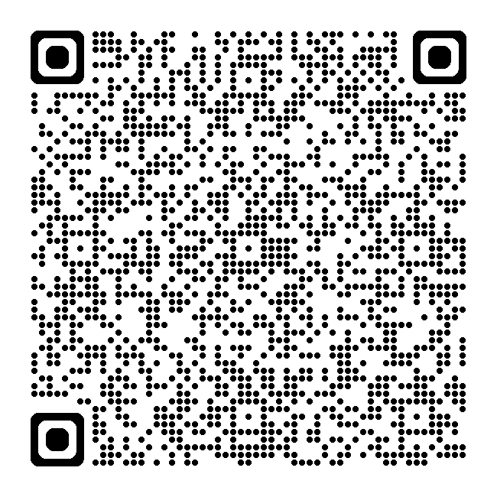
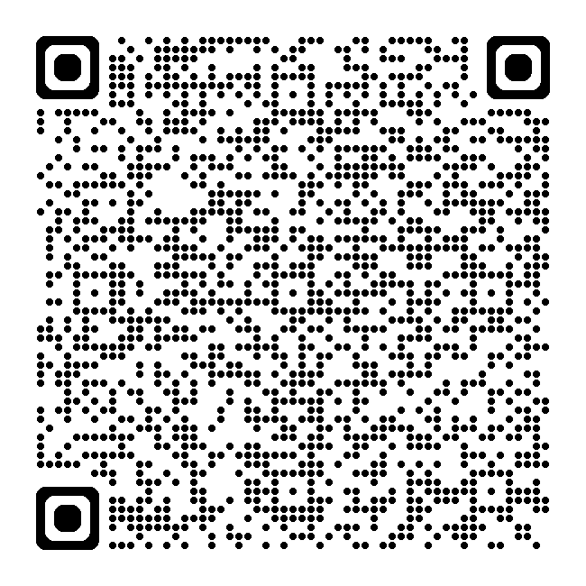
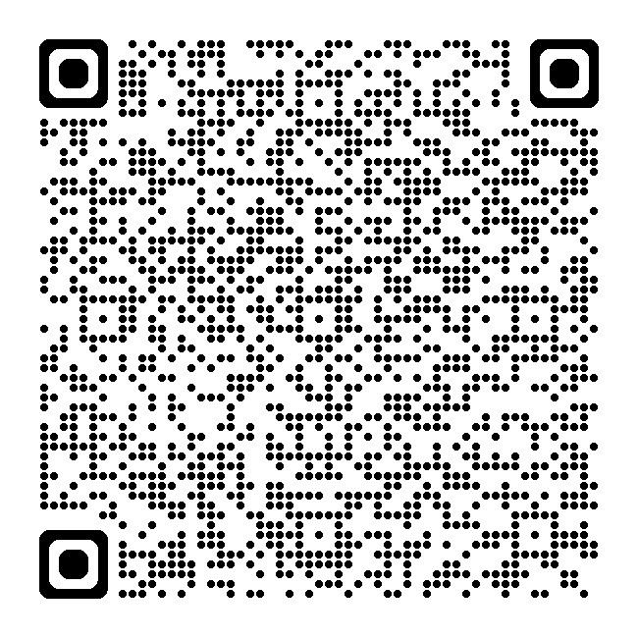
Resource Links
Standards for Mathematical Practice
Kindergarten - Grade 5
Grades 6-8
High School
Notes:
Standards for MP: https://education.ohio.gov/getattachment/Topics/Learning-in-Ohio/Mathematics/Model-Curricula-in-Mathematics/Standards-for-Mathematical-Practice/Standards-for-Mathematical-Practice.pdf.aspx

Slide 36
REFERENCES
Huinker, D., & Bill, V. (2017). Implementing effective mathematics teaching practices in Kindergarten-grade 5. Reston, VA: National Council of Teachers of Mathematics.
O'Connell, S., & SanGiovanni, J. (2013). Putting the practices into action: Implementing the common core standards for mathematical practice, K-8. Portsmouth, NH: Heinemann.
Strutchens, M. E., & Quander, J. R. (2011). Focus in high school mathematics: fostering reasoning and sense making for all students. https://www.amazon.com/Focus-High-School-Mathematics-Fostering/dp/0873536800

Slide 37
MATHEMATICS QUESTIONS?
Email
Mathematics@education.ohio.gov

Slide 38
Questions?

Slide 39
Ohio Department of Education and Workforce

