Slide 2
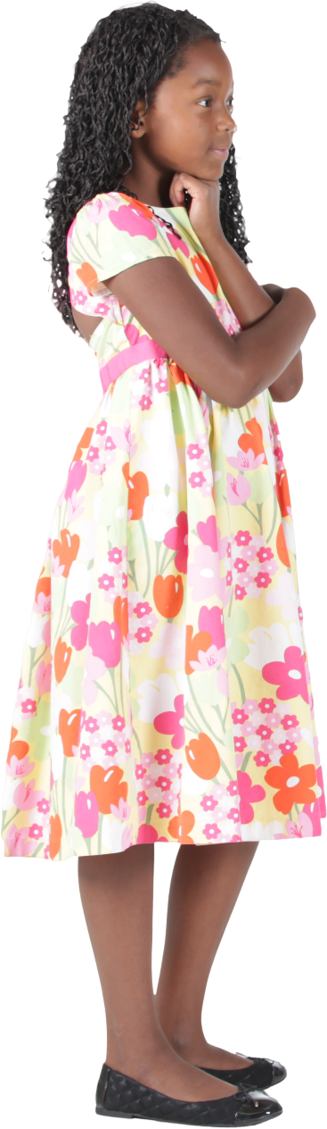

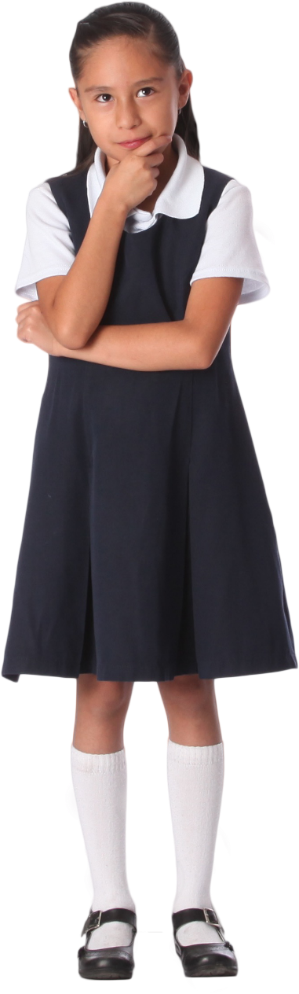
MP 2: Reason Abstractly and Quantitatively
Date

Slide 3
Welcome

Slide 4
Ohio Department of Education and Workforce Priorities
Literacy
Learning Acceleration
Workforce Readiness
Student Wellness
Notes:
The math plan looks to connect. To department priorities in the following areas:
Literacy Achievement: Building a foundation for lifelong success by ensuring every student is reading at or above grade level.
Learning Acceleration: Empowering each learner to reach their full potential through individualized, evidence-based support.
Student Wellness: Fostering safe and supportive environments that engage students and enable them to thrive.
Workforce Readiness: Preparing students for the future fully equipped with the skills needed to take the next steps in their career journeys.
Our strongest connection to the Department’s priorities is around learning acceleration. In mathematics, we want every student to be able to accelerate their learning. This means they can access the proactive, research-. And evidence-based, and individualized support they need to succeed. To achieve this priority, all students must have the opportunity to engage in grade-level core instruction regardless of ability, which requires replacing remediation (the practice of teaching below grade-level content) with the just-in-time intervention that allows students to complete unfinished learning and access grade-level instruction (or above).

Slide 5
Session Norms
Listen
Listen with the intent to understand. Ask questions!
Focus
Focus on how this applies to your daily work.
Imagine the possibilities!
Create
Create a safe place to air confusion and raise questions.
Support
Support ideas with evidence. Bring your vast experience to the table. Support participation of all.
Notes:
Welcome everyone. We want to take a moment to ground us in our Session Norms.
We want to Listen with the intent to understand. Ask question!
We want to Focus on how this applies to your daily work. Imagine the possibilities!
We want to Create a safe place to air confusion and raise questions.
We went to Support ideas with evidence. Bring your vast experience to the table. Encourage everyone’s participation. Part of Supporting others is to make sure we are providing space for all in group to share. In addition, we have noticed a few participants have invited an AI presence to curate notes for them during the session. While we appreciate the use of productivity tools, unfortunately, MS TEAMS does not know how to deal with these “non-human” participants and this is affecting breakout rooms, so going forward, we will not be admitting AI participants into our community meetings each month. If there are questions or concerns, please contact one of the Dept team on this session. Thank you!

Slide 6
Purpose:
Connect
Ohio’s Mathematics Vision from Ohio’s Plan for K-12 Mathematics to the Mathematical Practices.
Explore
MP 8: Look for and Express Regularity in Repeated Reasoning through grade band-aligned instructional tasks.
Identify
Resources to support instruction aligned to Math Practice 8: Look for and Express Regularity in Repeated Reasoning.
Utilize
Resources to help recognize and collect evidence of MP 8: Look for and Express Regularity in Repeated Reasoning in the classroom.

Slide 7
Agenda
What: | Why: | How:
Welcome and Introductions 5 minutes | To establish the session norms and outline the focus of the session | Facilitator presentation
Ohio’s Plan for K-12 Mathematics 5-10 minutes | To learn about Ohio’s Vision for Mathematics as outlined in Ohio’s Plan for K-12 Mathematics | Facilitator presentation
Resource Exploration and Discussions 45-60 minutes | Explore various Ohio resources aligned to Mathematical Practice 2 and identify their connections to Ohio’s Mathematics Vision. | Small and Whole Group Discussion
Closing 5-10 minutes | Address lingering questions and provide session feedback | Participant Q&A and Exit Tickets

Slide 8


Ohio’s Plan for
K-12 Mathematics
education.ohio.gov/math

Slide 9
Structure Of Ohio’s Plan
Why?
What?
How?
Section 1: Why a Comprehensive Mathematics Plan is Needed
Section 2: Ohio’s Mathematics Vision
Section 4: Strategies and Activities
Section 3: Ohio’s Theory of Action
Notes:
This session will connect best with Section 2: Ohio’s Mathematics Vision, which is outlined in Ohio’s Plan for K-12 Mathematics.

Slide 10
Section 2:
Ohio’s Mathematics Vision
The Importance of Mathematics
A Shift Toward Rigor
Ohio’s Vision for Mathematics Instruction
Notes:
This section defines mathematics and sets the vision
Outlines that across the state, all students must have access to rigorous instruction that advances their growth and confidence in mathematics.
Section 2 sets the foundation and expectations for mathematics instruction, focusing grounded in the effective math teaching practices and student practices.

Slide 11
Ohio’s Mathematics Vision
Ohio’s vision is to empower students with the confidence and ability to apply mathematical concepts, procedures, and reasoning, enabling students to thrive in a variety of contexts, life experiences, and career pathways.
Notes:
Improving mathematics outcomes for all Ohio students — across districts and grade levels and with special attention to those who are furthest behind — requires a thoughtful, multi-pronged strategy. Ohio’s Plan for K-12 Mathematics leverages multiple strands of activity and investment into a single, coherent theory of action. This theory builds upon existing math-related policies and initiatives in Ohio and proposes additional strategies to cultivate rigorous, high-quality mathematics instruction in every classroom and for all students. Ohio’s theory of action combines five interdependent strands of action. It is important to emphasize that these five strands of work are not sequential but should interact with and support one another in service of improved student learning.

Slide 12
A Shift Toward Rigor
Learning acceleration
Just-in-time interventions
Access
Notes:
It is not enough for some students to participate in a rigorous math curriculum. To ensure a full array of college and career opportunities for every graduate, all Ohio students must have opportunities to develop and advance their conceptual understanding, procedural skills and fluency, and application of mathematics. That requires a shared commitment to the following principles in all Ohio mathematics classrooms:
Learning acceleration: Every student accelerates their learning in math and has access to the proactive, evidence-based, and individualized support they need to succeed. All students must have the opportunity to engage in grade-level core instruction regardless of ability, which requires replacing remediation (the practice of teaching below grade-level content) with the just-in-time intervention that allows students to complete unfinished learning and access grade-level instruction (or above).
(Note: This term is not equivalent to grade-level or course acceleration, which occurs when advanced learners move ahead an entire grade level in one or more subject areas.)
Just-in-time intervention: Current learning data is used to identify gaps that would prevent students from accessing grade-level instruction, plan scaffolds to provide that access, and then remove those scaffolds as soon as they are no longer needed.
Access: Providing learning “access” means removing or accommodating any barriers that would prevent a student from successfully and equitably engaging with the grade-level curriculum. Ohio commits to providing equitable access to a grade-level (or above) curriculum for learners of all backgrounds and abilities.

Slide 13
Ohio’s Vision for Mathematics Instruction
Recommended Instructional Focus
Standards for Mathematical Practice
Effective Mathematics Teaching Practices
Notes:
The Ohio Learning Standards for mathematics were updated based on a review process led by educators and the Department in 2017. The revised standards define what learners should know and be able to do and guide districts in modifying local curricula, instructional plans, and materials to ensure all students have access to coherent, rigorous, grade-level instruction.
Ohio’s mathematics vision builds on long-accepted research about how students learn mathematics and the instructional practices that cultivate rigor.
Outlined in Ohio’s Vision for Mathematics Instruction, is first and foremost, an alignment to the Standards. In the Math Plan, we identify the recommended instructional focus for Pre-K through High Schools. These major topics or themes are taken from the Ohio Learning Standards and have been around since 2011.
Next, we have encouragement to utilize a more student-centered focus to mathematics learning through the inclusion of the Standards for Mathematical Practice. These outline ways that students can show their understanding of mathematics in every grade level and course.
Last, we highlight the importance of using the evidence-based Effective Mathematics Teaching Practices from the National Council of Teachers of Mathematics or NCTM. These Teaching Practices identify what teachers can do in the delivery of high-quality instruction.

Slide 14

Standards For Mathematical Practice
(What Students Must Do)
Make sense of problems and persevere in solving them.
Reason abstractly and quantitatively.
Construct viable arguments and critique the reasoning of others.
Model with mathematics.
Use appropriate tools strategically.
Attend to precision.
Look for and make use of structure.
Look for and express regularity in repeated reasoning.
Notes:
The eight Standards for Mathematical Practice outlined in Ohio’s Learning Standards for Mathematics describe varieties of expertise that mathematics educators at all grade levels should seek to develop in their students.
These eight practices rest on important “processes and proficiencies” with longstanding importance in mathematics education. This includes the process standards of problem-solving, reasoning, communication, representation, and connections described by the National Council of Teachers of Mathematics and the five strands of mathematical proficiency described by the National Research Council.

Slide 15
What comes to your mind when you think about MP 2: Reason Abstractly and Quantitatively?
Notes:
Be sure to provide ample time for the participants to read through and possibly discuss their responses with each other prior to moving forward. With that in mind, “what comes to mind when you think about Math Practice 2: Reason Abstractly and Quantitatively”?

Slide 16
Share Out
Notes:
Allow time for local conversations or discussions of the waterfall chat responses if providing this session as part of virtual PL.

Slide 17
Tasks That Promote MP 2
Notes:
As you discuss the tasks share with each other:
Where in the task are there opportunities for students to show their understanding of MP 2?
As a teacher, how would you highlight this with your instruction?
Additional Questions for Further Discussion:
What do you notice across the tasks at your grade band?
What do you wonder about the tasks at your grade band?
What commonalities are evident across the tasks?
What are the differences across the tasks?
These questions are listed in the notes of the PPT slides in case any on-demand audience members want to post them for their discussions with colleagues locally.

Slide 18
Discussions

Slide 19
Grades K-2 Tasks for MP 2
A squirrel has 7 acorns. He shares some acorns with his squirrel friend. How many acorns do both squirrels now have?
If I have 26 Skittles® and Marie has 40, how many more do I need to have as many as Marie?
Miguel had 6 pretzels. He ate 4. How many does he have left?
Where in the task are there opportunities for students to show their understanding of MP 2?
As a teacher, how would you highlight this with your instruction?
Notes:
Mathematically proficient students at the elementary grades make sense of quantities and their relationships in problem situations. They can contextualize quantities and operations by using images or stories. They interpret symbols as having meaning, not just as directions to carry out a procedure. Even as they manipulate the symbols, they can pause as needed to access the meaning of the numbers, the units, and the operations that the symbols represent. Mathematically proficient students know and flexibly use different properties of operations, numbers, and geometric objects.
Mathematically proficient students can contextualize an abstract problem by placing it in a context they then use to make sense of the mathematical ideas. For example, when a student sees the expression 40 − 26, she might visualize this problem by thinking, if I have 26 Skittles and Marie has 40, how many more do I need to have as many as Marie? Then, in that context, she thinks, 4 more will get me to a total of 30, and then 10 more will get me to 40, so the answer is 14. In this example, the student uses a context to think through a strategy for solving the problem, using the relationship between addition and subtraction and decomposing and recomposing the quantities. She then uses what she did in the context to identify the solution of the original abstract problem.
Mathematically proficient students can also make sense of a contextual problem and express the actions or events that are described in the problem using numbers and symbols. If they work with the symbols to solve the problem, they can then interpret their solution in terms of the context. For example, to find the area of the floor of a rectangular room that measures 5 m. by 6 m., a student might represent the problem as an equation, solve it mentally, and record the problem and solution as 5 × 6 = 60. He has decontextualized the problem. When he states at the end that the area of the room is 60 square meters, he has contextualized the answer in order to solve the original problem. Problems like this that begin with a context and are then represented with mathematical objects or symbols are also examples of modeling with mathematics (MP.4).

Slide 20
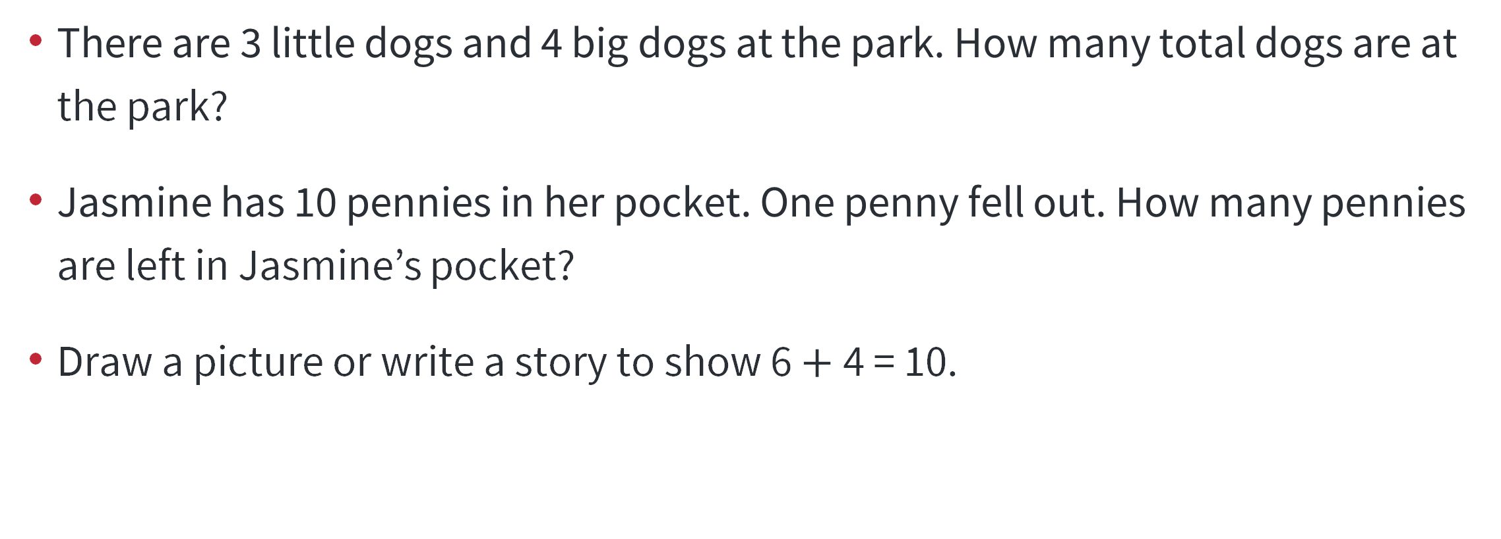
Grades K-2 Tasks for MP 2
There are 3 little dogs and 4 big dogs at the park. How many total dogs are at the park?
Jasmine has 10 pennies in her pocket. One penny fell out. How many pennies are left in Jasmine’s pocket?
Draw a picture or write a story to show 6 $+$ 4 = 10.
Where in the task are there opportunities for students to show their understanding of MP 2?
As a teacher, how would you highlight this with your instruction?

Slide 21
Grades K-2 Tasks for MP 2
Destiny played four basketball games. She scored:
  21 points in the first game,
  14 points in the second game,
  24 points in the third game, and
  11 points in the fourth game.
How many points did Destiny score in the four games combined?
Where in the task are there opportunities for students to show their understanding of MP 2?
As a teacher, how would you highlight this with your instruction?

Slide 22
Grades 3-5 Tasks for MP 2
There are 8 cupcakes on the plate. Three of them were chocolate, and the rest were vanilla. What fraction of the cupcakes were vanilla?
Andrea plays video games for 90 minutes each day for seven days. How many hours did she spend playing video games?
There are 120 students, and 5 chaperones are going on a field trip. Each bus holds 35 people. How many buses are needed for the field trip?
Where in the task are there opportunities for students to show their understanding of MP 2?
As a teacher, how would you highlight this with your instruction?

Slide 23

Grades 3-5 Tasks for MP 2
There are 6 soccer teams in a league. Each soccer team has 11 players. How many total players are in the soccer league?
Alejandro ate $\frac{1}{2}$ a pizza. Bianca ate $\frac{1}{3}$ of the same pizza. How much pizza did they eat?
Where in the task are there opportunities for students to show their understanding of MP 2?
As a teacher, how would you highlight this with your instruction?

Slide 24
Grades 6-8 Tasks for MP 2
In the barnyard is an assortment of chickens and pigs. Counting heads, I get 13; counting legs I get 46. How many pigs and chickens are there?
Solve the equation and write a word problem that goes with 5 × 1.5 = n.
The four members of a bowling team scored 120, 136, 128, and 162 in a game. What is the team’s mean score?
Where in the task are there opportunities for students to show their understanding of MP 2?
As a teacher, how would you highlight this with your instruction?

Slide 25
Grades 6-8 Tasks for MP 2
In the barnyard is an assortment of chickens and pigs. Counting heads, I get 13; counting legs I get 46. How many pigs and chickens are there?
Solve the equation and write a word problem that goes with 5 × 1.5 = n.
The four members of a bowling team scored 120, 136, 128, and 162 in a game. What is the team’s mean score?
Solve the following: |3x – 7| > 14
Where in the task are there opportunities for students to show their understanding of MP 2?
As a teacher, how would you highlight this with your instruction?

Slide 26
Grades 6-8 Tasks for MP 2
There are g gallons of paint available to paint a house. After n gallons have been used , then in terms of g and n, what percent of the paint has not been used?
Two cities n miles apart are located s inches apart on a certain map that is drawn to scale. In terms of n and s, what is the distance, in inches, on the map between two cities that are (n + 1) miles apart?
Where in the task are there opportunities for students to show their understanding of MP 2?
As a teacher, how would you highlight this with your instruction?

Slide 27
Grades 9-12 Tasks for MP 2
For a quadratic function f(x) = ax 2 + bx + c, determine whether it is possible that f(1) = f(2) = f(3).
Determine all the quadratic functions f(x) = ax 2 + bx + c that satisfy the relationship f(f(1)) = f(f(2)) = f(f(3)).
Where in the task are there opportunities for students to show their understanding of MP 2?
As a teacher, how would you highlight this with your instruction?
Task taken from mathpractices.edc.org

Slide 28
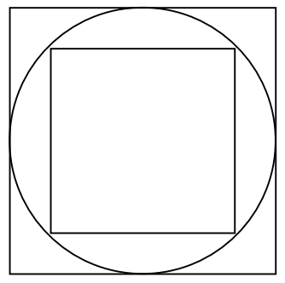
Grades 9-12 Tasks for MP 2
This diagram shows a circle with one square inside and one square outside. The circle has radius r inches.
Write down the side of the large square in terms of r. _________ inches
Find the side of the small square in terms of r. _________ inches.
What is the ratio of the areas of the two squares?
Draw a second circle inscribed inside the small square. Find the ratio of the areas of the two circles.
Where in the task are there opportunities for students to show their understanding of MP 2?
As a teacher, how would you highlight this with your instruction?

Slide 29
Discussion Debrief
Notes:
Where in the task are their opportunities for students to show their understanding of MP 2?
As a teacher, how would you highlight this with your instruction?

Slide 30
MP 2: Reason Abstractly & Quantitatively.
Notes:
Mathematically proficient students make sense of quantities and their relationships in problem situations. They bring two complementary abilities to bear on problems involving quantitative relationships: the ability to decontextualize—to abstract a given situation and represent it symbolically and manipulate the representing symbols as if they have a life of their own, without necessarily attending to their referents—and the ability to contextualize, to pause as needed during the manipulation process in order to probe into the referents for the symbols involved. Quantitative reasoning entails habits of creating a coherent representation of the problem at hand; considering the units involved; attending to the meaning of quantities, not just how to compute them; and knowing and flexibly using different properties of operations and objects.

Slide 31
Exploring Resources for MP 2
Notes:
Discuss with your colleagues what do you think Math Practice 2: Reason Abstractly and Quantitatively means or looks like at your grade level/course?
As with before, the discussion question is listed in the notes of the PPT slides in case any on-demand audience members want to post it for their discussions with colleagues locally.

Slide 32

MP 2 Progression:
Reason Abstractly And Quantitatively.
Ohio’s Standards for Mathematical Progressions
Notes:
In a moment we are going to explore Ohio’s Standards for Mathematical Practice Progressions. You can scan the QR Code on the slide to access the Progressions document, you can click the link in the PPT presentation, or click the link in the accompanying MP: 2 Facilitation Guide.

Slide 33



Resource Links
Standards for Mathematical Practice
Kindergarten - Grade 5
Grades 6-8
High School
Notes:
Standards for MP: https://education.ohio.gov/getattachment/Topics/Learning-in-Ohio/Mathematics/Model-Curricula-in-Mathematics/Standards-for-Mathematical-Practice/Standards-for-Mathematical-Practice.pdf.aspx

Slide 34
Discussions
Task: Review the MP progression documents.
Discussion question: What do you think Math Practice 2: Reason Abstractly and Quantitatively means or looks like at your grade level/course?
Notes:
Break out room slide
Discussion question: What do you think Math Practice 2: Reason Abstractly and Quantitatively means or looks like at your grade level/course? Feel free to carry discussions about what MP 2 looks like beyond the examples in the Progressions document to reflect evidence of what it looks like for the entire grade level or course.
Break out time approx. 10-20 min. depending on the number of people

Slide 35
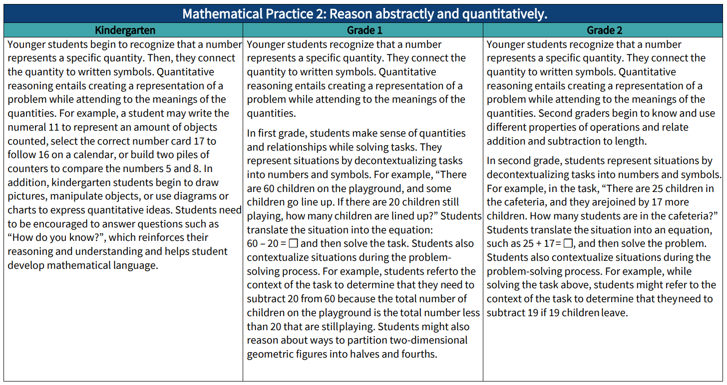

Slide 36
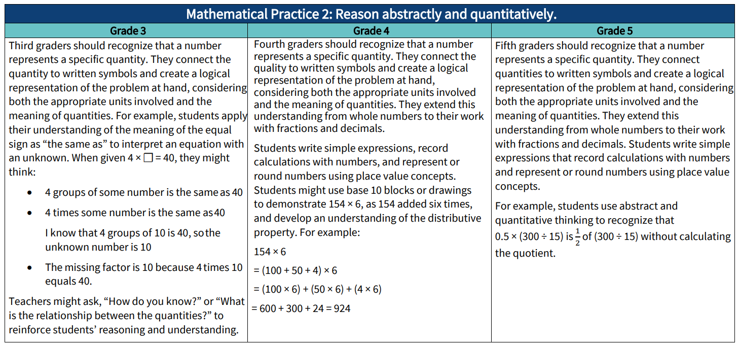

Slide 37
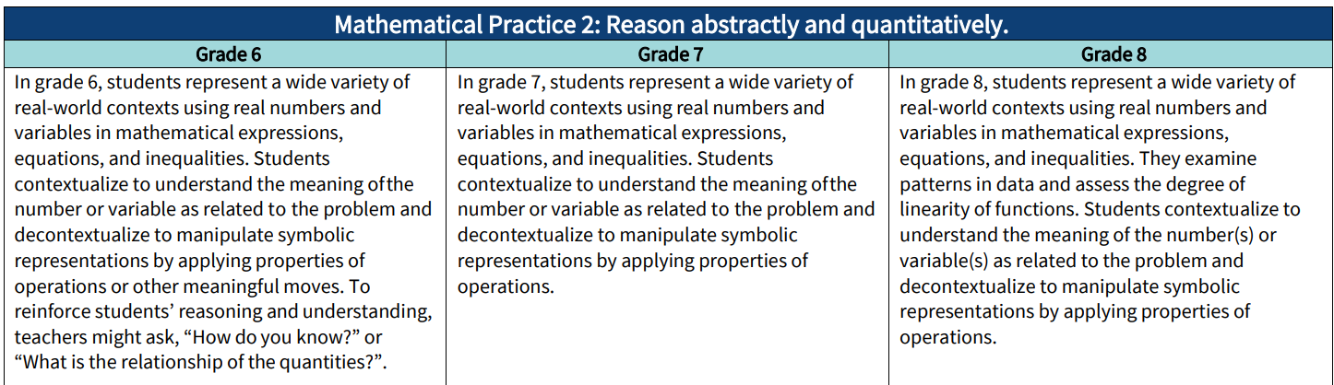

Slide 38
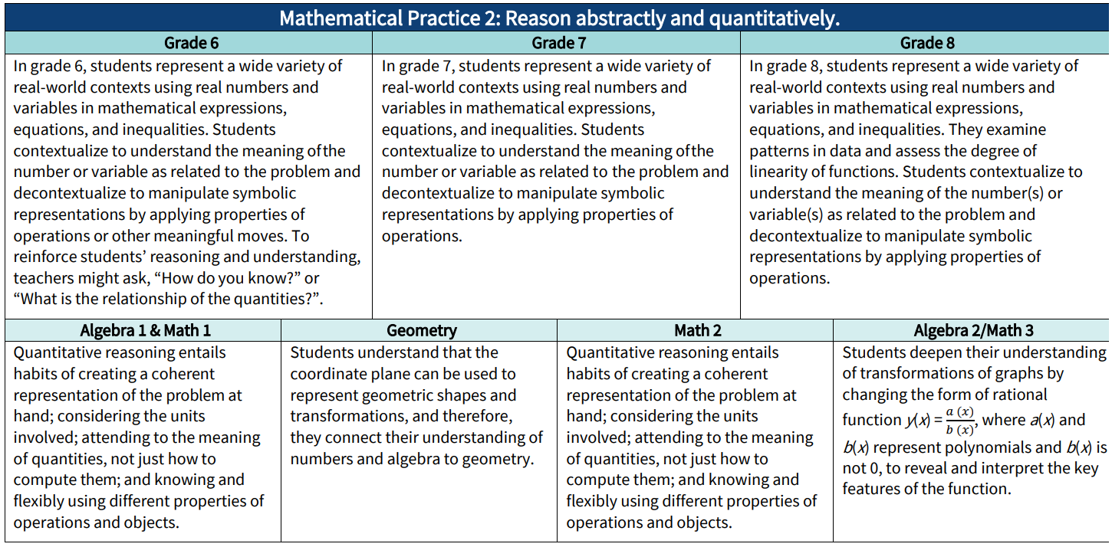
Notes:
Split the progression as Grades 6-A1 & Grade 8 – Geo

Slide 39
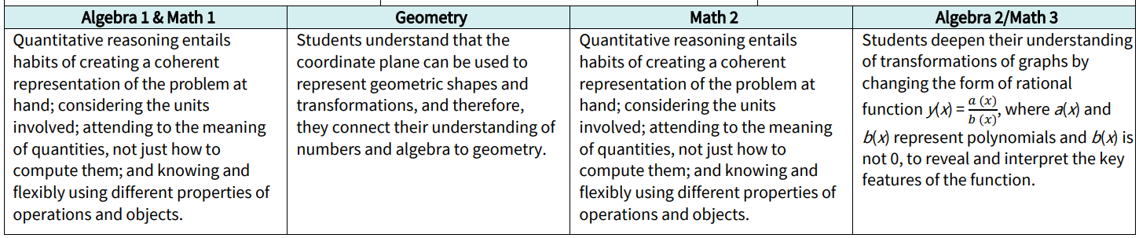

Slide 40
Discussion Debrief

Slide 41
What Does MP 2: Reason Abstractly and Quantitatively Look Like at My Grade Band?
Notes:
Now that you have had an opportunity to discuss what you think MP 2 looks like at your grade level and/or grade band, we are going to look at what some of the national resources on the Math Practices say.

Slide 42
MP 2: Reason Abstractly And Quantitatively.
Contextualized and decontextualized problems.
Connecting mathematical symbols and operations to real-world contexts.
Move back and forth between problem situations and symbolic notations.
Notes:
Contextualize & Decontextualize Problems: K-2 teachers will see evidence of this whenever students encounter addition and subtraction situations like change, addend, bigger, start, or smaller unknown problems in Table 1. Basically, the last two columns. Teachers in 3-5 can observe evidence of MP 2 with multiplication and division situations like group size and number of groups unknown problems

Slide 43
What Does MP 2 Look Like at K-5?
Make sense of quantities and their relationships in problem situations.
Contextualize quantities and operations by using images or stories.
Contextualize an abstract problem by placing it in a context that they then use to make sense of the mathematical ideas.
Notes:
Mathematically proficient students at the elementary grades make sense of quantities and their relationships in problem situations. K-2 teachers will see evidence of this whenever students encounter addition and subtraction situations like change, addend, bigger, start, or smaller unknown problems in Table 1. Basically, the last two columns. Teachers in 3-5 can observe evidence of MP 2 with multiplication and division situations like group size and number of groups unknown problems.
Mathematically proficient students can contextualize an abstract problem by placing it in a context they then use to make sense of the mathematical ideas. For example, when a student sees the expression 40 − 26, she might visualize this problem by thinking, if I have 26 marbles and Marie has 40, how many more do I need to have as many as Marie? Then, in that context, she thinks, 4 more will get me to a total of 30, and then 10 more will get me to 40, so the answer is 14. In this example, the student uses a context to think through a strategy for solving the problem, using the relationship between addition and subtraction and decomposing and recomposing the quantities. She then uses what she did in the context to identify the solution of the original abstract problem.
Mathematically proficient students can also make sense of a contextual problem and express the actions or events that are described in the problem using numbers and symbols. If they work with the symbols to solve the problem, they can then interpret their solution in terms of the context. For example, to find the area of the floor of a rectangular room that measures 10 m. by 12 m., a student might represent the problem as an equation, solve it mentally, and record the problem and solution as 10 × 12 = 120. He has decontextualized the problem. When he states at the end that the area of the room is 120 square meters, he has contextualized the answer in order to solve the original problem. Problems like this that begin with a context and are then represented with mathematical objects or symbols are also examples of modeling with mathematics (MP.4).

Slide 44
What Does MP 2 Look Like at K-5?
Interpret symbols as having meaning, not just as directions to carry out a procedure.
Know and flexibly use:
  different properties of operations,
  numbers, and
  geometric objects
Notes:
They interpret symbols as having meaning, not just as directions to carry out a procedure. Even as they manipulate the symbols, they can pause as needed to access the meaning of the numbers, the units, and the operations that the symbols represent. Mathematically proficient students know and flexibly use different properties of operations, numbers, and geometric objects.

Slide 45
What Does MP 2 Look Like at Grades 6-8?
Make sense of quantities and relationships in problem situations.
Applying ratio reasoning to convert measurement units and proportional relationships to solve percent problems.
Representing problem situations using symbols and then manipulate those symbols in search of a solution.
Notes:
Mathematically proficient students make sense of quantities and relationships in problem situations. For example, they can apply ratio reasoning to convert measurement units and proportional relationships to solve percent problems.
They represent problem situations using symbols and then manipulate those symbols in search of a solution. They can, for example, solve problems involving unit rates by representing the situations in equation form.

Slide 46
What Does MP 2 Look Like at Grades 6-8?
Solving problems involving unit rates by representing the situations in equation form.
Ability to pause as needed during the manipulation process to double-check or apply referents for the symbols involved.
Can look back at symbol referents and the applicable units of measure to clarify or inform solution steps.
Notes:
Mathematically proficient students also pause as needed during the manipulation process to double-check or apply referents for the symbols involved. In the process, they can look back at symbol referents and the applicable units of measure to clarify or inform solution steps.

Slide 47
What Does MP 2 Look Like at Grades 6-8?
Flexibly using different properties of operations and objects.
Using properties of operations to generate equivalent expressions and use the number line to understand multiplication and division of rational numbers.
Notes:
Quantitative reasoning also entails knowing and flexibly using different properties of operations and objects. For example, in middle school, students use properties of operations to generate equivalent expressions and use the number line to understand multiplication and division of rational numbers.

Slide 48

ODE Math Practice Rubric
Notes:
You can scan the QR Code on the slide to access the Math Practice Rubric document, you can click the link in the PPT presentation, or click the link in the accompanying MP: 2 Facilitation Guide.

Slide 49
MP | Needs Improvement | Emerging | Proficient | Exemplary
MP.2 Reason Abstractly and Quantitatively. | Does not understand that quantities have meaning. | Understands that quantities having meaning, but not able to see all the relationships between quantities. | Attends to the meaning of quantities and the relationships between quantities, rather than simply computing them. | Attends to the meaning of quantities and the relationships between quantities, rather than simply computing them; generalizes their relationships to new situations.
 | Ignores units. | Considers the units involved but does not understand how they relate to the problem; may use units as labels. | Pays attention to units and uses them appropriately. | Analyzes the use of symbols, variables and units accurately, consistently and appropriately.
 | Uses memorized procedures and algorithms incorrectly; cannot represent a situation symbolically. | Uses memorized procedures and algorithms but is not able to explain underlying concepts; can represent and manipulate simple situations symbolically. | Sees connections between procedures or algorithms and contextual meaning but has difficulty articulating them; can represent and manipulate routine situations symbolically. | Articulates connections between procedures or algorithms and contextual meaning; can take a situation and flexibly represent it symbolically and then manipulate the symbols (decontextualize).
 | Does not see a connection between the symbolic representation and the context. | Sees a connection between the symbolic representation and the context but has difficulty articulating it. | Takes a symbolic situation and relates it to the context (contextualize). | Takes a symbolic situation and relates it to the context and other similar contexts.
 | Does not use representations when approaching a problem. | Uses some representations to represent the problem. | Creates a coherent representation of the problem. | Creates, interprets, models, and connects multiple representations coherently.
 | Does not finish calculations or interpret solutions. | Finishes calculations but does not interpret solutions. | Interprets solutions appropriately. | Looks beyond solutions to make predictions, generalizations, and decisions.

Slide 50
Mathematics Questions?
Email
Mathematics@education.ohio.gov

