Slide 2

Math Practice 3: Construct viable arguments and critique the reasoning of others.

Slide 3
Welcome

Slide 4
Ohio Department of Education and Workforce Priorities
Literacy
Learning Acceleration
Workforce Readiness
Student Wellness
Notes:
The math plan looks to connect. To department priorities in the following areas:
Literacy Achievement: Building a foundation for lifelong success by ensuring every student is reading at or above grade level.
Learning Acceleration: Empowering each learner to reach their full potential through individualized, evidence-based support.
Student Wellness: Fostering safe and supportive environments that engage students and enable them to thrive.
Workforce Readiness: Preparing students for the future fully equipped with the skills needed to take the next steps in their career journeys.
Our strongest connection to the Department’s priorities is around learning acceleration. In mathematics, we want every student to be able to accelerate their learning. This means they can access the proactive, research-. And evidence-based, and individualized support they need to succeed. To achieve this priority, all students must have the opportunity to engage in grade-level core instruction regardless of ability, which requires replacing remediation (the practice of teaching below grade-level content) with the just-in-time intervention that allows students to complete unfinished learning and access grade-level instruction (or above).

Slide 5
Session Norms
Listen
Listen with the intent to understand. Ask questions!
Focus
Focus on how this applies to your daily work.
Imagine the possibilities!
Create
Create a safe place to air confusion and raise questions.
Support
Support ideas with evidence. Bring your vast experience to the table. Support participation of all.
Notes:
Welcome everyone. We want to take a moment to ground us in our Session Norms.
We want to Listen with the intent to understand. Ask question!
We want to Focus on how this applies to your daily work. Imagine the possibilities!
We want to Create a safe place to air confusion and raise questions.
We went to Support ideas with evidence. Bring your vast experience to the table. Encourage everyone’s participation. Part of Supporting others is to make sure we are providing space for all in group to share. In addition, we have noticed a few participants have invited an AI presence to curate notes for them during the session. While we appreciate the use of productivity tools, unfortunately, MS TEAMS does not know how to deal with these “non-human” participants and this is affecting breakout rooms, so going forward, we will not be admitting AI participants into our community meetings each month. If there are questions or concerns, please contact one of the Dept team on this session. Thank you!

Slide 6
Purpose:
Connect
Ohio’s Mathematics Vision from Ohio’s Plan for K-12 Mathematics to the Mathematical Practices.
Explore
MP 3: Construct Viable Arguments and Critique the Reasoning of Others through grade band-aligned instructional tasks.
Identify
Resources to support instruction aligned to Math Practice 3: Construct Viable Arguments and Critique the Reasoning of Others.
Utilize
Resources to help recognize and collect evidence of MP 3: Construct Viable Arguments and Critique the Reasoning of Others.

Slide 7
Agenda
What: | Why: | How:
Welcome and Introductions 5-10 minutes | To establish the session norms and outline the focus of the session | Facilitator presentation
Ohio’s Plan for K-12 Mathematics 5 minutes | To learn about Ohio’s Vision for Mathematics as outlined in Ohio’s Plan for K-12 Mathematics | Facilitator presentation
Resource Exploration and Discussions 45-60 minutes | Explore various Ohio resources aligned to the Standards for Mathematical Practice (MPs) 3: Construct Viable Arguments and Critique the Reasoning of Others and identify their connections to Ohio’s Mathematics Vision. | Breakout Rooms and Whole Group Discussion
Closing 5-10 minutes | Address lingering questions and provide session feedback | Participant Q&A and Exit Tickets

Slide 8
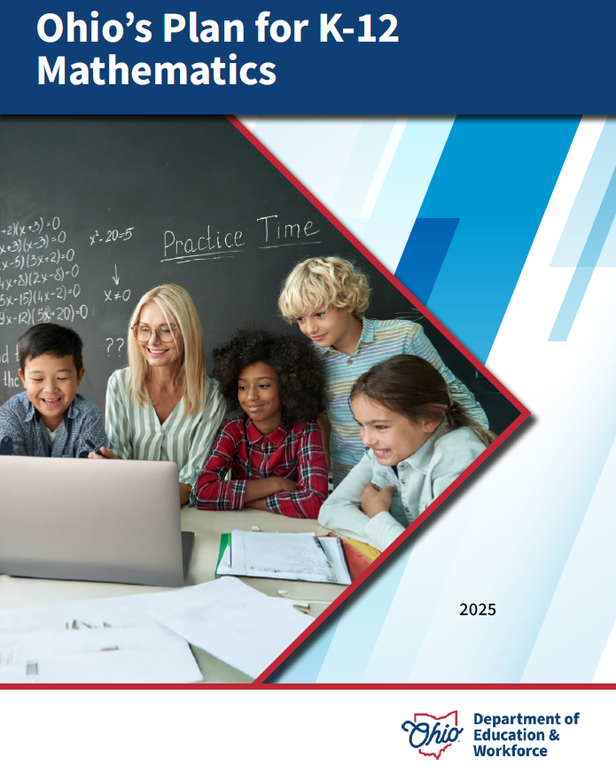
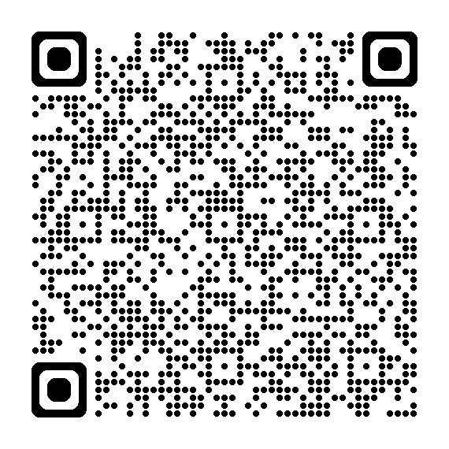
OHIO’S PLAN FOR
K-12 MATHEMATICS
education.ohio.gov/math

Slide 9
STRUCTURE OF OHIO’S PLAN
Why?
What?
How?
Section 1: Why a Comprehensive Mathematics Plan is Needed
Section 2: Ohio’s Mathematics Vision
Section 4: Strategies and Activities
Section 3: Ohio’s Theory of Action
Notes:
This session will connect best with Section 2: Ohio’s Mathematics Vision, which is outlined in Ohio’s Plan for K-12 Mathematics.

Slide 10
SECTION 2:
OHIO’S MATHEMATICS VISION
The Importance of Mathematics
A Shift Toward Rigor
Ohio’s Vision for Mathematics Instruction
Notes:
This section defines mathematics and sets the vision
Outlines that across the state, all students must have access to rigorous instruction that advances their growth and confidence in mathematics.
Section 2 sets the foundation and expectations for mathematics instruction, focusing grounded in the effective math teaching practices and student practices.

Slide 11
OHIO’S MATHEMATICS VISION
Ohio’s vision is to empower students with the confidence and ability to apply mathematical concepts, procedures, and reasoning, enabling students to thrive in a variety of contexts, life experiences, and career pathways.
Notes:
Improving mathematics outcomes for all Ohio students — across districts and grade levels and with special attention to those who are furthest behind — requires a thoughtful, multi-pronged strategy. Ohio’s Plan for K-12 Mathematics leverages multiple strands of activity and investment into a single, coherent theory of action. This theory builds upon existing math-related policies and initiatives in Ohio and proposes additional strategies to cultivate rigorous, high-quality mathematics instruction in every classroom and for all students. Ohio’s theory of action combines five interdependent strands of action. It is important to emphasize that these five strands of work are not sequential but should interact with and support one another in service of improved student learning.

Slide 12
A SHIFT TOWARD RIGOR
Learning acceleration
Just-in-time interventions
Access
Notes:
It is not enough for some students to participate in a rigorous math curriculum. To ensure a full array of college and career opportunities for every graduate, all Ohio students must have opportunities to develop and advance their conceptual understanding, procedural skills and fluency, and application of mathematics. That requires a shared commitment to the following principles in all Ohio mathematics classrooms:
Learning acceleration: Every student accelerates their learning in math and has access to the proactive, evidence-based, and individualized support they need to succeed. All students must have the opportunity to engage in grade-level core instruction regardless of ability, which requires replacing remediation (the practice of teaching below grade-level content) with the just-in-time intervention that allows students to complete unfinished learning and access grade-level instruction (or above).
(Note: This term is not equivalent to grade-level or course acceleration, which occurs when advanced learners move ahead an entire grade level in one or more subject areas.)
Just-in-time intervention: Current learning data is used to identify gaps that would prevent students from accessing grade-level instruction, plan scaffolds to provide that access, and then remove those scaffolds as soon as they are no longer needed.
Access: Providing learning “access” means removing or accommodating any barriers that would prevent a student from successfully and equitably engaging with the grade-level curriculum. Ohio commits to providing equitable access to a grade-level (or above) curriculum for learners of all backgrounds and abilities.

Slide 13
OHIO’S VISION FOR MATHEMATICS INSTRUCTION
Recommended Instructional Focus
Standards for Mathematical Practice
Effective Mathematics Teaching Practices
Notes:
The Ohio Learning Standards for mathematics were updated based on a review process led by educators and the Department in 2017. The revised standards define what learners should know and be able to do and guide districts in modifying local curricula, instructional plans, and materials to ensure all students have access to coherent, rigorous, grade-level instruction.
Ohio’s mathematics vision builds on long-accepted research about how students learn mathematics and the instructional practices that cultivate rigor.
Outlined in Ohio’s Vision for Mathematics Instruction, is first and foremost, an alignment to the Standards. In the Math Plan, we identify the recommended instructional focus for Pre-K through High Schools. These major topics or themes are taken from the Ohio Learning Standards and have been around since 2011.
Next, we have encouragement to utilize a more student-centered focus to mathematics learning through the inclusion of the Standards for Mathematical Practice. These outline ways that students can show their understanding of mathematics in every grade level and course.
Last, we highlight the importance of using the evidence-based Effective Mathematics Teaching Practices from the National Council of Teachers of Mathematics or NCTM. These Teaching Practices identify what teachers can do in the delivery of high-quality instruction.

Slide 14

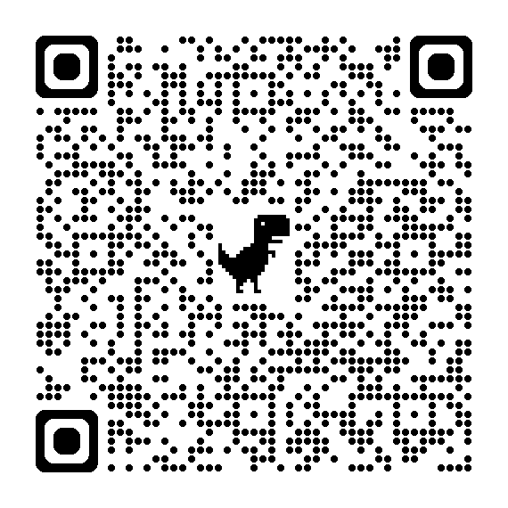
STANDARDS FOR MATHEMATICAL PRACTICE
MP 1: Make sense of problems and persevere in solving them.
MP 2: Reason abstractly and quantitatively. ​​
MP 3: Construct viable arguments and critique the reasoning of others.
MP 4: Model with mathematics.
MP 5: Use appropriate tools strategically.
MP 6: Attend to precision.
MP 7: Look for and make use of structure.
MP 8: Look for and express regularity in repeated reasoning.
Notes:
Links:
Standards for Mathematics Practice: https://education.ohio.gov/Topics/Learning-in-Ohio/Mathematics/Model-Curricula-in-Mathematics/Standards-for-Mathematical-Practice
The eight Standards for Mathematical Practice outlined in Ohio’s Learning Standards for Mathematics describe varieties of expertise that mathematics educators at all grade levels should seek to develop in their students.
These eight practices rest on important “processes and proficiencies” with longstanding importance in mathematics education. This includes the process standards of problem-solving, reasoning, communication, representation, and connections described by the National Council of Teachers of Mathematics and the five strands of mathematical proficiency described by the National Research Council.

Slide 15
Introduction
Notes:
Let’s begin.

Slide 16
Proof = Narrative
“Mathematicians are storytellers. Our characters are numbers and geometries. Our narratives are the proofs we create about these characters.”
-Marcus Du Sautoy
Notes:
Proof is a lot like a narrative. In math we often think of “proofs” like 2-column proofs in geometry. But proof is more of a narrative. Throughout this presentation, we want to reframe your thinking around proof. Think of mathematicians as storytellers. Our characters are numbers and geometries. Our narratives are the proofs we create about these characters. Think of proofs as more of a story. By reframing the idea of proofs in this way, you may see that you end up gaining more buy-in from students. This may be especially important for those students who may not really like to do proofs. Maybe these students have had an unpleasant experience with proofs in their past, so by reframing the idea of proofs as more of storytelling, you can more easily get students to think about proofs in a different way than before. As storytellers, students can tell new stories about numbers and mathematics.

Slide 17
What makes a courtroom so dramatic?
Discuss your thoughts or put them into the chat!
Notes:
Keeping with the theme of proofs as storytelling, we are going to think of a real-world situation where this can often be represented in a very dramatic way, the courtroom. At this point in our live session, we paused the presentation so our audience could have a live discussion. For those watching the session recording on-demand, in a moment you will want to pause the video so you and your colleagues can discuss what makes a courtroom so dramatic?

Slide 18
How is Doing Mathematics Like a Courtroom Drama?
Construct Arguments/ Conjectures/ Claims
Put your thoughts in the chat box!
Evidence/
Data
Critique Reasoning/ Proving or Disproving
Revising Arguments
Drawing Conclusions/ Reaching Verdicts
Notes:
Discuss how is going mathematics like a courtroom drama? This discussion question is available in the facilitation guide for MP 3 if needed.
[Pause for a moment]
Here are some of the ways we came up with in our discussions:
Construct Arguments/ Conjectures/ Claims
Evidence/Data
Critique Reasoning/ Proving or Disproving
Revising Arguments
Drawing Conclusions/ Reaching Verdicts

Slide 19
MP 3: Construct viable arguments & critique the reasoning of others.
Notes:
Mathematically proficient students understand and use stated assumptions, definitions, and previously established results in constructing arguments. They make conjectures and build a logical progression of statements to explore the truth of their conjectures. They are able to analyze situations by breaking them into cases, and can recognize and use counterexamples. They justify their conclusions, communicate them to others, and respond to the arguments of others. They reason inductively about data, making plausible arguments that take into account the context from which the data arose. Mathematically proficient students are also able to compare the effectiveness of two plausible arguments, distinguish correct logic or reasoning from that which is flawed, and—if there is a flaw in an argument—explain what it is. Elementary students can construct arguments using concrete referents such as objects, drawings, diagrams, and actions. Such arguments can make sense and be correct, even though they are not generalized or made formal until later grades. Later, students learn to determine domains to which an argument applies. Students at all grades can listen or read the arguments of others, decide whether they make sense, and ask useful questions to clarify or improve the arguments.

Slide 20
Discussion

Slide 21
Discussion Questions
What is the purpose of a trial?
  Who are the characters in a courtroom?
  Rank the level of convincing each person needs on the line from easiest to hardest.
  Discuss your rationale for your rankings.

Slide 22
Breakout Room Discussion Questions
If you wanted to convince someone of something, create a scenario and discuss who in your life would play each of the give roles.
    Discuss how the roles shown in the slide relate to a mathematics class?
    How do the roles relate to Math Practice 3: Construct viable arguments and critique the reasoning of others?
    Who is the judge?
    What role does the judge play in your classroom?

Slide 23
discussion debrief

Slide 24
Part 1:
What is Proof?
Notes:
Let’s talk for a moment about what is proof?

Slide 25
“A successful proof is like a set of signposts that allow all subsequent mathematicians to make the same journey. It is like the moment of harmonic resolution in a piece of music or the revelation of whodunnit in a murder mystery.”
- Marcus Du Sautoy
Proof = Narrative
Notes:
We are going to keep with the theme of proof as a narrative. Some of the best narratives capture the imagination. Marcus Du Sautoy would say that a successful proof is like a set of signposts that allow all subsequent mathematicians to make the same journey. It is like the moment of harmonic resolution in a piece of music or the revelation of whodunnit in a murder mystery. Thinking about proof in the way that Marcus Du Sautoy describes it makes proof almost sound like a story in a book in terms of how a story comes along. In mathematics, we want a proof to feel the same way for students.

Slide 26
Evidence/ Data/ Referent/ Grounds/ Facts/ Givens
Claim/
Conjecture
Conclusion
Narrative Link
Warrant
Proof
Viable Argument
Counter Arguments/ Rebuttal/
Critiquing the Reasoning of Others
Notes:
In this slide we show a visual example of what a proof could look like. Just like inside a courtroom, there are a lot of claims and conjectures in a math class. In both locations, the goal is to reach a conclusion. In both situations, it is the evidence that links the claim or conjecture to the conclusion. If you look at a variety of educational materials, you will notice that authors often use different words to mean the same thing as evidence. For example, some may refer to it as a proof, a warrant, or a viable argument. Ultimately, these are all synonyms used that link together the claim or conjecture to the conclusion. Interspersed along the way, in between the claim or conjecture and the conclusion are things like the evidence, which may come in the form or data, referents, grounds, facts, or givens. In both a courtroom and a mathematics classroom, you may have information coming in from one direction, while in another direction may be coming information from a defendant who may be presenting a counter argument, rebuttal, or simply critiquing the reasoning of others. In each story both, the prosecution and the defense, may be going in opposite directions of each other trying to convince the audience they are correct or right in their viewpoint. A courtroom and a mathematical classroom are not like a book that you can pick up to read from start to finish. In these environments, there is a conversation going where people can insert different ideas or opinions into the discussion.

Slide 27
Mathematical Argumentation
“Proof is a subset of argument, requiring deductive steps from one mathematical claim to another. Unlike a proof, an argument can depend on any data or warrants that students in the class find convincing including statements that might not be mathematically correct or complete.”
-Singletary & Conner
Argument
Proof
Notes:
Proof is a subset of argument, requiring deductive steps from one mathematical claim to another. Unlike a proof, an argument can depend on any data or warrants that students in the class find convincing including statements that might not be mathematically correct or complete. Therefore, it is important for teachers to push or encourage their students to not look solely at the convincing or persuasive argument but to also look at the mathematical facts behind the argument. This is a skill that will take some time to build up in students. Don’t worry if it doesn’t happen overnight. The process itself may take years for students to learn and that’s OK.
Teaching this in a mathematics classroom has applications in the real-world where we want our students to be critical consumers of information and informed citizens. We want our students when they get to the real-world to not just listen to the arguments put before them but to also delve deeper and look at the facts behind the arguments so they can make informed decisions.

Slide 28
Mathematical Argumentation
“Argumentation—in mathematics and other subject areas — goes beyond these types of communication.
We view mathematical argumentation as a process of dynamic social discourse for discovering new mathematical ideas and convincing others that a claim is true.”
-Rumsey & Langrall
Notes:
Argumentation—in mathematics and other subject areas — goes beyond these types of communication. We view mathematical argumentation as a process of dynamic social discourse for discovering new mathematical ideas and convincing others that a claim is true.
If you have mathematical argumentation regularly in your classroom or if you have any friends, you regularly like to argue or debate with, this can be a process used to really refine ones ideas on a particular topic. You may come find in this process that you solidify your original opinion or over time you may discover you are beginning to change your ideas.

Slide 29
Part 2: Convince Me!

Slide 30
I’m thinking of a math story….
1, 2, 4, 8….
What are the next steps in our math story?
What to you notice? What do you wonder?
Notes:
Read the slide

Slide 31
16 is the next step, but I’m not convinced that you have the story figured out yet.
I’m thinking of a math story….
1, 2, 4, 8, 16….
What’s the next number in my story?
Convince Me!
Notes:
Read the bubble in the slide.

Slide 32
I’m thinking of a math story….
Note: Some sequences have 32 as the next term, but mine does not!
32 is not correct!
1, 2, 4, 8, 16….
What’s the next number in my story?
Convince Me!
Notes:
Read the bubbles in the slide. Pause before each click to allow time for the audience to process.

Slide 33
Now, what do you think the next part of the story is?
1
2
4
8
16
Notes:
What if I showed you the same numbers represented this way? Now, what do you think the story is?
What are you counting in this story?

Slide 34
Things are not always as they appear! Dig Deeper!
What did you learn about proof from this?
Notes:
The number ends up actually being 34. The point is that things are not always as they appear. This task was selected to encourage all of you to dig deeper. This is no different in the classroom. Often students will jump to the first pattern they see as their conclusion. As the pattern extends to include more information, they may have to revise their initial mathematical thinking.
Note: The formula is $\left(n^{4}−6n^{3}+23n^{2}−18n+24\right)/24$

Slide 35
Part 3: Convince Me!
Notes:
Part 3: Convince Me!

Slide 36
Discussion
Notes:
In our live session, we paused the presentation so our audience could have a live discussion. For those watching the session recording on-demand, in a moment you can either participate in this activity with your colleagues as a whole group by continuing to play the video or you can go to the google document explore the task slides by grade band. I want to point out that there are more task slides in the google document than in the on-demand recording. Links to the grade band specific slides are available in the notes for this slide in the PowerPoint slide deck and in the facilitation guide for MP 3. If you want to view the slides in the google document, you can pause the video now otherwise, you can continue playing the video to view the tasks and pause as needed to engage in local discussions.
Part 3: Convince Me
Grades K-2 tasks slides 30-32
Grades 3-5 tasks slides 33-35
Grades 6-8 slides 36-38
High School slides 39-41
https://docs.google.com/presentation/d/1Flz-1FGmN4lH0_nLCqOqQFzwnmJJ3-4gG5-KDDwNHdM/edit#slide=id.gd9b5f2dd88_0_99

Slide 37
Grades K-5
Please discuss slides 38-39 with your breakout room.

Slide 38
Claim: An odd number + an odd number equal an odd number TRUE or FALSE convince me!

Slide 39
Counter example
How many examples do you need?
Notes:
See https://mathforlove.com/lesson/counterexamples/ for more Elementary ideas for counterexamples

Slide 40
Grades 6-12
Please discuss slides 41-42 with your breakout room.

Slide 41
Claim: Any two lines either intersect or are parallel
TRUE or FALSE convince me!

Slide 42
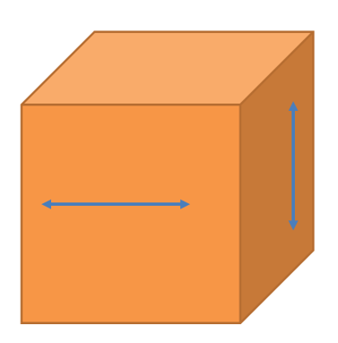
COUNTER EXAMPLE
How many counter examples do you need?

Slide 43
Discussions Debrief
Notes:
What strategies or approaches did you find most effective in constructing an argument for your task and/or critiquing the arguments of others?
How can these strategies be applied to enhance mathematical reasoning and problem-solving in your classroom?

Slide 44
Part 4: Convince Me!
Notes:
One of the highly discussed topics during the 2016 Ohio Learning Standards revision process was the idea of a visual proof. In mathematics, a visual proof does count as a proof. Students do not always have to do a 2-column proof for a response to be counted as a ‘proof’. A student, even in high school, can draw a picture and count it as their proof. The idea is applicable across all grade bands. Students can draw pictures as their proof just like they can do a formal proof. But by allowing students to use pictures as their proof, you creating entry points that draws students into problem solving. For some students, a picture may be their only entry point whereas some other students may have multiple entry points to use as their proofs. In mathematics, a mathematician would accept a visual proof; therefore, it would be appropriate for our students in K-12.
When selecting tasks to use during instruction, teachers can be on the look out for opportunities to incorporate visual proofs into their instructional practice as a way of engaging students in a variety of proofs. Teachers can use visual proofs and possibly more traditional versions of proofs to highlight their mathematical connections as part of their classroom discourse and whole group discussion.
https://docs.google.com/presentation/d/1Flz-1FGmN4lH0_nLCqOqQFzwnmJJ3-4gG5-KDDwNHdM/edit#slide=id.gd9b5f2dd88_0_99

Slide 45
Discussion

Slide 46
Grades K-2
Please discuss slides 49-52 with your breakout room.

Slide 47
Some number patters have a story to tell. What do you notice if you add any two counting numbers that are next to each other? What do you wonder?
1+2
2+3
3+4
4+5
Etc….
What’s their story?
Prove your idea.

Slide 48
Some number patters have a story to tell. What do you notice if you add any two counting numbers that are next to each other? What do you wonder?
Hint: Try using counters or paper graphs
1+2
2+3
3+4
4+5
Etc….
Is there a better way?

Slide 49
Some number patters have a story to tell. What do you notice if you add any two counting numbers that are next to each other? What do you wonder?
Proof by example means that you have to try all examples that exist in the whole world? How long would that take? Is it worth the effort?
1+2
2+3
3+4
4+5
Etc….

Slide 50
A visual picture can be proof!

Slide 51
Grades 3-5
Please discuss slides 54-61 with your breakout room.

Slide 52
Odd numbers also have a story to tell. What do you notice if you add up any two consecutive odd numbers that are next to each other?
What’s their story?
1+3
1+3+5
1+3+5+7
1+3+5+7+ …
Prove your idea.

Slide 53
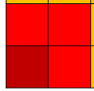


Directions:
To get you started, use graph paper and a different color for each number.
Each color must touch each other on one of the sides or corner.
Each new color must touch the previous color on at least one side. For example:
Continue whatever pattern you start.

Slide 54
Try on your own.

Slide 55
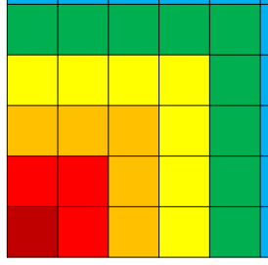
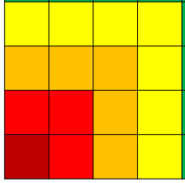
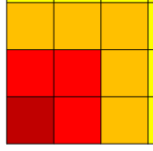
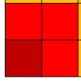
Students may come up with the following:
Ask them what they think will happen if they add any sequence of odd numbers. How do their pictures help prove their idea?

Slide 56
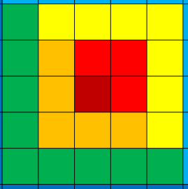
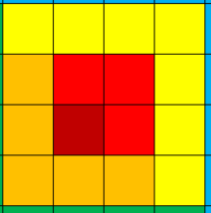
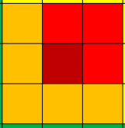
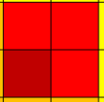
Students may come up with the following:
Ask them what they think will happen if they add any sequence of odd numbers? How do their pictures help prove their idea.

Slide 57
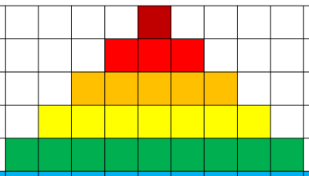
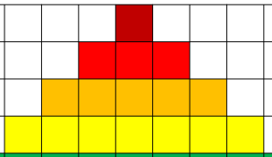
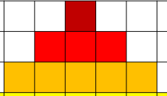

Students may come up with the following:
Ask them what they think will happen if they add any sequence of odd numbers? How do their pictures help prove their idea.

Slide 58
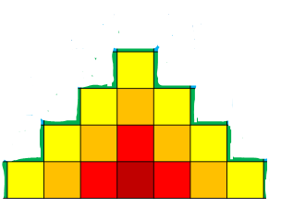
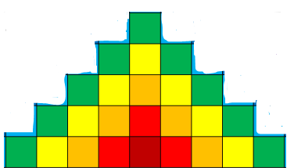
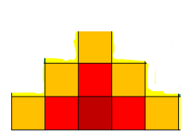
Students may come up with the following:
Ask them what they think will happen if they add any sequence of odd numbers? How do their pictures help prove their idea.

Slide 59
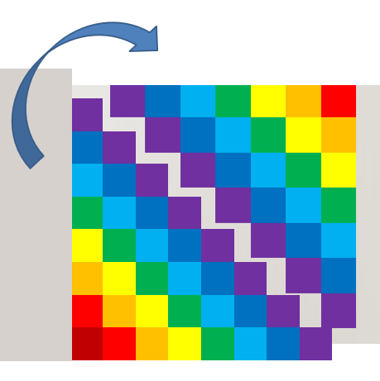

For discussion you can have students either cut apart the square or the triangles to show both ideas are true.

Slide 60
Grades 6-12
Please discuss slides 63-71 with your breakout room.

Slide 61
Odd numbers also have a story to tell. What do you notice if you add up any two consecutive odd integers starting at 1? What do you wonder?
What’s their story?
Make a conjecture.
1+3
1+3+5
1+3+5+7
1+3+5+7+ …
Prove your conjecture.

Slide 62
Some number patters have a story to tell. What do you notice if you add any two counting numbers that are next to each other? What do you wonder?
CONVINCE ME!
Hint: Try using counters or paper graphs
1+3
1+3+5
1+3+5+7 …
Is there a better way?

Slide 63
What do you notice if you add up consecutive odd integers starting at one? What do you wonder?
CONVINCE ME!
1+3
1+3+5
1+3+5+7 …
Proof by example means that you have to try all examples that exist in the whole world? How long would that take? Is it worth the effort?

Slide 64
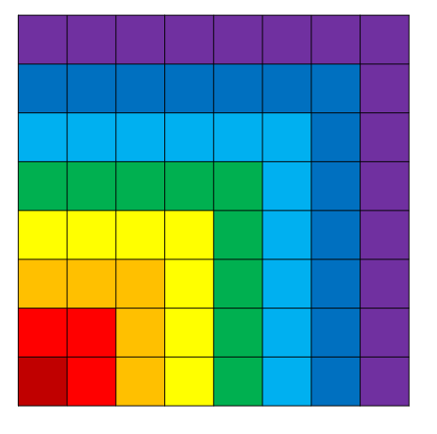
How do these visuals represent the proof?

Slide 65
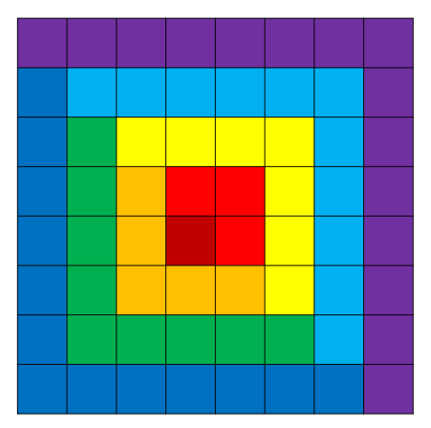
How do these visuals represent the proof?

Slide 66
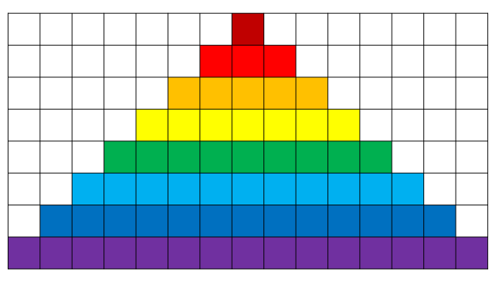
How do these visuals represent the proof?

Slide 67

How do these visuals represent the proof?

Slide 68
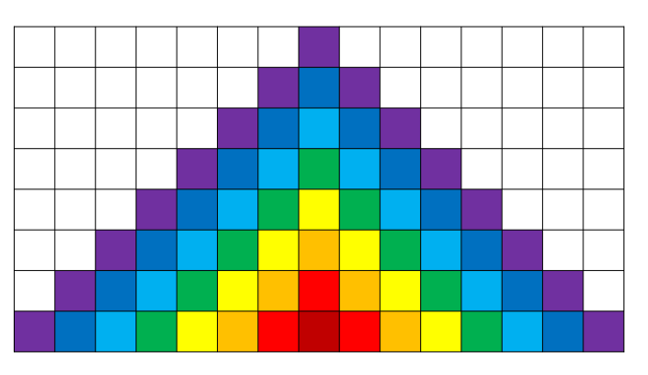
How do these visuals represent the proof?

Slide 69
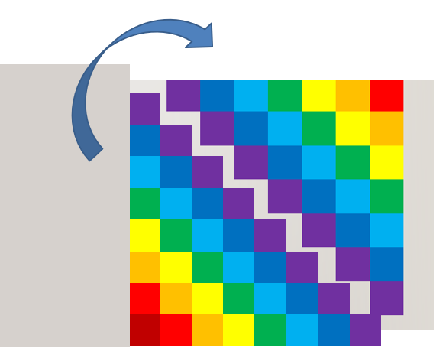
How do these visuals represent the proof?
Are the prosecutors convinced?

Slide 70
discussions debrief
Notes:
Who used visuals in their proof with this last task?
How did those visuals represent the proof?

Slide 71
Communicating Proof
Visually
Algebraically
Verbally (i.e., short statements or paragraphs)
Notes:
After looking at some examples of tasks teachers can use in the classroom with their students, hopefully, you noticed some of the following about proofs. Proofs can be communicated visually, algebraically, and/or verbally, which may be in the form of short statements or paragraphs. Each of these is are example of proof. These are all short and accessible to students, where they can engage in discussions about why something is or is not true.
The Ohio Learning Standards have the following to share about proofs
Proofs in high school mathematics should not be limited to geometry. Mathematically proficient high school students employ multiple proof methods, including algebraic derivations, proofs using coordinates, and proofs based on geometric transformations, including symmetries. These proofs are supported by the use of diagrams and dynamic software and are written in multiple formats, including not just two-column proofs but also proofs in paragraph form, including mathematical symbols. In statistics, rather than using mathematical proofs, arguments are made based on empirical evidence within a properly designed statistical investigation.

Slide 72
Part 5: Teaching MP.3
Notes:
Teaching MP 3

Slide 73
Progression of Reasoning
Empirical
Supports but does not justify a conjecture
“It works in a number of cases”
Pre-formal
Role of intuitive explanations and partial arguments that lend insight into what is happening.
Formal
The role of formal argumentation (based on logic) in determining mathematical certainty (proof) or in making statistical inferences.
Notes:
How do you teach MP 3? Like many other things in mathematics, there is a progression. Here our slide shows the progression of reasoning. In the empirical, it supports reasoning but does not justify a conjecture. It works in a number of cases. This can be a good way for students to begin because it gets them thinking and reasoning about the mathematics or recognizing patterns. In the pre-formal, the role of intuitive explanations and partial arguments lend themselves to insight into what is happening. At this stage, students are not quite yet to formal, but they are showing evidence of getting there until they finally reach the formal stage of reasoning. In the formal stage, the role of formal argumentation (based on logic) in determining mathematical certainty (proof) or in making statistical inferences. The formal stage is not just limited to high school students. Students in lower grades, even at the elementary level, students can use formal reasoning with their argumentation, discussion, or debate on a given topic. At the lower grades, the level of formal reasoning may not be as complex, abstract, or precise as what students in higher grades may demonstrate but it can still be there.

Slide 74
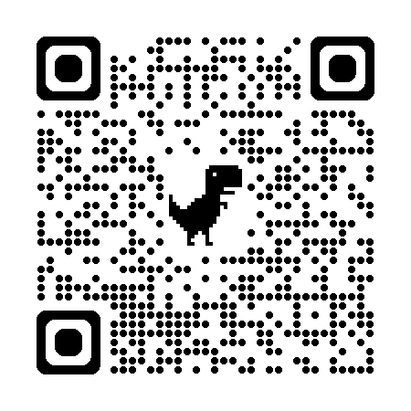
Fake math modeling problems
Focuses on higher-level demands: Tasks that bring out multiple representations or approaches and use error analysis.
Requires students to figure out things for themselves.
Requires communication and discussion.
Requires students to provide evidence and explain their thinking.
Uses a sequence of related tasks to help deepen student thinking.
Source: Fake Math Modeling Problems by Robert Kaplinsky
Notes:
Choosing a good task, is important for student reasoning to be required. When choosing instructional tasks, teachers need to look for tasks that lend themselves to high-level thinking and reasoning as part of a high-demand task. Teachers are encouraged to look for tasks that bring out multiple representations or approaches and use error analysis. Requires students to figure out things for themselves. Requires communication and discussion. Requires students to provide evidence and explain their thinking. Uses a sequence of related tasks to help deepen student thinking. Teachers can use a sequence of related tasks like was demonstrated earlier in this presentation with the pattern problem.
Next, since this presentation is focused on standard for mathematical practice 3, we are not certain on the audience’s level of understanding around the NCTM’s 8 Effective Math Teaching Practices. But, we wanted to point out that the idea of “choosing a good task” connects rather well with their Effective Math Teaching Practice 2: Implement tasks that promote reasoning and problem solving. This also connects with Effective Math Teaching Practice 1: Establish math goals to focus learning.

Slide 75
Asking the Right Questions
Ask advancing to probing student thinking and that require explanation or justification.
Ask questions that build on student thinking (as opposed to funneling) thinking.
Anticipate common misconceptions and ask students questions that will confront them.
Sample questions:
  How do you know that works?
  Why did you use that method?
  Can you prove that to us?
  Are you convinced by your own argument?
  Will others be convinced by your argument?
  Did your classmate convince your or do you have more questions?
  Do you agree or disagree? Why?
  What mathematical evidence supports your thinking?
  How can you be sure that .?
  How can you demonstrate a counterexample?
  Which of your statements are assumptions? Which are conjectures?
Notes:
Asking the right questions during instruction is always an important part of effective mathematical teaching. In the NCTM book series, Taking Action they write about two types of questions, assessing and advancing. Teachers want to ask advancing to probing student thinking and that require explanation or justification. A student response may tell the teacher one thing about their level of understanding, but in mind of the teacher, they already know where the content is going. They already know the answer and likely are already familiar with multiple approaches to solving the problem. Teachers can use this information to ask questions of their students that help to advance student thinking so the student can develop the mathematical reasoning on their own.
Ask questions that build on student thinking (as opposed to funneling) thinking. Teachers can use direct student feedback to help draw-out good mathematical ideas that can be used to help advance student understanding and problem-solving.
Anticipate common misconceptions and ask students questions that will confront them. Teachers who have already taught a grade level or course, will already know what types of questions, struggles, or challenges students will likely encounter in a lesson or with a specific task. Teachers can use some of the sample questions shown in the slide to help students confront the mathematics in a task or lesson. Some of these questions can be really helpful to use when students have a mathematical error. Teachers can use some of these sample questions to help students assess their own understanding and recognize their error so they can learn from their mathematical mistake, go back to apply what they learned, and try again.
[Read the sample questions]
The idea of asking the right questions of students connects to NCTM’s Effective Math Teaching Practice 4: Pose purposeful questions and Effective Math Teaching Practice 3: Facilitate meaningful discourse.

Slide 76
Fostering an Inquiry-Based Environment
Encourage questioning: Teacher to student, student to student, student to teacher.
Answer a question with a question. Do not give answers.
Foster student collaboration.
Create a safe space to make mistakes and where mistakes are made to leverage learning.
Encourage listening to one another’s ideas and clarifying what was said by repeating back.
Give opportunities for student to listen to the solution strategies of others, discuss alternative solutions and defend their ideas.
Use routines that produce reasoning such as “Notice and Wonder.”
Notes:
The goal is to create a classroom that fosters an inquiry-based environment. Encourage questioning: Teacher to student, student to student, student to teacher. An example of what this might look like in practice would be the Department’s Mathematical Modeling and Reasoning course as part of the High School Math Pathways Initiative. Answer a question with a question. Do not give answers. Foster student collaboration. An easy way to do this is by encouraging students to ask questions of other students. Create a safe space to make mistakes and where mistakes are made to leverage learning. This is something mathematicians do everyday. Mathematicians go down a path that sometimes leads to a dead end. In these situations, they must go back and re-work the problem. Sometimes, this means starting over in their problem-solving entirely. Encourage listening to one another’s ideas and clarifying what was said by repeating back. This can be an effective technique simply because the learner may not always know or understand what they are saying. But, when you repeat their words back to them, it helps to identify any areas where further clarification or elaboration is needed. Give opportunities for student to listen to the solution strategies of others. Discuss alternative solutions and defend their ideas. This can be helpful whenever a student comes up with a visual proof. Teachers can showcase a series of visual proofs for a small or whole group of students so they can see the different examples of thinking and approaches to problem-solving. Use routines that produce reasoning such as “Notice and Wonder.”
Again, these instructional strategies we just listed would be examples of the Effective Math Teaching Practices. This time it is an example of Practice 7: Support productive struggle in learning mathematics and Practice 8: Elicit and use evidence of student thinking.

Slide 77
Other Instructional Strategies
Model Effective Arguments.
Model and Encourage Mathematical Language
Provide Language Supports
Specify Conditions
Introduce False Claims
Manipulate Familiar Contexts to Be Unfamiliar
Notes:
Some other effective instructional strategies are:
Model Effective Arguments.
Model and Encourage Mathematical Language. This is important as students progress to higher grade levels. It is helpful for teachers to model the proper mathematical language for their students even though they may not be using the language correctly or at all in the early grades. If teachers are modeling this for their students, it should in time reinforce the use of proper or formal mathematical language for students. In time, this should encourage most use of that kind of language by students in earlier grades. By the time they reach the upper grades, you want students to be using more formal mathematical language.
Provide Language Supports
Specify Conditions
Introduce False Claims
Manipulate Familiar Contexts to Be Unfamiliar

Slide 78
Routines
Which One Doesn’t Belong
Students are given four choices and decide which one to eliminate based on a mathematical reason. “ doesn’t belong because….”
Agree or Disagree?
Students are given a statement, and students agree or disagree and give reasoning to support their statement.
My Two Cents
Students get sample arguments with flawed or incomplete logic and work together to try to improve the sample.
Notes:
Some instructional routines teachers can use that are good for this type of practice are:
Which One Doesn’t Belong - Students are given four choices and decide which one to eliminate based on a mathematical reason. “______ doesn’t belong because….”
Agree or Disagree? - Students are given a statement and students agree or disagree and give reasoning to support their statement.
My Two Cents - Students get sample arguments with flawed or incomplete logic and work together to try to improve the sample.

Slide 79
Routines: Number Talks
Fractions, fractions, fractions!
Visual Patterns
Estimation 180
Number Strings
Open Middle
Which One Doesn’t Belong?
Graphing Stories
Notes:
Number Talk routines are another good example. Places where teachers can find tasks to use with their number talks are:
Fractions, fractions, fractions!
Visual Patterns
Estimation 180
Number Strings
Open Middle
Which One Doesn’t Belong?
Graphing Stories

Slide 80
Routines: Number Talks
Visual Patterns
Estimation 180
Open Middle
Math Talks
Robert Kaplinsky
Graphing Stories
Would you rather?
Number Strings
Fraction Talks
101 Questions
Notes:
If you wanted even more resources for number talks, we have some listed here in the slide. These resources will provide you with tasks and/or ideas you can use in your classroom that will allow you to implement some of the strategies already discussed in this session.

Slide 81
Part 6: Assess
Notes:
How do you assess this? The Mathematical Practices are great. We know that teachers already buy into them. But how do we know when students are actually showing evidence of understanding associated with any of the Math Practices? Teachers may know their student are showing evidence, but not always know to what degree. Some out there may know their students show this but are struggle to identify what to use as evidence of understanding. To help teachers with this problem, we have been working at the Department on a rubric to help. There are some other rubrics available that are non-ODE created that you could choose to use or not use. All of these serve as examples to get teachers thinking about the math practices in their classroom.
Here in our live session, we sent our audience into breakout rooms. For those watching the session recording on-demand, in a moment you we will show a series of Math Practice rubrics that teachers can use in their classroom. You can pause the video at anytime to discuss any or all of the rubrics with your colleagues or you can view the rubrics in the google document. A link to the slides and the discussion questions are available in the facilitation guide or in the notes section of this slide in the slide deck. The discussion questions are:
What do you like and what do you not like about them?
How could you use them in your classroom?
Do some need to be modified for your classroom? If so, how?
Part 3: Rubrics slides 93-96
What do you like and what do you not like about them?
How could you use them in your classroom?
Do some need to be modified for your classroom? If so, how?
https://docs.google.com/presentation/d/1Flz-1FGmN4lH0_nLCqOqQFzwnmJJ3-4gG5-KDDwNHdM/edit#slide=id.gd9b5f2dd88_0_99

Slide 82
Grades K-12
Please discuss slides 85-98 with your breakout room.

Slide 83

Questions to Consider
As you look through these rubrics--
What do you like and what do you not like about them?
How could you use them in your classroom?
Do some need to be modified for your classroom? If so, how?

Slide 84
Rubric
MP | Needs Improvement | Emerging | Proficient | Exemplary
MP.3 Construct Viable Arguments and Critique the Reasoning of Others | Struggles or forgets to offer any explanation. | Explains reasoning, but does not use mathematical language; attempts to use an object, graph, chart, etc. | Explains and defends reasonings using mathematical language; explains each step and the reasoning behind it using objects, graphs, charts, etc. | Articulates and defends reasoning using concise mathematical language using objects, graphs, charts, etc.
 | Forgets to look for errors; arguments are based on opinion. | Identifies some errors; uses some arguments and logic, but arguments may have holes. | Analyzes a problem for errors and misconceptions; uses logical mathematical arguments to support and justify solutions. | Analyzes a problem for misconceptions and errors in logic, computation, and methodologies; uses logical arguments and justifies conclusions; uses definitions and previously established results in constructing arguments.
 | Struggles or forgets to defend or give rationale for the choices they made. | Defends their own choices, but concludes which plan is best without solid support, or concludes a single plan is best rather than looking at the conditions under which each plan is best. | Defends their own choices; concludes their choice is best by looking at the conditions of each plan. | Defends their own choices; concludes their choice is best by looking at the conditions of each plan and gives evidence to support their choices.
 | Struggles or forgets to seek understanding of classmates’ solutions. | Asks for clarification of classmates’ solutions. | Questions classmates’ solutions and asks “Why?” | Asks classmates probing questions to clarify and improve their arguments.
 | Struggles or forgets to list assumptions or logical conjectures. | Lists assumptions and logical conjectures but may not be able to clearly differentiate between them. | Differentiates between assumptions and logical conjectures. | Makes, recognizes and challenges assumptions and logical conjectures by providing evidence; evaluates peer arguments; able to compare the effectiveness of two plausible arguments.
Notes:
To support teachers in their professional development particularly in the math practices, there are some rubrics available to help teachers look for evidence of student understanding of the math practices. Here an example of one created by Ohio. While it was initially created for the high school math pathways initiative, the content is still applicable to lower grades and courses. The content on the rubric illustrates a continuum from needs improvement all the way to exemplary. While we want all students to at least reach proficient, we do recognize that some students will exceed this level and while others in the same classroom may still be emerging.

Slide 85
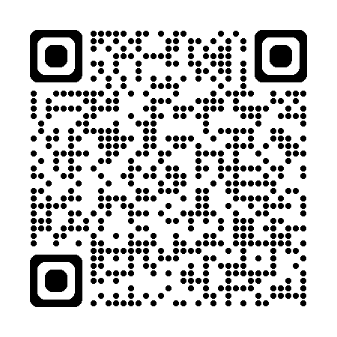
Rubric – Implementing Standards for Mathematical Practice
Practice | Needs Improvement | Emerging (Teacher does thinking) | Proficient (Teacher mostly models) | Exemplary (Students take ownership)
Construct viable arguments and critique the reasoning of others. | Task: Is either ambiguously stated. Teacher: Does not ask students to present arguments or solutions Expects students to follow a given solution path without opportunities to make conjectures. | Task: Is not at the appropriate level. Teacher: Does not help differentiate between assumptions and logical conjectures. Allows students to make conjectures without justification. | Task: Avoids single steps or routine algorithms. Teacher: Models evaluation of student arguments. Asks students to explain their conjectures. | Teacher: Helps students differentiate between assumptions and logical conjectures. Prompts students to evaluate peer arguments. Expects students to formally justify the validity of their conjectures.
Notes:
Here is an example of a rubric from the Institute for Advanced Study.
Institute for Advanced Study/Park City Mathematics Institute Summer 2011 Secondary School Teachers Program/Visualizing Functions

Slide 86
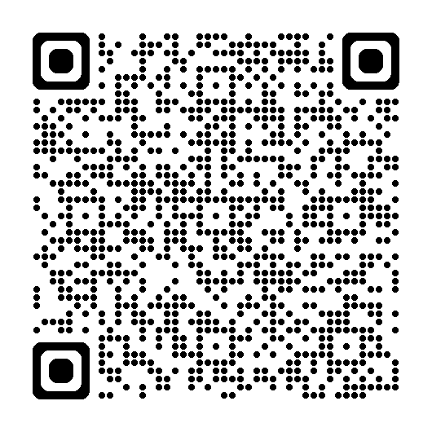
NCTM “Look Fors”
 | Students | Teachers
3. Construct viable arguments and critique the reasoning of others | Use definitions and previously established causes/effects (results) in constructing arguments Make conjectures and use counterexamples to build a logical progression of statements to explore and support ideas Communicate and defect mathematical reasoning using objects, drawings, diagrams, and/or actions Listen to or read the arguments of others Decide if the arguments of others make sense and ask probing questions to clarify or improve the arguments. Comments: | Provide and orchestrate opportunities for students to listen to the solution strategies of others, discuss alternative solutions, and defect their ideas Ask higher-order questions which encourage students to defend their ideas Provide prompts that encourage students to think critically about the mathematics they are learning Comments:
Notes:
Here is an example from the NCTM “Look Fors” document that identifies for teachers what evidence they should “look for” with the each of the math practices. A link to the full document by NCTM is available in the PowerPoint notes section on this slide and in the references slide at the end of the PowerPoint slide deck. We even included a link to this in the digital version of the Facilitation Guide for MP 3. So, there are multiple access points for everyone to be able to access this if interested.

Slide 87
Additional Resources

Slide 88

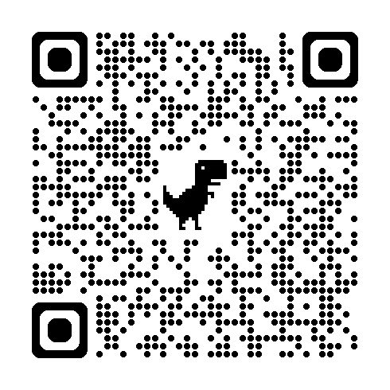
Math Practice Rubrics
Math Argumentation Rubric
Student Language Math Argumentation Rubric
Notes:
Hopefully, after look through those examples of the different math practice rubrics you found some of them to be useful to you in your classroom or in your district. There is no obligation that any of them be used at any level. We simply wanted to share them as examples for what could be used to support the math practices. The rubrics provide ideas of the type evidence teachers can be looking for from their students. The rubrics shown can be used to collect evidence of student understanding of the math practices as part of the OTES 2.0 evaluation. The evidence collected can be used to help craft teacher professional development goals and work great when paired with the 8 Effective Math Teaching Practices from NCTM.

Slide 89
Questions

Slide 90
MATHEMATICS QUESTIONS?
Email
Mathematics@education.ohio.gov

Slide 91
References
“Levels of Convincing” by Robert Kaplinsky.
“How Mathematicians are Storytellers and Numbers are the Characters” by Marcus du Sautoy.
Where Proof, Evidence, and Imagination Intersect” by Patrick Honner.
“The Power of Making Mistakes in Learning Math” posted on the Tarheelstate Teacher.
Louisiana Believes Teacher Guide for Mathematical Practice Implementation
Implementing the Mathematical Practice Standards
Inside Mathematics: Construct Viable Arguments, Critique the Reasoning of Others

Slide 92
References
Huinker, D., & Bill, V. (2017). Implementing effective mathematics teaching practices in Kindergarten-grade 5. Reston, VA: National Council of Teachers of Mathematics.
Lannin, J. K., Ellis, A. B., & Elliott, R. (2011). Developing essential understanding of mathematical reasoning for teaching mathematics in Prekindergarten-Grade 8. http://ci.nii.ac.jp/ncid/BB10507247
O'Connell, S., & SanGiovanni, J. (2013). Putting the practices into action: Implementing the common core standards for mathematical practice, K-8. Portsmouth, NH: Heinemann.
Strutchens, M. E., & Quander, J. R. (2011). Focus in high school mathematics: fostering reasoning and sense making for all students. https://www.amazon.com/Focus-High-School-Mathematics-Fostering/dp/0873536800

