Slide 1
Ohio Department of Education and Workforce

Slide 2
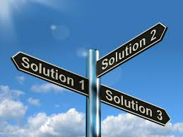
Math Practice 4: Model With Mathematics

Slide 3
Welcome

Slide 4
Ohio Department of Education and Workforce Priorities
Literacy
Learning Acceleration
Workforce Readiness
Student Wellness
Notes:
The math plan looks to connect. To department priorities in the following areas:
Literacy Achievement: Building a foundation for lifelong success by ensuring every student is reading at or above grade level.
Learning Acceleration: Empowering each learner to reach their full potential through individualized, evidence-based support.
Student Wellness: Fostering safe and supportive environments that engage students and enable them to thrive.
Workforce Readiness: Preparing students for the future fully equipped with the skills needed to take the next steps in their career journeys.
Our strongest connection to the Department’s priorities is around learning acceleration. In mathematics, we want every student to be able to accelerate their learning. This means they can access the proactive, research-. And evidence-based, and individualized support they need to succeed. To achieve this priority, all students must have the opportunity to engage in grade-level core instruction regardless of ability, which requires replacing remediation (the practice of teaching below grade-level content) with the just-in-time intervention that allows students to complete unfinished learning and access grade-level instruction (or above).

Slide 5
Session Norms
Listen
Listen with the intent to understand. Ask questions!
Focus
Focus on how this applies to your daily work.
Imagine the possibilities!
Create
Create a safe place to air confusion and raise questions.
Support
Support ideas with evidence. Bring your vast experience to the table. Support participation of all.
Notes:
Welcome everyone. We want to take a moment to ground us in our Session Norms.
We want to Listen with the intent to understand. Ask question!
We want to Focus on how this applies to your daily work. Imagine the possibilities!
We want to Create a safe place to air confusion and raise questions.
We went to Support ideas with evidence. Bring your vast experience to the table. Encourage everyone’s participation. Part of Supporting others is to make sure we are providing space for all in group to share. In addition, we have noticed a few participants have invited an AI presence to curate notes for them during the session. While we appreciate the use of productivity tools, unfortunately, MS TEAMS does not know how to deal with these “non-human” participants and this is affecting breakout rooms, so going forward, we will not be admitting AI participants into our community meetings each month. If there are questions or concerns, please contact one of the Dept team on this session. Thank you!

Slide 6
Purpose:
Connect
Ohio’s Mathematics Vision from Ohio’s Plan for K-12 Mathematics to the Mathematical Practices.
Explore
MP 3: Construct Viable Arguments and Critique the Reasoning of Others through grade band-aligned instructional tasks.
Identify
Resources to support instruction aligned to Math Practice 3: Construct Viable Arguments and Critique the Reasoning of Others.
Utilize
Resources to help recognize and collect evidence of MP 3: Construct Viable Arguments and Critique the Reasoning of Others.

Slide 7
Agenda
What: | Why: | How:
Welcome and Introductions 5-10 minutes | To establish the session norms and outline the focus of the session | Facilitator presentation
Ohio’s Plan for K-12 Mathematics 5 minutes | To learn about Ohio’s Vision for Mathematics as outlined in Ohio’s Plan for K-12 Mathematics | Facilitator presentation
Resource Exploration and Discussions 45-60 minutes | Explore various Ohio resources aligned to MP: 4 Model with Mathematics and identify connections to Ohio’s Mathematics Vision. | Breakout Rooms and Whole Group Discussion
Closing 5-10 minutes | Address lingering questions and provide session feedback | Participant Q&A and Exit Tickets

Slide 8

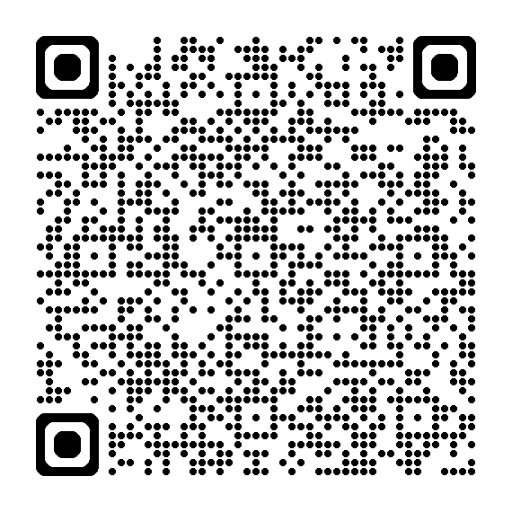
OHIO’S PLAN FOR
K-12 MATHEMATICS
education.ohio.gov/math

Slide 9
STRUCTURE OF OHIO’S PLAN
Why?
What?
How?
Section 1: Why a Comprehensive Mathematics Plan is Needed
Section 2: Ohio’s Mathematics Vision
Section 4: Strategies and Activities
Section 3: Ohio’s Theory of Action
Notes:
This session will connect best with Section 2: Ohio’s Mathematics Vision, which is outlined in Ohio’s Plan for K-12 Mathematics.

Slide 10
SECTION 2:
OHIO’S MATHEMATICS VISION
The Importance of Mathematics
A Shift Toward Rigor
Ohio’s Vision for Mathematics Instruction
Notes:
This section defines mathematics and sets the vision
Outlines that across the state, all students must have access to rigorous instruction that advances their growth and confidence in mathematics.
Section 2 sets the foundation and expectations for mathematics instruction, focusing grounded in the effective math teaching practices and student practices.

Slide 11
OHIO’S MATHEMATICS VISION
Ohio’s vision is to empower students with the confidence and ability to apply mathematical concepts, procedures, and reasoning, enabling students to thrive in a variety of contexts, life experiences, and career pathways.
Notes:
Improving mathematics outcomes for all Ohio students — across districts and grade levels and with special attention to those who are furthest behind — requires a thoughtful, multi-pronged strategy. Ohio’s Plan for K-12 Mathematics leverages multiple strands of activity and investment into a single, coherent theory of action. This theory builds upon existing math-related policies and initiatives in Ohio and proposes additional strategies to cultivate rigorous, high-quality mathematics instruction in every classroom and for all students. Ohio’s theory of action combines five interdependent strands of action. It is important to emphasize that these five strands of work are not sequential but should interact with and support one another in service of improved student learning.

Slide 12
A SHIFT TOWARD RIGOR
Learning acceleration
Just-in-time interventions
Access
Notes:
It is not enough for some students to participate in a rigorous math curriculum. To ensure a full array of college and career opportunities for every graduate, all Ohio students must have opportunities to develop and advance their conceptual understanding, procedural skills and fluency, and application of mathematics. That requires a shared commitment to the following principles in all Ohio mathematics classrooms:
Learning acceleration: Every student accelerates their learning in math and has access to the proactive, evidence-based, and individualized support they need to succeed. All students must have the opportunity to engage in grade-level core instruction regardless of ability, which requires replacing remediation (the practice of teaching below grade-level content) with the just-in-time intervention that allows students to complete unfinished learning and access grade-level instruction (or above).
(Note: This term is not equivalent to grade-level or course acceleration, which occurs when advanced learners move ahead an entire grade level in one or more subject areas.)
Just-in-time intervention: Current learning data is used to identify gaps that would prevent students from accessing grade-level instruction, plan scaffolds to provide that access, and then remove those scaffolds as soon as they are no longer needed.
Access: Providing learning “access” means removing or accommodating any barriers that would prevent a student from successfully and equitably engaging with the grade-level curriculum. Ohio commits to providing equitable access to a grade-level (or above) curriculum for learners of all backgrounds and abilities.

Slide 13
OHIO’S VISION FOR MATHEMATICS INSTRUCTION
Recommended Instructional Focus
Standards for Mathematical Practice
Effective Mathematics Teaching Practices
Notes:
The Ohio Learning Standards for mathematics were updated based on a review process led by educators and the Department in 2017. The revised standards define what learners should know and be able to do and guide districts in modifying local curricula, instructional plans, and materials to ensure all students have access to coherent, rigorous, grade-level instruction.
Ohio’s mathematics vision builds on long-accepted research about how students learn mathematics and the instructional practices that cultivate rigor.
Outlined in Ohio’s Vision for Mathematics Instruction, is first and foremost, an alignment to the Standards. In the Math Plan, we identify the recommended instructional focus for Pre-K through High Schools. These major topics or themes are taken from the Ohio Learning Standards and have been around since 2011.
Next, we have encouragement to utilize a more student-centered focus to mathematics learning through the inclusion of the Standards for Mathematical Practice. These outline ways that students can show their understanding of mathematics in every grade level and course.
Last, we highlight the importance of using the evidence-based Effective Mathematics Teaching Practices from the National Council of Teachers of Mathematics or NCTM. These Teaching Practices identify what teachers can do in the delivery of high-quality instruction.

Slide 14

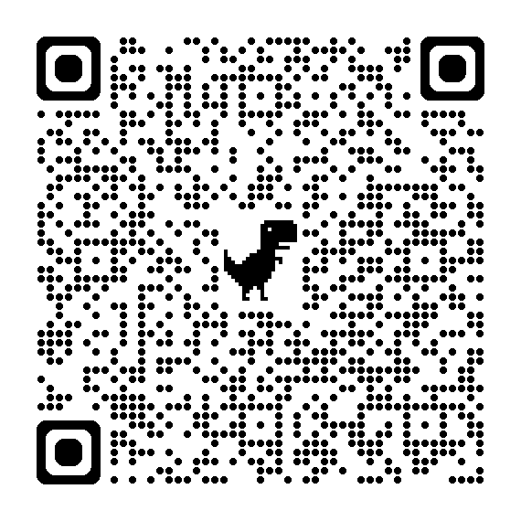
STANDARDS FOR MATHEMATICAL PRACTICE
MP 1: Make sense of problems and persevere in solving them.
MP 2: Reason abstractly and quantitatively. ​​
MP 3: Construct viable arguments and critique the reasoning of others.
MP 4: Model with mathematics.
MP 5: Use appropriate tools strategically.
MP 6: Attend to precision.
MP 7: Look for and make use of structure.
MP 8: Look for and express regularity in repeated reasoning.
Notes:
Links:
Standards for Mathematics Practice: https://education.ohio.gov/Topics/Learning-in-Ohio/Mathematics/Model-Curricula-in-Mathematics/Standards-for-Mathematical-Practice
The eight Standards for Mathematical Practice outlined in Ohio’s Learning Standards for Mathematics describe varieties of expertise that mathematics educators at all grade levels should seek to develop in their students.
These eight practices rest on important “processes and proficiencies” with longstanding importance in mathematics education. This includes the process standards of problem-solving, reasoning, communication, representation, and connections described by the National Council of Teachers of Mathematics and the five strands of mathematical proficiency described by the National Research Council.

Slide 15
Breakout Room Discussion
Notes:
Small group share out

Slide 16
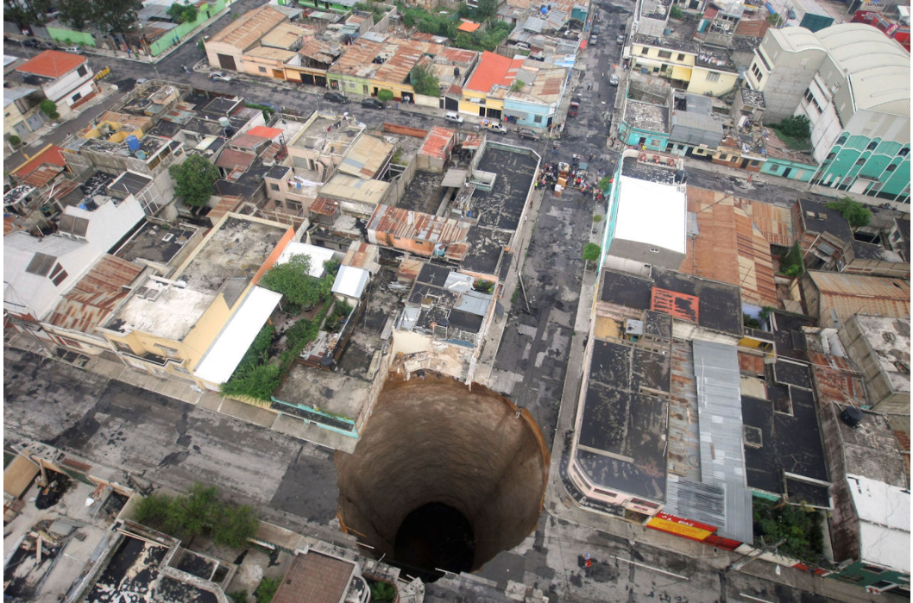
Act 1: A Guatemalan Sinkhole
What do you notice?
What do you wonder?
Notes:
We are going to start with an activity. In 2010, an enormous sinkholes, shown in the slide, suddenly appeared in the middle of a Guatemalan neighborhood and swallowed a three-story building above it.
For those watching the recording on-demand, in a moment, I will ask you to pause the recording so that you can have a conversation with your colleagues about this picture. Start by discussing what do you notice and what do you wonder?
Other potential discussion questions include:
How much material will they need to fill the sinkhole?--volume
How much will it cost to fill the sinkhole in?
What events cause sink holes?
Why did it happen here instead of somewhere else?
What are the land compositions that cause sinkholes?
Pause the video momentarily to discuss these questions with your colleagues. If needed, the questions are available in the facilitation guide in case anyone needs to see or hear them again.
https://robertkaplinsky.com/work/sink-hole/

Slide 17
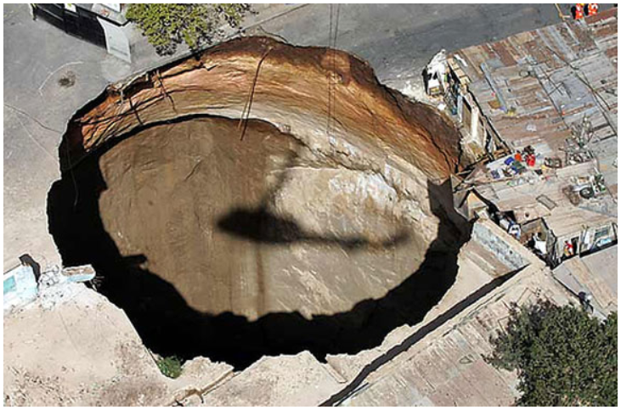
Act 2: Estimate
What do you know?
What information do we need?
What is a guess that is too high?
What is a guess that is too low?
What’s your best guess?
Notes:
Since you have had the opportunity to complete your notice and wonder discussion, we are going to do some estimation as the second part of our 3-Act Task. In a moment, I will again ask you to pause the video to engage in discussion with your colleagues. This time, the conversation will be centered around estimation. I want you to create a high estimate and a low estimate for the volume of this sink hole. Pause video momentarily to discuss your estimations with your colleagues and restart the video after your discussion.
Hopefully, in your discussions you observed evidence of Math Practice 6: Attend to Precision if you used units correctly in your estimates. One of the reasons we include estimation in our problem solving is to help students build their number sense and to better judge the reasonableness of answers with their estimation sense. If you wanted to know the actual volume of the sink hole, what information would you need? Asking questions like this in a numberless problem can be excellent instructional strategies to help get students identifying the critical information they need to solve a contextual problem. As you have likely already identified, you will need to know something about the sink hold such as the circumference, radius, or diameter and the depth of the sink hole if you were going to find the volume. It would also help if these measurements contained a standardized unit of measurement such as inches, feet, meters, or another length unit.
https://robertkaplinsky.com/work/sink-hole/

Slide 18
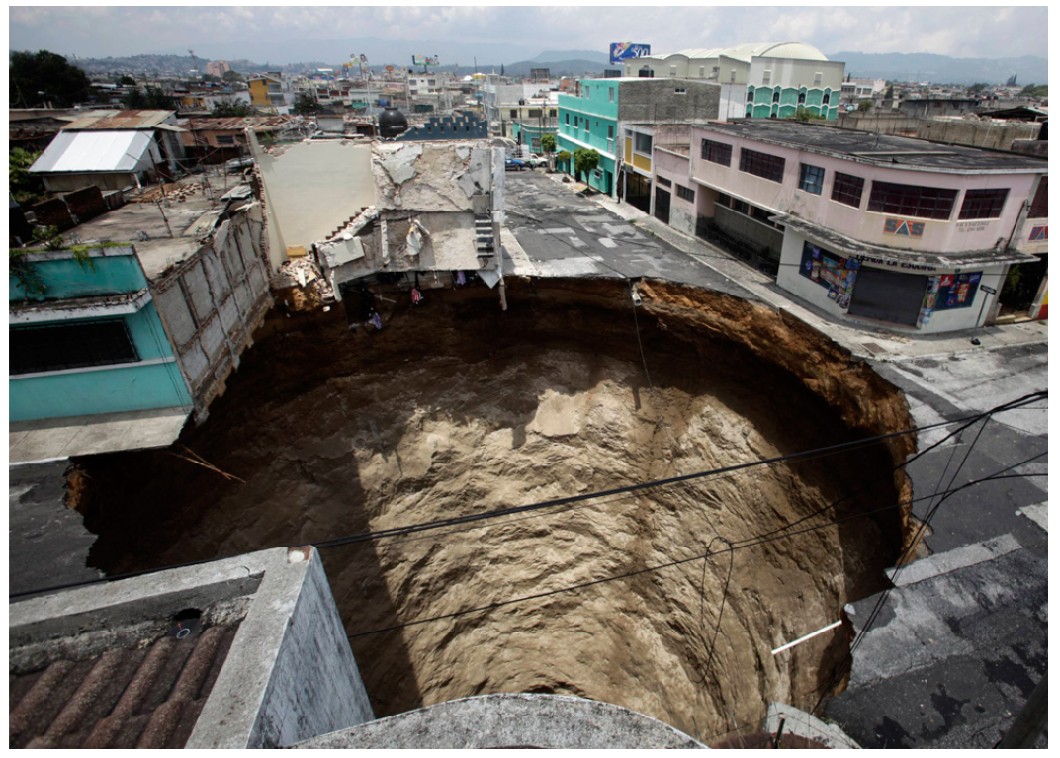
Act 2: Create a Mathematical Model to
Describe the Situation
Diameter of sinkhole:
20m (about 66 ft)
Depth of sinkhole:
30m (about 100 ft)
Notes:
To help you with your problem solving, we are going to give you some measurements from this sink hole in 2010. So as not to limit your mathematical thinking, the measurements are provided in both metric and U.S. Customary. For the sake of our problem solving, we are going to round these measurements to the nearest whole unit. In 2010, the diameter of this sink hole was measure to be 20 meter or approximately 66 feet. Meanwhile, the depth of the sink hole was measure to be 30 meters or about 100 feet deep.
Since you now have the measurements of the sink hole, in a moment, I want you to pause the video so that you can create a mathematical model to describe the situation. This mathematical model can be a picture, an equation, graph, or something else that can be used to describe the situation. Take a few moments to pause the video while you create your model. Also, while the video is paused, use this as an opportunity to discuss your model with your colleagues.
https://robertkaplinsky.com/work/sink-hole/

Slide 19
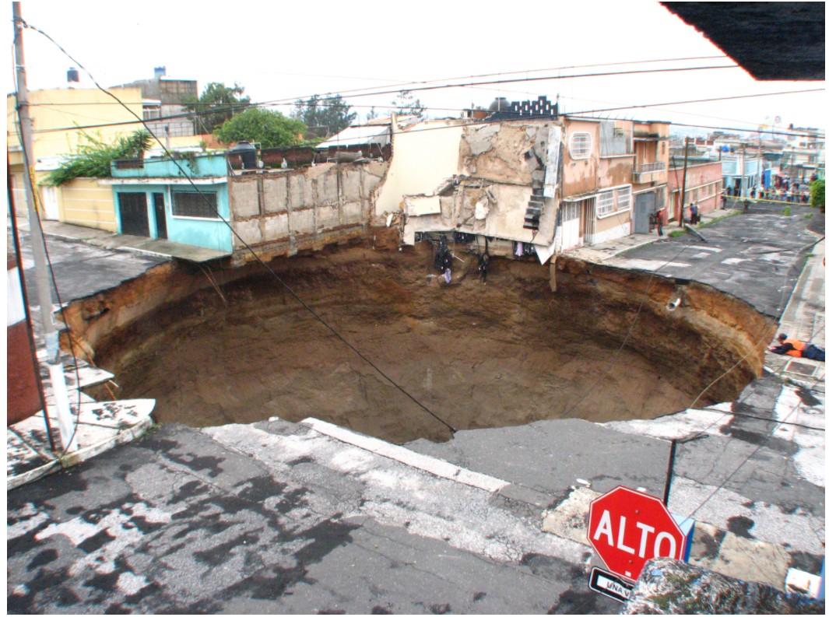
Act 3: Reveal
Notes:
Since you have completed your estimation and model in Act 2, we are moving on to the last part which is Act 3, the reveal.
V= 342,119.44 ft^3 or V=108,900pi ft^3
V= 9424.78 m^3 or V= 3,000pi m^3
https://robertkaplinsky.com/work/sink-hole/

Slide 20
Act 3: Next Steps
Could you revise your model to make it better?
What new questions do you have?
Notes:
These measurements are based on the unsubstantiated assumption that the shape of the sink hole was a cylinder. This is only an assumption because we do not know whether it was truly cylinder shaped, a cone, or something else. If you were to use this problem with high school students, you may want to use Act 3 as an opportunity to engage in conversations about assumptions. For example, we assumed the sink hole was perfectly circular, which it may not be. Conversations about assumptions can lead to students making discoveries about measurement irregularities.
What you just went through was a process known as a 3-Act task. We selected this because 3-Act Tasks provide a grade level appropriate example of a modeling task. There are hundreds like these available online that can be used at any grade level or course. These are excellent for instruction because they are typically very open which presents multiple entry points to problem solving for students. Because of these openness, they allow students to select a meaningful problem-solving pathway for them. When used regularly, students will begin to show evidence of understanding associated with other Math Practices such as precision, perseverance, reasoning abstractly and quantitatively, and others; not just modeling with mathematics.
If you wanted to expand upon the 3-Act task we just completed, you could engage in some cross curricular discussions involving science as it relates to sink holes. These discussions could include questions such as:
What events cause sink holes?
Why did it happen here instead of somewhere else?
What’s the land compositions causes sinkholes?
https://robertkaplinsky.com/work/sink-hole/

Slide 21
Discussions
Notes:
In the live version of this session the participants went into break out rooms at this stage of the presentation. For our audience watching the recording on-demand, there is a link to a google document in the notes for the PowerPoint presentation and in the Facilitation Guide for MP 4. In a moment, you will want to pause the recording so you can click on the Google doc link and access the grade band tasks. The grade bands are broken down into K-5, 6-8, and high school. Those watching this recording on-demand are encouraged to examine the tasks at the grade band they work with the most. However, if you work across grade bands or are curious about the tasks outside of your grade band, you are welcome to view those tasks as well. As you view the slides in the Google doc, you will want to discuss the questions found on each of the different slides with your colleagues locally. This activity can take as long as needed for those discussions to take place. If you want to, you can break up the tasks into multiple conversations if you choose not to review and discuss all of the tasks in a single sitting. You can break them up into a series of conversations if you want. Once the local discussions have concluded, simply continue playing this recording where you left off.
Grades K-5: Slides 3-11
Directions: Read through slides 3-11 and then discuss the questions with your group.
Grades 6 and above: Slides 27-37
Directions: Read through slides 28-32, create a model on slide 33, read slide 34, discuss slide 35 as a group, and then read through slides 36-39.

Slide 22
Kindergarten - Grade 2 Tasks
Complete the Breakout Room Discussions tasks that align with the grade band(s) you work with the most.

Slide 23
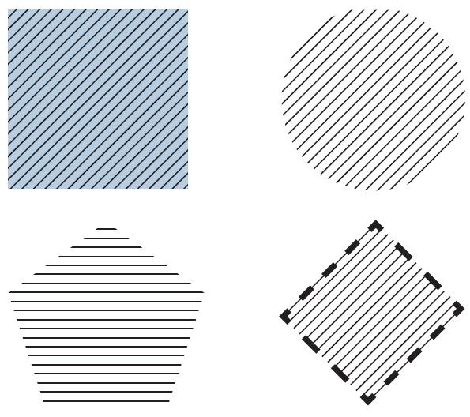
Kindergarten-Grade 2 Task
Which one doesn’t belong?
Which shape does not belong in the group? Why?
What makes each shape special or unique?
Task taken from the GAIMME Report

Slide 24
Kindergarten-Grade 2 Tasks
Include a model in your answer
  Model the math in an expression such as 3 + 1 or 27 – 15.
  11 horses are in a field. 6 horses are black. The rest are brown. How many horses are brown?
  Kelly was in line to buy lemonade. There were 3 people in front of her in the line. There were 2 people behind her in the line. How many people were waiting in line to buy lemonade?
Use a model to answer a question (Reflect upon how the models will look different in each context)
  Marcus has 3 apples. He picks 2 more apples. How many apples does Marcus have now?
  Three apples are lying on the ground. Some more apples fell from the tree to the ground. There are now 5 apples lying on the ground. How many apples just fell from the tree?
  Some apples were in a basket. Three more apples were added to the basket. There are five apples in the basket. How many apples were in the basket before?

Slide 25
Grades 3-5 Tasks
Complete the Discussions tasks that align with the grade band(s) you work with the most.

Slide 26
Grades 3-5 Task
THE BUS PROBLEM
A school bus holds 36 students. If an entire school building has 1,128 students going on a field trip together, how many school buses are needed?
How do you know? Explain your reasoning.

Slide 27
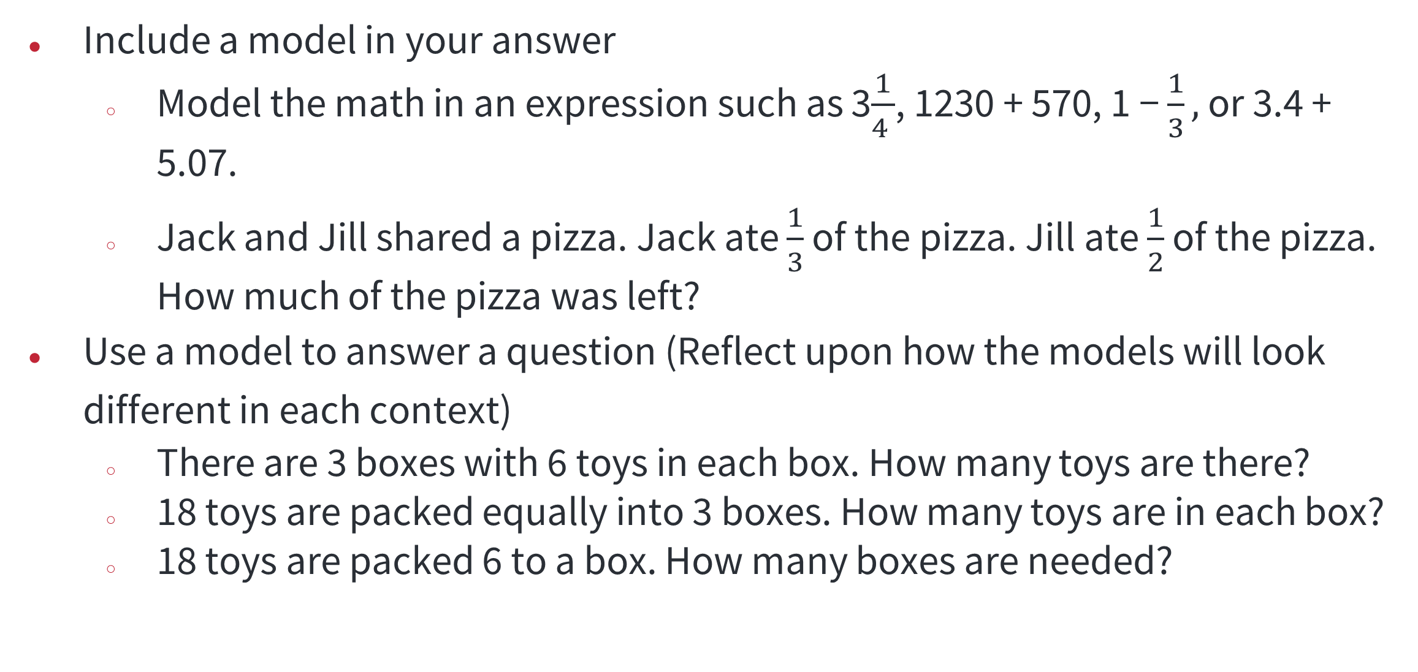
Grade 3-5 Tasks
Include a model in your answer
  Model the math in an expression such as 3$\frac{1}{4 }$, 1230 + 570, 1 − $\frac{1}{3},$ or 3.4 + 5.07.
  Jack and Jill shared a pizza. Jack ate $\frac{1}{3}$ of the pizza. Jill ate $\frac{1}{2}$ of the pizza. How much of the pizza was left?
Use a model to answer a question (Reflect upon how the models will look different in each context)
  There are 3 boxes with 6 toys in each box. How many toys are there?
  18 toys are packed equally into 3 boxes. How many toys are in each box?
  18 toys are packed 6 to a box. How many boxes are needed?

Slide 28
Grades 6-8 Task
Complete the Breakout Room Discussions tasks that align with the grade band(s) you work with the most.

Slide 29
How long does it take to infect a population?
Grades 6-8
To gather some information, we will perform a simulation…
(Advance to the next slide)

Slide 30
How long does it take to infect a population?
Grades 6-8 Cont’d
Tapping Activity
Ask for a volunteer to be Patient 0.
Patient 0 stands up, showing that they are infected and transmits the disease by tapping one person. The person who gets tapped stands and taps one other person until the whole class is tapped and is standing. Record the number of people tapped (infected) after 10 rounds of tapping.
Create a model (graph, equation, diagram, table, etc.) of a one-tap situation. Does your model show each round of tapping? How many new people are infected? The total number of people?
Notes:
Answer: 10 people per round

Slide 31
Grades 9-12 Task
Complete the Breakout Room Discussions tasks that align with the grade band(s) you work with the most.

Slide 32
How long does it take to infect a population?
Grades 9-12
To gather some information, we will perform a simulation…
(Advance to the next slide)

Slide 33
How long does it take to infect a population?
Grades 9-12 Cont’d
Tapping Activity
Patient 0 stands up, showing that they are infected and transmits the disease by tapping two other people. The people who get tapped stand and tap two other people until the whole class is tapped and is standing. Record the number of people tapped (infected) after 10 rounds of tapping.
Create a model of a two-tap situation. Does your model show each round of tapping? What is the number of new people who are infected? The total number of people?

Slide 34
Discussions Debrief
Notes:
How was modeling incorporated into the breakout room tasks?
How do you incorporate modeling in your classroom?
What challenges do you anticipate when implementing modeling tasks, and how can you address them?
How can you modify or scaffold modeling tasks to better suit the needs of your students?

Slide 35
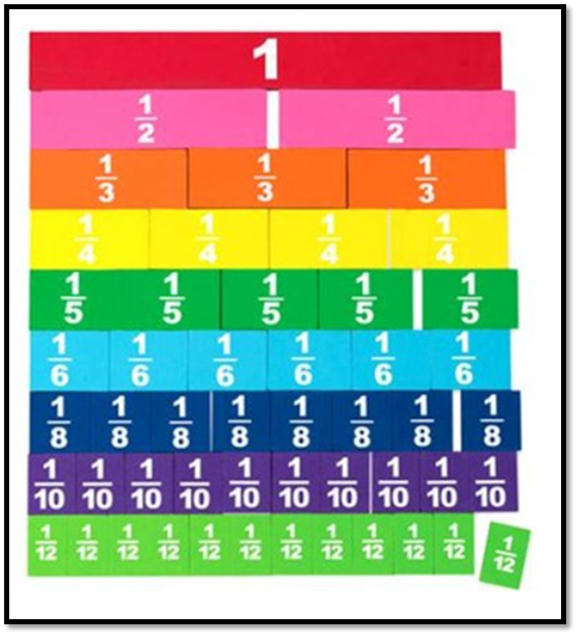
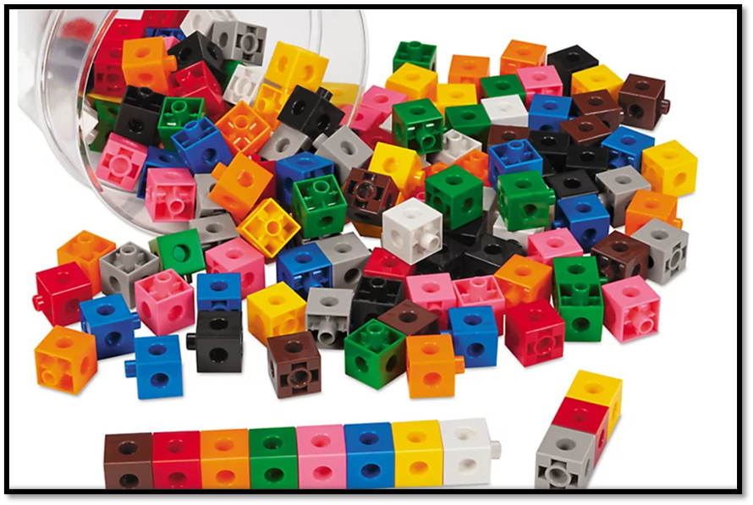
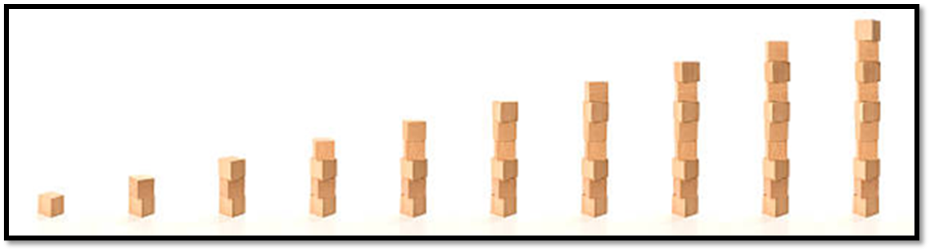
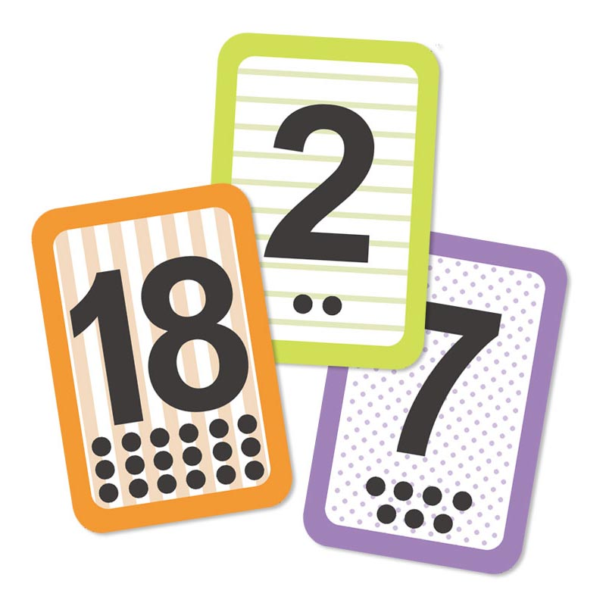
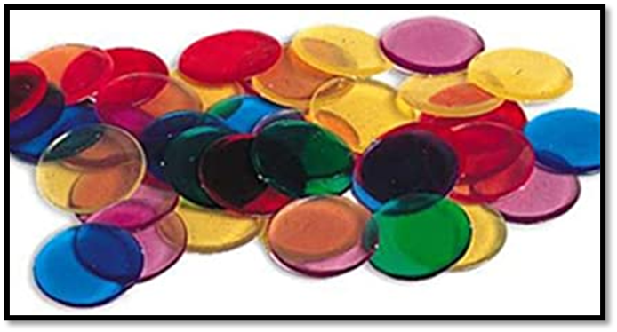
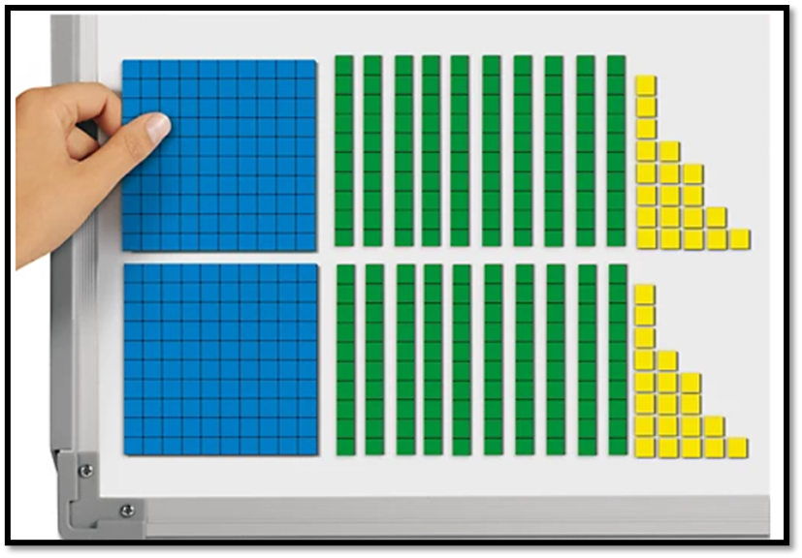
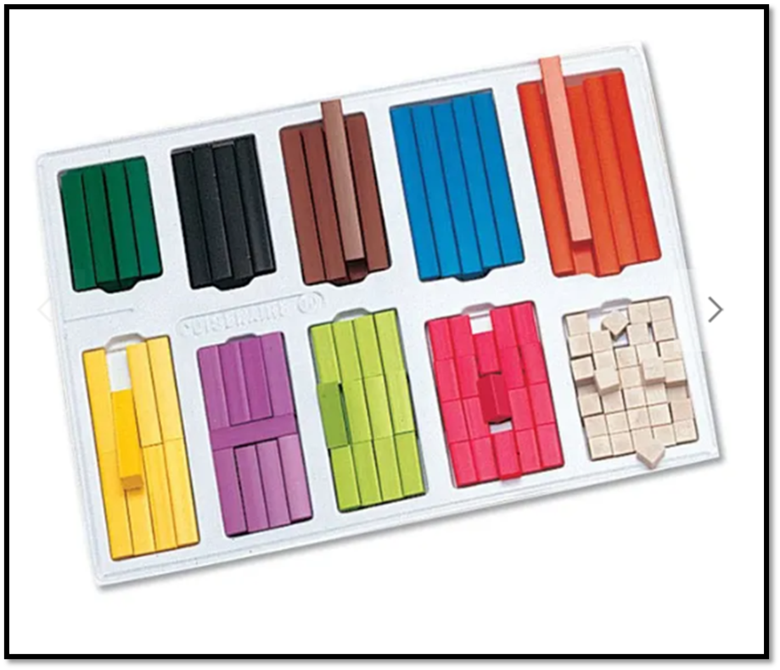
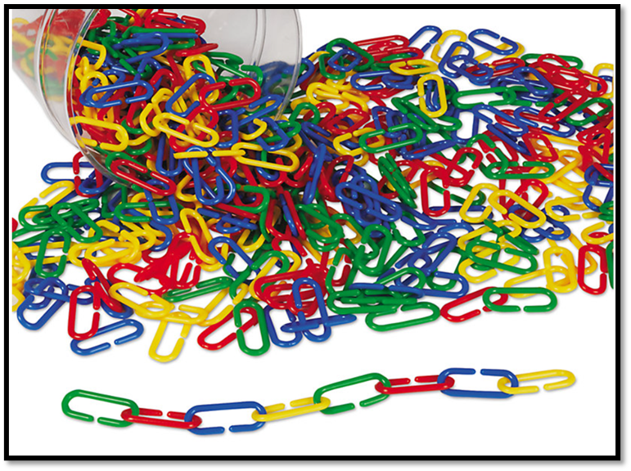
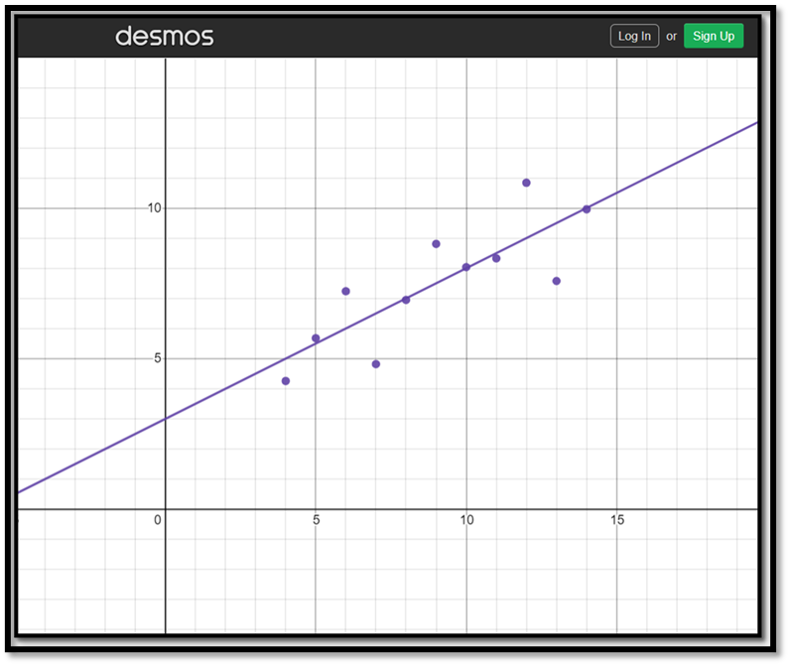
Modeling

Slide 36
Differences between traditional and modeling focused classrooms
Traditional Mathematics Class | Modeling-Focused Class
Skill-driven with concepts applied | Concept-driven with skills applied
Practice and then apply | Apply and then practice
Context removed, solve problem, insert context | Problem cannot be solved without context
Behaviorist approach | Inquiry-based
Teacher-centered | Student-centered
Individual-centered | Team-centered
Communication optional | Communication essential
Objects of study are abstract | Objects of study are data
For specific, high-level STEM careers | For all careers, and essential for good citizenship and personal finance decisions
Notes:
Now, let’s examine some of the main differences between a traditional math class and a modeling focused math class. In a traditional math class, the instruction is very skills driven with concepts applied. In contrast, a modeling focused class is concept driven with many of the math skills being applied in the concepts. An example of what this looks like in practice, if you are not already familiar with Ohio’s Mathematical Modeling and Reasoning Pilot Course, it provides a modeling focused class that is very much concept-driven with skills applied.
As you think more about the differences between these two types of classes, a traditional class starts with practice followed by application whereas a modeling-focused class starts with application and then practices.
In a traditional classroom the teacher may set-up a word problem that students do not think about or engage with until the end of the lesson. In this traditional approach the context can easily be removed from the problem and solved without any context. Only after the mathematics has been completed do you go back to insert the context back in the problem. While in a modeling focused class, the teacher starts with the word problem because the context is everything. The student could not solve the problem without the context because the context is needed to help the student know how to solve the problem.
A traditional classroom uses a behavioral approach versus a modeling-focused class which uses an inquiry-based approach. A traditional math class is very teacher centered while a modeling-focused class is student-centered. In a student-centered class, the focus is on the teacher asking the right assessing or advancing questions of the students. Traditional classes are individual-center. A modeling-focused class is team-centered.
In a traditional class, communication is optional. In a modeling-focused class communication is essential. This applies to the modeling, the reasoning, and the entire modeling process. In a traditional class, the object of study are abstract versus a modeling-focused class where the object of study are data. A traditional class is for specific, high-level STEM careers meanwhile, a modeling-focused class is for all careers including STEM careers and essential for good citizenship and personal finance decisions.

Slide 37
What is Mathematical Modeling?
Mathematical modeling is a process that uses mathematics to represent, analyze, make predictions, or otherwise provide insight into real-world phenomena. - GAIMME
In the Standards, modeling means using mathematics or statistics to describe (i.e., model) a real-world situation and deduce additional information about the situation by mathematical or statistical computation and analysis - AZ Progression
Purpose: To understand reality - AZ Progressions
Notes:
On the previous slide I used the phrase mathematical modeling on a couple of occasions, which may have led some of you to wondering what is mathematical modeling? Different sources use different definitions for mathematical modeling. Some of those different resources and their definitions are shown in this slide.
For starters, if you are unfamiliar with the Guidelines for Assessment & Instruction in Mathematical Modeling Education or (GAIMME) , you can access the full report in the references linked at the end of this PowerPoint or in the digital version of the Facilitation Guide for Math Practice 4. In the GAIMME, they define mathematical modeling as a process that uses mathematics to represent, analyze, make predictions or otherwise provide insight into real-world phenomena.
While the Arizona Progressions define modeling as using mathematics or statistics to describe (i.e., model) a real-world situation and deduce additional information about the situation by mathematical or statistical computation and analysis. The Arizona Progressions go on to state the purpose of modeling is to understand reality. It is worth noting that models are seldom perfect but, they should be useful for helping to better understand mathematics in reality.

Slide 38
Model vs Modeling
Mathematical Model | Mathematical Modeling Process
A tool that uses mathematics to represent a real-world situation to facilitate quantification, analyses, predictions, and gaining insight. There may be multiple mathematical models for any given scenario with varying degrees of complexity The type of model depends on the available resources and knowledge of the person creating it. | The creation of such a tool and often requires significant creativity and brainstorming, but not necessarily complicated mathematics. The process itself includes determining what the output of the model is (what is being quantified?) and identifying what variables may impact that quantity. Assumptions must be made to determine relationships between the input and output of the model. Validating the model to assess how well it performs at making a prediction or measurement, and the consideration of refinements.
Notes:
In mathematics we have models and we have mathematical modeling. A simplistic distinction between the two is one of these is a noun and one is a verb. Because of their similarities people often get confused by them and think they are the same when in fact they are different. To help distinguish between them, we put some of their differences into the table.
Mathematical models—
a tool that uses mathematics to represent a real-world situation to facilitate quantification, analyses, predictions, and gaining insight.
multiple mathematical models for any given scenario with varying degrees of complexity.
depends on the available resources and knowledge of the person creating it.
Mathematical Modeling Process—
Is the creation of such a tool and often requires significant creativity and brainstorming, but not necessarily complicated mathematics. For example, in our sink hole problem, we did not do a lot of complicated mathematics, but we still went through the modeling process. The process itself includes determining what the output of the model is (what is being quantified?) and identifying what variables may impact that quantity. Assumptions must be made to determine relationships between the input and output of the model. Back to our sink hole problem, there was an assumption the shape of the hole was cylinder when in reality we do not know for sure.
Validating the model to assess how well it performs at making a prediction or measurement and the consideration of refinements.
From GAIMME

Slide 39
Mathematical Modeling Is NOT…
Telling students “I do this; now you do the same.”
Using a graph, equation, or function and calling it modeling. True modeling is a process.
Starting with a real-world situation and solving a math problem. Modeling returns students to a real-world situation and uses mathematics to inform their understanding of the world (See MP.2)
Using manipulatives to represent mathematical concepts; this might instead be referred to as “using concrete representations.”
Beginning with mathematics and then moving to the real world. Modeling begins with real-world situations and represents them with mathematics.
Notes:
Now that we have given examples of what mathematical modeling is, we want to identify some examples of what mathematical modeling is not. It is not:
Telling students “I do this; now you do the same.”
Using manipulatives to represent mathematical concepts; this might instead be referred to as “using concrete representations.”
Using a graph, equation, or function and calling it modeling. True modeling is a process.
Starting with a real-world situation and solving a math problem. Modeling returns students to a real-world situation and uses mathematics to inform their understanding of the world (See MP.2)
Beginning with mathematics and then moving to the real world. Modeling begins with real-world situations and represents them with mathematics.

Slide 40
Mathematical Modeling Is NOT… Cont’d
Starting with a real-world situation and solving a math problem. Modeling returns students to a real-world situation and uses mathematics to inform their understanding of the world (See MP.2)
Beginning with mathematics and then moving to the real world. Modeling begins with real-world situations and represents them with mathematics.
It is not beginning with a contrived real-world situation; it is starting with a situation that is as close to how students would actually encounter it as possible.
Notes:
Some more examples of what mathematical modeling is not include:
Starting with a real-world situation and solving a math problem. Modeling returns students to a real-world situation and uses mathematics to inform their understanding of the world (See MP.2)
Beginning with mathematics and then moving to the real world. Modeling begins with real-world situations and represents them with mathematics.
It is not beginning with a contrived real-world situation; it is starting with a situation that is as close to how students would actually encounter it as possible.
If you can remove a problem’s context and solve it is not a modeling problem.

Slide 41
Tips
Modeling (like real life) is open-ended and messy.
When students are modeling, they must be making genuine choices.
Start big, start small, just start.
Assessment should focus on the process, not the product.
Modeling does not happen in isolation.
Notes:
As we bring this session to a close, we want to leave you with some tips. Modeling (like real life) is open-ended and messy. When students are modeling, they must be making genuine choices. Start big, start small, just start. If you just wanted to start by incorporating something like a 3-Act Task regularly into your instruction, that’s fine. Depending on your classroom it may even be appropriate to start by having multi-day modeling problems incorporated into each unit or simply as an instructional task you use only on Fridays. Assessment should focus on the process, not the product. This is important early on when students are learning the process and building a comfort level with the modeling process for the first time. Modeling does not happen in isolation.

Slide 42
Role of teacher
Role of Teacher
Provide appropriate, engaging tasks
Understanding of content to ask assessing and advancing questions
Encourage collaboration with peers and promote an environment that supports growth
Understanding of content to support individual student perspectives
Notes:
In mathematical modeling, you might be wondering about what is the role of the teacher? The role of the teacher is not to simply takes notes or outlines a process for students to follow. In mathematical modeling, the teacher is responsible for:
Provide appropriate, engaging tasks
Understanding of content to ask assessing and advancing questions
Encourage collaboration with peers and promote an environment that supports growth
Understanding of content to support individual student perspectives
Teacher understanding of the content is essential because this is what drives the teachers' decisions when determining which assessing and advancing questions to ask their students. It also drives the selection of the tasks used for instruction.

Slide 43
Types of Mathematical Models
Equations
Graphs
Diagrams
Geometric Illustrations
Tables
Spreadsheets
Simulations
Experiments
Notes:
There are a wide variety of models that can be used to demonstrate the modeling process. The list on the slide is by no means exhaustive. There are certainly some other examples not included. The intent here is just to highlight the variety of models that can be used as part of the modeling process. Some of those ways are equations, graphs, diagrams, geometric illustrations, tables, spreadsheets, simulations, and experiments. This list can be made to go on and on…

Slide 44
3-Act Task
Act 1: Pose the Problem.
A hook
Brainstorm Q & A
Act 2: The Model
Make an estimate
Act 3: The Resolution and Sequel.
The solution and reflection.
Next Steps-revise or elaborate
Develop a mathematical model
Notes:
3-Act Tasks elicit high student engagement from students. They are easy to integrate into instruction because there are hundreds of them already made available online. So, teachers to do necessarily have to create them on their own. Instead, the need to be critical consumers and evaluators when reviewing already made 3-Act Tasks to make sure they align to the Standards and/or match the learning goal(s) of the lesson. 3-Act Tasks can be an excellent way to introduce the modeling process to your students if they are unfamiliar. Regular use of 3-Act Tasks as part of an instructional routine are one example of how teachers can integrate modeling into their instruction and support their students as they become better at mathematical modeling. A modeling task can be as simple as part of a single day’s lesson, or it can take multiple days. As students get older and more familiar with modeling tasks, teachers can present more complex modeling tasks that may even take weeks to solve.
In a 3-Act Task, Part 1 is pose the problem. In Part 1, you are giving students the hook. The problem should be something that engaging enough to hook student’s engagement. Once they are hooked, you can advance to brainstorming some questions and answers associated with the task. Teachers can use the student generated Q&A to vote on which question(s) the class wants to explore, or teachers can allow students to explore answering their own self-generated questions.
In Act 2 it’s all about the model. With the Act 2, students make an estimate. This is where teachers can really drive home that number sense or estimation sense as part of the problem-solving process to get students to engage in mathematical sense-making. Once they have their estimate, students begin to develop a model. The model students use is dependent on both the student and context of the problem. With the 3-Act Task we completed moments ago, a 3-d figure could have been used as a visual model or an equation would have been appropriate as an abstract model. While these were probably the two most common, there were other possible models that could have been used such as a table.
Act 3 is the resolution and sequel. Act 3 is the big reveal. Where early we hooked the students, by now they are wondering what is the answer?. This is where students determine a solution and conduct some sort of reflection on their problem-solving process. To really get the full effect of the modeling process you want to be sure to include the identification of the next steps and/or getting students to revise their mathematical thinking. Teachers could even do one of these on the first day of a modeling task, such as revising mathematical thinking and then on the following day instruction can pick up where the previous days’ lesson left off and have students identify their next steps. Both activities establish time for students to engage in discussion either with each other in small groups or as a large group/whole class where they elaborate on their mathematical thinking and reasoning.

Slide 45
A Variety of Graphics, but a Similar Process…
Notes:
There are a variety of graphics available that illustrate the modeling process. While the graphics may be different, they typically use a very similar process. The recommendation is to select the graphic that best fits your classroom.

Slide 46
Things to Anticipate

Slide 47
Things to Anticipate Cont’d
What kinds of questions will the students need to ask as they try to define and answer the problem?
What information might they seek, and from whence will they seek it?
Which discussions should happen in small groups and which with the whole class?
What decisions will students need to make, and what information will they need to make them?
Notes:
Whenever you give modeling problems in the classroom, just like any other type of classroom problem or task, teachers will want to anticipate ahead of time the types of questions students may ask. Anticipating student questions ahead of time is an excellent preparatory exercise for teachers to prepare in advance answers for the kinds of questions students are likely to ask. Thinking ahead of the types of questions students are likely to ask will also help teachers prepare the types of questions they need to ask of their students during the lesson, unit, or in this case the modeling task. In this slide, we have a serious of questions to for teachers to help prepare them for their instruction with modeling tasks.
What kinds of questions will the students need to ask as they try to define and answer the problem?
What information might they seek and from whence will they seek it? If this means they need internet, then make sure they have access. If they need an article, make sure it is readily available to students during the task.
Which discussions should happen in small groups and which with the whole class? This is important when thinking about the closure of a lesson.
What decisions will students need to make and what information will they need to make them?

Slide 48
Things to Anticipate 2
What mathematical approaches might they take?
Will there be pieces of information to introduce later if students need steering in a particular direction?
How can I nudge my students without depriving them of the opportunity to develop concepts and discover relationships among them?
How many days should students work on this problem? How long each day?
Notes:
More questions to for teachers to anticipate and prepare for ahead of time.
What mathematical approaches might they take?
Will there be pieces of information to introduce later if students need steering in a particular direction?
How can I nudge my students without depriving them of the opportunity to develop concepts and discover relationships among them?
How many days should students work on this problem? How long each day?

Slide 49
Rubrics

Slide 50
Rubric Questions to Consider
As you look through these rubrics--
What do you like and what do you not like about them?
How could you use them in your classroom?
Do some need to be modified for your classroom? If so, how?

Slide 51
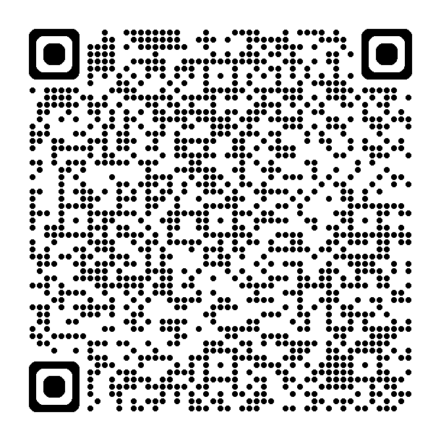
Ohio Learning Standards
PROBLEM
FORMULATE
VALIDATE
REPORT
COMPUTE
INTERPRET
Notes:
This is the modeling process graphic used by Ohio in the Ohio Learning Standards.

Slide 52
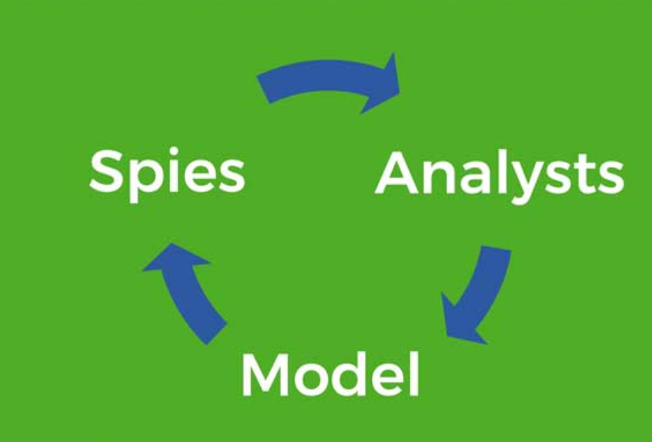
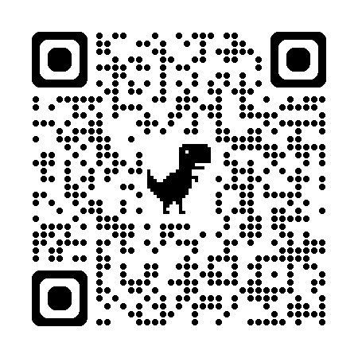
Spies, Analysts, Model by Robert Kaplinsky
Step 1: Spies–What information do I need and how do I acquire it?
Step 2: Analysts–Take the information and work with it to figure out how to use it.
Step 3: Model–Use the model and verify that it works.
Notes:
This graphic is the one used in the high school Mathematical Modeling and Reasoning Course because of its simplicity. It is easier for high school students to remember 3-steps instead of the 6-steps from the modeling process graphic in the Ohio Learning Standards. In this model, students begin at step 1 thinking of themselves as a spy. Here they think about, what information do I need and how do I acquire it? Next, they advance to becoming more of an analyst where they take the information and work with it to figure out how to use it. Finally, they model, which means they use the model and verify that it works.

Slide 53
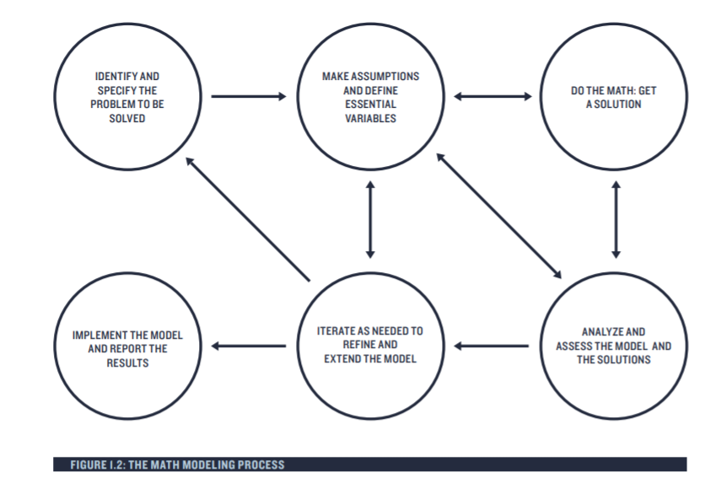
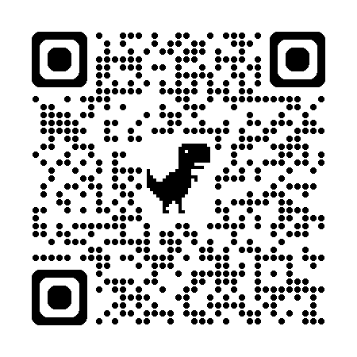
Guidelines for Assessment & Instruction in Mathematical Modeling Education (GAIMME)
Notes:
If you read the Guidelines for Assessment & Instruction in Mathematical Modeling Education (GAIMME) you will see this graphic. Given the number of bubbles and the directionality of the arrows, this may be a difficult graphic for many high school students to remember without the graphic available as a support. This graphic does illustrative a good modeling process for students if they choose to use it.

Slide 54
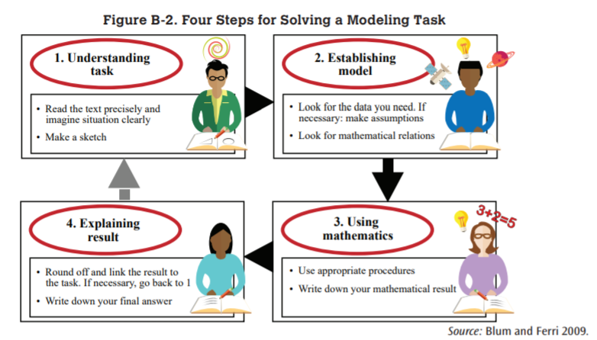
Blum and Ferri
Notes:
Blum and Ferri also have a modeling graphic. Here is their graphic and what each step in the process means. You can examine this process more if by pausing the presentation or going to the slide in the PowerPoint presentation.

Slide 55
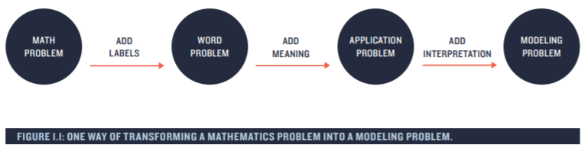
Transforming a Mathematical Problem into a
Modeling Problem
+
choices
Notes:
Teachers can also transform traditional math problems into modeling problems. If you take a math problem and add labels you get a word problem.
If you add meaning to the word problem, it becomes an application problem. Once you add interpretation and student choices, it becomes a modeling problem. The inclusion of student choices in the problem solving creates buy-in. In the workforce, many times a given problem does not have defined limitations. Take for example, a time when your boss gave you a task to work on and complete. Did your boss dictate to you how to solve the problem, or did they leave some of the decision making and choices up to you?

Slide 56
MP 4. Model with Mathematics Rubric
MP | Needs Improvement | Emerging | Proficient | Exemplary
MP.4 Model with Mathematics. | Forgets that attempting to make a simpler problem is a viable strategy. | Attempts to make a simpler problem; struggles to or forgets to identify assumptions. | Uses and identifies assumptions and approximations to make a simpler problem. | Uses and identifies, assumptions and approximations to make a simpler problem; explains how assumptions and/or approximations affect their solution.
 | Struggles or forgets to make a model or chooses an inappropriate model. | Uses a model to describe patterns or trends; it may be incomplete or partial model; explains the appropriateness of their model. | Identifies important quantities and maps their relationships using tools such as diagrams, two-way tables, graphs, flowcharts, and/or formulas, etc.; uses their model to describe patterns or trends; evaluates and explains appropriateness of their model. | Creates a model based upon important quantities; evaluates and explains the appropriateness of their model including variables and procedures; reflects on their model and makes any necessary revisions.
 | Struggles or forgets to identify variables. | Can correctly identify some, but not all, of the variables. | Identifies and justifies choice of variables in the problem; identifies extraneous or missing information. | Identifies and justifies choice of all variables in the problem; identifies extraneous information; seeks out missing information.
 | Struggles or forgets to compute results correctly; has difficulty interpreting their results. | Computes results correctly, but interprets their results, incorrectly, or interprets their results but computes incorrectly. | Computes and interprets results correctly and reports findings using a mixture of representations. | Computes and interprets results, and justifies the reasonableness of their results and procedures within the task’s context.
 | Struggles or forgets to check work. | Checks some calculations. | Checks calculations and checks to see if an answer makes sense within the context of a situation. | Checks to see if an answer makes sense within the context of a situation and changes a model when necessary.
Notes:
To support teachers in their professional development, particularly in the math practices, there are some rubrics available to help teachers look for evidence of student understanding of the math practices. Here is an example of one created by Ohio.

Slide 57
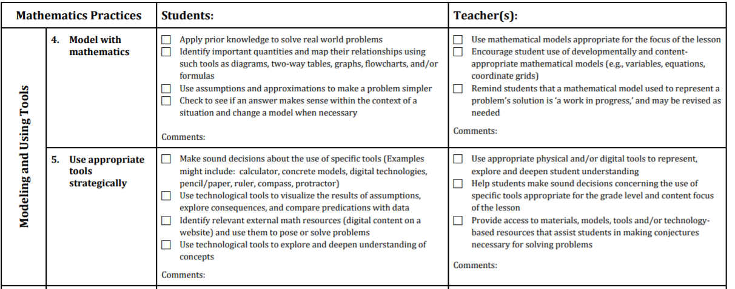

NCTM “Look Fors”
Notes:
Here is an example from the NCTM “Look Fors” document that identifies for teachers what evidence they should “look for” with each of the math practices. A link to the full document by NCTM is available in the PowerPoint notes section on this slide and in the references slide at the end of the PowerPoint slide deck. We even included a link to this in the digital version of the Facilitation Guide for MP 4. So, there are multiple access points for everyone to be able to access this if interested.
https://education.ohio.gov/getattachment/Topics/Learning-in-Ohio/Mathematics/Model-Curricula-in-Mathematics/Standards-for-Mathematical-Practice/Math-Practices-Rubric.pdf.aspx?lang=en-US
-OR-
bing.com/ck/a?!&&p=5e4e91fb186dc70eb4d140dac152ea68b76688e76f09d726741edf4a7702e5ceJmltdHM9MTc1MDg5NjAwMA&ptn=3&ver=2&hsh=4&fclid=1187f5bb-1957-6e8b-1c45-e06a18ef6fab&psq=nctm+look+fors&u=a1aHR0cHM6Ly93d3cubmN0bS5vcmcvQ29uZmVyZW5jZXMtYW5kLVByb2Zlc3Npb25hbC1EZXZlbG9wbWVudC9QcmluY2lwbGVzLXRvLUFjdGlvbnMtVG9vbGtpdC9SZXNvdXJjZXMvNS1TTVBMb29rRm9ycy8&ntb=1

Slide 58
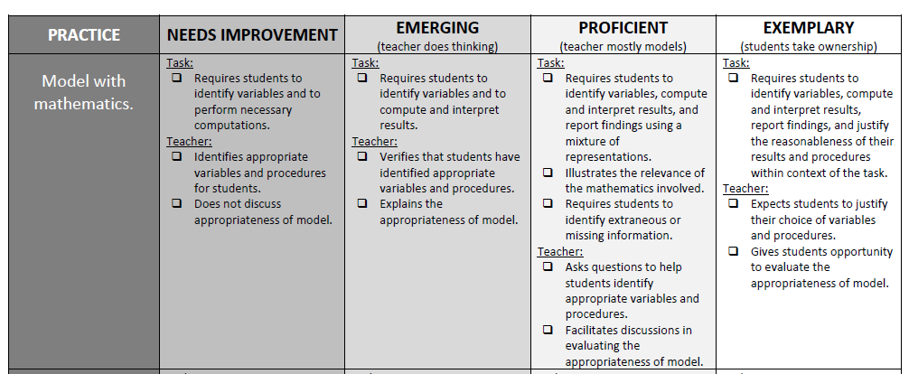

Another Rubric
Notes:
Here is an example of a rubric from the Institute for Advanced Study.
https://projects.ias.edu/pcmi/hstp/resources/rubric/rubric_revised.pdf

Slide 59
References
Conrad Wolfram on Computational Thinking
Engaging in Mathematical Practice Look Fors
Guidelines for Assessment & Instruction in Mathematical Modeling Education (GAIMME)
Mathematical Modeling of the Mathematics Framework for California Public Schools: Kindergarten through Grade 12
MPRES Toolkit for Teachers Conceptual Change – Using Mathematics & Computational Thinking
Notes:
Throughout this presentation we made references to several resources and materials. You can find links to those resources and materials here.

Slide 60
References Cont’d
Ohio Learning Standards
Robert Kaplinsky
  Beware of Fake Math Modeling Problems
  Do You Need Better Spies of Analysts?
  Sink Hole
  What Isn’t Modeling?
Using Mathematics and Computational Thinking

Slide 61
Mathematics Questions?
Email
Mathematics@education.ohio.gov

Slide 62
Questions?

Slide 63
Ohio Department of Education and Workforce 2

